Slide 1
Polarized Beam Mode for the Hybrid Spectrometer (HYSPEC) at the Spallation Neutron Source.
Igor Zaliznyak
Neutron Scattering Group, Brookhaven National Laboratory
HYSPEC Instrument Design Team
V. Ghosh, L. Passell and S. Shapiro (BNL), M. Hagen (SNS/BNL)
Outline
BNL’s HYSPEC project and its place in the SNS instrument suite
HYbrid SPECtrometer’s layout and principal features
Polarized beam setup: principle, specific features and components
Performance and optimization of the (Fe/Si) transmission polarizer for different neutron energies
Summary, work in progress and open questions

Slide 2

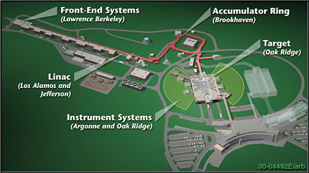
Spallation Neutron Source (SNS) at ORNL
http://www.sns.gov/
http://www.sns.gov/partnerlabs/partners.htm

Slide 3
HYSPEC timeline: history of the project
  March, 2004
    M. Hagen (instrument scientist) and W. Leonhardt (engineer) join the project
  May, 2003
    DOE CD0, part of the SING project
  December, 2002
    HYSPEC proposal submitted to DOE
  January, 2002
    HYSPEC IDT filed Letter of Intent with SNS
  Fall, 2001
    Instrument Development Team formed
    Workshop on the Hybrid Spectrometer held at BNL
    Refined HYSPEC concept presented to EFAC
  March, 2001
    Draft proposal of a Direct Geometry Hybrid Spectrometer first presented to EFAC, received positive reply
  December, 2000
    Completed review of the possible instrument designs
    Concept of the Hybrid Spectrometer formulated and adopted

Slide 4
HYSPEC Instrument Development Team and Design Team.
IDT Members (US) and their Affiliations
S. M. Shapiro, co-PI BNL
I. Zaliznyak, co-PI BNL
G. Shirane BNL
J. Tranquada BNL
L. Passell BNL
D. Abernathy SNS
L. Daemon Los Alamos
M. Greven Stanford
B. Gaulin McMaster
V. Kiryukhin Rutgers
S.-H. Lee NIST
Y. Lee MIT
R. MQueeney Ames/Iowa St.
S. Nagler ORNL
R. Osborn ANL
J. Rhyne U. Missouri
A. Zheludev ORNL
HYSPEC Instrument Design Team
I. Zaliznyak (BNL)
S. M. Shapiro (BNL)
L. Passell (BNL)
V. J. Ghosh (BNL) Monte-Carlo simulations
W. Leonhardt (BNL) Project Engineer
M. Hagen (SNS/BNL) Instrument scientist
http://neutrons.phy.bnl.gov/hyspec

Slide 5
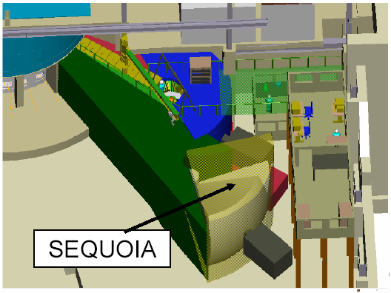
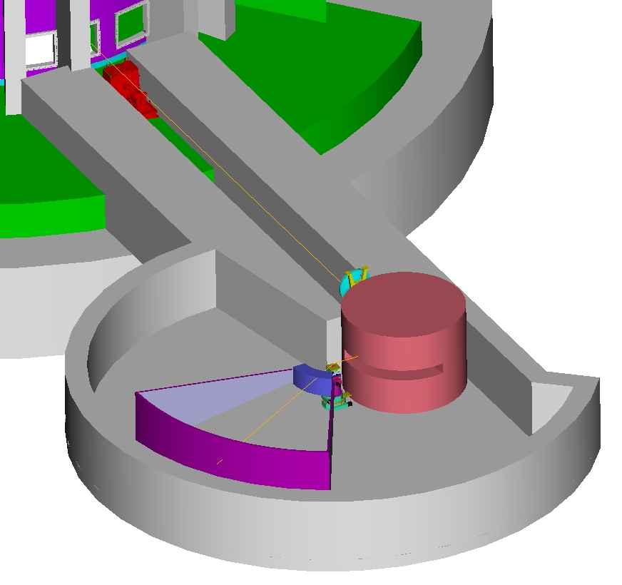
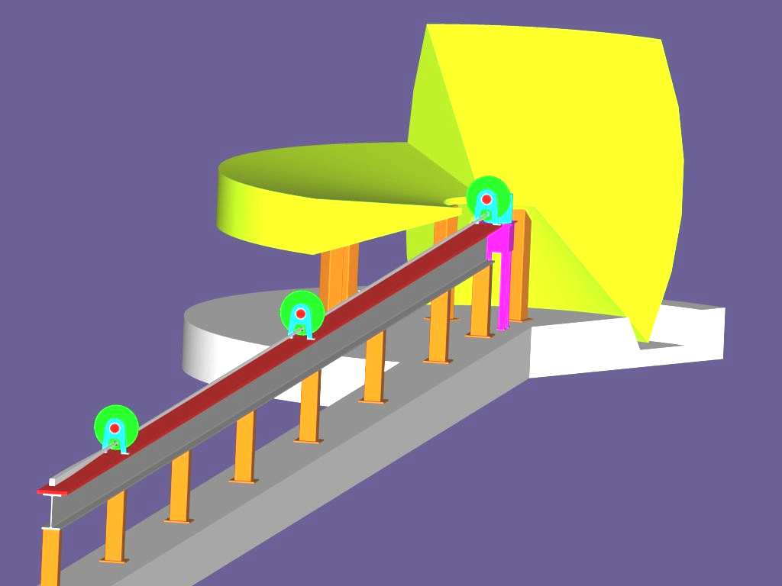
HYSPEC’s place in the SNS inelastic instruments suite.
ARCS
High energy transfer
10-1000 meV Fermi Chopper Spectrometer
  E = 10 - 1000 meV
  Q = 0.1 – 22 Å⁻¹
epithermal
High intensity at moderate resolution and medium energy transfer + polarized beam
Crystal Monochromator Hybrid Spectrometer
  E = 2.5 - 90 meV
  Q = 0.1 – 8 Å⁻¹
HYSPEC
thermal
High resolution and low energy transfer
10-100 μeV Multichopper Spectrometer
  E = 2 - 20 meV
  Q = 0.1 - 4 Å⁻¹
CNCS
subthermal

Slide 6
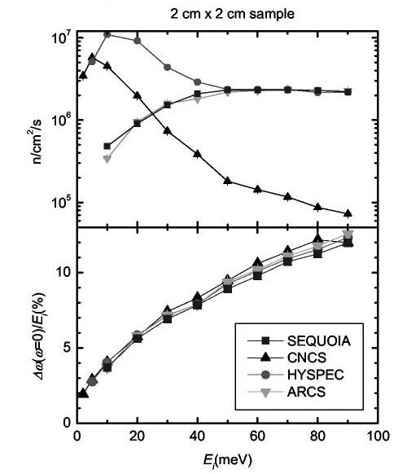
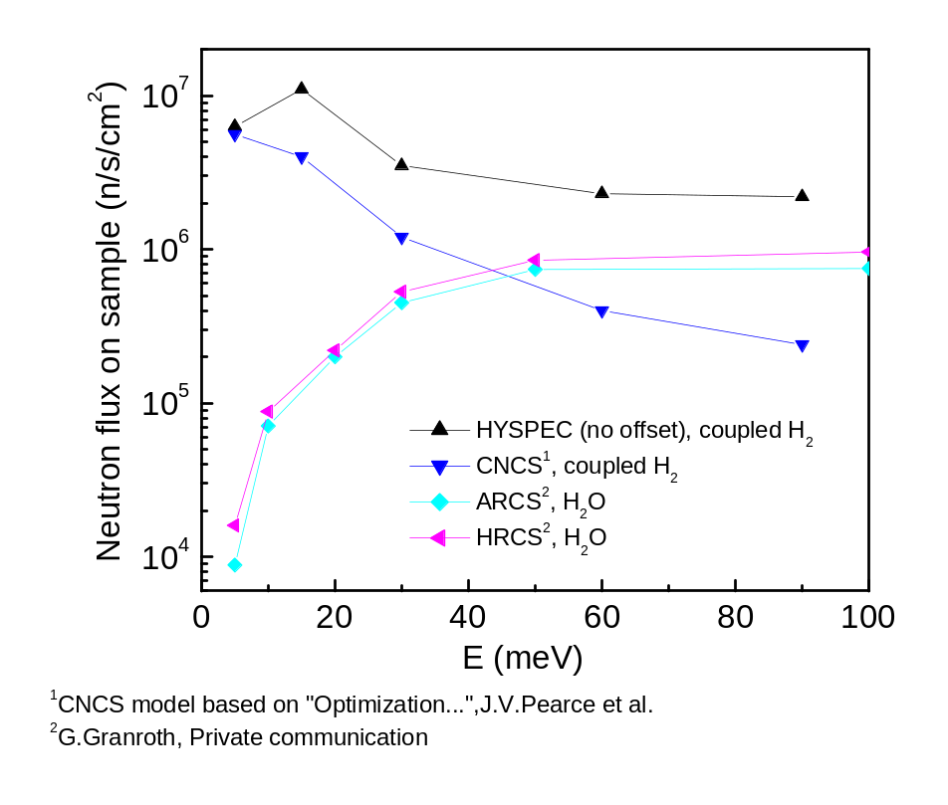
Comparison of the HYSPEC performance with other inelastic instruments planned for the SNS
MC simulations by SNS (G. Granroth and D. Abernathy)
MCSTAS simulations by HYSPEC IDT (V. Ghosh), with different re-scaling for ARCS and SEQUOIA
CNCS, ARCS and HRCS intensities were re-scaled to
the same, coarser energy resolution as HYSPEC (this over-estimates their actual intensity)

Slide 7
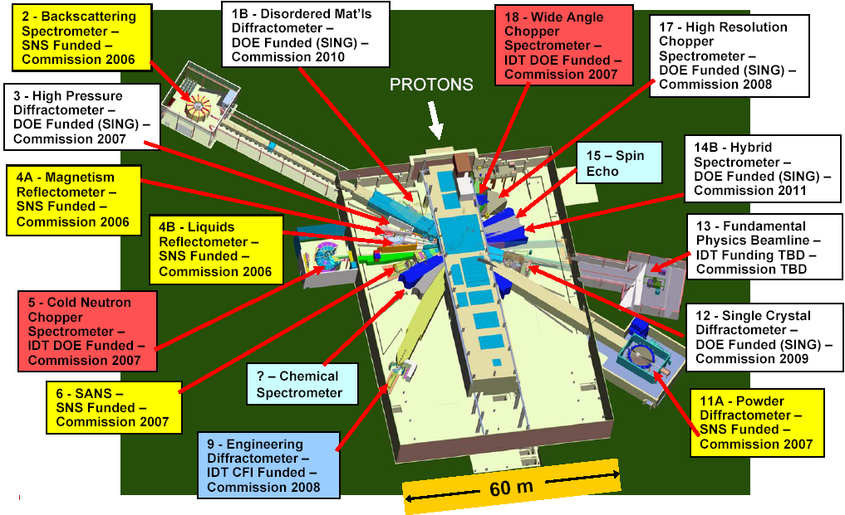
Current status of the SNS instrument suite

Slide 8
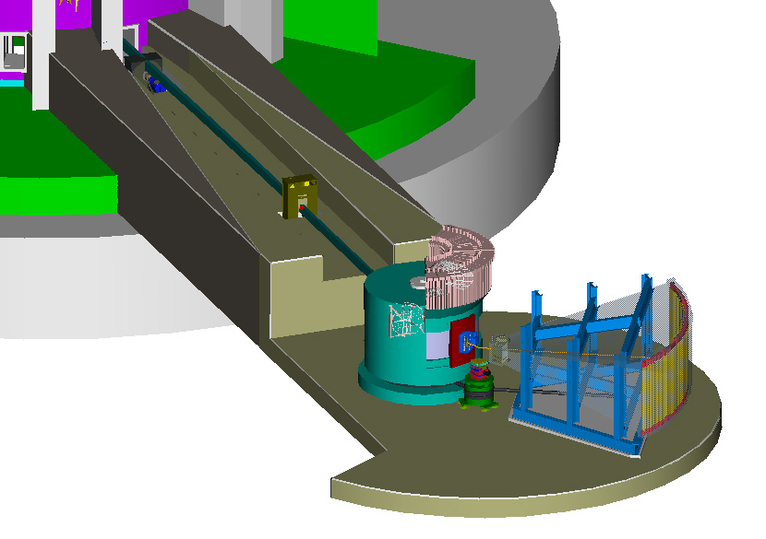
HYSPEC layout and principal features
To get more information, and for the project updates, please, visit
http://neutrons.phy.bnl.gov/hyspec
T₀ Chopper
Disc Chopper
Monochromator
Goniometer
Radial Collimator,
or Bender Polarizers
Flight Chamber (evacuated or Ar/He filled)
Detectors

Slide 9
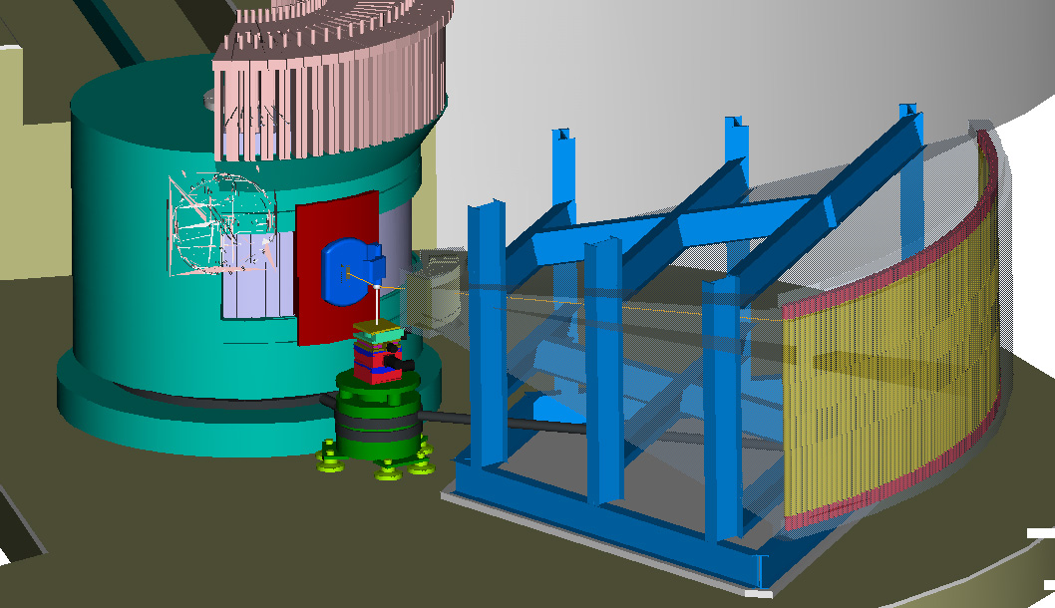
HYSPEC layout in the polarized beam mode
18-20 transmission polarizers
2cm x 5cm (WxL) with 20’ Soller collimators upfront
vertically focusing
Heusler crystal monochromator
neutron spin flipper

Slide 10
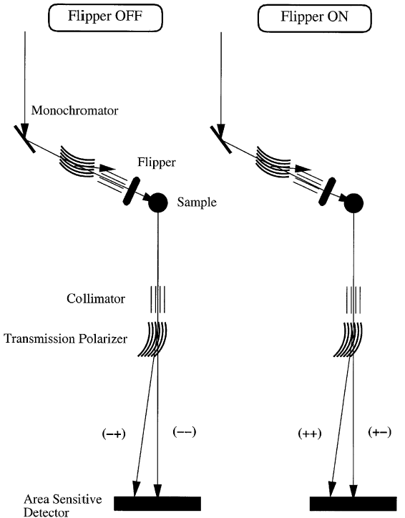
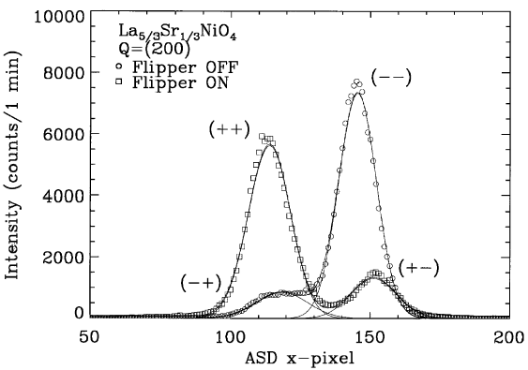
HYSPEC polarization analysis: principle and experimental demonstration on SPINS at NIST
Polarized beam Measurement with a Position Sensitive Detector (PSD)
Heusler
S.-H. Lee, C. F. Majkrzak, Physica B 267-268, 341 (1999)

Slide 11
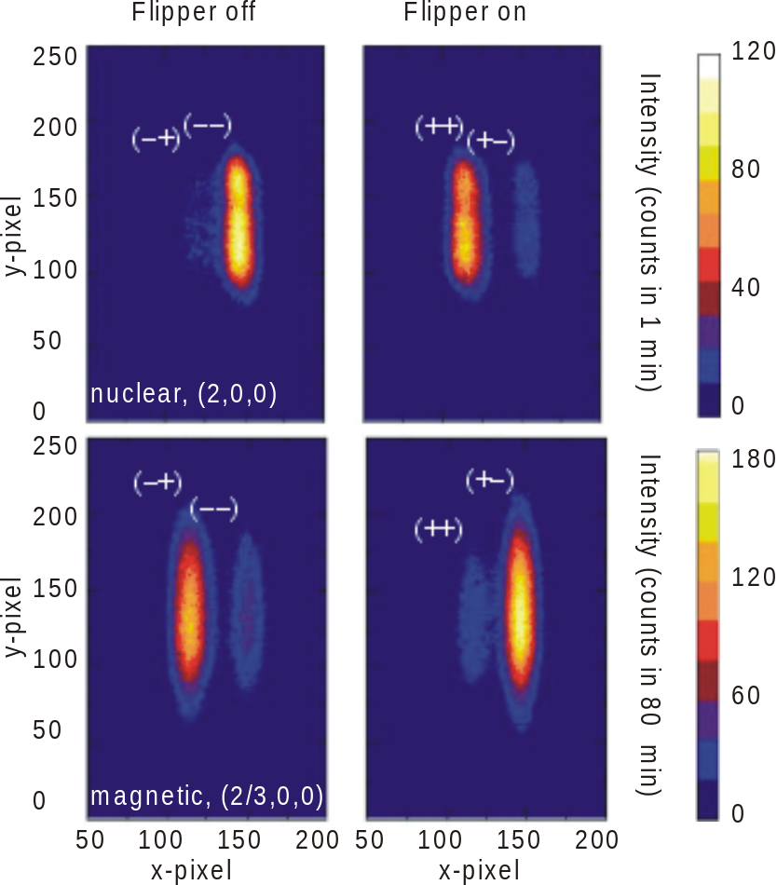
HYSPEC polarization analysis: experimental demonstration with PSD on SPINS
Nuclear and magnetic scattering intensities in La_{5/3}Sr_{1/3}NiO₄
I. A. Zaliznyak and S.-H. Lee,
in Modern Techniques for Characterizing Magnetic Materials, ed. Y. Zhu (to be published by Kluwer Academic, 2004)

Slide 12
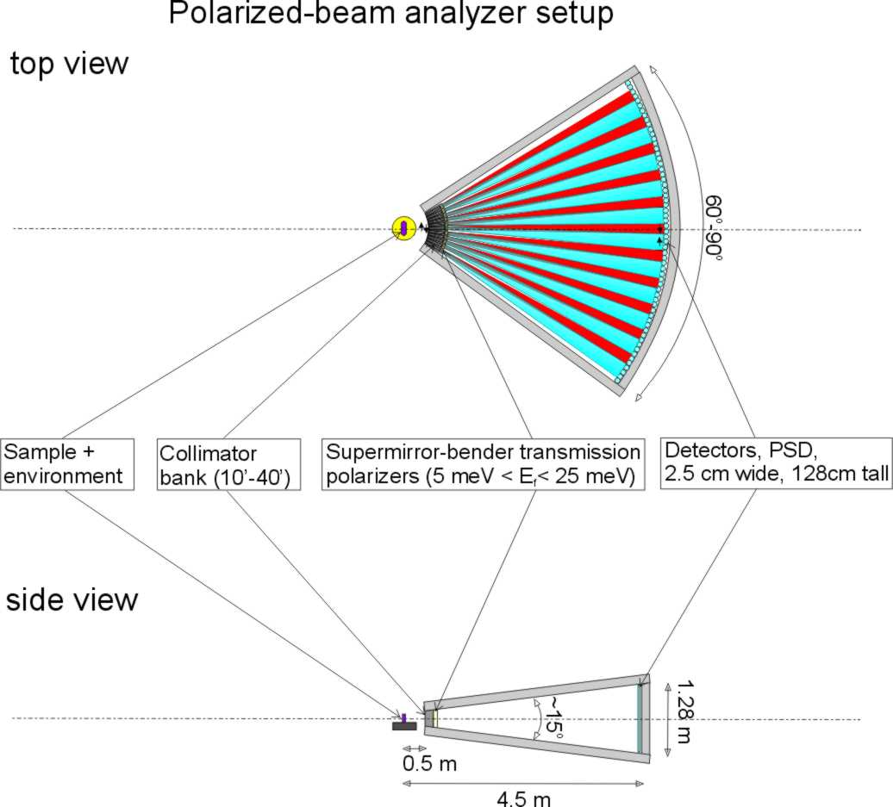
HYSPEC setup for polarization analysis
Polarized incident beam is supplied by reflection from the vertically focusing Cu₂MnAl (Heusler alloy) crystal monochromator
10 meV < E_{i}^{pol} < 90 meV
Polarization analysis of the scattered neutrons is performed by a set of 18-22 supermirror-bender transmission polarizers, each 2 cm wide, 5 cm thick and 15 cm high,
3.7 meV < E_{f}^{pol} < 15-25 meV

Slide 13
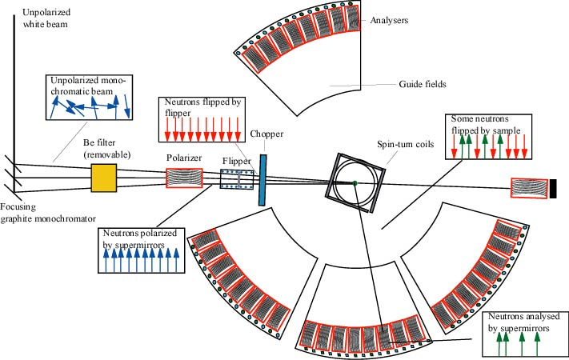
A somewhat similar concept: D7 at ILL
Important distinctions of the HYSPEC
  optimized for using the straight-through transmitted beam
  both spin states are measured by the detector array

Slide 14
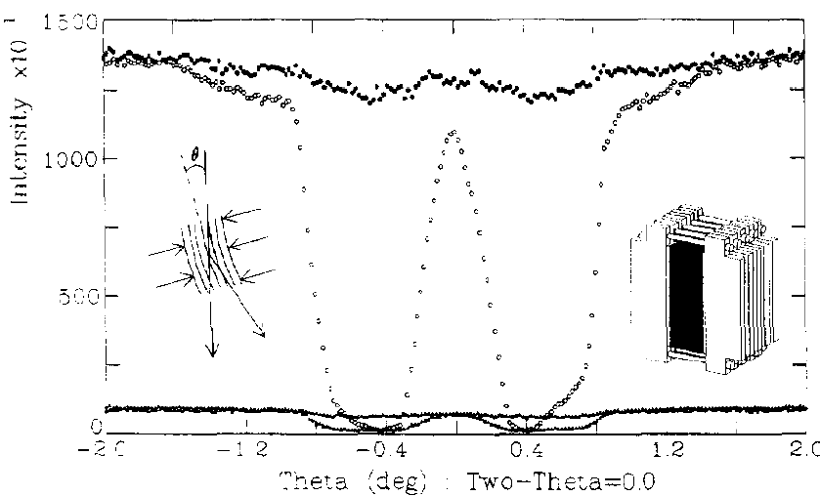
Most important question: can we expect the transmission polarizers to work up to 15-25 meV?
Performance of an optimized Fe/Si transmission polarizer for ~15 meV C. Majkrzak, Physica B 213&214 (1995)
Yes, but fine-tuning of the polarizer tilt angle is necessary.

Slide 15
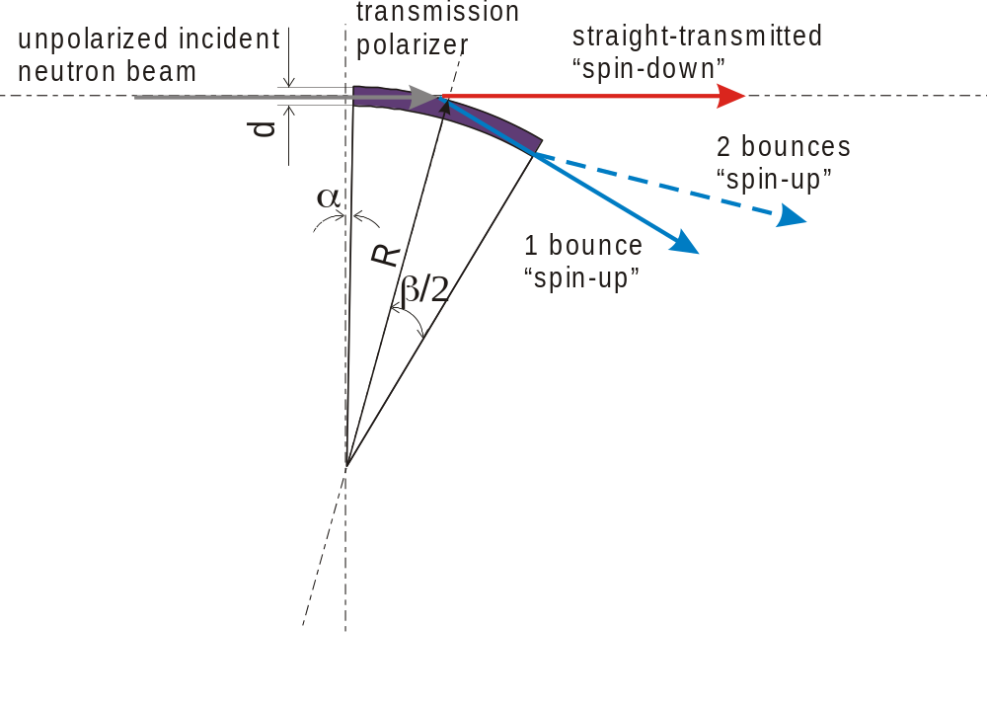
Optimizing the geometry of a single-bounce transmission polarizer
Defining parameters are:
θ_{c}^{(up)} and θ_{c}^{(down)}
L, length
d, channel width
α, tilt angle
β, bend angle
L ≈ 2R sin(β/2)≈ R β
Optimization considerations and constraints
θ_{c}^{(up)} = 3.0 θ_{c}^{(Ni)}, θ_{c}^{(down)} = 0.6 θ_{c}^{(Ni)}, => best we can imagine for now
L≈ 50 mm => maximum length is constrained by the transmission through Si
d ≤ R(1- cosβ) ≈ Lβ/2 ≈ 0.25 mm => to remove the line-of-sight
polarizer bend angle β => mechanically constrained, currently use 0.57°
polarizer tilt angle α => must be optimized
Simple optimization condition for a single-bounce device
(α + β) = θ_{c}^{(up)} = 3.0 θ_{c}^{(Ni)}

Slide 16
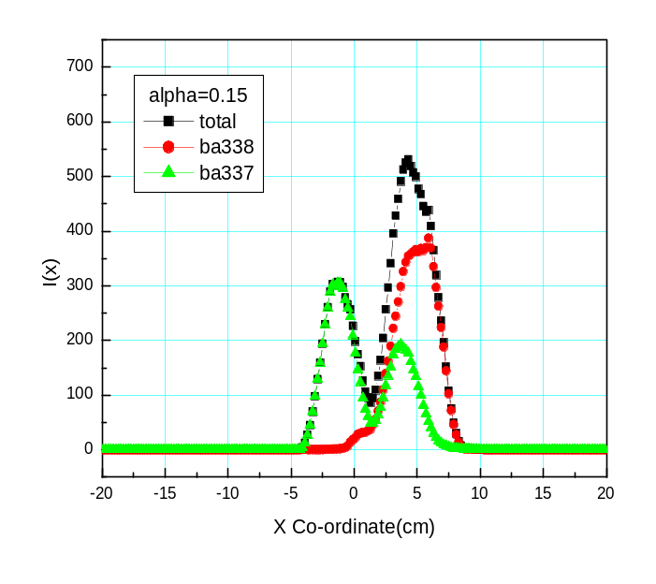
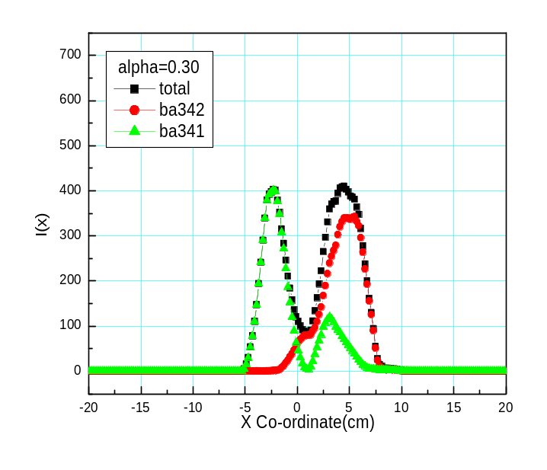
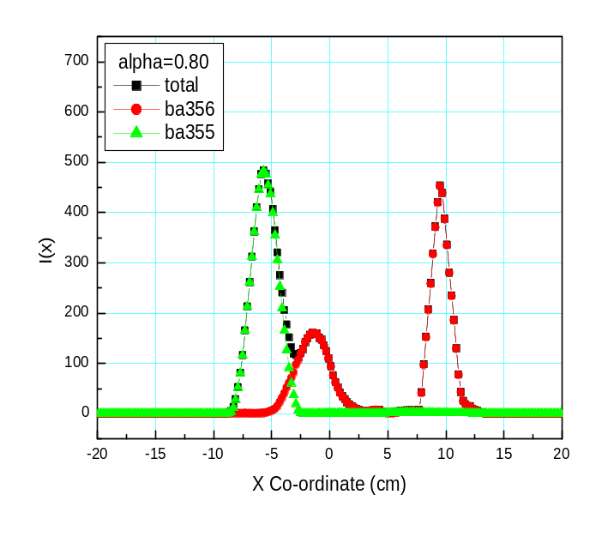
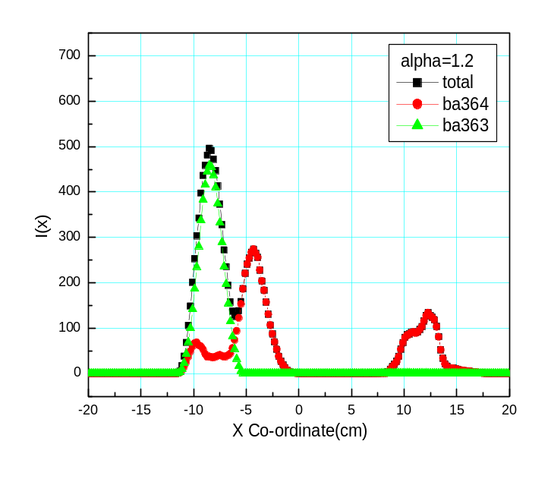
Optimizing the polarizer tilt angle at E = 3.7 meV
α = 0.15°
α = 0.3°
20’ collimator
in front
α = 0.8°
α = 1.2°
Neutron beam profiles on the detector

Slide 17
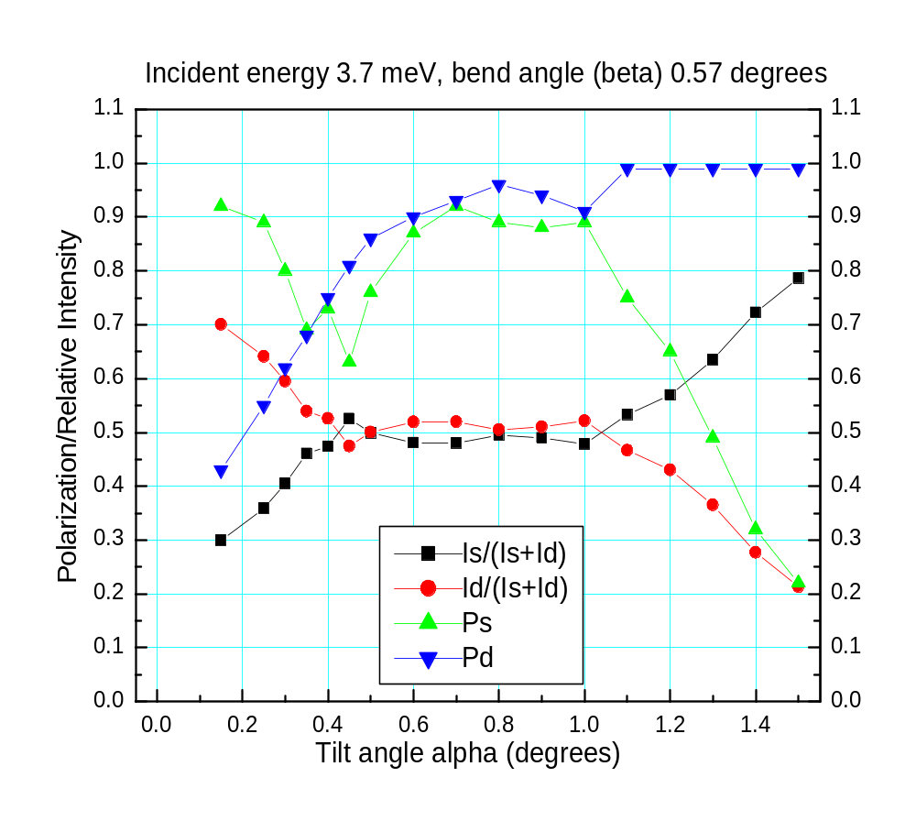
Optimizing the polarizer tilt: E = 3.7 meV is quite “forgiving”
Straight beam
Deflected beam

Slide 18
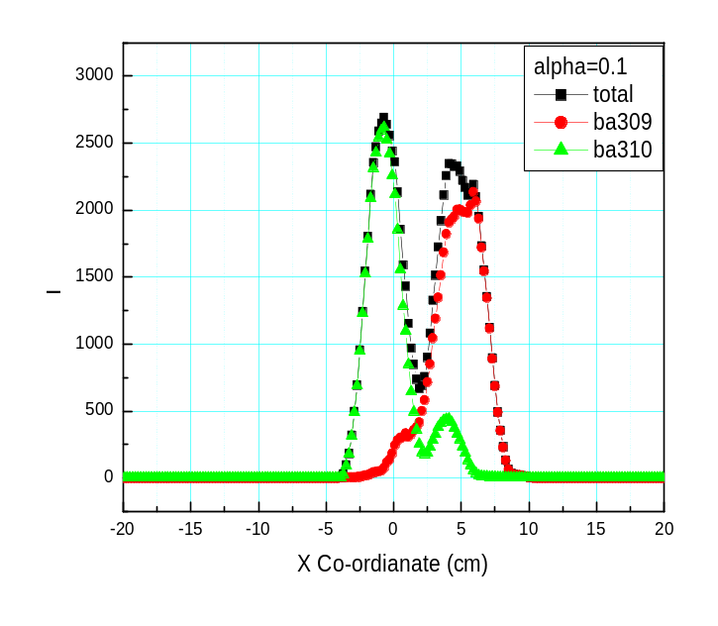
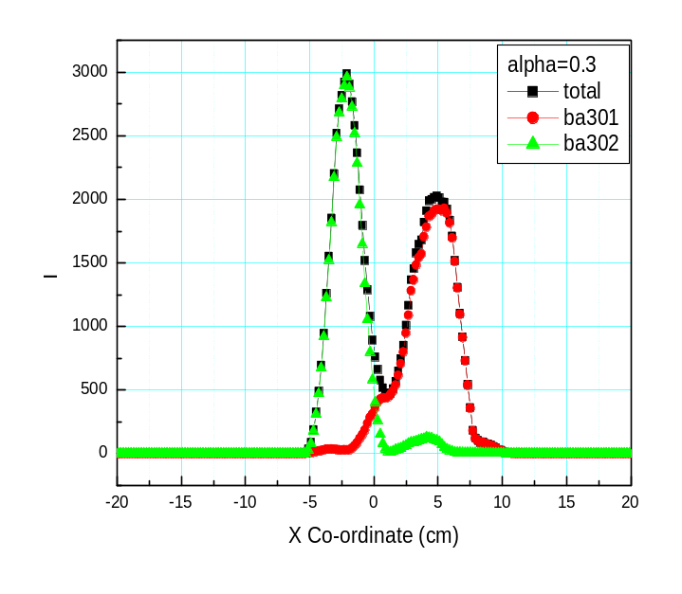
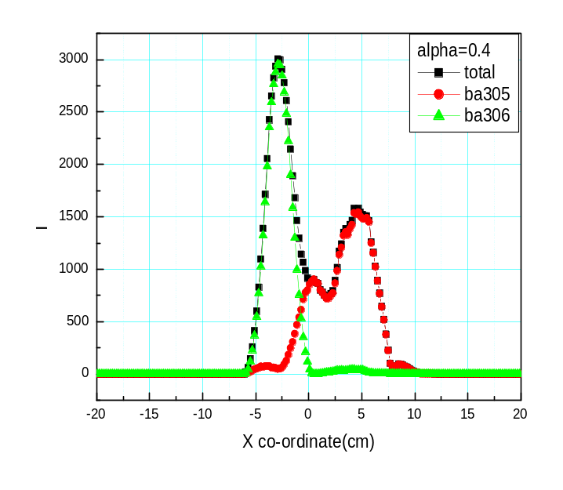
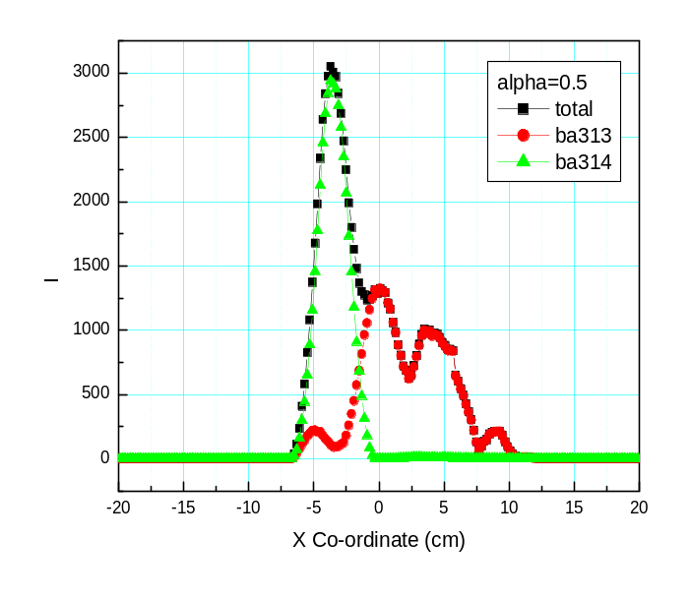
Optimizing the polarizer tilt angle at E = 10 meV
α = 0.1°
20’ collimator
in front
α = 0.3°
α = 0.4°
α = 0.5°
Neutron beam profiles on the detector

Slide 19
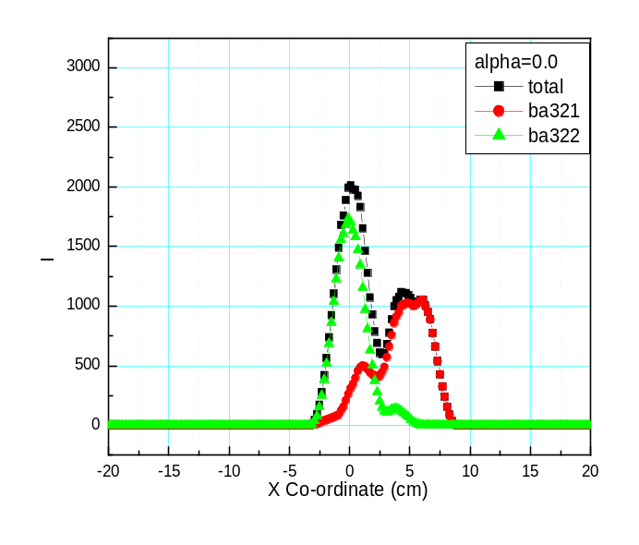
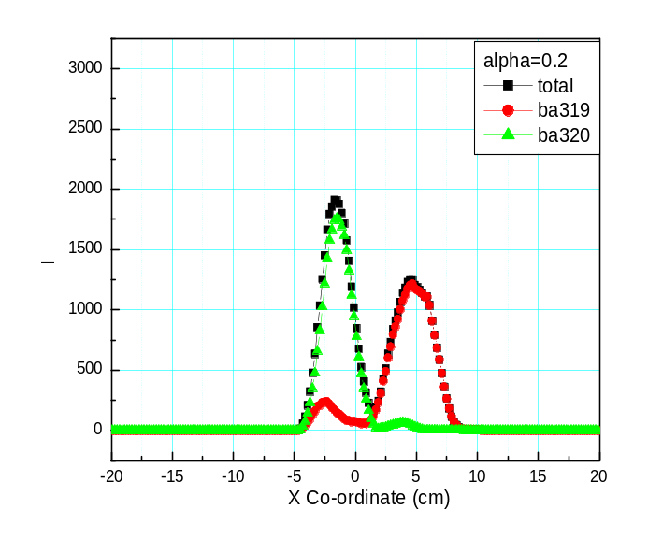

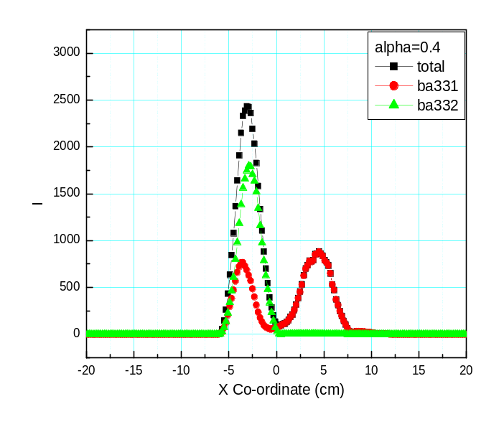
Optimizing the polarizer tilt angle at E = 20 meV
20’ collimator
in front
α = 0.0°
α = 0.2°
α = 0.3°
α = 0.4°
Neutron beam profiles on the detector

Slide 20
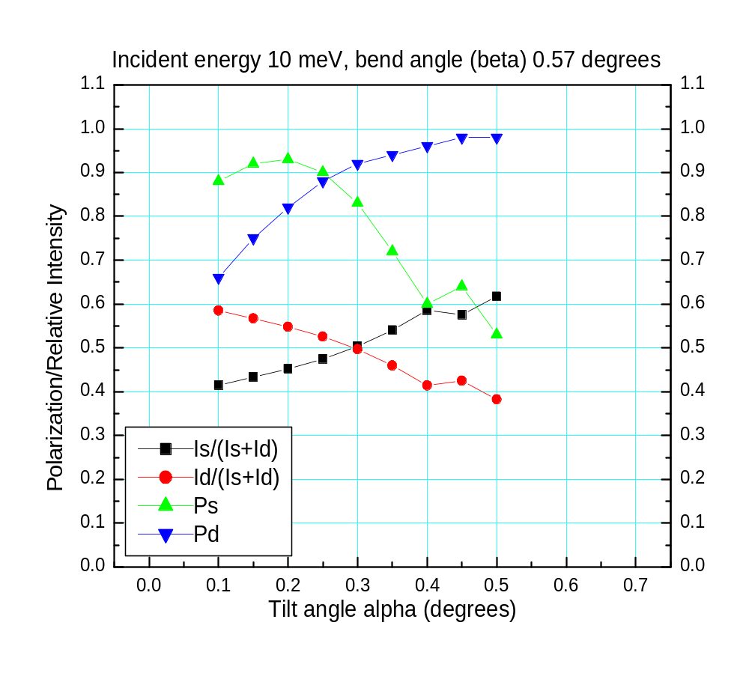
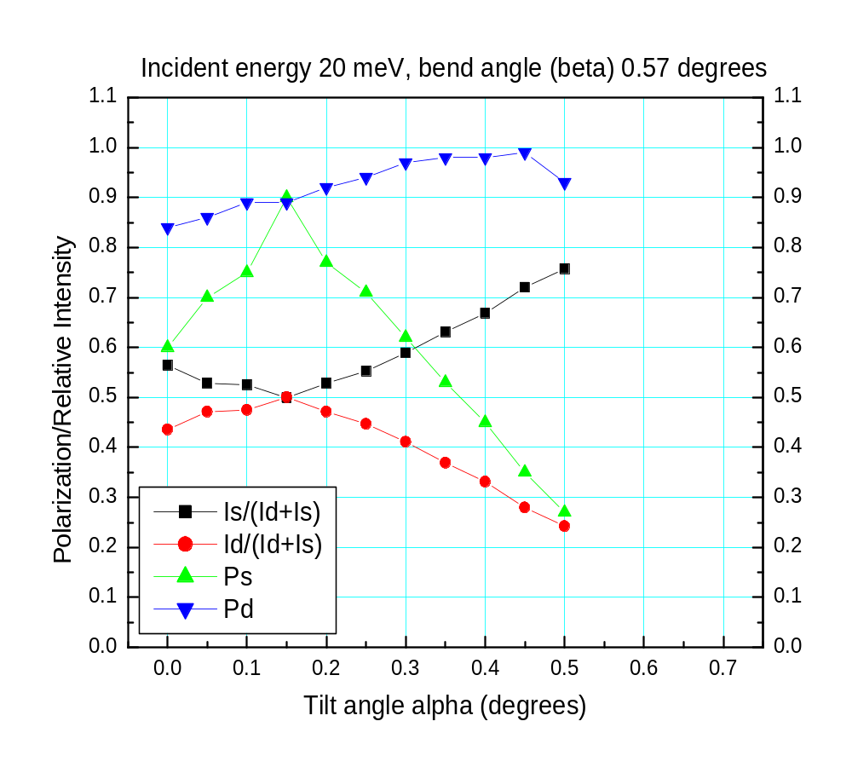
Optimizing the polarizer tilt: fine tuning is needed for higher energies
Straight beam
Deflected beam

Slide 21
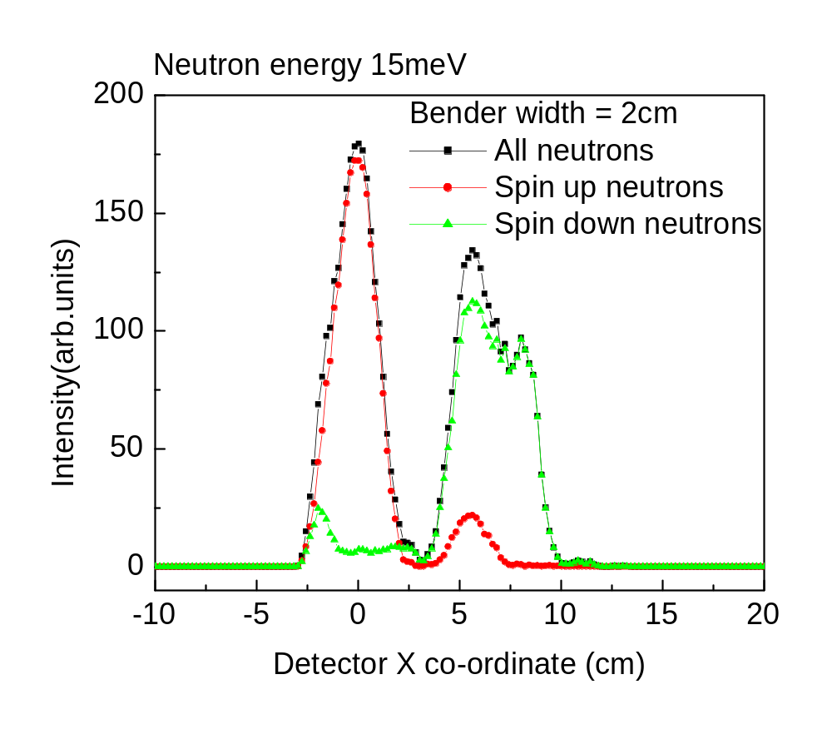
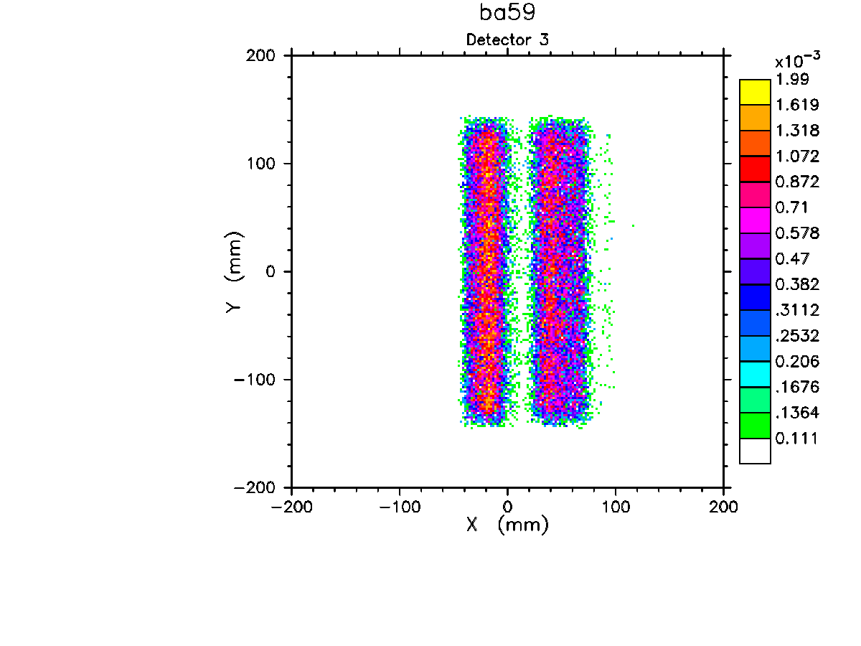
MC simulation (NISP) of the HYSPEC operation in the polarized beam mode: beam separation
Simulation for the bender geometry optimized for E=14.7 meV (C. Majkrzak, 1995) Sample-to-detector distance L_{SD} is 4.5 m

Slide 22
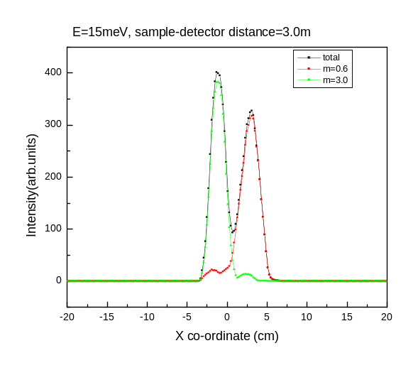
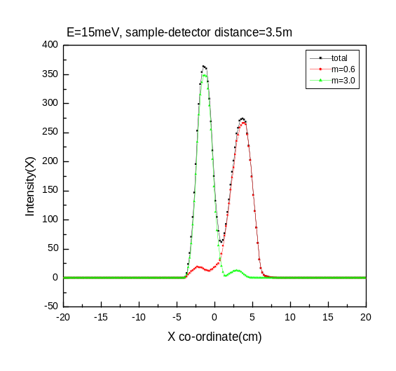
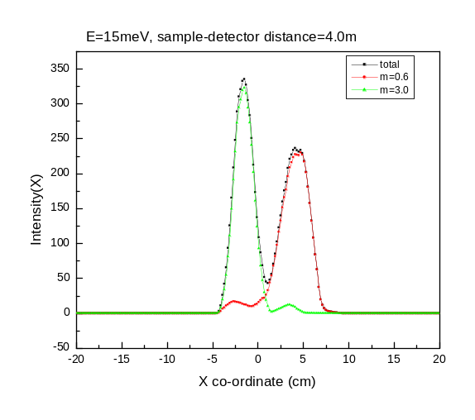
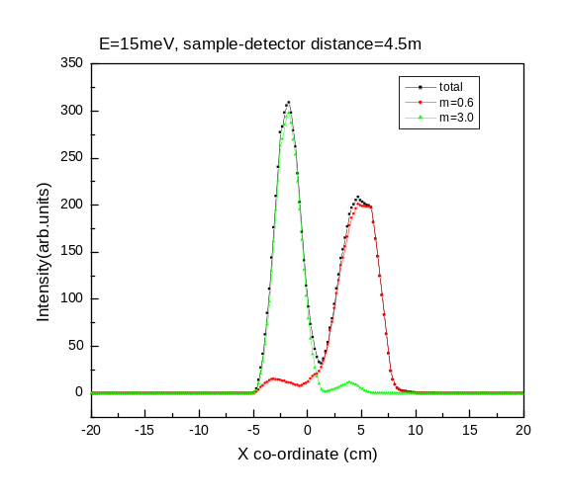
The spatial separation of two polarizations for different sample-to-detector distances
L_{SD} = 3.0m
L_{SD} = 3.5m
θ_{c}^{(up)} = 3.0 θ_{c}^{Ni},
θ_{c}^{(down)} = 0.6θ_{c}^{Ni}.
L_{SD} = 4.0m
L_{SD} = 4.5m
The two polarizations only become sufficiently separated that they can be measured cleanly in the adjacent detector tubes for values of the secondary flight path L_{SD} > 4.0m.

Slide 23
Summary, work in progress, and open questions
Heusler monochromator provides polarized incident beam
Scattered beam polarization is determined by an array of transmission polarizers
  Fe/Si, Co/Si, other?
  straight-through transmitted beam is always measured
  all scattering angles are covered
  most of the detectors are efficiently used
  price in intensity for using 20’ collimators also buys lower background and a somewhat better q-resolution
Optimization of the polarizer geometry for the broadband operation
  important to use the optimized tilt angle for every E_{i}, and E-range
  curvature choice (possibly straight stack)?
  fine tuning: length, channel width, collimation in front.
Effect of a coarse (2-3 degrees) radial collimator behind the polarizers?

Slide 24
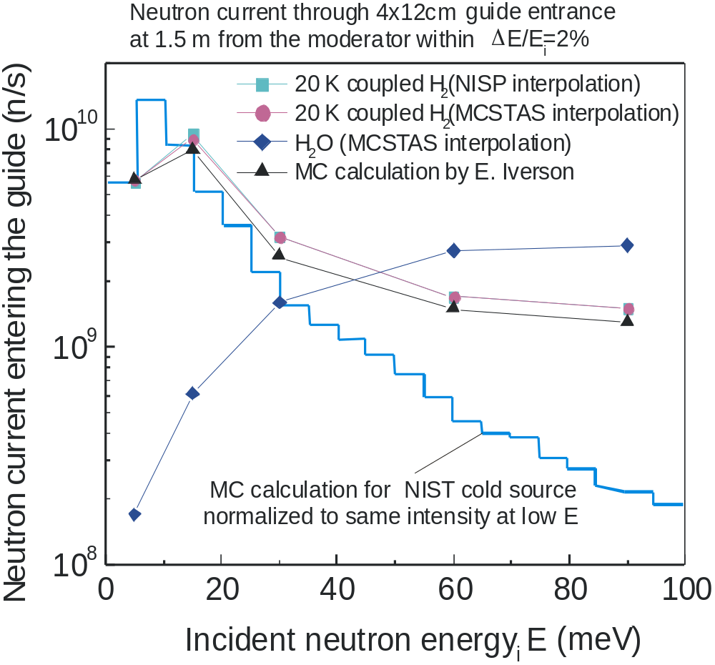
Neutron spectrum produced by SNS vs reactor

Slide 25
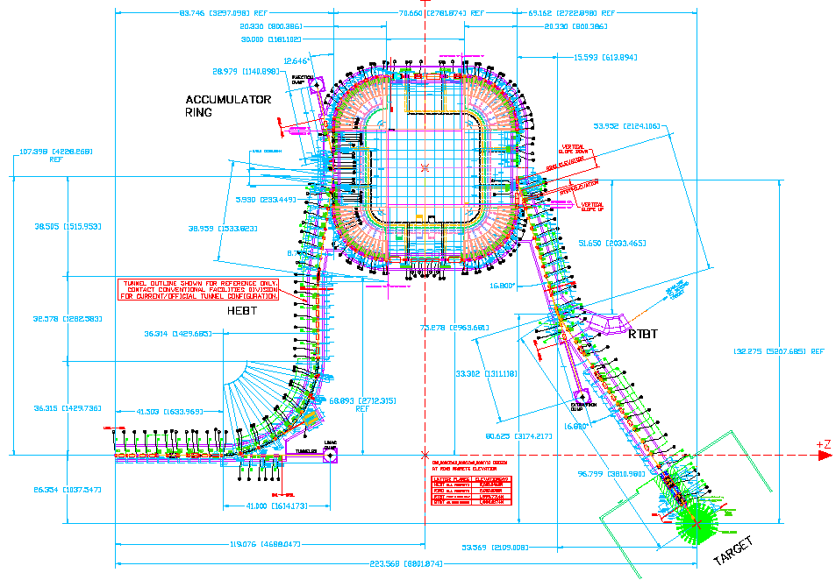
SNS accumulator ring built by BNL
http://sns.bnl.gov/
http://sns.bnl.gov/ap_group/ring.html

