Slide 1
Polarized Beam Operation of the Hybrid Spectrometer at the pulsed Spallation Neutron Source.
Igor Zaliznyak
Neutron Scattering Group, Brookhaven National Laboratory
HYSPEC Instrument Design Team
V. Ghosh, L. Passell and S. Shapiro (BNL), M. Hagen (SNS)
Outline
HYSPEC: project timeline and place in the SNS instrument suite
HYbrid SPECtrometer’s layout and principal features
Polarized beam setup: principle and components
Performance optimization of the (Fe/Si) transmission polarizer
Summary and open questions

Slide 2
HYSPEC’s timeline
  2000
    Concept of the Hybrid Spectrometer proposed at BNL
  2001
    Direct Geometry Hybrid Spectrometer presented to SNS EFAC
    HYSPEC Instrument Development Team (IDT) formed
  2002
    HYSPEC IDT filed Letter of Intent with SNS
    HYSPEC proposal submitted to DOE
  2003
    DOE CD0, HYSPEC is approved as part of the SING project
  2004
    HYSPEC’s placement approved, design&engineering: real work begins
  2005
    DOE CD2, HYSPEC’s performance baseline approved
  2006
    DOE CD3, construction begins
  2011
    CD4, commissioning & beginning of operation

Slide 3
HYSPEC Teams.
IDT Members and their Affiliations
IDT Executive Committee
S. M. Shapiro, co-PI BNL
I. Zaliznyak, co-PI BNL
D. Abernathy SNS
L. Daemen LANL
B. Gaulin McMaster
J. Gardner BNL
V. Ghosh BNL
M. Greven Stanford
M. Hagen SNS
K. Hirota ISSP
V. Kiryukhin Rutgers
Y. Lee MIT
C. Majkrzak NIST
R. MQueeney Ames/Iowa St. U.
S. Nagler ORNL
R. Osborn ANL
L. Passell BNL
L. P. Regnault ILL
J. Rhyne U. Missouri
J. Tranquada BNL
G. Xu BNL
A. Zheludev ORNL
S. M. Shapiro, PI (BNL)
I. Zaliznyak, PI (BNL)
L. Passell (BNL)
R. McQueeney (Ames/Iowa St. U.)
J. Rhyne (LANL)
J. Tranquada (BNL)
Instrument Design Team
I. Zaliznyak (BNL)
S. M. Shapiro (BNL)
L. Passell (BNL)
V. J. Ghosh (BNL) Monte-Carlo simulations
W. Leonhardt (BNL) Project Engineer
M. Hagen (SNS/BNL) Instrument scientist
http://neutrons.phy.bnl.gov/HYSPEC

Slide 4
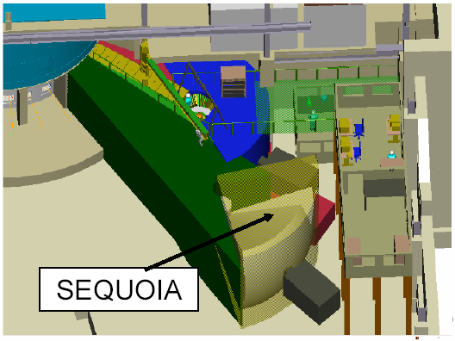
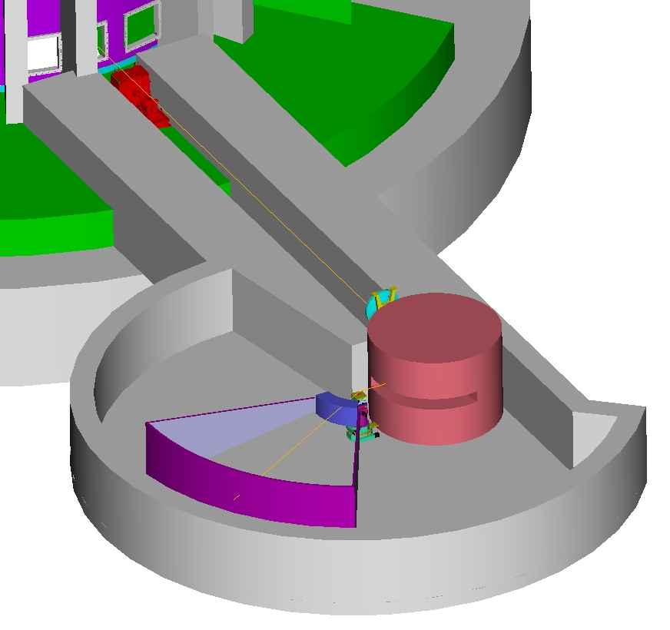
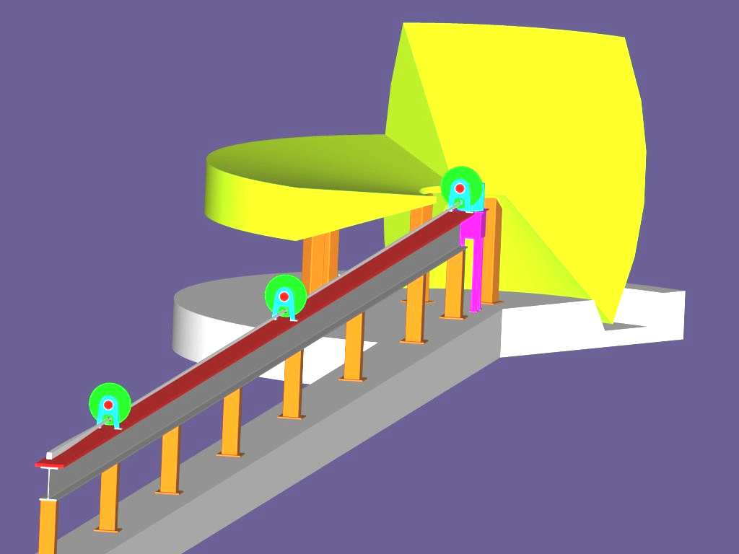
HYSPEC’s place in the SNS inelastic instruments suite.
ARCS
High energy transfer
10-1000 meV Fermi Chopper Spectrometer
  E = 10 - 1000 meV
  Q = 0.1 – 22 Å⁻¹
epithermal
High intensity at moderate resolution and medium energy transfer + polarized beam
Crystal-Focussing Hybrid Spectrometer
  E = 2.5 - 90 meV
  Q = 0.1 – 8 Å⁻¹
HYSPEC
thermal
High resolution and low energy transfer
10-100 μeV Multichopper Spectrometer
  E = 2 - 20 meV
  Q = 0.1 - 4 Å⁻¹
CNCS
subthermal

Slide 5
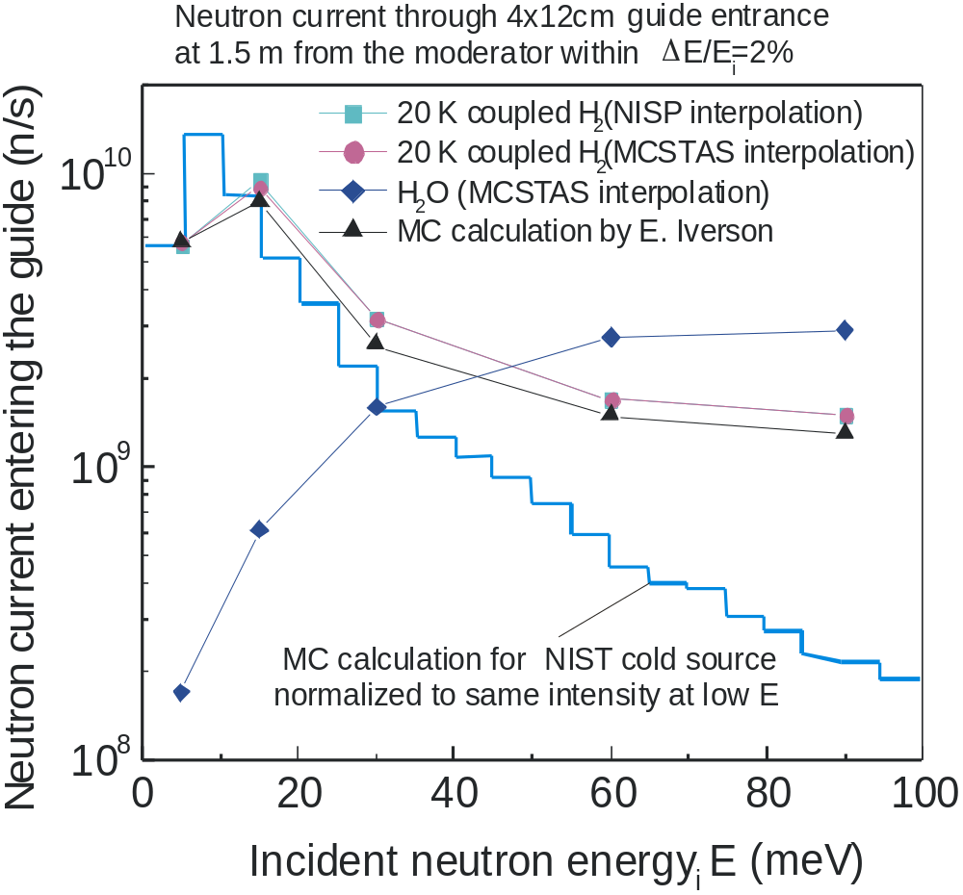
Neutron spectrum produced by SNS vs reactor

Slide 6
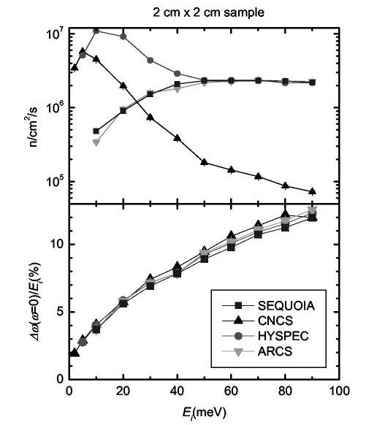
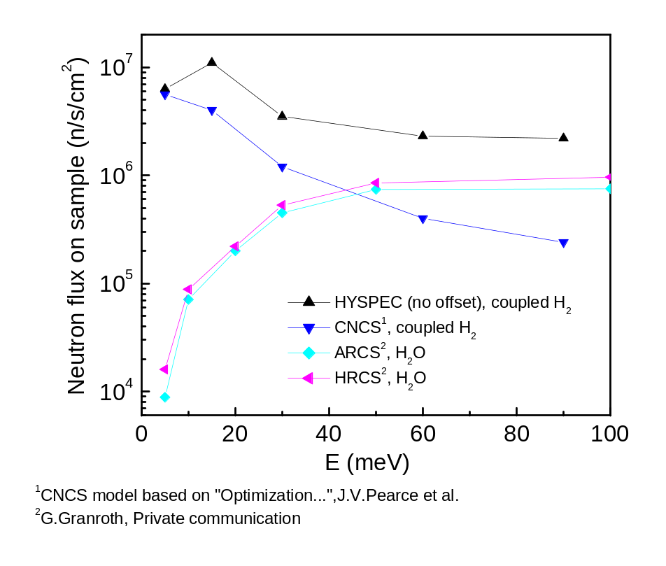
Comparison of the HYSPEC performance with other inelastic instruments planned for the SNS
MC simulations by SNS (G. Granroth and D. Abernathy)
MCSTAS simulations by HYSPEC IDT (V. Ghosh), with different re-scaling for ARCS and SEQUOIA
CNCS, ARCS and HRCS intensities were re-scaled to
the same, coarser energy resolution as HYSPEC (this over-estimates their actual intensity)

Slide 7
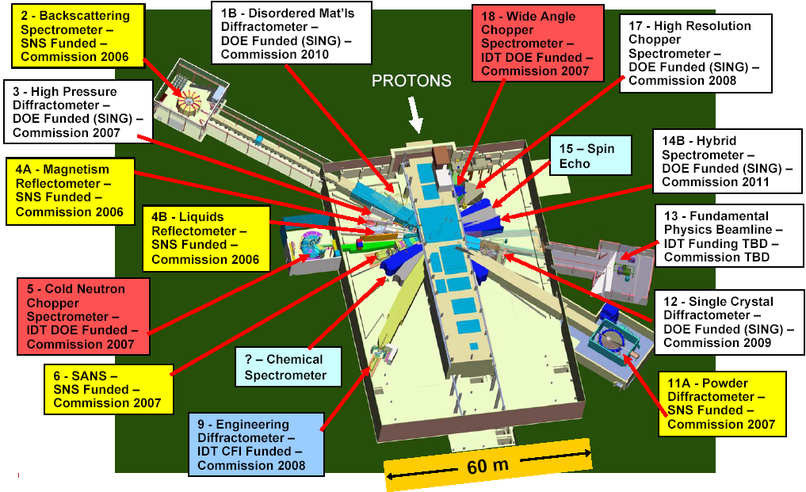
Layout of the SNS instrument suite - 2004

Slide 8
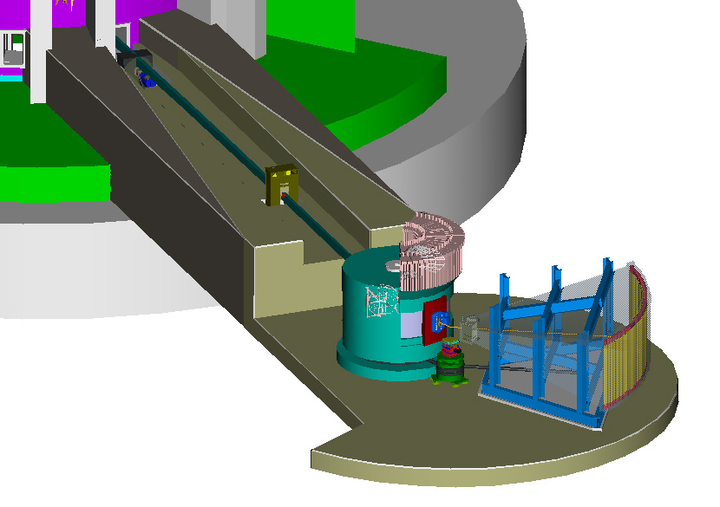
HYSPEC layout and principal features
To get more information, and for the project updates, please, visit
http://neutrons.phy.bnl.gov/HYSPEC
T₀ Chopper
T₂ Chopper
Monochromator
Goniometer
Radial Collimator
or Bender Polarizers
Flight Chamber (Ar/He filled)
Detectors

Slide 9
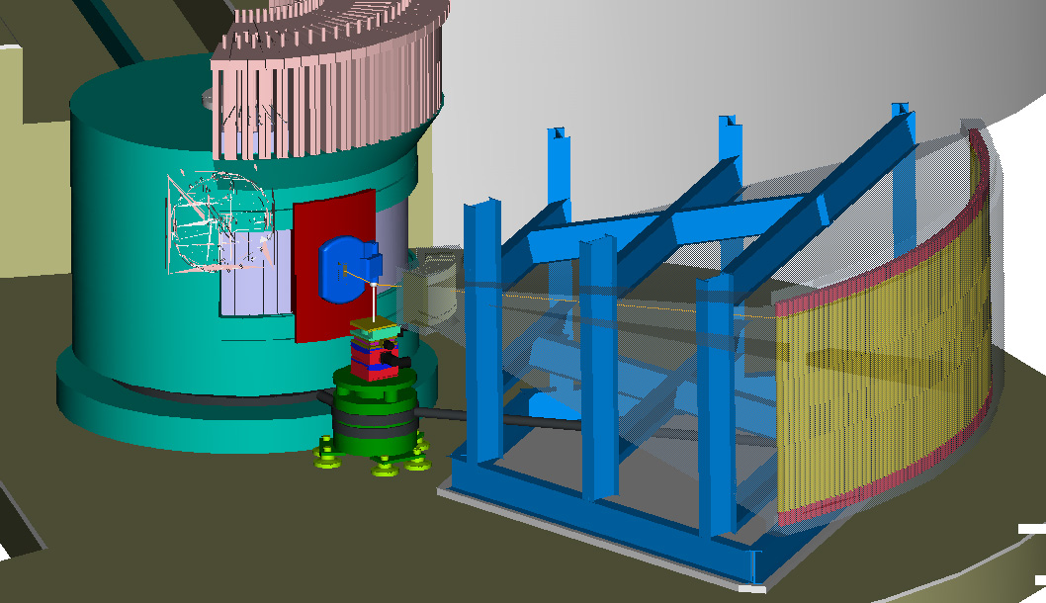
HYSPEC layout in the polarized beam mode
18-20 transmission polarizers
2cm x 5cm (WxL) with 20’ Soller collimators upfront
Heusler crystal monochromator,
vertically focussed
neutron spin flipper

Slide 10
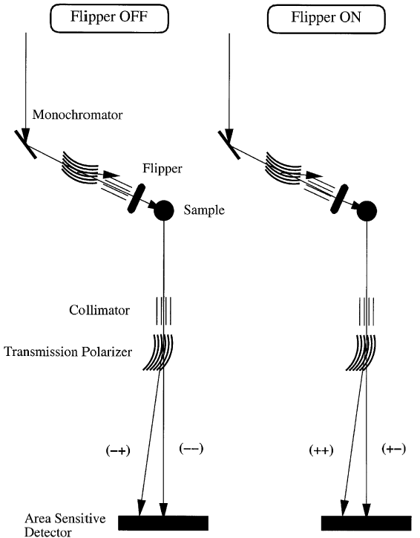
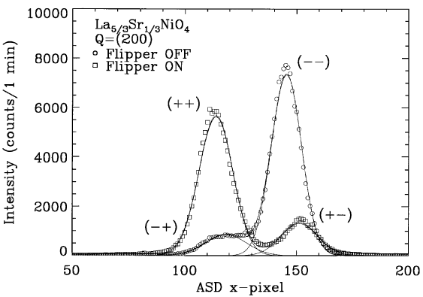
HYSPEC polarization analysis: principle and experimental demonstration on SPINS at NIST
Polarized beam Measurement with a Position Sensitive Detector (PSD)
Heusler
S.-H. Lee, C. F. Majkrzak, Physica B 267-268, 341 (1999)

Slide 11
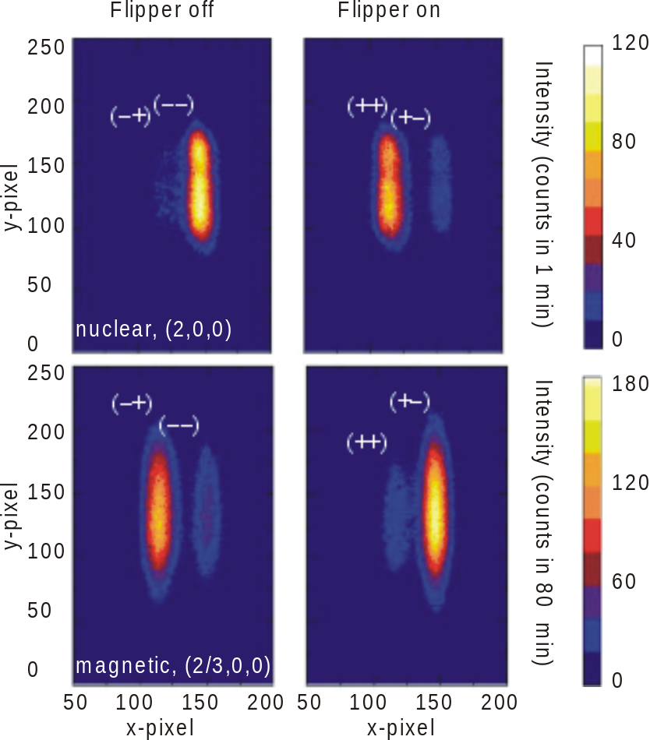
HYSPEC polarization analysis: experimental demonstration with PSD on SPINS
Nuclear and magnetic scattering intensities in La_{5/3}Sr_{1/3}NiO₄
I. A. Zaliznyak and S.-H. Lee,
in Modern Techniques for Characterizing Magnetic Materials, ed. Y. Zhu (to be published by Kluwer Academic, 2004)

Slide 12
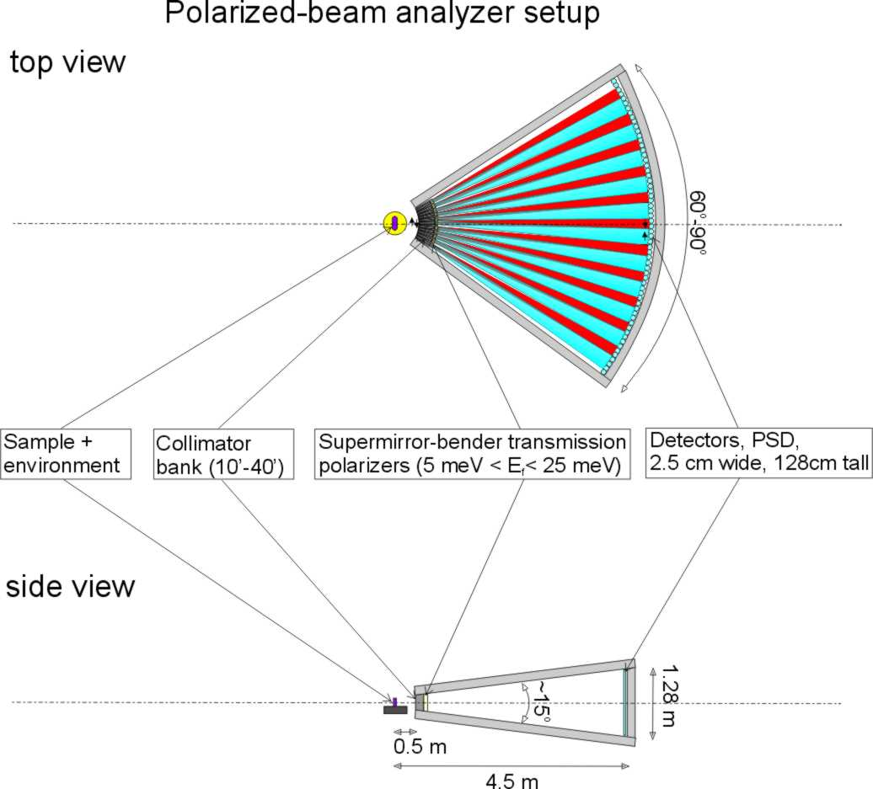
HYSPEC setup for polarization analysis
Polarized incident beam is supplied by reflection from the vertically focusing Cu₂MnAl (Heusler alloy) crystal monochromator
10 meV < E_{i}^{pol} < 90 meV
Polarization analysis of the scattered neutrons is performed by a set of 18-20 supermirror-bender transmission polarizers, each 2 cm wide, 5 cm thick and 15 cm high,
3.7 meV < E_{f}^{pol} < 15-25 meV

Slide 13
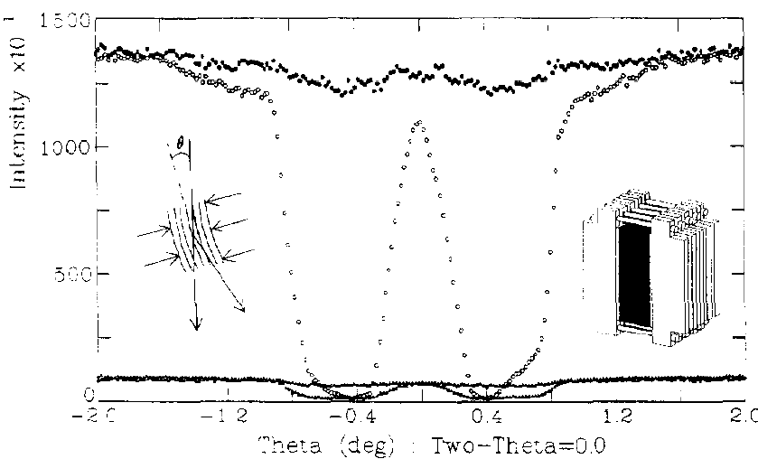
Most important question: can we expect the transmission polarizers to work up to 15-25 meV?
Performance of an optimized Fe/Si transmission polarizer for ~15 meV C. Majkrzak, Physica B 213&214 (1995)
Yes, but fine-tuning of the polarizer tilt angle is necessary.

Slide 14
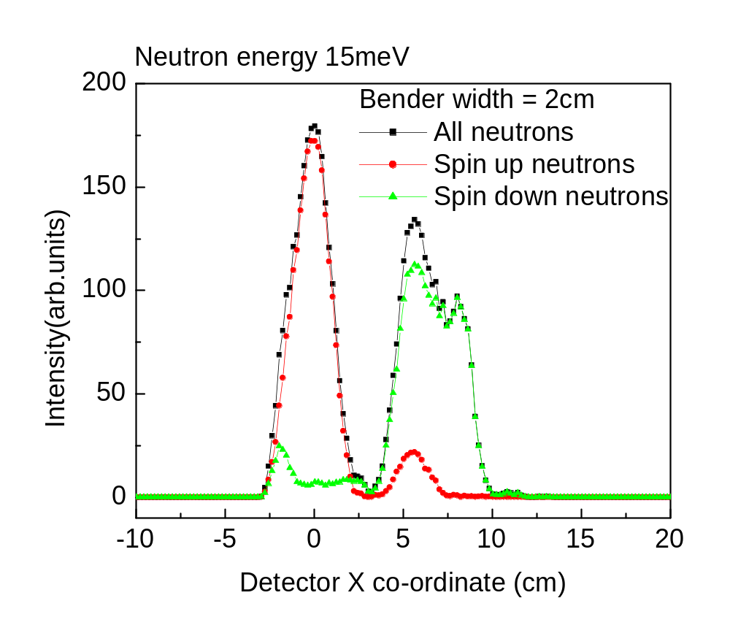
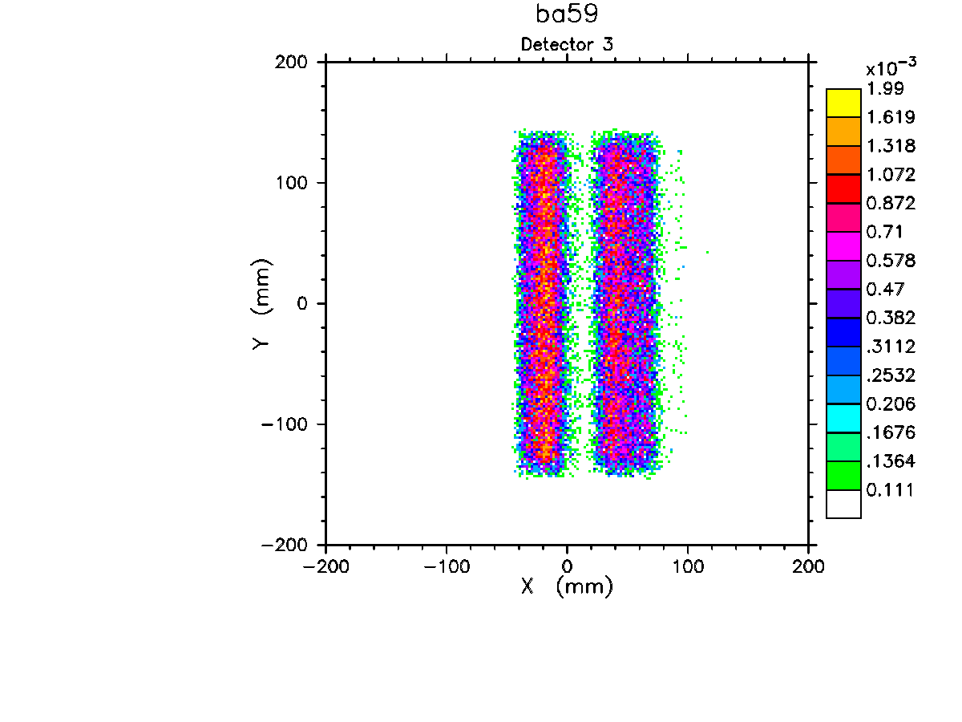
MC simulation (NISP) of HYSPEC operation in the polarized beam mode: beam separation
Simulation for the bender geometry optimized for E=14.7 meV (C. Majkrzak, 1995) Sample-to-detector distance L_{SD} is 4.5 m

Slide 15
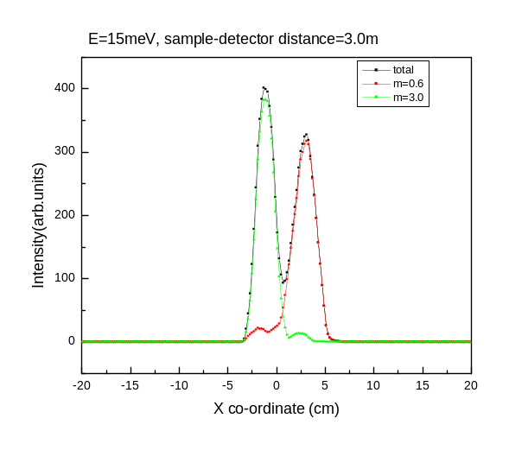
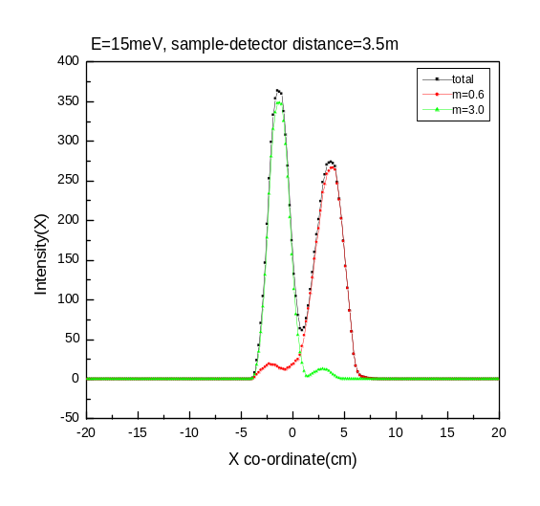
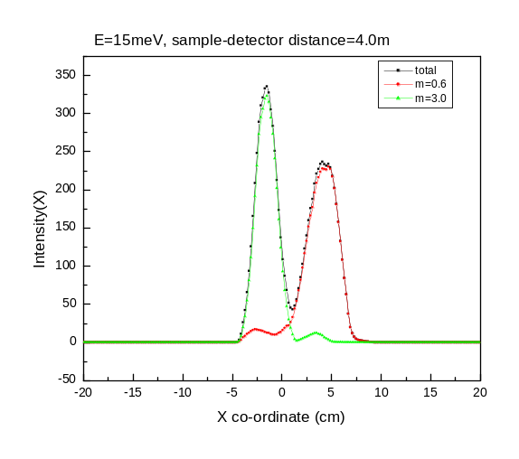
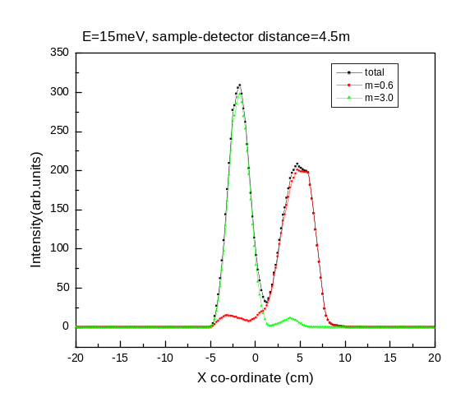
The spatial separation of two polarizations for different sample-to-detector distances
L_{SD} = 3.0m
L_{SD} = 3.5m
θ_{c}^{(up)} = 3.0 θ_{c}^{Ni},
θ_{c}^{(down)} = 0.6θ_{c}^{Ni}.
L_{SD} = 4.0m
L_{SD} = 4.5m
The two polarizations only become sufficiently separated that they can be measured cleanly in the adjacent detector tubes for values of the secondary flight path L_{SD} > 4.0m.

Slide 16
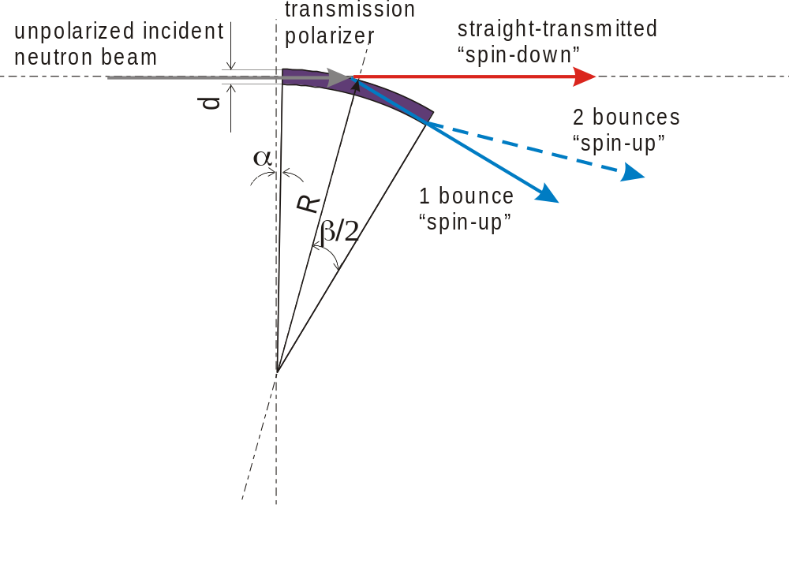
Optimizing geometry of the single-bounce transmission polarizer
Defining parameters are:
θ_{c}^{(up)} and θ_{c}^{(down)}
L, length
d, channel width
α, tilt angle
β, bend angle
L ≈ 2R sin(β/2)≈ R β
Optimization considerations and constraints
θ_{c}^{(up)} = 3.0 θ_{c}^{(Ni)}, θ_{c}^{(down)} = 0.6 θ_{c}^{(Ni)}, => best we can imagine for now
L≈ 50 mm => maximum length is constrained by the transmission through Si
d ≤ R(1- cosβ) ≈ Lβ/2 ≈ 0.25 mm => to remove the line-of-sight
polarizer bend angle β => mechanically constrained, currently use 0.57°
polarizer tilt angle α => must be optimized
Simple optimization condition for a single-bounce device
(α + β) = θ_{c}^{(up)} = 3.0 θ_{c}^{(Ni)}

Slide 17
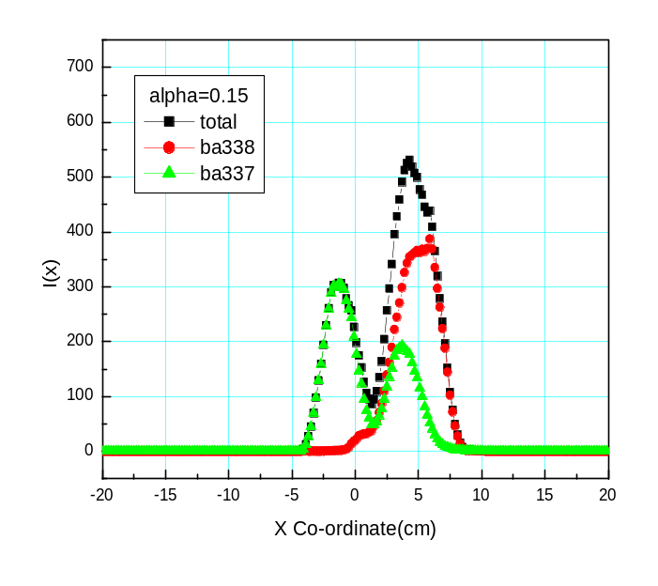
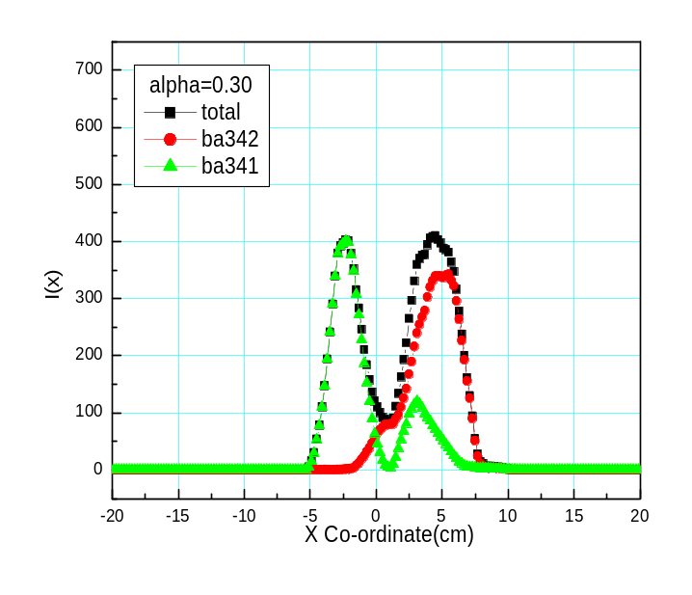
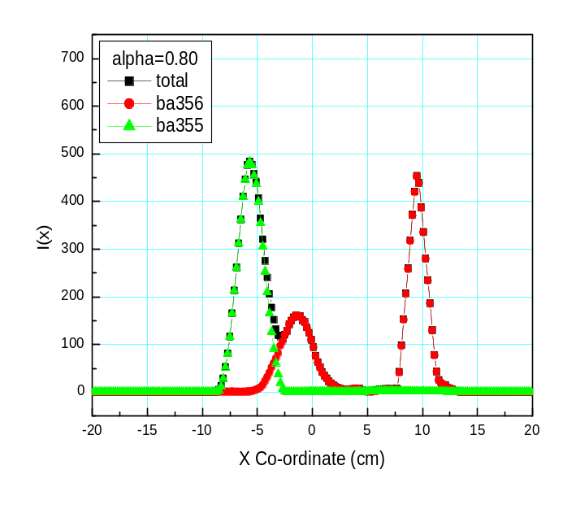
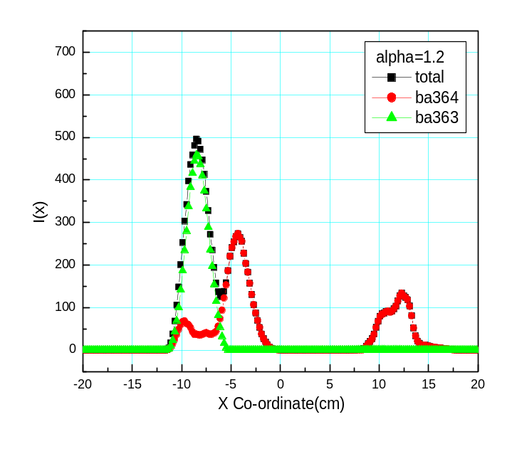
Optimizing polarizer tilt angle at E = 3.7 meV
α = 0.15°
α = 0.3°
20’ collimator
in front
α = 0.8°
α = 1.2°
Neutron beam profiles on the detector

Slide 18
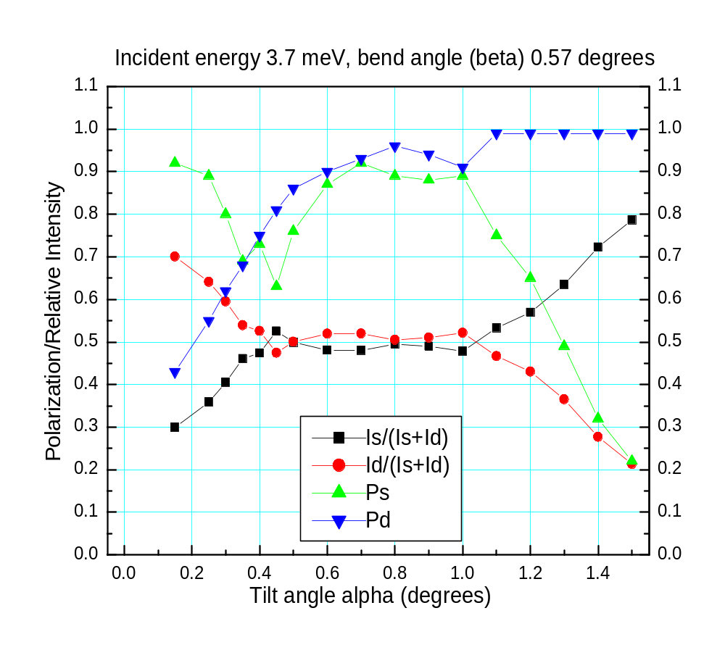
Optimizing polarizer tilt: E = 3.7 meV is quite “forgiving”
Straight beam
Deflected beam

Slide 19
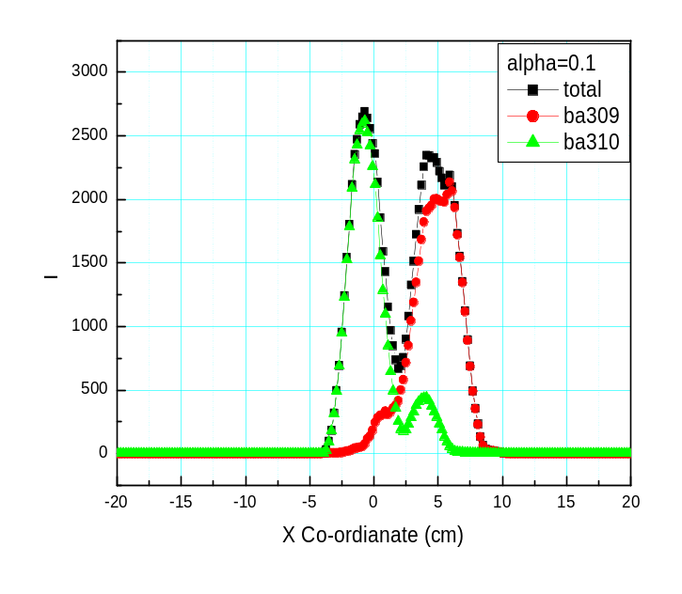
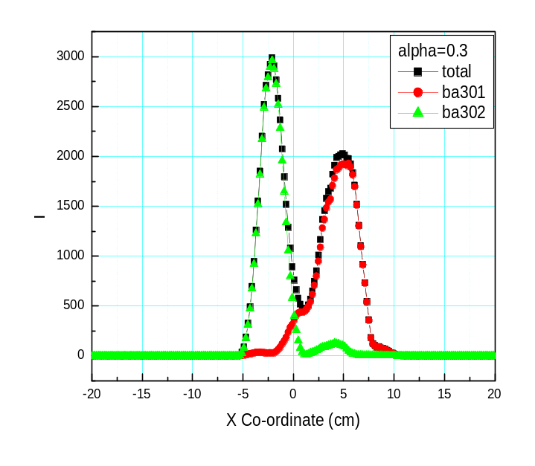
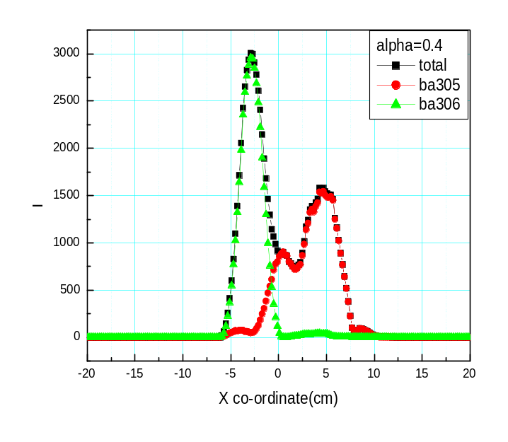
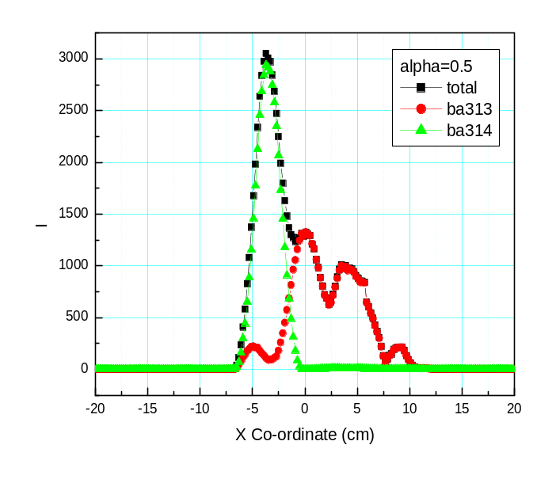
Optimizing polarizer tilt angle at E = 10 meV
α = 0.1°
20’ collimator
in front
α = 0.3°
α = 0.4°
α = 0.5°
Neutron beam profiles on the detector

Slide 20
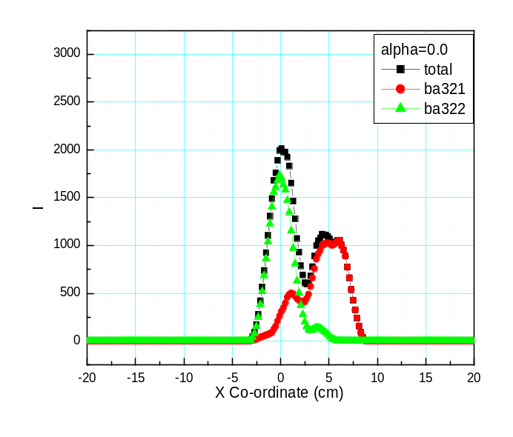
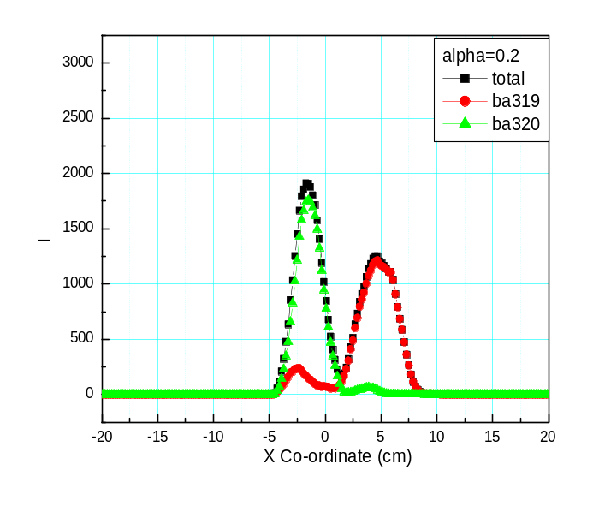

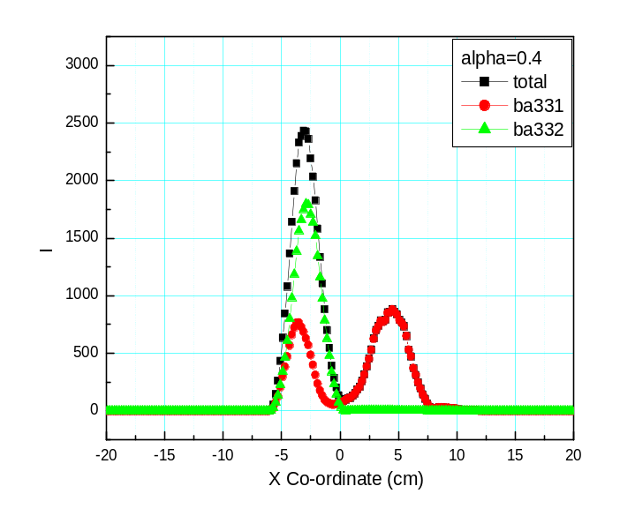
Optimizing polarizer tilt angle at E = 20 meV
20’ collimator
in front
α = 0.0°
α = 0.2°
α = 0.3°
α = 0.4°
Neutron beam profiles on the detector

Slide 21
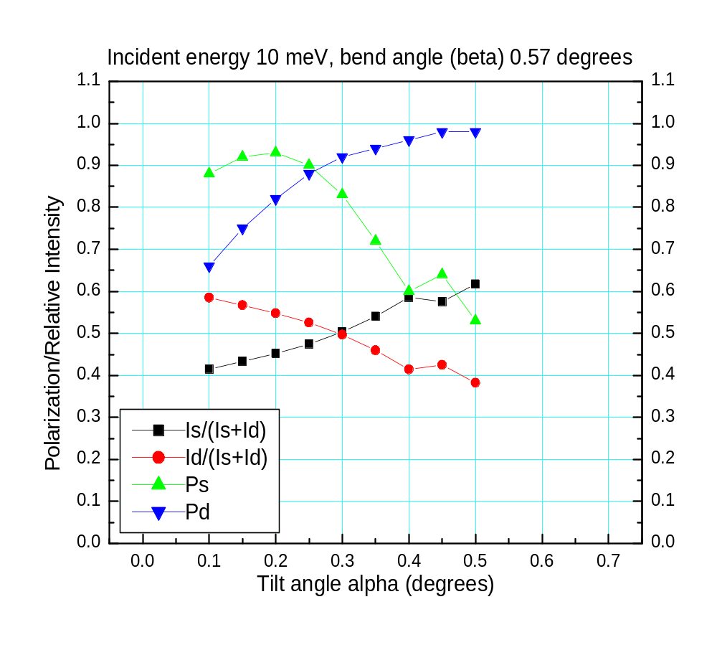
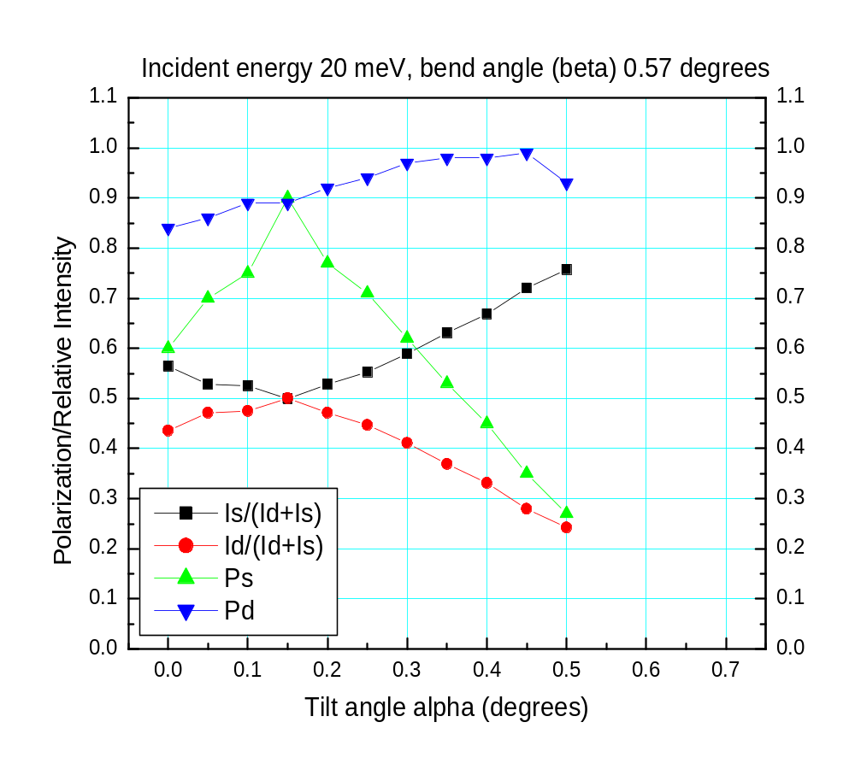
Optimizing polarizer tilt: fine tuning is needed for higher energies
Straight beam
Deflected beam

Slide 22
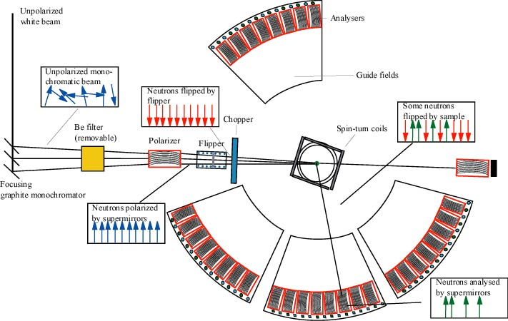
A somewhat similar concept: D7 at ILL
Important differences of the proposed HYSPEC setup
  optimized for thermal neutrons
  => optimized for using the straight-through transmitted beam
  => allows low-polarization-efficiency mode extending to high energies!
  both spin states are measured by the detector array

Slide 23
Summary and open questions
Heusler monochromator provides polarized incident beam
Scattered beam polarization is determined by the array of transmission polarizers
  straight-through transmitted beam is always measured
  polarization sensitivity covers thermal neutron energies up to ~30 meV
  all scattering angles are covered, ~2/3 of detectors are efficiently used
  price in intensity paid for using 20’ collimators also buys lower background and somewhat better q-resolution
  Fe/Si, Co/Si, other?
Optimization of the polarizer geometry for broadband operation
  important to use the optimized tilt angle for every E_{i}, and E-range
  curvature choice (possibly straight stack)?
  fine tuning: length, channel width, collimation in front.
Effect of a coarse (2-3 degrees) radial collimator behind the polarizers?

Slide 24

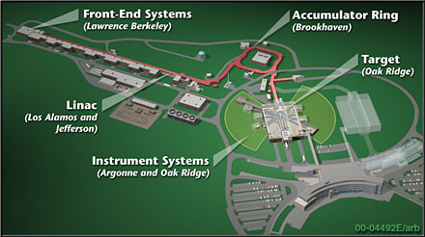
Spallation Neutron Source (SNS) at ORNL
http://www.sns.gov/
http://www.sns.gov/partnerlabs/partners.htm

Slide 25
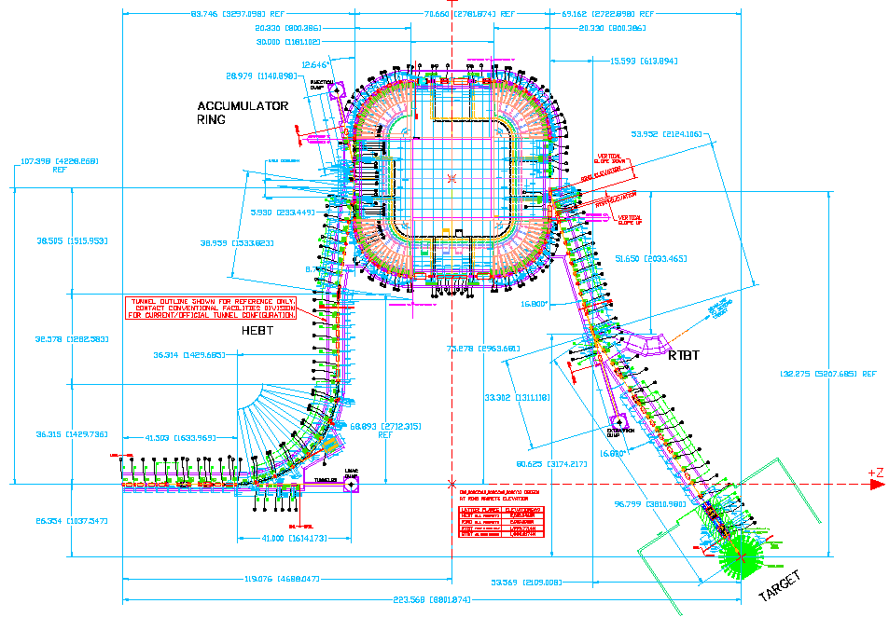
SNS accumulator ring built by BNL
http://sns.bnl.gov/
http://sns.bnl.gov/ap_group/ring.html

