Slide 1
This presentation is for illustrative and general educational purposes only and is not intended to substitute for the official MSHA Investigation Report analysis nor is it intended to provide the sole foundation, if any, for any related enforcement actions.

Slide 2
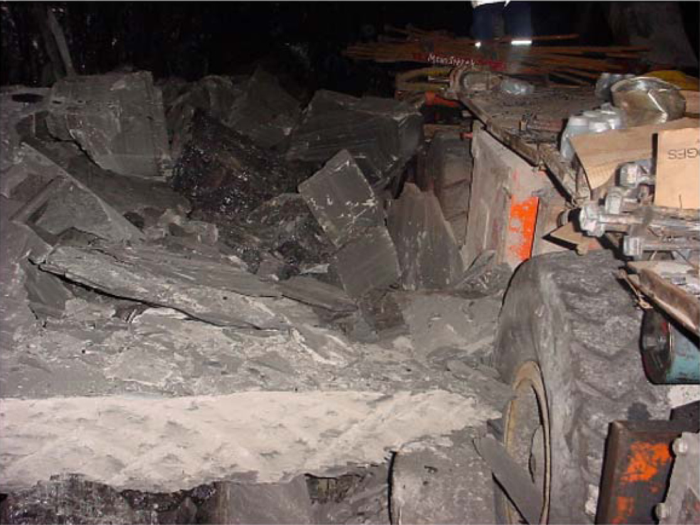
Coal Mine Fatal Accident 2003-05
GENERAL INFORMATION
Operator: Wabash Mine Holding Company
Mine: Wabash Mine
Accident Date: February 15, 2003
Classification: Fall of Rib
Location: District 8, Keensburg, IL
Mine Type: Underground
Employment: 195
Production 1,057 tons/day

Slide 3
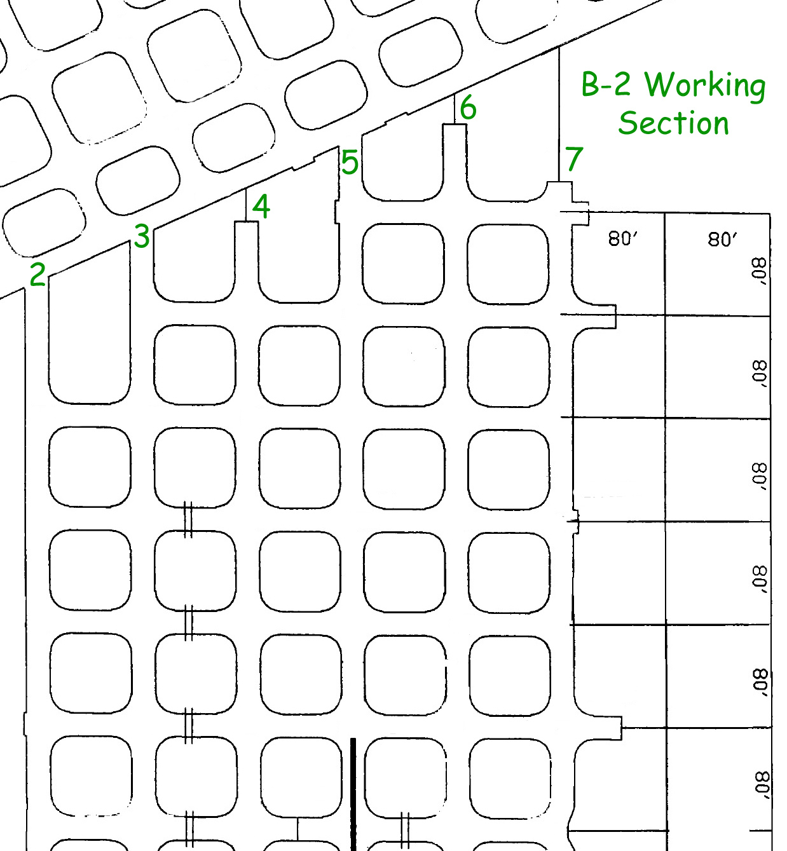
On Saturday, February 15, 2003, the 11-person midnight shift crew for the B-2 working section entered the mine at ~12:00 a.m.
Upon arriving on the section at ~12:50 a.m., the section foreman proceeded across the working faces to make his routine examinations.
ACCIDENT DESCRIPTION
After the faces were examined, he briefed the crew on the location of equipment and where they would be mining. He also informed them that a partial cut ~15 feet in depth had been mined in No. 7 Entry and mining would continue in that entry.

Slide 4
A power move was not yet complete on the left side of the unit because more high voltage cable was needed. The section foreman assigned the two left side roof-bolting machine operators to help with ventilation tasks, loading supplies, and rib bolting behind the right side roof-bolting machine.
As mining began, the continuous mining machine operator first cleaned rib rash in the No. 7 Entry working place and then continued mining.
When the cut advanced ~20 feet, a section of mine roof fell on the mining machine.
The continuous mining machine was backed up and used to trim the remaining loose mine roof. The place was then cleaned and the mining machine head was drug along the rib to knock down anything that might be loose.
The continuous mining machine was moved to No. 6 Entry to allow the roof bolting machine access to the No.7 Entry.
ACCIDENT DESCRIPTION

Slide 5
The right side Fletcher Roof Ranger roof-bolting machine was moved into position to start roof bolting in the No. 7 Entry. The right side roof bolting operators surveyed the area and decided to install additional bolts before they started roof bolting the cut.
The section foreman talked with one of the left side roof bolting machine operators in the last open crosscut, and then went to the mine phone because the belts were down.
The right side roof bolting machine operators continued roof bolting while the left side roof bolting machine operators bolted the left inby corner of the rib behind the machine, using a hydraulically operated two-man hand drill.
They had drilled one hole in the crosscut rib and were in the process of drilling the second hole, when a small portion of mine roof and rib fell down in front of them.
ACCIDENT DESCRIPTION

Slide 6
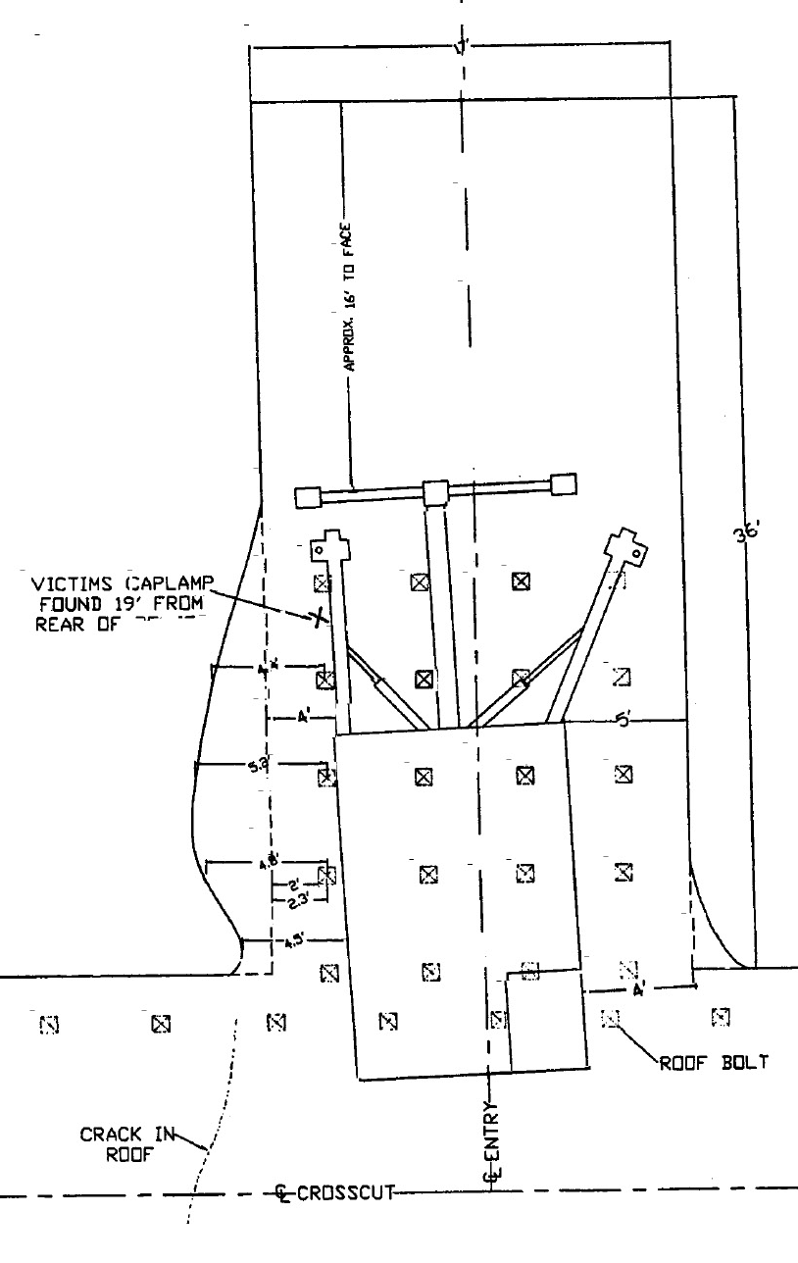
The roof-bolting machine operators completed installing the 4th row of bolts and started moving the machine forward to the next row.
One of the rib bolters noticed a crack that extended all the way down the rib. He then walked between the left rib and the roof-bolting machine to get a pry bar to pull the rib down.
As the rib bolter neared the front of the moving machine, the rib fell and covered him with rock and coal, with the exception of his feet and part of his face.
The other rib bolter started to follow him, but decided to go back when the rib fell, just brushing his legs.
ACCIDENT DESCRIPTION

Slide 7
ACCIDENT DESCRIPTION
The roof-bolting machine operator stopped the machine by hitting the panic bar, went around under the ATRS, and saw the amount of rock that was on the victim. The other rib bolter climbed on top of the machine and observed the victim covered up and asked for help.
Measures to rescue the victim were delayed as coal and rock continued to fall from the rib. When they first reached the victim, the section foreman checked for signs of life, but found none. Once the rib stopped falling, the crew extricated the victim and transported him to the surface.

Slide 8
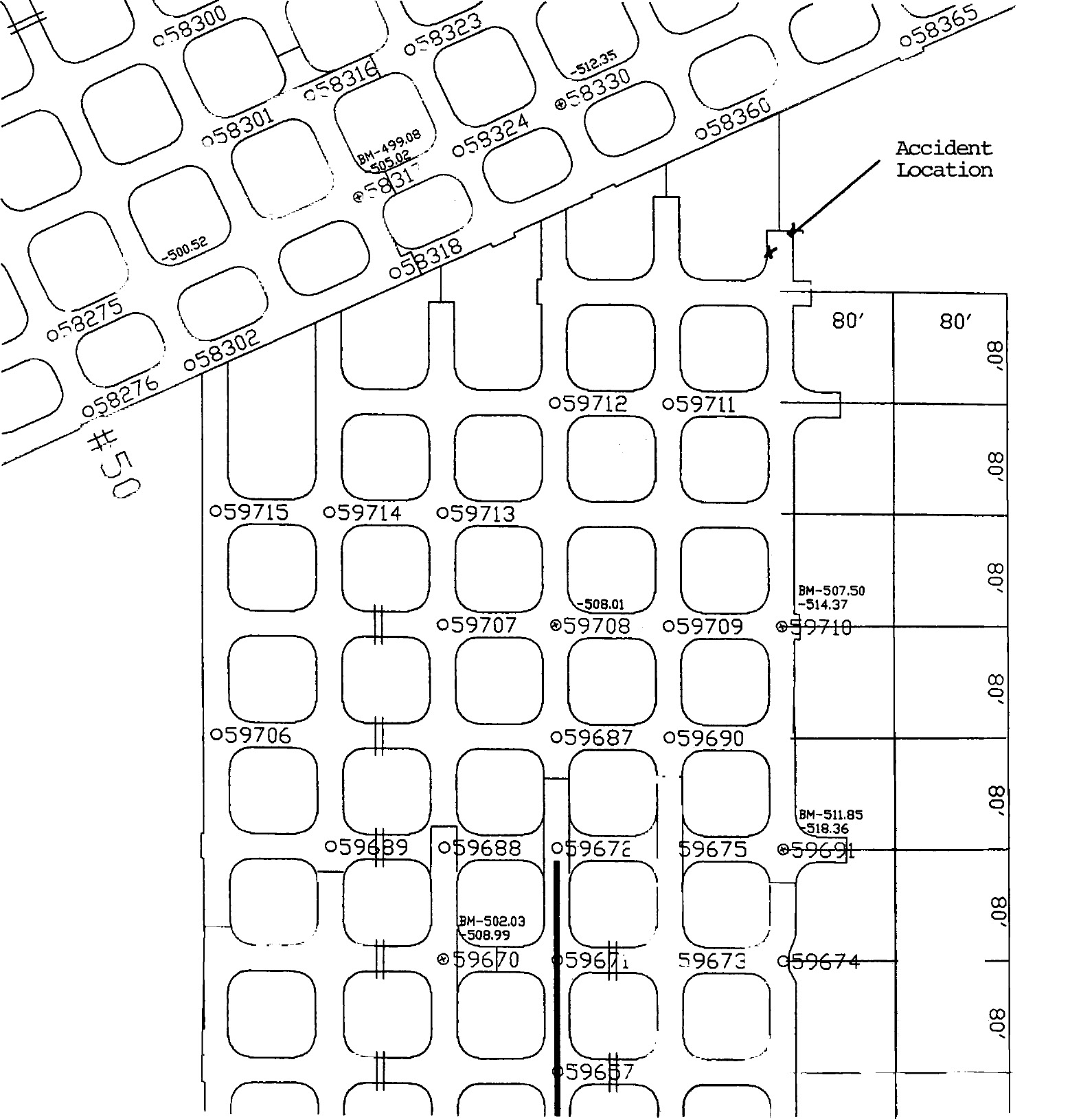
This area of the mine exhibited rib pressures and stresses due to the overburden pressure. The depth of overburden cover at the accident location was ~900’. The immediate mine roof strata consisted of 60’ of gray shale.
The B-2 Section was originally an 8-entry section, with a crosscut centerline spacing of 80’.
The Nos. 1 & 8 Entries were dropped during the previous month due to problems with ventilation.
The B-2 Section had been driven in a southeast direction, but experienced adverse roof conditions and was subsequently turned northeast to help control roof and rib conditions.
PHYSICAL FACTORS

Slide 9
The B-2 Section was mining toward an old B-2 worked out panel, and had been experiencing severe adverse roof and rib conditions. While working in the old B-2 panel, adverse roof conditions and some squeezing were encountered.
The roof and rib conditions worsened as the B-2 working section got closer to the old panel.
The approved roof control plan permits entry and crosscut centers of 60-120’ in mains/submains, with 50-120’ entry centers in panels.
The 4-way diagonal intersection measurement cannot be greater than 70’. Roof support is typically provided by 60” fully grouted, Grade 60 rebar bolts on a 5’ x 5’ centers.
PHYSICAL FACTORS

Slide 10
The approved rib bolting plan required a minimum of 4 bolts installed on 5’ centers on the rib corners only for mining heights of 8’ or less. For mining heights exceeding 8’, full rib bolting was required on 5’ centers.
Rib support was provided by a minimum 48” conventional roof bolt and a 36” rib board used for bearing surface.
There were very few additional measures taken when the ribs rashed beyond the maximum entry widths allowed in the plan, even though the roof control plan requires excessive widths to be timbered or cribbed.
The portion of the rib that fell was ~30’ x 8’ x 2’, weighing ~23 tons. The left side of the roof-bolting machine was 3.5’ from the original rib at the time of the accident.
The ATRS on the Fletcher double boom roof-bolting machine was released from the mine roof and the machine was being moved forward at the time of the accident. There was no evidence to indicate that lowering the ATRS caused the release of the coal and rock rib involved in the accident.
RIB CONTROL

Slide 11
No hazardous conditions were recorded in the B-2 Section preshift examination records for midnight shift.
Upon arriving on the section, the section foreman proceeded across the working faces to make his routine examinations.
Prior to the accident, the No. 7 Entry was mined to a depth of ~35’, during which time a 24” thick layer of the immediate mine roof fell onto the continuous mining machine and was subsequently loaded out and the entry trimmed.
The section foreman talked with the victim in the last open crosscut just prior to the accident.
There were no or few entries made in the on-shift examination report indicating that the certified person recognized the hazards which existed.
A review of the on-shift record books revealed that the on-shift certified person failed to recognize the hazardous conditions on the B-2 working section, even though statements from miners revealed that the roof and rib conditions had been deteriorating for the past several weeks.
EXAMINATIONS

Slide 12
ROOT CAUSE ANALYSIS
Causal Factor: The seriousness of the deteriorating roof and rib conditions on the B-2 working section were not fully evaluated. Little or no additional measures above the minimum specified in the roof control plan were taken to control the roof and ribs. During development of the B-2 working section, the mine roof was supported with 5’ fully grouted roof bolts. The coal ribs were supported by installing four 4’ conventional bolts on the rib corners only. The B-2 unit had initially been developed in a southeast direction, but roof and rib conditions had deteriorated and the unit direction had been changed to a northeast direction. As the unit advanced toward the old B-2 worked out area, conditions again worsened. In the two weeks prior to the accident, the rib conditions worsened considerably. Statements and physical evidence indicated that the B-2 unit was experiencing severe adverse roof and rib conditions prior to the accident. Statements indicated that the ribs would suddenly pop off without warning.
Corrective Actions: Abnormal, unusual, or unexpected roof conditions should be elevated to the attention of upper management immediately. The roof control plan should be reviewed with supervisors and all section workers to assure that they understand the requirements of the plan and that additional measures must be taken when unusual hazards are encountered.

Slide 13
ROOT CAUSE ANALYSIS
Causal Factor: On-shift examinations for the B-2 working section were inadequate. Prior to the accident there were no or few entries made in the on-shift examination report indicating that the certified person recognized the hazards which existed. The records were reviewed from January 26, 2003, through February 28, 2003. Citations were issued for excessive entry widths, wide diagonal intersection measurements, and wide roof bolt spacing. A citation was also issued for a violation of the approved mine ventilation plan for not following proper procedures when cutting into abandoned panels, resulting in poor ventilation in the section return which allowed methane to exist in excess of 5 percent. A review of the on-shift record books revealed that the on-shift certified person failed to recognize the hazardous conditions on the B-2 working section, even though statements from miners revealed that the roof and rib conditions had been deteriorating for the past several weeks.
Corrective Actions: The certified persons making the examinations should identify and record all hazardous conditions and make the appropriate corrections. Mine management should develop and follow procedures to identify and correct any and all hazardous conditions. Management should be aware that simply not entering hazardous conditions into the on-shift records is unacceptable.

Slide 14
CONCLUSION
On February 15, 2003, a fatal fall of rib accident occurred at approximately 2:30 a.m. in the B-2 working section resulting in fatal injuries to one miner. The accident occurred when the victim walked between the left side of the roof bolting machine and the left coal and rock rib when the rib fell, crushing the victim beneath the coal and rock.
The roof and rib conditions had been deteriorating in the B-2 working section for several weeks prior to the accident. There had been little or no extra measures taken to support the roof and ribs.
The accident resulted from a failure to determine the seriousness of the deteriorating roof and rib conditions in the B-2 working section.

Slide 15
ENFORCEMENT ACTIONS
104(a) Citation (S&S, High Negligence) for a violation of 30 CFR 75.220(a)
During the period of at least two weeks prior to February 15, 2003 unusual and hazardous roof and rib conditions were encountered on the B-2 working section, 022 MMU. During this period excessive rib popping and sloughing occurred due to increased pressures. Additional measures beyond the minimum specified in the roof control plan were not taken to protect persons from the unusual hazards. The mine has experienced a fatal fall of rib accident on the B-2 working section, 022 MMU, on February 15, 2003.
104(a) Citation (S&S, High Negligence) for a violation of 30 CFR 75.362
Adequate on-shift examinations were not conducted on the B-2 working section. Hazardous roof and rib conditions as evidenced by excessive popping and sloughing of the ribs due to increased pressures and stresses existed, but were not identified by the persons conducting the examinations. These conditions were obvious, widespread, and were in areas traveled by the certified persons conducting the examinations. Miners on the B-2 working section indicated that these conditions had existed for approximately two weeks prior to a fatal rib fall accident that occurred on February 15, 2003.
Additional hazardous conditions, which were not contributory to the accident, were also present on the B-2 working section. These hazardous conditions constituted violations of the regulations and were cited in violations Nos. 7566446, 7577172, 7577171, and 7575479. The certified person's failure to recognize and correct obviously hazardous conditions further demonstrates that adequate examinations were not conducted.

Slide 16
BEST PRACTICES
Examine the roof, face, and ribs immediately before working in any area. Also, examine frequently during work.
Take down or adequately support any loose roof and ribs.
Be aware of changing roof and rib conditions and act accordingly.
Take extended cuts only in areas with competent roof and rib conditions. Reduce cut depths when adverse conditions are encountered.

