Slide 1
Existing Booster Corrector Program
Eric Prebys
FNAL Beams Division

Slide 2
Basic Features of ORBIT Program (PA1915)
Based on Herrup’s DC orbit control program
Looks at a discrete series of time breaks and calculates deviations from “ideal orbit”
  Ideal ORBIT = fixed position plus corrections for BEX bumps and RPOS, which are not very well done
Calculates corrector settings at each time break to minimize RMS deviation from this ideal ORBIT
  Currently can use SVD or 3-bump algorithm
  Takes into account absolute current limits as well as slew rate limits.
Applies corrections and produces a limited number of diagnostic plots.

Slide 3
Handling limits
This is the tricky part!!
First, calculate ideal setting in the absence of limits
Look at the change in current since last time break and calculate Ρ=ΔΙ/ΔI_{max} for each corrector, where
  ΔΙ = change in current since last time break
  ΔI_{max} = maximum current change to nearest limit
If max R>1
  scale all dI by 1/R
  Set that corrector to the max
  Iterate with that corrector masked off
Repeat until all R’s<1 or all correctors masked off

Slide 4
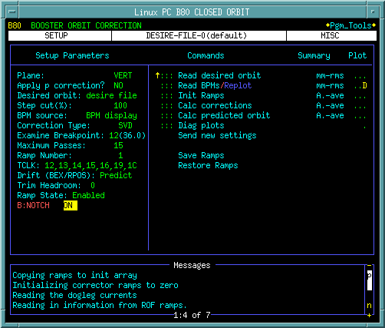
B80 (PA1915) – Ramped Corrector Control Program

Slide 5
Details of Closed Orbit Calculation
Read desired orbit (from file or a particular time in current cycle)
Read the beam position as a function of time.
Initialize the ramps.
Calculate the current ramps needed to hold the orbit at the desired point.
Calculate the predicted orbit, based on the calculated ramps.
Produce some diagnostic plots
Send the ramp current ramps to the ramp modules.
Save ramps for future use.
Restore ramps, either to their initial value or to a stored setting.

Slide 6
Program Options
Plane being corrected
Momentum correction (not correctly handled)
Desired orbit (file, injection, or zero)
Fraction of correction to apply
BPM source (display or file)
Alogrithm (SVD or 3-bump)
Which timebreak to examine (on diagnostic plots)
Maximum iterations
TCLK events
Ramp slot to use (1 to 15)
How to handle special points (kludgy at the moment)
How close to get to the peak current (old ad-hoc way of dealing with RMS limit)
Enable ramps
Left over from when BPM’s didn’t work with notch

Slide 7
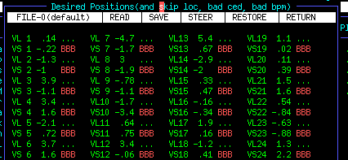
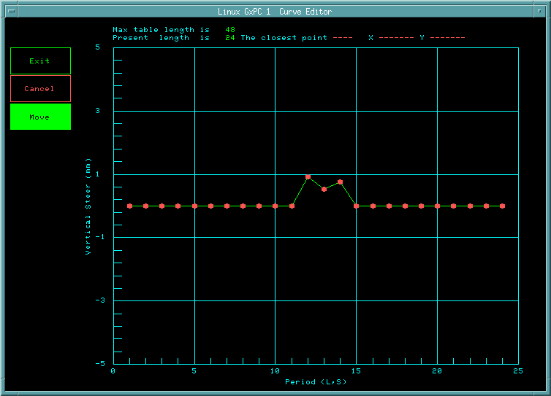
Orbit “tweaking”
Drag-edit deviations from current position
Edit positions by hand

Slide 8
Badly Needed Improvements
Ability to handle time dependent ideal orbits!!
  Not that big a deal
Better handling of BEX bumps
  Might solve itself with time dependent orbits
Proper momentum correction
  Coupled to proper RPOS handling
Include RMS limit
  Pretty easy
More versatile “tweaking”
  Interface to rampled 3-bump program??
Lots more diagnostic plots

Slide 9
Questions
Is this program worth salvaging, or would it be better to start from scratch?
How to we proceed?

