Slide 1
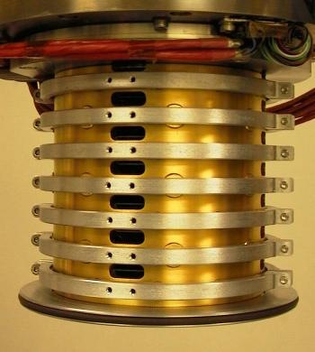

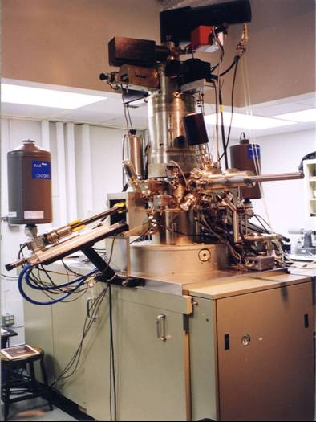
Acquisition of an Aberration Corrected Analytical Electron Microscope for Nanocharacterization of Materials
C.J.Kiely, C.E.Lyman, D.B.Williams, K.I.Winey* and M.Watanabe
Lehigh University and * University of Pennsylvania DMR-MRI Award # 0320906
This Major Research Instrumentation (MRI) award has allowed us to equip our 300kV HB603 Scanning Transmission Electron Microscope (STEM) with a Nion aberration corrector that significantly improves its imaging and spectroscopic capabilities.
Performance Metric | Old HB603 STEM | Aberration corrected HB 603 STEM
Beam diameter | 1.5 nm FWTM | 0.5nm FWTM
Beam current | 1nA | 1 nA
Spatial resolution of X-ray analysis | 2-3nm | 0.5-1nm
Stage stability | 0.1nm/min | 0.1nm/min
Image resolution | 0.4nm | <0.2 nm
Detection Limit | 2-3 atoms in metal thin foil | 1-2 atoms in metal thin foil

Slide 2
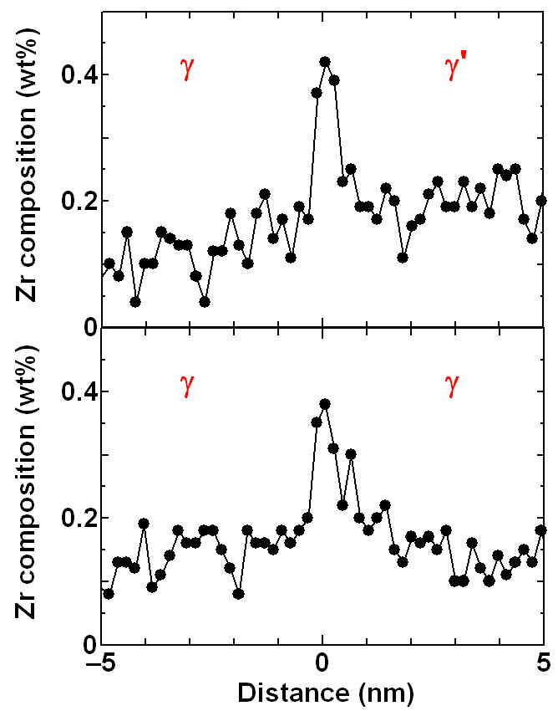
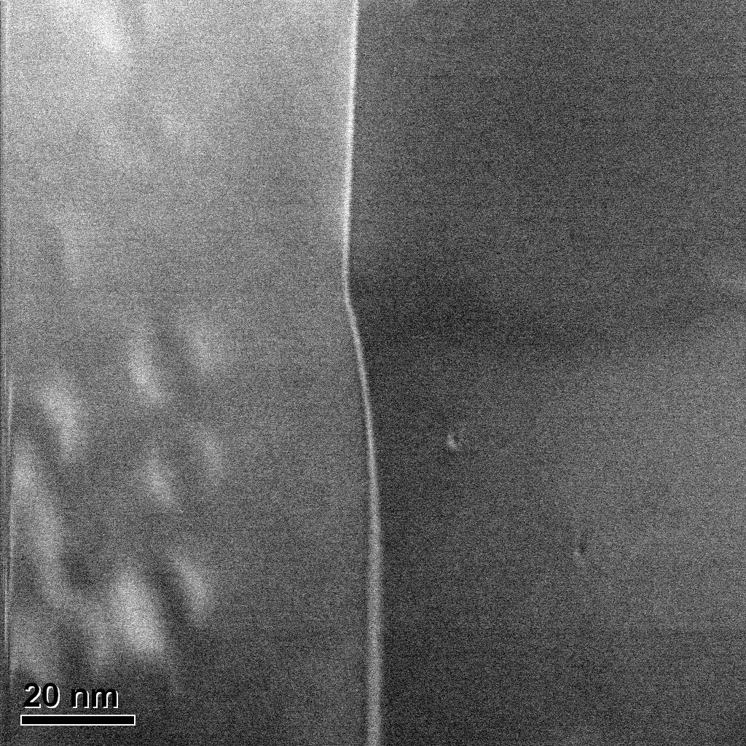
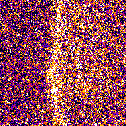

Acquisition of an Aberration Corrected Analytical Electron Microscope for Nanocharacterization of Materials
C.J.Kiely, C.E.Lyman, D.B.Williams, K.I.Winey* and M.Watanabe
Lehigh University and * University of Pennsylvania DMR-MRI Award # 0320906
Key Result: Our previous world record for spatial resolution in X-Ray Energy Dispersive Spectroscopy (XEDS) has been beaten by a factor of 3. This has been achieved by adding a Nion C_{s} corrector to our HB 603 STEM which reduces the minimum attainable electron probe size from 1.5 to 0.5nm. The graphic below shows a Zr XEDS map taken from some γ-γ’ and γ−γ grain boundaries in a Ni based superalloy. Zr atoms segregated to the grain boundary at a level of only about 0.12 monolayers are being detected with an XEDS mapping resolution of 0.5nm.
Zr
γ’
γ
γ
GB
0
0.5
(wt%)

