Slide 1
SNS Remote Operations Experience + Thoughts on Using Java
John Galambos
SNS, ORNL
Remote Operations Workshop
Sept. 17-20, 2002

Slide 2
Outline
SNS remote testing of high level applications
  During initial commissioning of SNS MEBT at LBNL
XAL java based high level application programming infrastructure
  Implications for remote operations
Acknowledgements: C. Allen, S. Aleksandrov, P. Chu, N. Pattengale, T. Pelaia, A. Shishlo, E. Williams, C. Lionberg, N. Malitsky

Slide 3
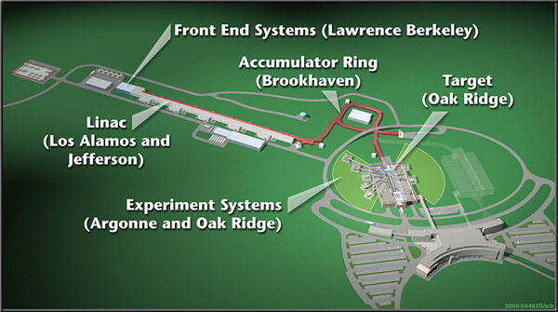
SNS is a Multi-lab Collaboration
Accelerator components provided by LBNL, LANL, Jlab, and BNL

Slide 4
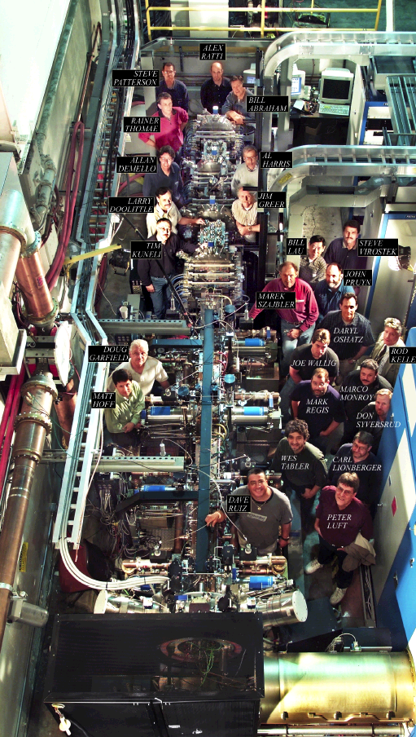
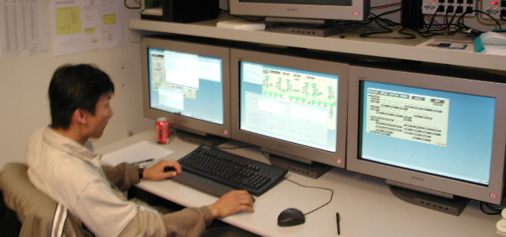
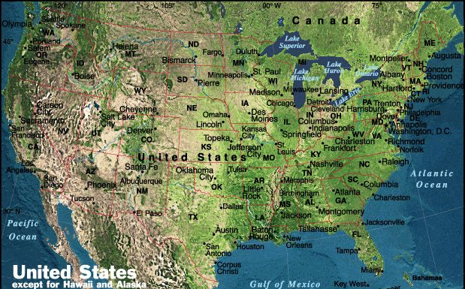
Remote Testing of Applications
Front End at LBNL
Test control room at ORNL
Remote testing of high level applications from ORNL on the Front End System at LBNL

Slide 5
SNS Medium Energy Beam Transport (MEBT) Section
Transport section from RFQ to the DTL
  Provides chopping and beam matching functionality
  3.65 m long
Beamline equipment
  14 quads
  6 vertical + 6 horizontal correctors
  4 RF rebunches
  6 BPMs, 2 current monitors, 4 profile monitors, 1 emittance measurement device
Beam Parameters
  Energy = 2.5 MeV
  Nominal current = 36 mA (commissioning current ~ 20 mA)
  Nominally 1 msec pulse length (commissioning pulse length ~ 100 μsec)
  Nominally 60 Hz (commissioning rate ~ 1 Hz)

Slide 6
SNS Remote Testing of High Level Physics Applications
The SNS MEBT was commissioned at LBNL April-May 2002.
The initial schedule included time for testing high level applications, but:
  Required components were not functional when our time approached,
  Many others were at LBNL
  Advised not to come
Through steady “pestering” we were able to secure 3 slots for testing our applications.
  “Bootleg” operation
  Total of ~ 5 hrs beam-time
  First 2 slots had no “set” privilege
Tested model comparison, orbit correction + general purpose diagnostic app.

Slide 7
SNS Remote Applications Testing Setup
Security
  EPICS gateway server used at LBNL
  Read/write access granted to ORNL Control room CPU IP address
Additional communications - phone
  We requested parameters to be tweaked, before we were given “set” privilege
  Told us when to start / stop

Slide 8
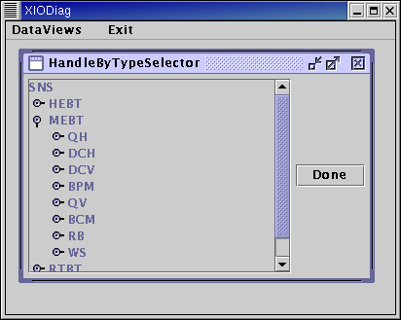
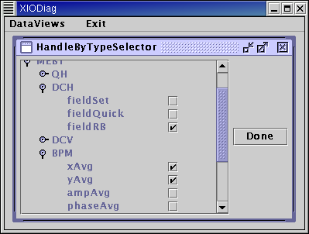
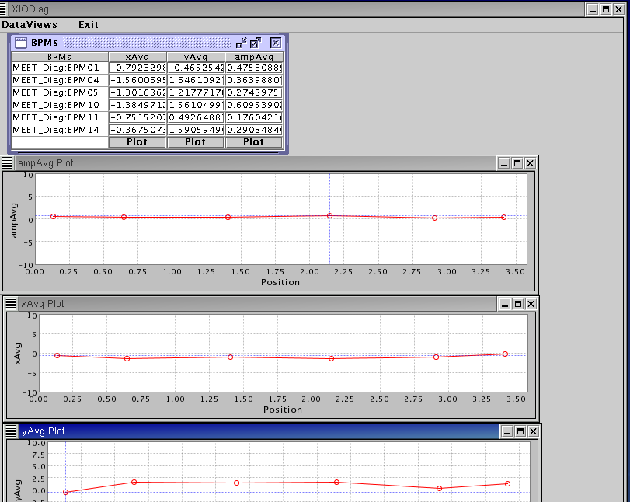
Diagnostic App (N. Pattengale)
General purpose: drill down accelerator hierarchy and tag items to be monitored
Monitor accelerator values without having to know their names
Works for any accelerator sequence

Slide 9
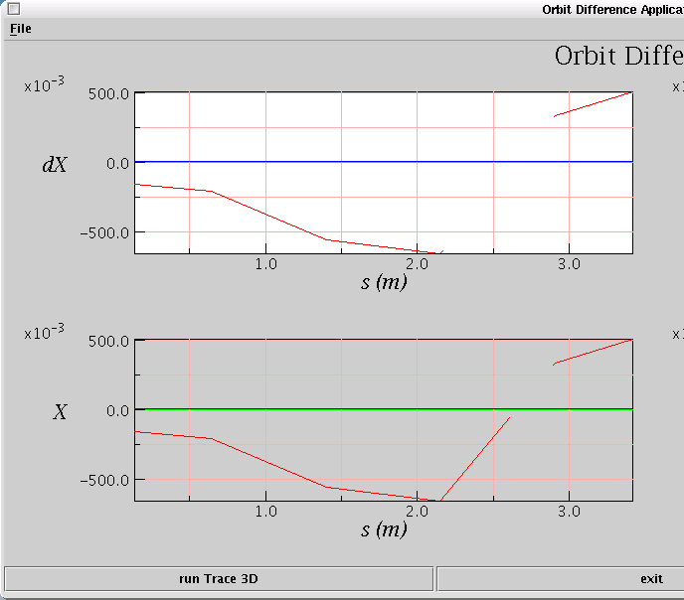
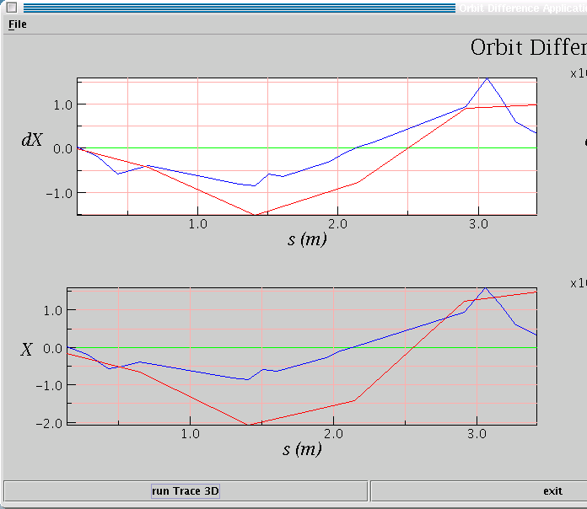
XAL Application: Model – Machine Comparison (P. Chu)
Before corrector
Diff. before/after correction
Change corrector
Using live “LBNL” MEBT data
Red = BPM,
Blue = model
Compare difference between two pulses
  Observe effect of a magnet change
  For both BPM signals and Model (Trace-3D)
The beamline-device initialization is from the global database
Also works with virtual accelerator

Slide 10
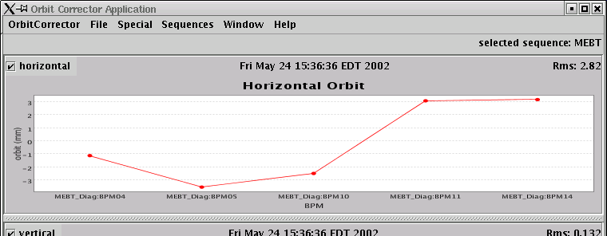
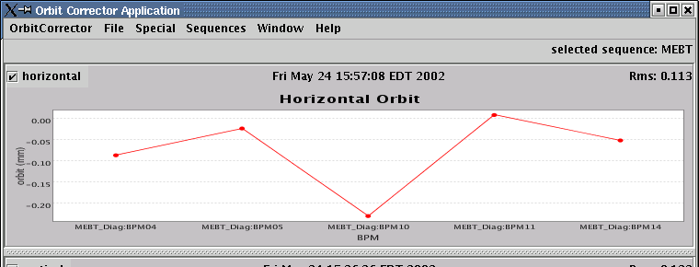
Orbit Correction application
(app at ORNL, machine at LBNL)
Before correction
3 to -3 mm
RMS error lowered
0 to -0.2 mm
After correction
1st use of orbit correction application on real hardware

Slide 11
Thoughts on Remote Use of Applications (SNS)
Requires interest on both ends + good communications
  Needed a somewhat interested contact at LBNL
  Took some “pestering” from ORNL side
  Needed to know the “state” of diagnostics etc.
Useful for commissioning
  Difficult to accurately schedule when things will happen, avoid experts sitting around
  Few hours of beam time was useful – able to identify some problems and see that some things worked
News of its use can be greatly exaggerated
  Bad: like to be honest
  Good: indicates interest in demo-ing this technology
Will partner labs remotely assist commissioning at ORNL?
  Passive monitoring – undoubtedly
  Active knob-turning – probably
  Where there’s a will, there’s a way

Slide 12
XAL – A Java based high level programming infrastructure for physics applications
Accelerator
SCL
HEBT
MEBT
…
Ring
Quad
BPM
Dipole
RfCavity
…
Quad
xAvg()
yAvg()
valid()
Java class structure that provides a hierarchical “device” view of the accelerator to the application programmers
Setup from database, EPICS connections hidden
Other similar frameworks
  Based on UAL2 (http://www.ual.bnl.gov/)
  Cosylab Abeans / databush (www.cosylab.com)

Slide 13
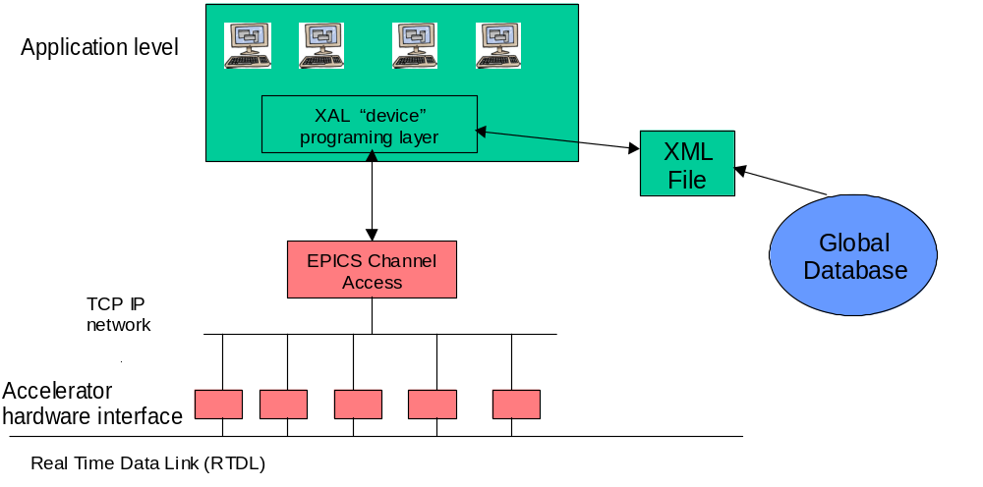
High Level Programming Infrastructure (XAL)
XAL is a new programming infrastructure to provide a hierarchical device oriented view for application programmers
Using Java - Interfaces exist to EPICS (java ca) and to database (JDBC + XML)

Slide 14
Advantages of Java (for remote operations)
Simple
Object Oriented
Robust
  Good memory management + exception handling
Multithreaded
Architecture neutral
Interpreted + high performance
Distributed
  Built in capabilities for TCP/IP and remote method invocation (client/server)
Dynamic
  Lots of run time information available – easy for applet deployment
Easier to attract good young programmers

Slide 15
Disadvantages of Java
Less open software available for scientific applications
  Graphics (contours, error bars, real-time, 3-D, …)
  Mathematical libraries less mature
Java Virtual Machine (VM) somewhat of a hog, but:
  With faster computers, matters less
  Can run multiple applications from a single VM
Have to teach old dogs new tricks

