Slide 1

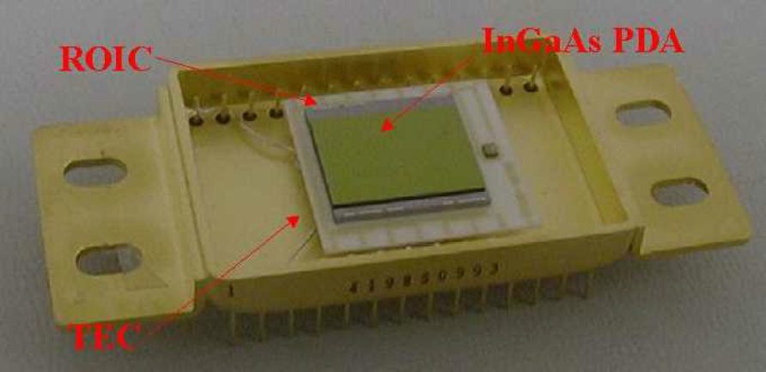
Monolithic, Active Pixel InGaAs
Near Infrared Focal Plane Array
Sensors Unlimited, Inc.
Princeton, NJ
Small
Business
Innovation
Research
INNOVATION
Developed an InGaAs/InP active pixel sensor wherein monolithic circuit functionality is integrated at every pixel.
ACCOMPLISHMENTS
Technology incorporated into hybrid focal plane array (FPA) consisting of an InGaAs photodiode array operable in the 0.9 µm to 1.7 µm spectrum at room temperature.
Contains a single stage thermoelectric cooler with an integrated thermistor allowing the user to reduce the temperature for "high sensitivity" applications, such as low light level detection, or to stabilize the FPA in a varying ambient temperature.
Easy to operate because the clock drivers and analog gain are all on one chip.
High-resolution, active pixel architecture.
  GOVERNMENT SCIENCE/APPLICATIONS
Technology is utilized in Atmospheric Corrector (AC) instrument which will be flown on NASA’s Earth Observing-1 (EO-1) mission. The AC will be tested for its ability to increase the accuracy of surface reflectance estimates.
PHOTOGRAPH
InGaAs/InP Focal Plane Array
COMMERCIALIZATION
A number of the processing techniques developed while working on this program have made their way into commercial devices that Sensors Unlimited sells to various customers.
Technology used in many industrial and commercial applications such as fiber optics inspection, eye-safe covert surveillance, spectroscopy, laser beam profiling, laser and light detection and ranging (Ladar, Lidar), machine vision, telecommunications, and many other applications where near infrared detection is required.
Sensors Unltd. was recently acquired by Finisar Corp., a fiber optic systems manufacturer in Sunnyvale, CA, in a stock deal presently worth over $800 million.
Goddard Space Flight Center
Points of Contact:
- NASA - Murzy Jhabvala; 301-286-5232
- Sensors Unlimited, Inc.- Gregory Olsen - 609-520-0610
1995 Phase II, SS5-040; 11/1/00

