Slide 1

Ocean Modeling at NCEP
Toward a national backbone capability
Hendrik L. Tolman
NOAA / NWS / NCEP / EMC
Marine Modeling and Analysis Branch
Hendrik.Tolman@NOAA.gov

Slide 2
Background
2004 SAB report on ocean modeling and 2006 NOAA response:
  NCEP to provide ocean modeling backbone for NOAA.
  Part of bigger ecosystems modeling effort
    NOS lead (Marie Colton).
  Part of bigger national picture.
    Partnerships outside NOAA (Navy, IOOS, USACE, academia ….)
  NCEP focus on physical modeling and larger scales.
    Enabling coastal scales physical modeling.
    Enabling ecosystems (Earth System) modeling.
    Enabling operational modeling.

Slide 3

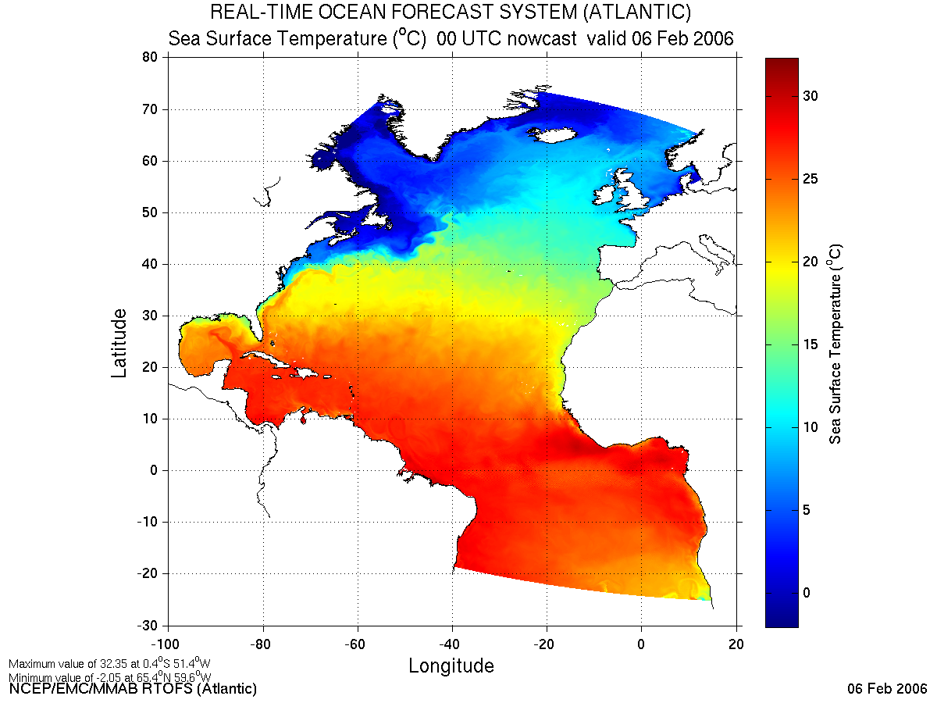
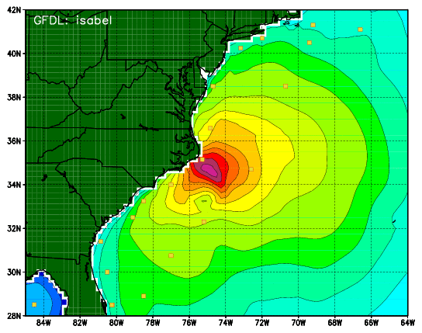
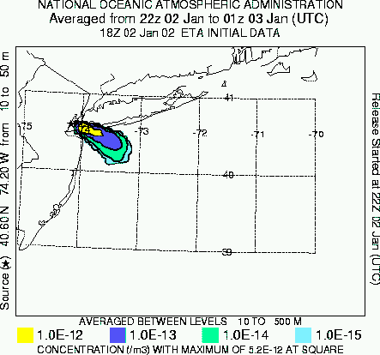
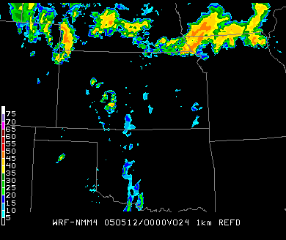
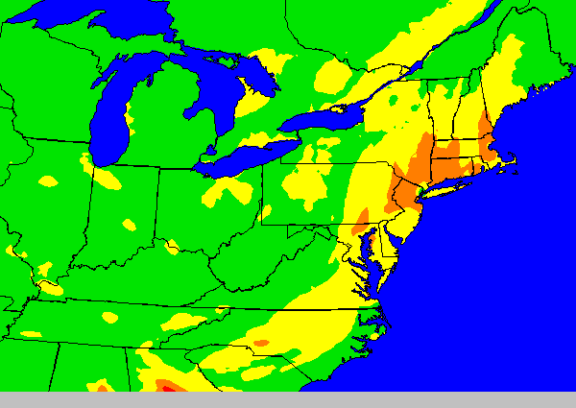
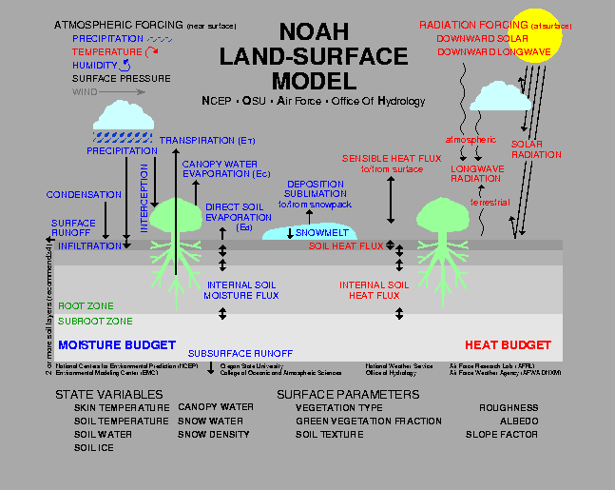
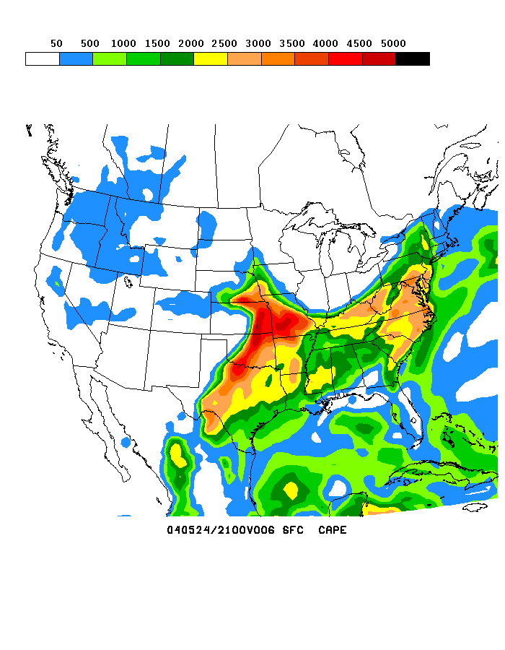
The big picture
1
Climate
CFS
Oceans
HYCOM
Wavewatch III
Hurricane GFDL
HWRF
Coupled
MOM3
1.7B Obs/Day
Satellites
99.9%
Global
Forecast
System
Regional NAM
WRF NMM
Dispersion
ARL/HYSPLIT
Global Data
Assimilation
Severe Weather
Short-Range
Ensemble Forecast
WRF NMM/ARW
Workstation WRF
North American Ensemble Forecast System
WRF: ARW, NMM
ETA, RSM
Air Quality
GFS, Canadian Global Model
NAM/CMAQ
Forecast
Rapid Update
for Aviation
NOAH Land Surface Model

Slide 4
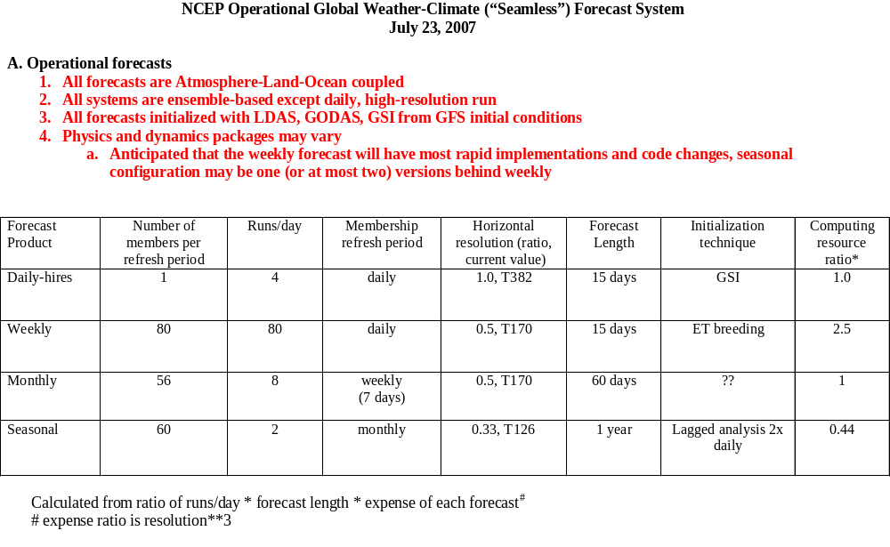
The big picture
2
Executing the weather-climate strategy
Need for appropriate ocean modeling component at all scales at NCEP

Slide 5
National Environmental Modeling System (NEMS)
(uses standard ESMF compliant software)
1
Application Driver
ESMF Superstructure
(component definitions, “mpi” communications, etc)
Atmospheric Model
Analysis
--------------
Ocean
-------------
Wind Waves
--------------
LSM
--------------
AQ
--------------
Ens. Gen.
--------------
Ecosystem
--------------
Etc
Dynamics
(1,2)
Physics
(1,2,3)
Coupler1
Coupler2
Coupler3
Coupler4
Coupler5
Coupler6
Coupler7
Etc.
1-1
1-2
1-3
2-1
2-2
2-3
Multi-component ensemble
+
Stochastic forcing
ESMF Utilities
(clock, error handling, etc)
Bias Corrector
Post processor & Product Generator
Verification
Resolution change
* Earth System Modeling Framework (NCAR/CISL, NASA/GMAO, Navy (NRL), NCEP/EMC), NOAA/GFDL
2, 3 etc: NCEP supported thru NUOPC, NASA, NCAR or NOAA institutional commitments
Components are: Dynamics (spectral, FV, NMM, FIM, ARW, FISL, COAMPS…)/Physics (GFS, NRL, NCAR, GMAO, ESRL…)

Slide 6
Present capability
Operational at NCEP
  1/12º resolution Real Time Ocean Forecast System for North Atlantic Ocean. (RTOFS-Atlantic).
    HYCOM based, developed as part of NOPP partnership.
    Other HYCOM applications are scheduled for development (regional, global).
    Presently deterministic and short range only.
  MOM3-4 (GFDL) ocean model as part of the coupled Climate Forecast System (CFS).
  NOS/GFDL local applications are being transferred to NCEP super computing.
  No ecosystem elements in operations.

