Slide 1

Surveying Green Light:
Impacts of Space Weather
Joseph Kunches,
Mihail Codrescu, Tim Fuller-Rowell
Space Weather Prediction Center
(nee Space Environment Center)
National Centers for Environmental Prediction
National Weather Service
Boulder, Colorado
CORS Users' Forum
Fort Worth
September 25, 2007

Slide 2
Summary of GPS Errors
Typical Error [m] Standard GPS Differential GPS
(per satellites)
Satellite Clocks 1.5 0
Orbit Errors 2.5 0
Ionosphere 5.0 0.4
Troposphere 0.5 0.2
Receiver Noise 0.3 0.3
Multipath 0.6 0.6
The ionosphere is the largest source of error for Standard GPS and second largest for Differential GPS.
http://www.trimble.com/gps/howgps-error2.shtml#3
Notes:
http://www.trimble.com/gps/howgps-error2.shtml#3

Slide 3
Ionosphere and Plasmasphere
The ionosphere is that part of the upper atmosphere where free electrons occur in sufficient density to have an appreciable influence on the propagation of radio frequency electromagnetic waves.
Less than 1% of constituents ionized
Lower boundary at ~ 60 km
Upper boundary at ~ 1000 km
Plasmasphere extends to several R_{E} and includes the radiation belts and the ring current

Slide 4
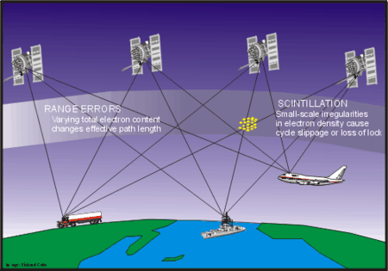
Ionospheric Effects on GPS
The ionosphere introduces a variable time delay in the
propagation of signals from the satellite to the receiver,
which affects positioning.
The delay calculation requires modeling the electron
density along the pass of the signal.

Slide 5
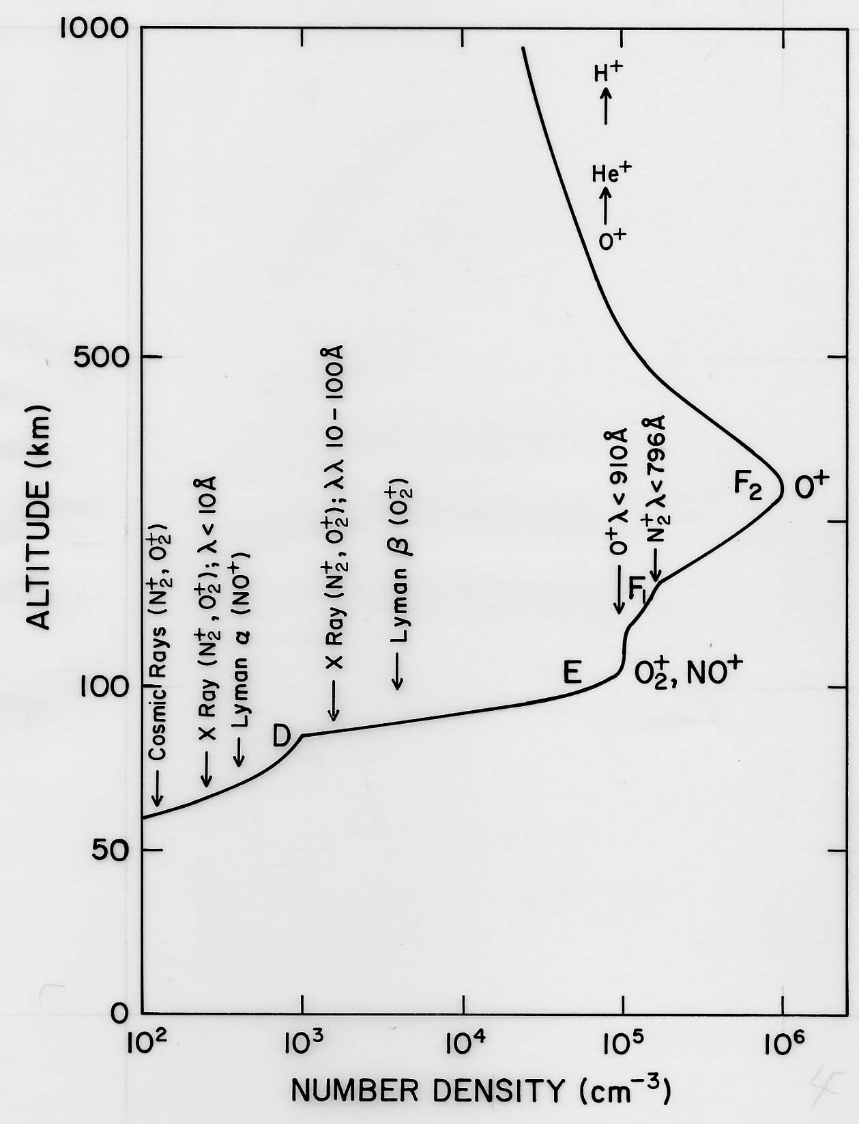
Electron\Ion Density Profile

Slide 6
Ionospheric Effects
Neutral composition
Affects production and loss of ionization
Can vary on several hours time-scales during storms
Neutral Winds
Redistribute plasma paralell to B field
Change charged particle life times
Have time scales of about one hour
Electric fields
Redistribute plasma perpendicular to B field
Change charged particle life times
Have time scales of minutes

Slide 7
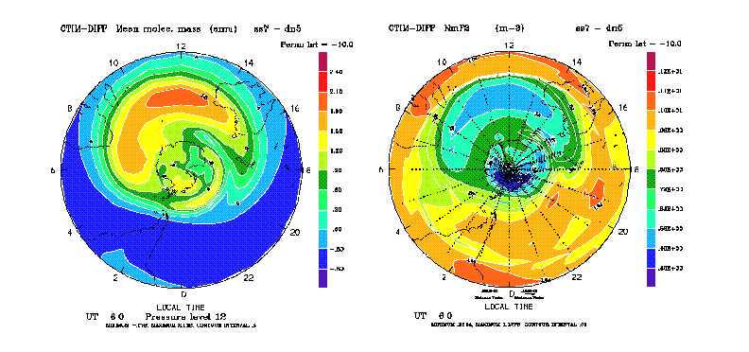
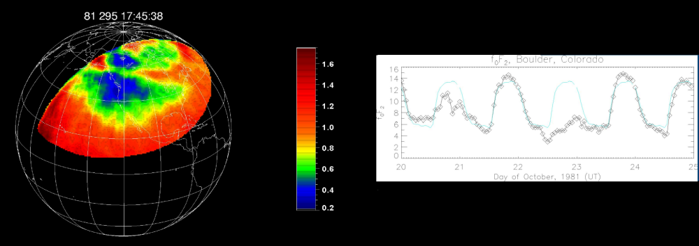
Regional Composition Changes and Ion Density
Ionospheric depletion
Increase in N₂
Modeling
Observations:
Paxton et al. 2001

Slide 8
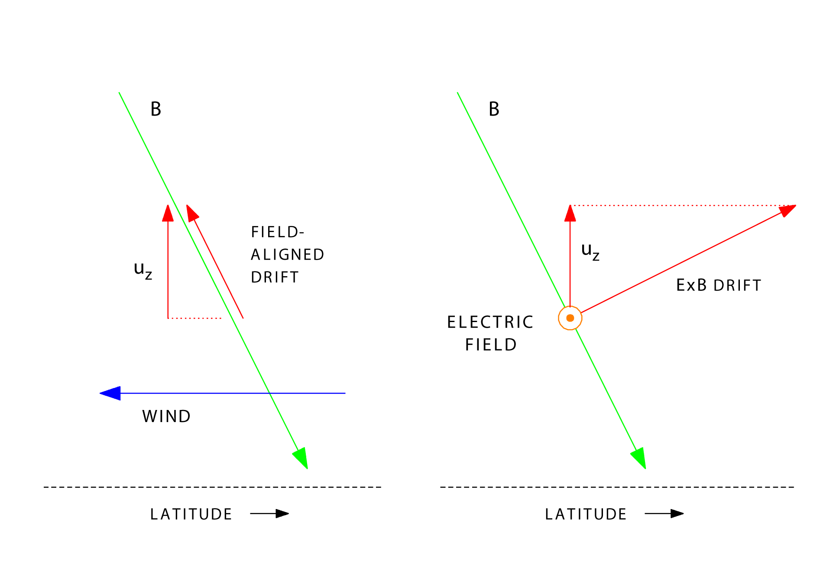
Wind & Electric Field Effects
Notes:
Both neutral winds and E-fields can transport charged particles, creating structure in electron density and TEC.
The structures created by neutral winds and E-fields during storms are not captured by climatological models.

Slide 9
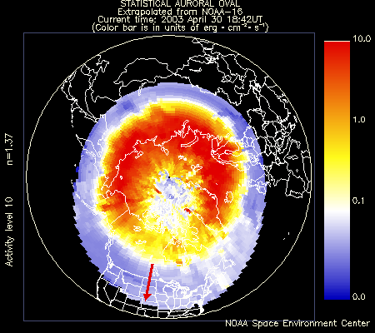
Integrated particle power 5 - 100 GW on minutes time scales
http://www.sel.noaa.gov/pmap/pmapN.html

Slide 10
Ionospheric Corrections
Need to model the ionosphere to compute corrections
Empirical climatological models: Klobuchar coefficients
Physics based numerical models: CTIPe, TIE-GCM
Data assimilation schemes: US-TEC, GAIM
Models can provide both specification and forecast
The ionosphere is highly variable in space and time

Slide 11
New Products
Gradient Detection
OPUS Ionospheric Correction Function

Slide 12
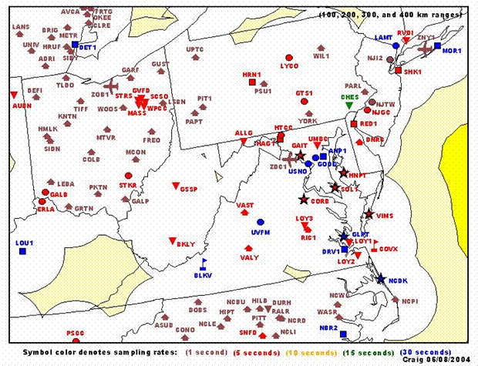
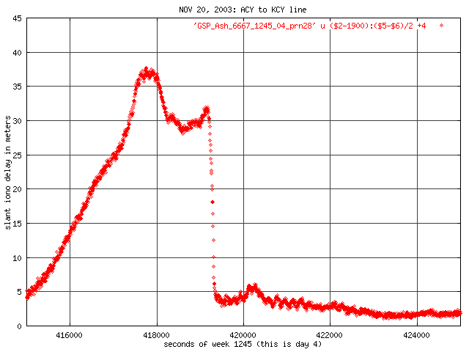
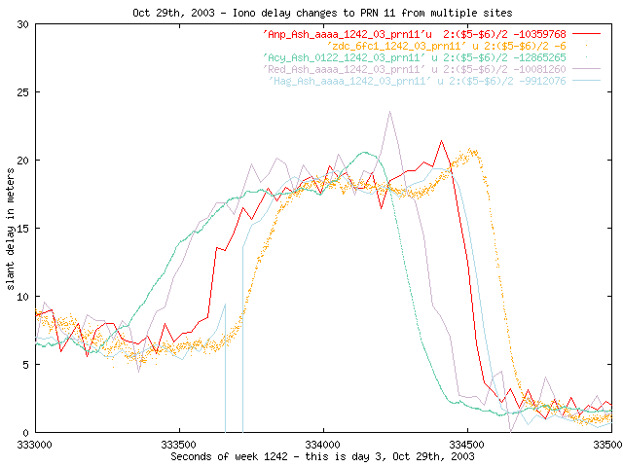
Gradient Detection
Fall 2003
stationary “walls” of TEC
Courtesy: Tom Dehel, FAA
TEC “walls”:
130 TEC units over 50 km
20 m of GPS delay;
walls move 100 to 500 m/s
“wall”
SED?

Slide 13
Background/Rationale
NGS was running US-TEC in 3-day latent mode
As the space weather agency, SWPC to provide ionospheric correctors
Avoid the need to continue to update ionospheric activities at NGS every time SWPC makes an improvement to services
SWPC is the natural place for providing the service of characterizing the ionosphere

Slide 14
Proposal
SWPC to provide a web-based customer application for providing ionospheric correctors from a user specified list of options
User submits a RINEX file over a particular interval
SWPC either uses “best-available” model to evaluate correctors or user specified model (e.g. US-TEC, GAIM, IRI, rtIRI, ….)
Return RINEX file to user with correctors inserted
Next version of RINEX format has place for corrector

Slide 15
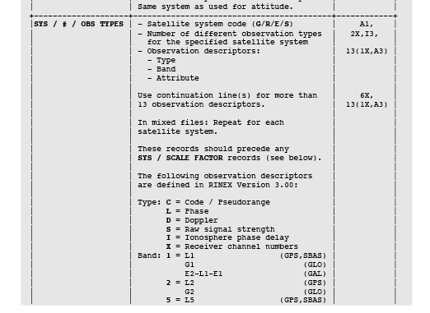
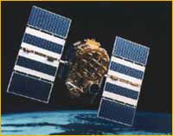
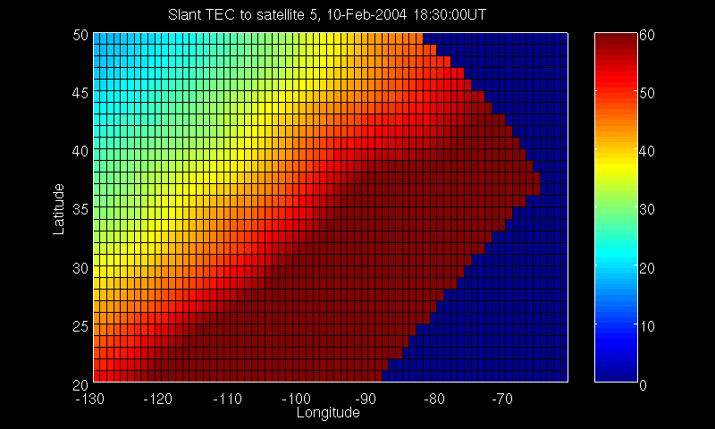
Ionosphere Correction for NGS
US-TEC slant TEC provides ionospheric correctors for RINEX files
A
B
Sat. 29
C

Slide 16
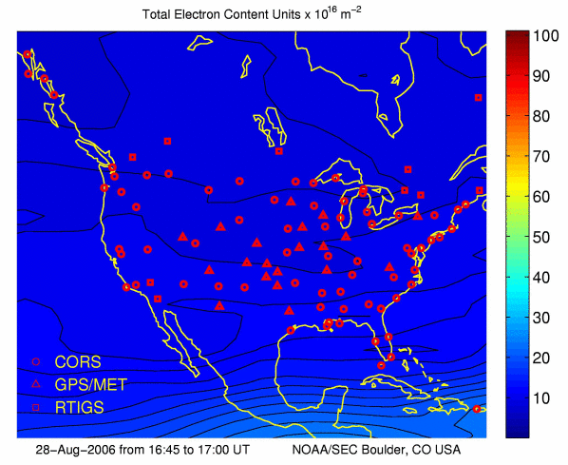
USTEC Product
http://www.swpc.noaa.gov/ustec
Current NOAA capability for characterizing the total number of free electrons (TEC) in the ionosphere, with parallel input data streams for reliability
Since 2004, a product characterizing the ionospheric TEC over the continental US (CONUS) has been running in real-time at NOAA’s Space Environment Center (SEC)
The ionospheric data assimilation model uses a Kalman filter and ingests ground-based GPS data to produce 2-D maps of total electron content over the CONUS
Product evolved from a collaboration between SEC and NOAA’s National Geodetic Survey (NGS), National Geophysical Data Center (NGDC), and Forecast Systems Laboratory (FSL)
Primary Product:
Real-time ionospheric maps of total electron content every 15 minutes. Currently uses about 100 real-time GPS stations from the CORS network

Slide 17
Slant-Path TEC Maps
A
B
Sat. 1
A
B
Sat. 14
C
A
B
C
A
B
Sat. 5
C
Sat. 29
C
….etc
Applications:
Ionospheric correction for single frequency GPS; NDGPS positioning;
dual-frequency integer ambiguity resolution for rapid centimeter accuracy positioning
Notes:
Work horse of the product are 2-D maps of slant path TEC over the CONUS for each GPS satellite in view updated every 15 minutes
Provides the information needed to estimate the group delay or phase advance for the GPS signals anywhere in the CONUS

Slide 18
Validation Summary
Differential TEC:
Slant = 2.4 TEC units
Vertical = 1.7 TEC units
“Absolute” FORTE ray tracing:
Slant = 2.7 TEC units
Vertical = 1.9 TEC units
Estimated USTEC slant path total electron content uncertainty < 3 TEC units (equivalent to about 45 cm of signal delay at L1 frequencies)
Estimate USTEC vertical total electron content uncertainty < 2 TEC units (equivalent to about 30 cm of signal delay at L1 frequencies)

Slide 19
SWPC Ionosphere Goals
Improve USTEC
CONUS: Specification
US-TEC slant path total electron content uncertainty < 2 TECU
US-TEC vertical electron content uncertainty < 1 TECU
CONUS: Forecast
1 hour forecast as good as specification
3 hour forecast: uncertainty < 3 TEC units
6-12 hour forecasts
GPS User Tools
Color coded regional maps of ionosphere disturbance
Support vendors to produce color coded maps for specific applications
Notes:
Global specification and forecast requires global, real-time data sets and we are actively working to acquire them (COSMIC, IHY Africa, National Geospatial-Intelligence Agency (NGA), EUREF-IP service, etc.).
The future of ionosphere services is in accurate forecast.
1-3 hour forecasts over CONUS are possible with the present models.
Longer forecasts and forecasts at high and low latitudes require thermosphere/ionosphere numerical models and accurate inputs.

Slide 20
Conclusions
Ionospheric services are a fast growing area in Space Weather
SWPC is committed to offer improved products and tools
SWPC is ready to collaborate on:
Data
Models and model results
Research
Services
Solar Maximum is on the way (2012?)

Slide 21
Ion Production
O + hν → O⁺ + e (910.3 Å)
O₂ + hν → O₂⁺ + e (1028 Å)
N₂ + hν → N₂⁺ + e (795 Å)

Slide 22
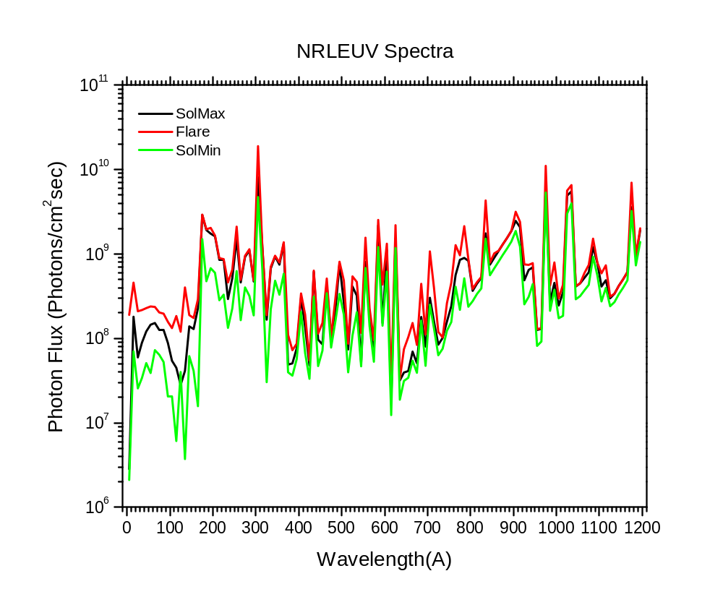
From Rodney Viereck, SEC
Notes:
Flare is X class

Slide 23
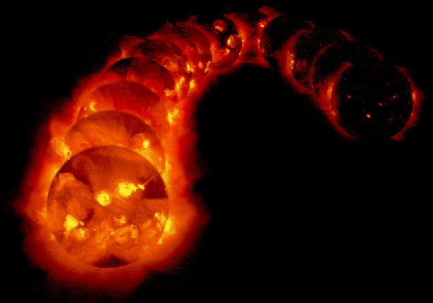
The solar x-ray images are from the Yohkoh mission of ISAS, Japan. The x-ray telescope was prepared by the Lockheed Palo Alto Research Laboratory, the National Astronomical Observatory of Japan, and the University of Tokyo with the support of NASA and ISAS. G.L. Slater and G.A. Linford

