Slide 1
Towards Real Time
National Geodetic Survey / NOS / NOAA
Silver Spring, MD

Slide 2
Main Concepts
Modify CORS sites for real time data transmission
GNSS receiver data
Transmission via the Internet
Standardized protocols and formats
Not a navigation service!

Slide 3
Framework for Real Time GNSS Networks
Federal Network
  200 CORS sites
  NDGPS, WAAS, NOAA, PBO sites
  Stream GNSS data, not correctors
  via NTRIP and tcp/ip protocol over the Internet,
Regional and local Networks
  Use Federal network to calibrate and/or enhance local networks

Slide 4
CORS Site Modification
Receiver modifications
  Firmware
  Multiple satellite systems
  Data interval
Communications / Network modifications
  Routers
  Increased bandwidth
  Internet
Software

Slide 5
Network Design Issues
What format?
What stations?
What software?
What distance?
What data rate?
What latency?

Slide 6
Data Distribution Formats
RTCM-SC104
  Versions – 2.0, 2.1, 2.2, 3.0
  Type 1 Fixed GPS corrections (1 sec)
  Type 3 GPS reference station parameters (10)
  Type 16 GPS special message (30,60)
  Type 18 RTK uncorrected carrier phases (1)
  Type 19 RTK uncorrected pseudoranges (1)
  Type 22 Extended station parameters (15)
  Type 59 Proprietary messages (1)

Slide 7
Data Collection Formats
Raw
  Topcon/Javad Compact (1)
  Ashtech MBEN (5) / PBEN (5) / SNAV
  Thales ASCII
  SP3 ASCII
  Trimble RT17, concise
  Leica LB2
  RINEX
  BINEX

Slide 8
Communications
Frame Relay – USCG, NDGPS CORS **
Internet (FTP, rcp) – State DOT’s, WAAS, university CORS.
Satellite / Modem – Hawaii, PBO CORS
NTRIP – RTK CORS **

Slide 9
Software
NTRIP - Networked Transport of RTCM via Internet Protocol (version 1.5)
NTRIP is an RTCM standard
Application-level protocol streaming Global Navigation Satellite System (GNSS) data over the Internet
Based on hypertext transfer protocol (HTTP/1.1)
Simultaneous connections from PC’s, laptops, receivers to a broadcast host
Streams data to stationary and mobile users

Slide 10
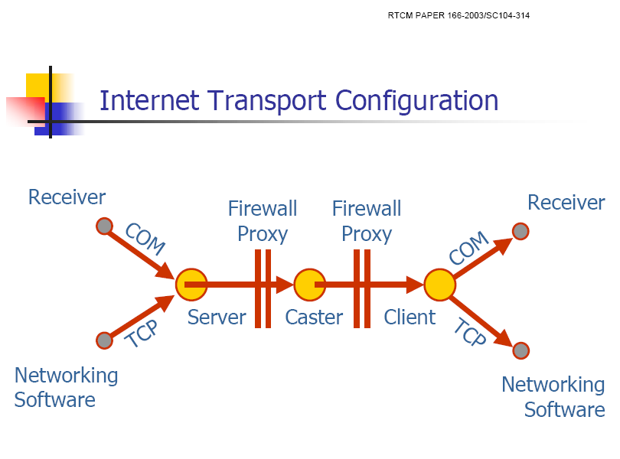

Slide 11
NTRIP
PROS
RTCM standard
Open documentation
Software components developed under GNU General Public License
Communications through a HTTP port
CONS
Workload on server side
Not supported by mobile IP provider

Slide 12
Processing Considerations for Real Time
Centralized Processing - NGS
  Correction models
    Ionospheric – dynamic or recent data
    Tropospheric – dynamic or recent data
    Satellite clocks
    Multipath - from past data
  Ambiguity resolution of reference station observables
  Usually one communications channel
Several processing locations
  Many reference stations lead to many corrector streams
  Several communications channels needed

Slide 13
Positioning Limitations from Real Time Networks
DGPS
  L1 code corrections
  Range 200 – 400 km
  Meter level accuracy
  Time delay – varies up to a few seconds
  Continental coverage
RTK – Single Base Station
  L1 code, L1 / L2 carrier corrections
  Range 10 to 15 km
  Centimeter level accuracy
  Time delay – typically less than a second
  Regional and local coverage

Slide 14
Post Processing Applications
Post mission static positioning.
  cm-level accuracy with a few hours of data, dm-level accuracy with one minute of data.
  Solution delay - one hour.
Post mission kinematic positioning.
  dm-level accuracy for an aircraft, boat, or terrestrial vehicle.
  Solution delay – more than one hour.
Geophysics - crustal motion.
Meteorology - water vapor in atmosphere.
Space weather - free electrons in ionosphere.

Slide 15
Real Time Applications
Structural monitoring
GIS – Rapid Response, 911
Precision guidance – machines
Meteorology - water vapor in atmosphere
Space weather – ionosphere, troposphere
Positioning – OPUS (rapid solution)
Assist other real time applications - RTK

Slide 16
PROPOSED POLICY FOR STREAMING GPS DATA VIA THE INTERNET
NOAA’s National Geodetic Survey is exploring the possibility of streaming GPS data (not correctors) from selected CORS via the Internet.
These data will be publicly available and free of direct user fees.
NGS is openly distributing these data to enable other organizations to provide location based services relative to the NSRS.

Slide 17
PROPOSED POLICY
Monitor the distribution of free electrons in the atmosphere.
Monitor the distribution of precipitable water vapor in the atmosphere.
Record the passage of seismic waves.
While these GPS data may be applied to track the path of a moving platform--such as an aircraft, water vessel, or land vehicle–these data will not possess sufficient “integrity” to support a robust navigation service.

Slide 18
NTRIP Installation at NGS
NGS Broadcaster 140.90.112.133 2101
  Converting NDGPS and other sites for NTRIP.
  RTK messages.
NTRIP Server
  Modifications made to send receiver ID and password.

Slide 19
Conclusion
Streaming GNSS data over the Internet is feasible
No significant lack of performance compared to other transportation media
Advantages for user / service providers
Developments for various products
Promising solution for GIS
Faster data access

Slide 20
Questions / Comments

