Slide 1



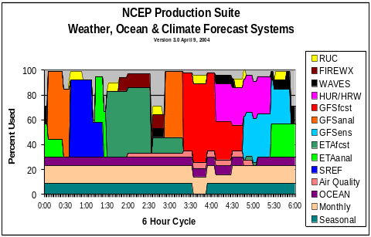
NCEP Production Suite Review - 2008
NCEP Production Suite
Weather, Ocean, Land & Climate Forecast Systems
EMC Senior Staff

Slide 2
Overview
Introduction to meeting
New Building
EMC management changes
NOMADS status
National Environmental Modeling System (NEMS)
Evolution of the NCEP Production Suite

Slide 3
Intro to meeting
Largest participation yet
EMC and field paired presentations on
  Marine
  Regional
    NAM
    RUC
    RTMA, etc
  Global
  Hurricanes
  Seasonal climate
  Space weather
Special Presentations
  Ecosystems
  New COMET NWP course
  Data assimilation
  Drought
  Hydrology and water resource applications
  Ensembles and post processing
Last in this building (some forecast uncertainty)

Slide 4


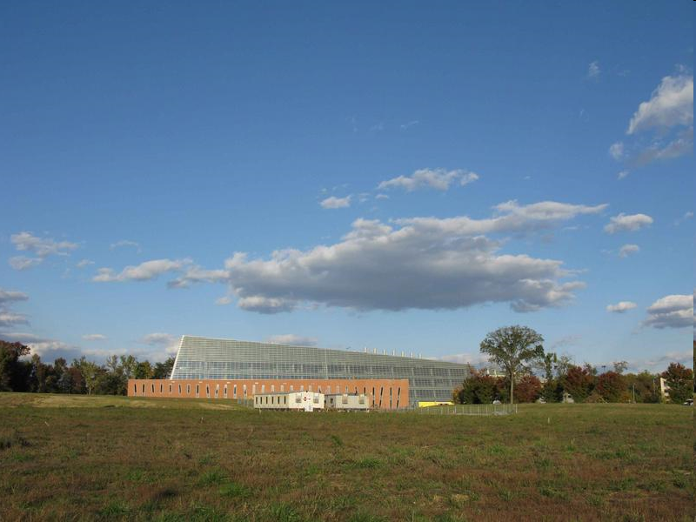
NOAA Center for Weather and Climate Prediction
Construction Start | 09-May-07
Move Start | May 09
Move Complete | January 10

Slide 5
NOAA Center for Weather and Climate Prediction
Construction Start | 09-May-07
Move Start | May 09
Move Complete | January 10

Slide 6
EMC Management Changes
EMC Deputy Director – Bill Lapenta
EMC Visiting scientist at Boulder DTC - Naomi Surgi
Focus on NEMS Software Engineering - Mark Iredell
Global Branch Chief – John Ward

Slide 7
Environmental Modeling Center Service-Science Linkage
Service
Marine & Coastal Ocean H. Tolman | Mesoscale Atmosphere G. DiMego | Global Climate & Weather Atmosphere & Ocean J. Ward | Science
X | X | X | Data Assimilation Leader: J. Derber
 | X | X | Climate Leader: H.-L. Pan
X | X | X | Model Atmosphere/Ocean/Ice Dynamics Physics
X | X | X | Land Surface/Hydrology Leader: K. Mitchell
X | X | X | Ensembles & Probabilistic Guidance Leader: Z. Toth
X | X | X | Hurricanes Leader: N. Surgi
X | X | X | Products Development Utilization

Slide 8




Real Time model data and applications for slicing, dicing and area sub-setting NCEP model data.
These services will become “high availability” (24/7) at the Web Operations Center (WOC) http://nomads.ncep.noaa.gov
Thursday, December 18, 2008.
High Availability server is mirrored (3 locations), owned by NOAA CIO which also handles NCEP anonymous ftp server (ftpprd).
NOAA Operational Model Archive Distribution System (NOMADS)
For details see Jordan Alpert jordan.alpert@noaa.gov

Slide 9
NOMADS is a distributed system with servers from different locations/agencies using the same protocol to distribute model and other data.
National Center’s for Environmental Prediction (NCEP) Real Time model data from NOAA’s Operational Models
Archives of model and other data at the National Climate Data Center (NCDC).
Other participations are GFDL, PMEL, NCAR, NASA for research data

Slide 10
NEMS: Forces for Change
Increasing emphasis on ensemble approaches
  Multi-model ensembles
    SREF
    NAEFS
    Hurricane (GFSL & HWRF)
    Climate Forecast System (?)
Entering the NPOESS era
  More rapid access to hyperspectral data
  GPS soundings
  Higher resolution surface
  imagery
All models run within ESMF
  Models run concurrently
  Hybrid vertical coordinate
  Coupled
  Spanning all time, space scales
Operational Earth System model – more explicit hydro, climate and ecosystems applications
ESMF-based System
Global/Regional Model Domain
Model Region 1
Model Region 2

Slide 11
National Environmental Modeling System (NEMS)
(uses standard ESMF compliant software)
Application Driver
ESMF Superstructure
(component definitions, “mpi” communications, etc)
Atmospheric Model
Analysis
--------------
Ocean
-------------
Wind Waves
--------------
LSM
--------------
AQ
--------------
Ens. Gen.
--------------
Other
Dynamics
(1,2)
Physics
(1,2,3)
Coupler1
Coupler2
Coupler3
Coupler4
Coupler5
Coupler6
Etc.
1-1
1-2
1-3
2-1
2-2
2-3
Multi-component ensemble
+
Stochastic forcing
ESMF Utilities
(clock, error handling, etc)
Bias Corrector
Post processor & Product Generator
Verification
Resolution change
* Earth System Modeling Framework (NCAR/CISL, NASA/GMAO, Navy (NRL), NCEP/EMC), NOAA/GFDL
2, 3 etc: NCEP supported thru NUOPC, NASA, NCAR or NOAA institutional commitments
Components are: Dynamics (spectral, FV, NMM, FIM, ARW, FISL, COAMPS…)/Physics (GFS, NRL, NCAR, GMAO, ESRL…)

Slide 12
Planned NEMS Capabilities
Modeling Research
  Global and regional
  Institutionally supported components
    Atmosphere
      GFS (NCEP)
      FV (NASA, GFDL)
      NMM (NCEP)
      ARW (ESRL, NCAR, AFWA)
      FIM (ESRL)
      FISL (NCEP)
    Ocean
      MOM4 (GFDL)
      HYCOM (NCEP, Navy)
    Land surface and hydrology
      Noah (NCEP)
      VIC (Princeton, U. Wash)
      MOSAIC (NASA)
      Sacramento (OHD)
      Smirnova LSM (ESRL)
    Air Quality and trace gases
      CMAQ (EPA, ARL)
      GOCART (NASA)
Beta testing
Under construction
Will include in future

Slide 13
Planned NEMS Capabilities (cont)
Operational Models (NCEP only)
  Global Forecast System
    GFS
  Global Ensemble (GENS, NAEFS)
    GFS
  North American (NAM)
    NMM
  Short-range Ensemble (SREF)
    NMM
    ARW
    Physics diversity
  High Resolution Window (HRW)
    NMM
    ARW
  Air Quality (AQ)
    CMAQ
  Land Surface & Hydrology (LIS)
    Noah
  Rapid Refresh (RR) Ensemble
    ARW Dynamics + GSD physics
    NMM dynamics + NCEP physics
  Hurricane (HUR)
    NMM for hurricanes
    HYCOM + Wavewatch
  Seasonal Climate Forecast (CFS)
    GFS for climate
    MOM4
Will include in
Operational NEMS

Slide 14
Criteria for Inclusion in NEMS
Research
  Adherence to ESMF standards
  Institutional support for code
  Participation in system evolution
Operations
  Research criteria plus:
  Standard “Transition to Operations” criteria
    NCEP: http://www.emc.ncep.noaa.gov/
      Forecast performance benefits
      IT compatibility
      Efficiency
      Sustainability
    AMOP (Navy)
    AFWA IPT process (USAF)

Slide 15
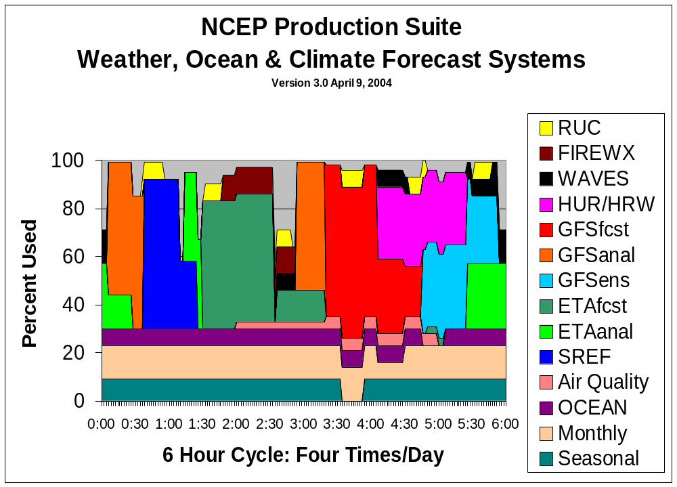
NCEP Production Suite
Weather, Ocean, Land & Climate Forecast Systems
Current - 2007
Current (2007)
GDAS
NAM anal
GFS anal
GFS
SREF
HUR
NAM
GENS/NAEFS
RDAS
AQ
RTOFS
CFS

Slide 16
NCEP Production Suite
Weather, Ocean, Land & Climate Forecast Systems
Next Generation Prototype
Phase 4
Rap Refresh
Reforecast
WAV
Added
Hourly GDAS
Moved
GFS, WAV
concurrent
to NAM & SREF
Expanded
Hurricane
capability (hires)
SREF
HUR
CFS
MFS
NAM
GENS/NAEFS
Global
GFS
RTOFS
RTOFS
AQ
Hydro / NIDIS/FF
AQ
CFS & MFS
Regional
RDAS
Hydro
GDAS

Slide 17
Thanks
Questions?

Slide 18
NCEP Production Suite
Weather, Ocean, Land & Climate Forecast Systems
Next Generation Prototype
Final Phase
Computing factor: > 240
GLOBAL NEXTGEN
SPACE WEATHER
Rap Refresh
Reforecast
GENS/NAEFS
HENS
ECOSYSTEMS
HUR
SREF
RTOFS
CFS
MFS
Global
>100% of 2015
computing
NAM
RTOFS
GFS
WAV
Regional
CFS & MFS
AQ
Hydro / NIDIS/FF
AQ
CFS & MFS
Hydro
RDAS
GDAS

Slide 19
EMC Mission
In response to operational requirements:
Maintain
  the scientific correctness and integrity of operational forecast systems
  modify current operational system to adapt to ever-present external changes
Enhance numerical forecasts
  Test and improve NCEP’s numerical forecast systems via
    Scientific upgrades
    Tuning
    Additional observations
Transition and Develop operational numerical forecast systems
  transform & integrate
    Code
    Algorithms
    Techniques
    from research status to operational status on NCEP computers

Slide 20
Ingredients for Improved
Numerical Forecast Systems
Primary ingredients
  Observations
  Data Assimilation & Model technology
  Computing resources
Secondary ingredients
  Post-processing and dissemination
  Research to Operations (R2O) process

Slide 21
Planned NEMS Capabilities
Components and capabilities of the NEMS infrastructure
  Configuration control
    Domain
    Resolution (horizontal, vertical)
    Standardized fixed field generation (WPS - topography, land use, etc)
    Tracer definition
  Observations ingest, formatting, QC, general I/O libraries
  Nesting (static and moving, telescoping, 1-way, 2-way)
  Concurrent ensemble execution (single executable, multiple members)
  Data assimilation (3D-var and advanced techniques)
  In-core updating for analysis increments and boundary conditions
  Model dynamics and physics including
    Atmosphere
    Ocean
    Land surface and hydrology
    Air Quality and trace gases
  Post-processor and product generator
  Standard operational verification
  Documentation for operational and research users

Slide 22
NCEP Production Suite
Weather, Ocean, Land & Climate Forecast Systems
Next Generation Prototype
Phase 3
Computing factor: 27
SREF
Reforecast
GFS
WAV
Added
Flash flood
products
Moved
SREF concurrent
to NAM
Expanded
Reforecast
capability
GFS Anal
HUR
NAM
NAM Anal
GENS/NAEFS
AQ
Hydro / NIDIS/FF
AQ
RTOFS
CFS & MFS
RDAS
GDAS

Slide 23
NCEP Production Suite
Weather, Ocean, Land & Climate Forecast Systems
Next Generation Prototype
Phase 1
Computing factor: 3
Reforecast
NAM anal
GFS Anal
GFS
WAV
SREF
NAM
HUR
Added
1-Hourly RDAS
3-Hourly GDAS
Reanalysis/
Reforecast
GENS/NAEFS
AQ
RTOFS
CFS
1-hourly RDAS (6)
3-hourly GDAS (2)

Slide 24
NCEP Production Suite
Weather, Ocean, Land & Climate Forecast Systems
Next Generation Prototype
Phase 2
Computing factor: 9
Added
Hydro/NIDIS
products
Moved
GFS ½ h earlier
Expanded
Hurricane & wave
products
Incorporated
Multi-domain
rapid updating
Reforecast
SREF
NAM Anal
NAM
GFS Anal
GFS
WAV
HUR
GENS/NAEFS
AQ
Hydro / NIDIS
AQ
RTOFS
CFS & MFS
RDAS
GDAS

Slide 25
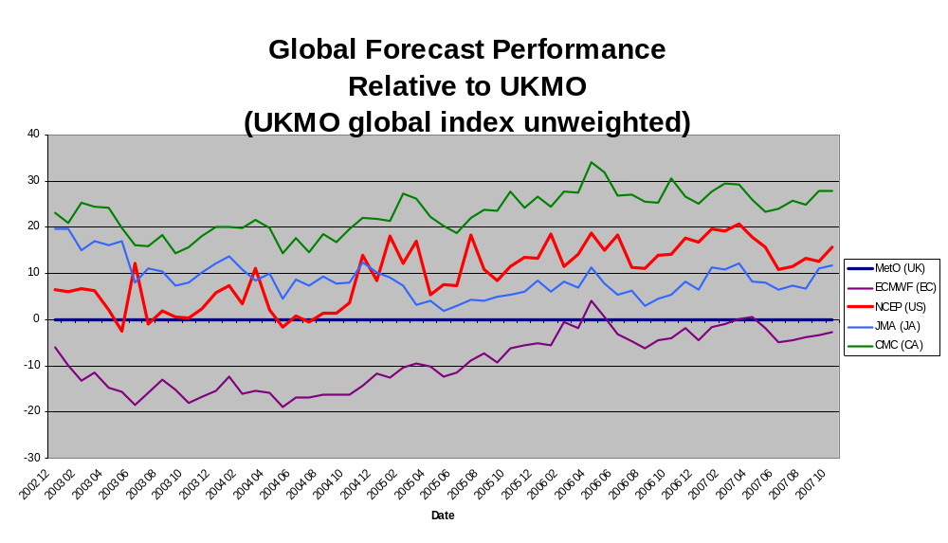
Worse
Than
UKMO
Better
Than
UKMO
UKMO
4D-VAR
implemented
NCEP GSI
implemented
Notes:
Figure shows performance relative to the UK Met Office global model. The performance measure is a basket of standard scores such as root-mean-square error of Temperature, surface pressure and more at 24, 48, 72 hours and longer. The number of forecast measures is 22. This picture shows the unweighted average of the 22 measures. The zero line is the UKMO performance, below zero is better than UKMO, above the line is worse. The NCEP performance is in red and is worse since 2003. In 2002, order of performance was ECMWF best, UKMO and NCEP in second, Japan third and Canada last. In 2007, the order is ECMWF barely in first, UKMO second, Japan third and NCEP fourth.

Slide 26
Community-based Development
Strategy and roles:
  Focus on single component instead of entire model system
  Collaborative, not competitive
  NCEP/EMC
    Maintains primary components for each part of Production Suite and for each application
    Supports ESMF applications in operations
    In collaboration with community
      Integrates new ESMF-based components into operations
      Performs final testing and preparation of upgrades of supported components in operations
  Collaborators
    Provide
      Component upgrades to be tested in operational setting
      Institutional support for their contributed components
      Diversity and expertise complementary to operations
    Work through DTC, JCSDA, CTB, etc.
Examples of current and potential collaborators
  OAR/GSD
    Model enhancements
    Aviation applications, including products and physics component
  NASA-(GMAO, HSB)
    Data assimilation (atmosphere, ocean, land)
    Finite-volume (FV) model
    Physics (aerosol, land surface)
    ESMF-based components (e.g. physics)
  NRL
    Aerosol physics and analysis
    ESMF-based model structure (atmosphere, ocean)
    Physics component
    Operational ensemble generation and processing
  NMFS
    Fishery ecosystems
NCAR
  ARW dynamics
  Physics components
NWS/OHD
  Land & Hydrological models for
    Streamflow
    Flash floods
  Precipitation analysis
NOS
  Dynamic storm surge
  Coastal ecosystems
  Water quality
Universities
  Specific physics upgrades

