Slide 1
LQX Engineering Design Review
Introduction
Jim Kerby
12 March 2001
      Scope
      Requirements
      Interfaces

Slide 2
Scope
To IP →
pipes*
MCBXA
MQXA
MQSXA
pipes
MQXB
MCBX
MQXB
pipes
MCBX
MQXA
pipes
TAS
BPM
TAS
BPM
C
/W
beam tube
beam tube
beam tube
beam tube
LMQXB
LMQXC
LMQXA
IK 4
LQXB
IK 3
LQXC
IK 2
LQXA
IK 1
“Q3”
“Q2”
“Q1”
KEK supplied
CERN supplied
FNAL supplied
Interconnect kits (IK) and beam tube liners installed at CERN
IP 2/8 interconnect kits do not have TAS components

Slide 3
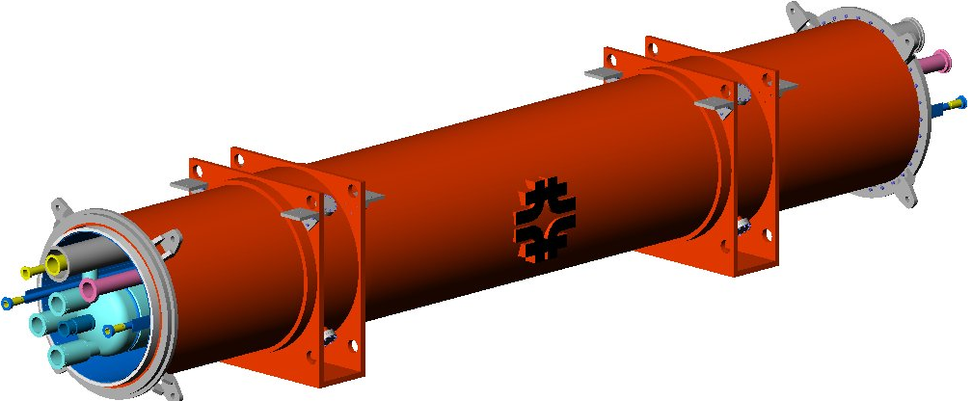
Requirements
Derived from Inner Triplet and Main Component Interfaces
Optics / Layout
Alignment
Heat Load / Cryogenic
Radiation
Electrical
Mechanical

Slide 4
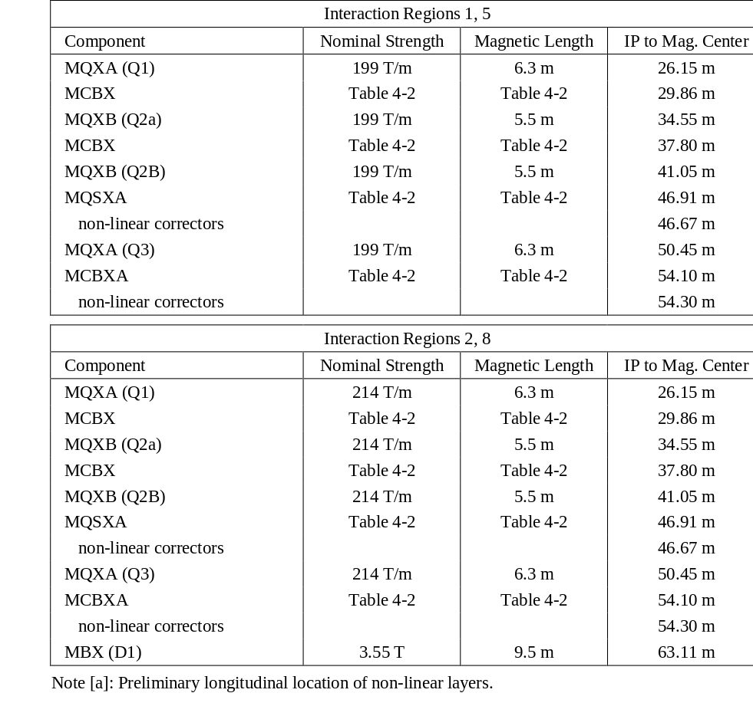
Optics / Layout
The optics / layout is based on v6.2 optics
recent discussions on moving Q2 further from the IP and relocating a BPM are not reflected in these presentations
the impact can be discussed later this afternoon

Slide 5
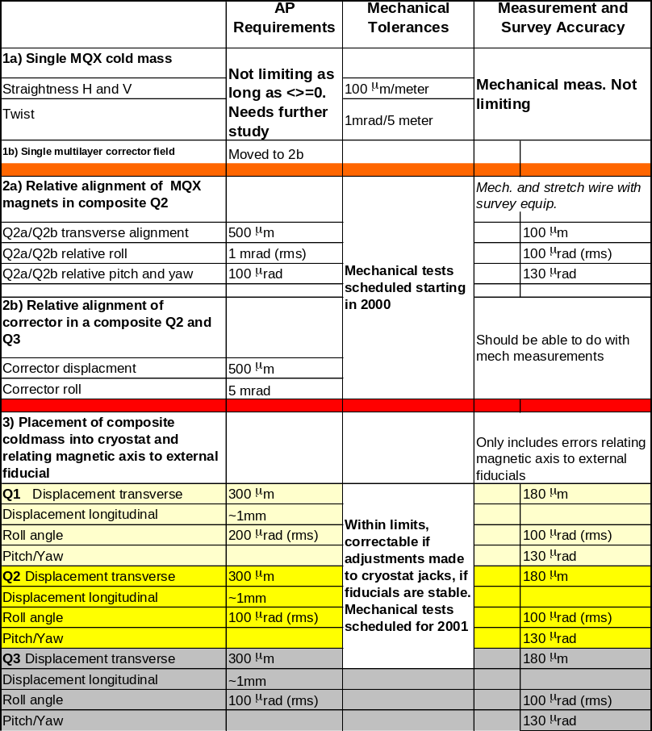
Alignment
Inner Triplet Alignment Table defines overall requirements
Q2a/Q2b assembly mechanical tests completed last year
Use of the Stretched Wire measurement system makes cryostat mechanical tolerances internal, and no build up of tolerances occurs
Positioning of the lugs is directly related to allowable bellows offset

Slide 6
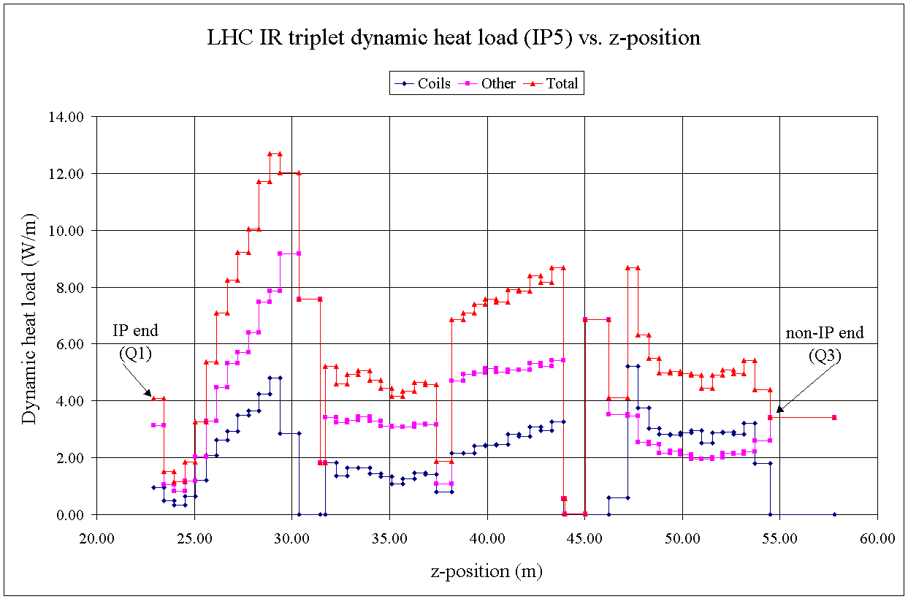
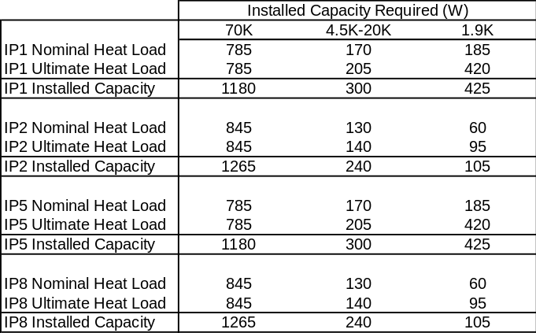
Cryogenics
The dynamic heat load of the inner triplet is much higher than in the arcs
6 W/m to 1.9K (avg)
Cryostat static heat load a less critical parameter
Heat Exchanger system designed and tested to effectively cool for these loads
Q1
(51W)
Q2a
(27W)
Q2b
(50W)
Q3
(43W)

Slide 7
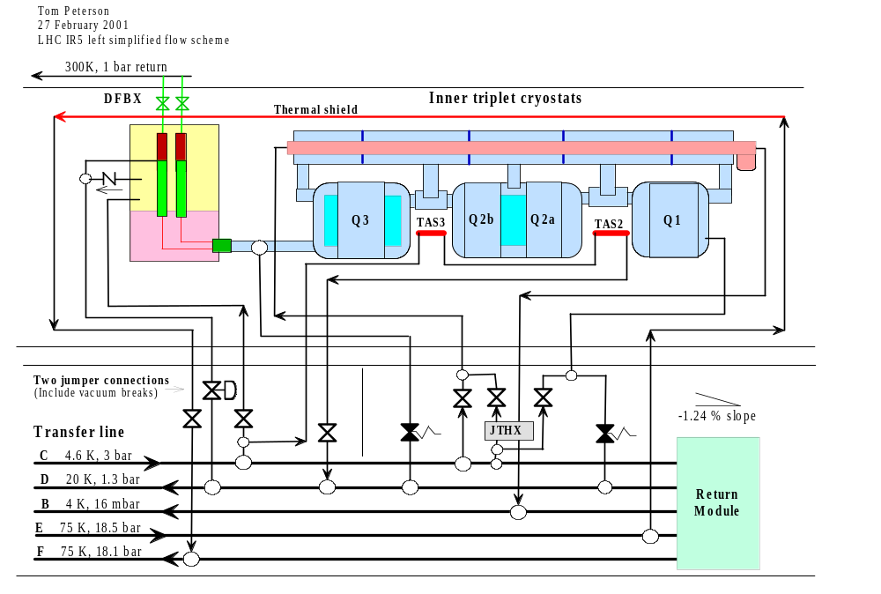
Cryogenics
Cryostat includes all piping for all cryogenic loops
All Cryostat assemblies include the piping required for location in any of the eight locations
4.5K loops left open in IP2/8
Liquid feed line added in uphill installations through heat exchanger
Feed and return lines included and connected depending on exact location in tunnel
All loops routed to DFBX

Slide 8
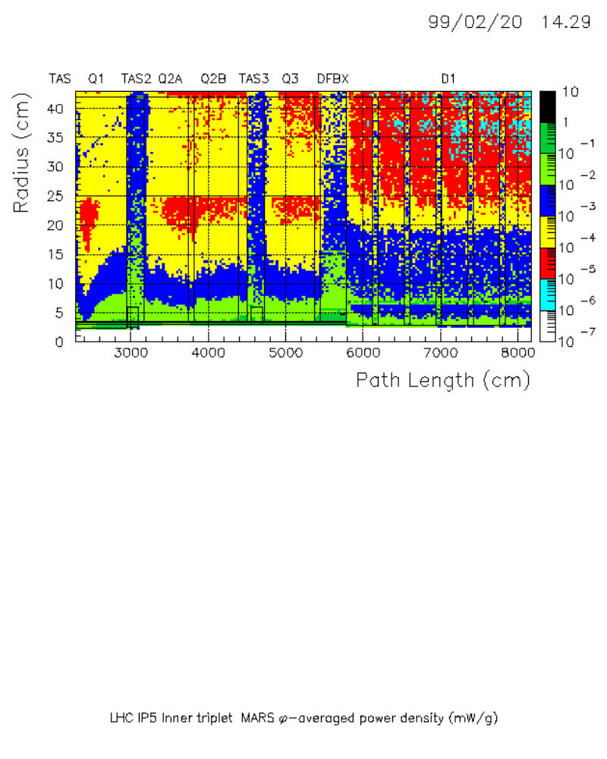
Radiation
Deposition studies also give radiation environment
MQXB and MQXA cold masses are limited to 6-7 years at nominal luminosity in LHC inner triplets
The peak calculated load to the cryostat components is 13.5kGy / year

Slide 9
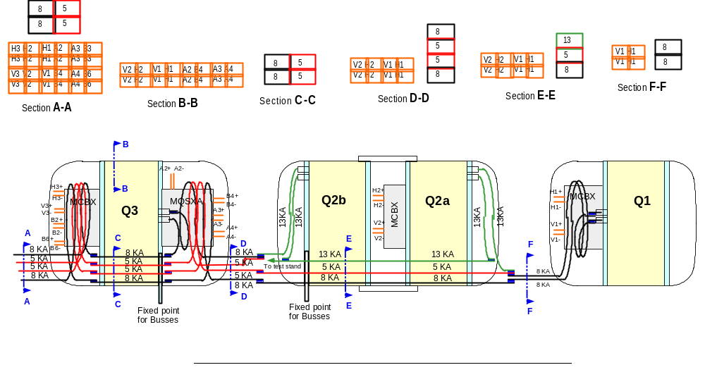
Electrical
Quads provide route for all bus and wire internal to the helium vessel
BPM leads, passive heater instrumentation routed out locally through vacuum vessel

Slide 10
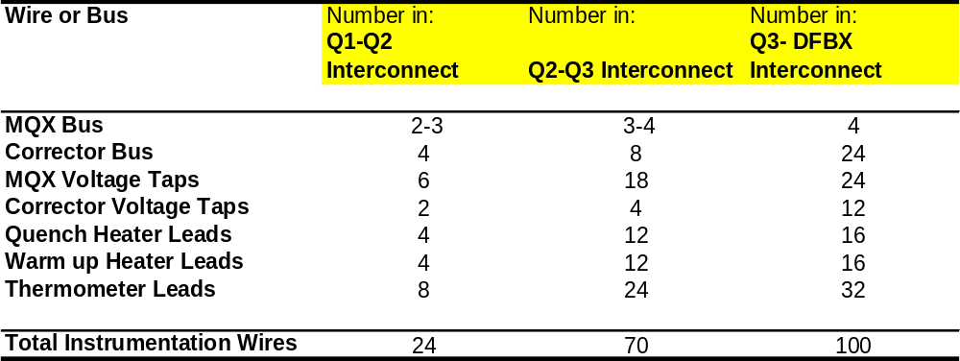
Electrical
All buss and wire in the magnets are routed back to the DFBX
Main and Corrector buss routed through lower slots in magnet
Expansion loops go around correctors
Instrumentation wires through side slots

Slide 11
Mechanical
Mechanical interfaces within the LQX are well understood
Mechanical drawings of Fermilab, KEK, and CERN magnets are circulated and discussed thoroughly. All production drawings are OK.
Discussions on the lengths and locations of leads have recently converged
Means to transfer the magnetic alignment information for each magnet are defined and reflected in the drawings
Cryostat interface to supports is known
Alignment transfer gallery interface has been defined
Interconnect Kits are impacted by the current discussions on BPM location, TAS design, and active/passive beam tube liners and therefore are not as yet converged.

Slide 12
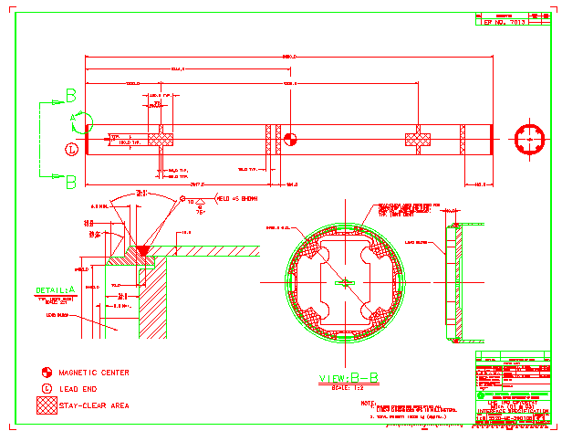
Mechanical
MQXA...

Slide 13
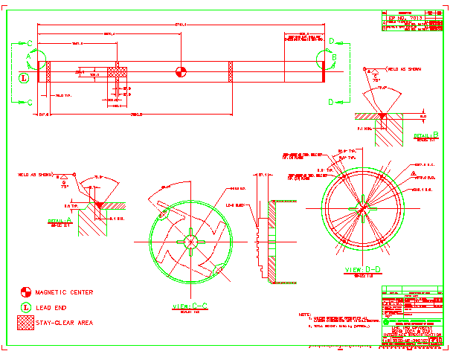
Mechanical
MQXB...

Slide 14
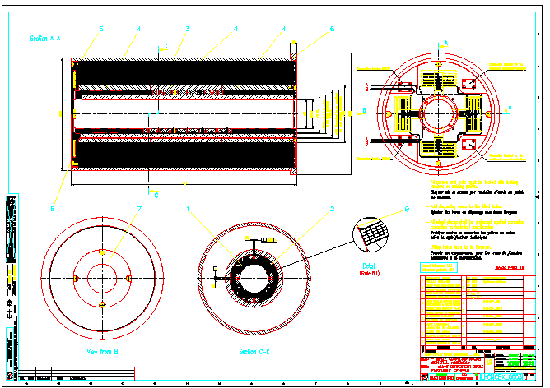
Mechanical
MCBX...

Slide 15
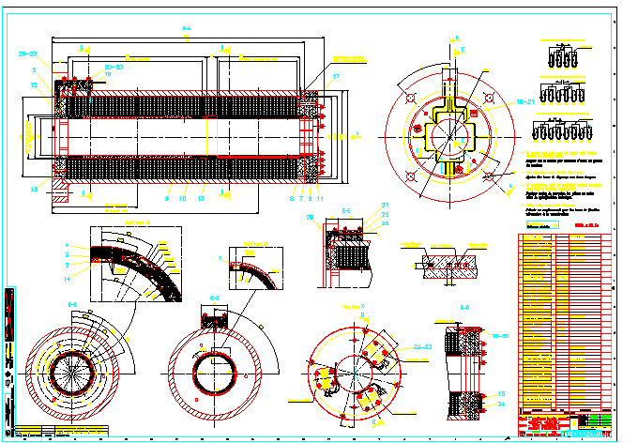
Mechanical
MQSXA...

