Slide 1
Introduction to the BTeV Project
Joel Butler
Fermilab Director’s CD2/3a Review
Sept. 28-30, 2004

Slide 2
Overview
The BTeV Project
  WBS 1.0 – the BTeV Detector, including the Trigger and Data Acquisition System
  WBS 2.0 – the Interaction Region
  WBS 3.0 – C0 Outfitting
  WBS 4.0 – BTeV Project Office, Project Management
Project Organization and Status
Project Management Documentation
Cost and Budget
  Whole Project
  FY05
Summary

Slide 3
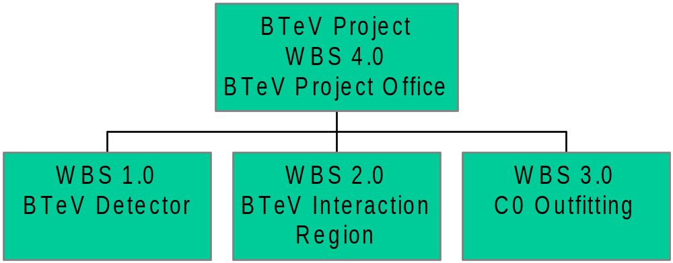
Introduction
Provide Infrastructure at C0
to support Experiment and IR
Provide High Luminosity collisions in C0
Provide a State-of-the Art
Detector to Study CP violation and
rare decays of B’s

Slide 4
Comment on Status of Subprojects
The designs of the three subprojects now fairly mature
  The detector has been designed starting with a simulation effort in 1996 and then a substantial R&D effort beginning in 1998. It has a nearly complete technical baseline.
  In Nov. 2003, FNAL decided to implement a “custom IR” based on new magnets, rather than to reuse components from existing installations. P5 supported this. This required design of a new low-β insertion and the construction and installation of the components. It has progressed rapidly and now has a Preliminary Technical Design Report.
  The C0 Collision Hall and Assembly Area was built in 1999-2000, but was not outfitted with even minimal facilities. This project will complete the basic infrastructure to permit safe utilization and then construct and outfit the counting rooms and provide the power and cooling required for BTeV and the IR, etc. It is past the conceptual design level and is ready for final engineering.

Slide 5
Organization
WBS 4.0
WBS 1.0
WBS 2.0
WBS 3.0
1.1 Magnet,Toroid
Beampipe
1.6 Straw Tracker
2.1 New Magnet,
Fabrication, Test
2.7 ES separators
3.1 C0 Outftting,
Phase1
1.2 Pixel Detector
1.7 Microstrip
Tracker
2.2 2005 Shutdown
2.8 2008 Shutdown
3.2 C0 Outfitting,
Phase 2
1.3 RICH
1.8 Trigger
2.3 Power Supplies
2.9 2006 Shut-
down
3.3 C0 Sector,
Hi Voltage
1.4 EMCAL
1.9 Data
Acquisition
2.4 Cryogenics
2.10 2007 Shut-
down
3.4 Preprocure-
ment Items
2.5 Controls
2.112009 Shutdown
1.5 Muon Detector
1.10 Integration
2.6 Instrumentation
2.12 Commission-
ing
Total Cost: $188M (CB, RD) (Material: $108M, Labor: $80M)
2.13 Management,
Beam Physics

Slide 6
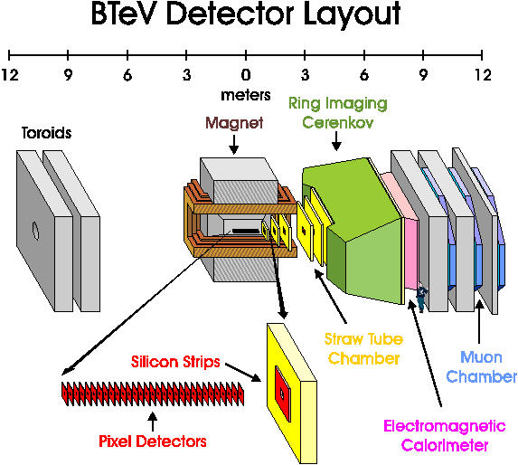
Work Breakdown Structure - Detector WBS 1.0
1.1 Vertex Magnet, Toroid and Beam Pipe
1.2 Pixel Detector
1.3 RICH
1.4 EMCAL
1.5 Muon Detector
1.6 Forward Straw Tracker
1.7 Forward Microstrip
tracker
1.8 Trigger
1.9 Data Acquisition
1.10 Installation,
Integration,etc (I&I)

Slide 7
Level 2 Managers WBS 1.0
1.1 Magnets, Toroids, Beampipes ($2.5M) Chuck Brown
1.2 Pixel Detector ($20.8M) Simon Kwan
1.3 Ring Imaging Cherenkov($16.5M) Marina Artuso, Tomasz Skwarnicki
1.4 Electromagnetic Calorimeter ($20.8M) Yuichi Kubota
1.5 Muon Detector ($6.0M) Paul Sheldon
Will Johns
1.6 Forward Straw Tracker ($12.7M) Alan Hahn
1.7 Forward Silicon Microstrip($10.0M) Luigi Moroni
1.8 Trigger ($16.1M) Erik Gottschalk
1.9 Event Readout and Control ($17.1M) Klaus Honscheid, Margaret Votava
1.10 Integration ($12.2M) Joe Howell
NOTE: UNLESS OTHERWISE STATED, COSTS ARE FULLY BURDENED, WITH CONTINGENCY, IN FY05 $

Slide 8
Detector Technical Status WBS 1.0
We have had a highly efficient R&D program which is succeeding on all fronts
The BTeV Detector design has been quite stable for several years, with changes mainly to simplify design or reduce costs, e.g.
  We have changed the design of the pixel support, cooling, and vacuum systems following the recommendations of previous reviews.
  We have simplified the trigger design by using a commercial switch for sorting the data in Level 1 and have replaced Level 1 DSPs with Microprocessors. This lowers cost and schedule risk and has been encouraged by our reviewers. This was done through the formal BTeV change control procedure.
No “gotcha”s. Many “plans” in 2000/2001/2002 are well on their way to realization today. Test beam work at Fermilab has begun again and most detectors have used it. We also have a very successful ongoing test beam program at IHEP/Protvino
There is a Preliminary Technical Design Report that is the technical baseline for the detector.

Slide 9
Detector Cost and Schedule
We have implemented a “staged schedule” for the detector construction and installation that will be described in detail in the next talk.
The key goal is to have a realistic and achievable schedule with the proposed funding profile that maintains our physics competitiveness with respect to LHCb. The way we achieve this is:
  To install on the original 2009 schedule the portion of the detector that allows us to do the physics where LHCb is able to compete with us
  To install in 2010 those portions of the detector that are unique to BTeV and where LHCb cannot really compete
The “staged schedule” is now our baseline and is the one presented in this review. All detector subprojects have at least 9 months of float.
We have also developed a commissioning plan to demonstrate that the first run will be a physics run
The IR and C0 Outfitting are not involved in the staging.

Slide 10
Interaction Region WBS 2.0
The custom design produces a β* of 35 cm, same as at B0 and D0. This will give BTeV the same luminosity as CDF orD0. BTeV’s luminosity need is consistent with the lab’s current plan for RUN II. Recent progress on the Luminosity has been very encouraging.
Recent design work has resulted in greater separation of the beams at the first parasitic crossing and also led to simplifications that reduced the types of correctors and consequently the number of spares. These changes went through the BTeV change control process.
Based on recommendations from our CD1 review, we decided to negotiate with BNL to build the correctors. If the negotiation is successful, this will reduce schedule risk but it has increased the cost.
Significant design work has been done and reviewed by AD. A list of elements has been prepared and is the basis of a cost estimate and schedule. There is a Preliminary Technical Design Report that will be the technical baseline for the IR.
Schedule float is now about 11 months and is based on changes in the funding profile for the IR, better knowledge of vendor capabilities, and changes in the design

Slide 11
Organization WBS 2.0
Level 2 Manager –Mike Church
2.1 New Magnets ($25.4M) Jim Kerby, Deepak Chichili
John Tompkins
2.2 2005 Shutdown ($1.0M) Peter Garbincius
2.3 New Power Supplies ($3.4M) George Krafczyk
2.4 Cryogenic Systems ($1.5M) Jay Theilacker
2.5 Controls ($0.7M) Sharon Lackey
2.6 Instrumentation ($0.2M) Randy Thurman-Keup
2.7 Electrostatic Separators ($0.9M) Roger Bossert
2.8 2008 Shutdown ($1.5M) Rob Reily
2.9 2006 Shutdown (currently no work planned) Rob Reilly
2.10 2007 Shutdown ($0.7M) Rob Reilly
2.11 2009 Shutdown ($2.2M) Rob Reilly
2.12 Hardware commissioning ($0.2M) Gerry Anala
2.13 Overall project management Mike Church (IR Leader),Peter Garbincius, John Johnstone (beam physics)
Total Cost= $37.7M,
M&S= $20.3M, Labor =$17.4M

Slide 12
IR Design Plan WBS 2.0
The plan is to use modified LHC quadrupoles because they are the elements we have the most recent experience with at FNAL.
  They need to run at 4.5º K rather than the design 1.9º K.
  The cryostat will be reduced in diameter so the magnet doesn’t intersect the tunnel floor. Work has already been done on this.
The corrector package design and power lead issues are now resolved
  Will procure correctors from BNL – agreement being negotiated
  Have demonstrated capacity of existing HTS leads (rated at 6K Amps) to carry 10 K Amps required. Some existing leads available from “Spares” at FNAL, others will have to be purchased.

Slide 13
C0 Outfitting WBS 3.0
Site Construction: hardstands, utility pads, gas shed,…
Mezzanine construction: walls, roofing, flooring, finishes (painting, carpeting), computer floor for counting room
Elevators
Cooling and HVAC: Chillers, Computer room cooling, Natural Gas
Plumbing
Electrical: lighting, substations, emergency generator, HV feeders
Fire Detection
This subproject has an Advanced CDR and a project team, including an engineer. It is divided into 3 phases for budgetary and technical reasons, but in a manner that always provides the access and facilities needed to carry out detector and IR related activities in the C0 area.

Slide 14
Project Organization and Cost WBS 3.0
The Level 2 manager is Tom Lackowski of Facilities Engineering Support Section (FESS)
The task coordinator is Emil Huedem. He will have a construction coordinator and a procurement administrator
3.1 C0 Outfitting Phase 1 ($2.4M)
Provides basic services and safety to make this a minimally functional building
3.2 C0 Outfitting Phase 2 ($2.9M)
Provides power, cooling, and other services and facilities to operate the BTeV detector and electronics
3.3 C Sector High Voltage Power Upgrade ($0.9M)
Brings in power from substations to fully support BTeV
3.4 Pre-procurement items ($0.8M)
3.5 CDR ACDR & Project Reviews ($0.1M)
Total Cost = $7.1M, M&S= $5.9M, Labor $1.2M

Slide 15
Project Office Staffing WBS 4.0
Project Director: Joel Butler
Deputy Project Director: Sheldon Stone
Project Manager: Michael Lindgren*
Scheduler: Bill Freeman*
Budget Officer: Suzanne Pasek*
Project Engineer – opening approved by FNAL**
Project Electronic Engineer: Ed Barsotti
Project Mechanical Engineer: Joe Howell
Project Software Engineer: Margaret Votava
Consultant: Bob Downing
Administrative Support: Lauren Curry
Quality Assurance/Procurement – to be posted for internal transfer**
Integration Physicist – approval to recruit internally**
Procurement Liaison in BSS: Joe Collins
Safety Liaison in PPD: Martha Heflin
* = added since January ’04; ** = recently approved
Total Cost = $8.4M, M&S= $0.8, Labor $7.6M

Slide 16
Project Organization
The BTeV Project is part of a larger organization extending through lab management, through the DOE Fermilab Site Office, OHEP, into the Office of Science, to the highest levels of DOE
All these groups work together to successfully execute the BTeV Project, I.e. to accomplish its scope on schedule and within budget
The management and oversight roles, including change control, are described in
  The Preliminary Project Execution Plan (PEP) for the B Physics at the Tevatron Project at the Fermi National Accelerator Laboratory
  The Preliminary Project Management Plan (PMP) for the BTeV Project
Note the the BTeV Organizational Breakdown Structure closely parallels the Work Breakdown Structure.

Slide 17
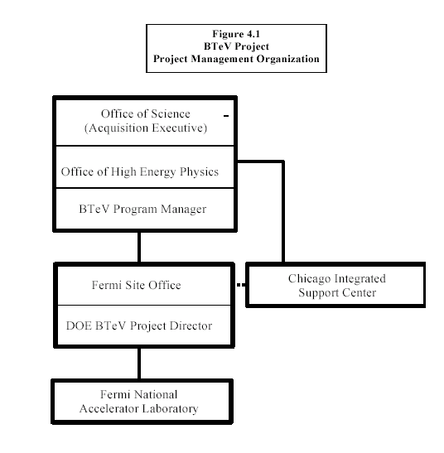
DOE Organization – from the PEP

Slide 18
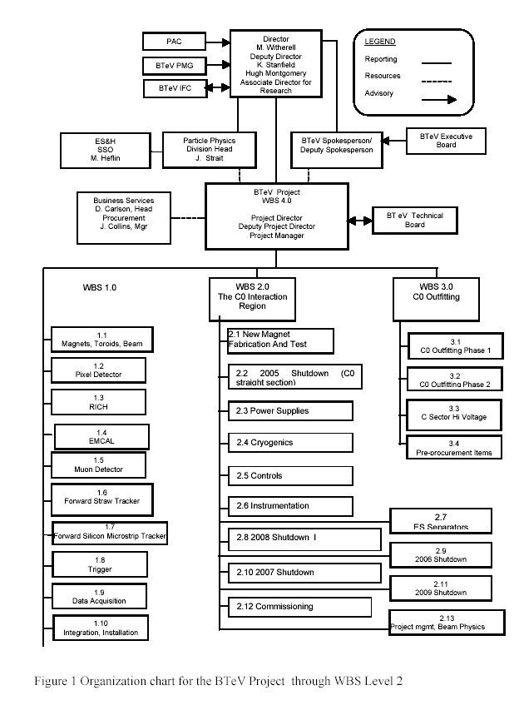
Fermilab –BTeV Collaboration-BTeV Project from PMP

Slide 19
ES&H WBS4.0
BTeV does not have unusual ES&H issues and has received a NEPA Categorical Exclusion
A Preliminary Hazard Assessment Document has been written and has been judged adequate for CD1 by DOE.
  The conclusion is that “operations at BTeV are characterized as low hazard.”
A Preliminary Safety Assessment Document (PSAD) has been written and is ready for review.
We have a Safety Liaison – Martha Heflin of Particle Physics Division
  There are four FNAL divisions and one section involved in BTeV and attention is being given to making sure there are clear lines of responsibility

Slide 20
BTeV Resource Loaded Cost and Schedule
The project is being managed using an integrated suite of project management software from WELCOM, inc.– Open Plan (scheduler), COBRA, and WelcomHome.
The cost estimate is derived from a complete, task-oriented WBS. Realistic assumptions are made about the production model. We have worked hard to include integration activities in a complete and consistent manner
Estimate starts in FY2005, when we will transition from an mainly an R&D Project to mostly a construction project. IT IS IN FY2005 DOLLARS.
  Includes contingency, labor rates for all institutions including Fermilab, overhead on labor.

Slide 21
Contingency
We develop a bottoms up contingency based on maturity of design using a consistent methodology for M&S and labor. It results in a contingency of about 36%. We believe this is reasonable because
  The BTeV detector and C0 IR are new but many pieces have been or are being built elsewhere, so some parts can have relatively low contingency.
  Our Cost Estimate is unusually complete for this stage in the project. In many cases, we are dealing with known vendors and have solid quotes
  The scope has been stable for several years
  There are parts that use new or unproven technologies and those do have much higher contingencies

Slide 22
Cost and Schedule Principles
In the following, we discuss the balance between our budget availability and our need for budget authority based on the “Staged Schedule” that is our proposed baseline
We focus on our need for Budget Obligation Authority vs the availability of Budget Obligation Authority
For this, we use a schedule
  that lumps all schedule float at the end;
  that has the budget authority for M&S available at the contract award;
  that assumes labor is paid linearly across the performance period;
  that respect fund types; and
  that takes into account DOE Critical Decision dates and the likelihood of a continuing resolution in FY05 that impacts “new starts.”
Note that in addition to the Project “Total Estimated Cost”, the “TEC”, we have three other fund sources
  RD in FY05 and 06
  IR Spares
  INFN funds

Slide 23
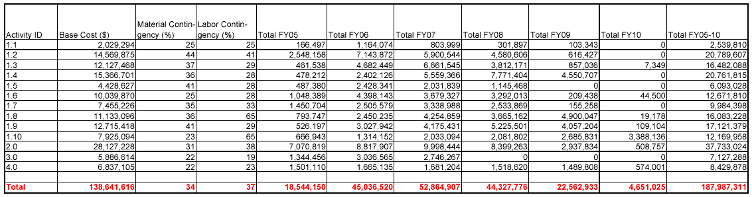
Total Cost (FY05$)
Base Cost = $138.6M, Total Cost = $188.0M, Contingency = 36%
Total M&S = $108M, Total Labor = $80M
This includes fund type CB(MIE) and RD and IM(INFN) from FY05 on. It does not include FY04. It does not include IR spares.

Slide 24
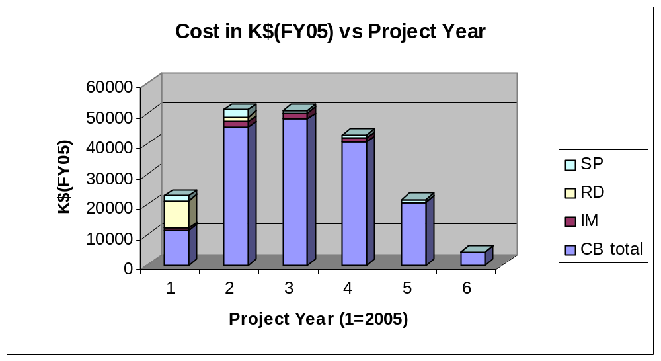
Total Cost by FY (FY05 $)

Slide 25
Lab/DOE Funding Profile($M/AY)
 | FY05 | FY06 | FY07 | FY08 | FY09/10 | Total
$M/AY | 13.1 | 41.2 | 51.2 | 51.7 | 44.9 | 202.1
The plan we have put forward is consistent with lab funding profile guidance. The funding profile, which is “back-end” loaded, we have met by
Deferring as many costs as possible, especially components such as computers whose cost fall with time
By using phased contracts
By using funds approved for BTeV by INFN. These are available to support the projects that are being worked on by the Italian physicists on BTeV.
We have forward funding arrangements with universities. So far, Syracuse ($7.5M), Wayne State ($1M), and Vanderbilt ($1M) have approved forward funding for BTeV. We are seeking more forward funding from our other collaborators.
We presented a schedule based on this profile based on issues raised in the CD1 that was judged to have adequate schedule float

Slide 26
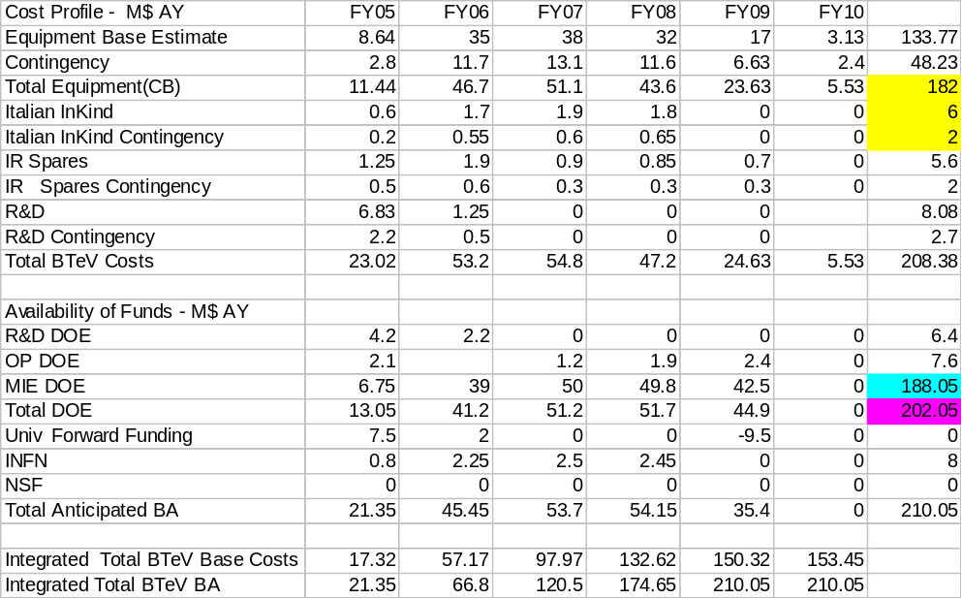
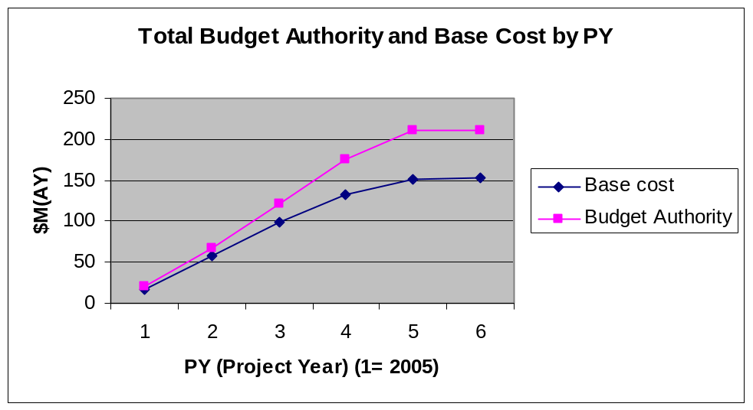
Lab Funding Profile
Other funds are being sought from the US NSF. This is still at the proposal stage and is uncertain. NSF provided key support for the R&D phase

Slide 27
Living with FY05 Budget
FY05 has some unusual problems
  We may not have CD3 until the end of FY05
  We may not have CD3a until the middle of FY05. The current schedule says Q2 ’05.
  We have the possibility of the continuing resolution lasting until late winter or early spring
  We are planning to be able to spend CONSTRUCTION MONEY based on CD3a beginning April 1, 05.
We will have to deal with this by
  Using a mix of R&D funds, MIE funds based on CD2 to complete designs, MIE funds based on CD3a for the second part of the year under Long Lead Time and Time Critical Procurements. If we are given flexibility to spend on some smaller items (<$10K), that would be highly desirable.
  Using Italian funding for the work of BTeV Italian collaborators
  Using forward funding to for some procurements and for contingency.
  Identifying and planning to do what is crucial to keep to the schedule. Prioritizing the least critical tasks and preparing to delay them if the schedule appears threatened.

Slide 28
Requests for Long Lead Time Procurements
Item | Base cost | Cont | Targ RFP date | Targ. Award Date | Dura-tion (Months) | Finish Date | FF Cand.
C0 Outfitting Phase 1 | 1,255,733 | 20% | Jan 05 | Apr 05 | 8 | Nov 05 | N
Superconductor | $930,000 | 25% | Jan, 05 | Apr 05 | 15 | Jun 06 | Y
Correctors | $881,268 | 40% | NA | Apr 05 | 7 | Oct. 05 | N
Cable Insulation | $63,753 | 40% | NA | Apr 05 | 15 | Jun 06 | Y
Steel for IR Quads | $110,000 | 50% | Feb 05 | Apr 05 | 6 | Dec 05 | Y
QIE9 Chip | $164,731 | 50% | Jun 05 | Jul –Sep 05* | 6 | Dec 05- Feb 06 | Y
Total Request for Long Lead Time Procurements =$3.41M
Total Candidate Forward Funding (base) = $1.27M

Slide 29
Requests for Time Critical Procurements
Item | Base cost | Cont | Target RFP date | Target Award Date | Duration (Months) | Finish Date | FF Candi-date
Pixel Sensors | 48,073 | 43% | Jun 05 | Aug 05 | 4 | Dec 05 | Y
Pixel Hybridization | 249,308 | 50% | Mar 05 | Jul 05 | 7 | Feb 06 | Y
High Density Interconnect | 54,859 | 50% | Jun 05 | Sep 05 | 3 | Dec 05 | Y*
Coil Handling Fixture (SM3) | 25,534 | 25% | NA | Jul 05 | 2 | Sep 05 | N
FY05 Shutdown M&S | 397,173 | 18% | NA | Apr 05-Aug 05 | varies | In time for shutdown | N
Cold Mass Tooling | 350,796 | 40% | Apr 05 | Jun 05 | 6 | Nov 06 | Y*
Coil end Parts | 175,000 | 40% | NA | Apr 05 | 14 | May 06 | Y
Quad. Vacuum Vessels | 371,200 | 40% | Jun 05 | Aug 05 | 10 | May 06 | Y
Cryostat parts | ~250,000 | 40% | Jun 05 | Aug 05 | 10 | May 06 | Y*
Total Request for Time Critical Procurements = $1.92M
Total Candidate Forward Funding (base) = $1.50M

Slide 30
FY05 Summary
Total opportunity for FORWARD FUNDING is $2.9M (base cost)
We include also $1.435M contingency for total of $4.3M
We can use forward funding for other, smaller(<$10K) items and for added contingency on RD and CB
The only labor that is connected to the “construction” is the labor involved in the FY05 Installation Activities for the C0 Straight Section. This is $374,265K base with 30% contingency.
The remaining labor is either R&D or Project Engineering and Design under CD2 to arrive at the final design needed for CD3. It is largely in place, both at FNAL and in the universities.
Total Cost:
OPC 6.83M
IM 0.50M
CB 8.74M
------------------
16.07M
Funding:
OPC 6.30M
IM 0.70M
MIE 6.75M
FF LL 2.77M
Univ FF/C 4.80M
------------------- 21.25M
Total Long Lead M&S: $3.41M
Total Time Critical M&S: $1.92M
Total Time Critical Labor: $ 0.38M
-------------------------------------------
Total $5.71M
Univ FF LL $2.77M
MIE CD3a $2.94M
MIE CD2/Design $3.81

Slide 31
Summary of Key Points for the Review
We have a technically sound, well-defined project scope that will accomplish our physics goals. The technical design has been stable for two years and has only a few options, which are about equal in cost. The design meets our stated requirements. Our R&D program has helped reduce risks
Our cost estimate is quite complete. Our need for money balances our funding guidance. Forward funding authority, now $9.5 M, will allow us to deal with problems with the budget
In the next talk, we will review how we have reorganized our schedule after the CD1 review based on staging the detector. We now have an achievable schedule
The experiment has less “coupling” than hermetic central collider detectors, resulting in lower costs, fewer uncertainties, ease of installation, integration, and commissioning.
We have a plan to cope with the special challenges we expect to arise in FY05. We are ready to get started!
An experienced team is in place to do the project. We are using formal project management techniques.

