Slide 1

Studying Dark Energy with Clusters of Galaxies
Joe Mohr
Department of Astronomy
Department of Physics
University of Illinois
Outline
  Observational leverage on dark energy
  Cluster structure and its evolution
  Cluster surveys- present and future
  Remaining challenges

Slide 2
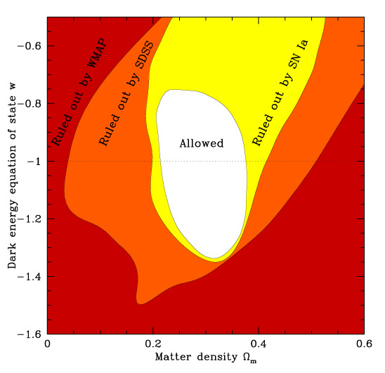
How Can One Study the Dark Energy?
Measuring (relative) distances or volumes out to z~2
Measuring the growth rate of cosmic structures
Detecting dark energy clustering in the power spectrum of density fluctuations
Measure evolution of gravitational potential wells using the Integrated Sachs-Wolfe effect
Laboratory experiments and Theoretical progress
Tegmark et al 2004

Slide 3
The Dark Energy and Its
Equation of State Parameter
Density Parameter
Equation of State Parameter
Expansion history of the universe depends on the amount and nature of dark energy
Expansion History

Slide 4
Key Methods to Measure the Expansion History and/or Growth Function
Type Ia Supernovae as standard candles
Weak lensing measurements
Power spectrum measurements
Galaxy cluster surveys
(Cosmic Microwave Background anisotropy)

Slide 5
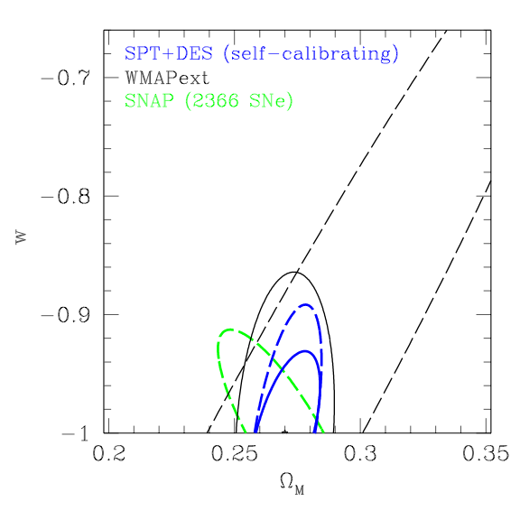


Cluster Survey Studies of the Dark Energy are Complementary and Competitive
Cluster constraints on dark energy:
  The cluster redshift distribution, the cluster power spectrum and 30% accurate mass measurements for 100 clusters between z of 0.3-1.2
  Fiducial cosmology (WMAP: σ₈=0.84, Ω_{m}=0.27); 29000 clusters in the 4000 deg² SPT survey.
The joint constraints on w and Ω_{m}:
  Curvature free to vary (dashed); fixed (solid)
  Marginalized constant w 68% uncertainty is 0.046 (flat) or 0.071 (curvature varying)
Parameter degeneracies complementary
SPT: Majumdar & Mohr 2003
SNAP: Perlmutter & Schmidt 2003
WMAP: Spergel et al 2003

Slide 6
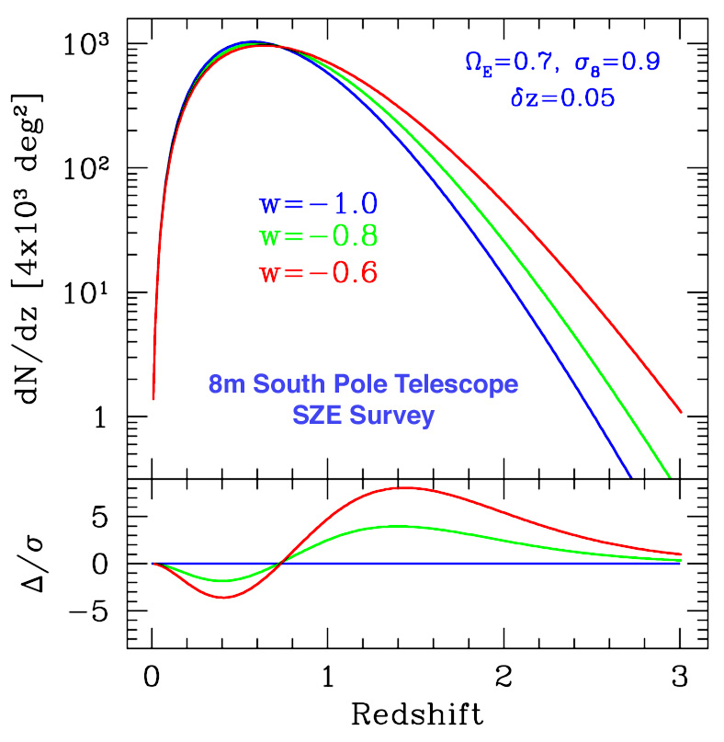

Cluster Redshift Distribution is Sensitive to the Dark Energy Equation of State Parameter
w constraints:
Raising w at fixed Ω_{E}:
  decreases volume surveyed
  decreases growth rate of density perturbations
Volume effect
Growth effect

Slide 7

The Cluster Power Spectrum
A second observable in a large solid angle (contiguous area) cluster survey is the clustering of the clusters
Clusters are biased tracers of the dark matter, and the bias is a function of cluster mass (rarer, more massive clusters are also more highly biased)
The cluster power spectrum gives us information about the transfer function of dark matter perturbations, and the transfer function is sensitive to the matter density Ω_{m}
The amplitude of the cluster power spectrum gives us indirect information about the masses of the clusters

Slide 8

What About the Cluster Abundance n(z)?
The cluster abundance is an integral over the detectable portion of the cluster mass function
Cluster mass function dn(M,z)/dM depends on mean matter density ρ and amplitude of density fluctuations σ(Μ) on mass scale M

Slide 9
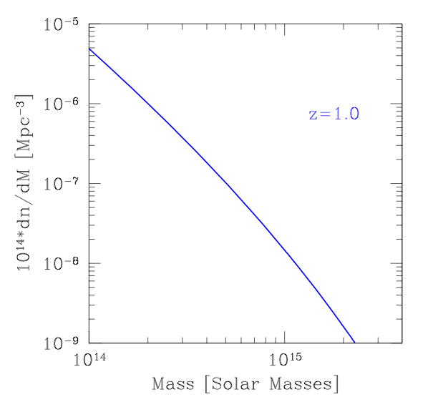
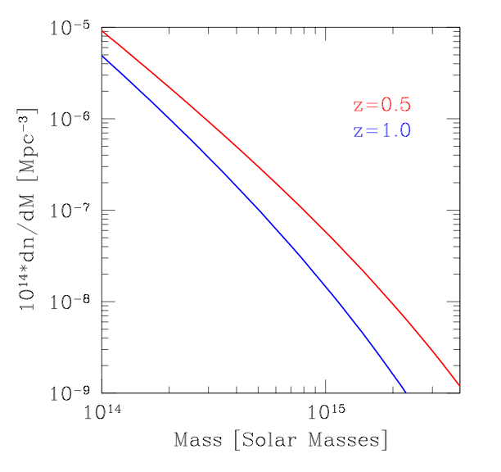
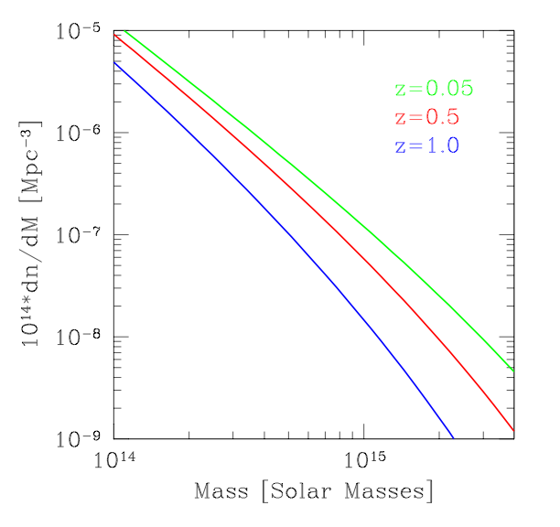
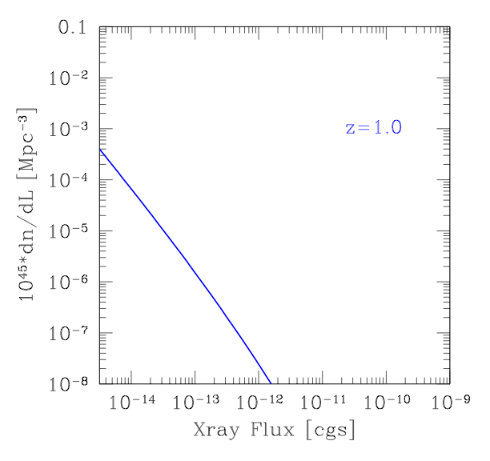
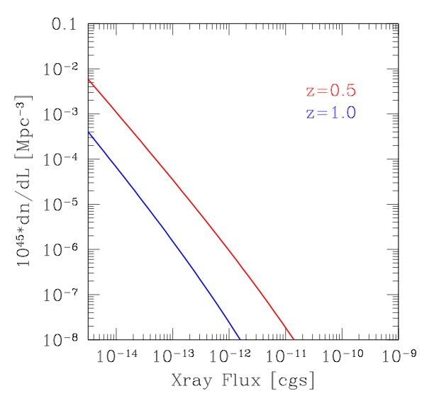
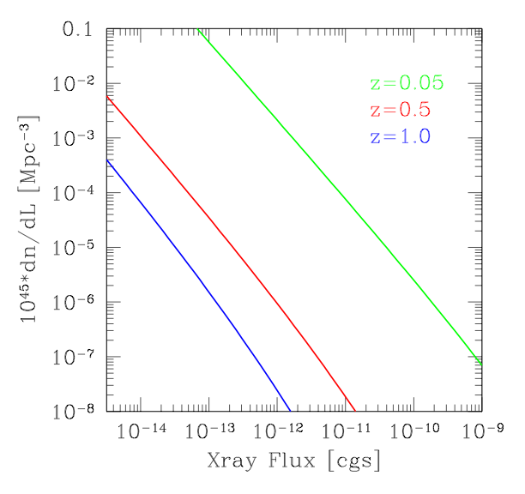
Cluster Formation
As density perturbations grow, clusters appear and the cluster mass function (dn/dM) evolves. We observe the “luminosity” or “shear” function.
Mass Function
Luminosity or Flux Function

Slide 10
The Press-Schechter Mass Function
Consider the cosmic density field filtered on a mass scale M
Assume that density perturbations have collapsed by the time their linearly evolved overdensity exceeds some critical value δ_{c}
Abundance (number density) of collapsed objects with mass M is then proportional to an integral over a Gaussian distribution
δ_{c}
δ_{c}
collapsed
collapsed
Gaussian Distributed Perturbations on Scale M

Slide 11
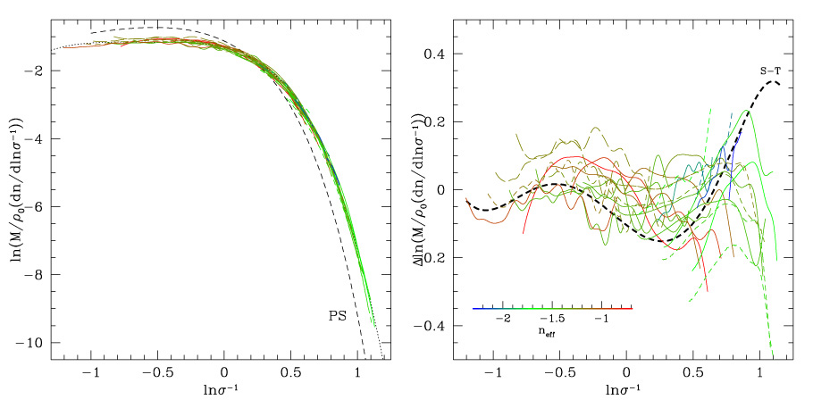
Jenkins Mass Function
Jenkins et al. 2001, MNRAS 321, 372
Jenkins fitting function good to better than 20% over entire range, corresponding to 10¹¹ to 10¹⁶ solar masses at z=0 in standard cosmologies.

Slide 12
Abundance Evolution
Mass function evolution requires only that we know how σ(M) changes with redshift
Linear growth of perturbations is sensitive to the expansion history of the universe and to the dark matter density
  Universal expansion is a factor in the drag term
  Clustered dark matter density is a factor in the source term
Density perturbations evolve more slowly in a low density universe.

Slide 13
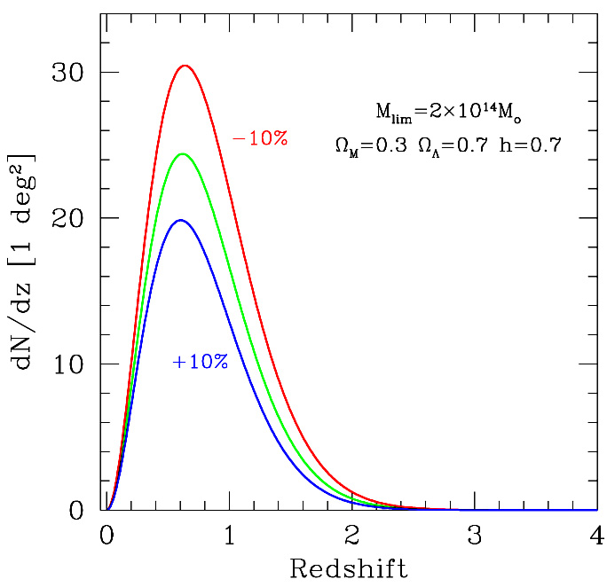
Mass Selection Function
Cluster redshift distribution dN(z)/dz/dΩ
Sensitivity to Mass
Mass selection function
Detection efficiency f(M)
  In simplest case, selection is just a step function
    Survey selects all clusters more massive than M_{lim}
  But we don’t observe virial mass directly
  Connecting cluster virial mass to observables is critically important
    X-ray luminosity or emission weighted temperature
    SZE luminosity
    Weak lensing shear amplitude
    Galaxy light/dynamical estimators

Slide 14

Are Clusters Suitable?
So far the discussion is really about the emergence and evolution of dark matter halos in an expanding universe
Will any dark matter halo do?
Requirements:
  Must be observable over a significant fraction of cosmic history
  Must exhibit regularity
    Observables can be tied to halo mass in a reasonably clean manner
    Simple redshift evolution is a plus
Clusters meet these requirements

Slide 15
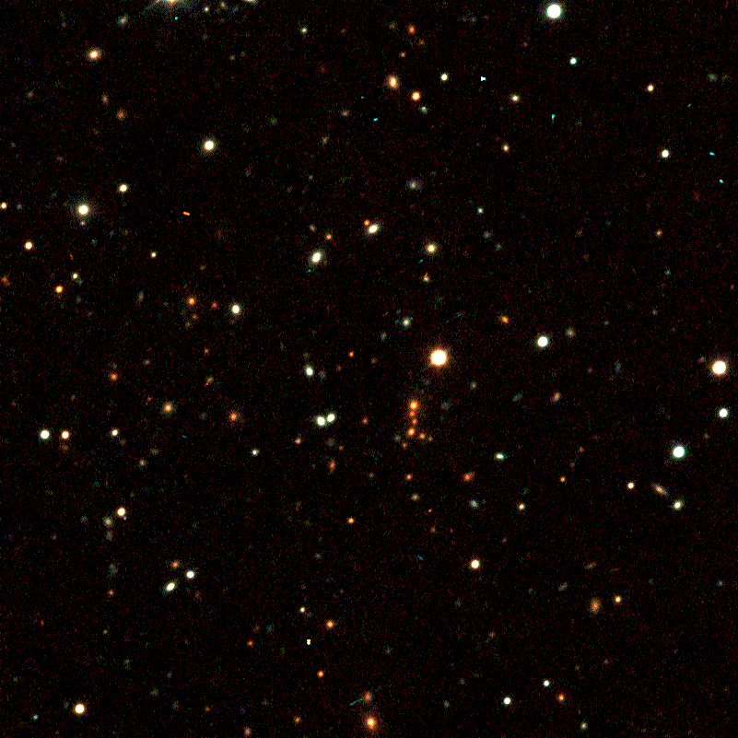
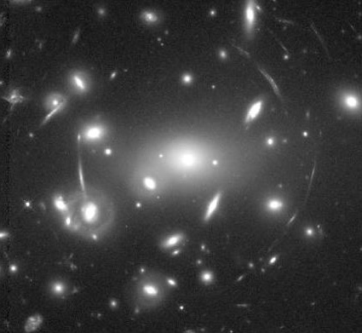
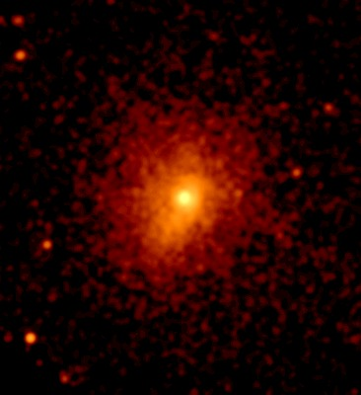
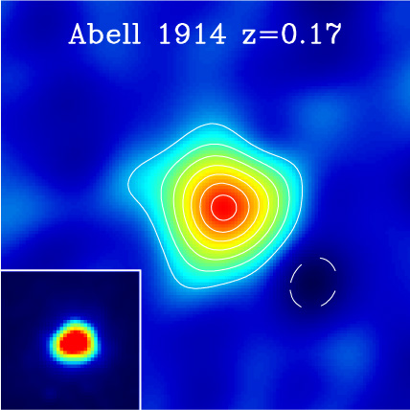
Galaxy Clusters Observables
Galaxy clusters are the most massive, collapsed structures in the universe. They contain galaxies, hot, ionized gas (10⁷⁻⁸K) and dark matter.
In typical structure formation scenarios, low mass clusters emerge in significant numbers at z~2-3
Clusters are good probes, because they are massive and “easy” to detect through their:
z=1 cluster from Gladders & Yee
HST Image of Abell 2218
Chandra Image of Zw3158
X-ray emission
SZE
X-ray
Sunyaev-Zel’dovich Effect
Gravitational lensing
Light from galaxies

Slide 16
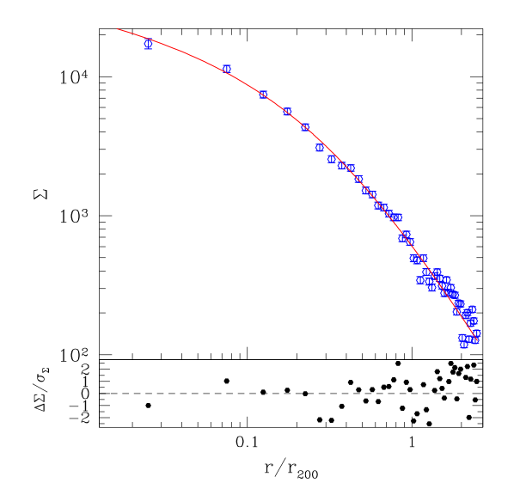

Clusters Have No Outer Surface
Dark matter, ICM, and galaxy distributions all fall off with distance from the cluster center, but there’s no clear signature of the edge of the cluster
Thus, the mass of a galaxy cluster is an ambiguous quantity
There are preferred definitions of cluster mass- we tend to choose a region which is a few hundred times denser than the background or critical density
With this definitions, the cluster mass function evolution is simple
89 Stacked 2MASS Clusters
Lin, Mohr and Stanford 2004
(ApJ, in press, astro-ph/0402308)

Slide 17
Dual Nature of Galaxy Clusters
Clusters are young objects and, yet, as a population they exhibit striking regularity
Evidence for cluster-subcluster merging abounds:
  1980’s: Einstein images of double clusters, Messy galaxy distributions
  1990’s: Statistical studies of (X-ray flux limited samples of) galaxy clusters reveal that more than half exhibit merger signatures
  Now: Chandra observations reveal merger signatures on even smaller physical scales
Statistical studies of galaxy clusters reveal regularity
Implications:
    Cluster population on the whole is regular
    While mergers are common, recent major mergers that grossly perturb the cluster structure must be relatively rare

Slide 18
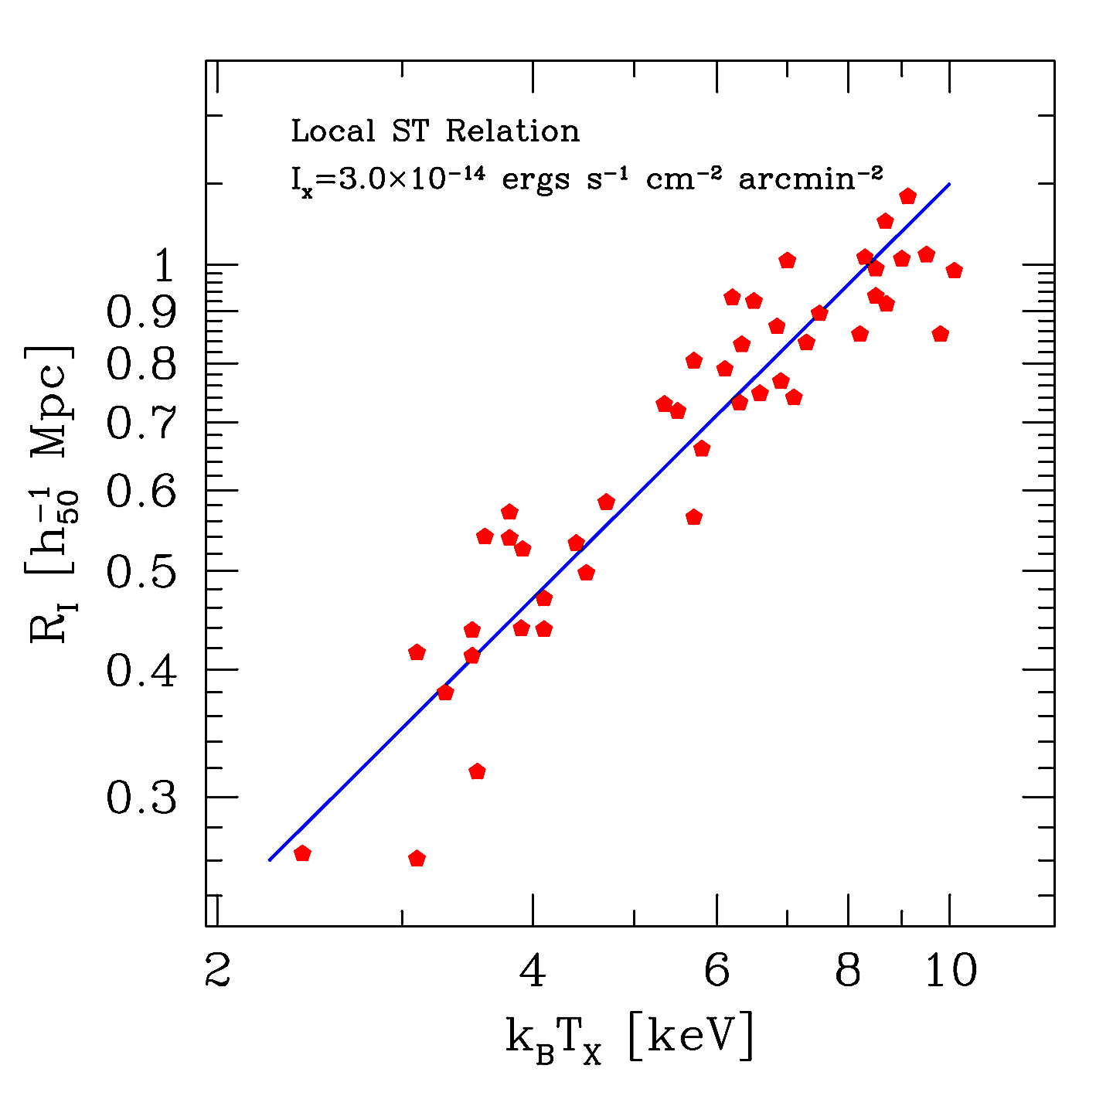
The Local Size-Temperature Relation
Analysis of 45 clusters (an X-ray flux limited sample) observed with the ROSAT PSPC. Emission weighted mean temperatures taken from the literature
Characteristics:
  RMS scatter is ~15% in size
  Slope suggests some source of entropy for the intracluster medium in addition to that provided by shocks during infall and cluster formation
Mohr & Evrard, ApJ, 1997

Slide 19
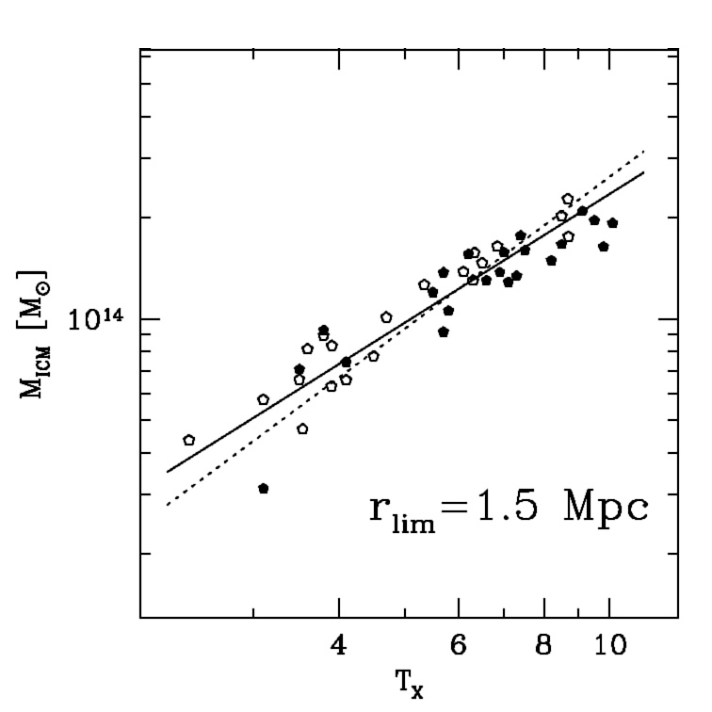
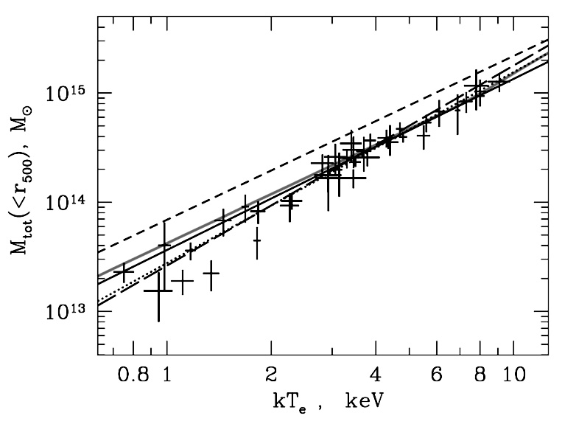
Cluster Mass-Temperature Scaling Relations
Emission weighted mean temperature is a good predictor of galaxy cluster mass (~20% scatter)
Mohr, Mathiesen & Evrard 1999
Finoguenov, Reiprich &
Boehringer 2001
X-ray Flux Limited Sample
Implication: Structure of cluster ICM and dark matter comparable for clusters of the same mass. Similar scaling relations are also seen in hydrodynamical simulations of galaxy clusters and in the observed K-band properties of the galaxies!

Slide 20
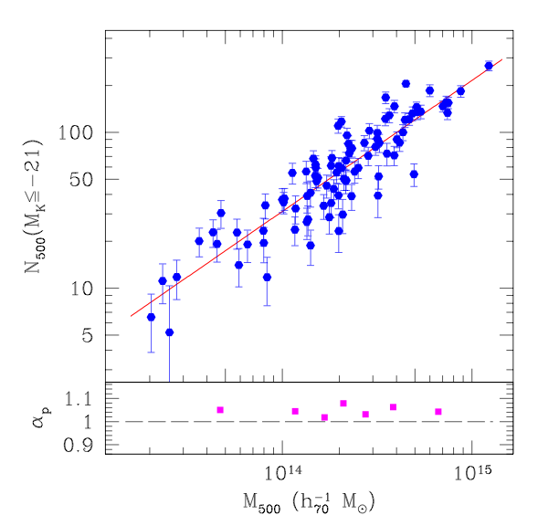

Regularity in Galaxy Population, too
The Halo Occupation Number on group and cluster mass scales varies as the cluster binding mass to the 0.85+/-0.04 power
Scatter about this bulk behavior is about 30% (similar to scatter in total light)
Thus, the number of galaxies per unit mass is lower in massive clusters than in low mass clusters and groups
Galaxies must be lost or must be growing less massive through stripping as their cluster/group halos merge to form higher mass structures
Lin, Mohr & Stanford 2004
(astro-ph/0402308)

Slide 21
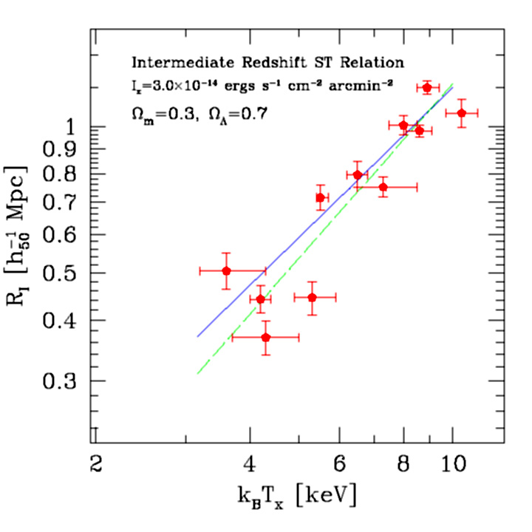
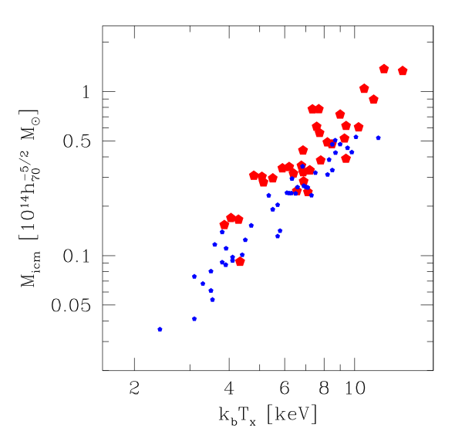
Scaling Relations
Persist at Intermediate Redshift
Evolution Corrected
Best Fit ST
Mohr, Reese, Ellingson, Lewis & Evrard, ApJ, 2000
Local ST
HRI Observations of 11 CNOC Clusters
Chandra Observations of 35 Clusters
(Sanderson et al. in preparation)
See also Chandra and XMM studies of Vikhlinin et al 2002, Ettori et al. 2003

Slide 22
Scaling Relations and Precision Cosmology
The good news:
  Existence of these scaling relations demonstrates that simple observables are correlated with mass
The bad news:
  Not all cluster finding approaches lead to similarly clean mass estimators
    ICM properties are rather clean, because the ICM “lights up” when a cluster collapses and begins to relax
      X-ray luminosity and temperature are relatively clean
      SZE is promising, but observational issues must be overcome
    Galaxy and dark matter properties are much more challenging
      Galaxies and dark matter were around long before the cluster collapsed.
      Lensing kernel is very broad in redshift space, so when you find a cluster you have also found the large scale structures surrounding it
      Shape information (projected galaxy and dark matter distributions) will be key in estimating cluster halo mass, but these methods are likely to deliver much less accurate mass estimates
  Need to understand evolution of the mass-observable relations

Slide 23
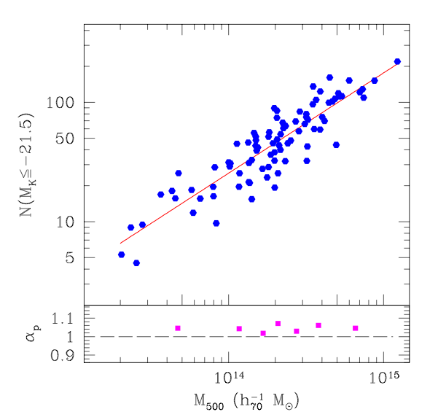
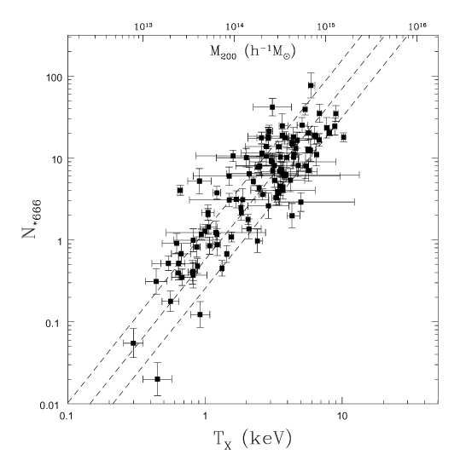
Why X-ray Cluster Surveys?
The mass-observable relations in the optical are not as clean
  On the left: adopt X-ray emission peak as cluster center, choose cluster radius using the emission weighted mean X-ray temperature (calibrated by cluster studies with temperature profiles- Finoguenov, Reiprich & Boehringer)
  On the right: finding clusters and boot-strapping to the halo mass using only the K band galaxy data
Cluster selection is also very clean in the X-ray compared to optical methods- projection issues are not as severe
Lin, Mohr & Stanford 2004 (astro-ph/0402308)
Kochanek et al. 2003
89 clusters
28% scatter
84 clusters
81% scatter

Slide 24
What Are the Primary Challenges?
Primary challenges are:
  Sensitive cluster finding over large solid angle
    A special purpose X-ray survey mission like DUO
    Special purpose SZE surveys like the South Pole Telescope
    Large optical/near-IR (OIR) survey projects like SDSS, PAN-STARRS, RCS2, CTIO Dark Energy Survey or LSST
  Obtaining redshift estimates for all of these clusters
    Requires photometric redshift estimates from multiband OIR surveys
    Extensive effort, but natural by-product of other projects
  Connecting observables (X-ray/SZE/OIR flux or weak lensing shear) to the cluster halo mass

Slide 25
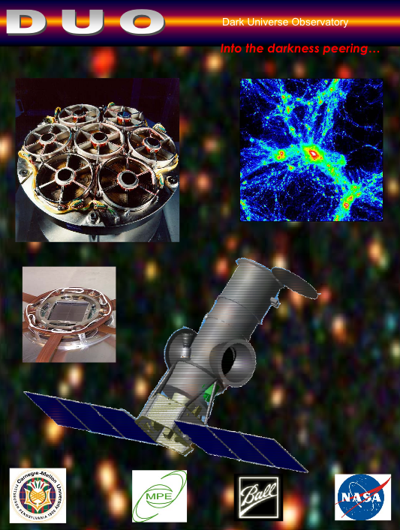
DUO: The Dark Universe Observatory
DUO (PI is Richard Griffiths- CMU) is a NASA Small-Explorer mission currently in Phase A study with 3 other missions. Two will be selected for flight.
Goal is to study dark energy, inflation and other cosmological issues with a deep, extragalactic X-ray survey that measures the cluster redshift distribution and power spectrum out to z~0.7
PI is Richard Griffiths (CMU) with collaborators at Goddard Space Flight Center, Max Planck Institute (Germany), Ball Aerospace, U Illinois, Columbia and U Hawaii.
Launch in 2007 followed by a two year X-ray survey for galaxy clusters (10,000+) and active galactic nuclei (100,000+)
6000 deg² to 7x10⁻¹⁴ cgs [0.5-10keV] in the north (overlapping SDSS) and deeper, 150 deg² to 9x10⁻¹⁵ cgs [0.5-10keV] southern survey

Slide 26
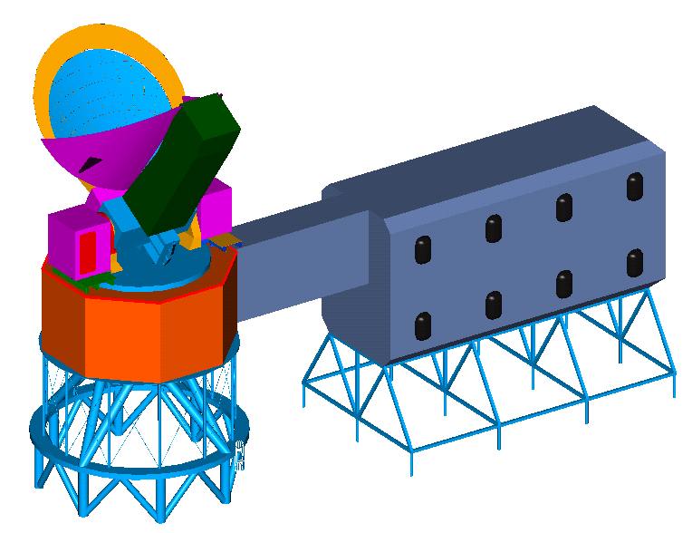
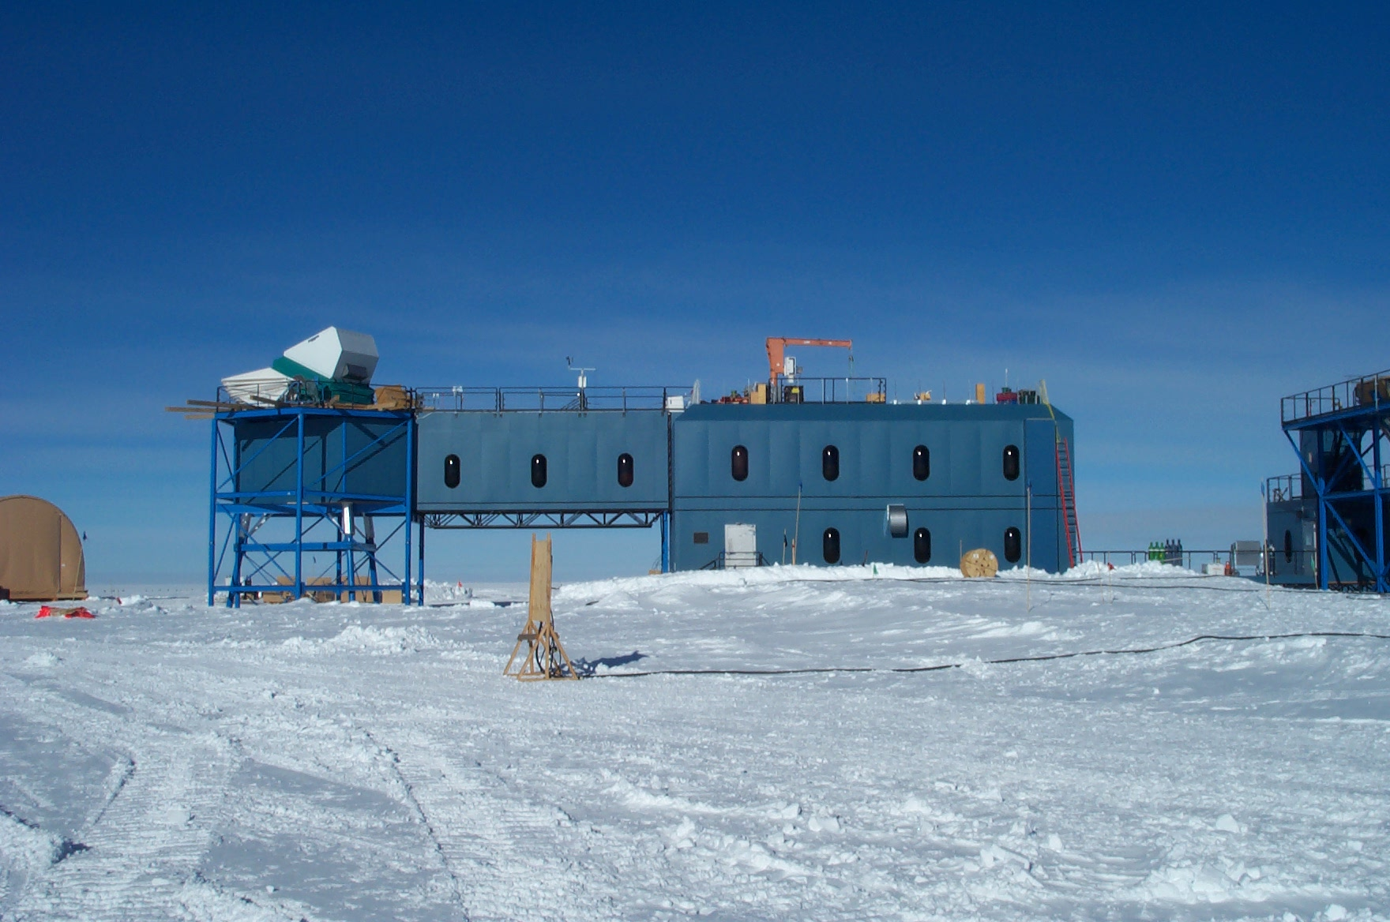
SZE cluster finding: 10m South Pole Telescope
PI John Carlstrom (U Chicago)
Collaborators at Chicago, CWRU, Berkeley, Illinois and Harvard-Smithsonian CfA
Goal: Study dark energy with cluster redshift distribution and power spectrum out to z~1.5 and study CMB (polarization) on scales of 1 arcmin and above
Survey of 4000 deg² in three bands begins Feb 2007
Telescope Support Building (DSL)
Overfill Guards
Telescope Access
Figure courtesy Tony Stark and John Ruhl

Slide 27
Near Term Cluster Surveys
X-ray serendipitous surveys with XMM and Chandra
SZE surveys with SZA, AMI and APEX
NIR surveys with FLAMINGOS
Optical surveys with SDSS, RCS2, etc
These will set the stage for the longer term, precision studies of the dark energy using clusters

Slide 28
What Are the Primary Challenges?
Primary challenges are:
  Sensitive cluster finding over large solid angle
    A special purpose X-ray survey mission like DUO
    Special purpose SZE surveys like the South Pole Telescope
    Large optical/near-IR (OIR) survey projects like SDSS, PAN-STARRS, RCS2, CTIO Dark Energy Survey or LSST
  Obtaining redshift estimates for all of these clusters
    Requires photometric redshift estimates from multiband OIR surveys
    Extensive effort (but natural by-product of other projects)
  Connecting observables (X-ray/SZE/OIR flux or weak lensing shear) to the cluster halo mass

Slide 29
Photometric Redshifts and Cluster Followup
DUO (wide) will survey the SDSS region in the north, so photo-z’s should be available out to z~0.6
The SPT 4000 deg² survey will yield roughly 29,000 clusters (assumes WMAP+ cosmology, the standard structure formation model and our current estimates of the survey cluster flux limi)t. So we expect to find roughly 7 clusters per deg²
Followup will be carried out for several reasons:
  Photometric redshift estimates (optical and/or NIR)
    Accuracy is acceptable (δz~0.02 with shallow SDSS data to z=0.6). Similar accuracy with deeper two-band photometry to z=1 (Yee and Gladders)
    g’, r’, i’ and z’ photometry to 10 sigma depth of 24.6, 24.1, 24 and 23.6 would be sufficient for determining redshifts of those clusters at z~1.3 (>95% of our SPT sample)
    Such a survey on the Blanco 4m with a 3deg² camera would take approximately 500 nights
    Higher redshift (most interesting but <1/deg²) systems will likely require NIR data
  Additional, independent mass estimates
    galaxy light or number, weak lensing, X-ray hydrostatic masses possible
  Determine completeness and contamination in cluster sample
    Compare cluster lists in SZE, optical, NIR, and X-ray for a subset of the survey

Slide 30
Dark Energy Survey
Dark Energy Science
  Four independent constraints on the dark energy
    Cluster survey- SPT
      (and perhaps DUO X-ray survey as well)
    Cosmic shear
    Galaxy angular power spectrum
    SNe Ia distance measurements
Dark Energy Collaboration
    Fermilab- Camera building
      Annis, Flaugher, Lin, Kent, Peoples, Wester, Dodelson, Stebbins, Stoughton, and Tucker
    U Illinois- Data Management, Data Acquisition
      Brunner, Karliner, Mohr, Plante, Selen and Thaler
    U Chicago- Cluster and weak lensing science components
      Carlstrom, Frieman, Hu, Sheldon and Wechsler
    LBNL/UC Berkeley- Red sensitive detectors, SNe science component
      Aldering, Roe, Levi and Perlmutter
    CTIO- Telescope & Camera Operations, SNe science component
      Smith, Suntzeff, Abbott and Walker
    Mike Gladders (Carnegie Observatories)
5000 deg² survey
Repeated observation of 40 deg²

Slide 31
Dark Energy Camera
Camera build and data management preparations begin 2005
  3deg² prime focus camera, ~60 2kX4k 15 micron (0.26 arcsec) LBNL SNAP-like devices
  2.1degree diameter corrector on Blanco 4m
  First survey season begins fall 2008 and runs through end of 2012
Dark energy survey data released to public
  Full dataset is 100TB + four 1Tpix images + Catalogs
  Reduced exposures released 1 year after observation
  Co-added sky images in four bands released at half-way point and at survey end

Slide 32
What Are the Primary Challenges?
Primary challenges are:
  Sensitive cluster finding over large solid angle
    A special purpose X-ray survey mission like DUO
    Special purpose SZE surveys like the South Pole Telescope
    Large optical/near-IR (OIR) survey projects like SDSS, PAN-STARRS, RCS2, CTIO Dark Energy Survey or LSST
  Obtaining redshift estimates for all of these clusters
    Requires photometric redshift estimates from multiband OIR surveys
    Extensive effort, but natural by-product of other projects
  Connecting observables (X-ray/SZE/OIR flux or weak lensing shear) to the cluster halo mass

Slide 33
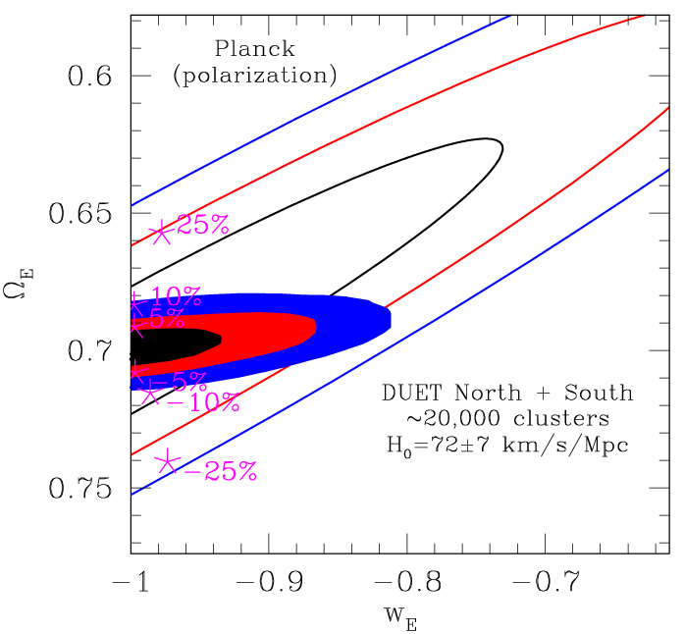
Systematic Errors in Cluster Mass Estimates
Systematic errors in mass estimates could potentially bias determinations of the density and nature of the dark energy
In fact, this problem lies at the root of problems some have encountered in interpreting the rather small cluster samples available today
High yield surveys over contiguous portions of the sky-- like the DUO X-ray survey-- will enable us to overcome this limitation through a process we call self-calibration
Parameter Biases
ΔlogM Ω_{E} <w> σ₈
+25% 0.657 -0.9775 1.027
+10% 0.683 -0.9975 1.016
+5% 0.691 -0.9973 1.008
0% 0.700 -1.0000 1.000
-5% 0.708 -0.9969 0.993
-10% 0.715 -0.9858 0.978
-25% 0.741 -0.9733 0.944

Slide 34
Self-calibration in Galaxy Cluster Studies of the Dark Energy
High yield cluster surveys can in principle deliver percent level constraints on the equation of state of the dark energy and many other cosmological parameters of interest
  Haiman, Mohr & Holder 2000
  Holder, Haiman & Mohr 2001
  Weller et al 2001
  Levine et al 2002
  Hu & Kravtsov 2003
  Majumdar & Mohr 2003
  Hu 2003
  Majumdar & Mohr 2003b
  Lima & Hu 2004
  Wang et al 2004
Working Requirements:
  Hierarchical structure formation theory is correct
  A mass-observable relation exists that can be used to estimate cluster halo masses from observables like X-ray luminosity, galaxy light, weak lensing shear, SZE luminosity
  Crude redshift estimates are available for each cluster detected in the survey
The four highlighted papers have shown that high yield cluster surveys can constrain cosmology while simultaneously solving for the nature and evolution of the mass-observable relation.

Slide 35
A Thought Experiment
Imagine that you are presented with a dataset including ~10⁴ clusters with redshift estimates and X-ray or SZE flux measurements. What can you learn about the fundamental parameters of cosmology?
  Assume you know nothing about clusters except that
    Mass-observable scaling relations exist and evolve with redshift
    You have 100 mass measurements, each accurate to 30% (1 sigma) and distributed evenly in mass and redshift from 0.3 to 1.2. These come from detailed observational studies from X-ray or other methods (in each redshift bin we effectively have a single mass measurement accurate to 10% at 1 sigma)
  Parametrize your lack of knowledge:
    7 cosmological parameters (h, Ω_{M}, Ω_{E}, Ω_{B}, w, σ₈, and n )
    3 scaling relation parameters: power law slope, normalization and redshift evolution
  Use the survey data to measure the cluster redshift distribution and cluster power spectrum
  Use Fisher matrix approach to examine parameter constraints and degeneracies
Mass-observable relation

Slide 36
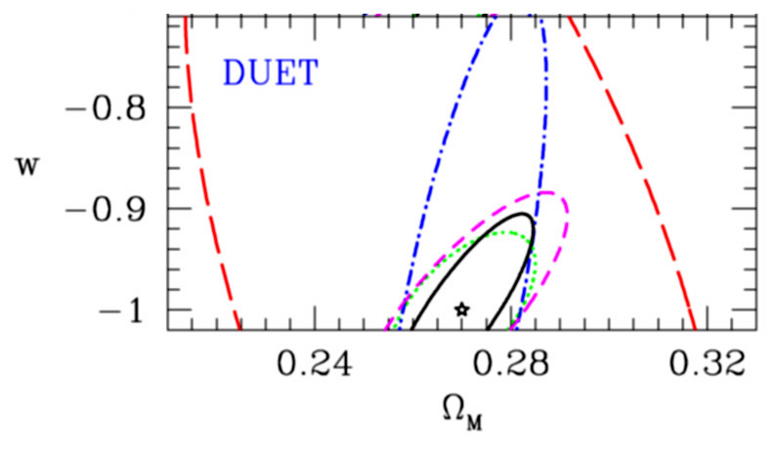
Constraints on the Dark Energy Equation of State
Joint constraints on Ω_{M} and w for DUET (assuming zero curvature)
List of constraints:
  Green- uses dN/dz and assumes perfect knowledge of mass-observable relation
  Red- self cal with dN/dz
  Blue- self cal with dN/dz & P_{cl}(k)
  Magenta- self cal with dN/dz & 100 mass estimates
  Black- self calibrating with dN/dz, P_{cl}(k) and 100 mass estimates
Majumdar & Mohr, ApJ submitted (astro-ph/0305341)
X-ray
Self-calibration using cluster power spectrum, redshift distribution and detailed studies of 100 clusters provides 6% 1σ constraint on w for DUET
P_{cl}(k) is providing indirect cluster mass information through its amplitude, which depends on the cluster bias, which is mass dependent. Moreover, P_{cl}(k) constrains the transfer function of density perturbations, which is very sensitive to the matter density Ω_{m}

Slide 37
Survey Self-calibration and Cosmology
Implications:
  The most robust cluster mass estimates will be statistical estimates derived from the properties of tens of thousands of clusters. Large samples over large, contiguous areas of the sky are required. Direct mass estimates are advantageous, if they are unbiased at better than 10% level.
  Simulated cluster mass-observable relations will be an important guide for tuning the survey analysis, but they will not be used to calibrate the surveys.
  Self-calibration reduces the need for high-accuracy flux calibration of the survey and high-accuracy flux corrections in each cluster. It reduces sensitivity to cluster redshift errors, too.
  Problems such as an increasing AGN contribution to cluster flux or changes in the fraction of clusters with cool cores with redshift (or mass) are simply self-calibrated out
Improvements and cross checks:
  There is additional dark energy information to be had by including (a) the mass function as a function of redshift together (see Hu 2003) with (b) the cluster power spectrum with CMB calibration. There are many levels of redundancy in this approach.
  The best fit cosmology and mass-observable relation can be used to predict the observed cluster mass function as a function of redshift. Level of agreement with theoretical dark matter mass functions will be direct test of robustness

Slide 38
What Calculations are Needed Between Now and Then?
The cluster mass function and bias-mass relation
  Test universality of Jenkins or Sheth-Tormen mass function
  Add baryons (15% component) to large volume simulations
Develop better cluster detection algorithms
  Multiwavelength techniques are key
  Must tune algorithms using realistic noise
Understand survey selection in detail
  Requires large volume, medium resolution simulations with baryons

