Slide 1
MI60 Quad Offsets For NuMI
Quad offsets and dipole currents for NuMI design
Existing MI closed orbits and dipole currents
Installation of Lambertsons with present dipole settings

Slide 2
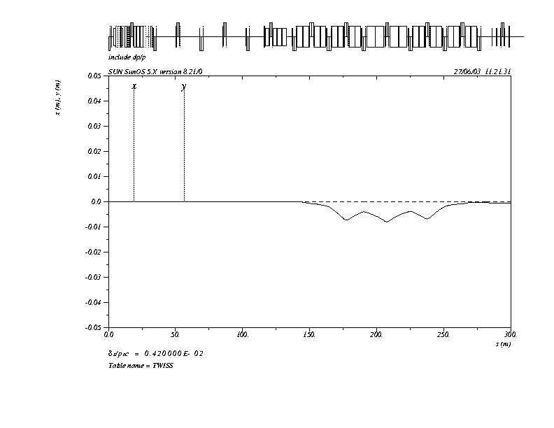
Main Injector orbits with momentum offsets

Slide 3
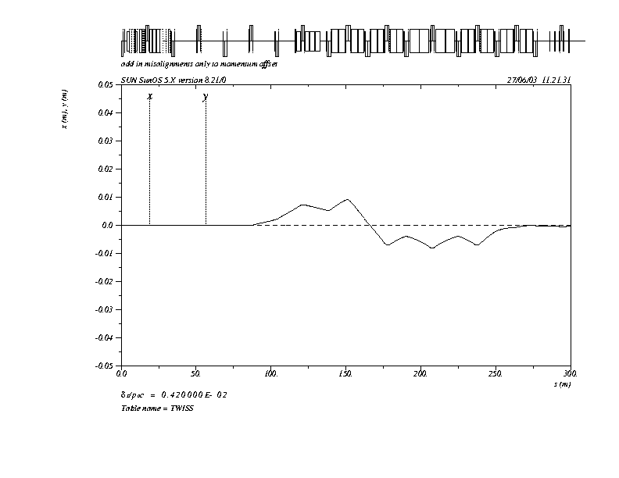
Orbits with only quad offsets
All quads are offset to
the inside of the ring
inside
Q606 1.5 mm
Q608 2.154 mm
Q610 1.62 mm
Q612 1.95 mm
outside
Here positive-x is to the inside of the ring

Slide 4
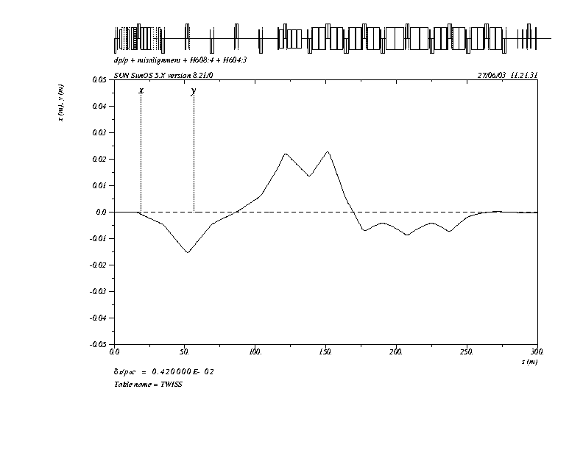
Closed orbit with kicker counter-wave and maximum Lambertson bump
Corrector currents
H602 -15.53 A
H604 -0.84 A
H606 -1.75 A
H608 +16.7 A
H610 +20.41 A
H612 +19.04 A

Slide 5
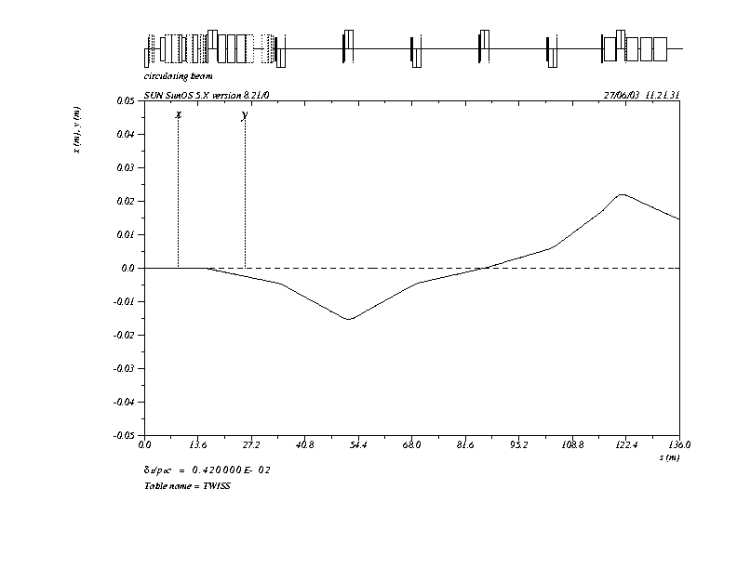
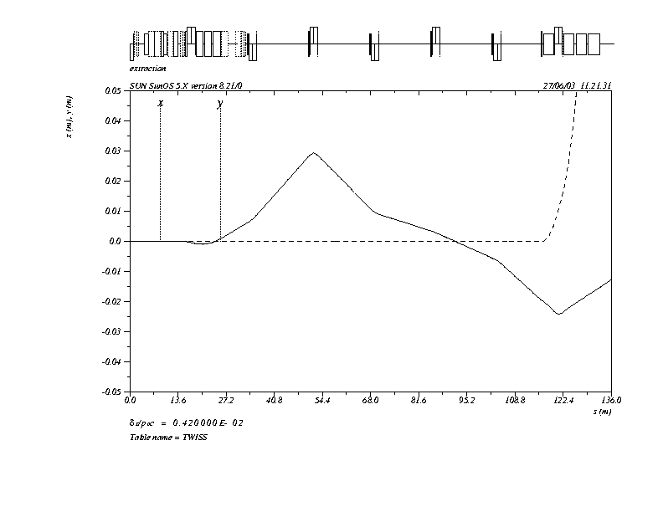
Maximum circulating and extraction orbits
Extraction positions match Design Report at LAM60C
X = 18.071 mm X’ = -0.773 mr

Slide 6
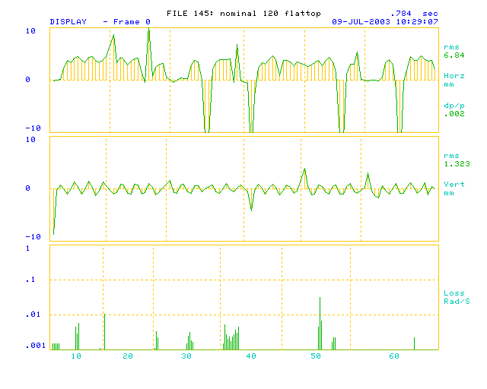
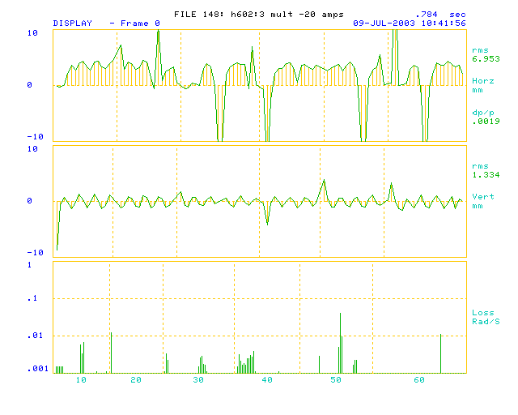
Current MI 120 GeV/c flattop orbit w and w/o H604:3 bump

Slide 7
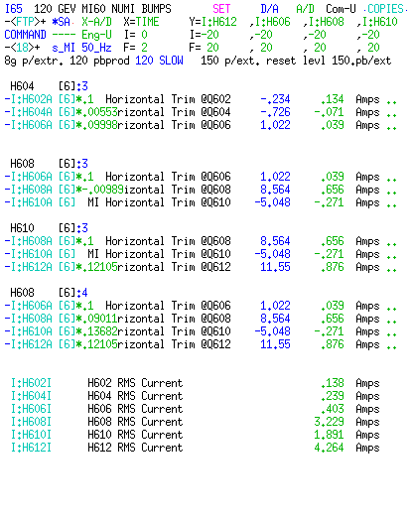
Flattop Corrector settings
Note corrector currents
Ratio of currents look
like a closed bump

Slide 8
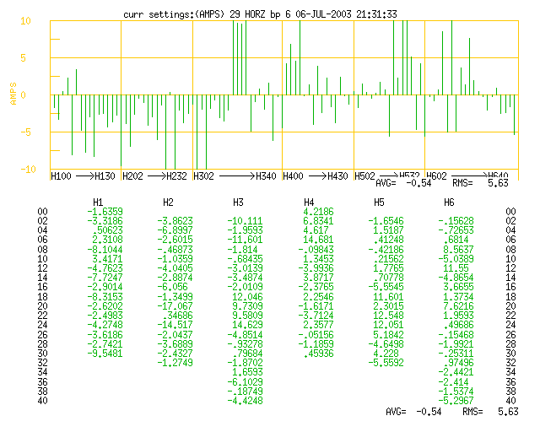
Current 120 GeV/c corrector currents

Slide 9
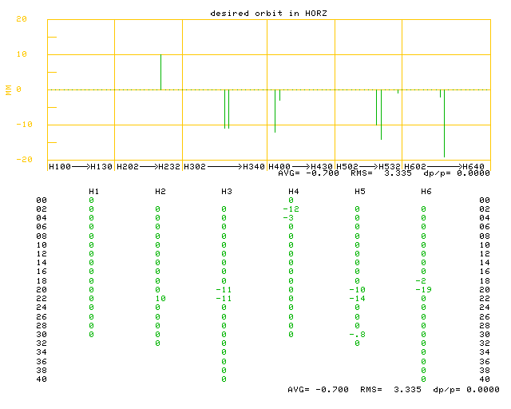
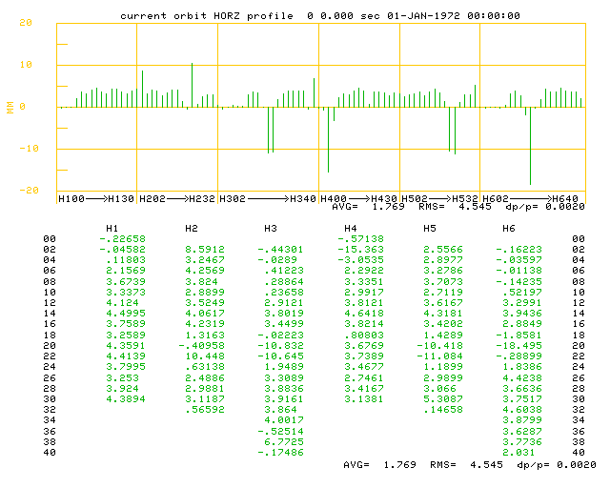
Desired positions and flattop orbit
Current MI52 desired positions
Current MI52 orbit

Slide 10
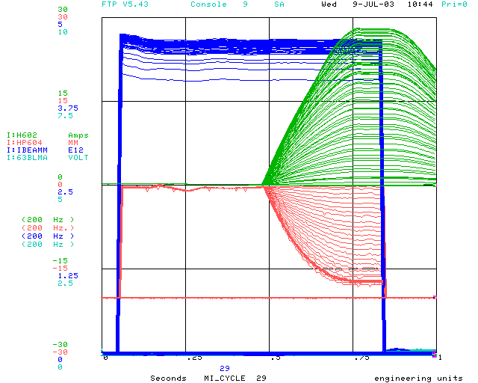
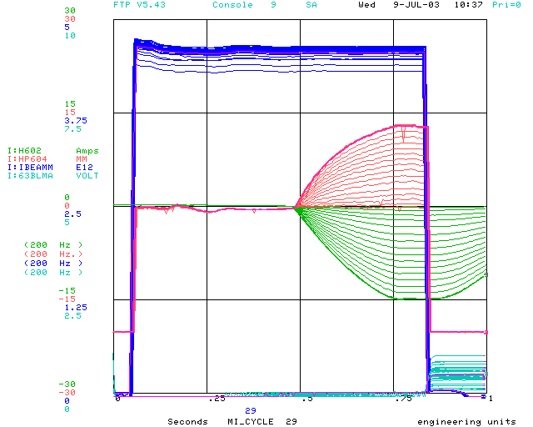
H604:3 Bump
^Loss present before kicker fires
maybe during bunch rotation
RMS current 10.3 A
28 Amps on H602
H602
HP604
LM604^
Bump inside
Bump outside*
*Amplitude used in design

Slide 11
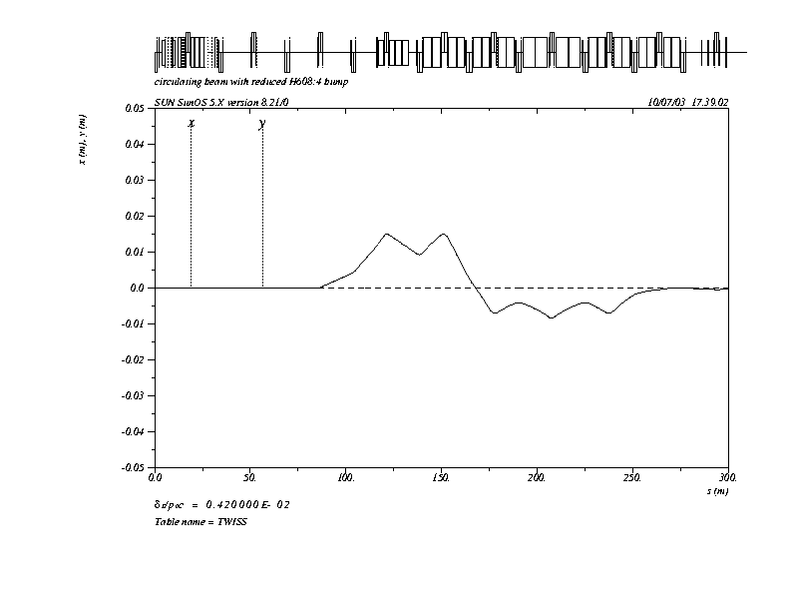
Closed orbit with reduced Lambertson bump
Corrector currents^
H606 +7.2 A
H608 +7.27 A
H610 +10.24 A
H612 +8.32 A
HP608* 15 mm
HP610* 15 mm
^These currents added to
existing corrector currents
*Bump amplitude greater than current MI52 desired positions

Slide 12
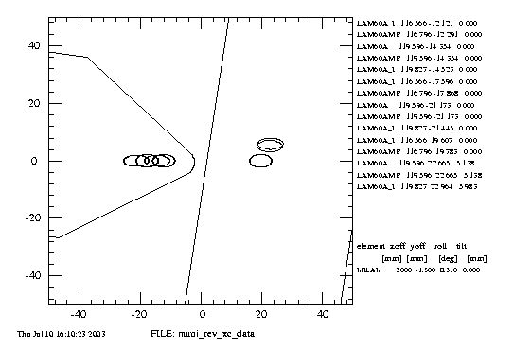
Beam Profiles thru LAM60A
Design
Extracted
Reduced bump

Slide 13
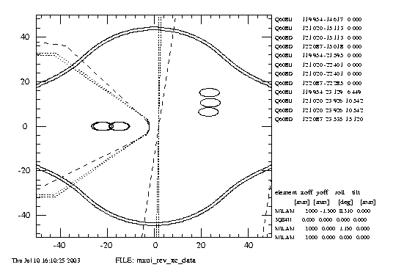
Beam Profiles thru Q608
Design
Reduced bump

Slide 14
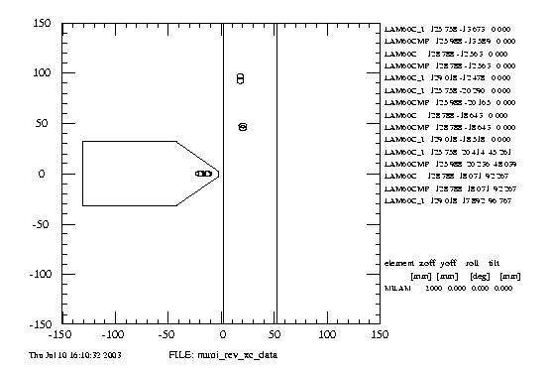
Beam Profiles thru LAM61C

Slide 15
Bottom line
Based upon the presented quad offsets, current corrector currents, reduced bump amplitude- there should not be a problem in steering around the NuMI Lambertsons.
Based upon the corrector offsets, the MI Dept should investigate the machine alignment by smoothing the 120 GeV/c closed orbit by quad moves and reducing the corrector offsets in the 60 to 30 region of the ring.
The MI Dept should understand the loss seen at Q604 at pbar production extraction time when the beam is bumped to the outside.
The MI Dept should assure that there is plenty of loss monitor coverage for the new Lambertsons

