Slide 1
WBS 2.0 Schedule Changes
Mike Church (WBS 2.0)

Slide 2
Project Flow
Corrector
Design
Spool
Design
SC Cable &
Steel
Fabrication
Cryostat
Design
Outside Vendor
SynchLite
Design
Design
Fabricated @Fermilab
2005
Shutdown
Cryogenic
Design
Controls &
Instrumentation
HTS Lead
Fabrication
Corrector
Fabrication
Test Stand
Fabrication
Cold mass
Production
←3 months
add. float
3 months
add. float→
Power Supply
Design
5 months
add. float→
Separator
Fabrication
Quadrupole
Assembly
←7 months
add. float
Regulator
Fabrication
Cryogenic
Fabrication
2007
Shutdown
Spool
Assembly
Quadrupole
Cold Test
Power Supply
Fabrication
2008
Shutdown
Spool
Cold Test
Critical Path is in red (9 months)
Power Supply
Assembly &
Installation
10 months float→
2009 Installation of C0 IR Components

Slide 3
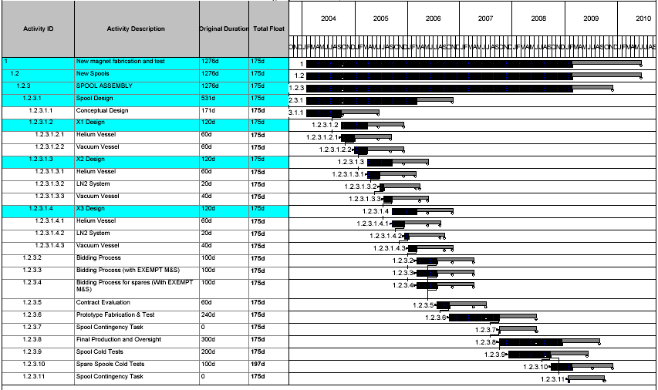
Critical Path

Slide 4
Critical Path Changes
Critical path float went from 0 months to +9 months
2009 shutdown corrected (+2 months float)
Last spool required later than shutdown start (+2 months float)
Last spool redefined as last “required” spool (+1 month float)
Design, procurement, fabrication times re-analyzed
  Spool bidding process (+7 months float)
    Additional up front design effort has made this possible
  Spool production (-3 months float)
    Closer analysis of DFBX production experience
In addition, corrector procurement process was reduced by 4 months to remove it from the critical path
    Based on communication with 4 labs; have detailed schedule estimates from BNL and CERN

Slide 5
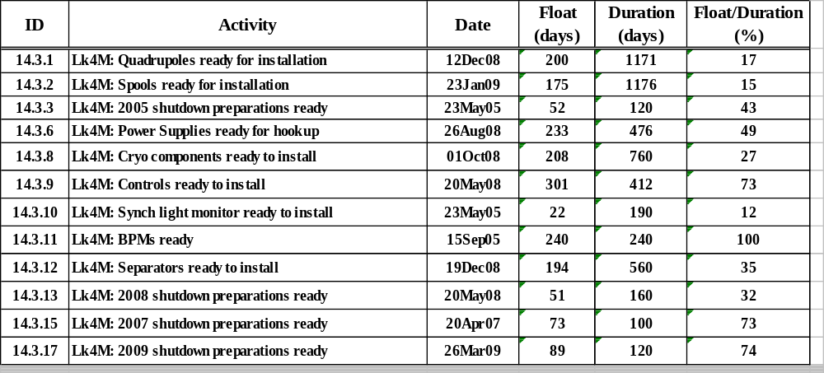
Key “Ready By” → “Need By” Floats

Slide 6
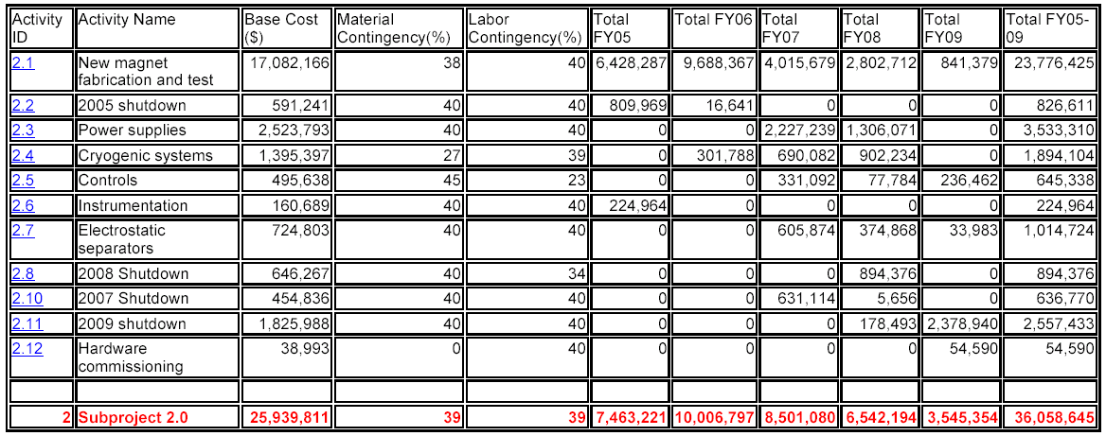
Old Construction Cost
Old Base cost: $25.9M (Material: $13.1M, Labor: $12.8M)
17,000,540
570,145
2,423,298
1,395,397
495,638
186,672
724,803
575,491
437,435
2,114,905
102,344
26,026,671
New Base cost: $26.0M (Material: $13.1M, Labor: $12.9M)

Slide 7
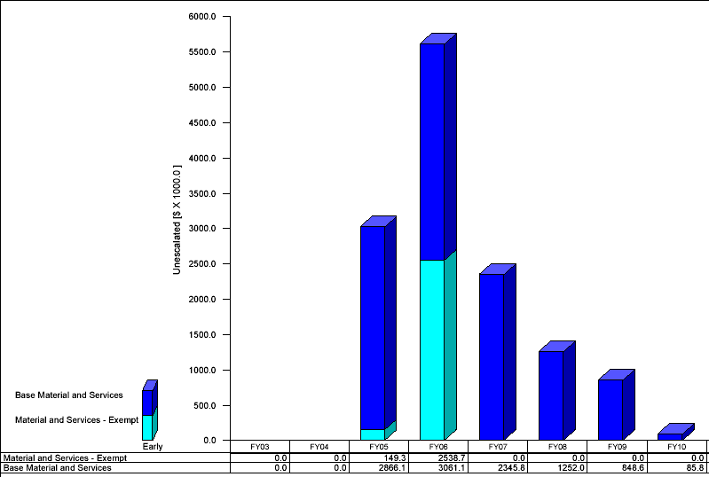
New M&S Obligation Profile by Fiscal Year
change from CD-1 (K$) → -10 +746 -747 -346 +285 +86

Slide 8
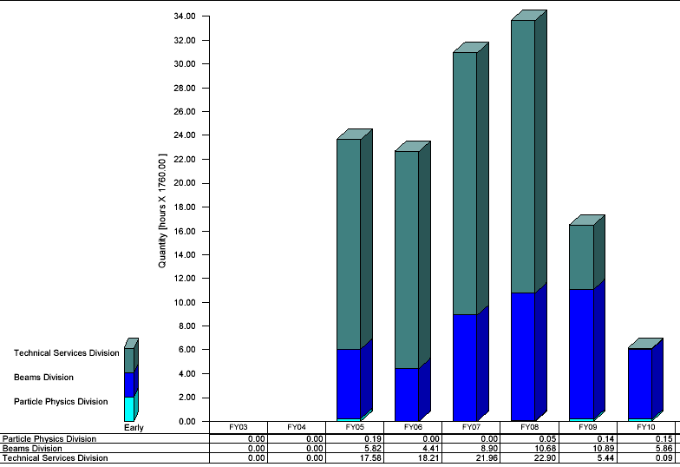
New Labor Profile by Fiscal Year
change from CD-1 (FTEs) → +0.5 +0.7 -0.8 -1.8 -4.5 +6.1

Slide 9
Summary
Critical path float is 9 months (spools)
Next critical path float is 10 months (quadrupoles)
Floats are accurately calculated in Open Plan
Total base cost up ~87K$ (0.3%) since CD-1 review

