Slide 1
APEX Schedule April 25 2006
Ramps
injection
Beam-beam limit with one collision
Montag
Beebe-Wang
Ptitsyn
Orbit
response
matrix
Satogata
Niedziela
Beam Based Alignment
Niedziela
Satogata
Start
Machine
Development
(rotator change
for PHENIX)
Rotator on at injection
MacKay
10pm
1am
2am
5am
8am
Turned on rotators at injection at
~1/2 current
Potential: shorter rotator ramp
Drawbacks: new ramp, effect on polarization

Slide 2
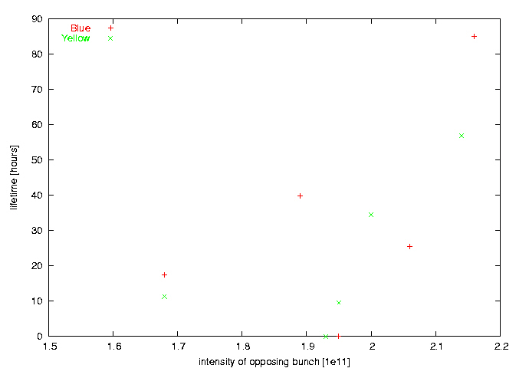
Beam-beam effect –1 collision
Montag,
Filled bunches with
different intensities
1 collision point
(IP8)
Counterintuitive results: lifetime increases with intensity of
colliding bunch
No gated tune measurements – will do it again when gated
BBQ becomes available

Slide 3
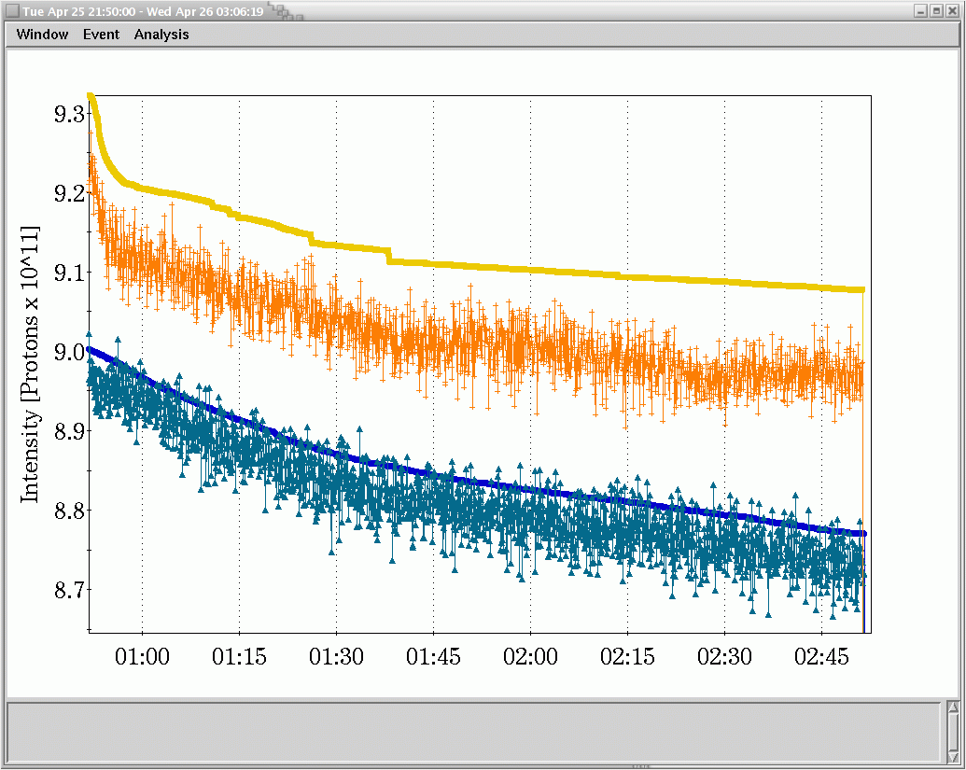
Orbit Response Matrix
Satogata, Niedziela
Simultaneous measurements of blue/yellow at store (~2h)
  Used leftover beam from 6-bunch beam-beam ramp (uncogged!)
  Use new perl scripts to try improve measurement robustness
  Corrector changes: 20 urad, or about 1mm orbit changes
  Beam intensity through store was (mostly) unaffected

Slide 4
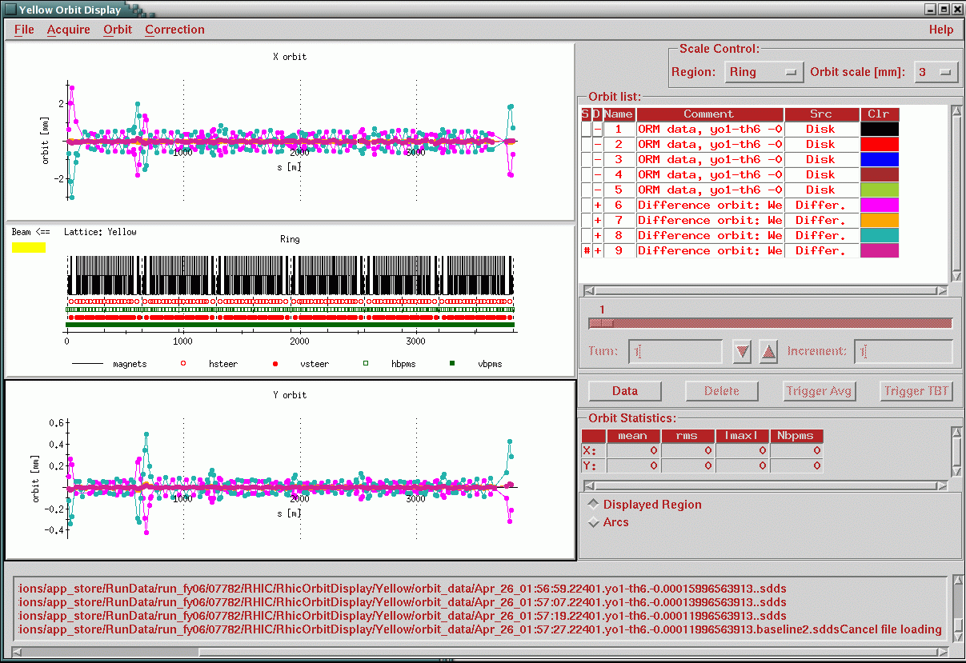
Typical yellow difference orbits (yo1-th6)
Difference orbits good to 10um or better

Slide 5
Analysis and Planning
Acquired about 1/2 of correctors in each ring in 2 hours
  Multiple strengths per corrector (too aggressive)
  Orbit data acquisition dominates running time
    Belt and suspenders, should eliminate from script and use logged orbits in the future (less study time, more analysis time)
  New script is definitely more robust, but not faster
Enough data to analyze for optics in those store conditions
  Orbit data looks good enough to use in Matlab ORM analysis
  ~1h necessary to evaluate how optics change before/after PHENIX rotator reconfiguration
Orbit drift/10Hz effects should be evaluated
  ~50um/~1mm: systematic or random may come out of analysis

Slide 6
APEX Schedule May 3 2006
Store: high bunch intensity
Injection
Ramps pp31
Beam Based Alignment
Niedziela
Long range
Beam beam
Fischer
Luccio
Beam-beam
1 collision
Montag
Electron
detectors
Drees
Jimenez
Snake
resonance
Bai
Back
2
Physics
11am
2pm
4pm
5pm
6pm
10pm
11pm
2/3 resonance
Luo, Bengtsson
Calaga, Satogata,
Bai
unpolarized source
polarized source

