Slide 1
PD Magnets Update
050505
Organization
Requirements/specifications/decree s
Draft Plan
  Overview
  Solenoids
  Quadrupoles
  Magnetic Measurements
  Cold Test Systems

Slide 2
Organization
Task structure (approximate)
  Lead Engineer – TBD
    Integration desperately needed!
  Solenoids – I. Terechkine, Va. Kashikhin
  Quadrupoles – Vl. Kashikhin
  3D Magnetic Design – TBD (Vadim over committed)
  Magnetic Measurements – J. DiMarco, C. Ginsburg
  Cold Test Engineering – (C. Sylvester)
  Technician – TBD
  Design/drafter – TBD

Slide 3
Organization, cont.
Meetings
  Typically Tuesdays 10:00 am (almost weekly) but dependent on local schedule chaos
Meeting materials, minutes, supporting documents, etc.
  \\TDSERVER1\project\8GeVLinac\PD Magnets
  Menu: PD Magnet Meetings.html
Project related issues
  Specifications are changing
    Parameter List (March 2005) is obsolete
    Some modestly more formal coordination, integration and tracking mechanism is needed
  Budget codes for procurements needed

Slide 4
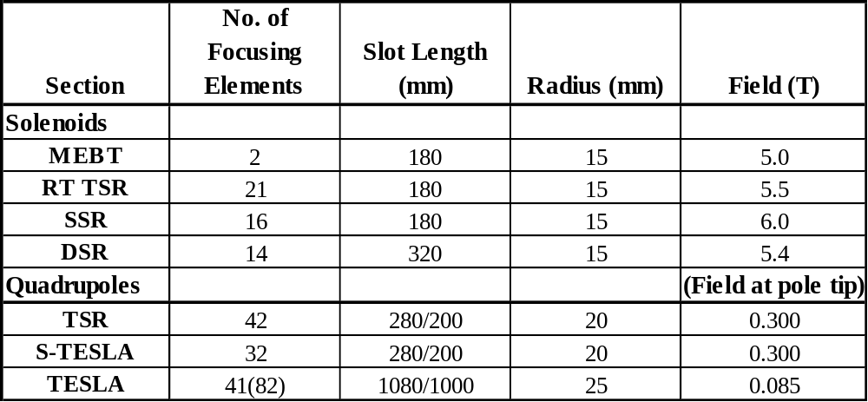
Specifications, Requirements, etc
Magnet Specifications from G. Romanov
050419

Slide 5
Specifications, Requirements, etc, cont.
Strength
  TBD (assume “loose” ⇒ ~per cent ?)
Field Quality
  “Loose” ⇒ ~per cent
  Needs some additional scrutiny
Note: for iron dominated magnets (quadrupoles) strength and field uniformity should be very manageable
Dipole Trims
  TBD (no applicable requirements to date)
Alignment
  TBD (no applicable requirements to date)

Slide 6
Specifications, Requirements, etc., cont.
Stray Field
  <10μT is ‘challenging’ ⇒ shielding required
  Present cold solenoid design constraints do not have a magnetic solution that meets all requirements simultaneously…
SSR section solenoid does not have sufficient margin (≤10%)
  Alternative approach would use Nb₃Sn insert (inner coil)
    More challenging technology
    Schedule uncertain, definitely longer
    Cost increase
    Structure more complicated
RT solenoid specs have changed(?) – design needs review; higher field requirement implies margin will change

Slide 7
Draft Plan
Overview
  Short term plan (a): RT solenoid (less difficult)- design, fabricate and test – to verify technology before SSR solenoid (6T) (more difficult) for use in SMTF commissioning test
  Short term plan (b): design, fabricate and test quadrupole (15T/m) for use with triple spoke and higher beta cavities
  Short term plans are for a period of about one year – 16months, starting now
  Long term:
  115(156) quadrupoles - 4/5 configurations (TBD)
  53 solenoids – 3 configurations

Slide 8
PD Magnets – Solenoid Plan
Solenoid Design, Prototype (Iouri)
  Study wire and winding properties; insulation; impregnation; build ‘engineering study’ solenoid model to determine design parameters
  Develop full magnetic and mechanical design that meets the specifications and allows convenient assembly and stress management. Key to this is the choice of wire and insulation system.
  Define assembly technology and method of applying pre-stress
  Make stress calculations for all stages of assembly and thermal cycling.
  Start magnet and tooling design.

Slide 9
PD Magnets – Quadrupole Plan
Quadrupole Design, Prototype (Vladimir)
  Study wire and winding properties; insulation; impregnation; build ‘engineering study’ quadrupole model to determine design parameters
  Define quadrupole prototype specification.
  Develop quadrupole conceptual design, including 2D magnetic, mechanical, thermal calculations, quench protection, power supply parameters.
  Superconductor choice and specification.
  3D quadrupole end field calculations with ferromagnetic shields.
  Quadrupole prototype and tooling drawings.
  Purchase parts and superconductor.
  Assemble 2 prototypes.

Slide 10
Magnetic Measurement Plan
Magnetic Measurement Activities
  Field Strength/Field Quality
    Solenoids:
      Develop small form factor 3-D Hall array with fixturing, drive system, etc.
      Calibration techniques (reference magnets)
      Develop reconstruction/analysis code for solenoid field evaluation
      Axis measurement with SSW(?) – studies needed
    Quadrupoles:
      Determine coil availability to meet aperture and length requirements
      Evaluate fixtures needed for SSW measurements
    For both: evaluate warm measurement possibilities – current limits, sensitivities, AC/pulsed powering schemes.

Slide 11
Magnetic Measurement Plan, cont.
Low Field Magnetic Measurements
  Measurements in the μT range
    Stray field limits 1 – 10μT ⇒ small compared to background (earth’s field ~50μT)
  Devices – at least two approaches (systems)
    Fluxgate magnetometers:
    commercially available as systems ~10k$
    Magnetoresistive sensors:
    sensors available Philips, Honeywell; systems costs ~10k$; local experience K. Carlson (AD) electronics; H. Glass, measurements

Slide 12
Cold Test Systems Plan
Cold Test Systems
  Short term - modifications to Stand 3 dewar
    Modify top plate
      Presently being modified for Tevatron corrector test
      WBT port for measurement access
      HTS current leads ~800A (max?); use ‘conning tower’ for Tev correctors in short term (?)
      Instrumentation wiring – quench heaters(?), quench protection voltage taps(‘center tap’ for noise reduction), etc.
    Use corrector power supply system (400A max)
  Long term – test cryostat for Stand 2?

Slide 13
Magnetic Shielding
Background fields
  Earth’s field
  Local structures (iron in the vicinity)
Mu-metal
  ‘Standard’ for room temperature applications
“Cryoperm”
  Mu-metal for low temperature use
Vendor information (from C. Sylvester)
  Cryoperm is specially processed mu-metal
  Cryoperm is costs more (considerably?)
  Mu-metal, in layers, can be used at low temperature

Slide 14
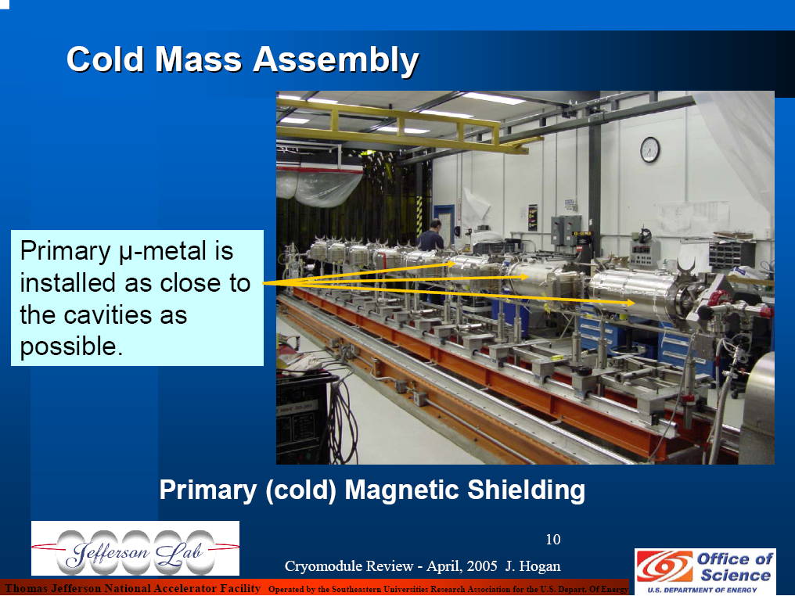
JLab Shielding Example

