Slide 1
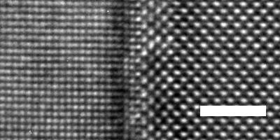
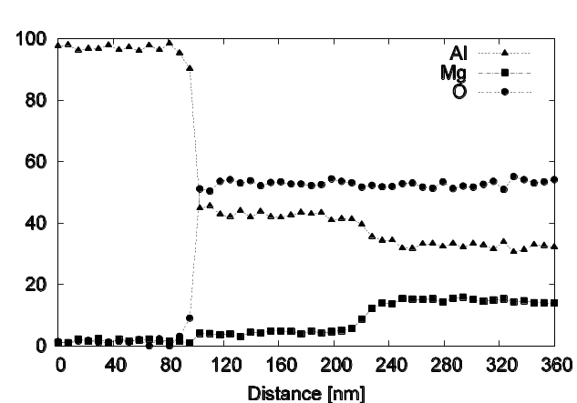
Ion Exchange at Metal–Ceramic Interfaces
F. Ernst,¹ R. Raj²
¹Case Western Reserve University, ²University of Colorado at Boulder
DMR-0208008
Objectives:
• To study diffusion reactions at planar aluminum-spinel (Al–MgAl₂O₄) interfaces.
• To investigate the effect of an external electric field on diffusion reactions at such interfaces.
Right: High-resolution TEM image revealing the interface structure of an as-grown Al–MgAl₂O₄.
Result:
Tempering aluminum–spinel interfaces in applied electric fields, we found credible evidence that diffusion reactions of magnesium, aluminum, and oxygen ions can be controlled by the strength and polarity of applied electric fields. Positive ions were more mobile than negative ions in a spinel under the influence of applied electric fields. Differences in mobility and valency of constituent ions suggest a correlation between interdiffusion and electrical fields, which is conceptually consistent with the electrostatic model of mechanical adhesion.
Al film
MgAl₂O₄
2 nm
Al film
Mg-deficient reaction layer
MgAl₂O₄
O
Al³⁺
Al
Right: Composition profiles show the different response (diffusion) of ions across the interface when annealing in an external electric field.
Mg²⁺
Mg

Slide 2
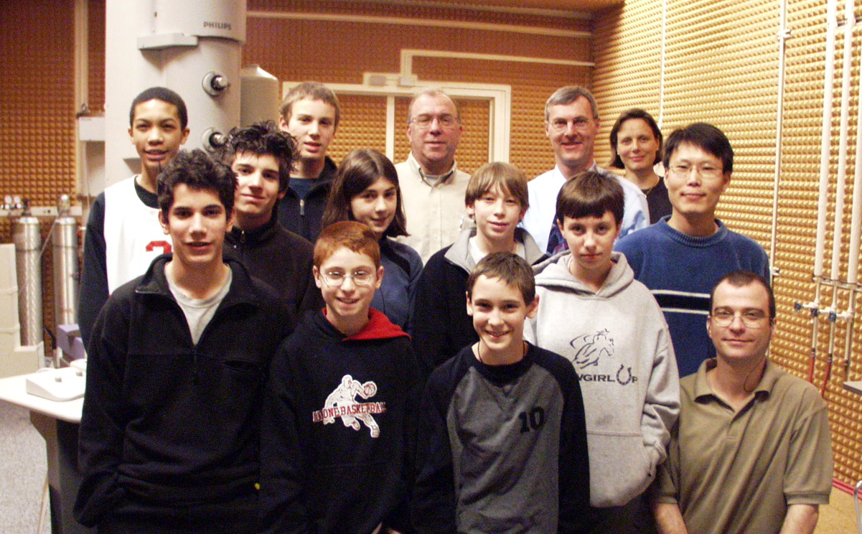
Ion Exchange at Metal–Ceramic Interfaces
F. Ernst,¹ R. Raj²
¹Case Western Reserve University, ²University of Colorado at Boulder
DMR-0208008
Education and Outreach
On January 14 and 21, 2005, the team at Case invited students of the Ruffing Montessori middle school in Cleveland Heights for two lectures on "Materials and Microscopy" and a hands-on demonstration of scanning electron microscopy and transmission electron microscopy. (http://www.ruffingeast.org/webpages/middle_school.htm →)
Jeremy Mark, an undergraduate student performed his senior project in relation to this project.
Gurpreet Singh, graduate student at UCB, was trained in UHV techniques, thin-film preparation, and mechanical testing of thin films.
Yeonseo Yu, graduate student at Case completed his Ph.D. degree in August 2005. His Ph.D. thesis is based on the work on this project.
Broader Impacts
The latest results of this project are going to be presented at the 2006 TMS Annual Meeting & Exhibition.
A journal article about the effects of annealing under applied electric fields is in preparation.

