Slide 1

Alumina Volatility in Water Vapor at Elevated Temperatures
Elizabeth Opila, NASA Glenn Research Center
Dwight Myers, East Central University, Ada, OK
Environmental Barrier Coatings for Microturbine and Industrial Gas Turbine Ceramics Workshop
November 18–19, 2003
Nashville, TN

Slide 2
Motivation
Drive to increase operating temperatures of turbine engines for power generation and propulsion
Need for material systems that can be used at temperatures of 1200 to 1650°C in combustion environments
Al₂O₃ is possible component of high temperature material systems
  oxide/oxide composites
  high temperature alumina-containing coatings
Understand chemical durability of Al₂O₃ in water vapor-containing combustion environments

Slide 3
Background
Primary volatilization reaction for alumina in water vapor:
1/2 Al₂O₃(s) + 3/2 H₂O(g) = Al(OH)₃(g)
Thermochemical data estimated for Al(OH)₃(g) using partition functions and structures of similar molecules, e.g., AlF₃(g), B(OH)₃(g)
  L.V. Gurvich, I.V. Veyts, C.B. Alcock, Thermodynamic Properties of Individual Substances, Begell House, Inc., New York, 1996.
Al(OH)₃(g) identified as volatile species from a transpiration study of a mixture of CaAl₂O₄(s) and CaAl₄O₇(s)
  A. Hashimoto, Geochim. Cosmochim. Acta 56, 511-32 (1992).
Al₂O₃(s) recession measured and quantified in combustion test rig. Pressure and temperature dependence consistent with Al(OH)₃(g) formation.
  I. Yuri, T. Hisamatsu, ASME Turbo Expo, paper GT2003-38886.

Slide 4
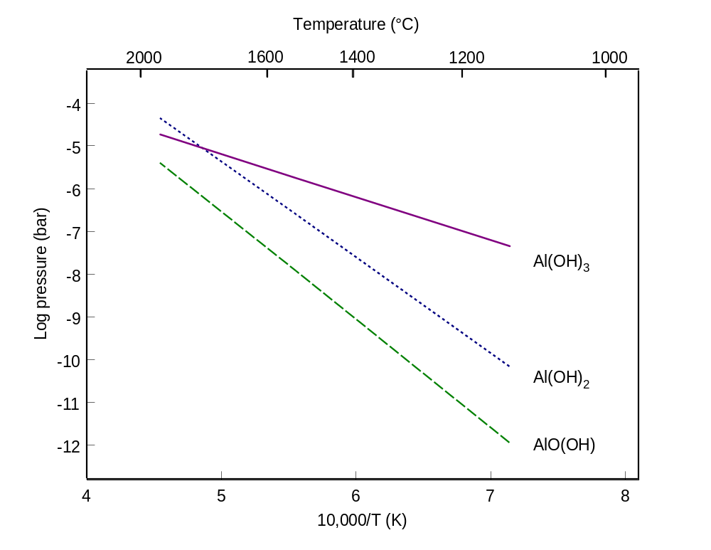
Volatile Species in Al-O-H System
Calculated using Gurvich data: Al₂O₃ + 1 bar H₂O(g) + 1 bar O₂(g)

Slide 5
Objectives
Experimentally determine temperature and water vapor partial pressure dependence of alumina volatility directly from alumina
Confirm identity of volatile aluminum hydroxide species
Identify combustion conditions where alumina volatility limits useful component life

Slide 6
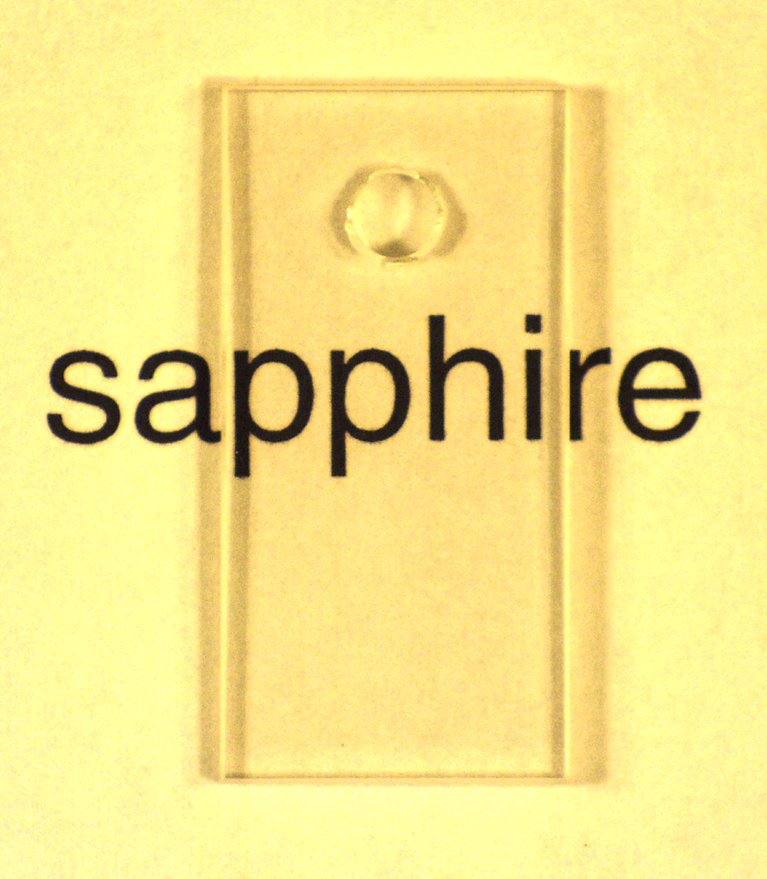
Material Description
sapphire coupons
2.5 x 1.25 x 0.2 cm
flame fusion grown
<100 ppm impurities
(0001) basal plane orientation
General Ruby and Sapphire Corp., New Port Richey, FL
1 cm

Slide 7
Experimental Procedure
Thermogravimetric Analysis Apparatus
  coupon weight measured before and after exposure
  TGA only used to monitor weight anomalies during experiment
  volatiles condense on cool portion of sample hanger
  TGA apparatus allows laminar flow over coupon
T=1250 to 1500°C
P(H₂O) = 0.15 to 0.68 atm, balance O₂
P_{total} = 1 atm

Slide 8
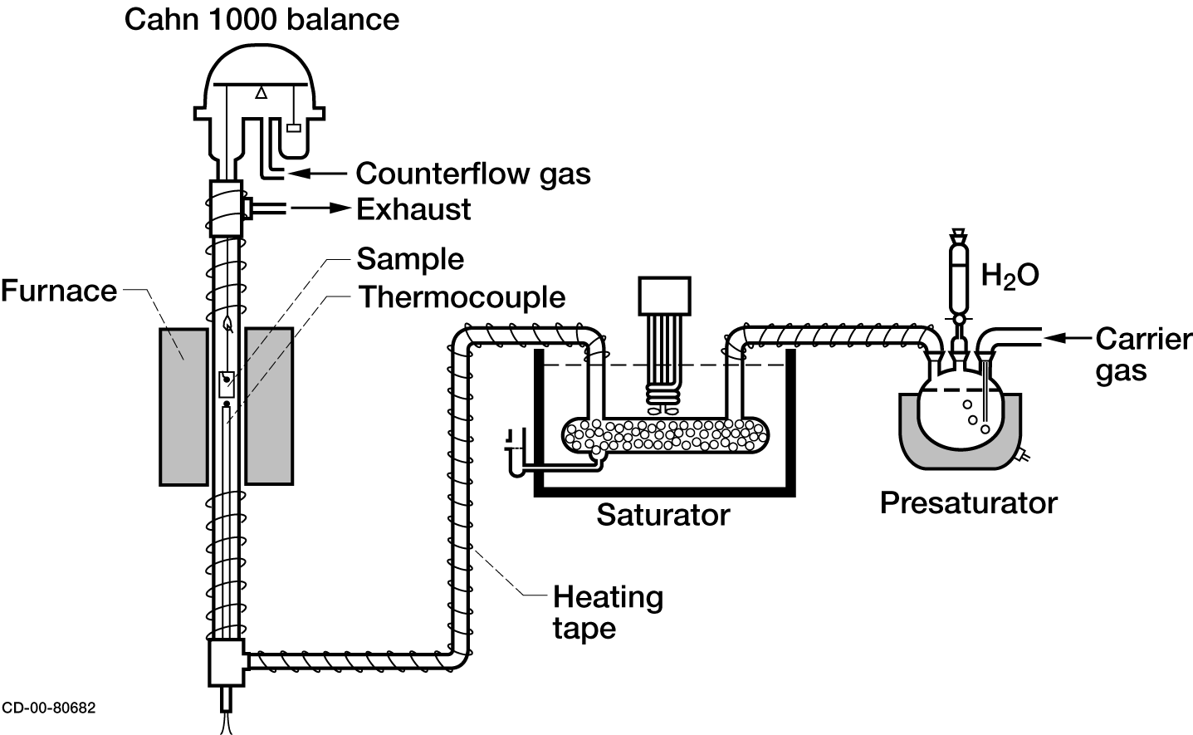
Schematic Drawing of TGA Apparatus

Slide 9
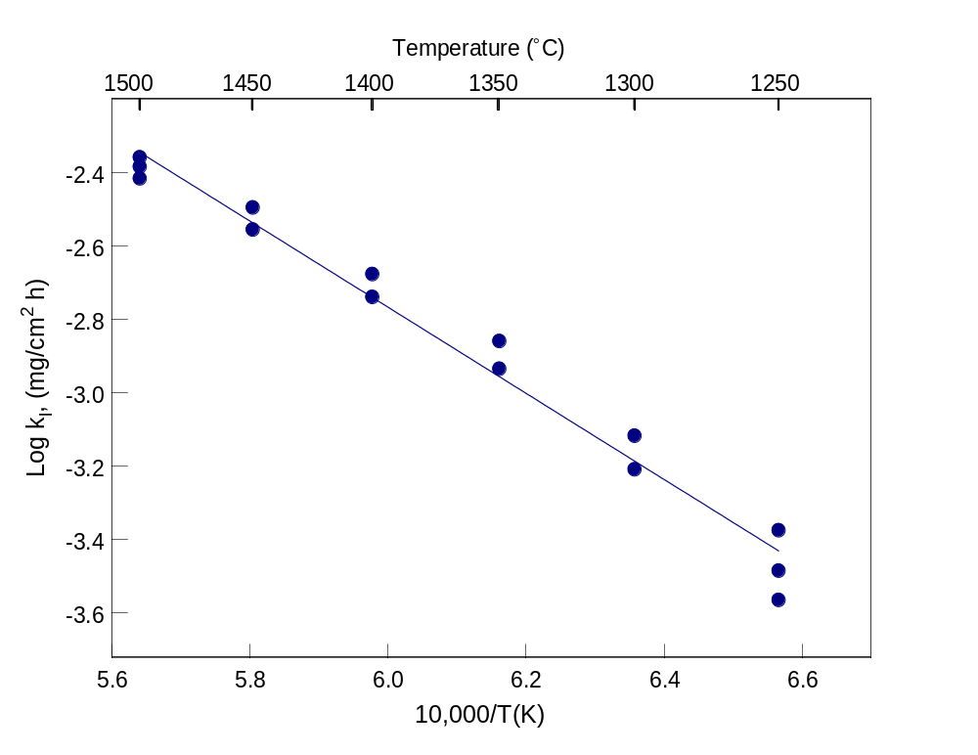
Alumina Volatility: Weight Loss Rates
Al₂O₃, 0.5 atm H₂O/0.5 atm O₂

Slide 10
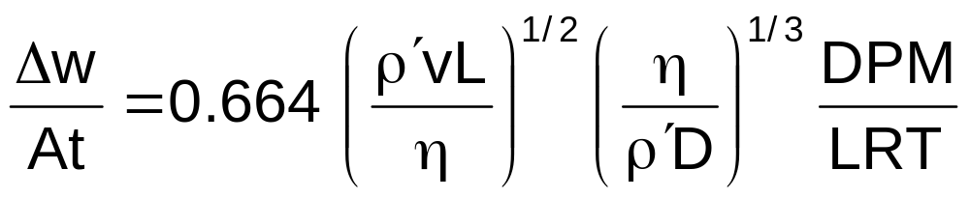
Determination of Al(OH)₃(g) Partial Pressure from Weight Change
Measure Δw, calculate P
Assumptions:
  volatility is controlled by transport of volatile species through gas boundary layer
  laminar flow over flat plate
  D is interdiffusion of Al(OH)₃(g) in H₂O(g)
  use collision diameter and integral of AlF₃(g) as approximation for Al(OH)₃(g)

Slide 11
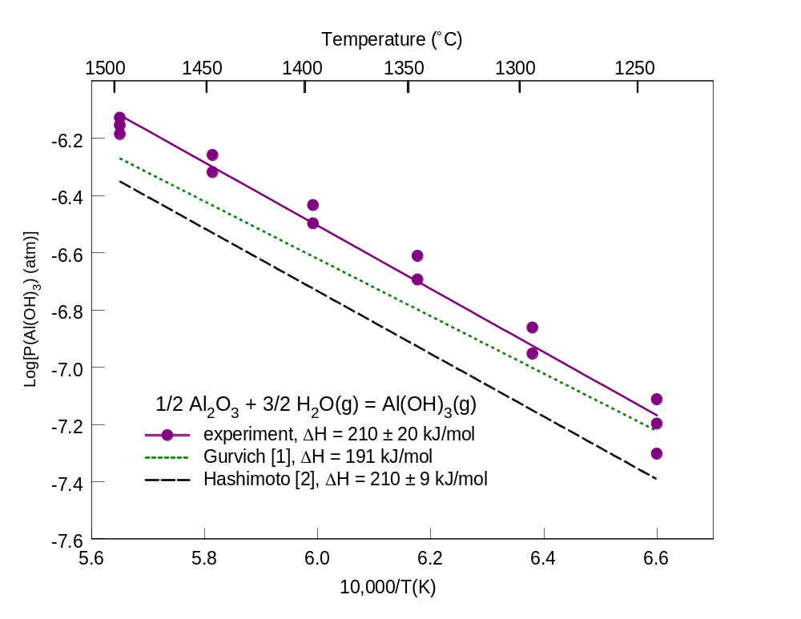
Temperature Dependence of Al(OH)₃(g) formation
Al₂O₃, 0.5 atm H₂O/0.5 atm O₂

Slide 12
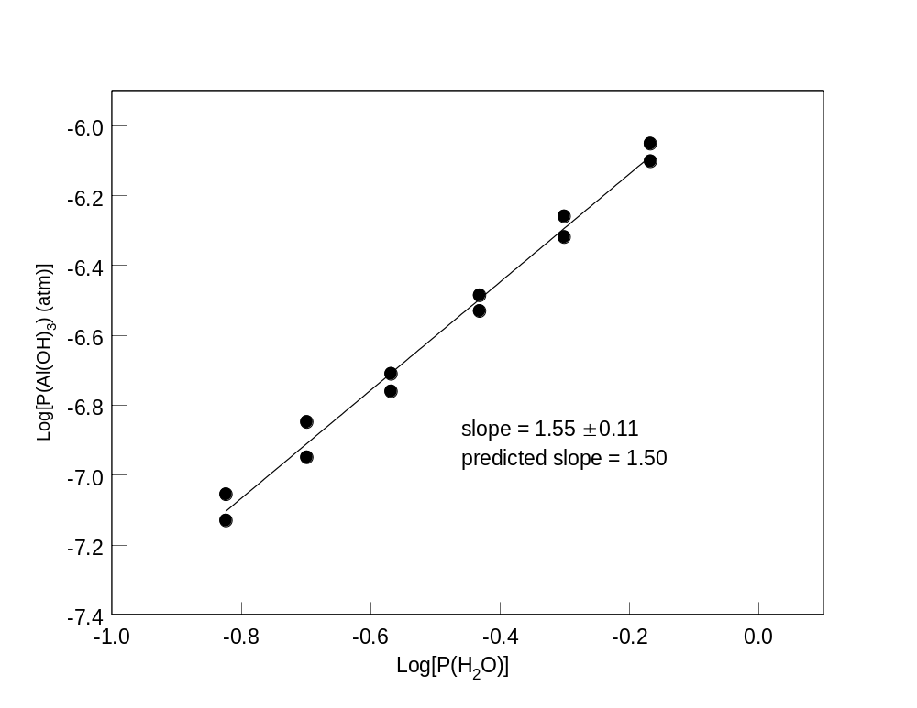
Pressure Dependence of Al(OH)₃(g) formation
Al₂O₃, 1450°C

Slide 13
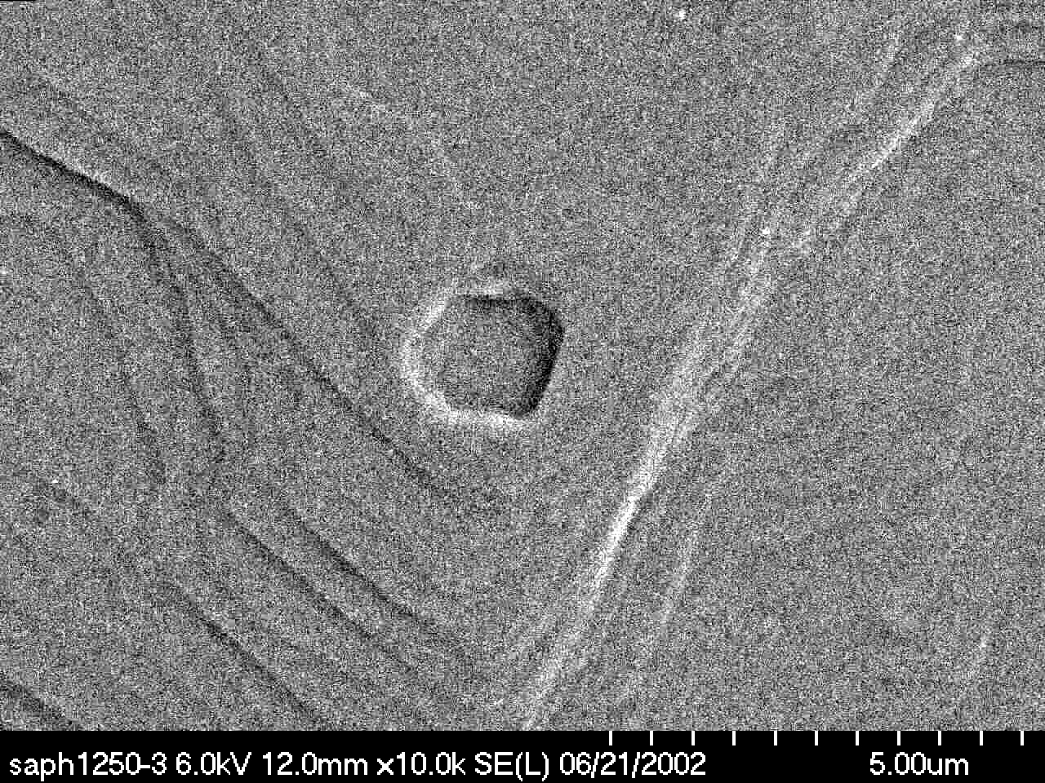
Surface Etching of Sapphire after Exposure in High Temperature Water Vapor
typical surface, (0001) basal plane
5 μm
1250°C, 0.5 atm H₂O, 240h

Slide 14
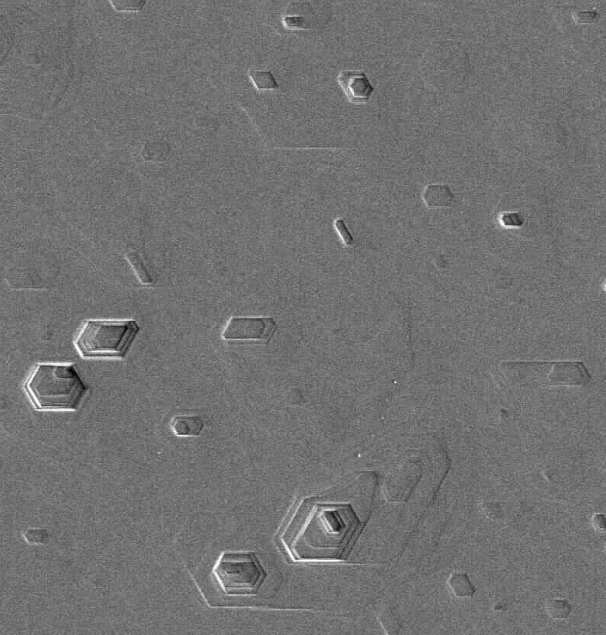
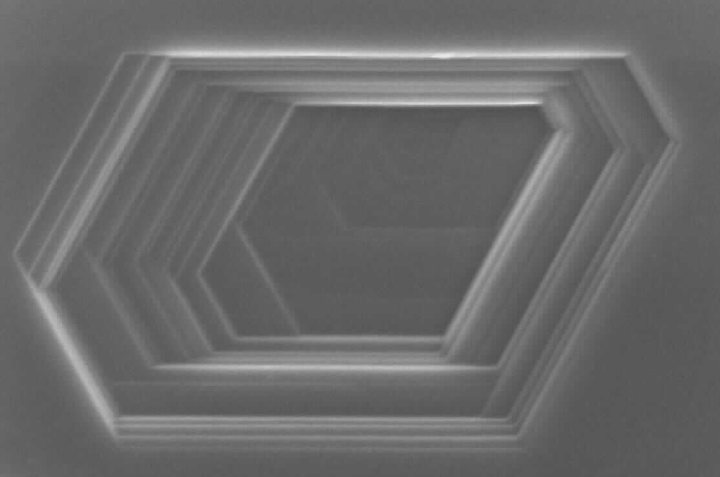
Surface Pitting of Sapphire after Exposure in High Temperature Water Vapor
Hole put in coupon by grit blasting, (0001) basal plane surface
10 μm
1 μm
1350°C, 0.5 atm H₂O, 94h

Slide 15
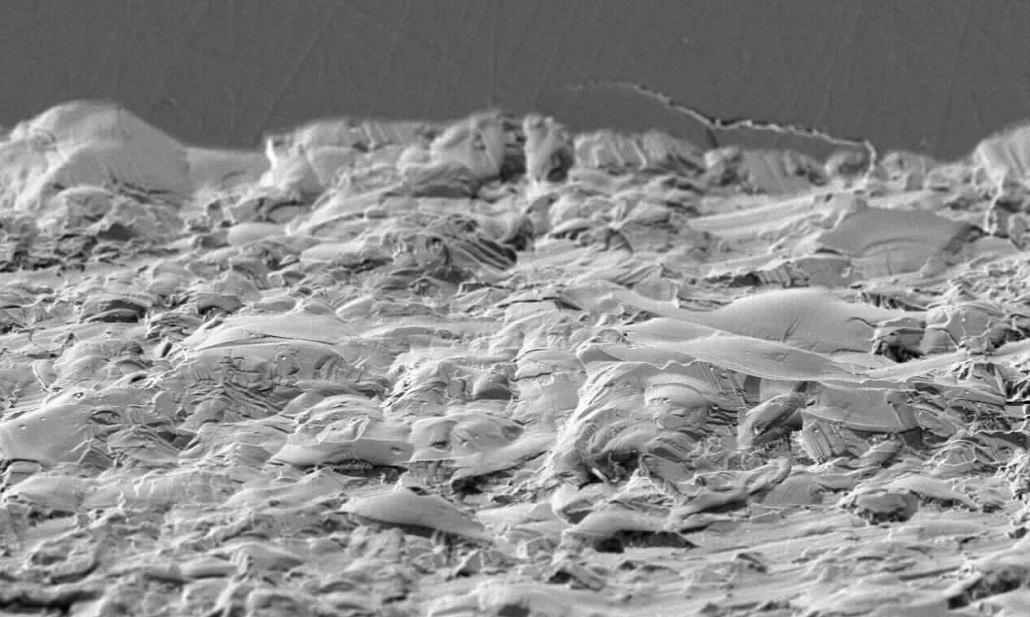
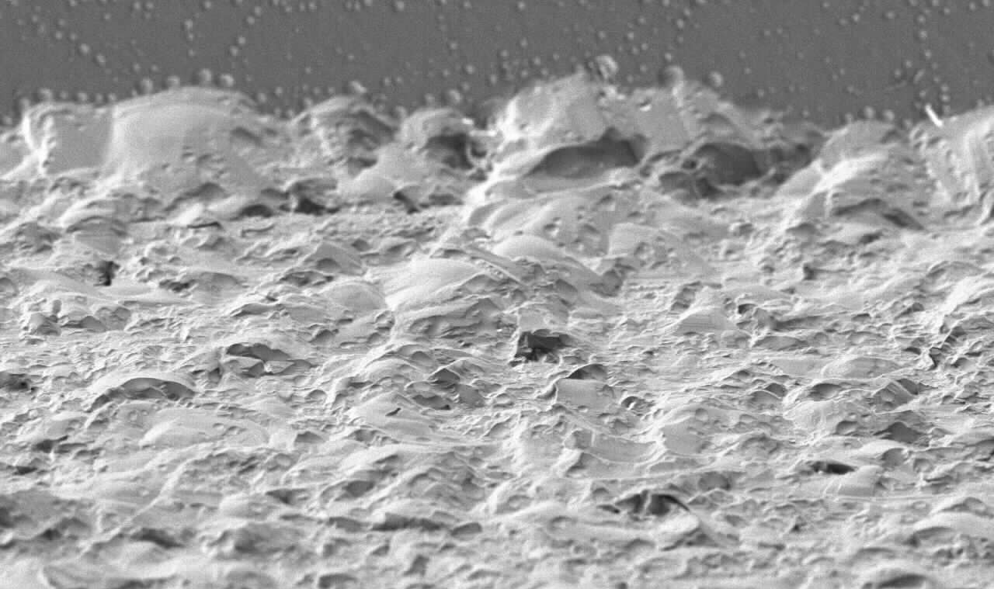
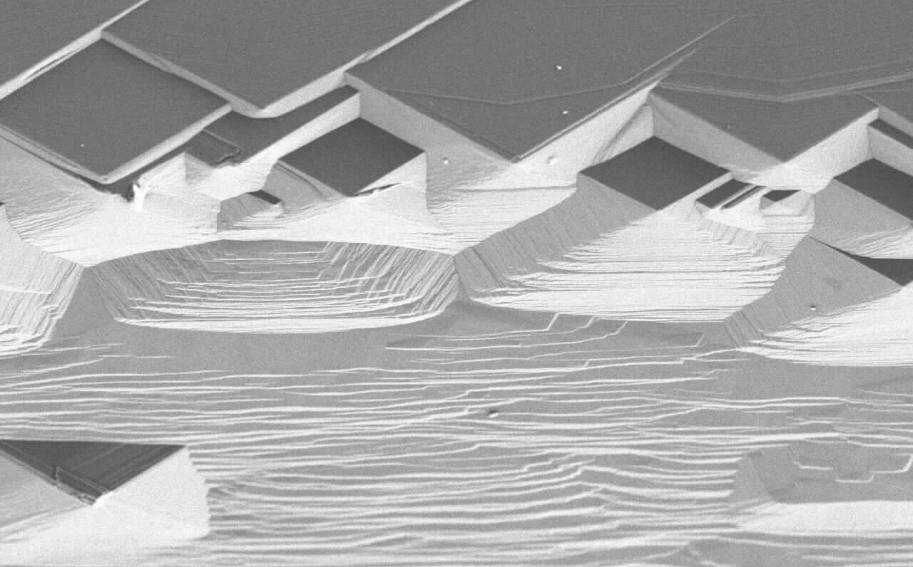
Etching of Sapphire Coupon Edge after Exposure in High Temperature Water Vapor
polished surface
ground beveled edge
20 μm
20 μm
as-received
1500°C, 235h, O₂
1450°C, 72h,
0.68 atm H₂O
20 μm

Slide 16
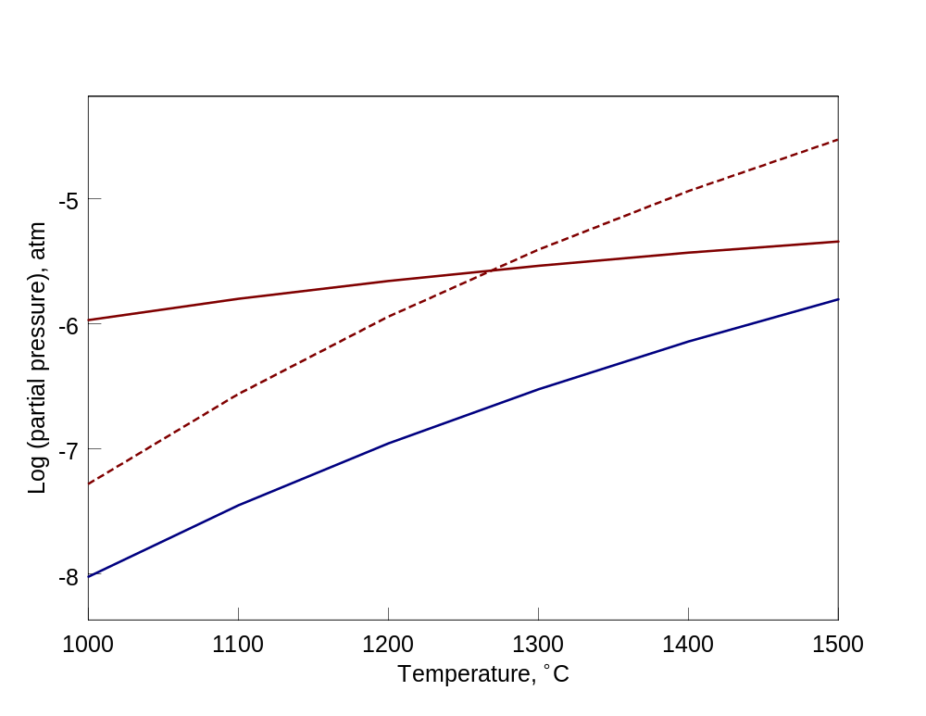
Comparison of Alumina and Silica Volatility in High Temperature Water Vapor
Volatile species in 1 atm water vapor
SiO(OH)₂
Si(OH)₄
Al(OH)₃

Slide 17
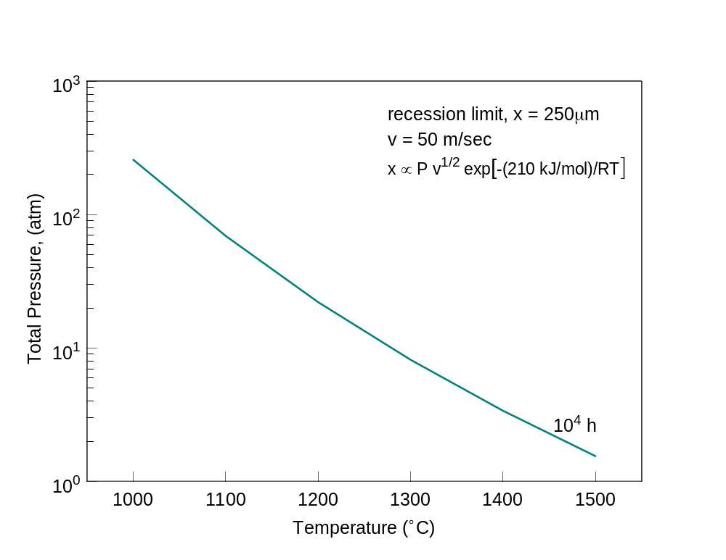
Recession Map for Al₂O₃ Use in Combustion Environments
Calculated with data of Gurvich et al.

Slide 18
Summary and Conclusions
Alumina volatility in water vapor measured directly by weight loss and found to agree with literature values.
Pressure dependence of volatility consistent with Al(OH)₃(g) formation.
Surface etching of sapphire coupons observed in high temperature water vapor.
Recession ∝ P v^{1/2} exp[-(210 kJ/mol)/RT].
Alumina volatility will limit lifetimes of components and coatings for long term applications in combustion environments, e.g.,
  250 μm recession in 10,000 h
  T=1300°C, P=10 atm, v=50 m/sec

Slide 19
Possible Future Work
Transpiration studies on Al₂O₃ + H₂O
  more precise thermochemical data possible
  complement Hashimoto’s study on mixed calcium aluminates
  requires fusion technique to dissolve condensed volatile species
Free jet sampling mass spectrometry of Al₂O₃ + H₂O
  first mass spectrometric identification of Al(OH)₃(g)
  complement study of Vasiliy Smirnov conducted at much higher temperatures for other Al-O-H species

Slide 20
Acknowledgments
Ralph Garlick, Nathan Jacobson, Serene Farmer, all from NASA Glenn Research Center
This work was funded by the Aeropropulsion and Power Program at NASA Glenn Research Center

