Slide 1
Extending the Temperature Range of Electronics for Spacecraft
Extreme Environment Technologies for Space Exploration
Randall Kirschman
NASA/JPL
14-16 May 2003
Pasadena, California

Slide 2
Why are we here?
(Why are we having this meeting?)

Slide 3
“Very Little of the Solar System
(or the Universe) Is at
Room Temperature.”

Slide 4
How do we approach this situation?

Slide 5
Traditional approach:
Send “room-temperature” to the
remote site for the electronics.

Slide 6
Spacecraft
HEATING/COOLING
SYSTEM
TEMPERATURE
CONTROL
CONVENTIONAL
ELECTRONICS
(HEAT STORAGE)
THERMAL INSULATION
COLD/HOT ENVIRONMENT

Slide 7
Spacecraft
4
1
3
HEATING/COOLING
SYSTEM
TEMPERATURE
CONTROL
2
CONVENTIONAL
ELECTRONICS
(HEAT STORAGE)
THERMAL INSULATION
4
COLD/HOT ENVIRONMENT

Slide 8
Drawbacks of Using
Conventional Electronics
Insulation
  adds volume and weight
  reduces maneuverability
  limits operating time (passive)
Heating/cooling (active)
  uses large amount of power
  adds control complexity
  disturbs environment
  reduces reliability
Sometimes impractical

Slide 9
Another approach:
Let the spacecraft electronics operate at the temperature of the remote environment.

Slide 10
Spacecraft
LOW/HIGH TEMP
ELECTRONICS
COLD/HOT ENVIRONMENT

Slide 11
Benefits of LT or HT Electronics
Reduce mass & volume
Reduce power requirements, increase efficiency
(Improve performance)
Reduce complexity
Increase mission lifetime
Improve maneuverability
Increase overall reliability
Less disruption of environment
(size and waste heat)
Enable missions

Slide 12
Difficulties of LT or HT Electronics
Relatively unknown and unproven technologies
Limited experience
Limited background information
New effects
Electronics may be less reliable (esp. HT)
Need more extensive qualification
More difficult design
Reduced performance (esp. HT)
Lack of specified components
Complete range of components not available

Slide 13
Alternative Approaches
Part extreme temp &
part conventional Temp
(temperature partition)
Intermediate temperature

Slide 14
Low T or High T Electronics:
What Is Possible and
What Is Practical?

Slide 15
Electronics Temperature Capabilities
Active devices (usually semiconductor)
Passive components
Power sources (especially batteries)
Assembly & packaging (putting it all together)

Slide 16
Low Temperature

Slide 17
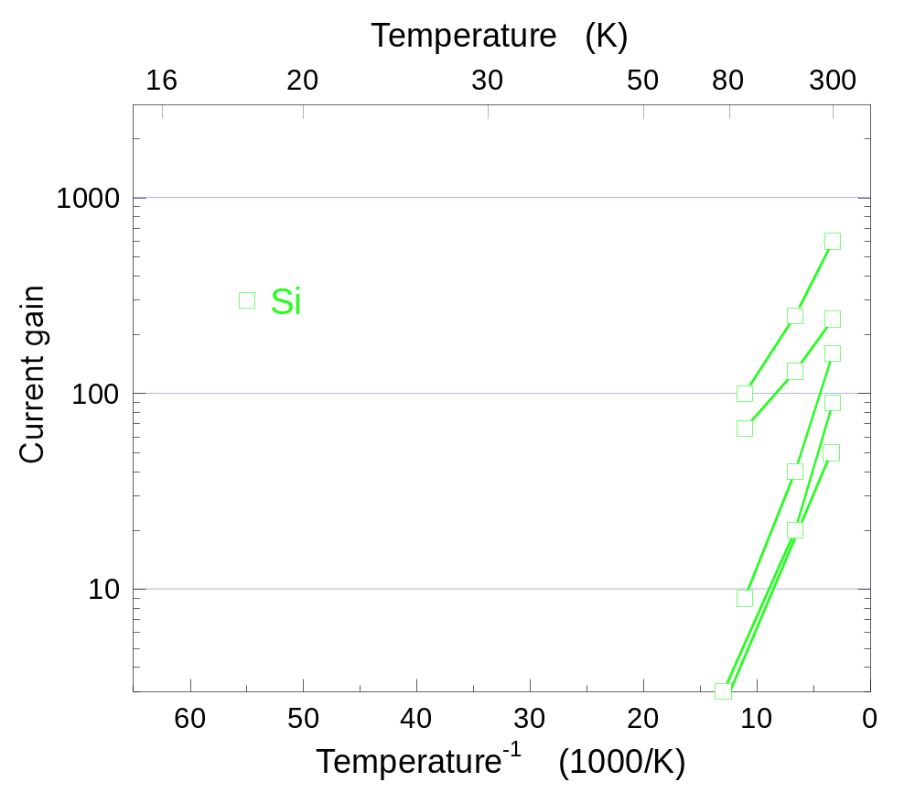
Si Bipolars: BJTs

Slide 18
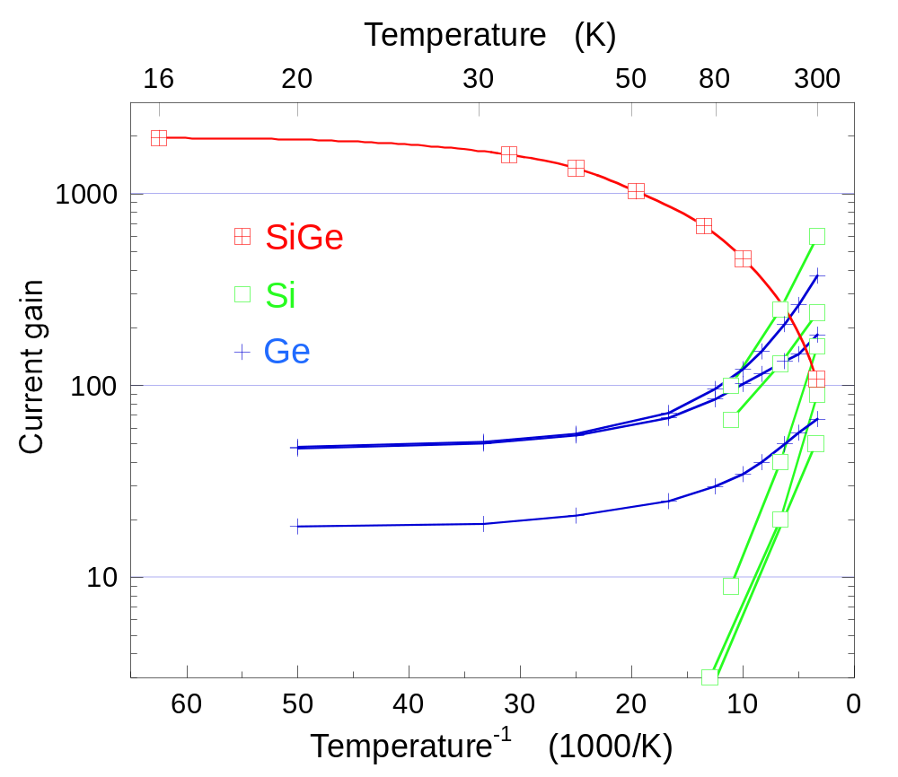
Bipolars: Si BJTs, Ge BJTs, SiGe HBTs

Slide 19
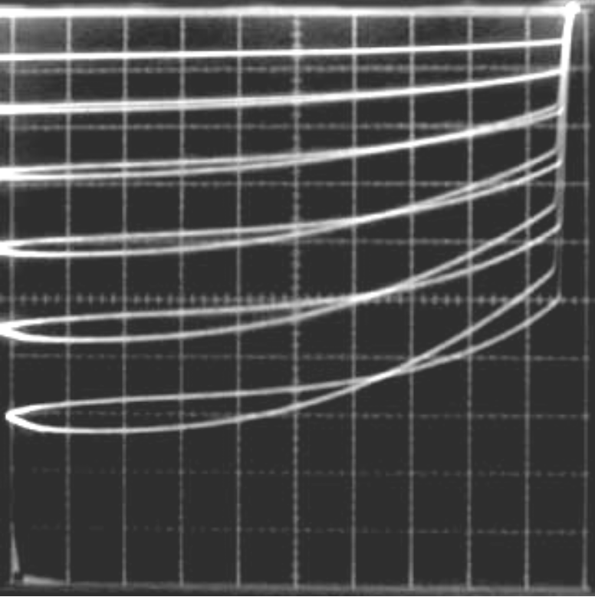
Ge BJT: –269°C (4 K)
PNP; horiz: 0.5 V/div; vert: 1 mA/div; base current step: 0.1 mA (liquid helium); beta ~ 15 (RT beta ~ 70).
R. R. Ward, unpublished data.

Slide 20
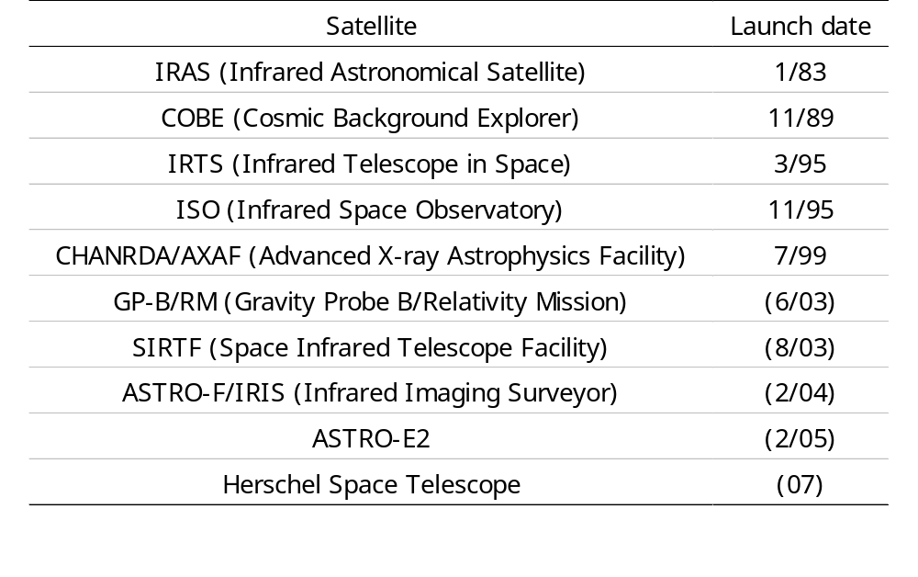
Low-Temp Electronics in Spacecraft

Slide 21
High Temperature

Slide 22
Passives and Packaging
Low temperature
  relatively easy
  with care in materials selection and design can go to ~0 K
High temperature
  more difficult
  melting, decomposition, interactions
  depends on packaging “level,” component types, . . .
  ~200–500°C
Low or high temperature
  primary difficulties are large-value capacitors
  (electrolytic, ceramic) and batteries
Depends on requirements
  allowable TCR, TCC, . . .
  aging, lifetime

Slide 23
The Overall Picture
Temperature is not the only factor/stress
Examples of additional factors
  Time
  Radiation
  Acceleration, vibration, shock
  Pressure
  Corrosive ambients
Temperature does no act in isolation
Interaction between temperature and other factors is often complex

Slide 24
The Overall Picture
Temperature is not the only factor/stress
Examples of additional factors
  Time
  Radiation
  Acceleration, vibration, shock
  Pressure
  Corrosive ambients
Not acting in isolation
Interaction between T and other factors is often complex

Slide 25
Aging Rates
Arrhenius relation: Rate ∝ exp (–E_{a}/kT)
E_{a} = Activation energy
k = Boltzmann’s constant
T = absolute temperature

Slide 26
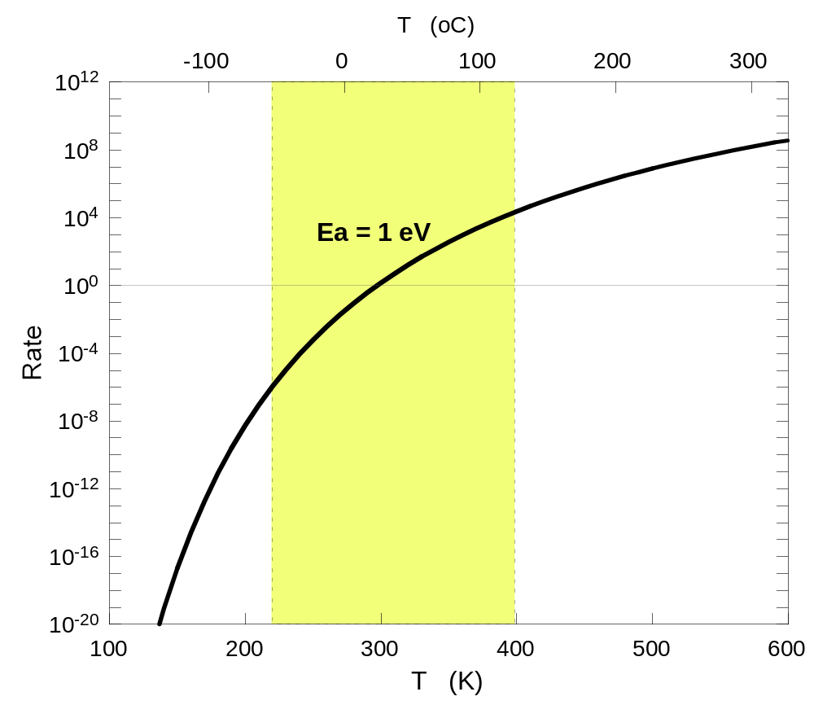
Arrhenius - One Process

Slide 27
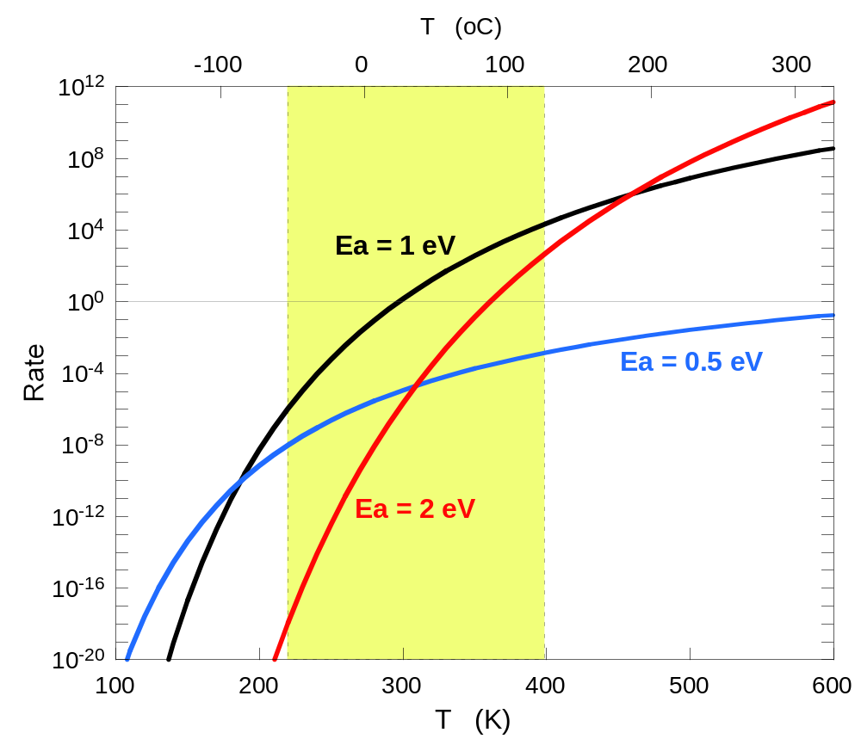
Arrhenius - Three Processes

Slide 28
Extrapolation (or Interpolation) - risky
Assumptions:
  Dominant mechanism remains so for all temperatures
  Dominant mechanism remains so for all times

Slide 29
Degradation at Low Temperature?

Slide 30
Degradation at Low Temperature
Most processes are thermally activated, essentially absent
  Corrosion, electromigration, interdiffusion, ...
Charge trapping
  High electric field
  Radiation
  Can be reversible
  Warming can de-trap (“anneal”)

Slide 31
Temperature Effects
Too much thermal energy (HT)
  Decomposition, corrosion, electromigration, interactions, interdiffusion, restructuring, . . .
  Excessive leakage currents
Too little thermal energy (LT)
  Freeze-out (semiconductor devices,
  capacitors, batteries)
  Charge trapping

Slide 32
“Often temperature (thermal energy) works against you,
but sometimes it works for you.”

Slide 33
Summary/Conclusions
Extending the temperature range of electronics has benefits for spacecraft
Electronics is capable of operation at extreme temperatures in practice as well as in principle
In designing electronics, all the factors need to be taken into account (time, radiation, . . . )
The interaction of temperature with other factors
(e.g. time) can be complicated
Thermal energy can work for us or against us

Slide 34
EEE Meetings
This meeting - future?
NEPP usually yearly
ECS LTE usually odd years (October 2003 in Florida)
WOLTE even years (June 2004 in Netherlands)
HITEN usually odd years (July 2003 in Oxford)
HiTEC usually even years (2004?)
ISAS yearly (Spring in Japan)
 Check The ETE Web Site

Slide 35
www.ExtremeTemperatureElectronics.com

