Slide 1
US Health Care Spending
Scott Park-Vokoun, Ioana platon,
and Brandon Umana

Slide 2

Agenda
Introduction
Total Spending by Sex & Age Groups
Total Spending by Service
Regression Plotting of Total Spending
Takeaways

Slide 3

Total spending
sex & age groups

Slide 4
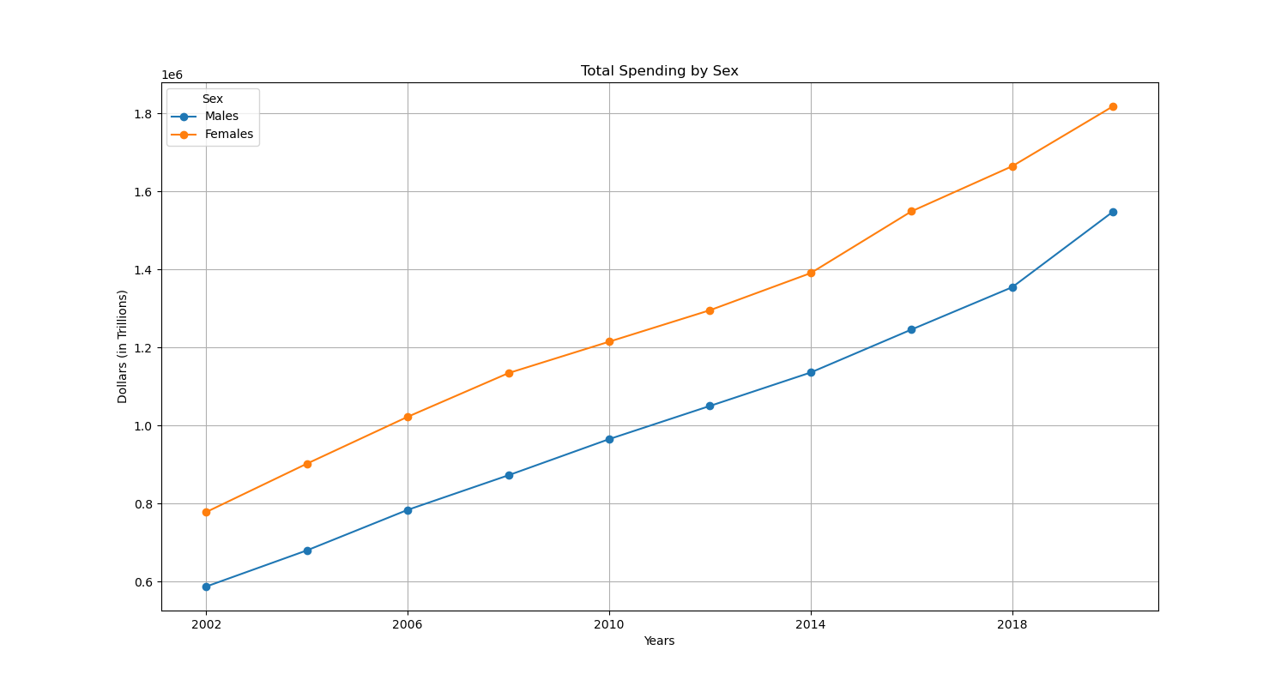
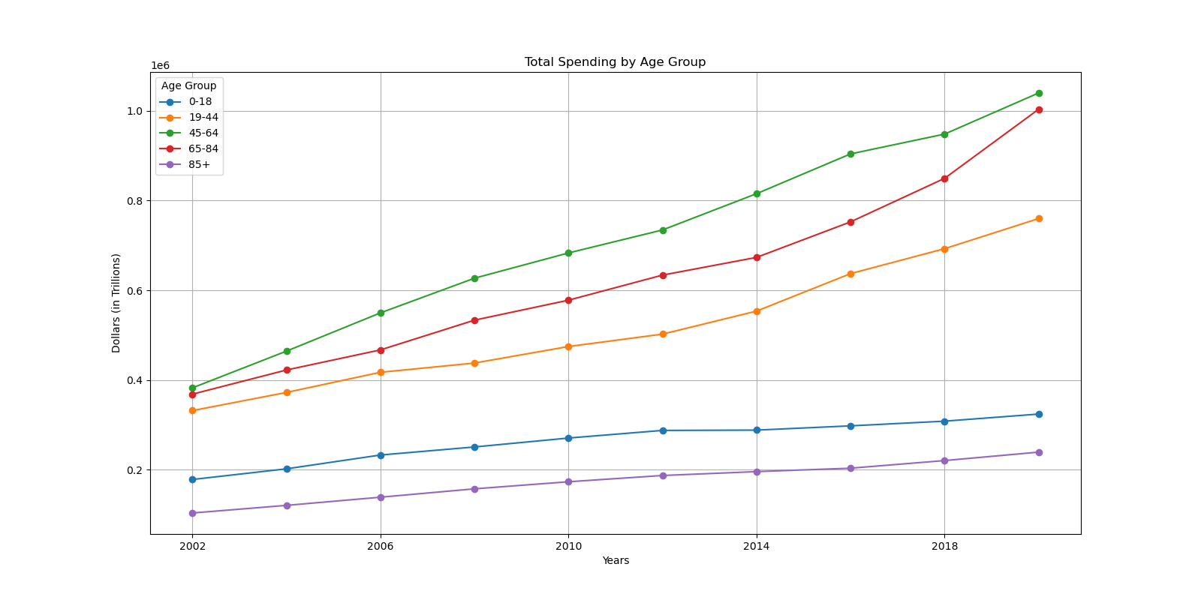

sex & age groups
Female spending consistently outpaced male spending.
Spending for Females increased from $.78 to $1.8 trillion.
Spending for Males increased from $.58 to $1.5 trillion.
The 45-64 age group has the highest spending & 85+ the lowest.
Notes:
Based on the line charts created in our analysis, we can see that spending for females consistently outpaced males from 2002 to 2020. Total healthcare spending for Females went from $778,215 millions in 2002 to $1,818,581 millions in 2020, while spending from Males went from $587,266 millions to $1,548,394 millions.
The highest healthcare spending occurred in the 45-64 age group throughout all the years, but the 65-84 age group is encroaching on this spending as of 2020. The lowest healthcare spending is within the 85+ plus age group, probably due to the smaller size of this population as individuals pass.
Lastly, when we look at spending per sex and age group for females, the spending between the three age groups (45-64, 65-84, & 19-44) is pretty similar, with some fluctuations over the years. In 2002, the 65-84 age group was just over the other two and then dipped in the middle from 2006 to 2018, then shot up in 2020 (most likely due to COVID-19 spending per CMS). The 0-18 and 85+ show the lowest spending across all of the years, with under $156,000 millions each in 2020.
Spending per sex and age group for males follows a similar pattern between age groups, with the 45-64 age group showing the highest expenditure and the 85+ age group the lowest. Unlike health care spending for females, spending for males across age groups does not intertwine over the years; all age groups continuously increase at similar rates. The 65-84 group is showing a spike in 2020, like female spending, but it does not surpass the 45-64 group as female expenditure does.

Slide 5
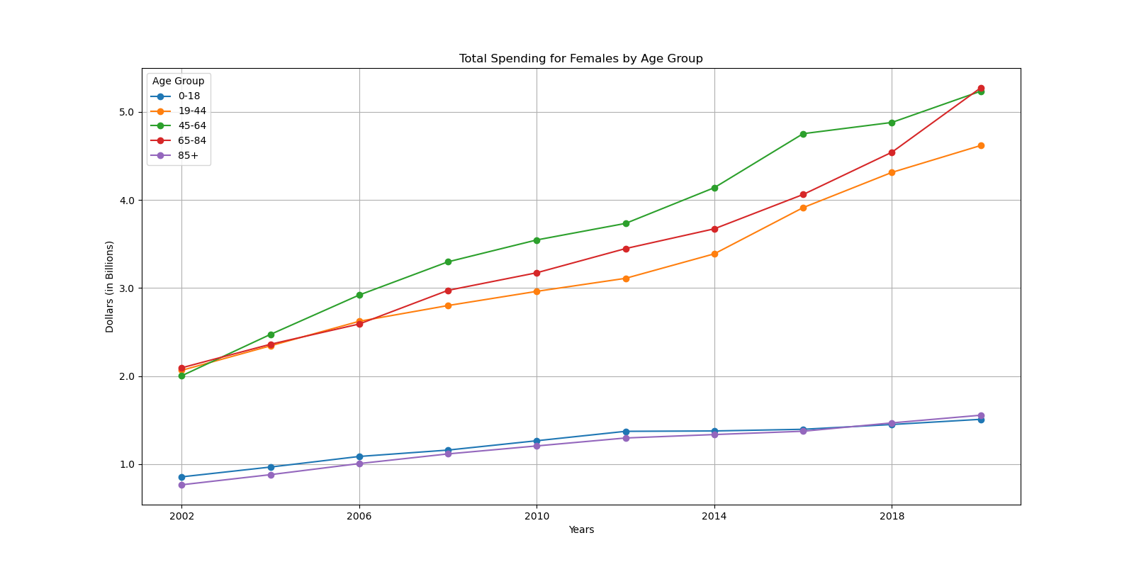
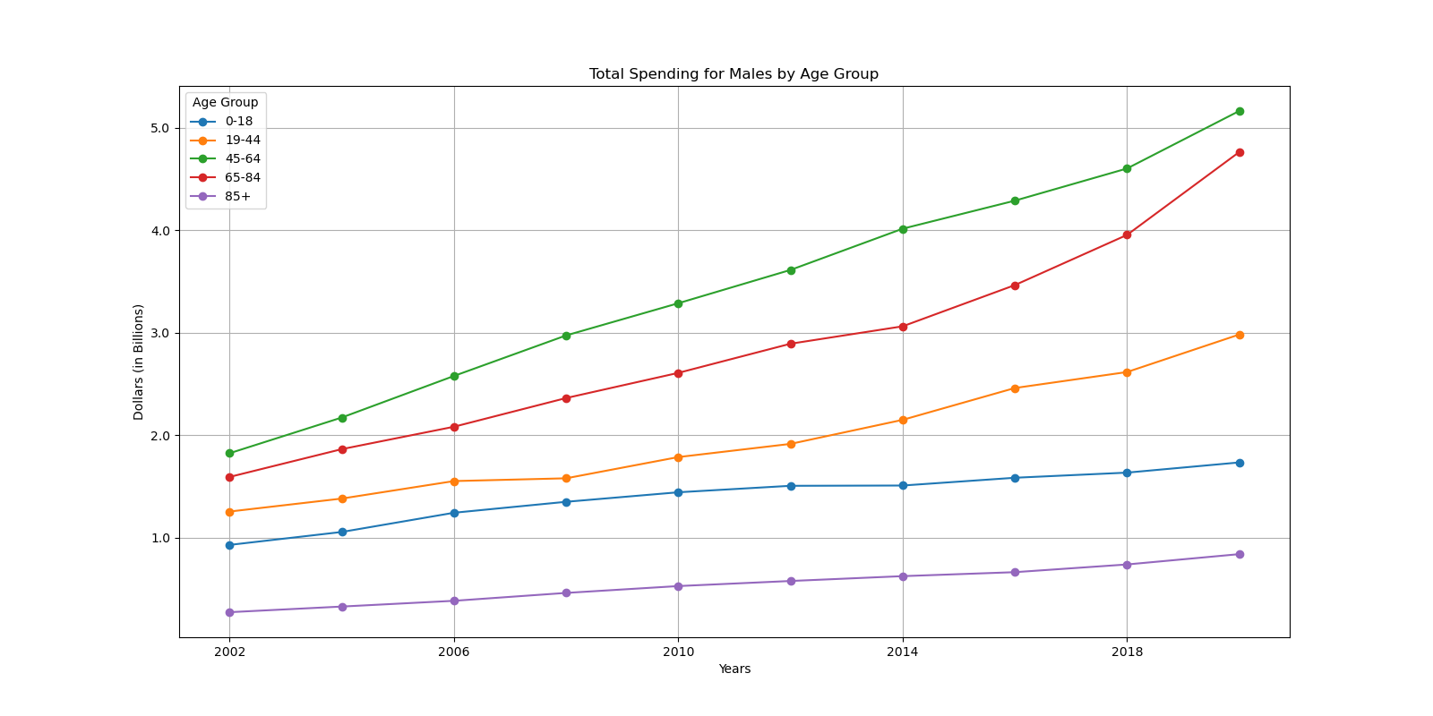

sex & age groups
The is a gap in spending between the top three age groups and the lowest two in spending for females.
Spending for males by age group is consistently spaced.
The male 65-84 age group spiked in 2020.
Notes:
Based on the line charts created in our analysis, we can see that spending for females consistently outpaced males from 2002 to 2020. Total healthcare spending for Females went from $778,215 millions in 2002 to $1,818,581 millions in 2020, while spending from Males went from $587,266 millions to $1,548,394 millions.
The highest healthcare spending occurred in the 45-64 age group throughout all the years, but the 65-84 age group is encroaching on this spending as of 2020. The lowest healthcare spending is within the 85+ plus age group, probably due to the smaller size of this population as individuals pass.
Lastly, when we look at spending per sex and age group for females, the spending between the three age groups (45-64, 65-84, & 19-44) is pretty similar, with some fluctuations over the years. In 2002, the 65-84 age group was just over the other two and then dipped in the middle from 2006 to 2018, then shot up in 2020 (most likely due to COVID-19 spending per CMS). The 0-18 and 85+ show the lowest spending across all of the years, with under $156,000 millions each in 2020.
Spending per sex and age group for males follows a similar pattern between age groups, with the 45-64 age group showing the highest expenditure and the 85+ age group the lowest. Unlike health care spending for females, spending for males across age groups does not intertwine over the years; all age groups continuously increase at similar rates. The 65-84 group is showing a spike in 2020, like female spending, but it does not surpass the 45-64 group as female expenditure does.

Slide 6
Total spending
Service Categories

Slide 7
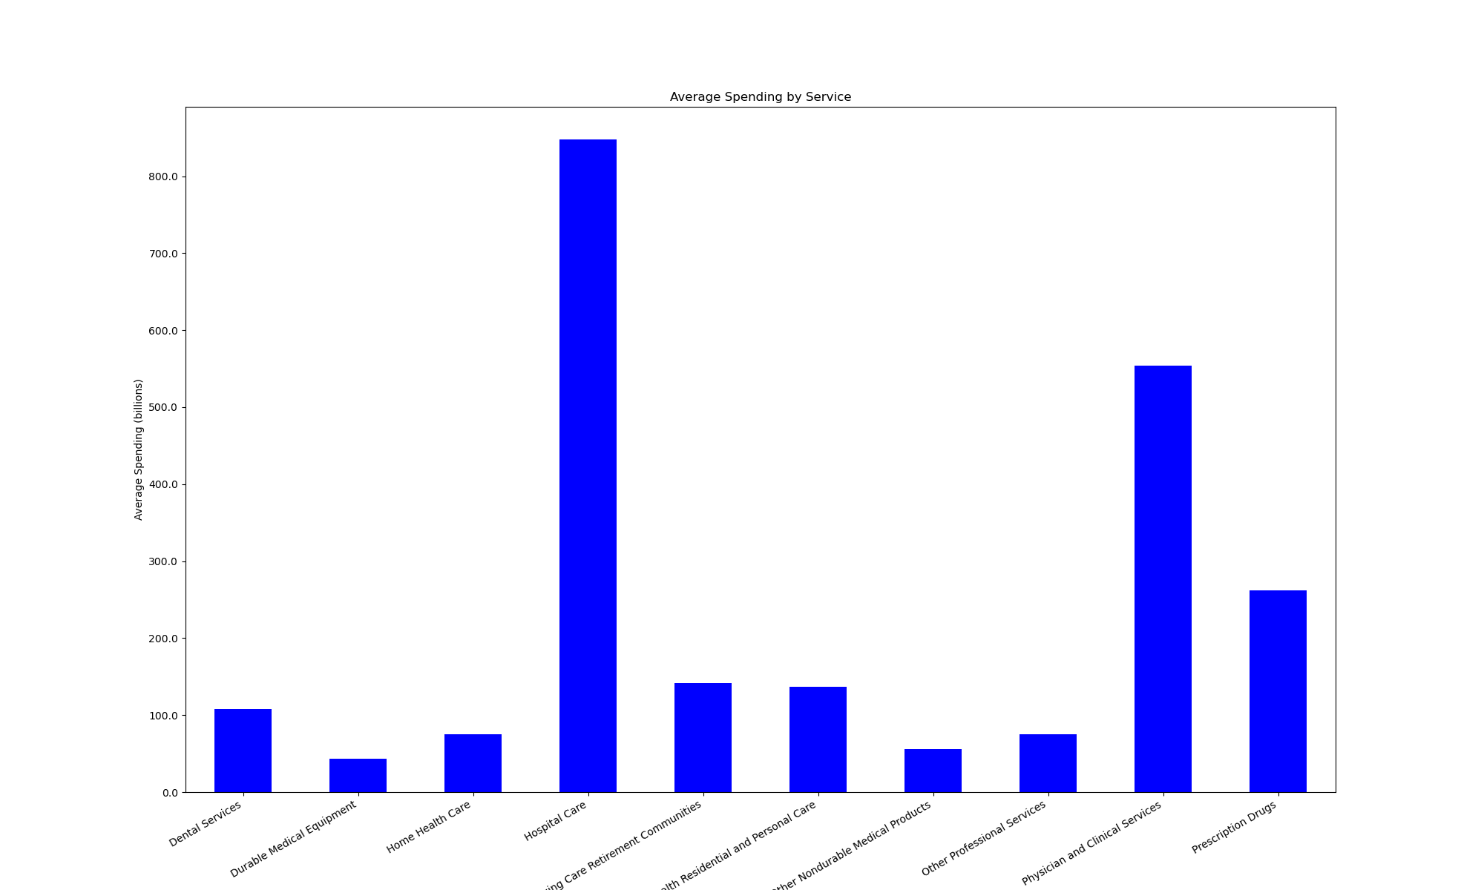
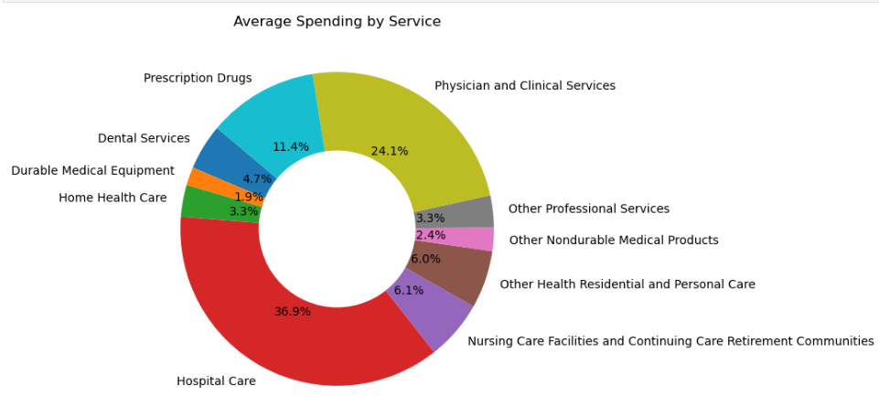
Service Categories
Hospital Care, Physician and Clinical Services, and Prescription Drugs are the highest spending categories
They account for:
72.4% of all spending
Roughly $1.6 billion on average per year

Slide 8
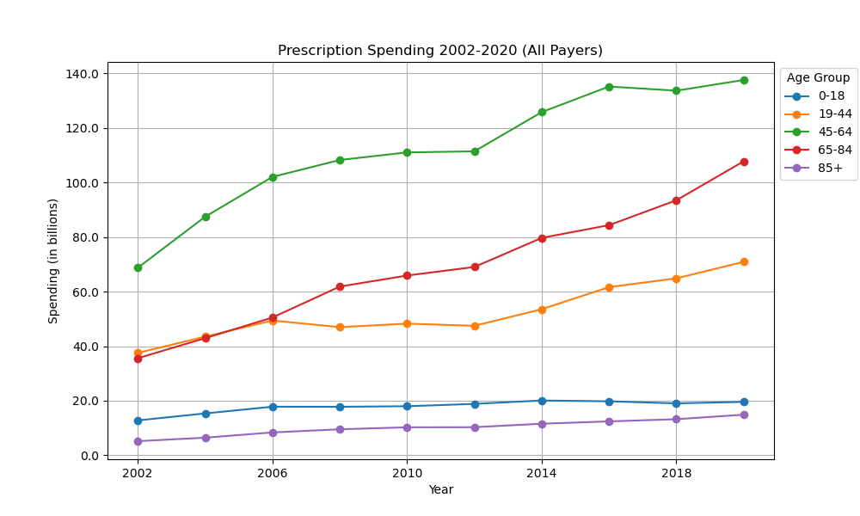
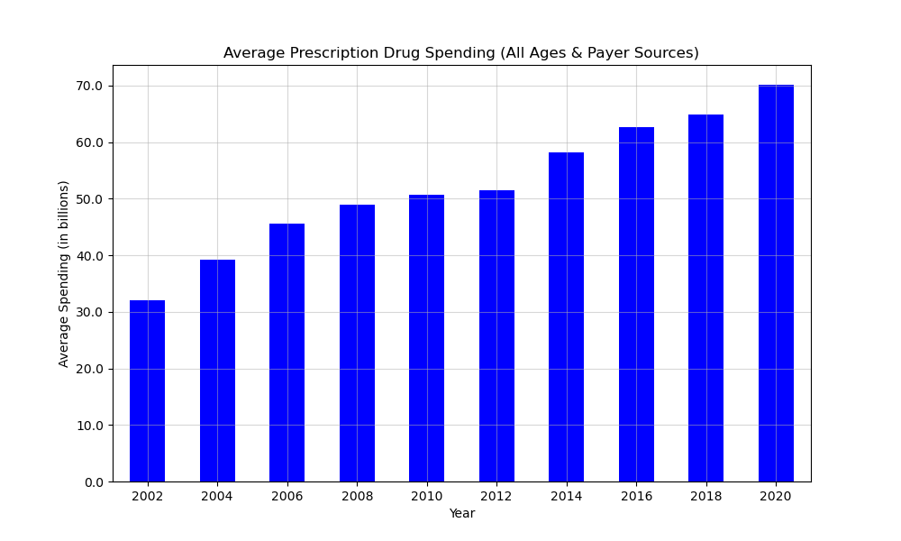
Service Categories
Prescription Drugs
45-64 age group highest spender
65-84 and 19-44 age groups spent similar amount 2002-2006
85+ spent least
Spending increased every year since 2002
More than doubled by 2020

Slide 9
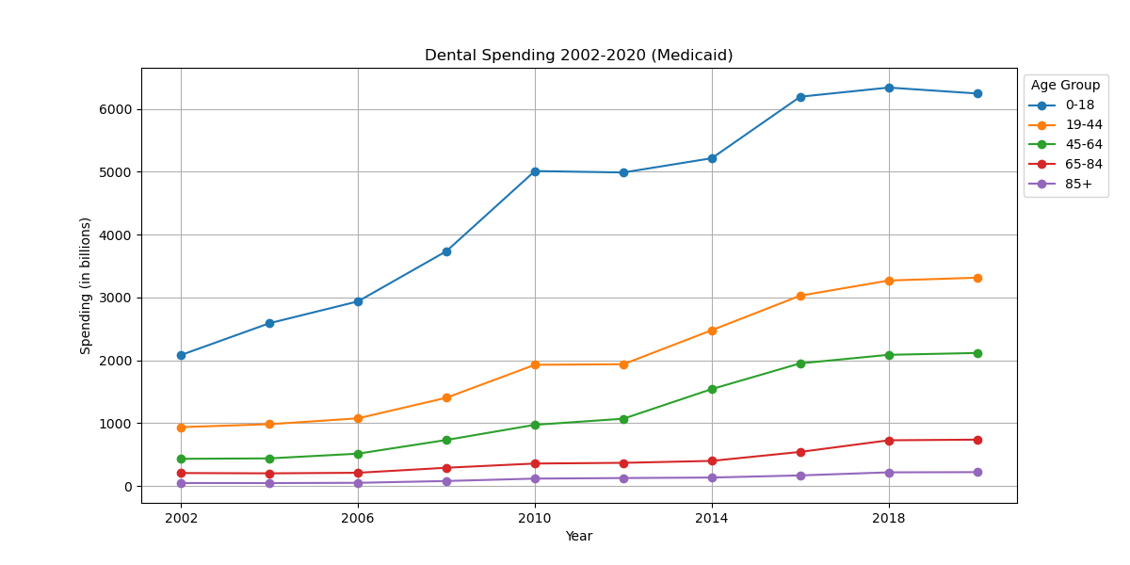
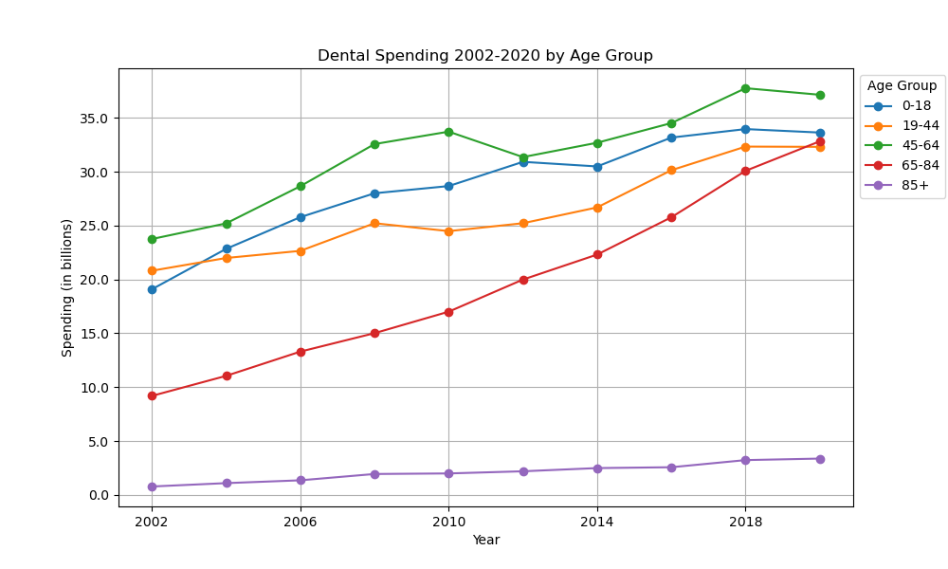
Service Categories
Dental Services
Spending decreases as age increases (Medicaid)
65-84 age group saw biggest increase in spending
85+ age group spent the least and saw the smallest increase in spending

Slide 10
Total spending
Regression Plotting

Slide 11
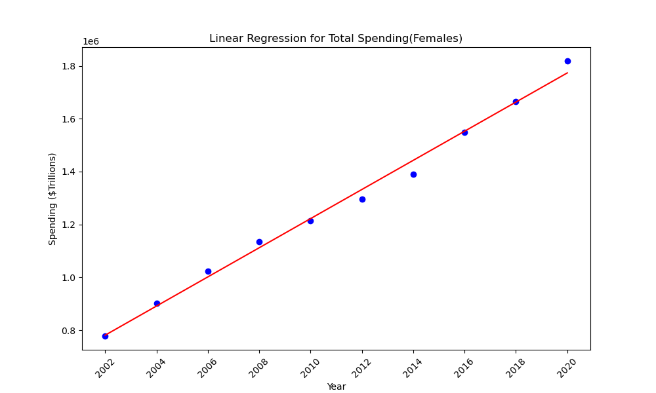

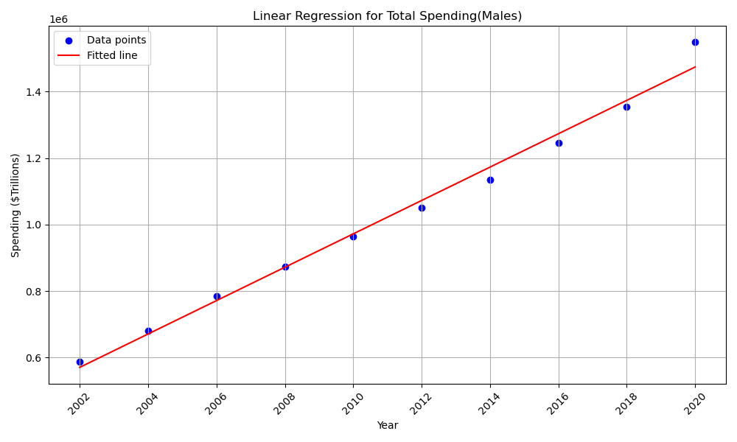

Regression Plotting
Male spending increases more steadily than female.
Female spending increased by 1,040,366.
Male spending increased by 961,128.
Notes:
Based on the linear regression showing the healthcare spending between males and females, I observed that male spending appeared more consistent, while female spending showed more fluctuations in its increase. From 2018 to 2020, The healthcare expenditure for females saw an increase of approximately $1,040,366(one million forty thousand three hundred sixty-six) millions, while during the same period, spending for males only increased by $961,000(nine hundred ninety-one thousand) millions.
When considering both males and females, total healthcare spending between 2002 to 2018 increased by $2,001,000(two million one thousand 0) millions. The largest increase occurred between 2018 and 2020, when spending rose from $ 3,019,769(three million nineteen thousand seven hundred sixty-nine)to $3,366,975(three million three hundred sixty-six thousand nine hundred seventy-five), a difference of $647,206(six hundred forty-seven thousand two hundred six ). The most likely reason for this significant increase is the impact of COVID-19, according to the provided Data. I anticipate that healthcare spending will continue to rise significantly in the coming years.

Slide 12
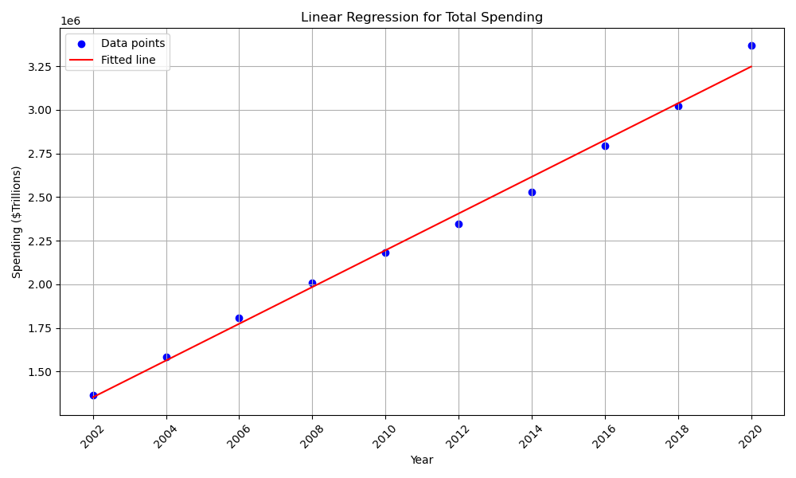

Regression Plotting
The total spending increased by 2,001,494 from 2002 – 2020.
The highest increase in two years was between 2018-2020.
Predicting it will continue to increase.
Notes:
Based on the linear regression showing the healthcare spending between males and females, I observed that male spending appeared more consistent, while female spending showed more fluctuations in its increase. From 2018 to 2020, The healthcare expenditure for females saw an increase of approximately $1,040,366(one million forty thousand three hundred sixty-six) millions, while during the same period, spending for males only increased by $961,000(nine hundred ninety-one thousand) millions.
When considering both males and females, total healthcare spending between 2002 to 2018 increased by $2,001,000(two million one thousand 0) millions. The largest increase occurred between 2018 and 2020, when spending rose from $ 3,019,769(three million nineteen thousand seven hundred sixty-nine)to $3,366,975(three million three hundred sixty-six thousand nine hundred seventy-five), a difference of $647,206(six hundred forty-seven thousand two hundred six ). The most likely reason for this significant increase is the impact of COVID-19, according to the provided Data. I anticipate that healthcare spending will continue to rise significantly in the coming years.

Slide 13
TAKEAWAYS
Pay attention to multiple header columns.
Account for the way the data is laid out in your DataFrame.
Have a set initial DataFrame name for all team members.
Clear communication with your team when merging GitHub Branches.
Opportunities for improvement:
Find data regarding how many people are in each age group or use specific payer sources.
Deeper analysis of each service provided.
Use regression analysis to predict future spending.
Notes:
A few takeaways I noticed with this project was taking careful attention to the header column and what data we were trying to grab from the column which lead to wanting our years column to be our rows and problem solving for this issue.
We also noticed that when we merged our projects folders, our Data Frame was causing issues due to the fact we had different punctuation and or names, which caused more cleaning; communication between teammates was also super important to understand where everyone was at when we merged our projects some things overlapped to due to lack of communication.

Slide 14
THANK YOU

