Slide 1
FHIR QuestionnaireResponse
2020-10-16 (五) 陽明生資所碩二 吳宇婷

Slide 2
QuestionnaireResponse
QuestionnaireResponse provides a complete or partial list of answers to a set of questions filled when responding to a questionnaire.
The questions may be included directly or by reference to a Questionnaire resource that defines the questions as well as the constraints on the allowed answers.
QuestionnaireResponse
subject
questionnaire
Patient
Questionnaire
https://www.hl7.org/fhir/questionnaireresponse.html

Slide 3
QuestionnaireResponse
Examples of Questionnaires include:
Past medical history (PMH)
Family diseases
Social history
Research questionnaires and Case report forms (CRFs)
Quality and evaluation forms
Patient intake form (e.g. clipboard)
Insurance claim form
This resource is referenced by ClinicalImpression, Consent, Contract, DeviceUseStatement, FamilyMemberHistory and Observation

Slide 4
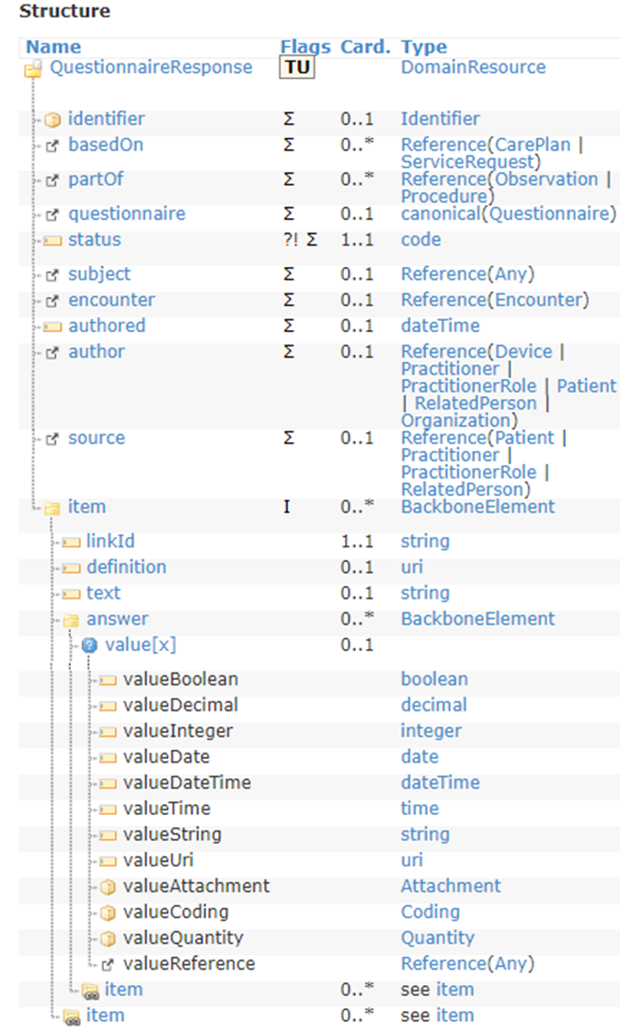
QuestionnaireResponse
Tag | Value
"resourceType": | "QuestionnaireResponse"
"id": | 0..1
"basedOn": | 0..*
"partOf": | 0..*
"questionnaire": | 0..1
"status": | 1..1 in-progress | completed | amended | entered-in-error | stopped
"subject": | 0..1
"encounter": | 0..1
"authored“: | 0..1
"author“: | 0..1
"source“: | 0..1
"item“: | 0..*

Slide 5
QuestionnaireResponse
Tag | Card.
"item": | 0..*
"linkid": | 1..1
“definition": | 0..1
“text": | 0..1
“answer": | 0..*
Value[x] | 0..1
…valueboolean
Item | 0..*

Slide 6
QuestionnaireResponse
{
"linkId": "2",
"text": "General questions",
"item": [
{
"linkId": "2.1",
"text": "What is your gender?",
"answer": [
{
"valueString": "Male"
}]},
{
"linkId": "2.2",
"text": "What is your date of birth?",
"answer": [
{
"valueDate": "1960-03-13"
}]},
{
"linkId": "2.3",
"text": "What is your country of birth?",
"answer": [
{
"valueString": "The Netherlands"
}]},
{
"linkId": "2.4",
"text": "What is your marital status?",
"answer": [
{
"valueString": "married"
} ]}]},
{
"resourceType": "QuestionnaireResponse",
"id": "f201",
"status": "completed",
"subject": {
"reference": "Patient/f201",
"display": "Roel“
},
"authored": "2013-06-18T00:00:00+01:00",
"author": {
"reference": "Practitioner/f201"
},
"source": {
"reference": "Practitioner/f201"
},
"item": [{
"linkId": "1",
"item": [
{
"linkId": "1.1",
"text": "Do you have allergies?",
"answer": [
{
"valueString": "I am allergic to house dust"
}]}] },

Slide 7
{
"linkId": "3",
"text": "Intoxications",
"item": [
{
"linkId": "3.1",
"text": "Do you smoke?",
"answer": [
{
"valueString": "No"
}
]
},
{
"linkId": "3.2",
"text": "Do you drink alchohol?",
"answer": [
{
"valueString": "No, but I used to drink"
}
]
}
]
}
]
}
https://hl7.org/FHIR/questionnaireresponse-example-f201-lifelines.json.html

Slide 8

The HTML DOM (Document Object Model)
When a web page is loaded, the browser creates a Document Object Model of the page.

Slide 9
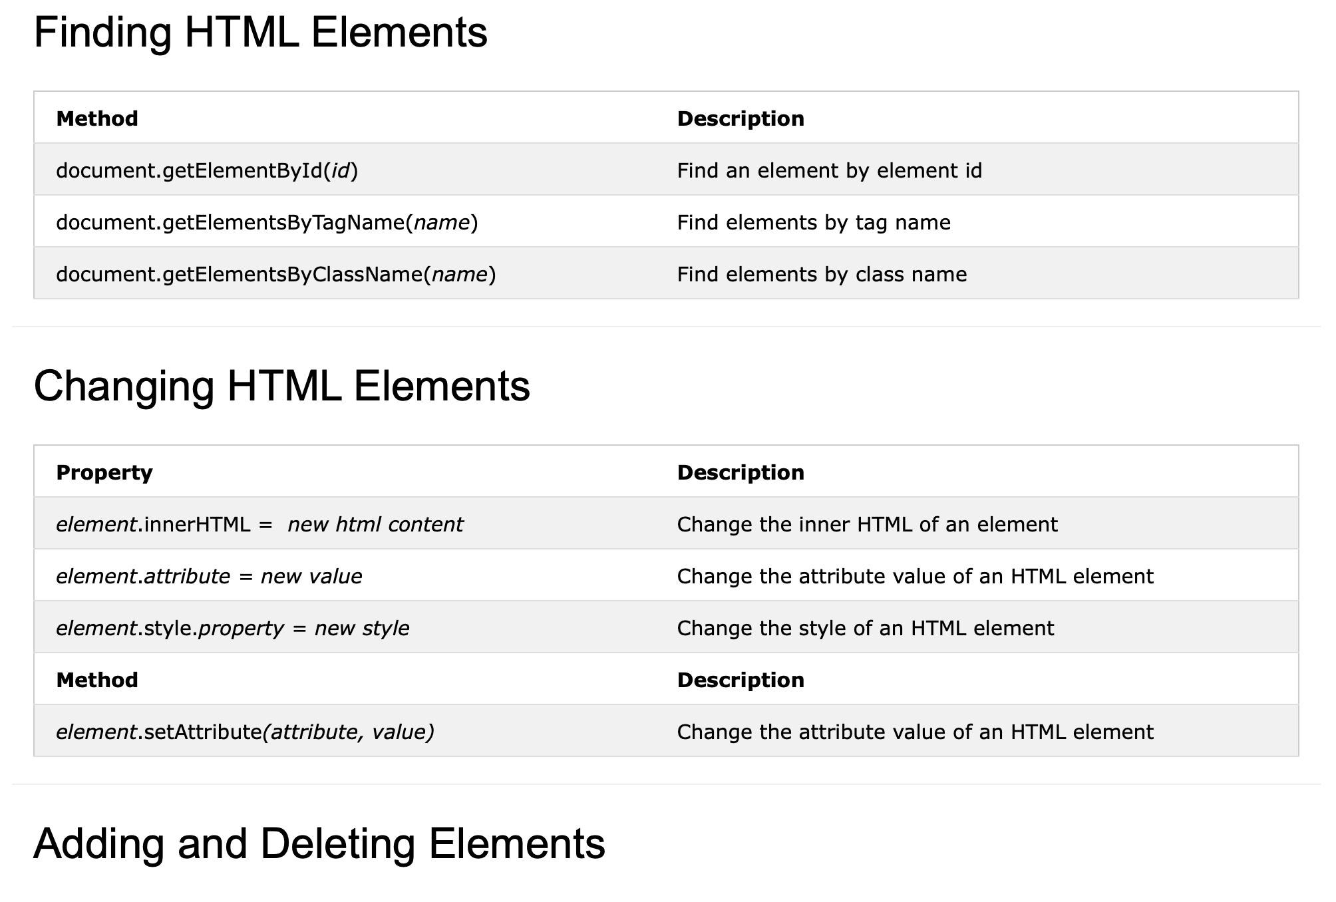
The HTML DOM Document Object
https://www.w3schools.com/js/js_htmldom_document.asp

Slide 10
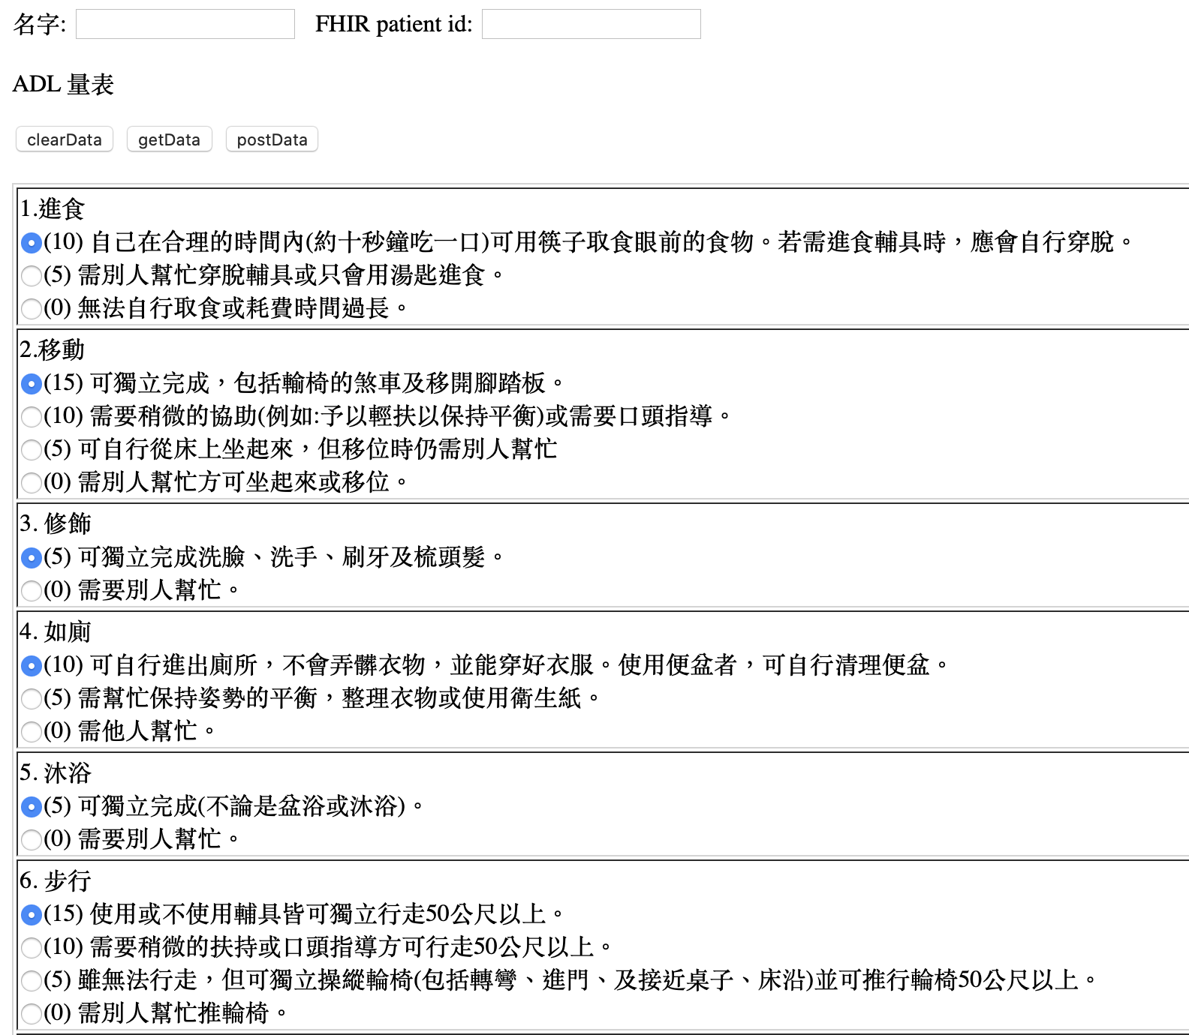
Practice
getElementsByTagName
getElementsByName
<input type="text" name="pateintName" value="Mickey" id="name" />
getElementsById
Name v.s Id -> what’s different?
getElementsByTagName
getElementsByName
getElementsById
程式位置
https://github.com/mos2718/JS-FHIR2020.git
http://hapi.fhir.org/baseR4/QuestionnaireResponse/1604735

