Slide 1
ActiveMQ vs AmazonMQ vs SQS
Artem Volobuev

Slide 2
Disclaimer
Information that you'll listen next might be containing:
Inaccuracies
Rude mistakes
It might have not been 100% proven

Slide 3

Disclaimer
Information that you'll listen next might be containing:
Inaccuracies
Rude mistakes
It might have not been 100% proven
These all are true except for Wikipedia links.

Slide 4

Introduction
Basic things about Message Broker

Slide 5
Introduction
Basic things about Message Broker
ActiveMQ

Slide 6
Introduction
Basic things about Message Broker
ActiveMQ
AmazonMQ

Slide 7
Introduction
Basic things about Message Broker
ActiveMQ
AmazonMQ
SQS

Slide 8
Introduction
Basic things about Message Broker
ActiveMQ
AmazonMQ
SQS
Some conclusions

Slide 9
What do we have?
Microservice architecture

Slide 10
What do we have?
Microservice architecture
ActiveMQ as a standalone service

Slide 11
What do we have?
Microservice architecture
ActiveMQ as a standalone service
Scaling requirements

Slide 12
What do we have?
Microservice architecture
ActiveMQ as a standalone service
Scaling requirements
Aim to save money

Slide 13

What do we have?
Microservice architecture
ActiveMQ as a standalone service
Scaling requirements
Aim to save money
We want to be in the cloud!

Slide 14
What is Message Broker?

Slide 15
What is Message Broker?
A message broker is an intermediary computer program module that translates a message from the formal messaging protocol of the sender to the formal messaging protocol of the receiver.
Wikipedia

Slide 16
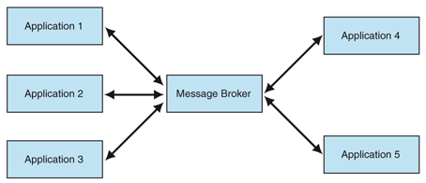
Why Message Broker?
Route messages to one or more destinations

Slide 17
Why Message Broker?
Route messages to one or more destinations
Transform messages to an alternative representation

Slide 18
Why Message Broker?
Route messages to one or more destinations
Transform messages to an alternative representation
Perform message aggregation

Slide 19
Why Message Broker?
Route messages to one or more destinations
Transform messages to an alternative representation
Perform message aggregation
Interact with an external repository

Slide 20
Why Message Broker?
Route messages to one or more destinations
Transform messages to an alternative representation
Perform message aggregation
Interact with an external repository
Invoke web services to retrieve data

Slide 21
Why Message Broker?
Route messages to one or more destinations
Transform messages to an alternative representation
Perform message aggregation
Interact with an external repository
Invoke web services to retrieve data
Respond to events or errors

Slide 22
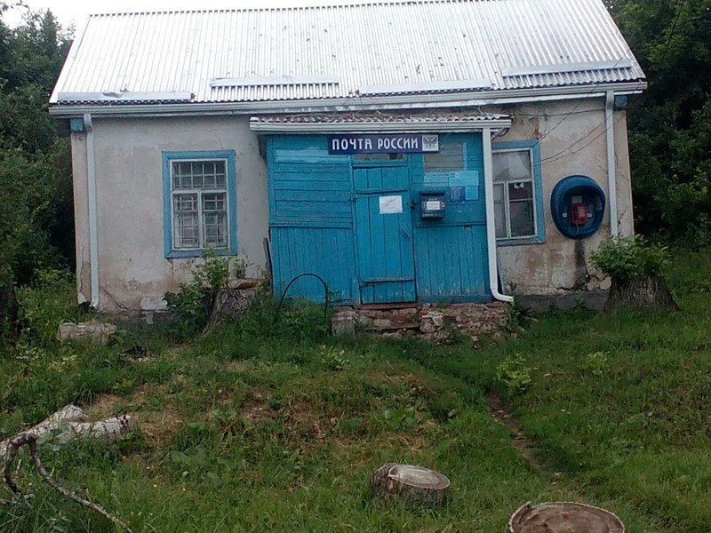
Why Message Broker?

Slide 23
To the cloud

Slide 24

Migration options
ActiveMQ within docker

Slide 25

Migration options
ActiveMQ within docker
AmazonMQ

Slide 26

Migration options
ActiveMQ within docker
AmazonMQ
SQS

Slide 27
ActiveMQ

Slide 28
Pros
High volume throughput

Slide 29
Pros
High volume throughput
Datagram

Slide 30
Pros
High volume throughput
Datagram
Guaranteed single delivery

Slide 31
Pros
High volume throughput
Datagram
Guaranteed single delivery
JMS Support

Slide 32
Pros
High volume throughput
Datagram
Guaranteed single delivery
JMS Support
Message Selectors

Slide 33
Pros
High volume throughput
Datagram
Guaranteed single delivery
JMS Support
Message Selectors
Indefinite Message Retention

Slide 34
Pros
High volume throughput
Datagram
Guaranteed single delivery
JMS Support
Message Selectors
Indefinite Message Retention
Automatic on demand queue creation

Slide 35
Pros
High volume throughput
Datagram
Guaranteed single delivery
JMS Support
Message Selectors
Indefinite Message Retention
Automatic on demand queue creation
Message Priorities

Slide 36
Pros
Cons
High volume throughput
Datagram
Guaranteed single delivery
JMS Support
Message Selectors
Indefinite Message Retention
Automatic on demand queue creation
Message Priorities
Requires configuration for securing message

Slide 37
Pros
Cons
High volume throughput
Datagram
Guaranteed single delivery
JMS Support
Message Selectors
Indefinite Message Retention
Automatic on demand queue creation
Message Priorities
Requires configuration for securing message
Requires EFS(Amazon Elastic File System)

Slide 38
Pros
Cons
High volume throughput
Datagram
Guaranteed single delivery
JMS Support
Message Selectors
Indefinite Message Retention
Automatic on demand queue creation
Message Priorities
Requires configuration for securing message
Requires EFS(Amazon Elastic File System)
Cost(EC2+EFS)

Slide 39
How much does it cost?
EFS 100 GB : 39.86 USD
EC2 Linux on c5.2xlarge with 8 vCPU and 16GiB Memory : 283.47 USD
Total (monthly): 323.33 USD

Slide 40
To the code!

Slide 41
AmazonMQ

Slide 42
Pros
Cons
High volume throughput and high availability
Datagram
Guaranteed single delivery
Secured message in transit and at rest
JMS Support
Message Selectors
Indefinite Message Retention
Automatic on demand queue creation
Message Priorities
Cost

Slide 43
How much does it cost?
AmazonMQ on mq.m5.large with 2 vCPU and 8GiB Memory : 251,85 USD
Data Transfer 100GB: 1 USD
Total (monthly): 252.85 USD

Slide 44
SQS

Slide 45
Pros
High availability
High volume throughput
Datagram
Secured message in transit and at rest
JMS Support
Indefinite Message Retention

Slide 46
Pros
High availability
High volume throughput
Datagram
Secured message in transit and at rest
JMS Support
Indefinite Message Retention
Cost

Slide 47
Pros
Cons
High availability
High volume throughput
Datagram
Secured message in transit and at rest
JMS Support
Indefinite Message Retention
Cost
No automatic on demand queue creation

Slide 48
Pros
Cons
High availability
High volume throughput
Datagram
Secured message in transit and at rest
JMS Support
Indefinite Message Retention
Cost
No automatic on demand queue creation
No Message Priorities

Slide 49
Pros
Cons
High availability
High volume throughput
Datagram
Secured message in transit and at rest
JMS Support
Indefinite Message Retention
Cost
No automatic on demand queue creation
No Message Priorities
No Message Selectors

Slide 50
Pros
Cons
High availability
High volume throughput
Datagram
Secured message in transit and at rest
JMS Support
Indefinite Message Retention
Cost
No automatic on demand queue creation
No Message Priorities
No Message Selectors
No guaranteed single delivery

Slide 51
How much does it cost?
First 1 000 000 messages for free
Each next million is 0.40 USD
Free inner traffic
Outer traffic: 8.91 USD per 100 Gb/Month
Total (monthly): 2 cups of coffee in Starbucks

Slide 52
To the code!

Slide 53
Some conclusions

Slide 54

Soooooooo… What did we learn today?
Migration to AWS is easy to start

Slide 55
Soooooooo… What did we learn today?
Migration to AWS is easy to start
There is no reason to use ActiveMQ within Docker

Slide 56
Soooooooo… What did we learn today?
Migration to AWS is easy to start
There is no reason to use ActiveMQ within Docker
Use Amazon native services in order to optimize expenses

Slide 57
Thank You!

