Slide 1



MOTION PLANNING IN THE BROWSER
Can It
Fit?
Will the sofa make it through the hallway? Let's build the room, then let a robot-style planner figure it out — and learn how it thinks.
Notes:
Hi Everyone, I'm Can! Have you ever been stuck on a staircase, holding one end of a couch, thinking: "there is no way this fits"?
Today we're going to settle that argument with math.
I built a browser app called Can It Fit, where you can design a room in 3D, drop in a piece of furniture, and a motion planner will figure out whether it can actually get through.
In the next few minutes I'll show you how to use it, and then, the fun part, how the planner really solve the problem. No installs. No build step. Just a browser.
Let's go.

Slide 2
THE PROBLEM
Moving a couch is a 6-dimensional puzzle
It slides in 3 directions: x, y, z
It spins in 3 ways: yaw, pitch, roll
Walls, corners and doorways don't care how clever you are
"Does it fit?" really means: is there a collision-free path through 6-D space?
Notes:
Here's why this is harder than it looks.
A couch isn't just sliding along a hallway. It can move in three directions, and it can rotate in three ways: yaw, pitch and roll. That's six degrees of freedom.
So "does it fit?" is secretly a question about finding a path through six-dimensional space, where every single pose along the way has to avoid every wall.
Look at this corner. The sofa can't just slide through. It has to turn, at exactly the right moment, by exactly the right amount.
That turning is what makes this problem interesting.

Slide 3
WHAT YOU'LL SEE
One app, three ways to answer it
Manual mode
Deterministic solver
Probabilistic solver
Hold M, drag the furniture yourself. The app tells you when you collide.
a deterministic straight-shot heuristic.
RRT-Connect.
1 Build
2 Entrance & exit
3 Furniture
4 Solve
Notes:
This app gives you three ways to answer the question.
First, manual mode, where you grab the furniture yourself and try it virtually.
Second, a deterministic straight-shot heuristic.
Third, a probabilistic solver using motion planning algorithm called RRT-Connect,
and Everything follows four simple steps: build the room, choose the entrance and exit, describe the furniture, and solve. Let's walk through each one.

Slide 4
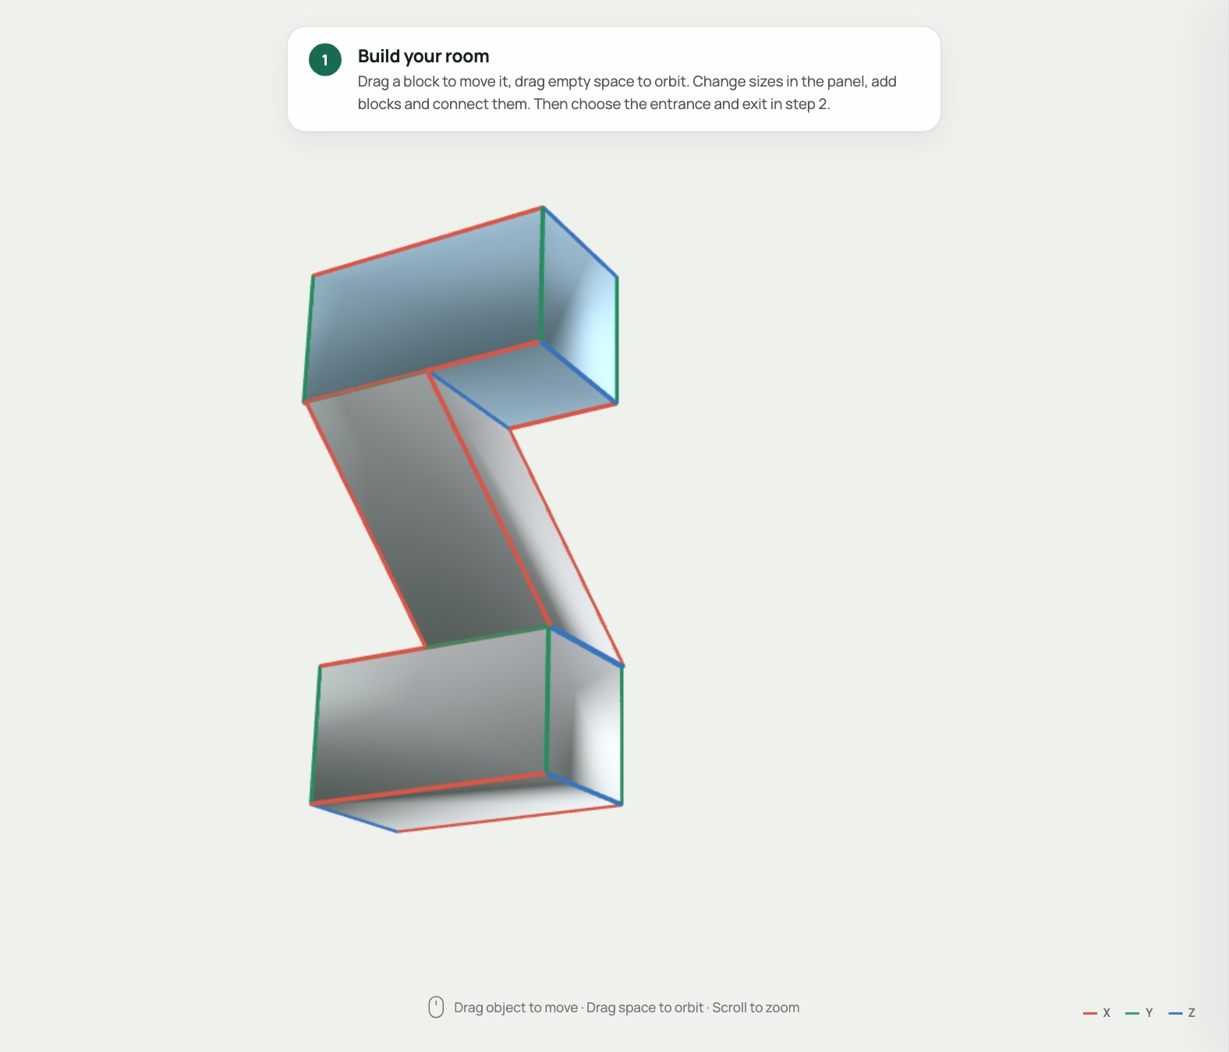
HANDS-ON · STEP 1
Build any shape you can imagine
Stairs, L-shaped halls, zig-zags. If you can make it from blocks, you can test it.
Shape simple blocks: stretch them, tilt them.
Connect the blocks together.
Test your furniture.
This staircase is just three blocks and two connections.
Notes:
Now for the fun part: building the place your furniture has to travel through.
And here's the best thing about this app: you're not stuck with one shape. You can build almost anything. A straight hallway, an L-shaped corner, a zig-zag, or a full flight of stairs like this one.
The idea is simple. You shape some blocks, you connect them together, and then you test your furniture inside. That's it.
This staircase is built from just three blocks and two connections. Let me show you how.

Slide 5
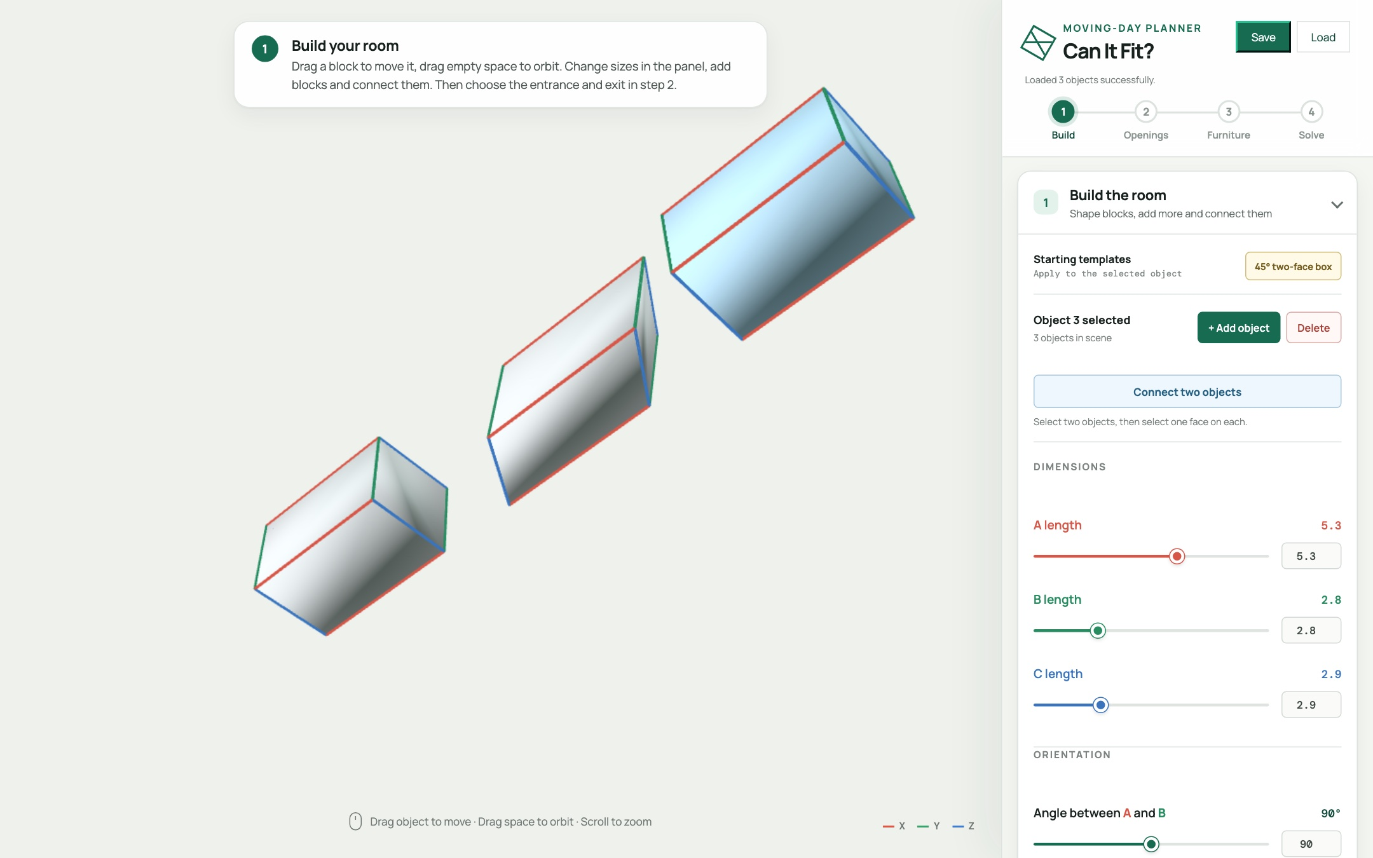
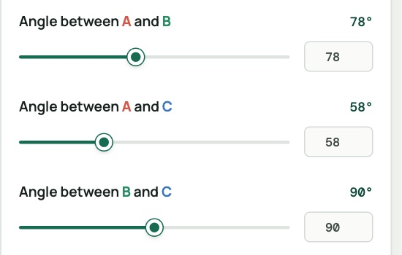
STEP 1 · SHAPE
Shape the blocks
Start with a simple box.
Stretch it with the length sliders.
Tilt it with the angle sliders. A tilted box becomes a ramp or stairs.
Add as many blocks as you need.
Every block is a box you can stretch and tilt. That's all you need.
Notes:
Step one: shape your blocks.
Every block starts out as a simple box. Use the length sliders to stretch it, and the angle sliders to tilt it. A tilted box is how you get a ramp, or the slope of a staircase.
Need more pieces? Press "Add object" and another block appears. Here we have two ordinary boxes for the hallways, and one tilted box in the middle that will become the stairs.
You can make as many blocks as you like, in any size, at any angle.

Slide 6
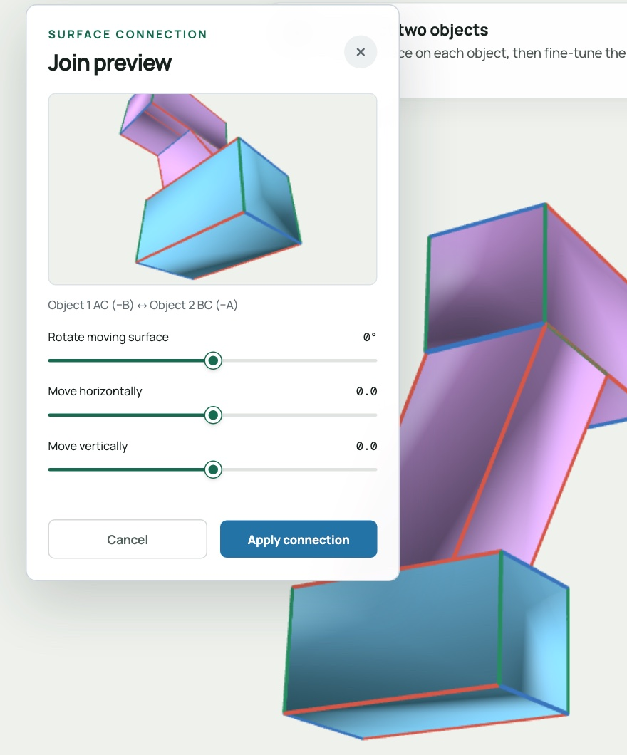
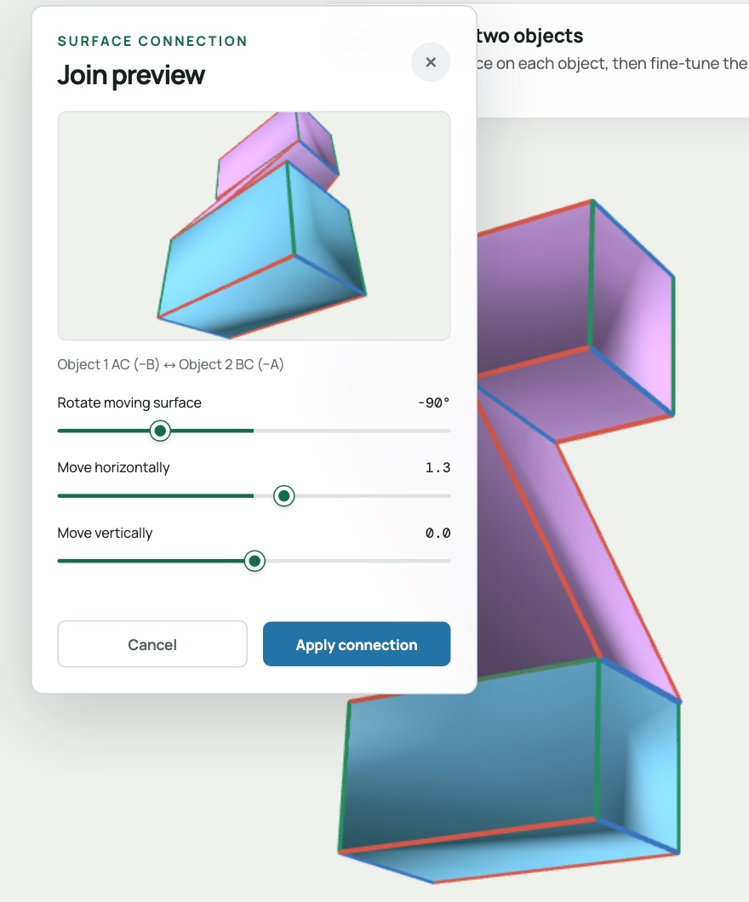
STEP 1 · CONNECT
Connect them together
Press Connect two objects.
Click one face on each block.
Drag the sliders to rotate and slide them until they line up.
Press Apply. Repeat for every joint.
Rotating one block against the other changes the angle between the two surfaces. That's how you bend a hallway.
Just attached
After rotating and sliding
Notes:
Step two: connect the blocks. Press "Connect two objects", then click one face on each block you want to join.
A small preview window opens, with three sliders. When two blocks first snap together, they might stick out the wrong way, like on the left.
So you drag the sliders: one rotates the block around the surface it's attached to, and the other two slide it along that surface. Rotating changes the angle between the two surfaces, and that's the trick that lets you bend a hallway, or turn a flat block into stairs.
When it looks right, like on the right, press Apply. Then repeat for the next joint.
That's the whole recipe: shape, connect, adjust. With those three moves, you can build whatever your own home looks like.

Slide 7
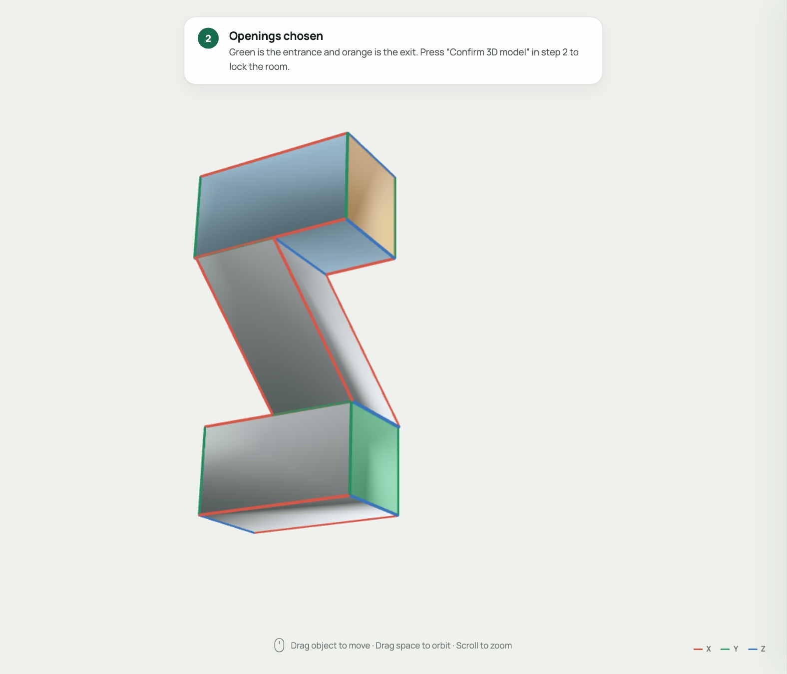
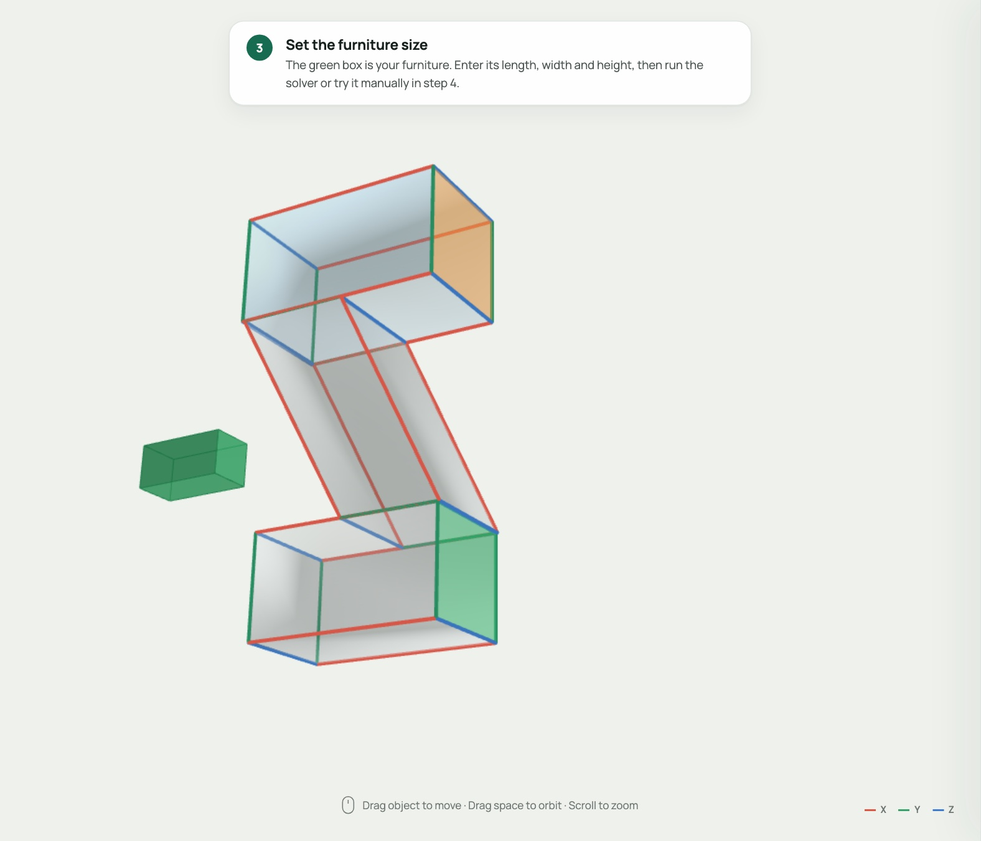
HANDS-ON · STEPS 2 & 3
Pick the doors, set the furniture
Click where the furniture goes in (green) and out (orange).
Press Confirm 3D model. The walls turn see-through.
Type the furniture's length, width and height. The green box previews it.
Only those two faces are doorways. Every other wall stays solid, so the furniture can't cheat.
Entrance and exit
Furniture preview
Notes:
Steps two and three are quick.
First, tell the app where the furniture comes in and where it has to come out. Click the end of the bottom hallway for the entrance, and the top for the exit. Press "Confirm 3D model" and the walls turn see-through.
Those two faces are the only doorways. Every other wall is solid, so the furniture can't cheat by walking through one.
Then type in the size of your furniture: length, width and height. The green box next to the building is a preview of it. I'll start with a big sofa, two and a half by one point two by one point two.

Slide 8
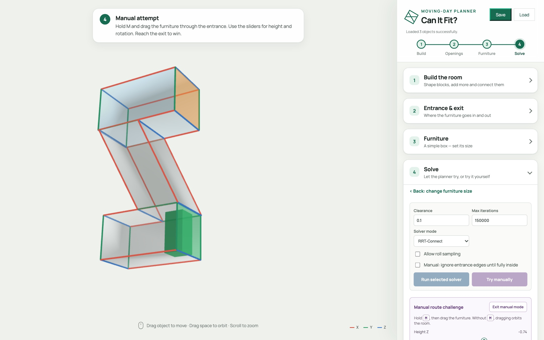
HANDS-ON · STEP 4A
Try it yourself first
Press Try manually. The furniture starts outside the entrance.
Hold M and drag it through. Sliders tilt and lift it.
Stuck? Auto Pilot lines it up for you.
■ legal ■ outside ■ collision
Reach the exit and you win. A pop-up tells you.
Notes:
Before we let the computer try, try it yourself. Press "Try manually" and the furniture starts just outside the entrance.
Hold the M key and drag it into the building. The box turns green when it's legal, yellow when it's outside, and red when it hits a wall. Use the sliders to tilt and lift it.
If you get stuck, Auto Pilot lines the furniture up with a wall for you. Reach the exit and you win.
It's trickier than it looks, which is exactly why a planner is so useful.

Slide 9
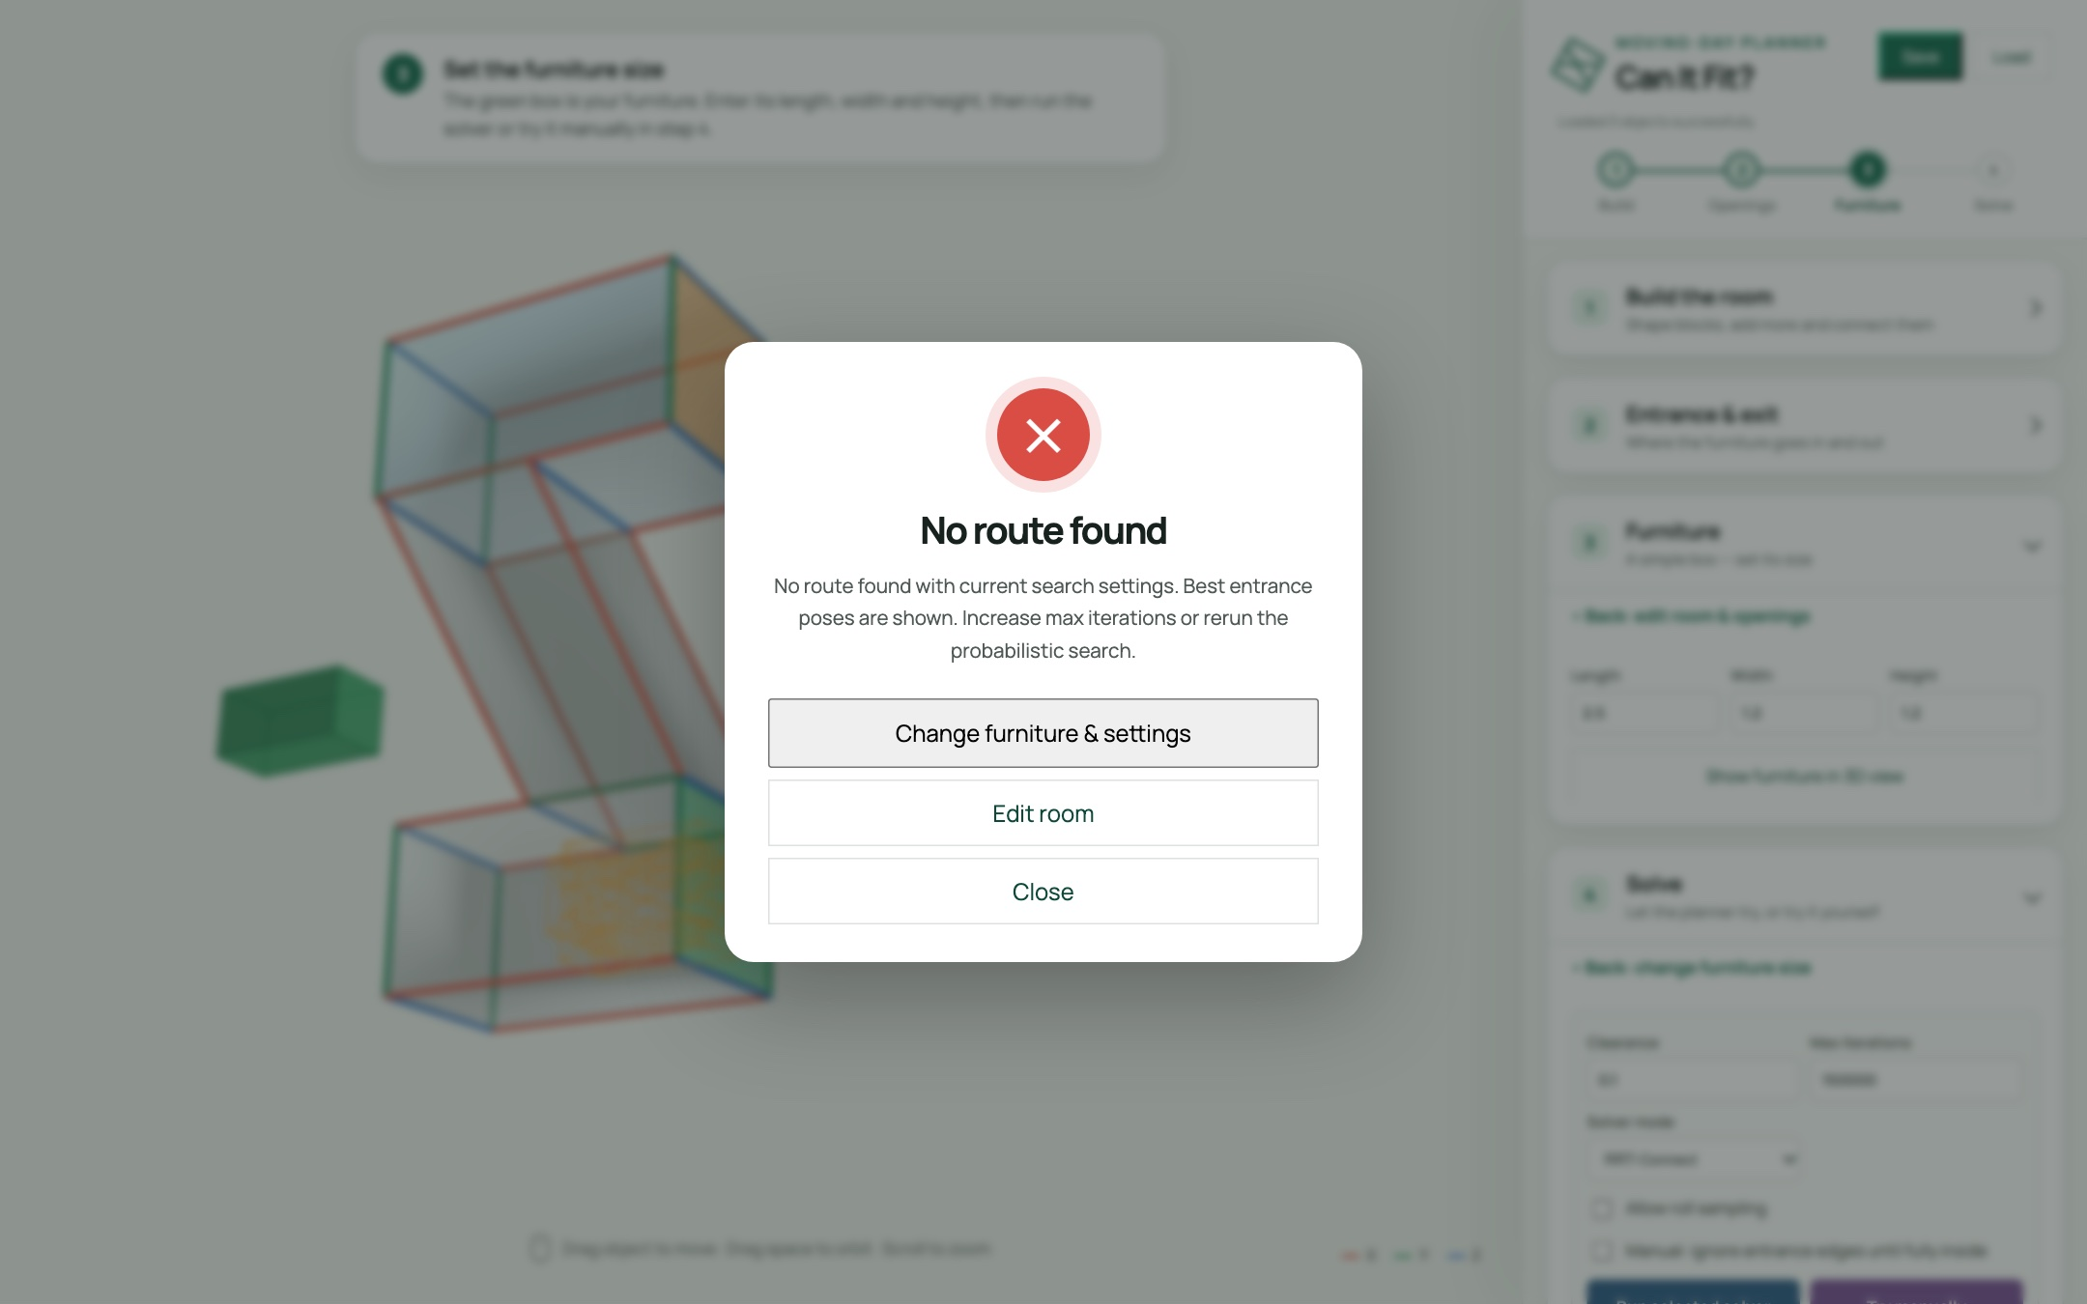
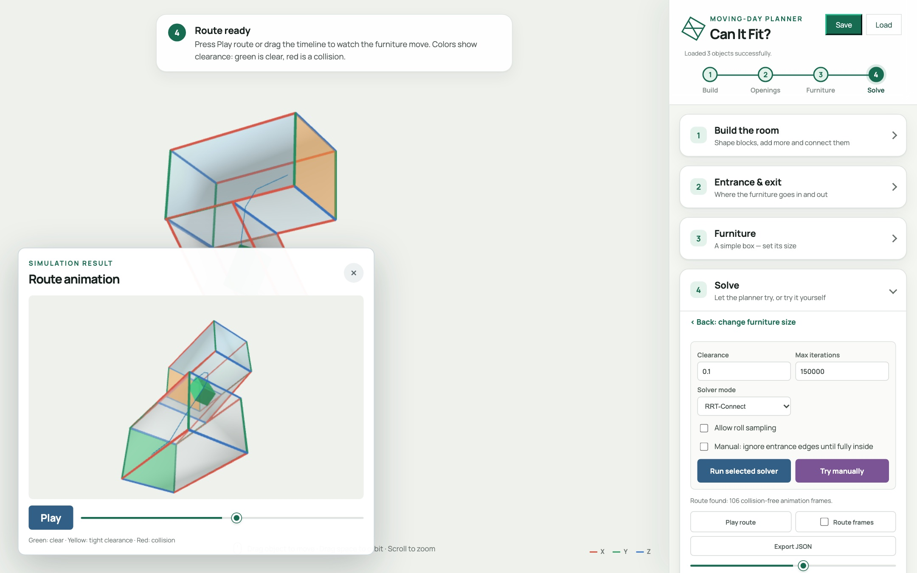
HANDS-ON · STEP 4B
Now let the solver try
Big sofa · 2.5 × 1.2 × 1.2: No route found
Smaller · 1.6 × 0.9 × 0.9: It fits!
Press Run selected solver. Same building, same solver, only the furniture changed. "No route found" isn't proof, so change something and try again.
Notes:
Now let the computer try. Press "Run selected solver", and the planner searches for a path.
With the big sofa, it comes back: "No route found". Now, be careful how you read that. The search is random, so it can't prove that no route exists. It's strong evidence, not a guarantee. So we change something.
I'll shrink the furniture and run it again. And this time: "It fits!" You can drag the timeline and watch the box travel up the stairs, tilting to follow the slope.
Same building, same solver. The only thing that changed was the size of the furniture. That's the whole point: you can test a move before you ever lift a couch.

Slide 10
UNDER THE HOOD
How does it
actually work?
1 · Pose
2 · Collision
3 · Search
How is a position stored?
How do we know it's legal?
How do we find a path?
Notes:
So far you've seen what it does. Now let's open the hood.
Three questions. How is a position stored? How do we know a position is legal? And how do we search for a path?
By answering those three questions, you will understand the whole planner.

Slide 11

TECHNIQUE · 1
A position is six numbers
// furniture pose
{ x, y, z,
yaw, pitch, roll }
3 to translate, 3 to rotate
Rotations use Euler order ZYX, converted to a quaternion
Allow roll sampling off? The search drops to 5-D — faster
Notes:
Question one: how do you describe where a couch is?
With six numbers. X, Y and Z for position, and yaw, pitch and roll for rotation.
The code stores that as a simple object, and converts the three angles into a quaternion, using Z-Y-X Euler order. We use the same convention everywhere, so rendering, collision checking and saving always agree.
And here's a neat trick: turn off "Allow roll sampling" and the search drops from six dimensions to five. That makes it faster, and most furniture never needs to barrel-roll anyway.

Slide 12

TECHNIQUE · 2
Is this pose legal?
Every point must be inside the room
Between two poses we interpolate and check every step
Crossing a wall is allowed only through the entrance / exit polygon
Notes:
Question two: given a pose, is it legal?
If every boundary point of the furniture is inside the room, the pose is legal.
To check a move between two poses, we interpolate and test every little step along the way.
And crossing a wall? That's only allowed through the entrance or exit.
It's the exact same check for manual mode and for both solvers. Nobody gets special treatment.

Slide 13

TECHNIQUE · 3
RRT-Connect: two trees, one path
One tree grows from the start, one from the goal
Then the other tree greedily chases that new node
Trees touch → path found. Smooth it, resample it, animate it
Probabilistic: finding a route proves it fits — failing doesn't prove it can't. Run it again or raise iterations. We never "fix" failures by quietly shrinking clearance.
Notes:
Question three: how do we find a path through six-dimensional space?
With an algorithm called RRT-Connect. RRT stands for Rapidly-exploring Random Tree.
Specifically, RRT-Connect grows two trees, one from the start and one from the goal.
It randomly samples new nodes in each iteration, attempting to connect the two trees while avoiding the obstacles.
When the two trees touch, we have a path. We smooth it, resample it, and animate it.
One honest caveat. It's probabilistic. So Finding a route proves the furniture fits.
But failing to find one does not prove it can't. You may try run it again, raise the iterations, or use the manual solver.

Slide 14

TECHNIQUE · 4
Smart starts beat pure luck
Random sampling alone rarely threads a tight doorway. So we seed the search:
Sample offsets across the opening × 15° yaw / pitch / roll orientations
Refine the promising ones at 5°
Probe inward: how deep does each candidate get?
Rank by depth, clearance, alignment, offset, tilt
Feed the top poses as many starts and goals
Notes:
Pure random sampling struggles with a tight doorway. The chance of randomly guessing a good entrance pose is tiny.
So we don't start blind. We sample offsets across the opening, combined with fifteen-degree yaw, pitch and roll orientations. We refine the promising ones at five degrees. Then we probe each candidate inward, to see how deep it gets.
We rank them by depth, clearance, alignment, offset and tilt, and feed the best ones to the planner as candidate starting poses.
And this will increase the chance of successfully finding a path.

Slide 15
TECHNIQUE · 5
The straight-shot heuristic
Travel direction = the block edge not in the entrance face
Point the furniture's longest axis along it
Project the doorway along that direction: does the cross-section (with clearance) fit?
Centre it, stage it outside, slide straight in
 | RRT-Connect | Heuristic
Idea | Random search | Slide it in straight
Result | Different each run | Same every run
Handles turns | Yes | Via handoffs
On failure | Try again | Shows the stuck spot
Deterministic, instant, and when it fails it names the checkpoint where it got stuck. Multi-block rooms hand off between blocks with a short RRT.
Notes:
The second solver is the straight-shot heuristic, and it's the opposite of random.
The travel direction is the room edge that isn't part of the entrance face. We line up the furniture's longest axis with it, project the doorway along that direction, and check whether the furniture's cross-section, with clearance, fits through.
If it does, we centre it, park it outside, and slide it straight in.
For rooms made of several blocks, it hands off between blocks using a short RRT.
My rule of thumb: use the heuristic for a fast yes on simple straight room, and RRT-Connect when you need real manoeuvring.

Slide 16

YOUR TURN
Challenge: find the tipping point
Build an L-shaped hallway: two blocks (5 * 2 * 2), connected end to end
Furniture (1.5 * 1.2 * 1.2), clearance 0.1
Try it manually, then run both solvers
Increase the furniture size until it stops fitting
Does roll sampling rescue it?
🛋️
What's the largest sofa that fits your hallway?
Share your number in the comments.
entrance
exit
Notes:
Now it's your turn.
Build an L-shaped hallway out of two connected blocks. You can make furniture and clearance of this size
Try it manually first. Then run both solvers.
Then increase the furniture size until it stops fitting, and see whether roll sampling rescues it.
So here's the question: what's the largest sofa that fits your hallway?
Pause the video, give it a go, and drop your number in the comments. I'm really curious what you find.

Slide 17

TRY IT NOW
Open it in your browser
LAUNCH THE APP — NO INSTALL
volcano1998.github.io/FurnitureSim_3D
SLIDES + POWERPOINT
volcano1998.github.io/FurnitureSim_3D/slides
SOURCE CODE ON GITHUB
github.com/volcano1998/FurnitureSim_3D
Click any card to open it
Prefer to run it locally? One command: python3 -m http.server 8000 — see the README.
Thanks for watching — go move some couches.
Notes:
That's everything. And the best part: you can try it right now.
The app is live in your browser. No install, no account. The link is on screen and in the description.
The full source code is on GitHub, so you can read the planner, change it, or even add your own solver.
Thanks so much for watching. Now go move some couches.

