Slide 1



MOTION PLANNING IN THE BROWSER
Can It
Fit?
Will the sofa make it through the hallway? Let's build the room, then let a robot-style planner figure it out — and learn how it thinks.
Notes:
Hi Everyone, I'm Can! Have you ever been stuck on a staircase, holding one end of a couch, thinking: "there is no way this fits"?
Today we're going to settle that argument with math.
I built a browser app called Can It Fit, where you can design a room in 3D, drop in a piece of furniture, and a motion planner will figure out whether it can actually get through.
In the next few minutes I'll show you how to use it, and then, the fun part, how the planner really solve the problem. No installs. No build step. Just a browser.
Let's go.

Slide 2
THE PROBLEM
Moving a couch is a 6-dimensional puzzle
It slides in 3 directions: x, y, z
It spins in 3 ways: yaw, pitch, roll
Walls, corners and doorways don't care how clever you are
"Does it fit?" really means: is there a collision-free path through 6-D space?
Notes:
Here's why this is harder than it looks.
A couch isn't just sliding along a hallway. It can move in three directions, and it can rotate in three ways: yaw, pitch and roll. That's six degrees of freedom.
So "does it fit?" is secretly a question about finding a path through six-dimensional space, where every single pose along the way has to avoid every wall.
Look at this corner. The sofa can't just slide through. It has to turn, at exactly the right moment, by exactly the right amount.
That turning is what makes this problem interesting.

Slide 3
WHAT YOU'LL SEE
One app, two ways to answer it
Manual mode
Probabilistic solver
Hold M, drag the furniture yourself. The app tells you when you collide.
RRT-Connect.
1 Build
2 Entrance & exit
3 Furniture
4 Solve
Notes:
This app gives you two ways to answer the question.
First, manual mode, where you grab the furniture yourself and try it virtually.
Second, an automatic solver that uses a motion planning algorithm called RRT-Connect, and I'll show you how it thinks later on.
Either way, the workflow is the same four steps: build the room, choose the entrance and exit, describe the furniture, and solve.
That's plenty of talking, so let's open the app and walk through those four steps together.

Slide 4
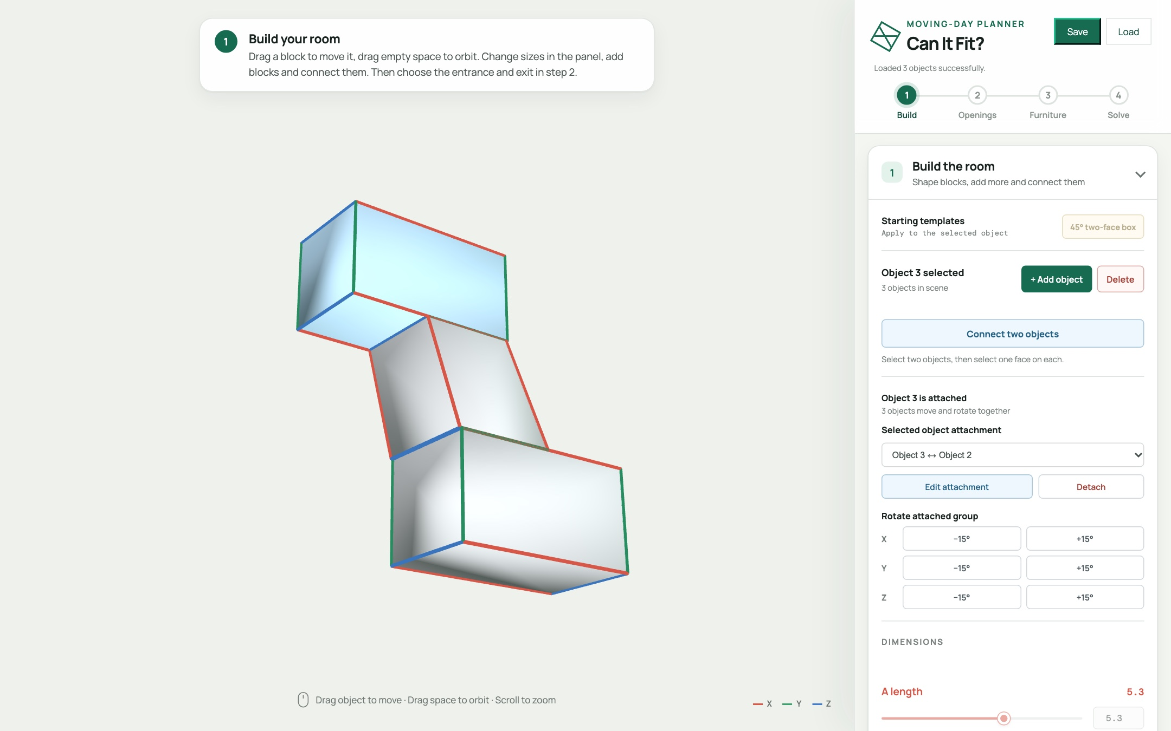
LET'S OPEN THE APP
Four steps, one screen
1
Build
Shape blocks and connect them
2
Openings
Pick where the furniture goes in and out
3
Furniture
Set the size
4
Solve
Try it yourself or let the planner try
Notes:
Here's the app. The big window on the left is the 3D view, and that's where everything you build will appear. On the right is the control panel, and at the top of it you can see the four steps, one through four, with a progress bar that follows you along.
You never have to hunt for the next button, because the app always tells you what to do next.
We'll start with step one, building the room.

Slide 5





HANDS-ON · STEP 1
Build any shape you can imagine
They are all built in my app!
L-shaped hallway
Zig-zag hallway
U shaped staircase
S shaped staircase
Super twisty
1 Shape blocks
2 Connect them
3 Test your furniture
Each of these are built from simple blocks. Change how the blocks are shaped or connected, and you get a different building.
Notes:
Step one is the fun part: building the place your furniture has to travel through.
And here's the best thing about this app: you're not stuck with one shape. Look at these five models. An L-shaped hallway, a zig-zag hallway, U-shaped, S-shaped staircase, and a post-modern super twisted staircase. They're all made from simple blocks. The only difference is how the blocks are shaped and connected.
The recipe is always the same. You shape some blocks, you connect them together, and then you test your furniture inside.
So whatever your own home looks like, a narrow stair, a tight corner, a crooked hallway, you can build it. Let me show you how.

Slide 6






STEP 1 · SHAPE
Shape the blocks
Stretch it
Tilt it
Add more
Drag the length sliders to make a block longer, wider or taller.
Drag the angle sliders. A tilted block becomes a ramp or stairs.
Press + Add object for another block. Build as many as you need.
Length 3.0
Length 7.0
Angle 90°
Angle 60°
1 block
3 blocks
Notes:
Step one: shape your blocks. There are just three things to learn.
First, stretch. Every block has length sliders. Drag one and the block gets longer, wider or taller. Here's a short block, and here's the same block stretched out into a long hallway.
Second, tilt. The angle sliders lean the block over. A box with right angles is a plain hallway, but pull one angle down to sixty degrees and you get a slanted block. That's how you make a ramp, or the slope of a staircase.
And third, add more. Press "Add object" and another block appears. Add as many as you need.
That's the whole toolbox: stretch, tilt, add. The next step is gluing them together.

Slide 7


STEP 1 · CONNECT
Connect them together
Press Connect two objects.
Click one face on each block.
Drag the sliders to rotate and slide them until they line up.
Press Apply. Repeat for every joint.
Just attached
After rotating and sliding
Rotating one block against the other changes the angle between the two surfaces. That's how you bend a hallway.
Drag Rotate moving surface and Move horizontally / vertically in the preview, and watch the blocks line up.
Notes:
Step two: connect the blocks. Press "Connect two objects", then click one face on each block you want to join.
A small preview window opens with three sliders. When two blocks first snap together, they can stick out the wrong way, like on the left.
So you drag the sliders. One rotates the block around the surface it's attached to, and the other two slide it along that surface. Rotating changes the angle between the two surfaces, and that's the trick that bends a hallway, or turns a flat block into stairs.
Watch the right-hand picture: the same two blocks, now lined up into one continuous staircase. When it looks right, press Apply, then repeat for the next joint.
Shape, connect, adjust. With those three moves you can build whatever your own home looks like.

Slide 8
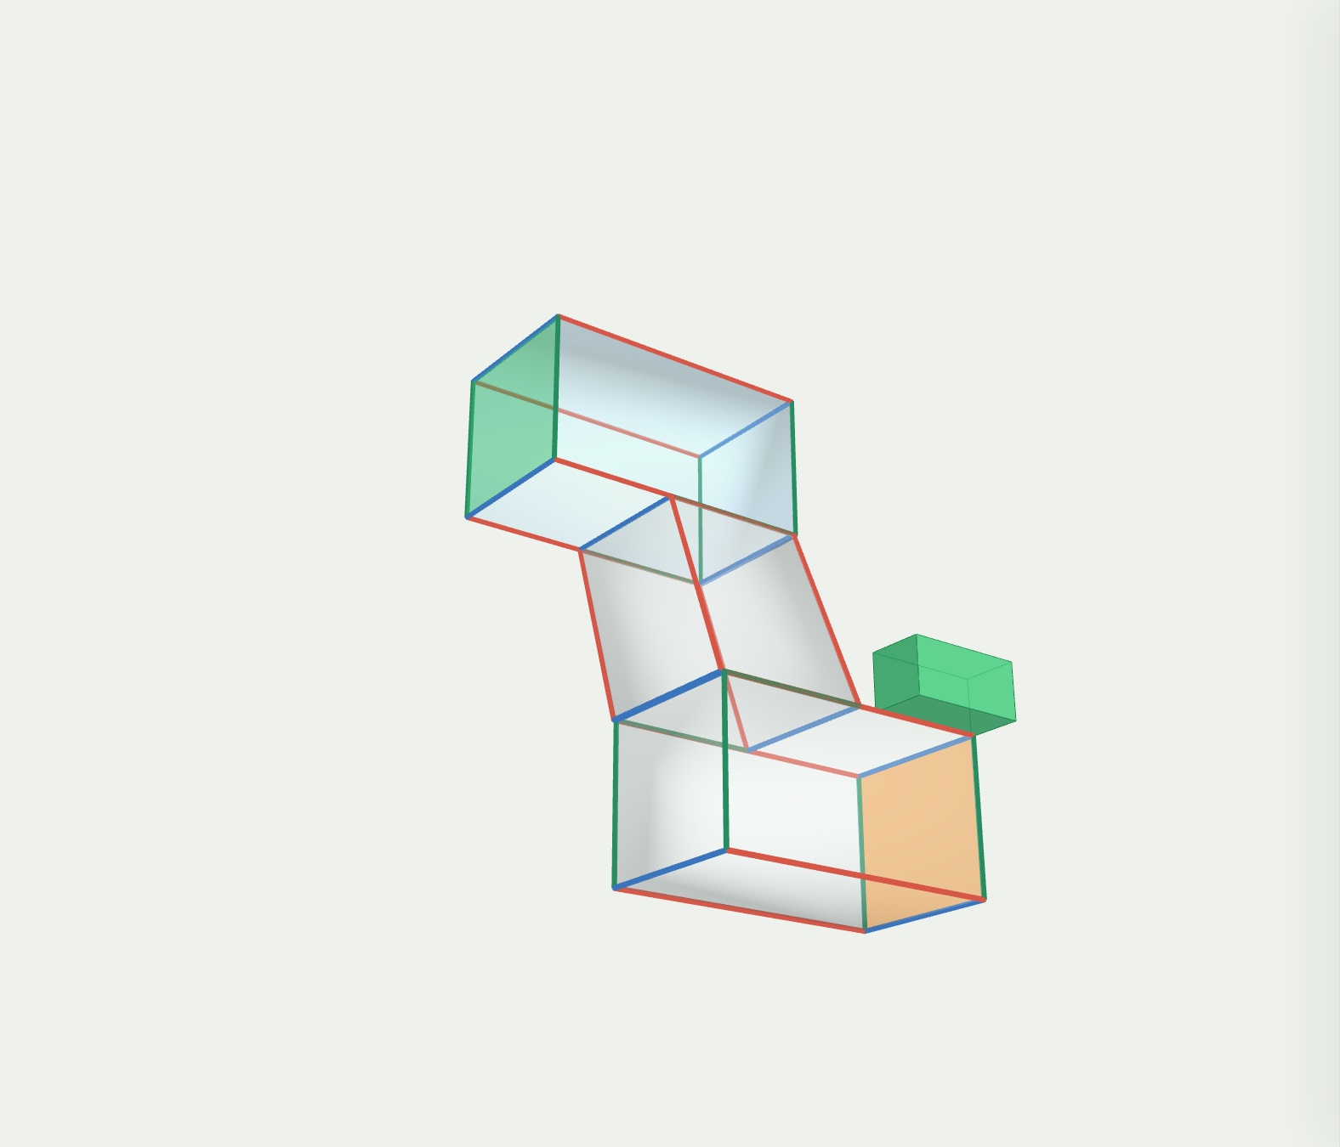
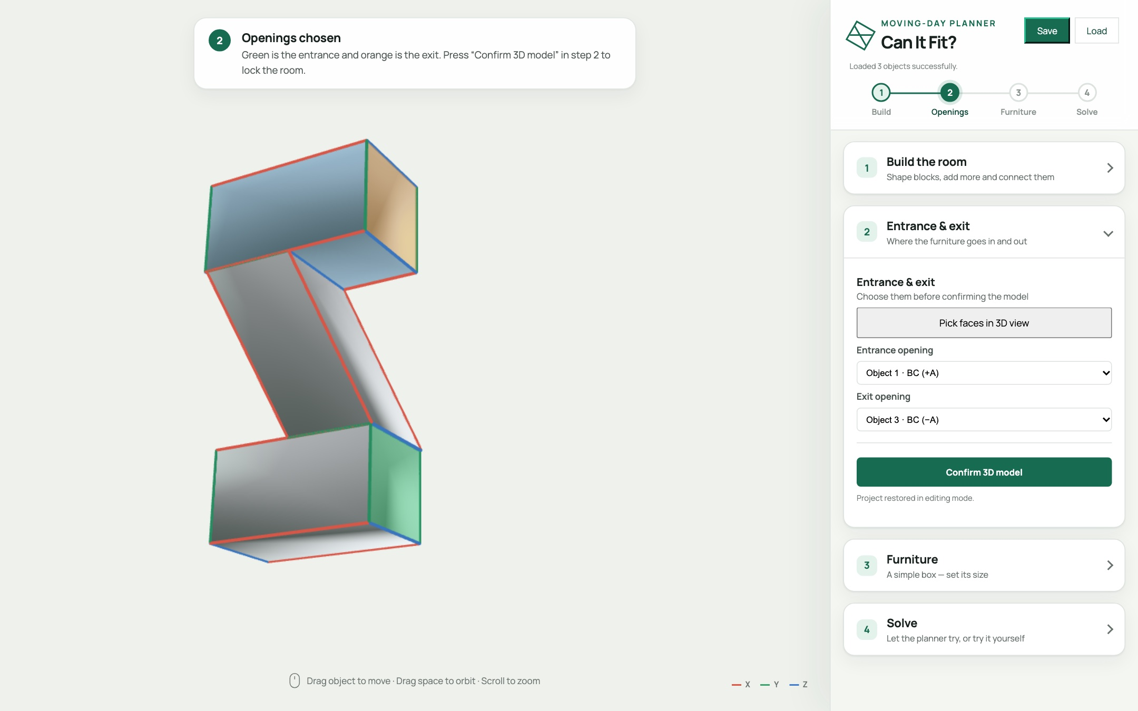
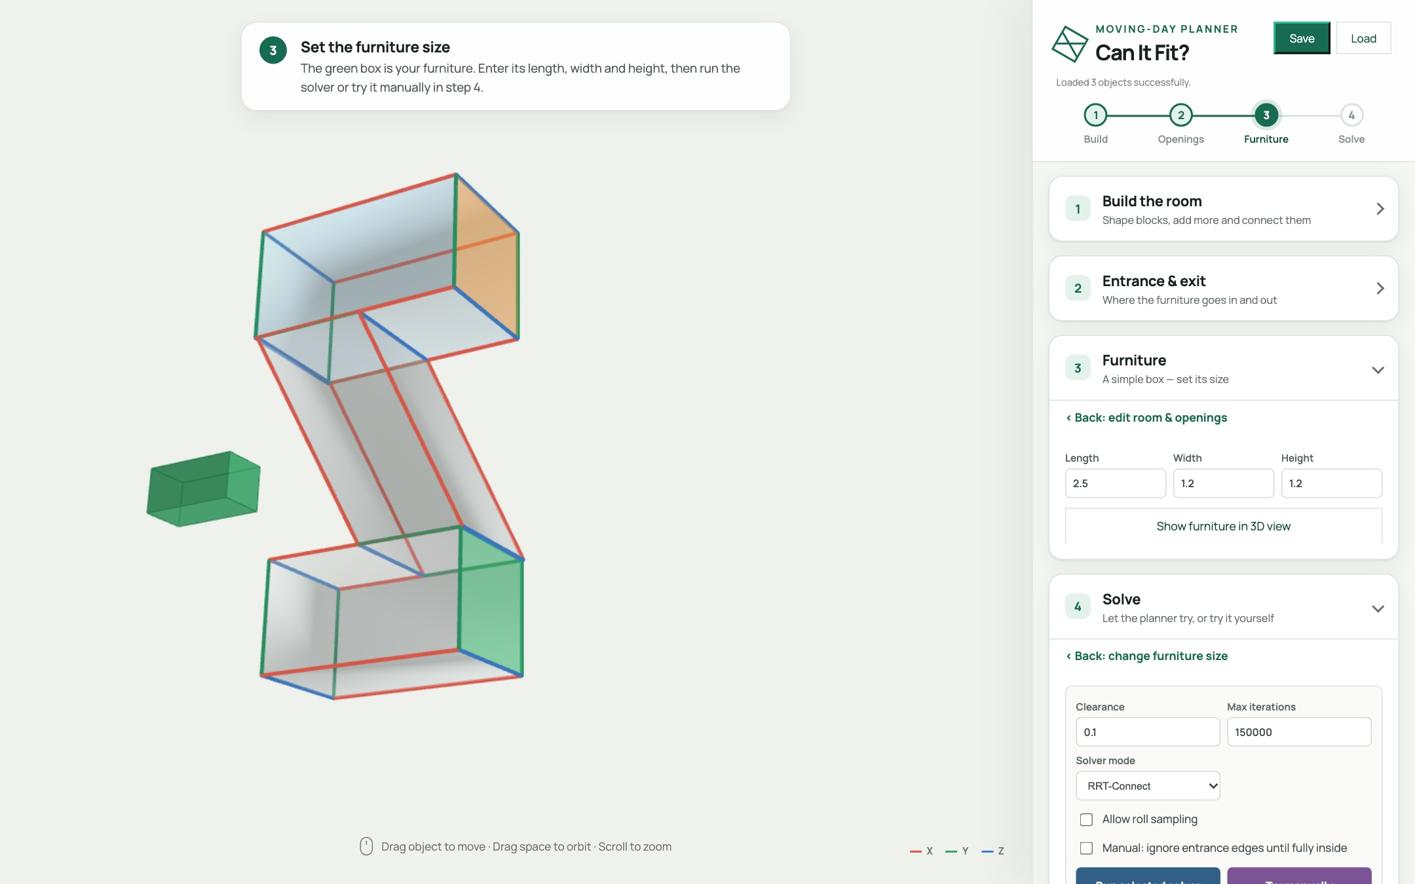
HANDS-ON · STEPS 2 & 3
Pick the doors, set the furniture
Click where the furniture goes in (green) and out (orange).
Press Confirm 3D model. The walls turn see-through.
Type the furniture's length, width and height. The green box previews it.
Only those two faces are doorways. Every other wall stays solid, so the furniture can't cheat.
Entrance and exit
Furniture preview
Notes:
Steps two and three are quick.
First, tell the app where the furniture comes in and where it has to come out. Click the end of the top hallway for the entrance, and it turns green. Then click the end of the bottom hallway for the exit, and it turns orange. Press "Confirm 3D model" and the walls turn see-through.
Those two faces are the only doorways. Every other wall is solid, so the furniture can't cheat by walking through one.
Then type in the size of your furniture: length, width and height. The green box next to the building is a preview of it. I'll start with a big sofa, two and a half by one point two by one point two.

Slide 9
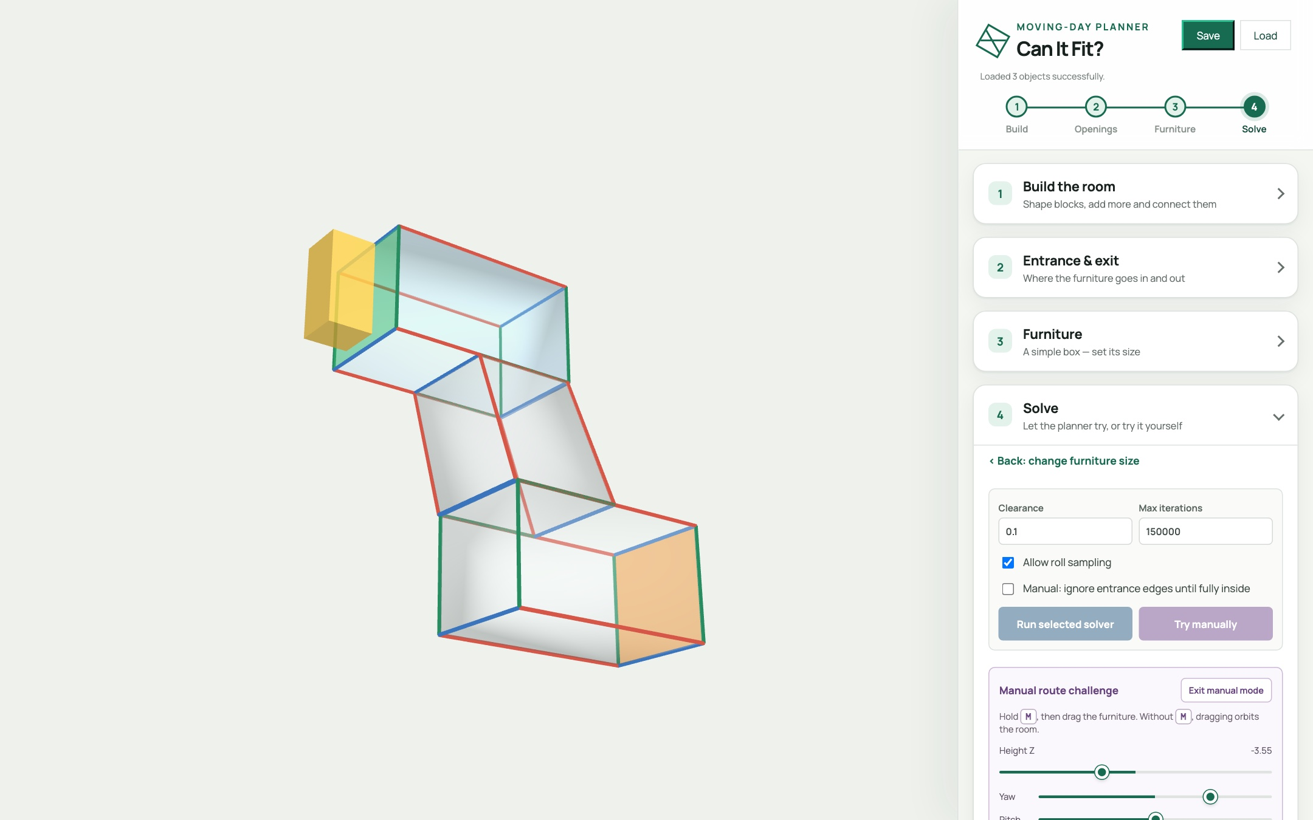
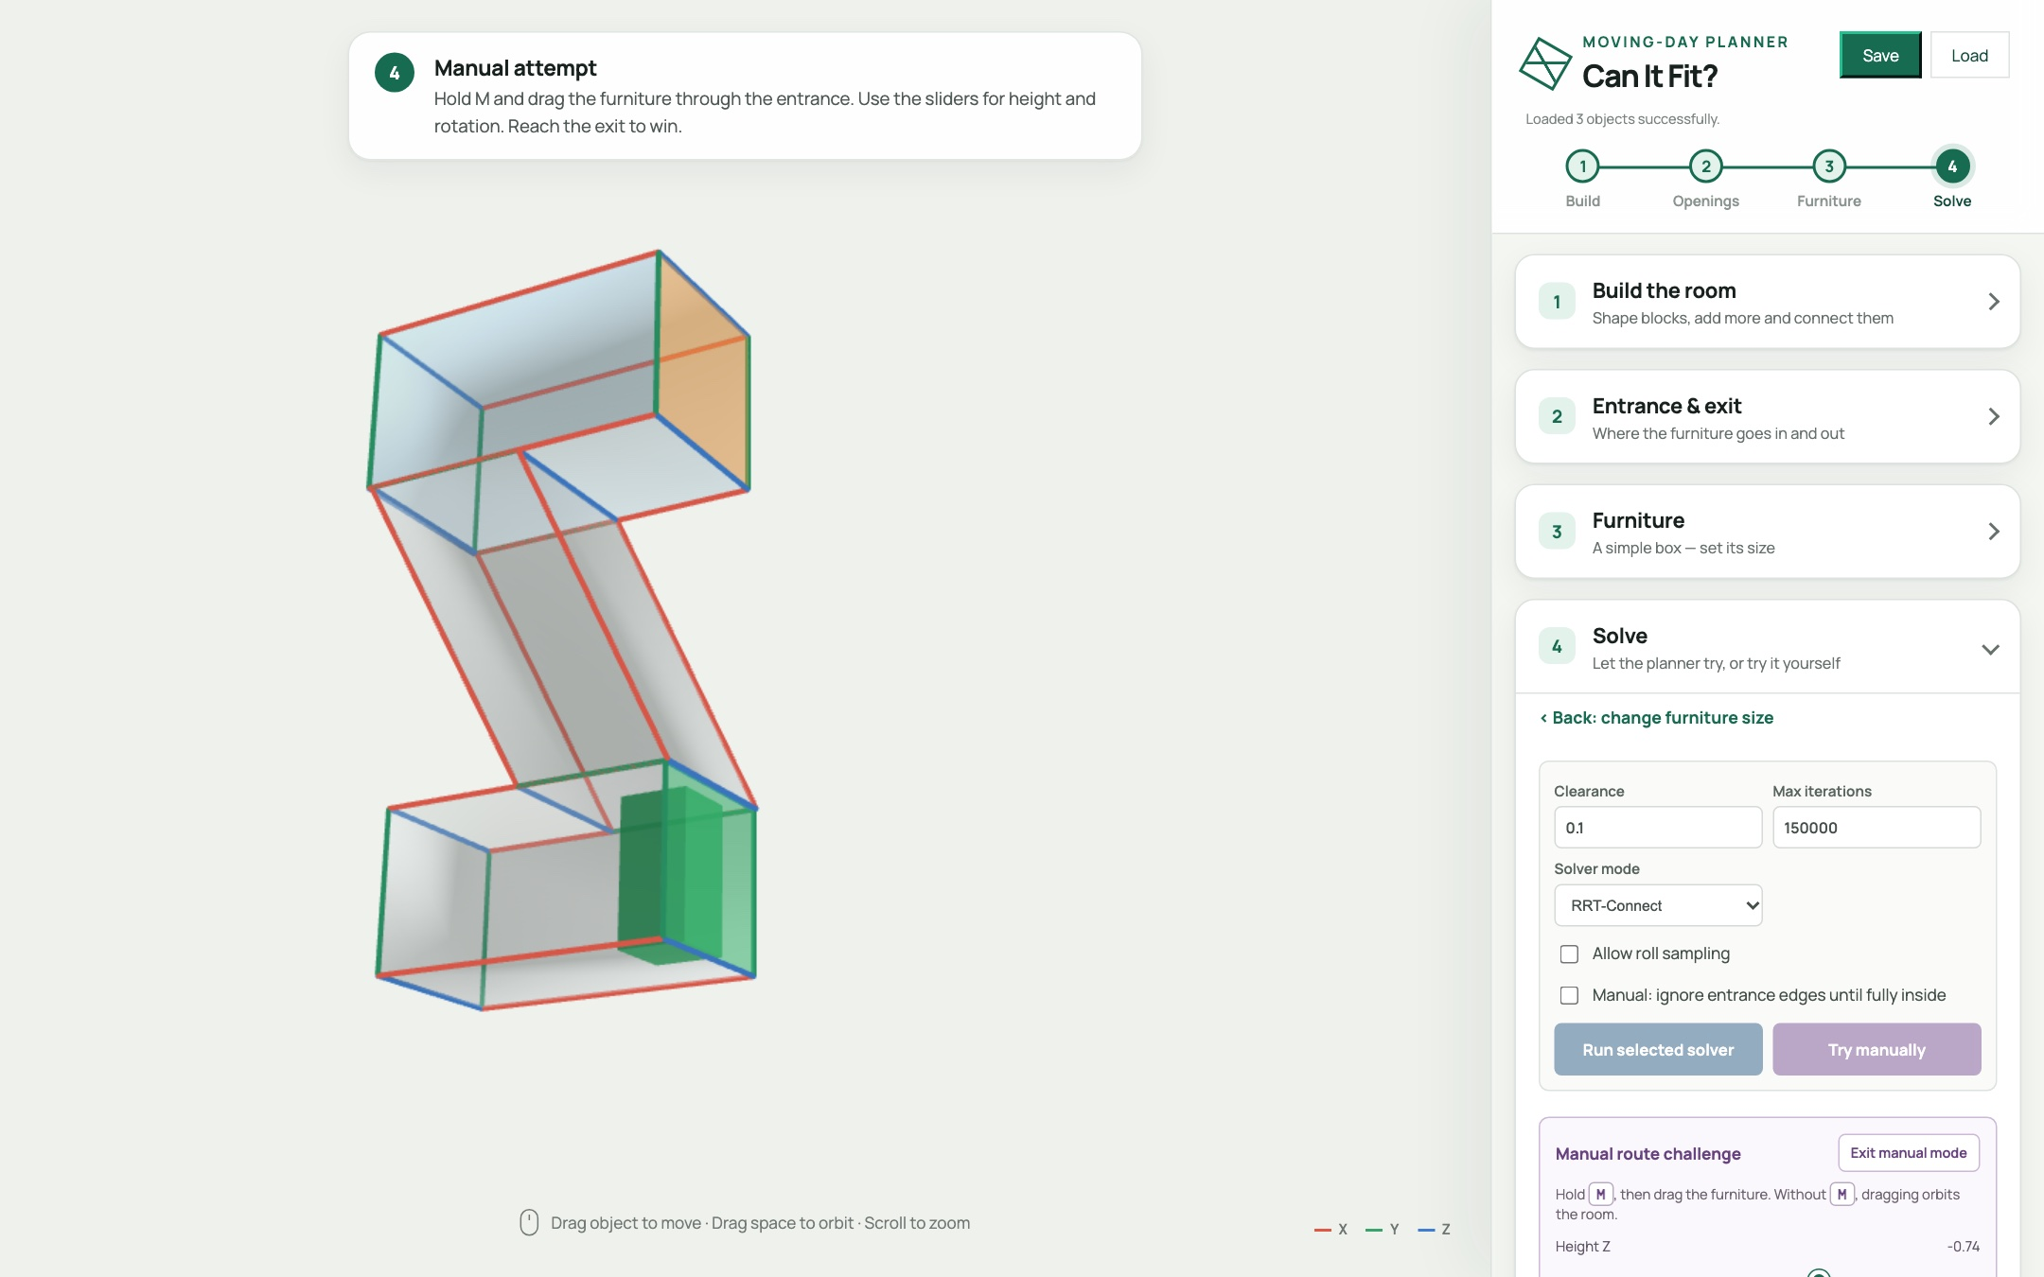
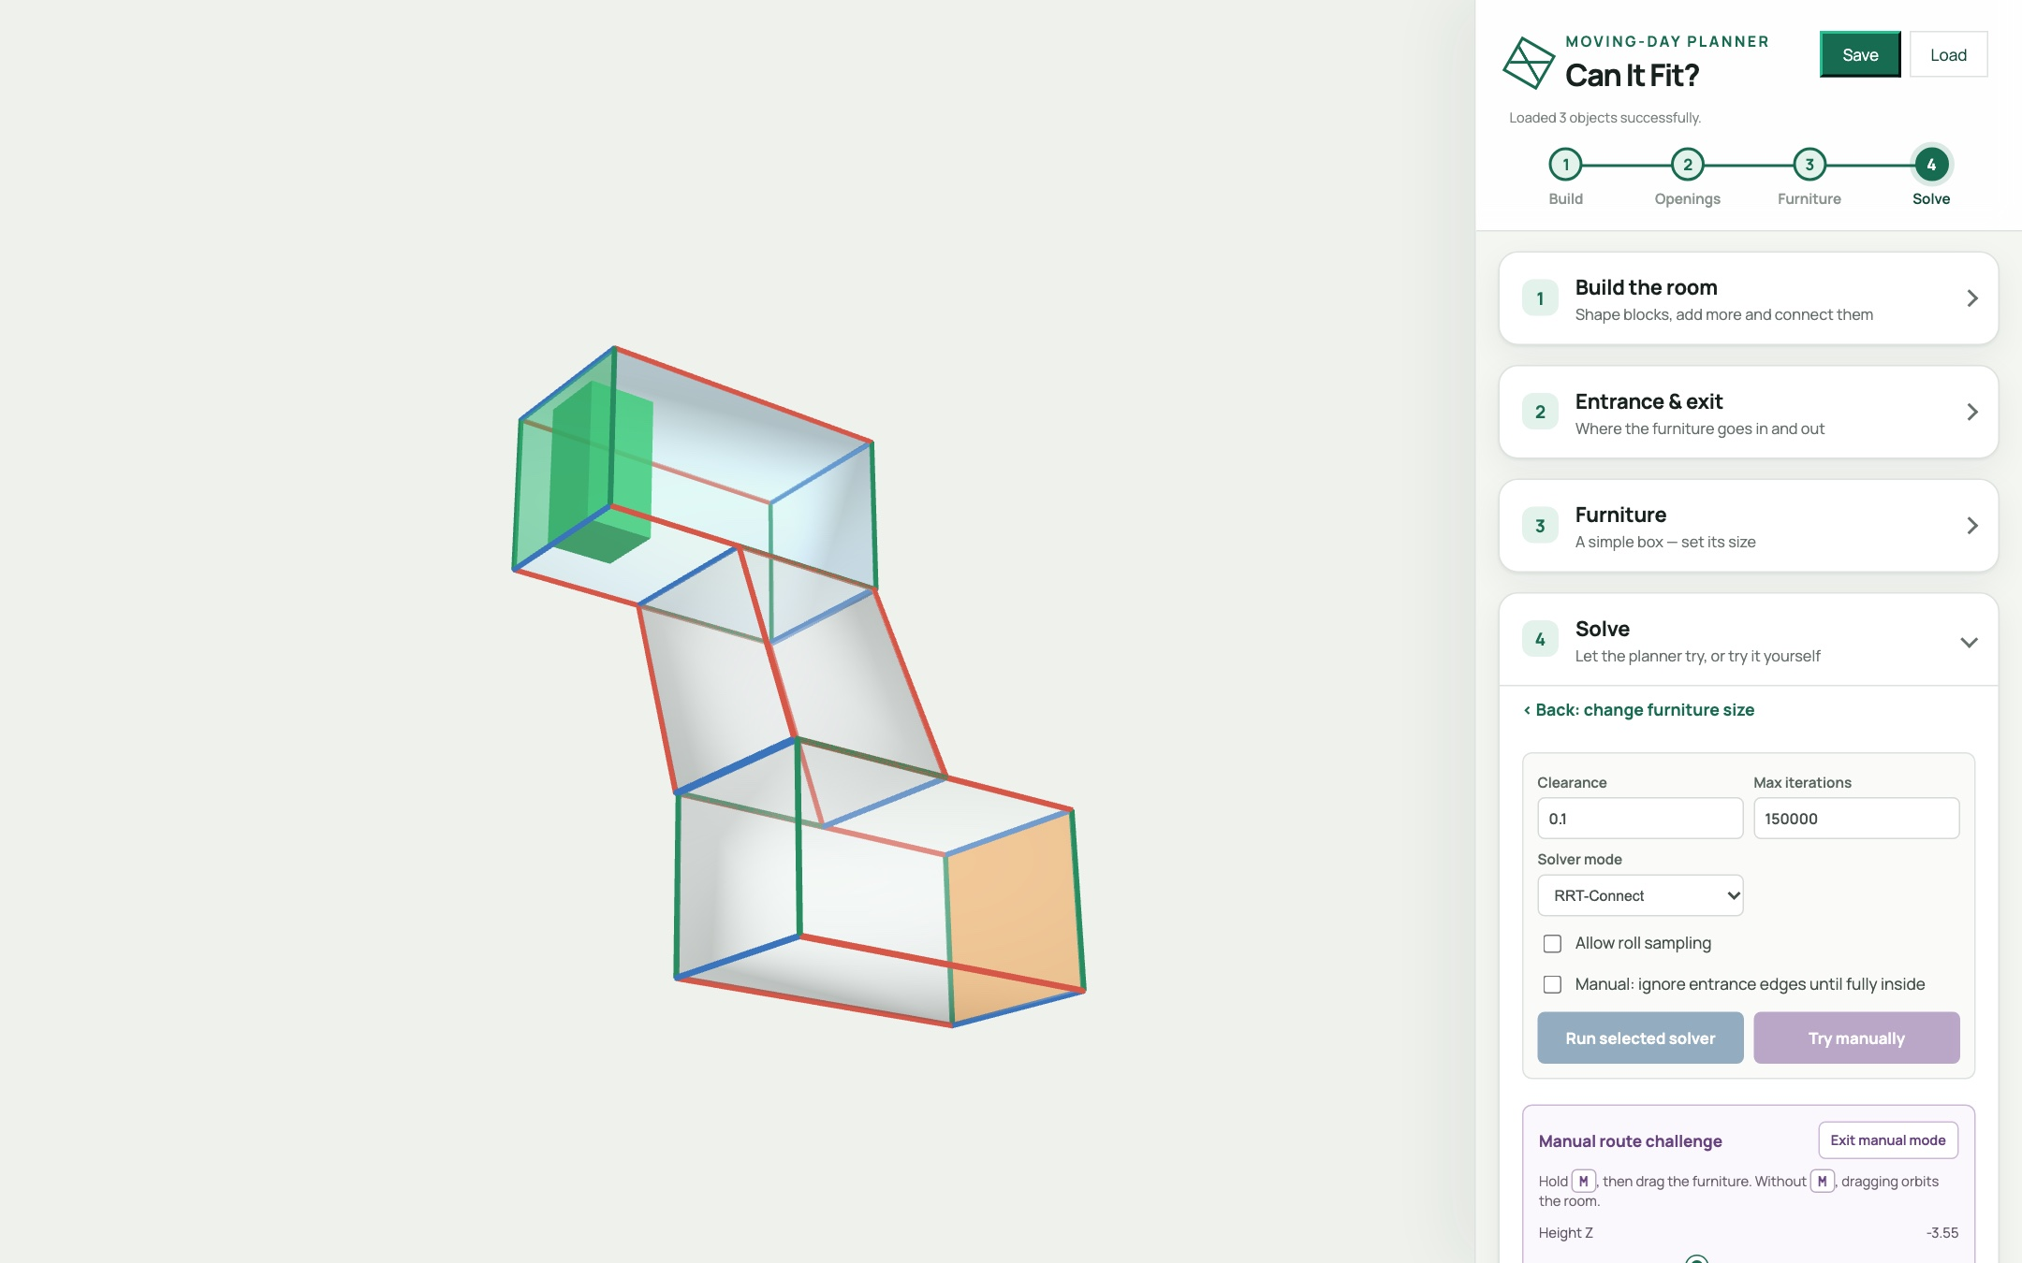
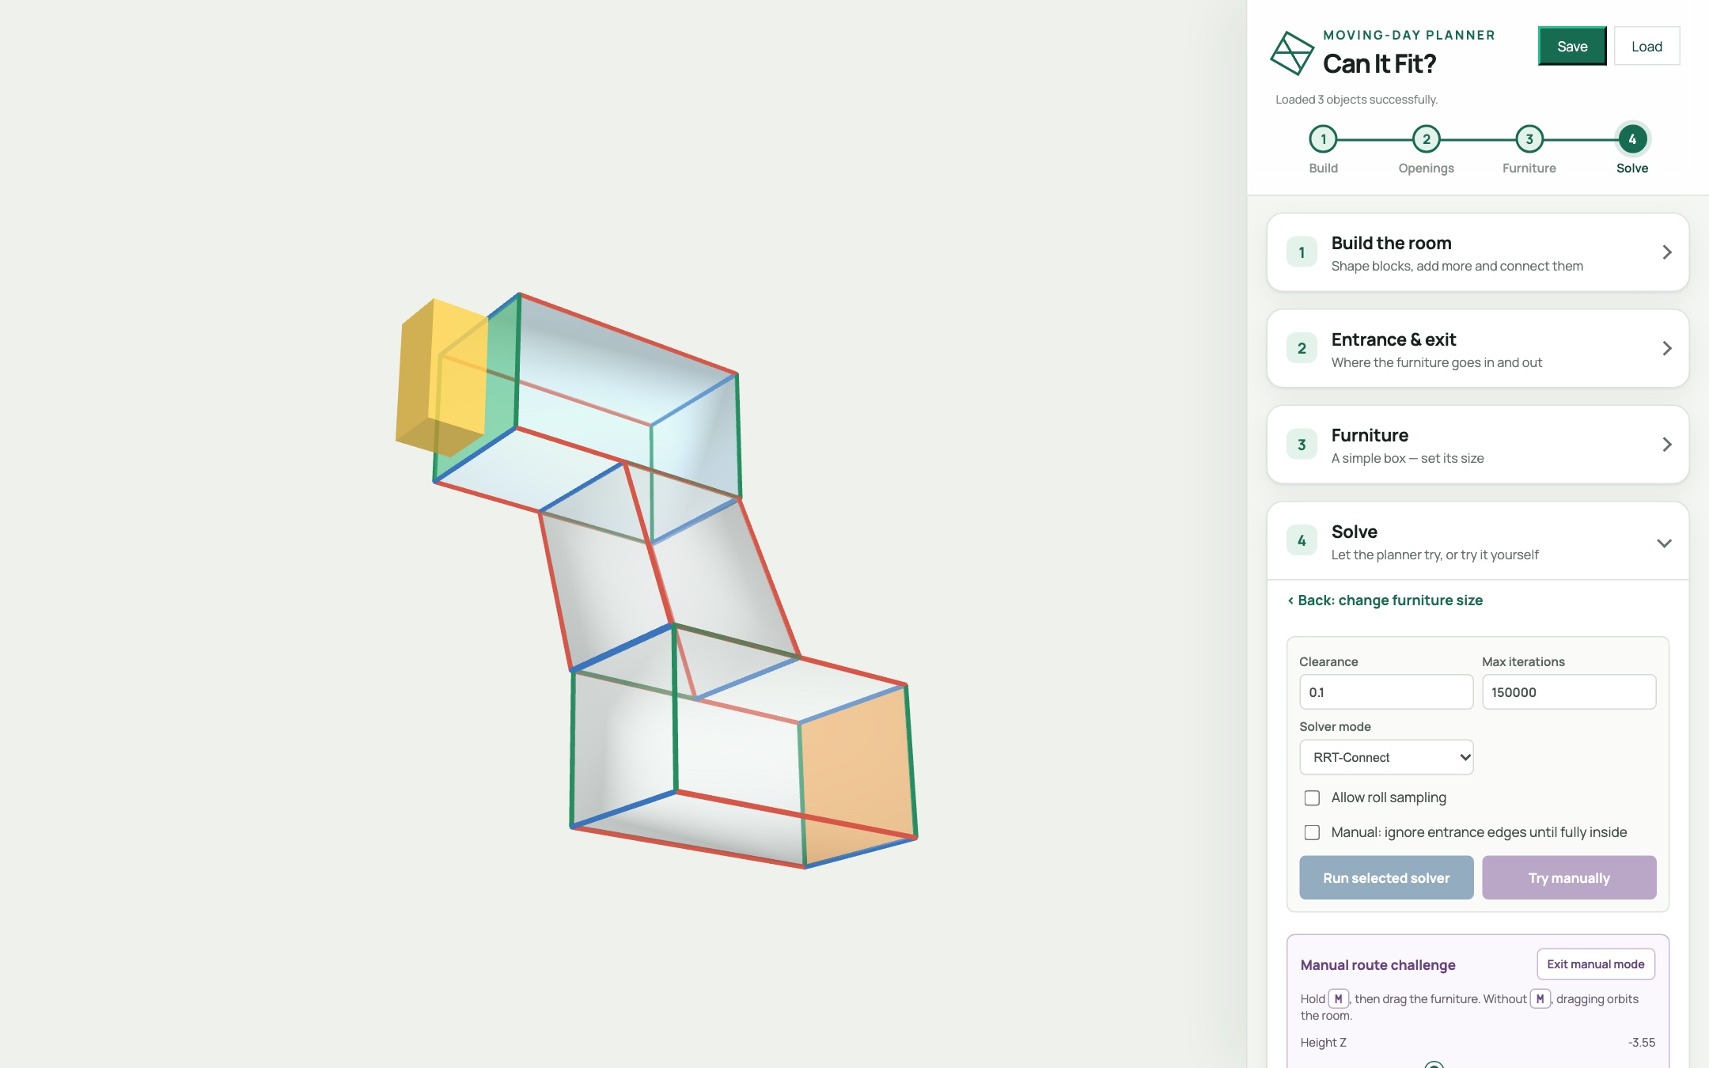
HANDS-ON · STEP 4A
Try it yourself first
Press Try manually. The furniture starts outside the entrance.
Hold M and drag it through. Sliders tilt and lift it.
Stuck? Auto Pilot lines it up for you.
■ legal ■ outside ■ collision
Reach the exit and you win. A pop-up tells you.
Notes:
Before we let the computer try, try it yourself. Press "Try manually" and the furniture starts just outside the entrance.
Hold the M key and drag it into the building. The box turns green when it's legal, yellow when it's outside, and red when it hits a wall. Use the sliders to tilt and lift it.
If you get stuck, Auto Pilot lines the furniture up with a wall for you. Reach the exit and you win.
It's trickier than it looks, which is exactly why a planner is so useful.

Slide 10
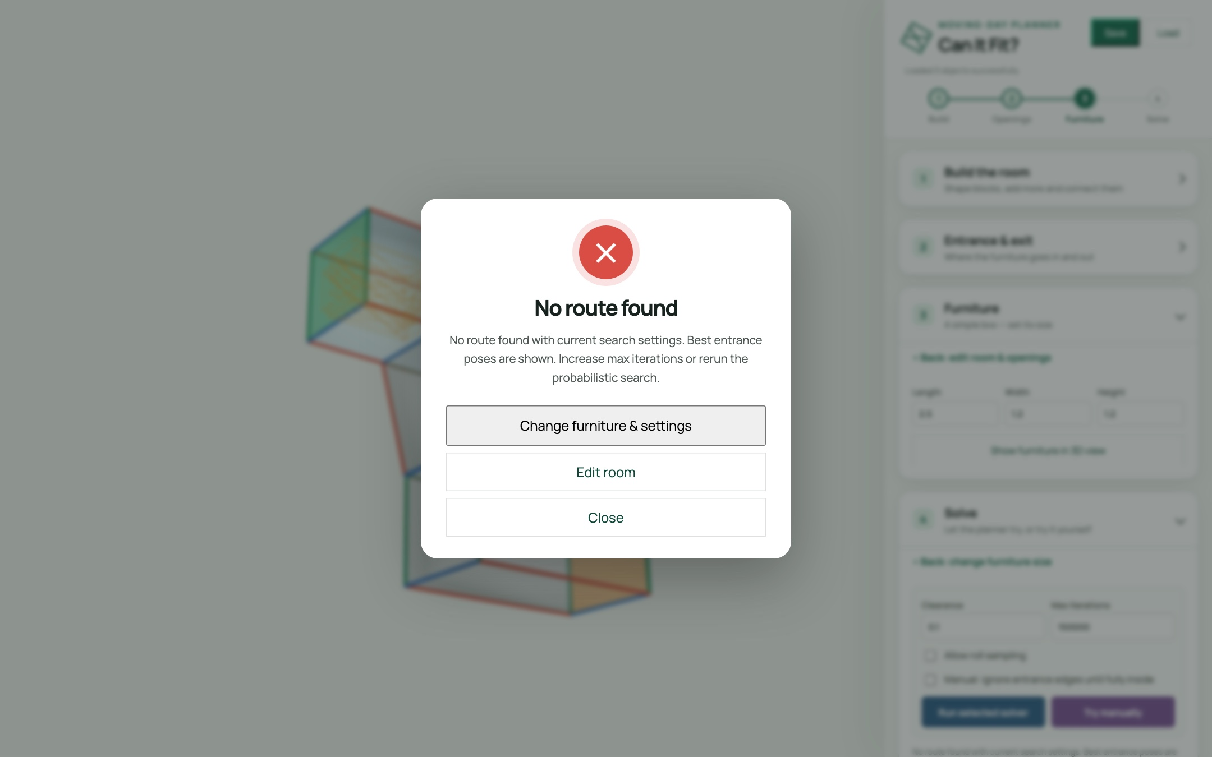
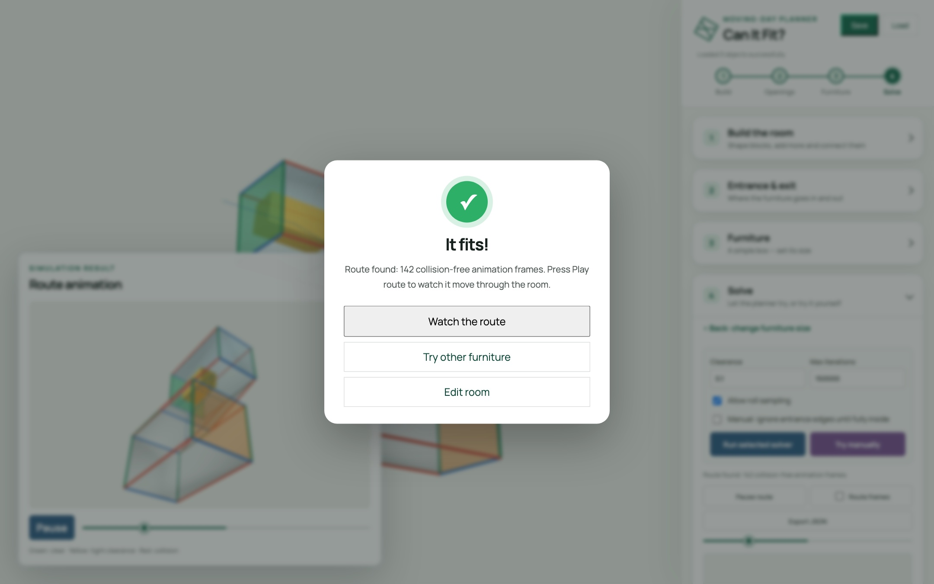
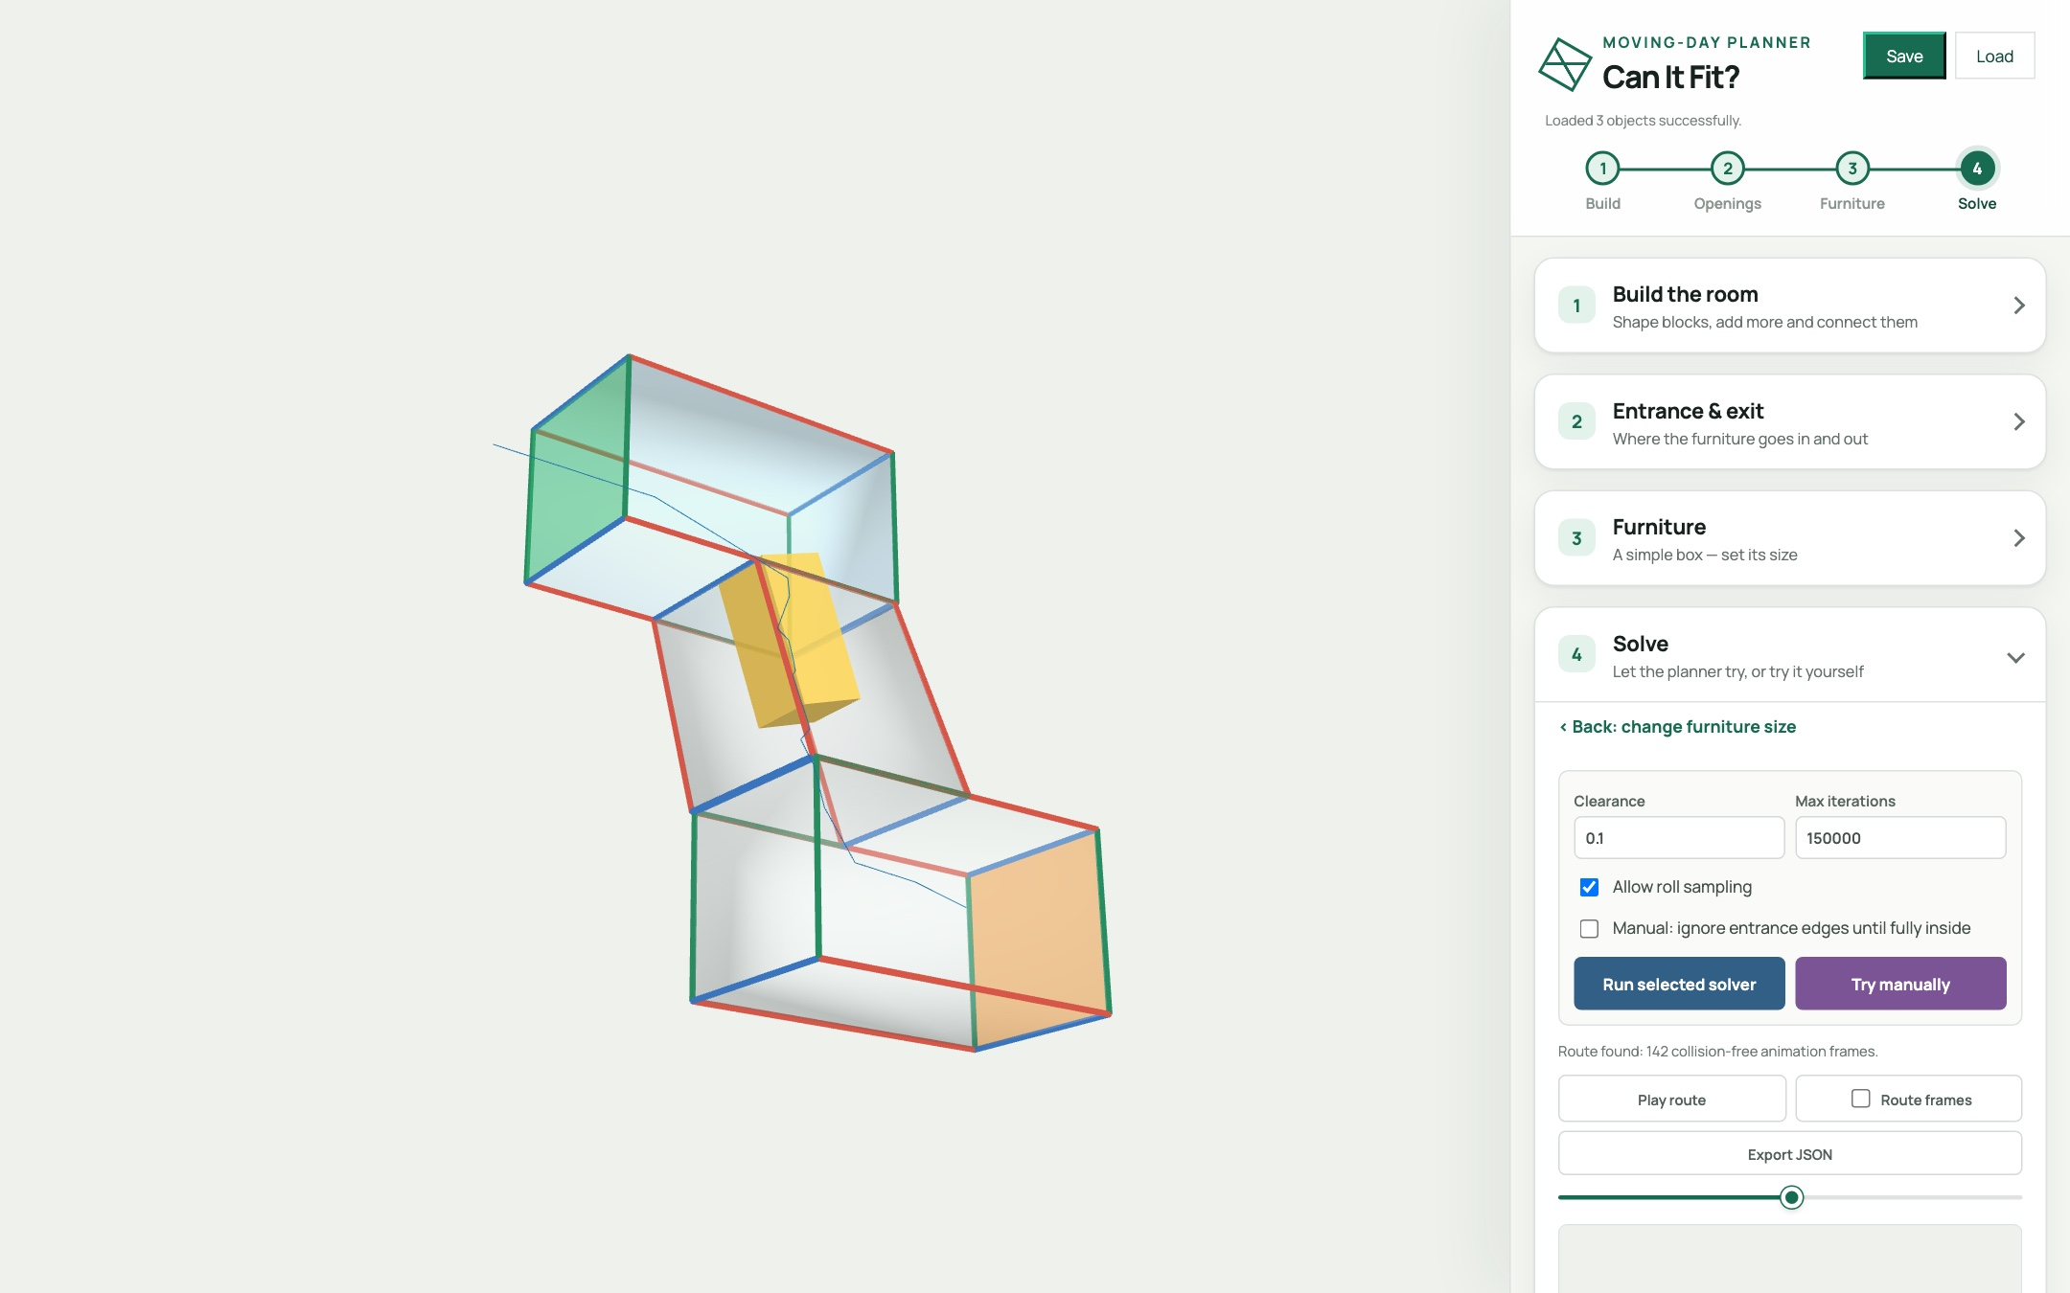
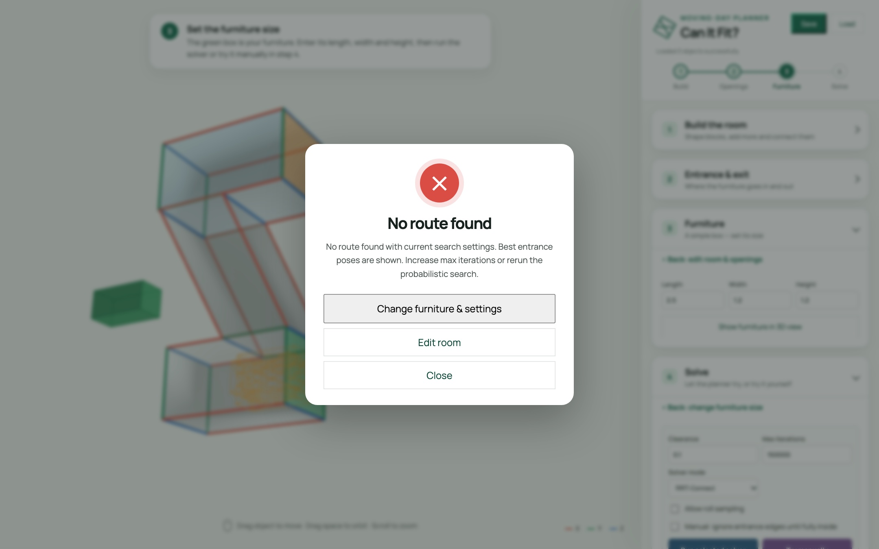
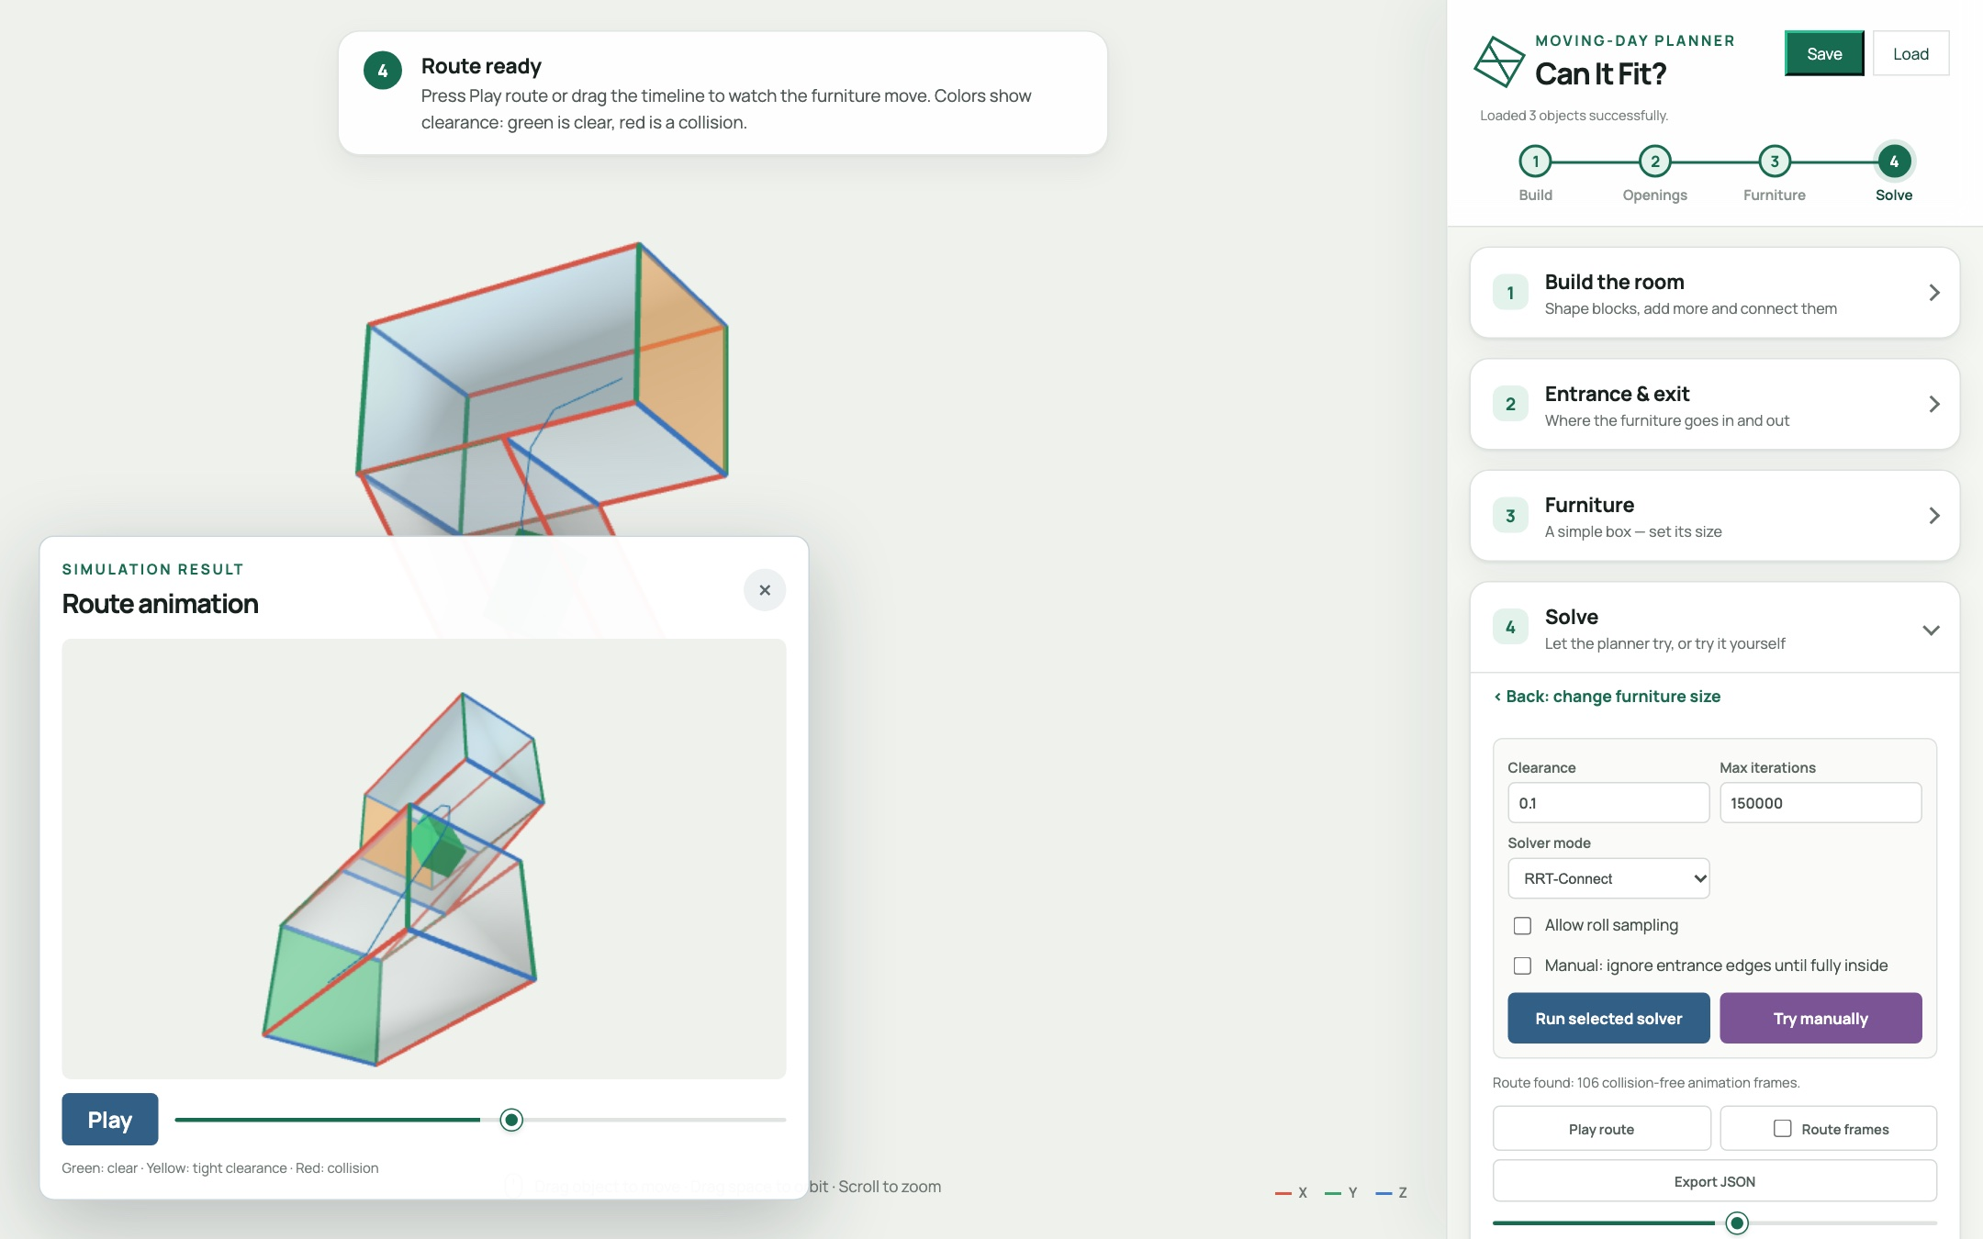
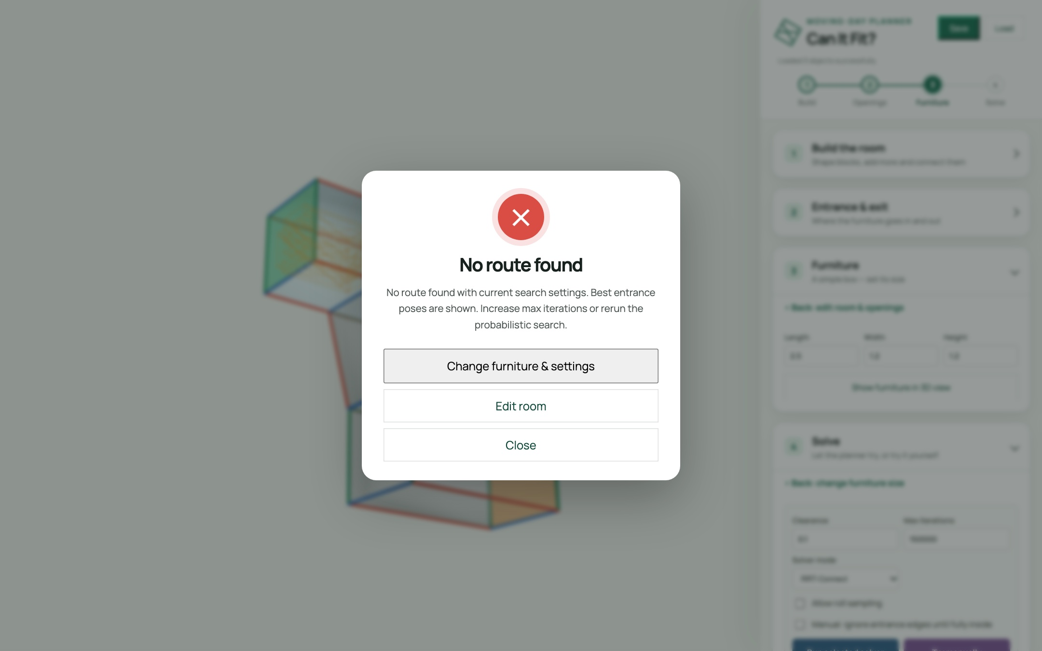
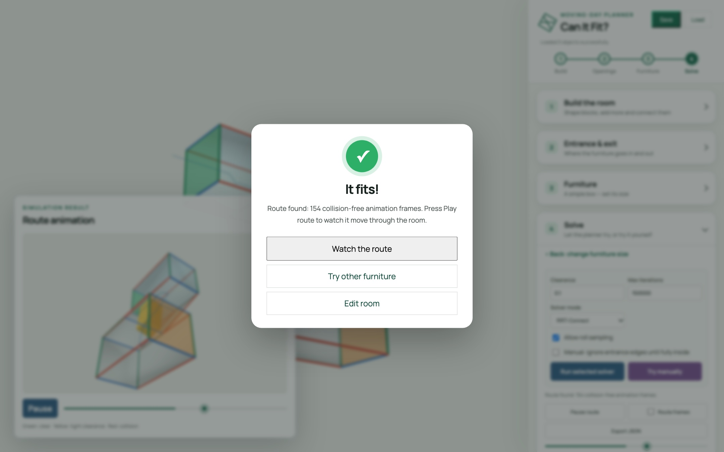
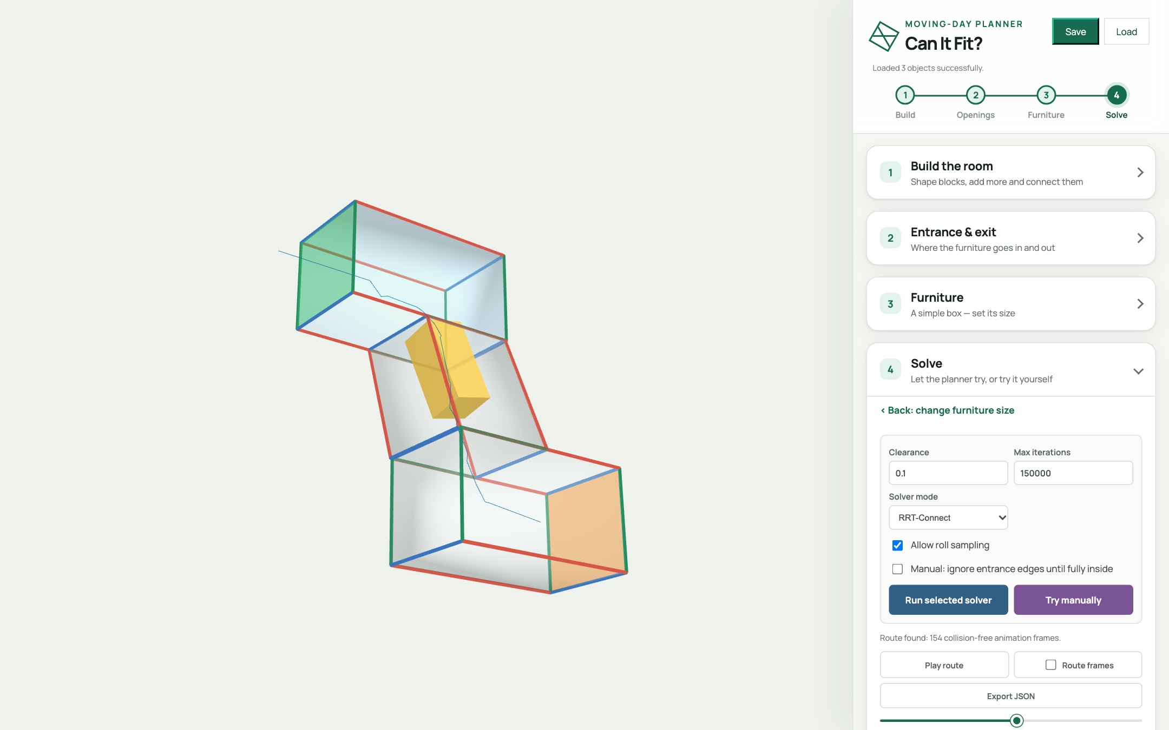
HANDS-ON · STEP 4B
Now let the solver try
Roll sampling OFF: No route found
Roll sampling ON (default): It fits!
The sofa rolls through the stairs
Same building, same sofa, one checkbox. Allow roll sampling is on by default. It lets the planner roll the sofa as well as tilt and turn it, and in tight stairs that's what finds the way. Turn it off and the search fails. "No route found" never proves it's impossible, so change a setting and try again.
Solve settings in the app
Notes:
Now let the computer try. Press "Run selected solver", and the planner searches for a path.
There's one setting worth knowing about, and it's already switched on for you: "Allow roll sampling". It lets the planner roll the sofa onto its side, as well as tilt it and turn it. In a tight stairwell, that's exactly the extra move that makes the difference.
To see why, I turned it off. Our big sofa, two and a half by one point two by one point two, comes back with: "No route found". Now, be careful how you read that. The search is random, so it can't prove that no route exists. It just didn't find one.
With roll sampling on, the way it is by default, the same sofa comes back with: "It fits!" A hundred and forty-two collision-free frames. Drag the timeline and you can watch the sofa roll its way up through the stairs.
Same building, same sofa, one checkbox. That's the whole point of the tool: you can test a move before you ever lift a couch.

Slide 11
UNDER THE HOOD
How does it
actually work?
1 · Pose
2 · Collision
3 · Search
How is a position stored?
How do we know it's legal?
How do we find a path?
Notes:
So far you've seen what it does. Now let's open the hood.
Three questions. How is a position stored? How do we know a position is legal? And how do we search for a path?
By answering those three questions, you will understand the whole planner.

Slide 12

TECHNIQUE · 1
A position is six numbers
// furniture pose
{ x, y, z,
yaw, pitch, roll }
3 to translate, 3 to rotate
Rotations use Euler order ZYX, converted to a quaternion
Allow roll sampling off? The search drops to 5-D — faster
Notes:
Question one: how do you describe where a couch is?
With six numbers. X, Y and Z for position, and yaw, pitch and roll for rotation.
The code stores that as a simple object, and converts the three angles into a quaternion, using Z-Y-X Euler order. We use the same convention everywhere, so rendering, collision checking and saving always agree.
And here's a neat trick: "Allow roll sampling" is on by default, so the search uses all six dimensions. Turn it off and it drops to five, which is faster, but as you saw on the solver slide, some tight spots, like our staircase, can only be solved by rolling the furniture.

Slide 13

TECHNIQUE · 2
Is this pose legal?
Every point must be inside the room
Between two poses we interpolate and check every step
Crossing a wall is allowed only through the entrance / exit polygon
Notes:
Question two: given a pose, is it legal?
If every boundary point of the furniture is inside the room, the pose is legal.
To check a move between two poses, we interpolate and test every little step along the way.
And crossing a wall? That's only allowed through the entrance or exit.
It's the exact same check for manual mode and for the solver. Nobody gets special treatment.

Slide 14

TECHNIQUE · 3
RRT-Connect: two trees, one path
One tree grows from the start, one from the goal
Then the other tree greedily chases that new node
Trees touch → path found. Smooth it, resample it, animate it
Probabilistic: finding a route proves it fits — failing doesn't prove it can't. Run it again or raise iterations. We never "fix" failures by quietly shrinking clearance.
Notes:
Question three: how do we find a path through six-dimensional space?
With an algorithm called RRT-Connect. RRT stands for Rapidly-exploring Random Tree.
Specifically, RRT-Connect grows two trees, one from the start and one from the goal.
It randomly samples new nodes in each iteration, attempting to connect the two trees while avoiding the obstacles.
When the two trees touch, we have a path. We smooth it, resample it, and animate it.
One honest caveat. It's probabilistic. So Finding a route proves the furniture fits.
But failing to find one does not prove it can't. You may try run it again, raise the iterations, or use the manual solver.

Slide 15

TECHNIQUE · 4
Smart starts beat pure luck
Random sampling alone rarely threads a tight doorway. So we seed the search:
Sample offsets across the opening × 15° yaw / pitch / roll orientations
Refine the promising ones at 5°
Probe inward: how deep does each candidate get?
Rank by depth, clearance, alignment, offset, tilt
Feed the top poses as many starts and goals
Notes:
Pure random sampling struggles with a tight doorway. The chance of randomly guessing a good entrance pose is tiny.
So we don't start blind. We sample offsets across the opening, combined with fifteen-degree yaw, pitch and roll orientations. We refine the promising ones at five degrees. Then we probe each candidate inward, to see how deep it gets.
We rank them by depth, clearance, alignment, offset and tilt, and feed the best ones to the planner as candidate starting poses.
And this will increase the chance of successfully finding a path.

Slide 16

YOUR TURN
Challenge: find the tipping point
Build an L-shaped hallway: two blocks (5 * 2 * 2), connected end to end
Furniture (1.5 * 1.2 * 1.2), clearance 0.1
Try it manually, then run the solver
Increase the furniture size until it stops fitting
What happens when you try turning roll sampling off?
🛋️
What's the largest sofa that fits your hallway?
Share your number in the comments.
entrance
exit
Notes:
Now it's your turn.
Build an L-shaped hallway out of two connected blocks. You can make furniture and clearance of this size
Try it manually first. Then run the solver.
Then increase the furniture size until it stops fitting, and then turn roll sampling off and see what changes.
So here's the question: what's the largest sofa that fits your hallway?
Pause the video, give it a go, and drop your number in the comments. I'm really curious what you find.

Slide 17

TRY IT NOW
Open it in your browser
LAUNCH THE APP — NO INSTALL
volcano1998.github.io/FurnitureSim_3D
SLIDES + POWERPOINT
volcano1998.github.io/FurnitureSim_3D/slides
SOURCE CODE ON GITHUB
github.com/volcano1998/FurnitureSim_3D
Click any card to open it
Prefer to run it locally? One command: python3 -m http.server 8000 — see the README.
Thanks for watching — go move some couches.
Notes:
That's everything. And the best part: you can try it right now.
The app is live in your browser. No install, no account. The link is on screen and in the description.
The full source code is on GitHub, so you can read the planner, change it, or even add your own solver.
Thanks so much for watching. Now go move some couches.

