Slide 1

MOTION PLANNING IN THE BROWSER
Can It
Fit?
Will the sofa make it through the hallway? Let's build the room, then let a robot-style planner figure it out — and learn how it thinks.
THREE.JS
RRT-CONNECT
NO BUILD STEP
Notes:
Have you ever been stuck on a staircase, holding one end of a couch, thinking: "there is no way this fits"?
Today we're going to settle that argument with math.
I built a browser app called Can It Fit. You design a room in 3D, drop in a piece of furniture, and a motion planner figures out whether it can actually get through.
In the next few minutes I'll show you how to use it, and then, the fun part, how the planner really thinks. No installs. No build step. Just a browser.
Let's go.

Slide 2
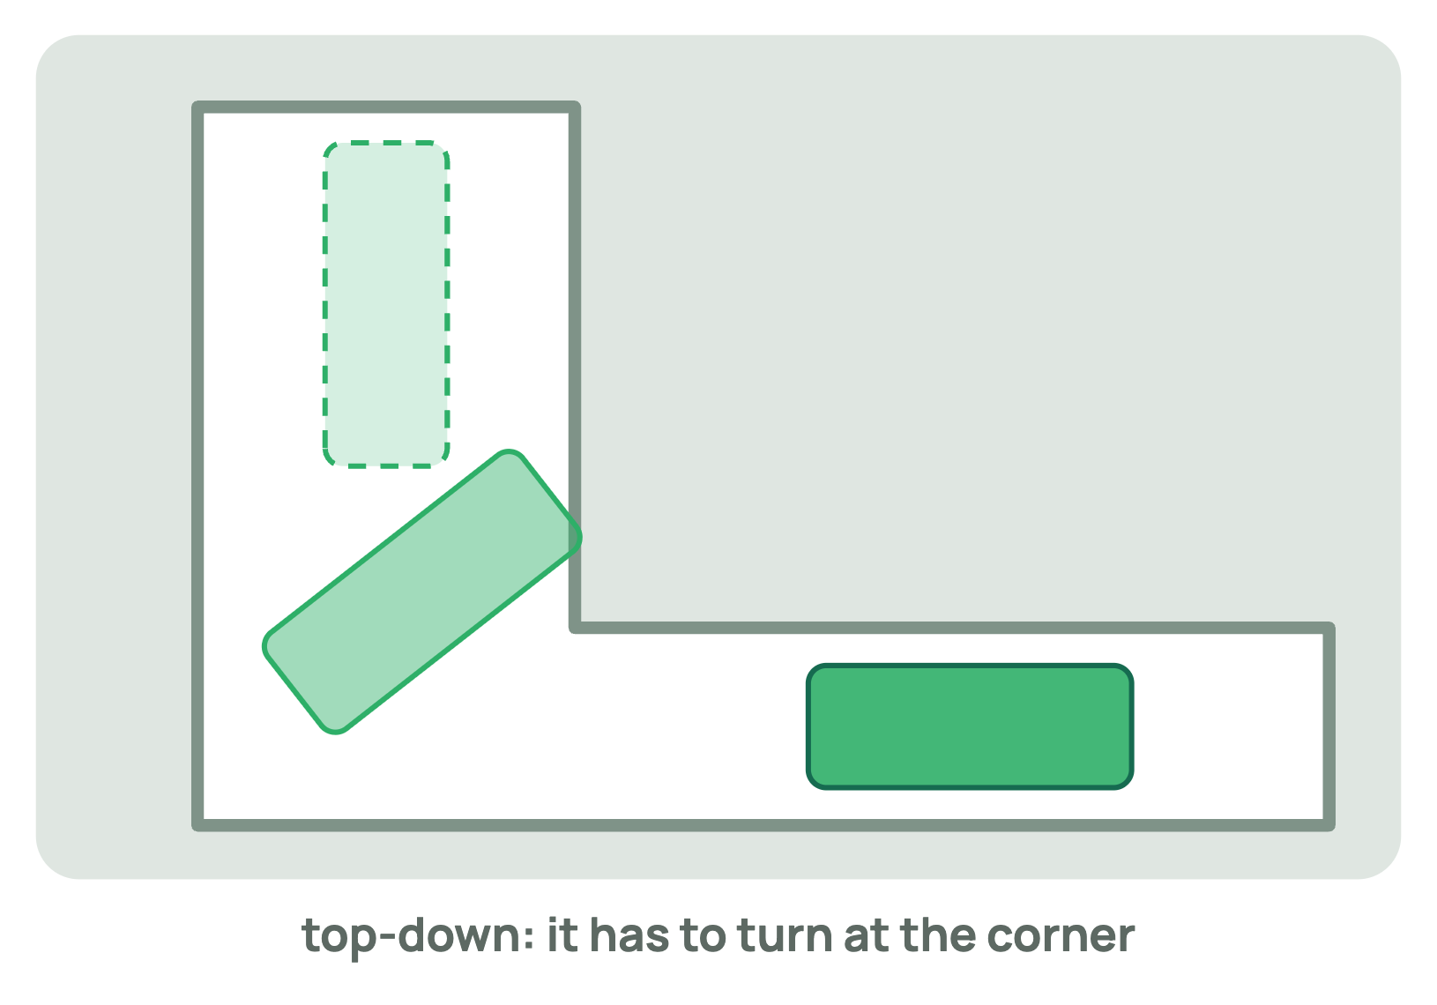
THE PROBLEM
Moving a couch is a 6-dimensional puzzle
It slides in 3 directions: x, y, z
It spins in 3 ways: yaw, pitch, roll
Walls, corners and doorways don't care how clever you are
"Does it fit?" really means: is there a collision-free path through 6-D space?
Notes:
Here's why this is harder than it looks.
A couch isn't just sliding along a hallway. It can move in three directions, and it can rotate in three ways: yaw, pitch and roll. That's six degrees of freedom.
So "does it fit?" is secretly a question about finding a path through six-dimensional space, where every single pose along the way has to avoid every wall.
Look at this corner. The sofa can't just slide through. It has to turn, at exactly the right moment, by exactly the right amount.
That turning is what makes this problem interesting.

Slide 3
WHAT YOU'LL SEE
One app, three ways to answer it
3D room editor
Two auto-solvers
Manual mode
Rooms are boxes defined by an origin and three edge vectors. Stretch, skew, add, connect.
A probabilistic one (RRT-Connect) and a deterministic straight-shot heuristic.
Hold M, drag the furniture yourself. The app tells you when you collide.
1 Build
2 Entrance & exit
3 Furniture
4 Solve
Notes:
The app gives you three ways to answer the question.
First, a 3D room editor. Every room is a box defined by an origin and three edge vectors, and you can stretch it, skew it, and connect boxes together.
Second, two automatic solvers: a probabilistic one called RRT-Connect, and a deterministic straight-shot heuristic.
Third, manual mode, where you grab the furniture yourself and try.
Everything follows four simple steps: build the room, choose the entrance and exit, describe the furniture, and solve. Let's walk through each one.

Slide 4
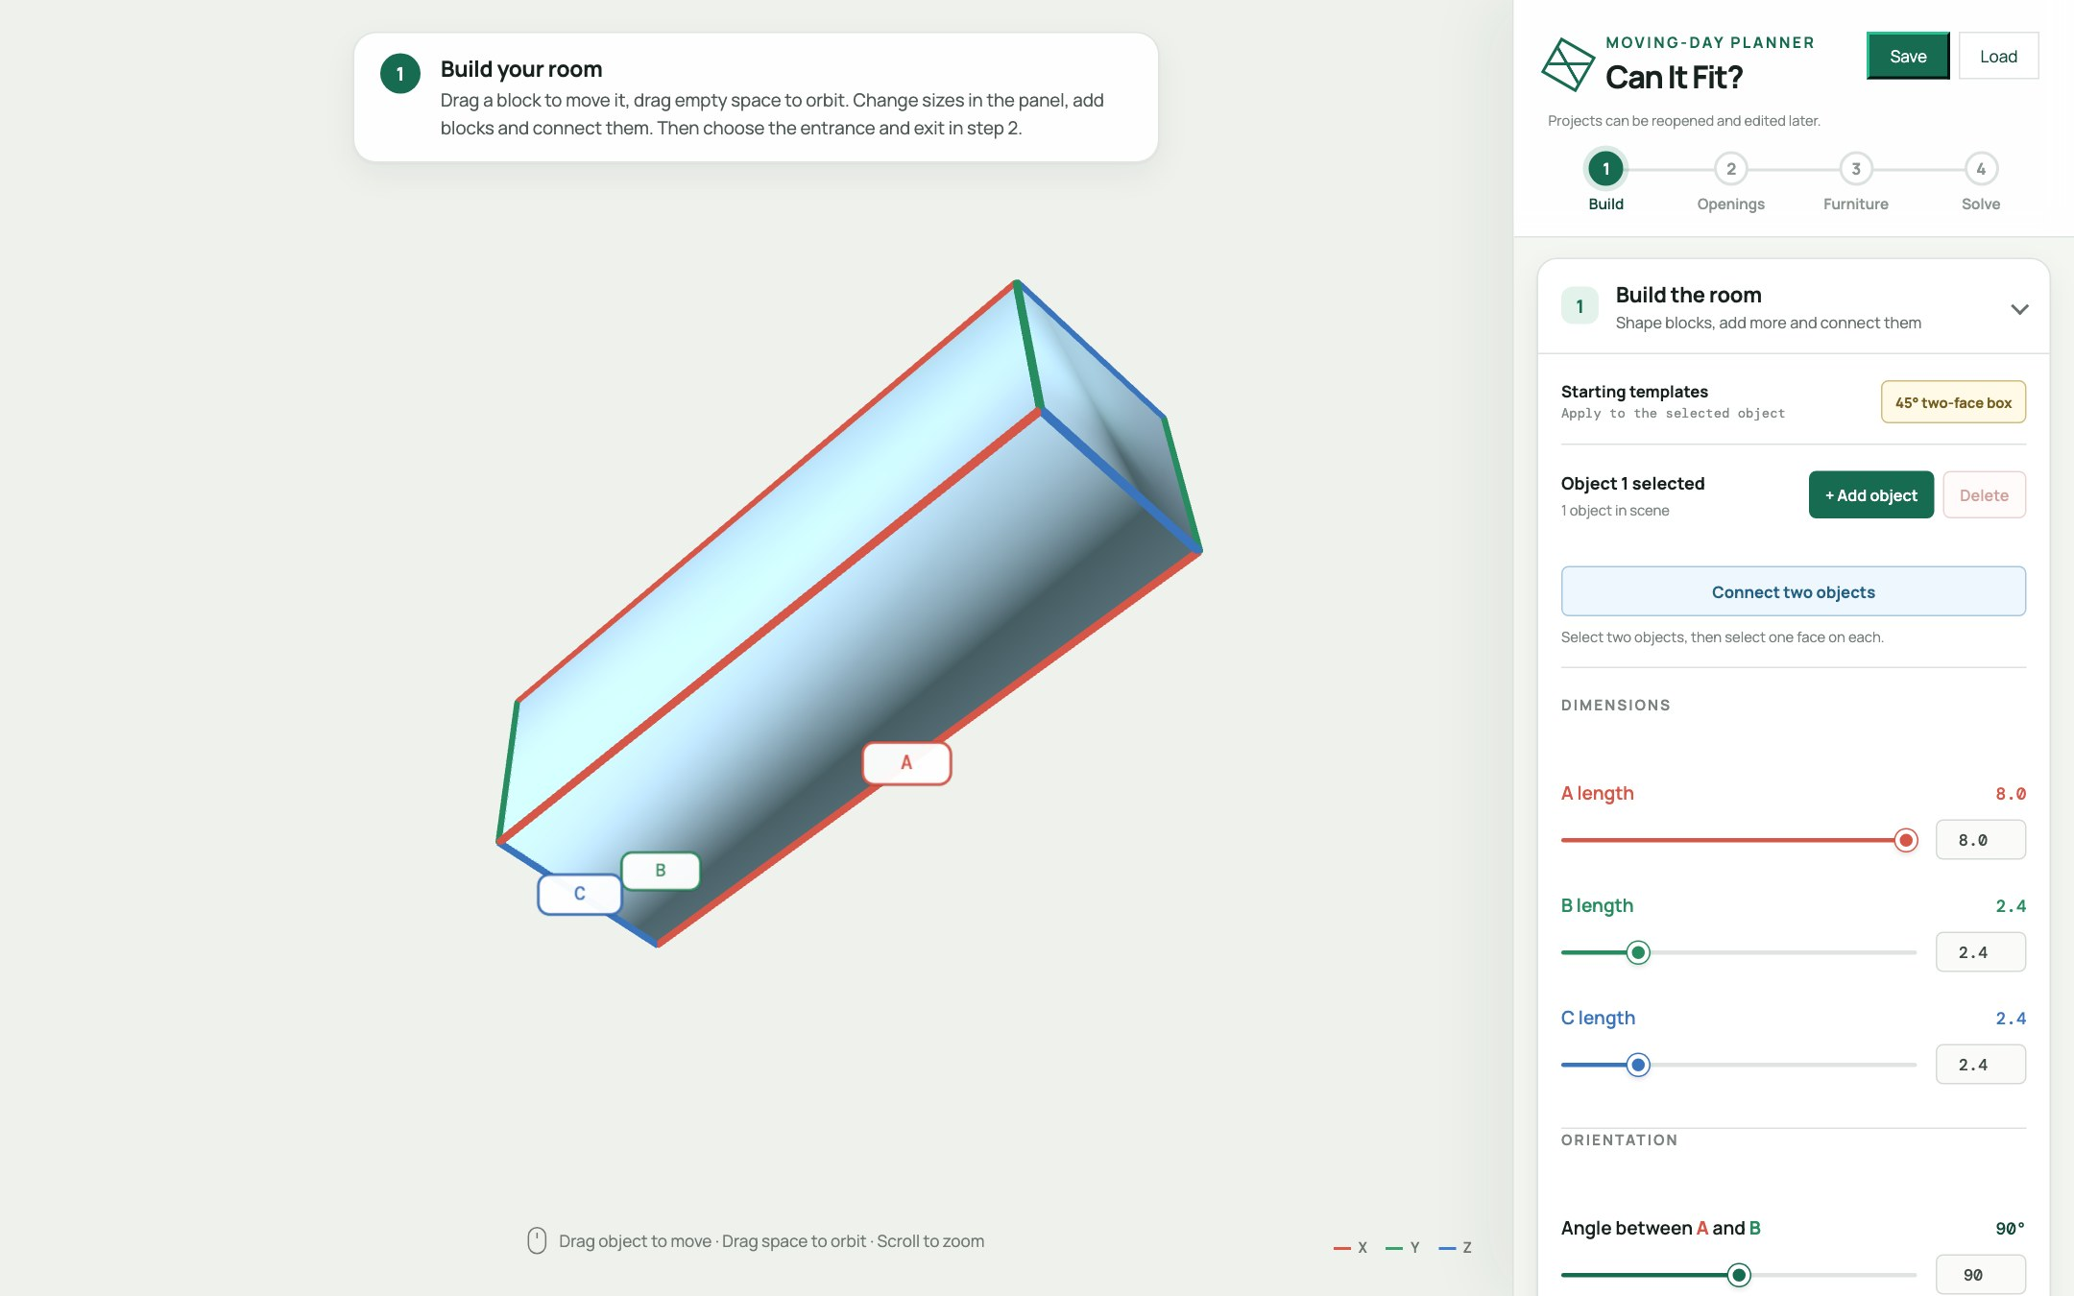
HANDS-ON · STEP 1
Build the room
Drag the A / B / C length sliders. Try 8 · 2.4 · 2.4 — instant hallway.
Change the angles to skew it, or hit the 45° two-face box template.
Need a turn? + Add object → Connect two objects → click a face on each.
Every room is a box: O + s·A + t·B + u·C, with s, t, u from 0 to 1. Turn on vector labels to see A, B, C.
Notes:
Step one: build the room.
[DEMO: drag the A, B and C length sliders]
I'll set A to eight, and B and C to two point four. And just like that, we have a hallway.
Change the angles between the vectors and the box skews. There's even a one-click forty-five degree template.
Need a corner? Add a second object, hit "Connect two objects", and click a face on each. Now you have an L-shaped hallway.
Under the hood, every room is simply a point O, plus s times A, plus t times B, plus u times C, with s, t and u between zero and one.
Turn on the vector labels and you can see A, B and C right on the model.

Slide 5
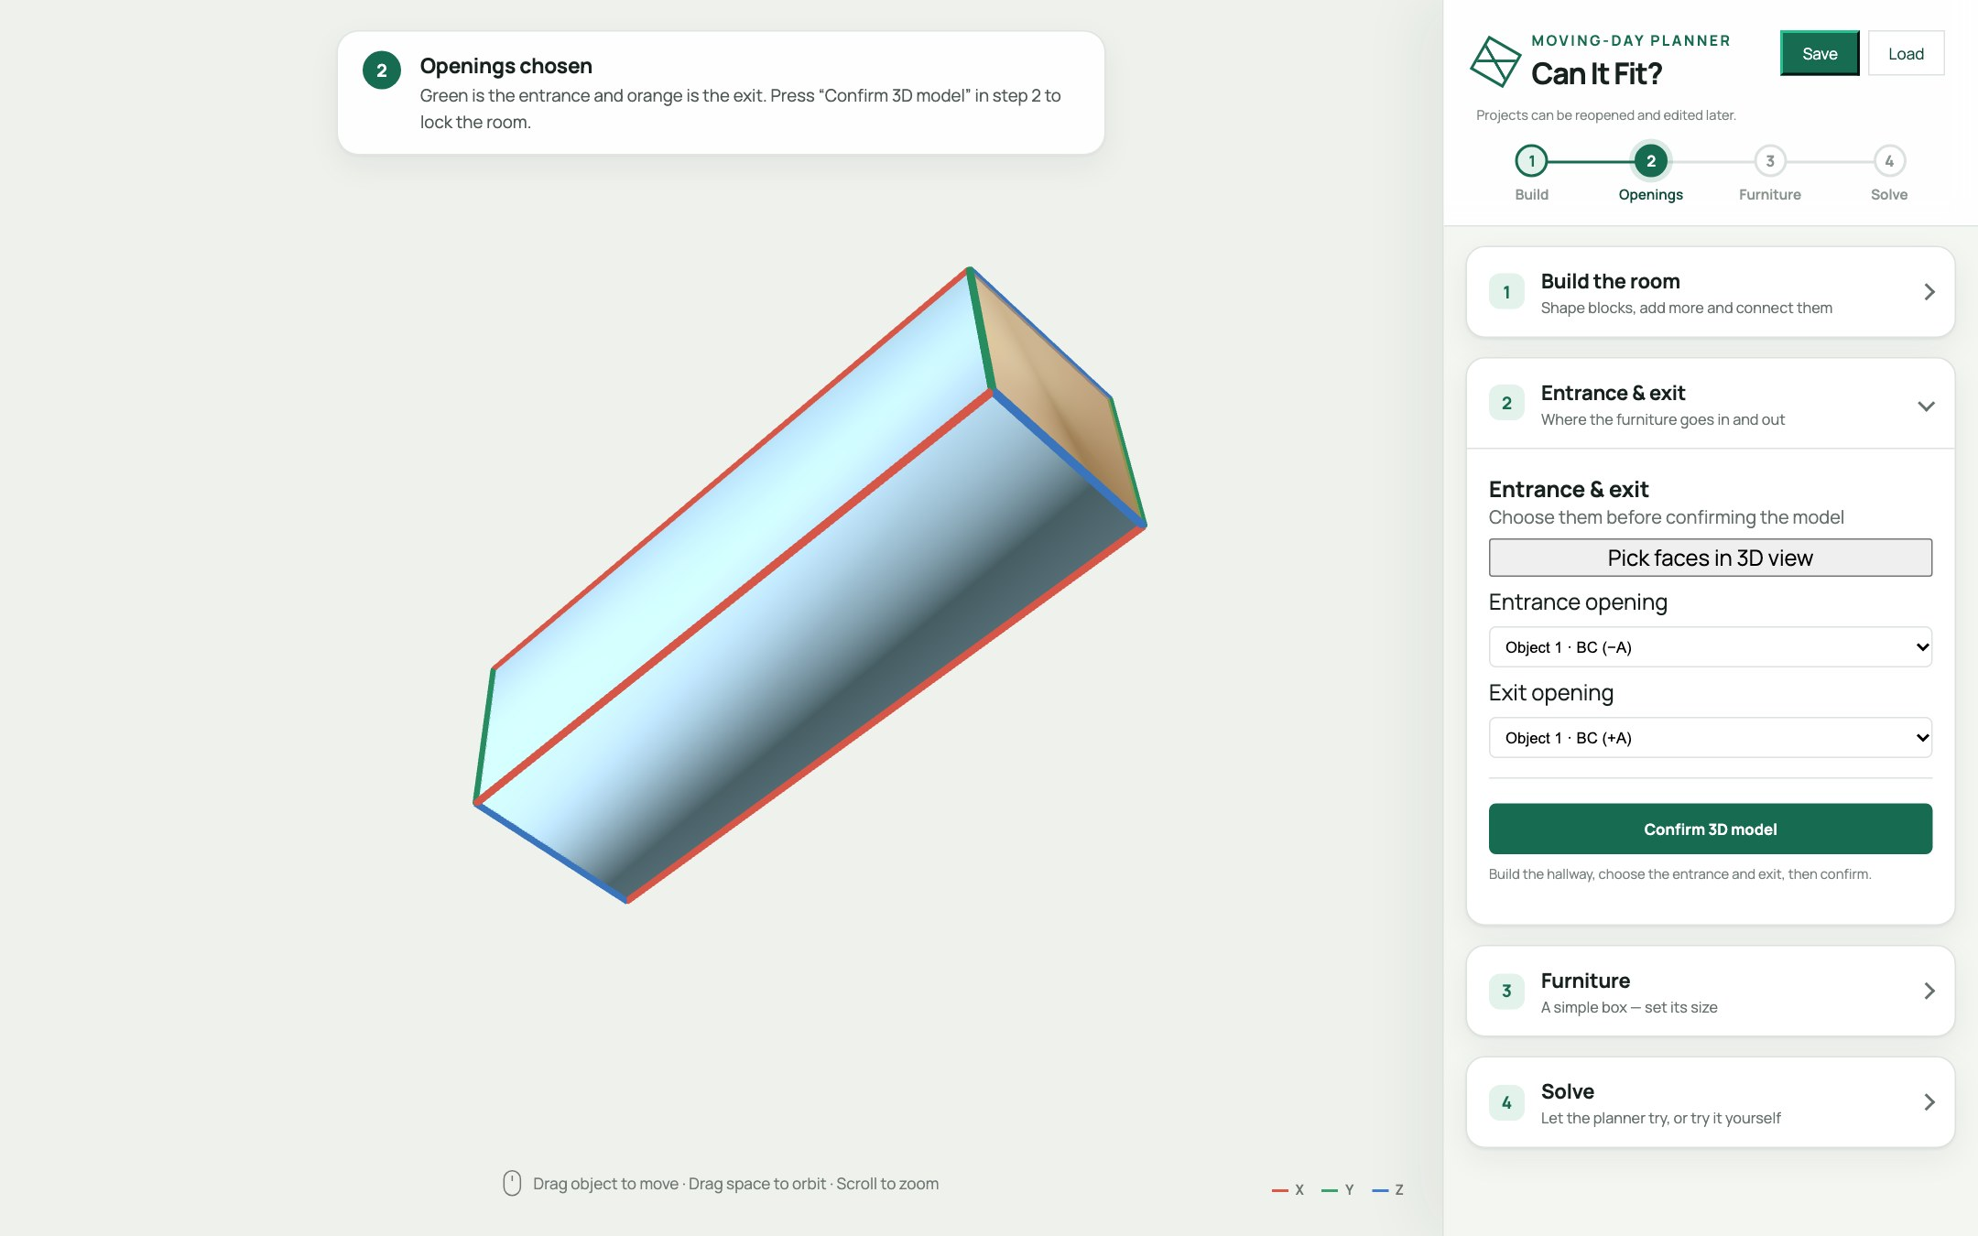
HANDS-ON · STEP 2
Choose the entrance & exit
Press Pick faces in 3D view.
Click an outside wall: first the entrance, then the exit. (Or use the dropdowns.)
Press Confirm 3D model — the room locks.
Only these two faces are doorways. Every other wall stays solid — the furniture can't cheat through them.
Notes:
Step two: tell the planner where the furniture comes in, and where it has to come out.
Press "Pick faces in 3D view". Click an outside wall for the entrance, which turns green, then click another for the exit, which turns orange. You can also use the dropdowns.
Then press "Confirm 3D model", and the room locks.
Here's the key rule: these two faces are the only doorways. Every other wall is solid, so the furniture can't cheat.
And if you change your mind later, just click step one or step two in the progress bar and the room unlocks again.

Slide 6
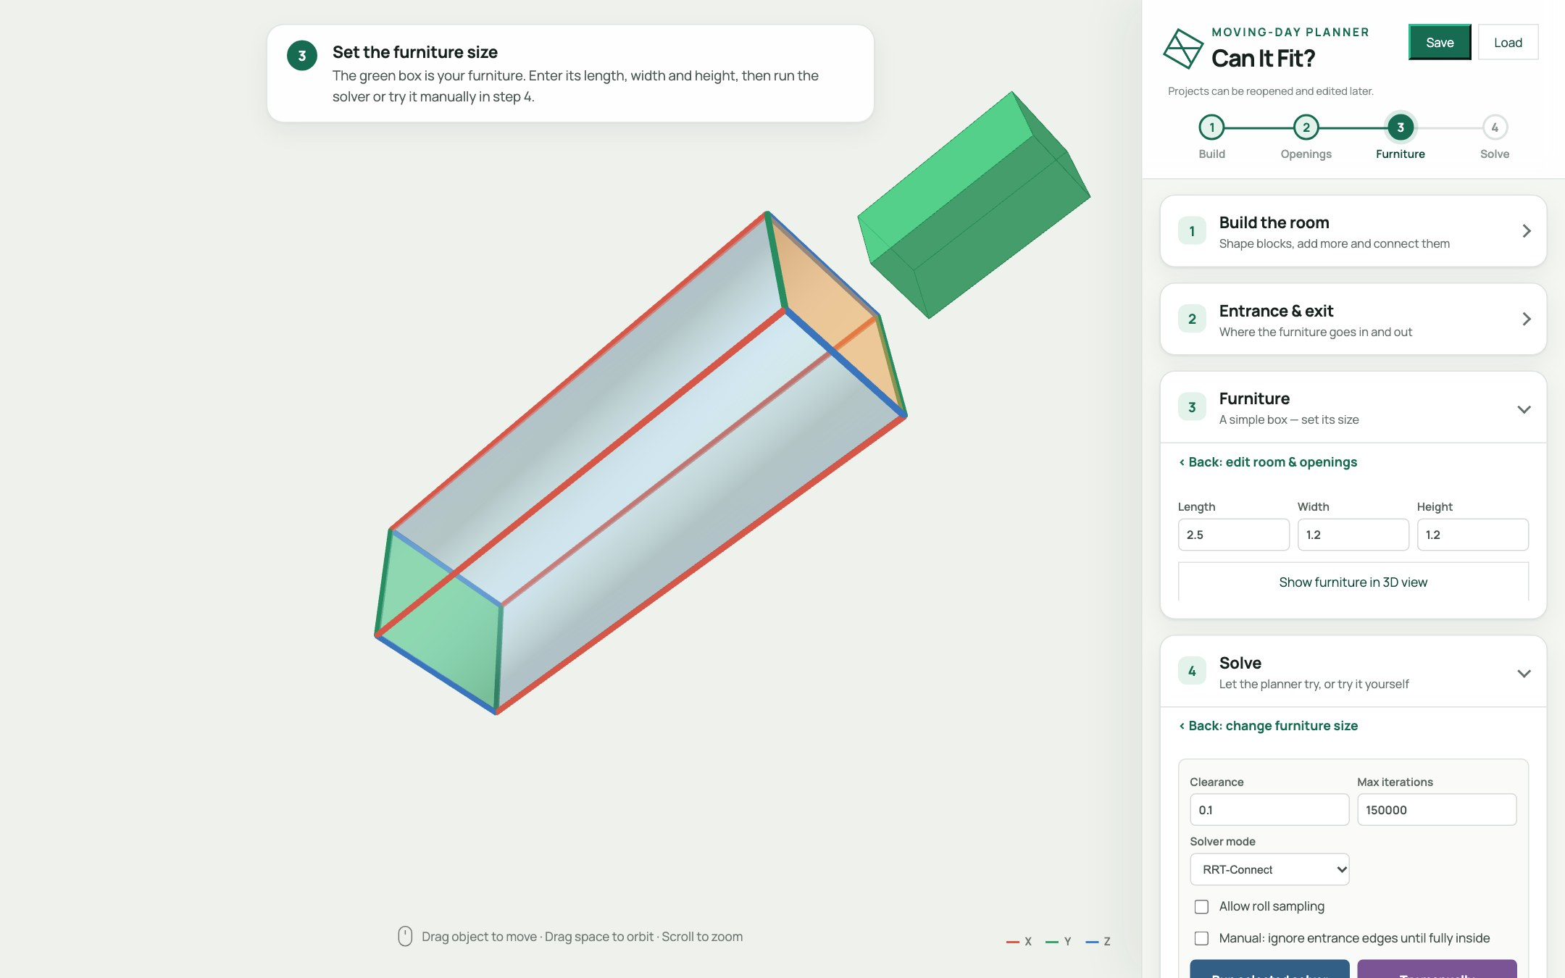
HANDS-ON · STEP 3
Describe the furniture
Enter Length · Width · Height. Try 2.5 · 1.2 · 1.2.
The green box is your furniture, parked beside the room. Show furniture in 3D view to focus it.
Set Clearance (0.1) — a safety margin around every side.
Furniture is one rigid box. Clearance grows the box in every direction before any collision check.
Notes:
Step three: describe your furniture.
Enter the length, width and height. I'll use two point five by one point two by one point two.
That green box next to the room is your sofa.
Then set the clearance, which is a safety margin around every side. And here's the important detail: clearance doesn't just add a rule at the end. It actually inflates the box in every direction before any collision check.
So a clearance of point one means the planner treats your sofa as slightly fatter than it really is. That's realistic, and it's deliberately conservative.

Slide 7
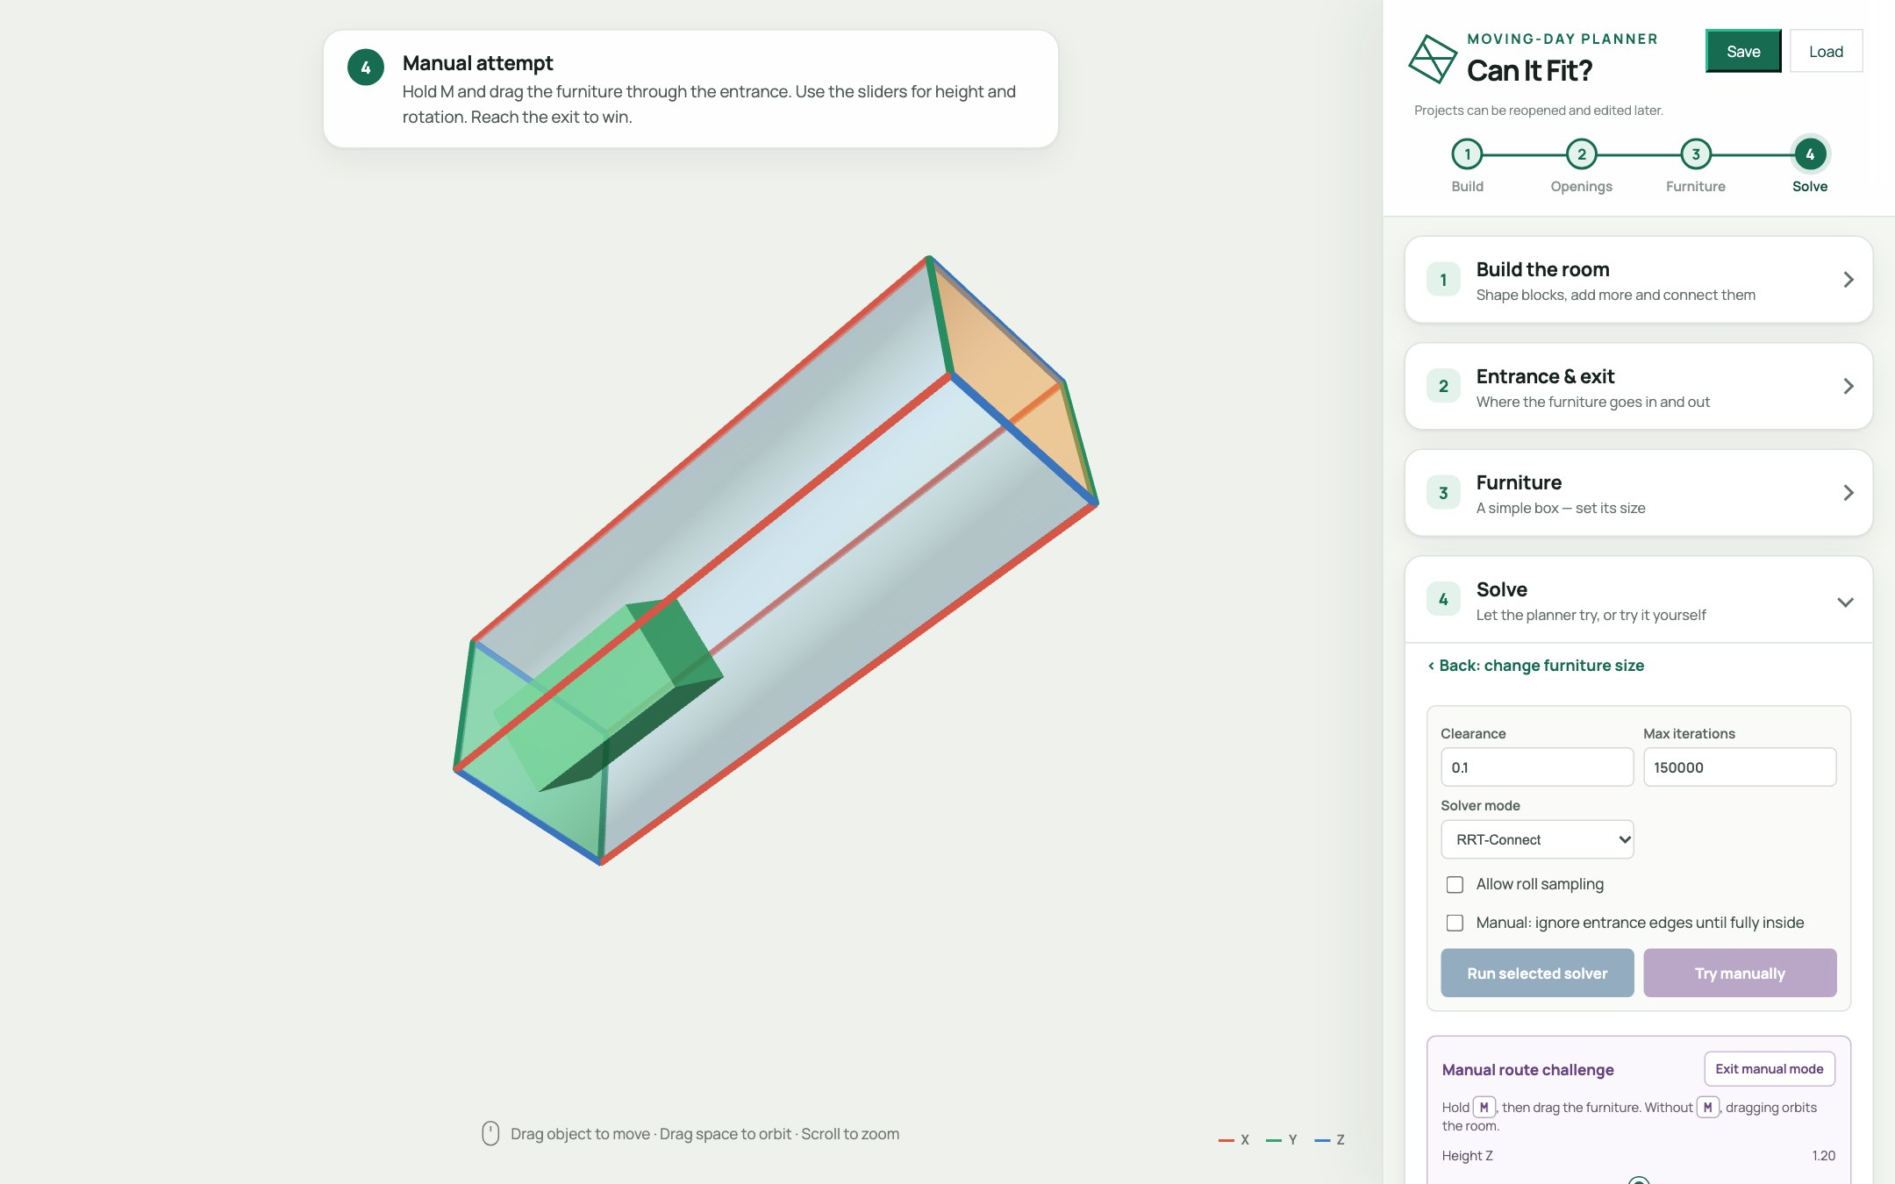
HANDS-ON · STEP 4A
Try it yourself first
Try manually — the furniture starts fully outside the entrance.
Hold M and drag. Use the sliders for height, yaw, pitch, roll.
Stuck at a corner? Auto Pilot: click a furniture edge, then a room edge — they snap parallel.
■ inside, legal ■ outside ■ collision
You win when the furniture passes completely through the exit — a pop-up tells you.
Notes:
Before we let the computer try, try it yourself.
Press "Try manually". The furniture starts fully outside the entrance.
[DEMO: hold M and drag the furniture in]
Hold M and drag. Use the sliders for height, yaw, pitch and roll. Watch the colour: green means you're inside and legal, yellow means you're still outside, and red means you've collided with a wall.
Stuck at a corner? Try Auto Pilot. Click an edge of the furniture, then an edge of the room, and the app snaps them parallel for you.
Get all the way through the exit and you win.
I promise it's harder than it looks, and that's exactly why we need a planner.

Slide 8

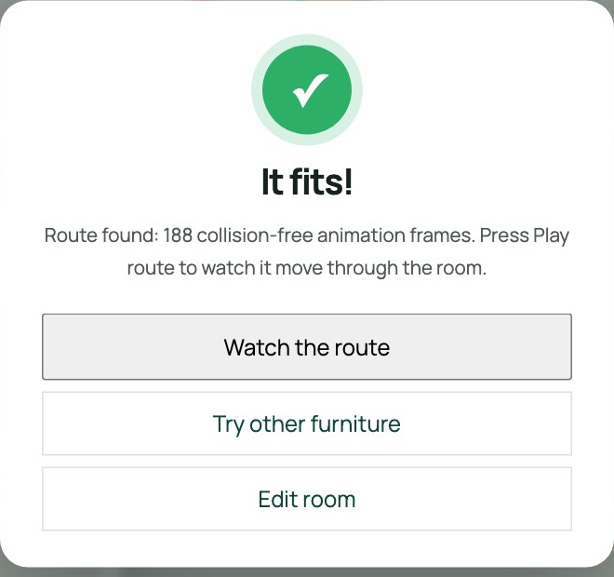
HANDS-ON · STEP 4B
Now let the solver try
Pick RRT-Connect or Heuristic, then Run selected solver.
A pop-up gives the verdict: It fits! or No route.
Scrub the timeline. Colours: green clear, yellow tight, red collision.
Failed? Raise max iterations, allow roll sampling, reshape the room — or go back a step.
Notes:
Now let the planner try.
Choose RRT-Connect or Heuristic, and press "Run selected solver".
[DEMO: run it]
When it's done, a pop-up gives you the verdict: "It fits!", or "No route found". Close it, and scrub the timeline to watch the sofa travel through the room. Green means clear, yellow means tight, red means a collision.
If it fails, you have options. Raise the max iterations. Allow roll sampling. Reshape the room. Or just click back a step and change the furniture. Nothing is locked in.

Slide 9
UNDER THE HOOD
How does it
actually think?
1 · Pose
2 · Collision
3 · Search
How is a position stored?
How do we know it's legal?
How do we find a path?
Notes:
So far you've seen what it does. Now let's open the hood.
Three questions. How is a position stored? How do we know a position is legal? And how do we search for a path?
Answer those three, and you understand the whole planner.

Slide 10

TECHNIQUE · 1
A position is six numbers
// furniture pose
{ x, y, z,
yaw, pitch, roll }
3 to translate, 3 to rotate
Rotations use Euler order ZYX, converted to a quaternion
Allow roll sampling off? The search drops to 5-D — faster
Notes:
Question one: how do you describe where a couch is?
With six numbers. X, Y and Z for position, and yaw, pitch and roll for rotation.
The code stores that as a simple object, and converts the three angles into a quaternion, using Z-Y-X Euler order. We use the same convention everywhere, so rendering, collision checking and saving always agree.
And here's a neat trick: turn off "Allow roll sampling" and the search drops from six dimensions to five. That makes it faster, and most furniture never needs to barrel-roll anyway.

Slide 11

TECHNIQUE · 2
Is this pose legal?
The room is a union of boxes. A point is inside if p = O + sA + tB + uC with s, t, u ∈ [0, 1]
Furniture is sampled on its shell: a 5×5×5 grid minus the interior = 98 points, grown by clearance
Every point must be inside the room
Between two poses we interpolate and check every step
Crossing a wall is allowed only through the entrance / exit polygon
Notes:
Question two: given a pose, is it legal?
The room is a union of boxes. A point is inside a box if you can write it as O plus s A plus t B plus u C, with every coefficient between zero and one.
For the furniture, we don't test the whole volume. We sample its shell. A five-by-five-by-five grid, minus the interior, gives us ninety-eight points, after growing the box by the clearance. If every one of those points is inside the room, the pose is legal.
To check a move between two poses, we interpolate and test every little step along the way.
And crossing a wall? That's only allowed through the entrance or exit polygon.
It's the exact same check for manual mode and for both solvers. Nobody gets special treatment.

Slide 12
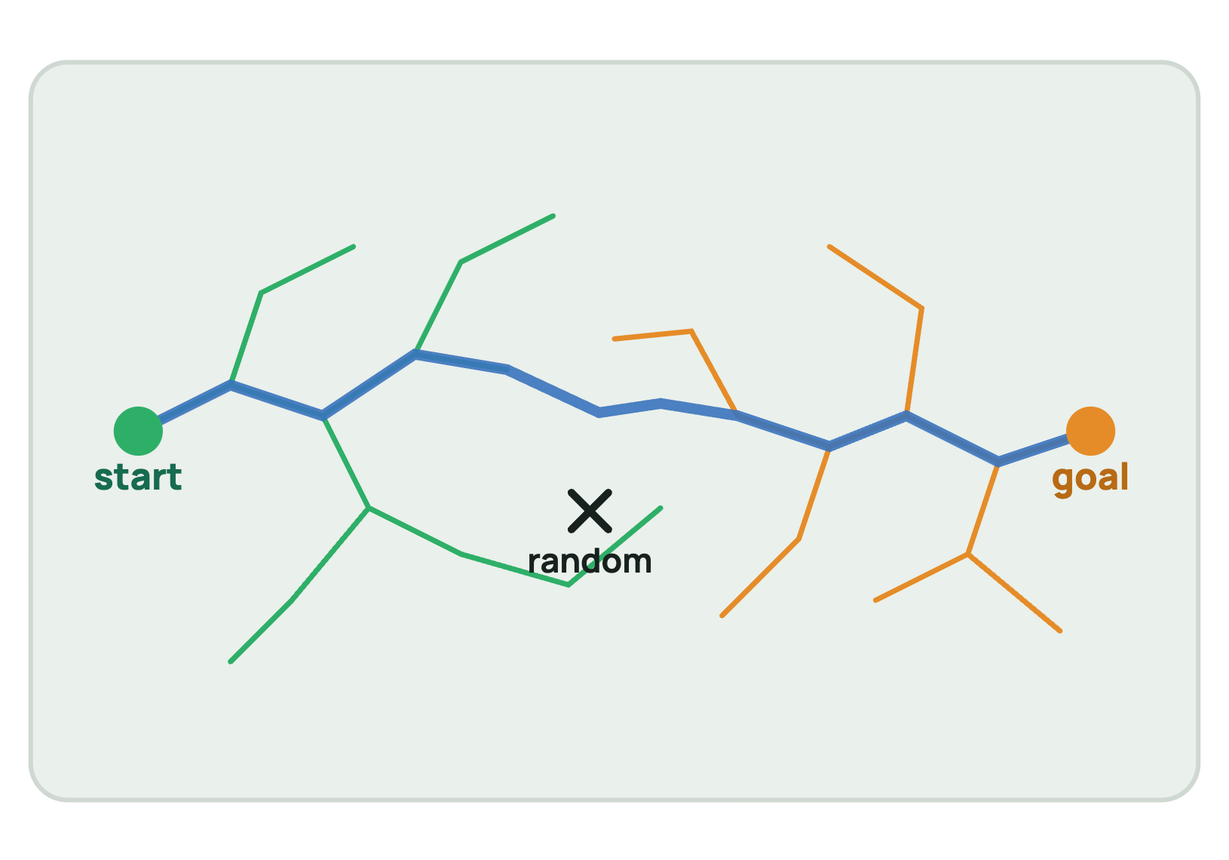
TECHNIQUE · 3
RRT-Connect: two trees, one path
One tree grows from the start, one from the goal
Pick a random pose (the ✕). Step the nearest node toward it — if the edge is legal, keep it
Then the other tree greedily chases that new node (up to 160 steps)
Trees touch → path found. Smooth it, resample it, animate it
Probabilistic: finding a route proves it fits — failing doesn't prove it can't. Run it again or raise iterations. We never "fix" failures by quietly shrinking clearance.
Notes:
Question three: how do we find a path through six-dimensional space?
With an algorithm called RRT-Connect. RRT stands for Rapidly-exploring Random Tree.
One tree grows from the start pose. Another grows from the goal. Each round, we pick a random pose, that's the X, and step the nearest node in a tree toward it. If that little move is legal, we keep it.
Then the other tree greedily chases the new node, for up to a hundred and sixty steps.
When the two trees touch, we have a path. We smooth it, resample it, and animate it.
One honest caveat. It's probabilistic. Finding a route proves the sofa fits. Failing to find one does not prove it can't. So run it again, or raise the iterations.
And we never cheat by quietly shrinking the clearance.

Slide 13

TECHNIQUE · 4
Smart starts beat pure luck
Random sampling alone rarely threads a tight doorway. So we seed the search:
Sample offsets across the opening × 15° yaw / pitch / roll orientations
Refine the promising ones at 5°
Probe inward: how deep does each candidate get?
Rank by depth, clearance, alignment, offset, tilt
Feed the top poses as many starts and goals
Notes:
Pure random sampling struggles with a tight doorway. The chance of randomly guessing a good entrance pose is tiny.
So we don't start blind. We sample offsets across the opening, combined with fifteen-degree yaw, pitch and roll orientations. We refine the promising ones at five degrees. Then we probe each candidate inward, to see how deep it gets.
We rank them by depth, clearance, alignment, offset and tilt, and feed the best ones to the planner as many starts and many goals.
That one idea is the difference between "sometimes works" and "usually works".

Slide 14
TECHNIQUE · 5
The straight-shot heuristic
Travel direction = the block edge not in the entrance face
Point the furniture's longest axis along it
Project the doorway along that direction: does the cross-section (with clearance) fit?
Centre it, stage it outside, slide straight in
 | RRT-Connect | Heuristic
Idea | Random search | Slide it in straight
Result | Different each run | Same every run
Handles turns | Yes | Via handoffs
On failure | Try again | Shows the stuck spot
Deterministic, instant, and when it fails it names the checkpoint where it got stuck. Multi-block rooms hand off between blocks with a short RRT.
Notes:
The second solver is the straight-shot heuristic, and it's the opposite of random.
The travel direction is the room edge that isn't part of the entrance face. We line up the furniture's longest axis with it, project the doorway along that direction, and check whether the furniture's cross-section, with clearance, fits through.
If it does, we centre it, park it outside, and slide it straight in.
It's deterministic: the same answer every time, instantly. And when it fails, it tells you exactly which checkpoint got stuck. For rooms made of several blocks, it hands off between blocks using a short RRT.
My rule of thumb: use the heuristic for a fast yes on straight corridors, and RRT-Connect when you need real manoeuvring.

Slide 15
TECHNIQUE · 6
You + planner = hybrid
Get the furniture fully inside by hand (Auto Pilot helps)
Press Continue with solver
The planner starts from your exact pose and finds the rest
Honest limits
Furniture is a single box
Rooms are connected boxes (no curves)
Rigid only: no bending, no taking legs off
RRT is probabilistic
Humans are great at the awkward entrance. Planners are great at the long middle.
Notes:
My favourite feature is the hybrid mode.
Humans are great at the awkward entrance. Planners are great at the long, boring middle. So let each do what it's best at.
Get the furniture fully inside by hand, using Auto Pilot if you like, then press "Continue with solver". The planner starts from your exact pose and finds the rest.
And to be upfront about the limits: the furniture is a single box, rooms are connected boxes with no curves, everything is rigid, and RRT is probabilistic.
This is a fast feasibility estimate, not a CAD guarantee. But it's a surprisingly good one.

Slide 16
YOUR TURN
Challenge: find the tipping point
Build an L-shaped hallway: two blocks, connected end to end
Furniture 2.5 · 1.2 · 1.2, clearance 0.1
Try it manually, then run both solvers
Shrink the hallway width until it stops fitting
Does roll sampling rescue it?
🛋️
What's the narrowest hallway your sofa survives?
Share your number in the comments.
Notes:
Now it's your turn.
Build an L-shaped hallway out of two connected blocks. Use furniture of two point five by one point two by one point two, with a clearance of point one.
Try it manually first. Then run both solvers.
Then shrink the hallway width until it stops fitting, and see whether roll sampling rescues it.
So here's the question: what's the narrowest hallway your sofa can survive?
Pause the video, give it a go, and drop your number in the comments. I'm really curious what you find.

Slide 17
RUN IT YOURSELF
Two commands to start
# no npm, no build
cd FurnitureSim_3D_can
python3 -m http.server 8000
# open http://localhost:8000
Where things live
app.js scene & UI
planner.js collision & solvers
manual.js drag-it-yourself
index.html + styles.css
Three.js loads from a CDN, so you just need a browser and an internet connection.
Thanks for watching — go move some couches.
Notes:
To run this yourself, you need two commands.
Change into the project folder, and start a simple web server with "python3 -m http.server 8000". Then open localhost, port 8000, in your browser.
There's no npm and no build step. Three.js loads from a CDN.
The code lives in just four places: app.js for the scene and interface, planner.js for collision checking and the solvers, manual.js for drag-it-yourself mode, and the HTML and CSS.
Thanks so much for watching. Now go move some couches.

