Slide 1



MOTION PLANNING IN THE BROWSER
Can It
Fit?
Will the sofa make it through the hallway? Let's build the room, then let a robot-style planner figure it out — and learn how it thinks.
Presented by Can Luo
2026.10.24
Notes:
Hi Everyone, I'm Can! Have you ever been stuck on a staircase, holding one end of a couch, thinking: "there is no way this fits"?
Today we're going to settle that argument with math.
I built a browser app called Can It Fit, where you can design a room in 3D, drop in a piece of furniture, and a motion planner will figure out whether it can actually get through.
In the next few minutes I'll show you how to use it, and then, the fun part, how the planner really solve the problem. No installs. No build step. Just a browser.
Let's go.

Slide 2
THE PROBLEM
Moving a couch is a 6-dimensional puzzle
It slides in 3 directions: x, y, z
It spins in 3 ways: yaw, pitch, roll
Walls, corners and doorways don't care how clever you are
"Does it fit?" really means: is there a collision-free path through 6-D space?
Notes:
Here's why this is harder than it looks.
A couch isn't just sliding along a hallway. It can move in three directions, and it can rotate in three ways: yaw, pitch and roll. That's six degrees of freedom.
So "does it fit?" is secretly a question about finding a path through six-dimensional space, where every single pose along the way has to avoid every wall.
Look at this corner. The sofa can't just slide through. It has to turn, at exactly the right moment, by exactly the right amount.
That turning is what makes this problem interesting.

Slide 3
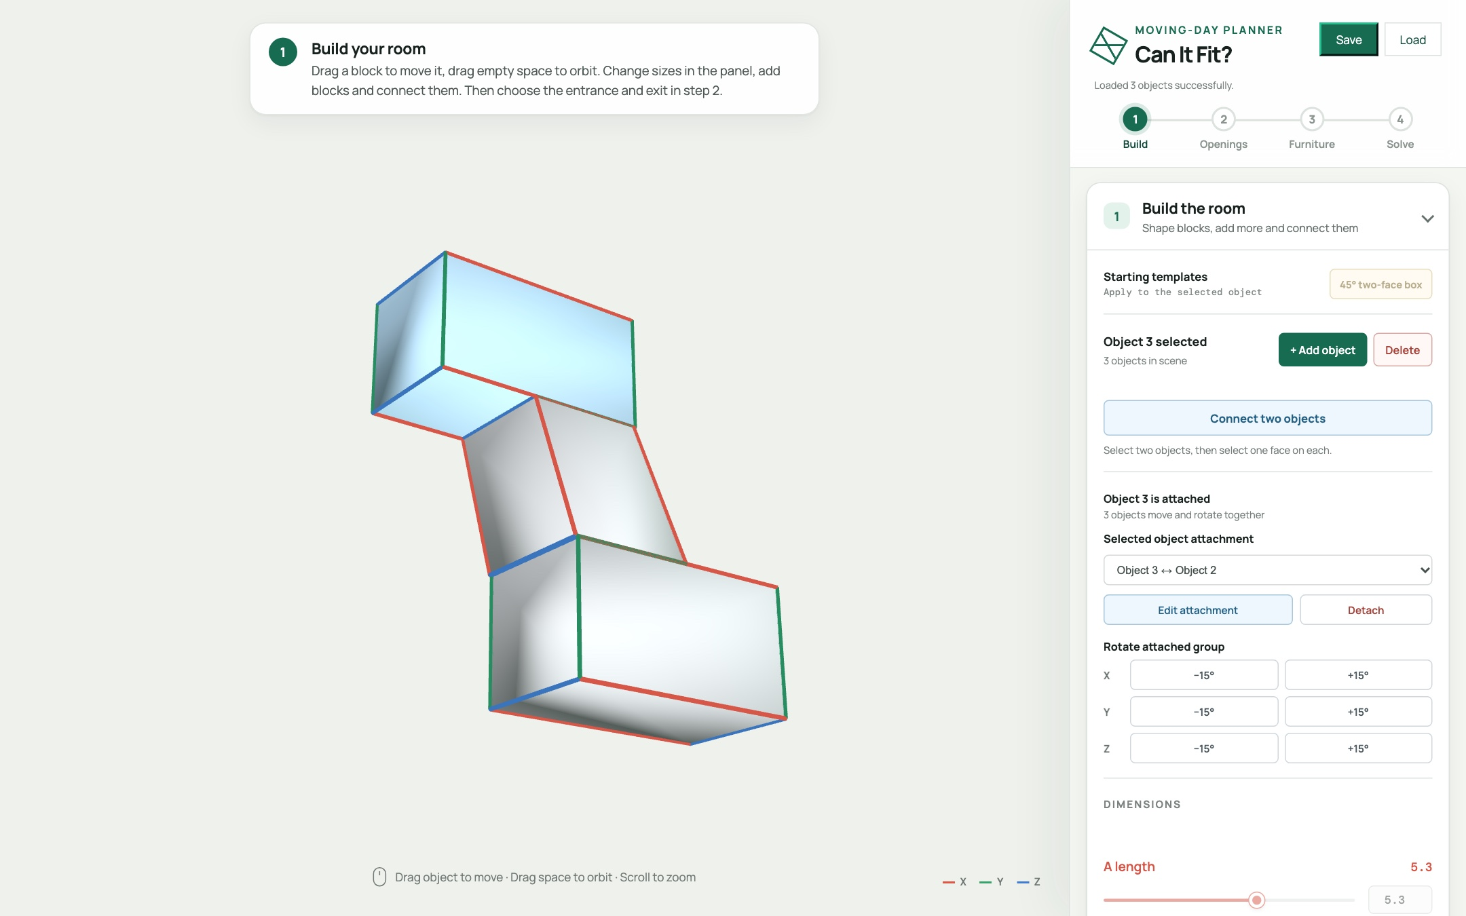
WHAT YOU'LL SEE
One app, three simple steps
1 Build the room
2 Build the furniture
3 Solve the route
Manual solver
Auto-solver (RRT-connect)
Notes:
And our app, can it fit, solves this problem in a smart way. In our app, you can build a 3D model that simulates your own hallway or staircase, you can also specify the size of the furniture.
After that, you will have two ways to know if the furniture fits:
First, a manual solver, where you can drag the furniture manually to see if it can go through.
Secondly, an automatic solver that leverages a motion planning algorithm called RRT-connect. I will talk about it in detail after the demo.
Now let's walk through the steps together, starting with step one, building the room.

Slide 4





HANDS-ON · STEP 1
Build any shape you can imagine
They are all built in my app!
L-shaped hallway
Zig-zag hallway
U shaped staircase
S shaped staircase
Super twisty
1 Shape blocks
2 Connect them
3 Specify entrance & exit
Each of these are built from simple blocks. Change how the blocks are shaped or connected, and you get a different building.
Notes:
And here's the best thing about this app: you're not stuck with one shape.
Look at these five models. An L-shaped hallway, a zig-zag hallway, a U-shaped staircase, an S-shaped staircase, and a post-modern super twisted staircase.
They're all made from simple blocks. The only difference is how the blocks are shaped and connected.
So whatever your own home looks like, a narrow stair, a tight corner, a crooked hallway, you can build it. Let me show you how.

Slide 5






STEP 1 · SHAPE
Shape the blocks
Stretch it
Tilt it
Add more
Drag the length sliders to make a block longer, wider or taller.
Drag the angle sliders. A tilted block becomes a ramp or stairs.
Press + Add object for another block. Build as many as you need.
Length 3.0
Length 7.0
Angle 90°
Angle 60°
1 block
3 blocks
Notes:
Any complex building is composed of simple block. How to shape individual block, there are just 2 things to learn.
First, stretch. Every block has length sliders. Drag one and the block gets longer, wider or taller.
Second, tilt. The angle sliders lean the block over. A box with right angles is a plain hallway, but pull one angle down to sixty degrees and you get a slanted block. That's how you make a ramp, or the slope of a staircase.
If you need more blocks, press "Add object" and another block appears. Add as many as you need.

Slide 6


STEP 1 · CONNECT
Connect them together
Press Connect two objects.
Click one face on each block.
Drag the sliders to rotate and slide them until they line up.
Press Apply. Repeat for every joint.
Just attached
After rotating and sliding
Rotating one block against the other changes the angle between the two surfaces. That's how you bend a hallway.
Drag Rotate moving surface and Move horizontally / vertically in the preview, and watch the blocks line up.
Notes:
To connect the blocks, press "Connect two objects", then click one surface on each block you want to join.
A small preview window will pop up with three sliders, through which you can adjust how the two blocks are attached.
For example, you can use the slider to rotate and slide one object along the joint surface, until it reach your ideal position.
If you want more complex composition, you can repeat this step to add more blocks and connect them.

Slide 7
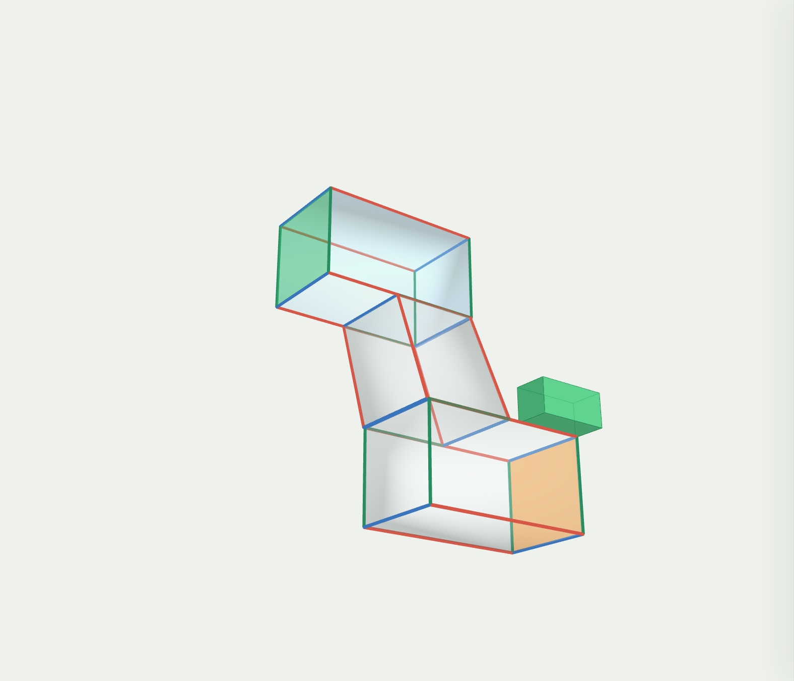
HANDS-ON · STEPS 1 & 2
Pick the doors, set the furniture
Click where the furniture goes in (green) and out (orange).
Press Confirm 3D model. The walls turn see-through.
Type the furniture's length, width and height. The green box previews it.
entrance
furniture
exit
Notes:
After you get your ideal 3d model, you will need to tell the app where the furniture comes in and where it has to come out. For example, click the top end of the hallway for the entrance, and it turns green. Then click the bottom end of the hallway for the exit, and it turns orange. Press "Confirm 3D model" and the walls turn see-through.
Then type in the size of your furniture: length, width and height. The green box next to the building is a preview of it.

Slide 8
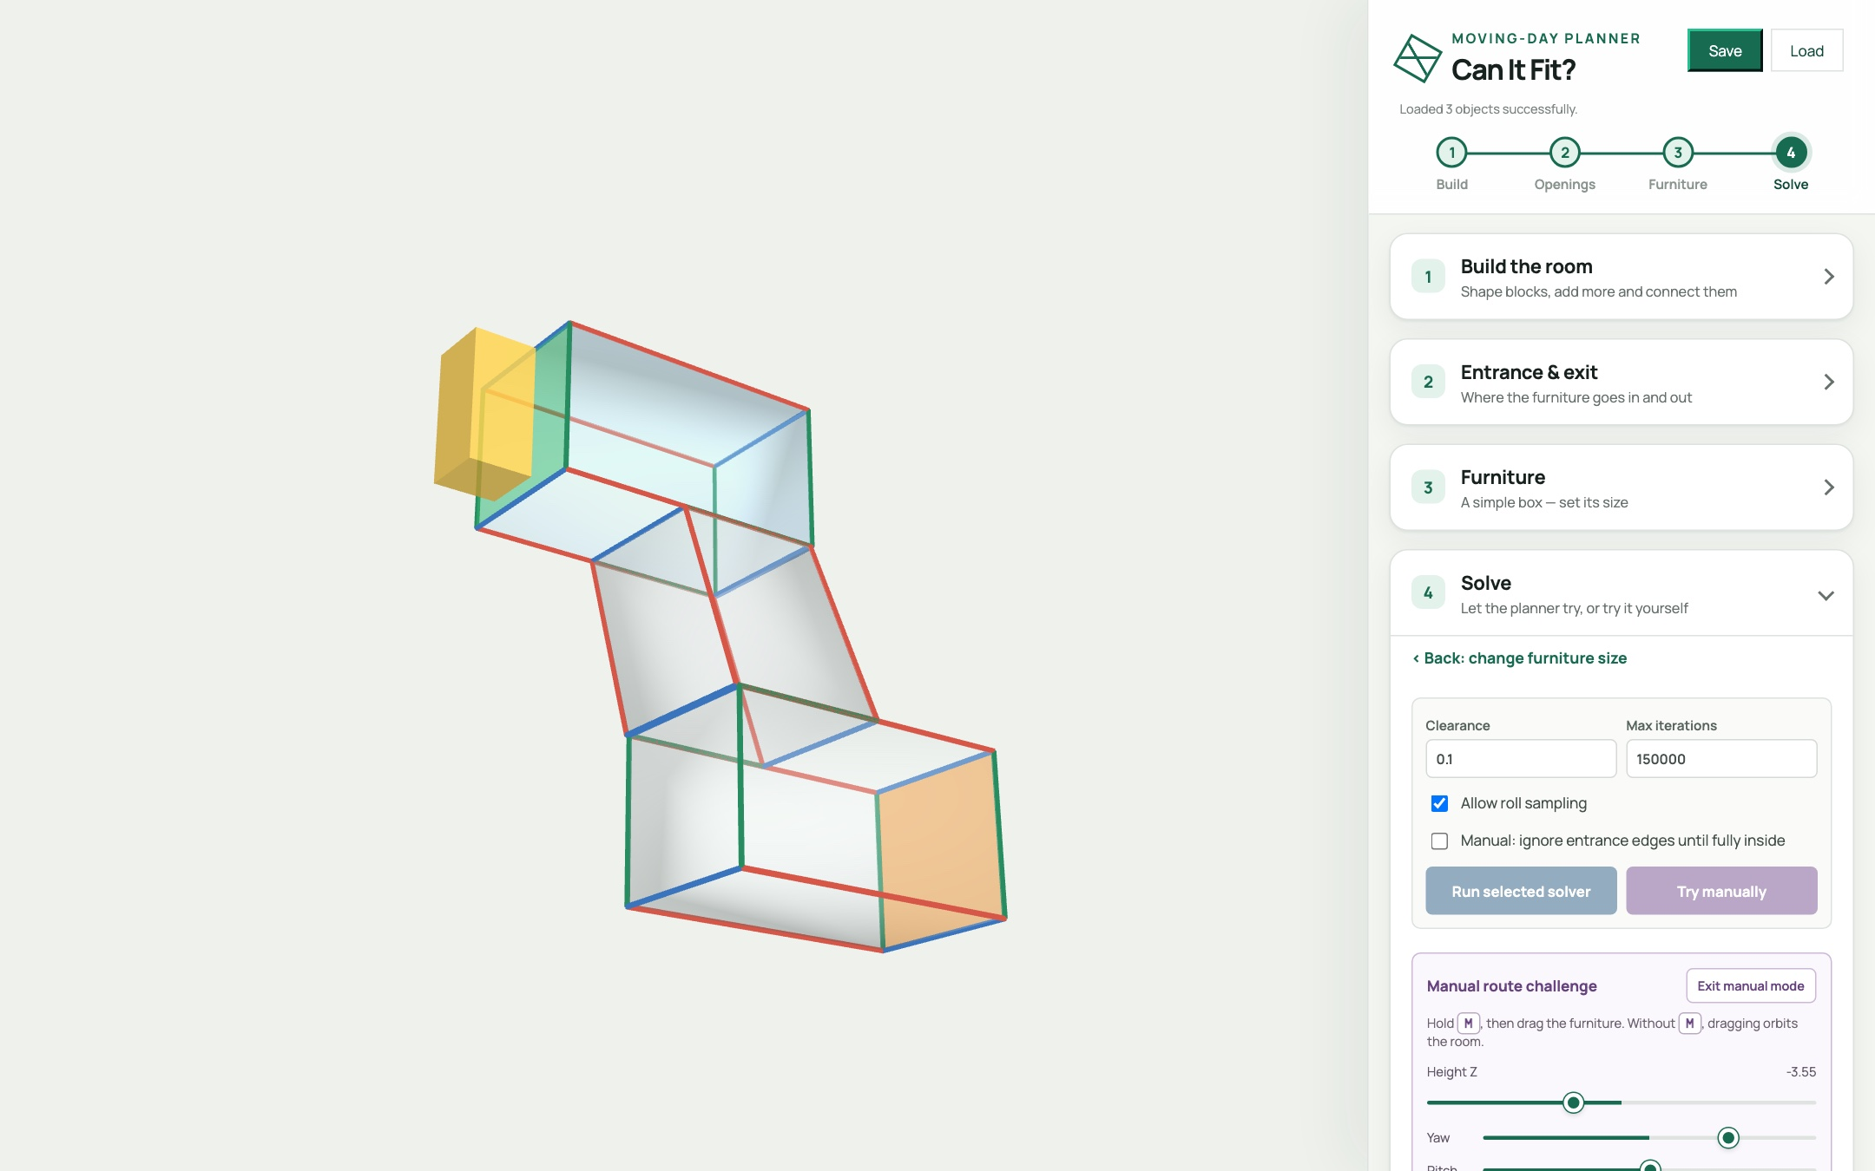
HANDS-ON · STEP 3A
Try it yourself first
Press Try manually. The furniture starts outside the entrance.
Hold M and drag it through. Sliders tilt and lift it.
■ legal ■ outside ■ collision
Reach the exit and you win！
Notes:
Now it’s the exciting part: solve the route.
Before we let the computer try, try it yourself. Press "Try manually" and the furniture starts just outside the entrance.
Hold the M key and drag it into the building. The box is yellow when it's outside, turns green when it’s fully inside, and red when it hits a wall. Use the sliders to tilt and lift it.
If you can reach the exit, you win.
It's trickier than it looks, which is exactly why a planner is so useful.

Slide 9
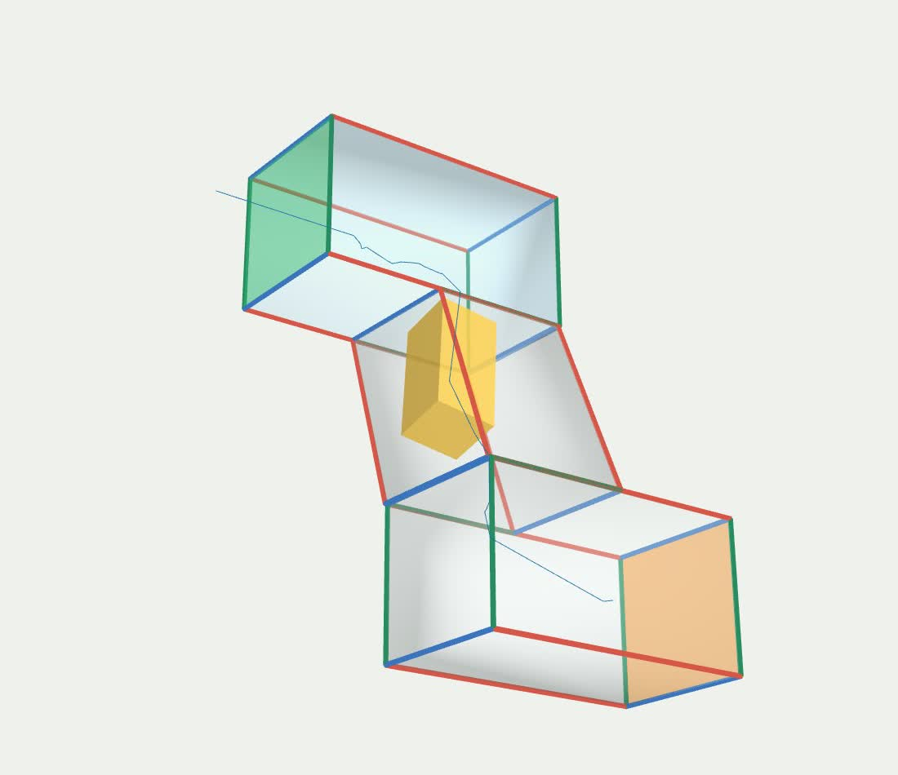
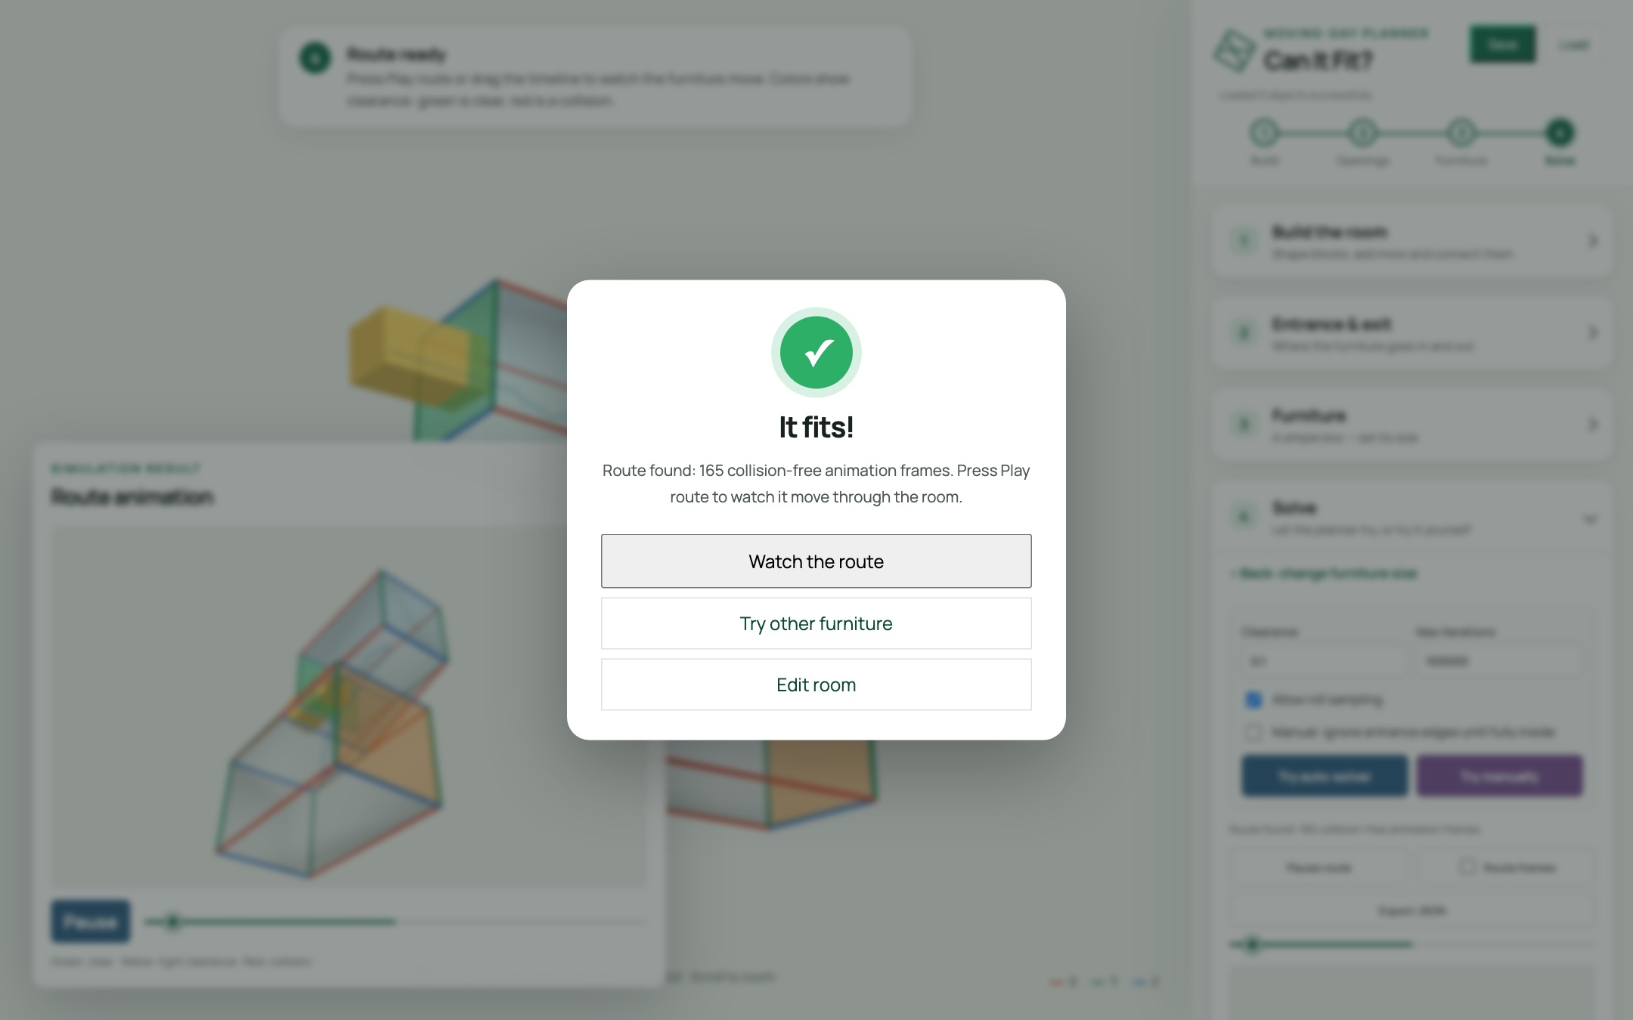
HANDS-ON · STEP 3B
Now let the auto-solver try
Press Try auto-solver.
The planner searches for a route.
A pop-up gives the verdict: It fits!
Press Play route or drag the timeline to watch it again. If it says "No route found", try again or change the furniture.
The route it found: the sofa travels from the entrance to the exit
Notes:
Now let the computer try. Press "Try auto-solver", and the planner searches for a path through the building.
You can watch its progress as it works, and when it's done, a pop-up gives you the verdict. For our test funriture, it comes back with: "It fits!" The planner found a route of a hundred and sixty-five collision-free frames.
Here's what that route looks like. The test furniture starts outside the entrance, slips in, turns and tilts to follow the stairs, and comes out at the exit, without touching a single wall.
If you ever get "No route found", don't give up right away. The search is random, so it can't prove that no route exists. Run it again. If it still fails after a few try, you might need to consider a slightly smaller piece of furniture.
And this is the whole point of the tool: you can test a move before you ever lift a couch.

Slide 10
UNDER THE HOOD
How does it
actually work?
1 · Pose
2 · Collision
3 · Search
How is a position stored?
How do we know it's legal?
How do we find a path?
Notes:
Okay, so far you've seen what our app can do. Now let's open the hood.
To understand the solver, we need to answer three questions. How is a position stored? How do we know a position is legal? And how do we search for a path?

Slide 11

TECHNIQUE · 1
A position is six numbers
// furniture pose
{ x, y, z,
yaw, pitch, roll }
3 to translate, 3 to rotate
Rotations use Euler order ZYX, converted to a quaternion
Notes:
Question one: how do you describe where a couch is?
With six numbers. X, Y and Z for position, and yaw, pitch and roll for rotation.
The algoirthm stores that as a simple object, and converts the three angles into a quaternion, using Z-Y-X Euler order. We use the same convention everywhere, so rendering, collision checking and saving always agree.

Slide 12

TECHNIQUE · 2
Is this pose legal?
Every point must be inside the room
Between two poses we interpolate and check every step
Crossing a wall is allowed only through the entrance / exit polygon
Notes:
Question two: given a pose, is it legal?
If every boundary point of the furniture is inside the room, the pose is legal.
To check a move between two poses, we interpolate and test every little step along the way.
And crossing a wall? That's only allowed through the entrance or exit.
It's the exact same check for manual mode and for the solver. Nobody gets special treatment.

Slide 13

TECHNIQUE · 3
RRT-Connect: two trees, one path
One tree grows from the start, one from the goal
Then the other tree greedily chases that new node
Trees touch → path found. Smooth it, resample it, animate it
Notes:
Question three: how do we find a path through six-dimensional space?
With an algorithm called RRT-Connect. RRT stands for Rapidly-exploring Random Tree.
Specifically, RRT-Connect grows two trees, one from the start and one from the goal.
It randomly samples new nodes in each iteration, attempting to connect the two trees while avoiding the obstacles.
When the two trees touch, we have a path. We smooth it, resample it, and animate it.
One honest caveat. It's probabilistic. So Finding a route proves the furniture fits.
But failing to find one does not prove it can't. You may try raise the iterations and run it again.

Slide 14

TECHNIQUE · 4
Smart starts beat pure luck
Random sampling alone rarely threads a tight doorway. So we seed the search:
Sample offsets across the opening × 15° yaw / pitch / roll orientations
Refine the promising ones at 5°
Probe inward: how deep does each candidate get?
Rank by depth, clearance, alignment, offset, tilt
Feed the top poses as many starts and goals
Notes:
Pure random sampling struggles with a tight doorway. The chance of randomly guessing a good entrance pose is tiny.
So we don't start blind. We sample offsets across the opening, combined with fifteen-degree yaw, pitch and roll orientations. We refine the promising ones at five degrees. Then we probe each candidate inward, to see how deep it gets.
We rank them by depth, clearance, alignment, offset and tilt, and feed the best ones to the planner as candidate starting poses.
And this will increase the chance of successfully finding a path.

Slide 15

YOUR TURN
Challenge: find the tipping point
Build an L-shaped hallway: two blocks (5 * 2 * 2), connected end to end
Furniture (1.5 * 1.2 * 1.2), clearance 0.1
Try it manually, then run the auto-solver
Increase the furniture size until it stops fitting
🛋️
What's the largest sofa that fits your hallway?
Share your number in the comments.
entrance
exit
Notes:
Now it's your turn.
Build an L-shaped hallway out of two connected blocks. You can make furniture and clearance of this size
Try it manually first. Then press Try auto-solver.
Then increase the furniture size until it stops fitting.
So here's the question: what's the largest sofa that fits your hallway?
Pause the video, give it a go, and drop your number in the comments. I'm really curious what you find.

Slide 16
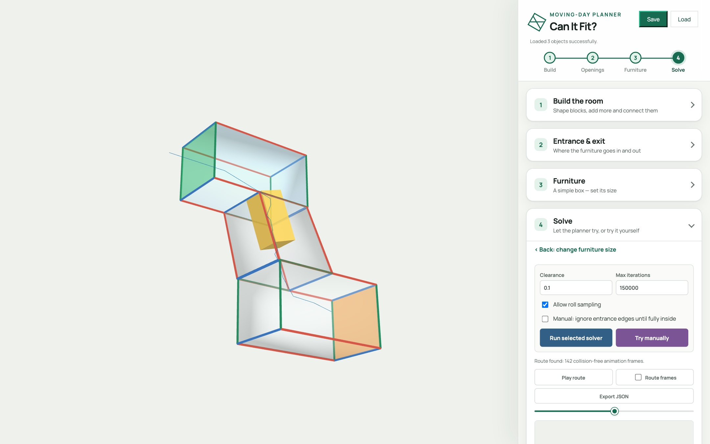
TRY IT NOW
Open it in your browser
LAUNCH THE APP — NO INSTALL
volcano1998.github.io/FurnitureSim_3D
SLIDES + POWERPOINT
volcano1998.github.io/FurnitureSim_3D/slides
SOURCE CODE ON GITHUB
github.com/volcano1998/FurnitureSim_3D
Thanks for watching, go move some couches!
Notes:
That's everything. And the best part: you can try it right now.
The app is live in your browser. No install, no account. The link is on screen and in the description.
The full source code is on GitHub, so you can read the planner, change it, or even add your own solver.
Thanks so much for watching. Now go move some couches.

