Slide 1
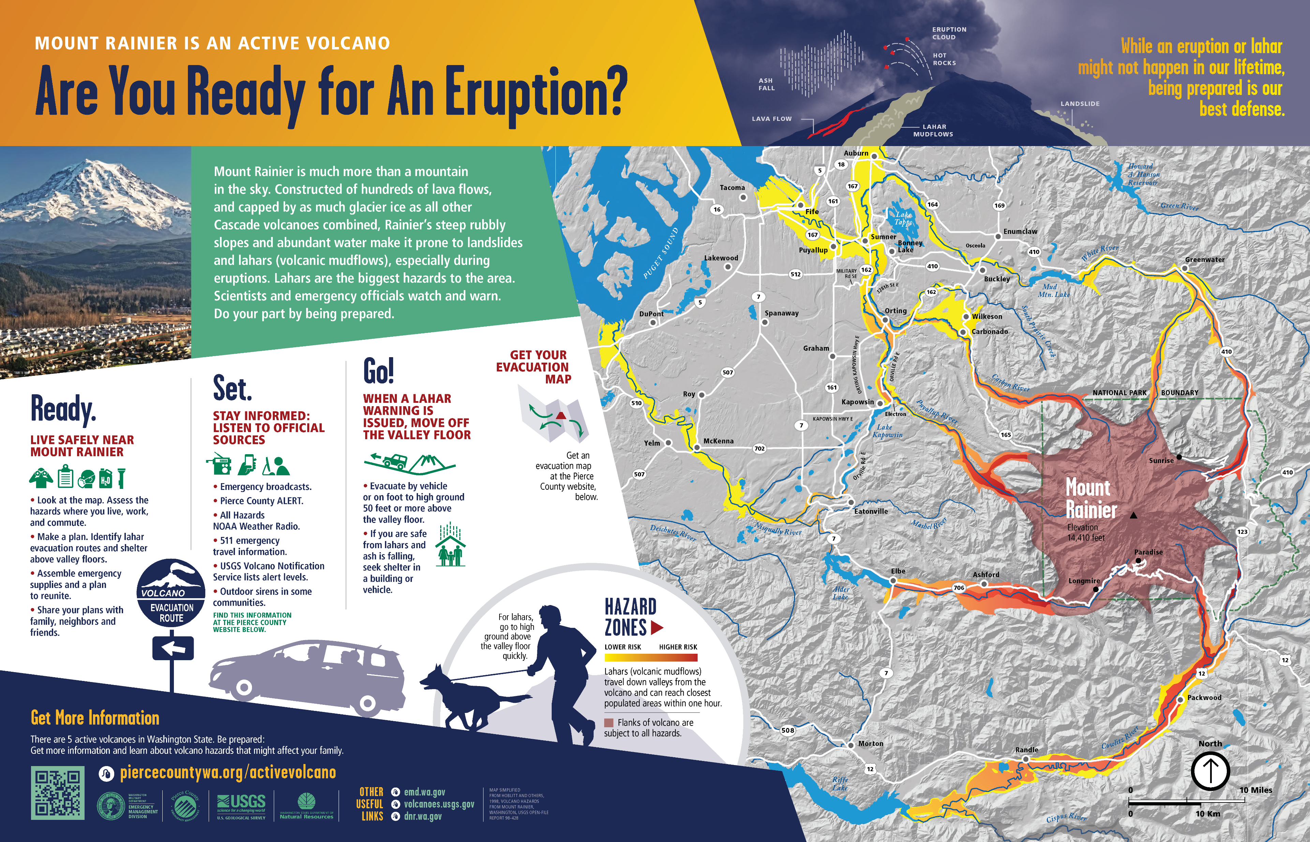

CSAV LAHARZ 2024
Lahar processes
Hazard map making and design
LAHARZ
GIS
VICTOR platform
Pyroclastic flow processes
Class project

Slide 2
End goal of this class is to make a map. But really, the end goal is communication.
the single most important message to communicate to the public – is to seek higher ground
Notes:
End goal of this class is to make a map. But really, the end goal is communication.

Slide 3
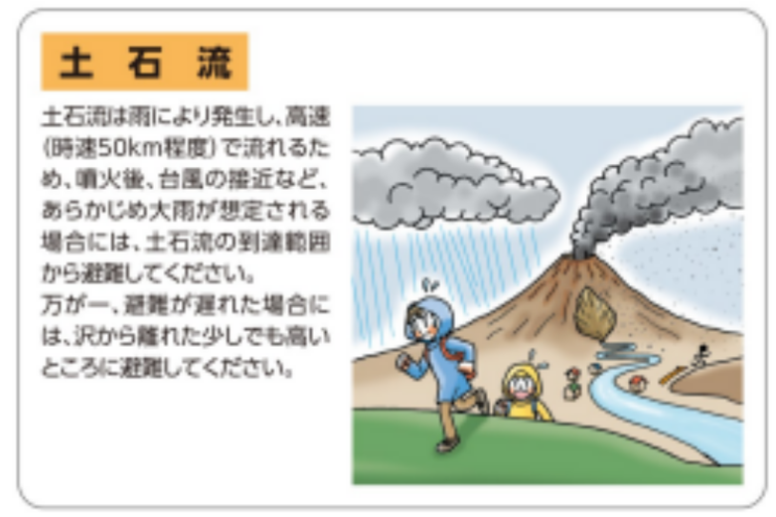
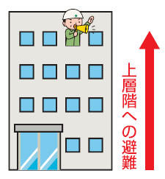
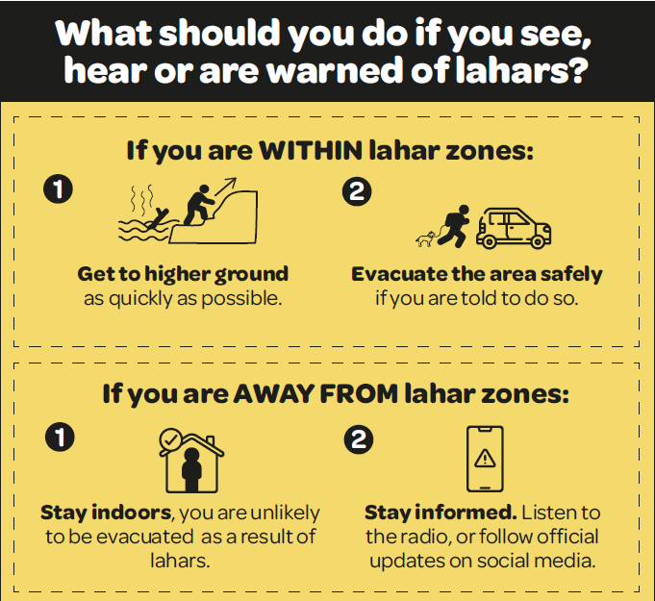




Washington Department of Natural Resources. (2014). Mount Rainier is An Active Volcano, Are You Ready for An Eruption
Volcano Disaster Management Councils of Iwatesan. (2019). Volcanic disaster prevention map of Iwatesan volcano.
Inawashiro Town. (2016). Adatarayama Volcano Disaster Prevention Map.
the single most important message of what we need to communicate to the public – is to seek higher ground
the single most important message of what we need to communicate to the public – is to seek higher ground
Taranaki Emergency Management. (2022). Taranaki Maunga. Lahars from Taranaki Version 1.0.
GNS Science (compiler). (2019). Volcanic Hazards at Whakapapa Mt. Ruapehu. Version 6.0 2019.
IG-UNAM, CENAPRED, SEGOB. (2016). Popocatépetl - Lahares.
Vanuatu Meteorology & Geo-Hazards Department. (2019). Ambae Long-Term Background Volcanic Hazards Map.
Notes:
I really like this. Before we get too far into the descriptions of what lahars are, the statement right up front – the single most important message of what we need to communicate to the public – is to seek higher ground. Nothing complicated about that. No maps, no models.

Slide 4

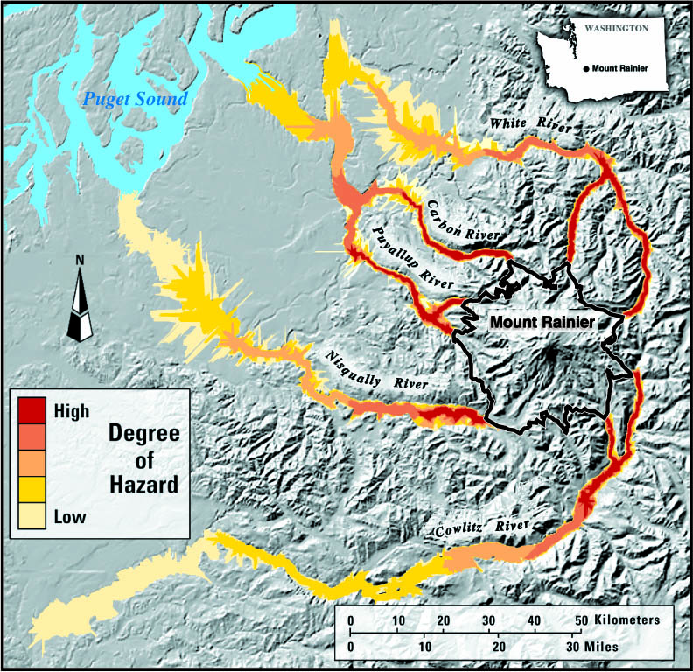
About LAHARZ
Semi-empirical model for forecasting lahar inundation
First developed by the USGS in 1998 (Iverson et al. 1998, Schilling 1998) in ArcMap
Updated to ArcMap python tools for new versions of ArcGIS (Schilling 2014)
Updated for ArcPro in 2023 by Julie Griswold
Taught at CSAV by Steve Schilling and Julie Griswold since ????
I started teaching the course with Julie in 2016 as Steve was retiring
LAHARZ is open-source, but ArcGIS is not
We’ve always wanted an open-source version of LAHARZ because ArcGIS is $$$$$$$$$

Slide 5
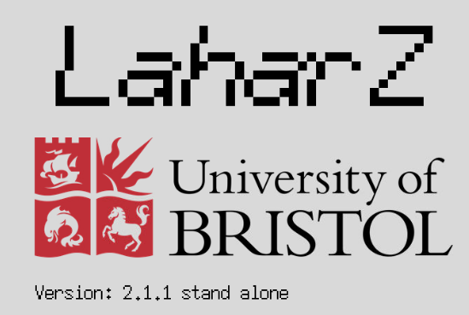

About LAHARZ
Keith Blair at University of Bristol wrote a stand-alone Python version in late 2022, with DEM preparation done in QGIS
I’ve been working with Keith to suggest new features and improvements over the last year
You can download this version and install on your local machine from here: https://github.com/Keith1815/laharz
Keith’s Python LAHARZ was installed on the VICTOR platform this year (we’ll discuss more about VICTOR), which makes it easy to run without having to worry about installing packages
We are teaching the VICTOR LAHARZ version using QGIS for the first time this year!

Slide 6
About Me and Sam

Slide 7
About you
ArcMap? ArcGIS Pro? QGIS?
LAHARZ? Other lahar models?
Pyroclastic flow modeling? (energy cone, TITAN2D, VolcFlow?)
Hazard-map making?
Let’s do some introductions: your name, what country you are from, what agency you work for, what your main job is (field technician, seismologist, geologist, etc.)

Slide 8
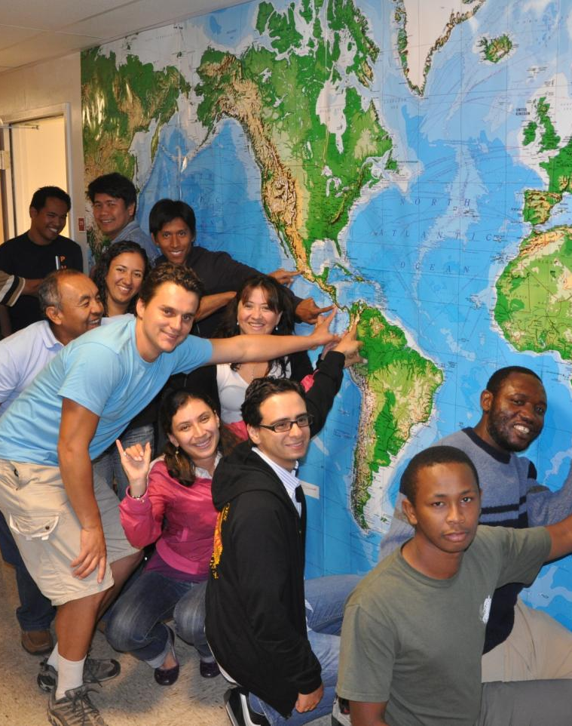
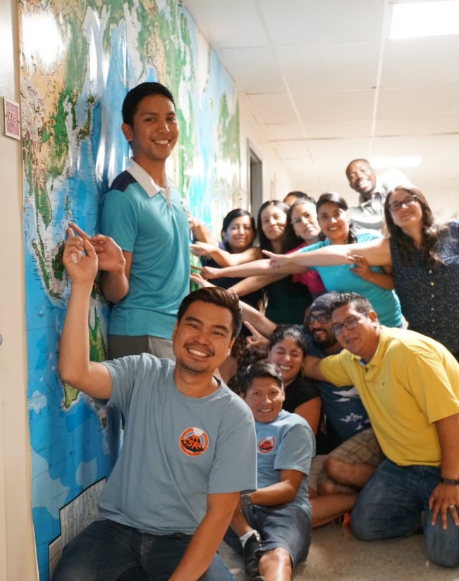
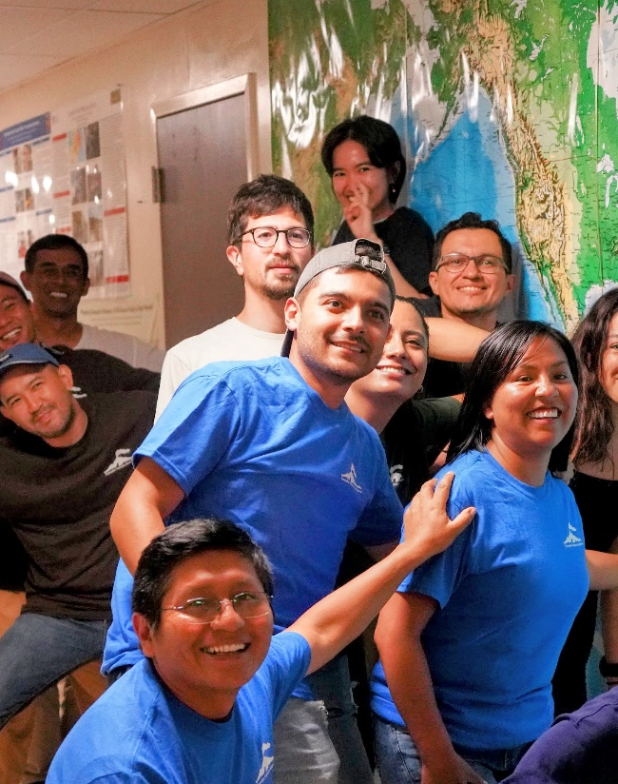
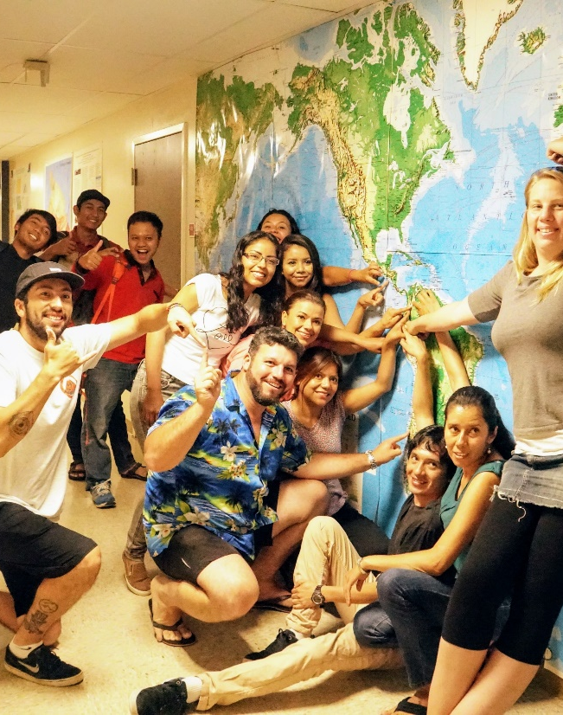
LAHARZ Olympics

Slide 9
Homework- Day One
With your team, pick a volcano where you want to make a lahar hazard map.
Review the eruption history of your volcano using the Smithsonian Institution GVP website (http://www.volcano.si.edu/) and/or observatory reports.
What is typical behavior for an eruption in recent history (VEI, domes/flows/magma type/effusive/explosive)?
What are the potential larger, longer-term styles of eruption?
Gather information about lahars at your volcano:
lahar history, volumes and recurrence frequency (how big? how often?)
what are the triggers for lahars (typhoon, rainstorm, earthquake, eruption, landslide, pyroclastic flow, rapid snow melt, dome collapse, avalanche)
where have lahars been mapped or reported?
Is there already a lahar hazard map?
Is there perhaps a good reason to make a new map for a different scenario or different audience?
Use https://volcanichazardmaps.org/ to look at maps for your volcano and other maps you might like
Summarize potential lahar hazards based on this historic information. Discuss what scenario you would like to portray.

Slide 10
Homework- Day Two
Review any spatial information about your volcano.
geologic map (where are the pyroclastic flows, lava flows, river channels, areas for downstream flooding)
topographic map (where are the steep areas or steep canyons- where will a flow be well contained and where will a flow perhaps spill over into a flat area?) what does the geomorphology tell you?
Use Google Earth to explore your volcano.
Make an elevation profile and think about the H/L value you might use
2. Where are the people?
Find a population map. How many people live nearby?
3. Identify major roads, rivers, lakes, villages, major cities. Where are the most important,
critical places if a disaster happens?
Airports, energy resources, military assets, hospitals, schools and evacuation centers, sensitive natural areas
4. Decide on the scenario or scenarios for hazard map:
What type of lahars are you portraying (rain-fall triggered, eruption triggered, etc?)
If eruption-triggered, what size eruption are you considering?
5. Decide on your target audience:
General public? Mining company or transportation agency? Tourists?
Emergency managers? Land-use planners?

Slide 11
Judging Criteria
Map should be beautiful and easy to understand.
Put your names on it. Stake your professional reputation on it.
Scale bar, north arrow, location map or spatial context (latitude, longitude)
Metadata on DEM (source, resolution, projection), cite references or make acknowledgements to other data sources
Should be easy to recognize scenario and your message
Should be clear who your audience is: technical or non-technical?
Appropriate colors with good design elements.
Logos for partner agencies; make it authoritative.
Areas of relative hazard easy to understand (high, medium, low)
Show some indication of your level of uncertainty and possible error
Oblique photo and/or 3-D view are optional but helpful
Be creative and have fun!

