Slide 1
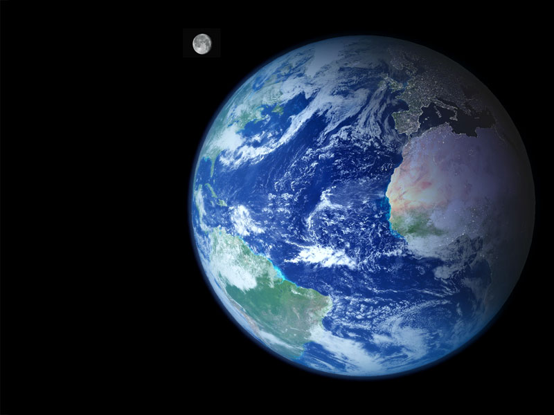
A brief
Introduction
To
GIS

Slide 2
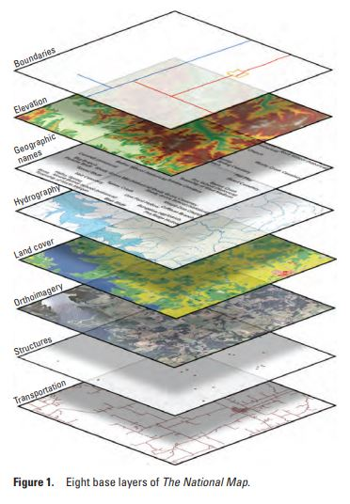
What is GIS?
Geographic Information System
“..integrated computer hardware and software that store, manage, analyze, edit, output, and visualize geographic data. Much of this often happens within a spatial database…In a broader sense, one may consider such a system also to include human users and support staff, procedures and workflows, the body of knowledge of relevant concepts and methods, and institutional organizations.”-Wikipedia
“Any system for capturing, storing, checking, and displaying data related to positions on the Earth's surface.” -National Geographic Education Encyclopedia
In a GIS, you connect data with geography
-GISgeography.com

Slide 3



Two popular GIS programs
Expensive, commercial
Windows (but there are work-arounds)
More stable, consistent, compatible; less flexible, less customizable
Cannot open some QGIS files
Until this year, it was the ONLY way to run LAHARZ!
Free, open source
Windows, Mac, Linux, Android
More flexible, customizable (plug-ins, scripting), but can have bugs
Can open ArcGIS formatted files
Thanks to Keith Blair, there is now an open-source, stand-alone python version of LAHARZ!

Slide 4
Two popular GIS programs
For this year’s course, we will use QGIS for the first time and the open-source version of LAHARZ on the VICTOR platform
However, the ArcGIS course materials (ArcMap and ArcPro) and LAHARZ code are still available and will be provided to you in the class files

Slide 5
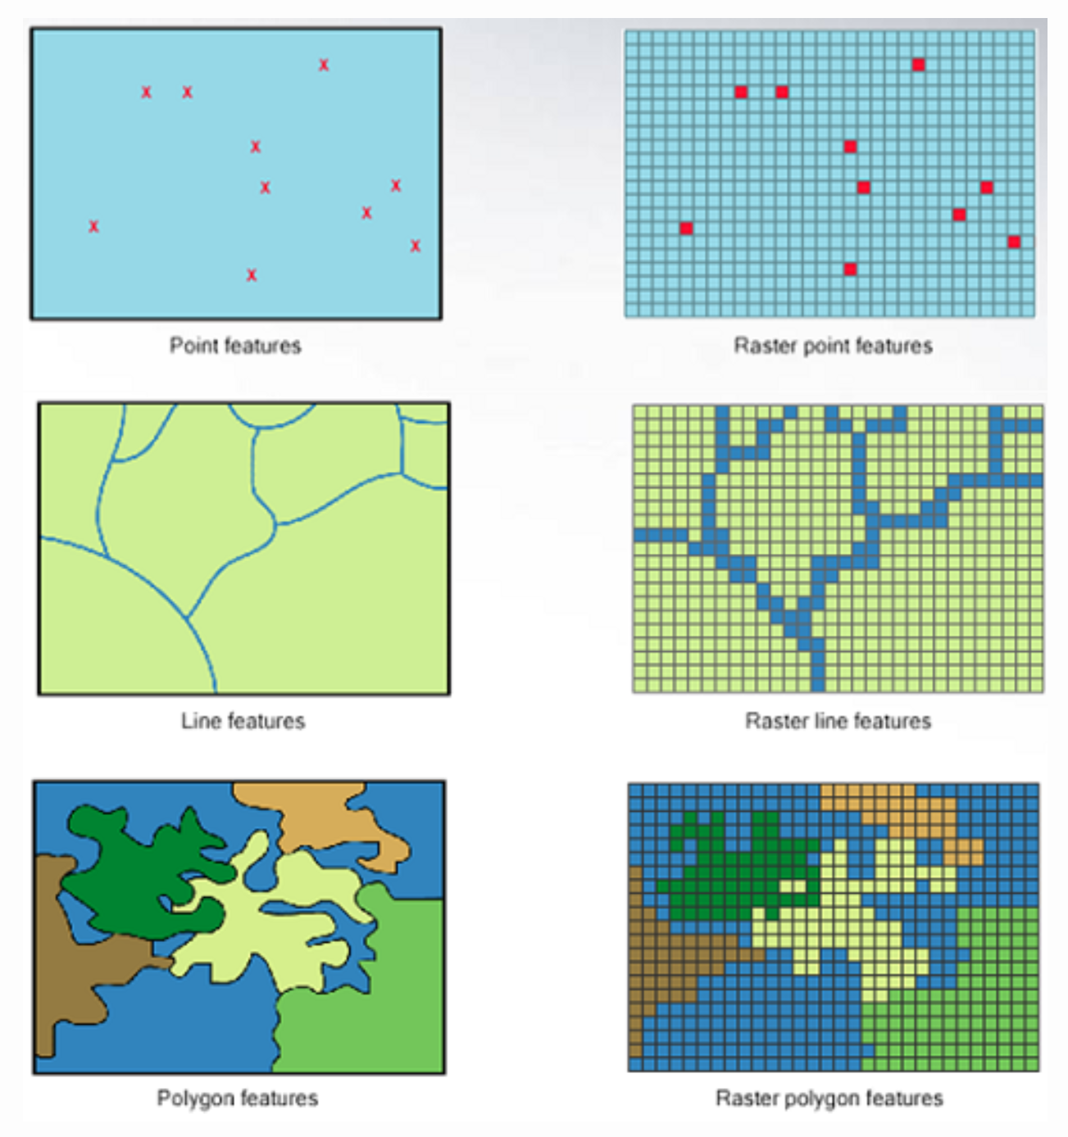
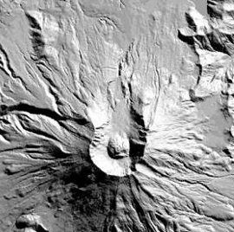
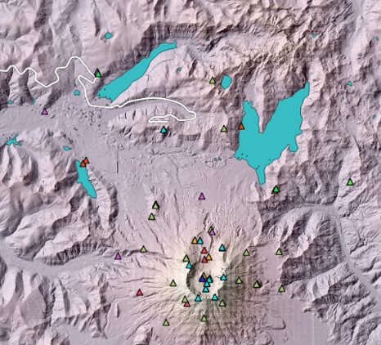
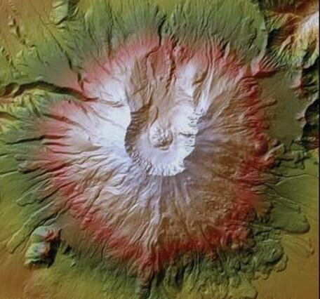
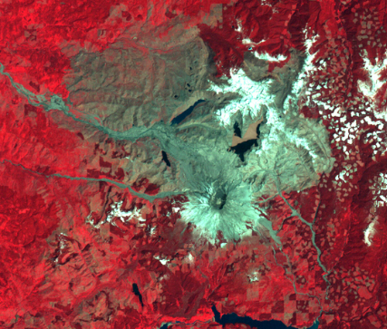
Representing Geographic Features
“Raster is faster;
Vector is correct-er”
Vector Data
Raster Data
Features like road networks, lakes, park boundaries, station locations, etc. are usually vectors (in ArcGIS these are shapefiles)
Digital elevation models (DEMs), hillshades, satellite images are all rasters
Points
Lines
Polygons

Slide 6
GIS works when you combine geographic location with attribute information
Where is it?
Spatial Coordinates
(204654, 3984988)
What is it?
Attributes
FID | Shape * | Volcano | Instrument | Solar?
024 | point | Kilauea | Seismometer | Yes
and you display it with
scale, direction, and system of measurement

Slide 7
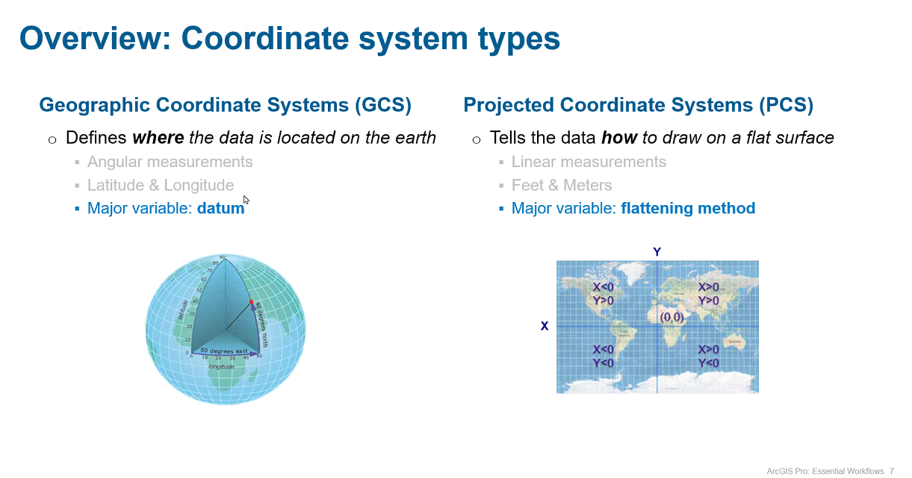
Projections can preserve size, shape, and distance, but not all three at the same time!
Notes:
Not a flat earth. Project reality onto a plane. There are many ways to do this. And none is close to perfect.
Polar coordinates to linear coordinates is complex math. Flattening can be achieved by sacrificing one or more:
Angular direction, area, distance, shape

Slide 8
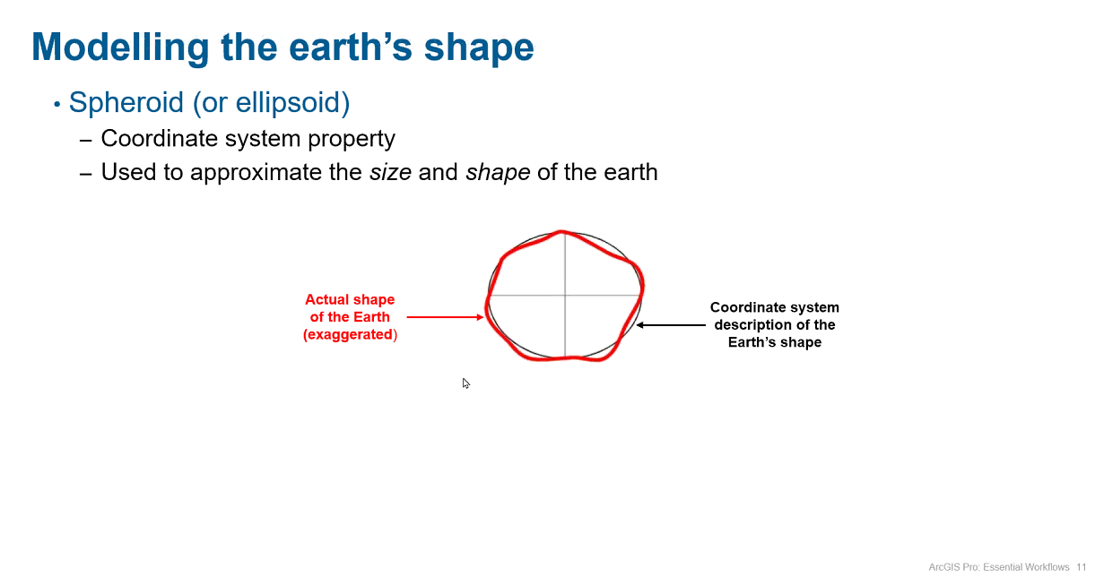
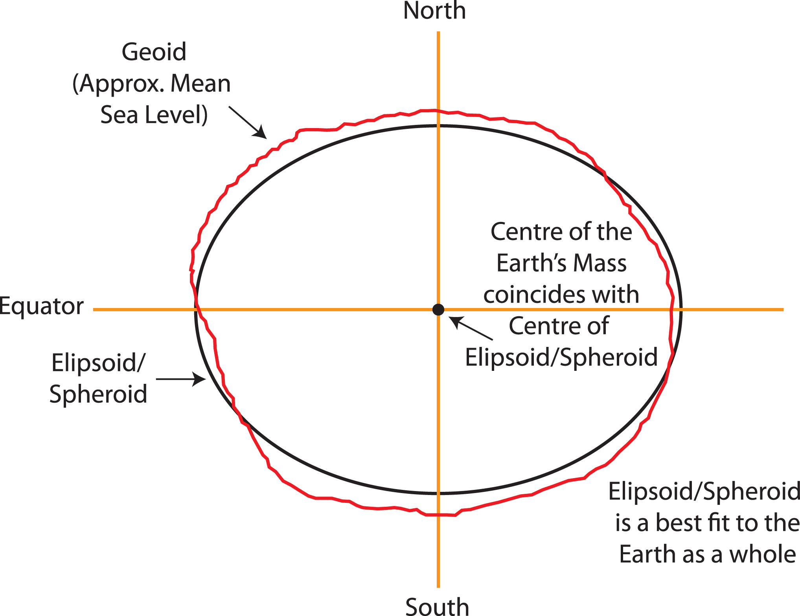
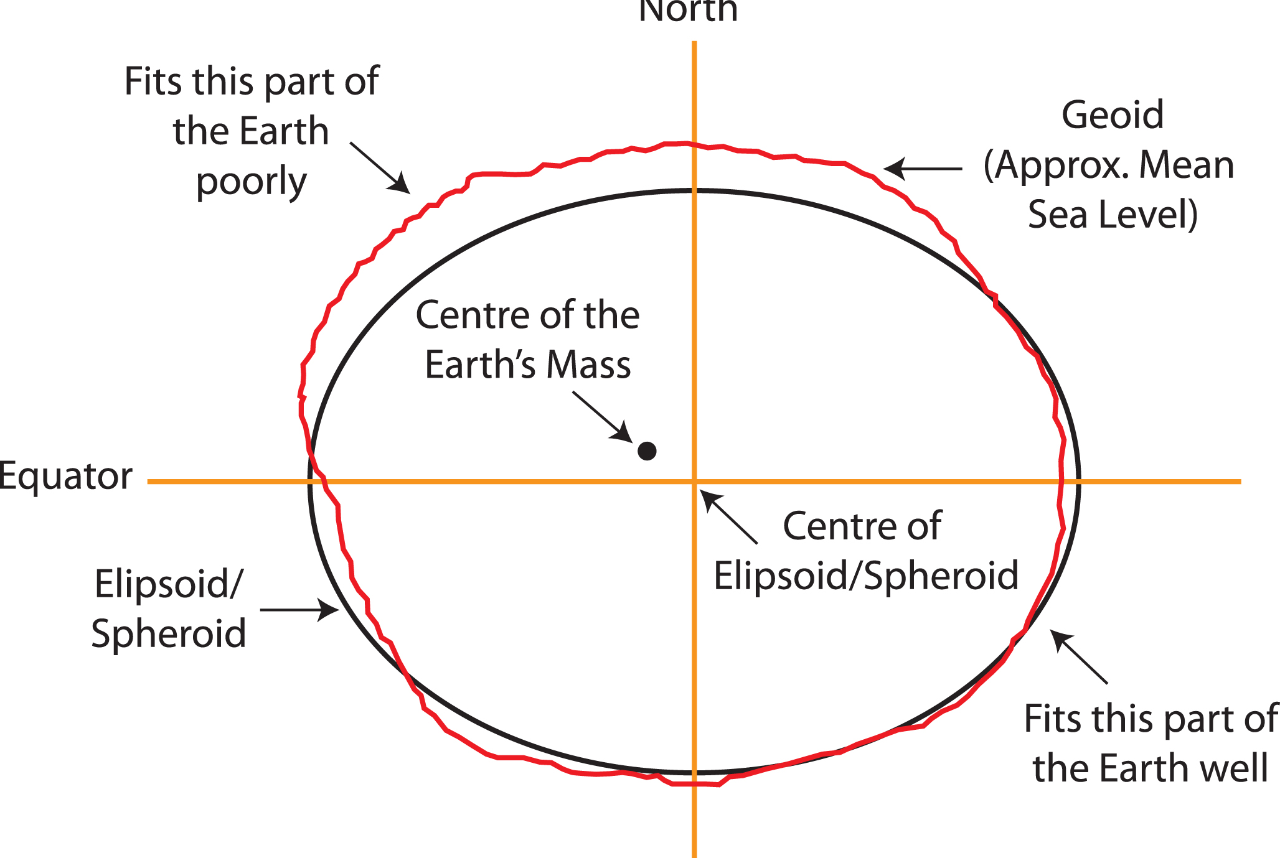
Geoid
approximates mean sea level without winds or tides
Spheroid (ellipsoid)
Mathematically idealized approximation of the size and shape of Earth
WGS84 datum
World Geodetic System
Defines an earth-centered coordinate system with the origin coordinate at the Earth’s center of mass
Used by GPS and satellite data
https://en.wikipedia.org/wiki/World_Geodetic_System
Notes:
And those projections assume a spheroid or an ellipsoid. When we know there are places on earth that are above and below sea level – the Tibetan Plateau, Mauna Kea. And sea level is also in flux. When you shrink down from global projections to a local projection that is tied to a local datum so that your local areas, distances, vectors are more accurate, there are even more mathematical ways to compute coordinate systems with datums. For the rest of this class, we are only going to work with Transverse Mercator and WGS84 datum. It’s not necessarily the best, but it works well as a standard when you’re looking at all the volcanoes around the world.

Slide 9
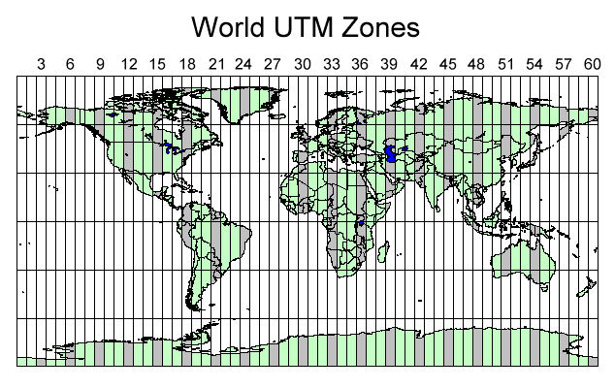
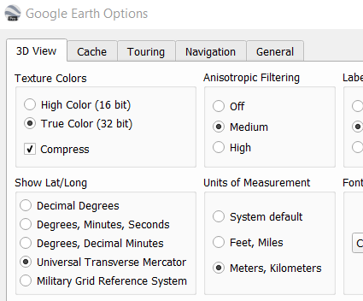
Universal Transverse Mercator (UTM)
Divides earth into 60 zones and projects each to the plane as a basis for its coordinates
Specifying a location means specifying the zone and the x, y coordinate in that plane.
Uses a grid-based, cartesian system so calculating distances is easy (which is why we use it for ArcGIS versions of LAHARZ)
https://hub.arcgis.com/datasets/esri::world-utm-grid/explore?location
For the ArcMap and ArcPro versions of LAHARZ, the DEM needs to be in UTM
For the VICTOR and stand-alone python versions, projections are handled internally
Google Earth: tools/options

Slide 10
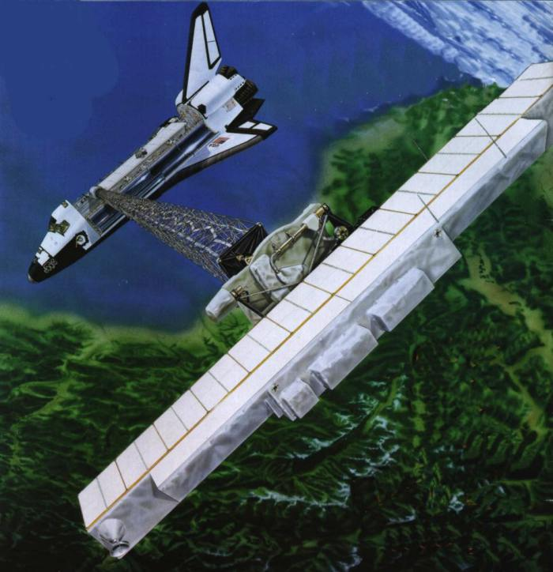
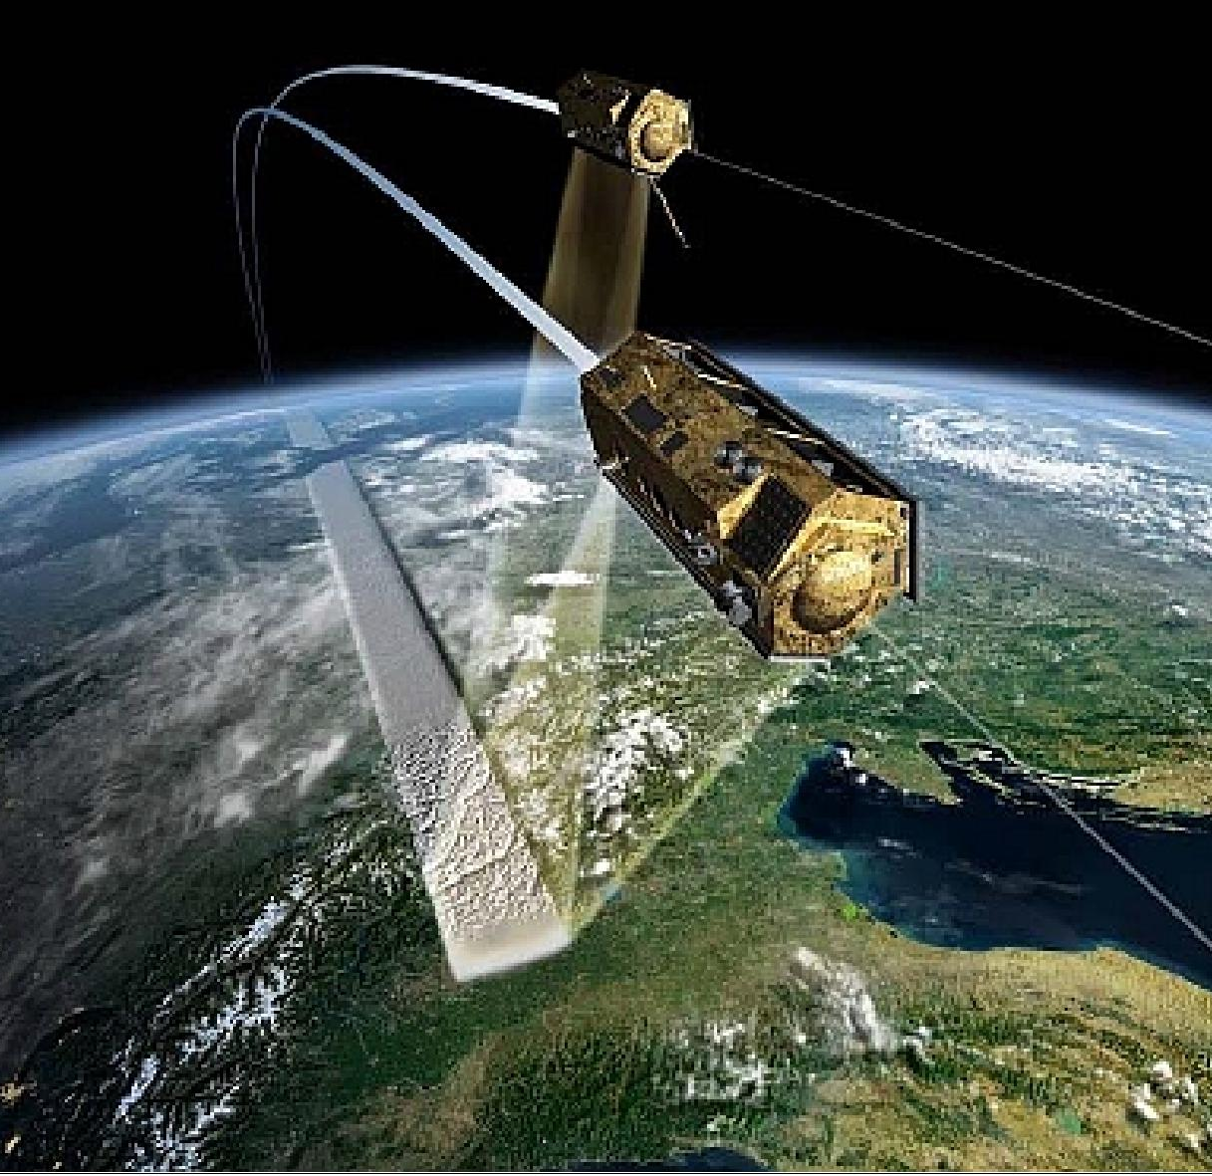
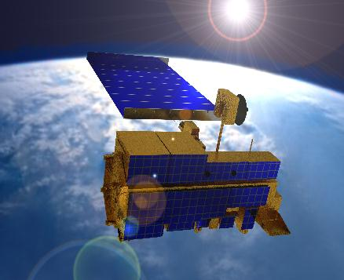
SRTM
Space Shuttle Radar Topography Mission Survey
Collected for 11 days in February 2000
Radar “sees” through clouds
60° N to 56° S, free
X-band ~6cm wavelength
30-meter global dataset
Version 3 “MEASURES” released 2020
TerraSAR-X & Tandem-X
Pair of satellites flying in close formation
Collected over 6 years of 2010-2015
Radar “sees” through clouds
0° N to 0° S, free
X-band ~6cm wavelength
90-meter global dataset
(future release of 30 or 12 meters?)
ASTER
Advanced Spaceborne Thermal Emission
and Reflection Radiometer (optical instrument) on Terra
4 million images 2000-2019
Data gaps: persistent clouds; filled with SRTM
83° N to 83° S, free
Optical stereo derived; elevations may include vegetation
30-meter global dataset
Version 3 released 2019

Slide 11

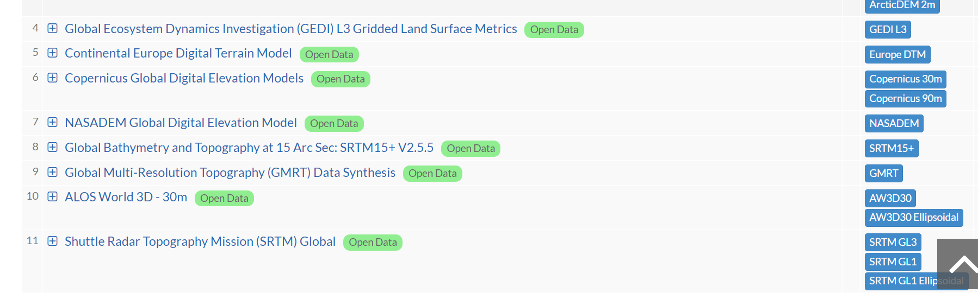
DEMs on VICTOR

Slide 12
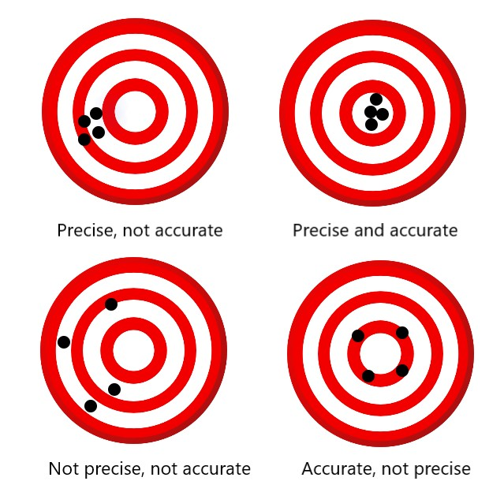

Slide 13

How much did my phone cost?
 | Precise | Not Precise
Not Accurate
Accurate
$400
$399.99
$3,999,999.999
$4,000,000
=
Precision Accuracy

Slide 14
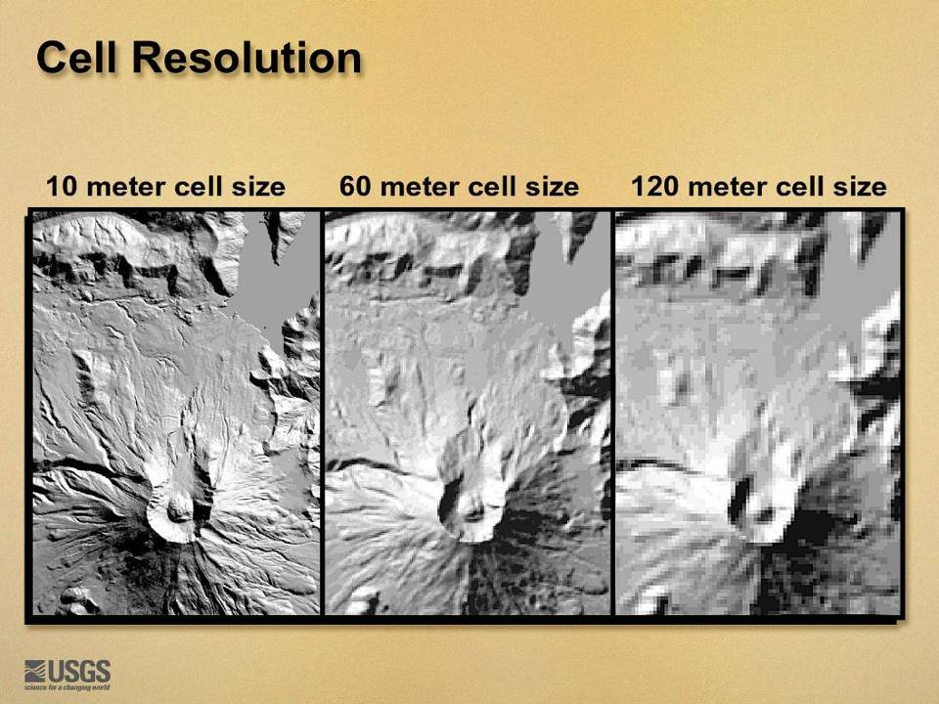
Which DEM would you want to use?

Slide 15
Which DEM would you want to use?
2005
June 19, 2024
2023

