Slide 1
Choosing volumes: more details

Slide 2
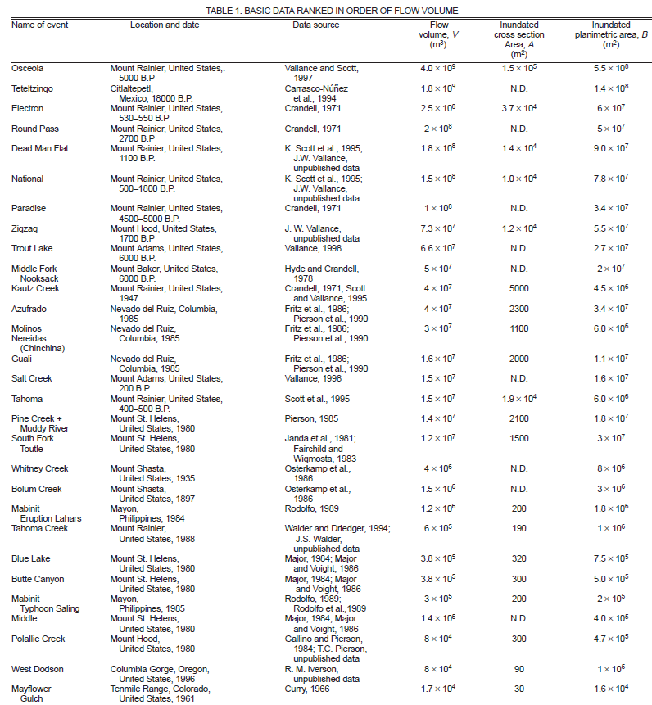
LAHARZ equations are based on very well measured lahars, most of which are 10⁴ – 10⁹ m³ (10,000 m³ – 1 km³) in volume
^{(Iverson et al. 1998)}

Slide 3

How big, how far, how frequent?
Small: Up to 10⁴ m³, up to 10 km, once or more per decade
Large: 10⁴ to 10⁶ m³, up to 50 km, once or more per century
Very large: 10⁶ to 10⁸ m³, up to 100 km, once per 100 to 1,000 years
Extremely large: 10⁸ to 10¹⁰ m³, >200 km, once per 1,000 to 10,000 years

Slide 4
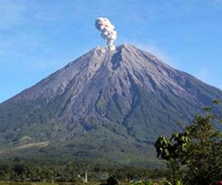
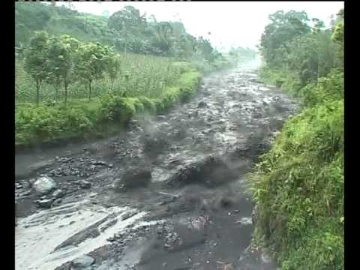
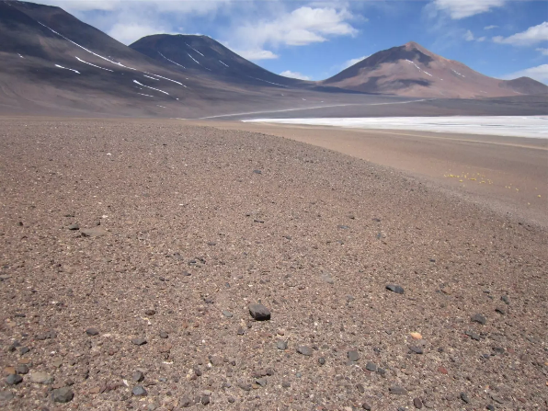
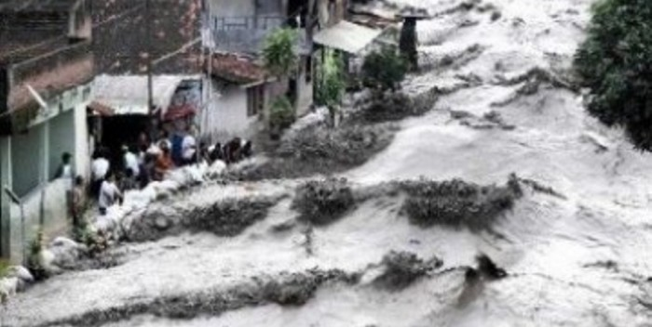
10⁵ - 10⁶ m³
Semeru, Indoneisa, February 2007, lahars range 100,000 – 1,000,000 m³
Atacama, Chile, March 2015
Estimated 2 million m³

Slide 5
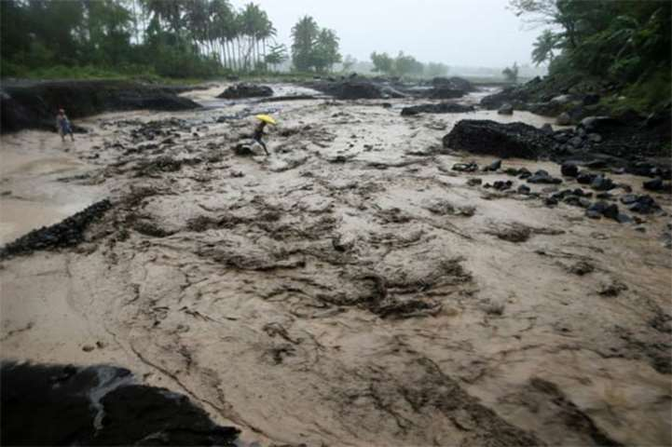
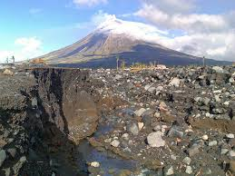
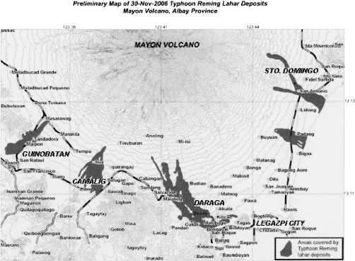
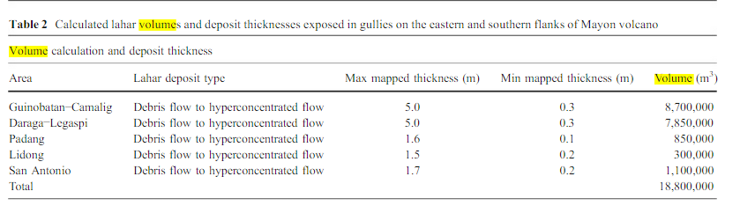
10⁵ - 10⁶ m³
Ruapehu in NZ March 2007
~7-9 million m³
Mayon, Philippines, 2006 (typhoon Reming), lahar volumes range 300,000 m³ to 9 million m³

Slide 6
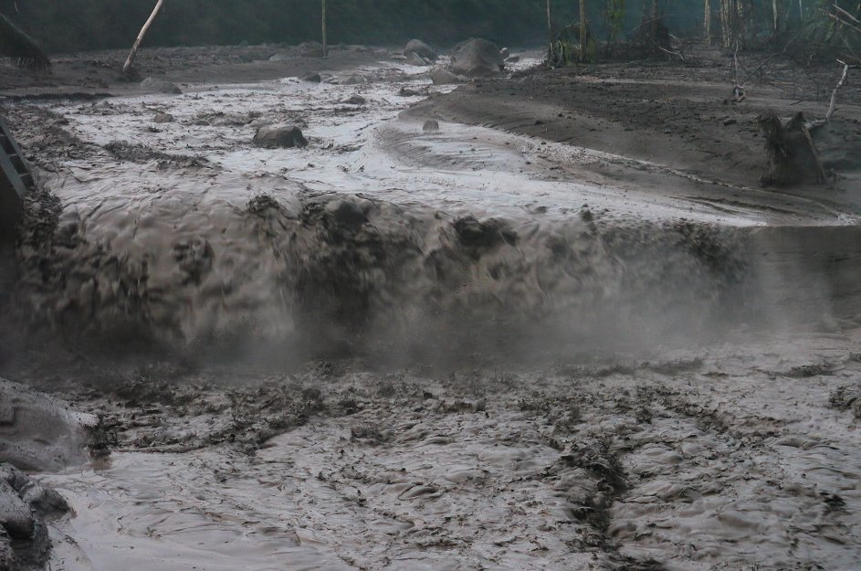
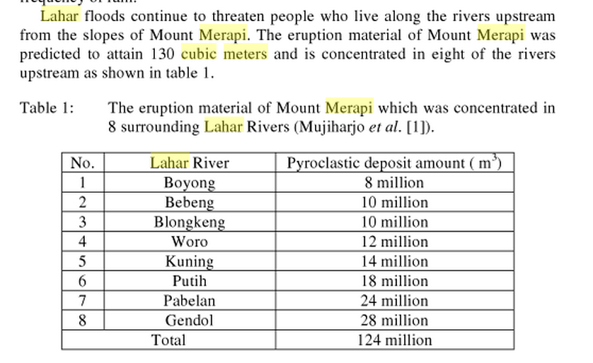
10⁷ m³
Mount Merapi, Indonesia, October 2010, lahars in 8 channels flowed 15-20 km & range 8-28 million m³

Slide 7
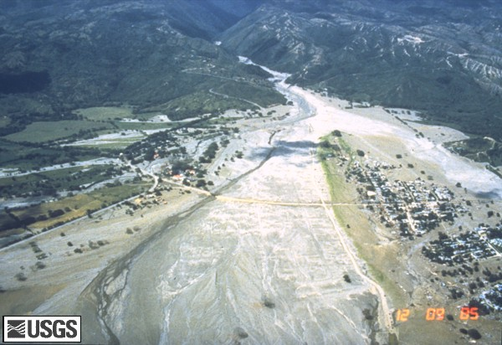
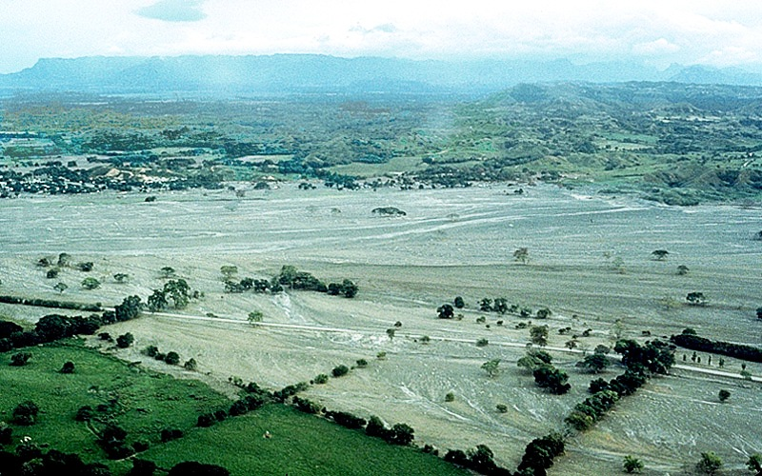
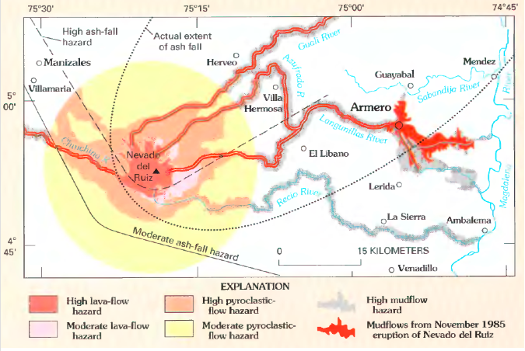
10⁷ m³
Armero Tragedy
>25,000 deaths of 30,000 inhabitants
Nevado del Ruiz, Colombia, 1985
Lahars in 3 channels range from
40 million m³ (Azufrado)
30 million m³ (Molinos Nereidas- Chinchina)
16 million m³ (Guali )

Slide 8
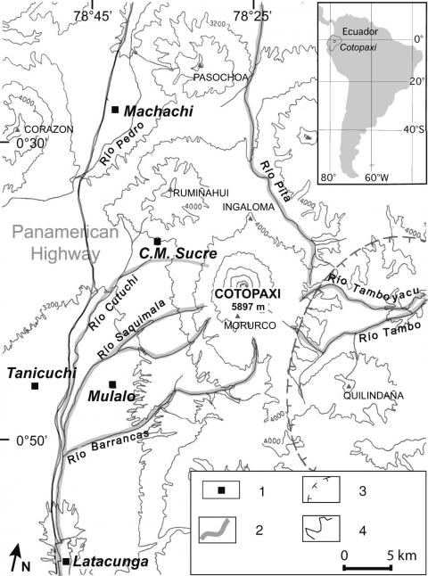
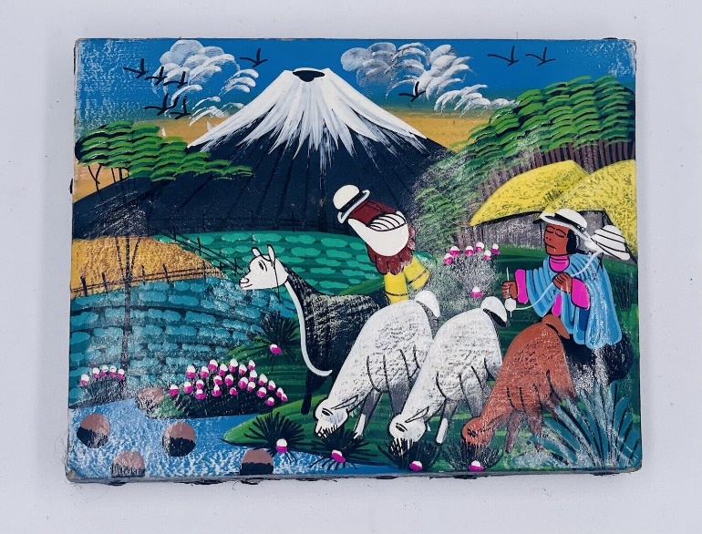
10⁸ m³
Cotopaxi, Ecuador, 1877 lahars
Traveled 100 km
Total volume of 0.5 km³
Accumulated from 4 drainages
https://journals.openedition.org/geomorphologie/4022

Slide 9
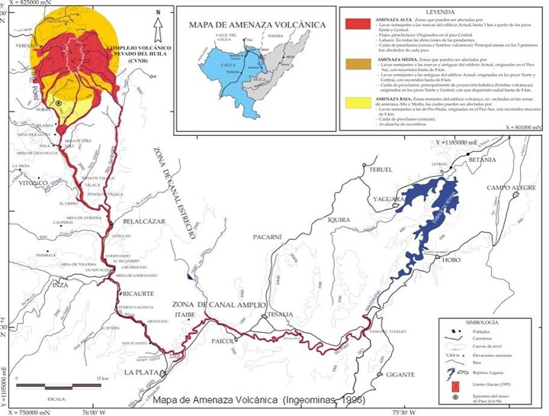
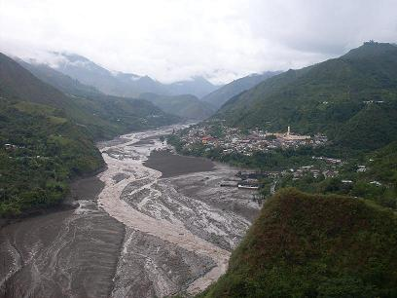
10⁸ m³
@ 45km
Nevado del Huila, Colombia, February 2007, lahars traveling ~150 km with a volume 0.3 km³

Slide 10
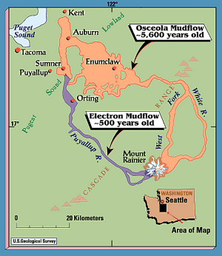
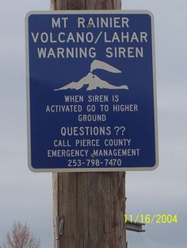
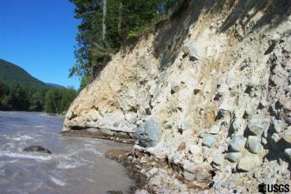
10⁹ m³
Mount Rainier Osceola Lahar, USA, 5600 years ago, 3 lahars traveling ~100 km covering 550 km² with a combined volume of 4 km³

Slide 11
How to choose volumes for LAHARZ
Because of uncertainty and naturally occurring error in the regression equations, you should choose volumes that increase by at least 2x (1, 2, 4, 8, 16 million m³, for example)
Even better is to use values that increase by 10^{0.5} (1, 3, 10, 30, 100 million m³, for example)

Slide 12
How to choose volumes for LAHARZ
Check historical records of lahar volumes at your volcano
What types of lahars are produced at your volcano?
Rainfall-triggered
eruption-triggered (Snow melt? Ice melt? Groundwater expulsion? Damming of rivers by deposits? Flows impacting lakes or rivers? Crater lake expulsion?)
What is the most common lahar volume?
What is the worst-case scenario (biggest) lahar volume?
Investigate the amount of snow and ice on your volcano
Investigate whether any crater lakes are present
Investigate the rainfall/typhoon/hurricane history at your volcano
Is there a rainy season?
Check historical records at analog volcanoes
Volcanoes of a similar size
Volcanoes with similar amounts of snow/ice
Volcanoes with similar eruptive histories
Volcanoes with similar crater lakes
Volcanoes in similar climates

