Slide 1
Node.JS
Server side JavaScript

Slide 2
What is Node.js?
Server side JavaScript
An asynchronous event driven framework.
Runs on Linux, Windows, Mac OS & most other major operating systems
Written in C and C++
API in JavaScript

Slide 3
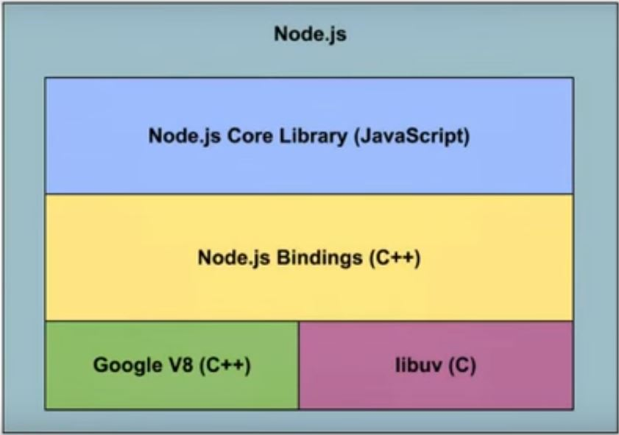
Node Architecture

Slide 4
v8 runtime engine
Used in Google Chrome
Just in Time compiler, written in C++
Consists of compiler, optimizer, and garbage collector

Slide 5
libuv
Provides asynchronous event notification
abstraction around libev (doesn't support Windows)

Slide 6
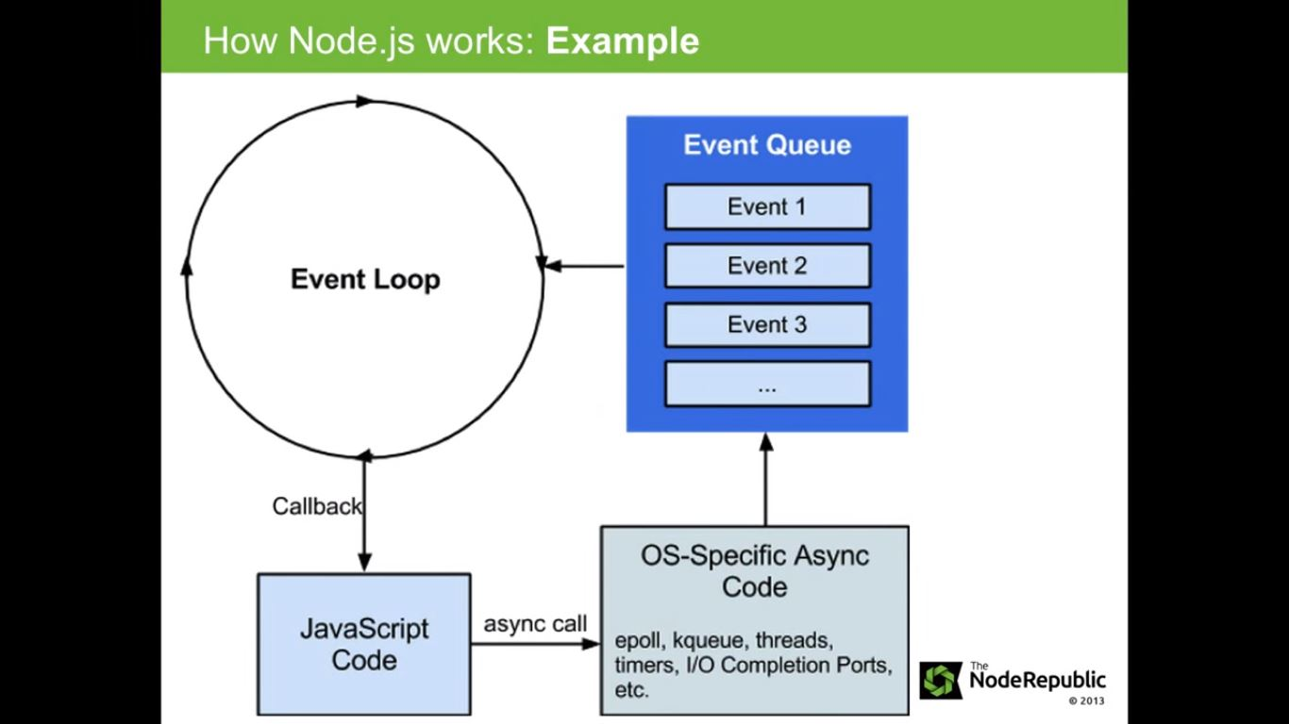
How it works

Slide 7
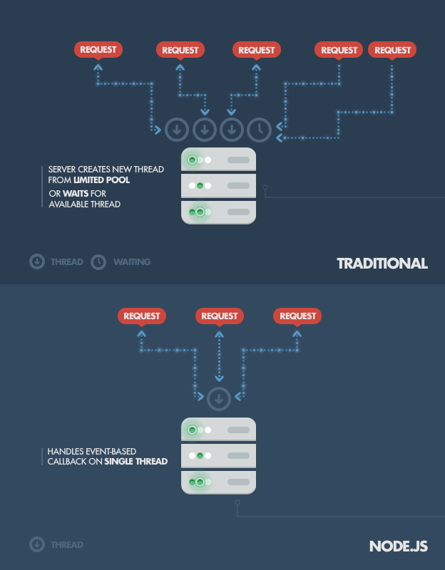

Slide 8
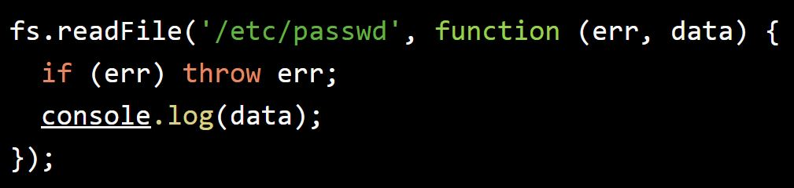

Slide 9
When should Node.JS be used?
real-time web applications
Node.js is especially suited for applications where you'd like to maintain a persistent connection from the browser back to the server. For example -
browser-based chat application
Gmail

Slide 10
Installation
Using node installer https://nodejs.org/en/download/
Using Package manager https://nodejs.org/en/download/package-manager/

Slide 11
NPM
npm makes it easy for JavaScript developers to share and reuse code.
Bundled with Node.js
Basic commands
npm install <package_name>
npm init

