Slide 1
Towards Implementing Carry-Free Primitives for Prime Field
by Vikram Voleti
Promoter: Prof. Dr. Ingrid Verbauwhede
Supervisor: Sujoy Sinha Roy

Slide 2
Contents
Introduction
Our Solution: Carry-Free Arithmetic
Recoded Binary Signed Digit (RBSD) numbers
Carry-Free Addition
Carry-Free Subtraction
Multiplication using Karatsuba algorithm
Modular Reduction
Problems
Future Work

Slide 3
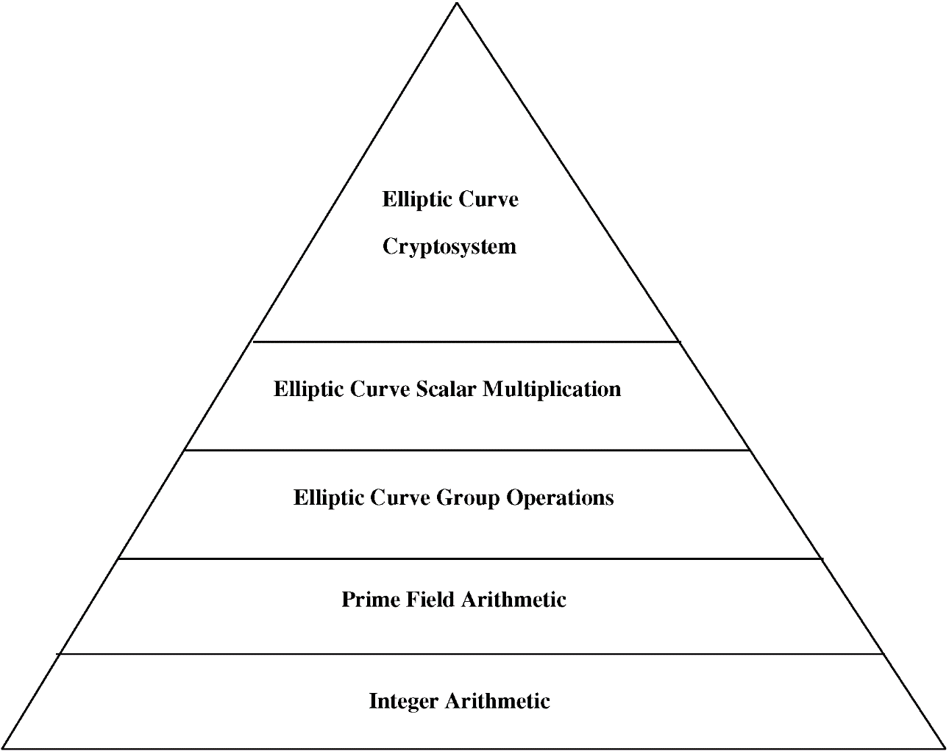
1. Introduction
Problem:
Carry Propagation in
Integer Arithmetic

Slide 4
2. Our Solution: Carry-Free Arithmetic
“Carry-Free Addition of Recoded Binary Signed-Digit Numbers”
by Behrooz Parhami
Use of Recoded Binary Signed Digit numbers
Carry-Free Addition of Recoded Binary Signed Digit numbers
Use of Carry-Free Addition in other arithmetic operations: subtraction, multiplication, modular reduction

Slide 5
3. Recoded Binary Signed Digit number
RBSD: Numbers represented by {-1, 0, 1}, with no two consecutive 1’s or -1’s
n-bit Binary number => 2*(n+1)-bit RBSD number: n+1 bits for sign, n+1 bits for value
3 = [1 1] in binary
3 = [1 0 -1] in RBSD

Slide 6
3. Recoded Binary Signed Digit number
Binary to RBSD
Conversion:
2. BSD to RBSD Conversion:
These are combinational circuits, there is no delay due to carry propagation.

Slide 7
4. Carry-Free Addition: RBSD numbers
This is a combinational circuit, there is no delay due to carry propagation.

Slide 8
4. Carry-Free Addition: RBSD numbers
Maximum combinational delay:
69-bit Carry-Free RBSD Addition: 4.784ns
133-bit Carry-Free RBSD Addition: 4.784ns
For Carry-Free addition of two 132-bit (each of sign and value) RBSD numbers is:
Selected Device : 5vlx30ff324-3 (Virtex-5)
Slice Logic Utilization: Number of Slice LUTs: 928 out of 19200 4%
Slice Logic Distribution: Number of LUT Flip Flop pairs used: 928

Slide 9
4. Carry-Free Addition: RBSD numbers

Slide 10
4. Carry-Free Addition: binary numbers
This is a combinational circuit, there is no delay due to carry propagation.

Slide 11
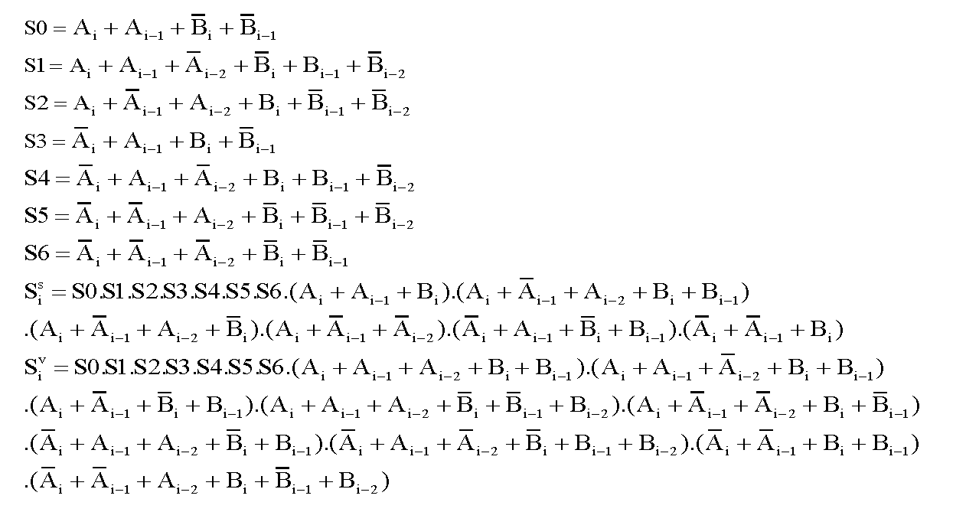
4. Carry-Free Addition: binary numbers
Maximum combinational delay:
Carry_Free_Add_Bin32: 4.028ns
Carry_Free_Add_Bin132: 4.028ns
For Carry-Free addition of two 132 bit binary numbers:
Selected Device : 5vlx30ff324-3 (Virtex-5)
Slice Logic Utilization: Number of Slice LUTs: 265 out of 19200 1%
Slice Logic Distribution: Number of LUT Flip Flop pairs used: 265

Slide 12
5. Carry-Free Subtraction of RBSD numbers
A - B = A + (-B)
3 = [1 1] in binary
= [1 0 -1] in RBSD
-3 = [1 0 1] in 2’s Complement
= [-1 0 1] in RBSD
To negate an RBSD number: invert the 1’s and -1’s:
Xs_new = ~Xs & Xv;
Xv_new = Xv;
Adder/Subtractor circuit for 256 bits:
Maximum combinational path delay: 5.402ns
Selected Device : 5vlx30ff324-3
Slice Logic Utilization: Number of Slice LUTs: 1802 out of 19200 9%
Slice Logic Distribution: Number of LUT Flip Flop pairs used: 1802

Slide 13
6. Multiplication of 66-bit binary numbers
Karatsuba Multiplication Algorithm for 66-bit numbers:
P = ((Ah*Bh)*2^66 + Al*Bl )+ ((Ah+Al)*(Bh+Bl) – (Ah*Bh+Al*Bl))*2^33
Karatsuba Multiplication of 256-bit binary numbers is performed using 66-bit Karatsuba Multiplication incorporating Carry-Free Addition.

Slide 14
6. Multiplication of 66-bit binary numbers
Using
Karatsuba
Multiplication
Algorithm

Slide 15
6. Multiplication of 66-bit binary numbers
Maximum combinational path delays of individual modules:
Carry_Free_Add_Bin32: 4.028ns
Carry_Free_Add_Bin64: 4.028ns
Carry_Free_Add_Bin132: 4.028ns
Add_RBSD69: 4.784ns
Add_RBSD133: 4.784ns
RBSD_to_Bin33: 12.824ns
Bin_to_RBSD68: 3.607ns
BSD_to_RBSD68: 4.028ns
BSD_to_RBSD132: 4.028ns
Maximum combinational path delay of Multiplier: 24.978ns
Slice Logic Utilization: Number of Slice LUTs: 2223 out of 19200 11% Slice Logic Distribution: Number of LUT Flip Flop pairs used: 2223

Slide 16
7. Modular Reduction
Fast reduction modulo p256 = 2^256 −2^224 +2^192 +2^96−1
INPUT: An integer c = (c15, . . ., c2, c1, c0) in base 2^32 with 0 ≤ c < p256^2.
OUTPUT: c mod p256.
1. Define 256-bit integers:
s1 = (c7, c6, c5, c4, c3, c2, c1, c0),
s2 = (c15, c14, c13, c12, c11,0,0,0),
s3 = (0, c15, c14, c13, c12,0,0,0),
s4 = (c15, c14,0,0,0, c10, c9, c8),
s5 = (c8, c13, c15, c14, c13, c11, c10, c9),
s6 = (c10, c8,0,0,0, c13, c12, c11),
s7 = (c11, c9,0,0, c15, c14, c13, c12),
s8 = (c12,0, c10, c9, c8, c15, c14, c13),
s9 = (c13,0, c11, c10, c9,0, c15, c14).
2. Return(s1 + 2s2 + 2s3 + s4 + s5 − s6 − s7 − s8 − s9 mod p256).

Slide 17
7. Modular Reduction

Slide 18
7. Modular Reduction
This is a sequential circuit, it 10 clock cycles to complete.
Minimum period: 5.215ns (Maximum Frequency: 191.755MHz)
Minimum input arrival time before clock: 5.880ns
Maximum output required time after clock: 7.229ns
Maximum combinational path delay: 7.895ns
Selected Device : 5vlx30ff324-3 (Virtex-5)
Slice Logic Utilization: Number of Slice Registers: 1051 out of 19200 5%
Number of Slice LUTs: 10612 out of 19200 55%

Slide 19
8. Problems
Binary -> RBSD conversion:
It is assumed that binary number is positive
This conversion increases bit size by 1, and then doubles the bit size for inclusion of sign
Carry-Free Addition:
Results in a BSD number that is not necessarily RBSD; fortunately, BSD to RBSD conversion is combinational
RBSD -> Binary conversion:
Involves carry propagation
Karatsuba Multiplication with Carry-Free Addition incorporated:
Splitting a BSD or an RBSD number can result in carry propagation
Have to use 64-bit RBSD to Binary converter in which Carry Propagation occurs, instead of faster sequential 32-bit RBSD to Binary conversion
Ultimately, integer multiplication is performed, which involves Carry Propagation

Slide 20
9. Future Work
Implement 2’s complement binary number to RBSD conversion
Implement carry-free integer multiplication
Incorporate splitting and concatenation of BSD and RBSD numbers in carry-free arithmetic
Design of ECC Processor that works with Carry-Free arithmetic:
design of arithmetic modules that work completely in the BSD number domain, without conversions to and from binary

Slide 21
References
Behrooz Parhami, “Carry-Free Addition of Recoded Binary Signed-Digit Numbers”, IEEE Transactions on Computers, Vol. 37, No. 11, November 1988
Behrooz Parhami, “Generalized Signed-Digit Number Systems: A Unifying Framework for Redundant Number Representations”, IEEE Transactions on Computers, , Vol. 39, No. 1, January 1990
Darrel Hankerson, Alfred Menezes, Scott Vanstone, “Guide to Elliptic Curve Cryptography”
*All the modules described have also been coded in Octave to verify the results.
*For long integer calculation, GP/PARI calculator has also been used.

Slide 22
Thank you!

