Slide 1



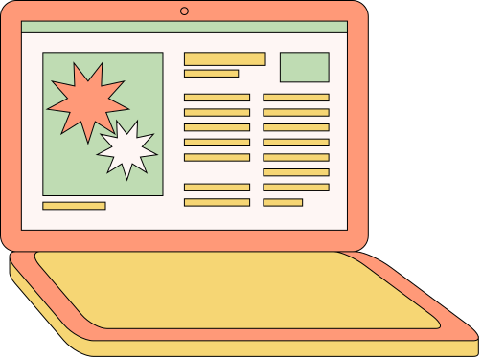
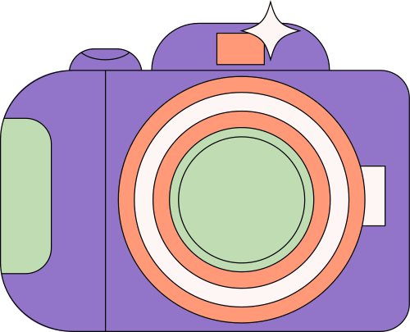
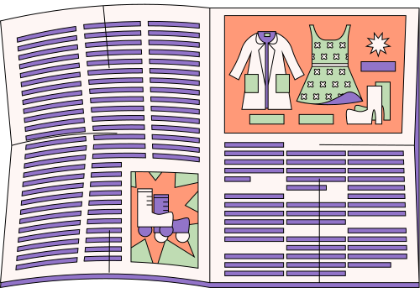
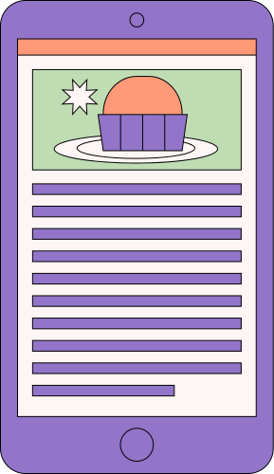
MEDIA PLATFORMS
CSPT
Hannah Aurora Busto | Jaser Galang | Josh Ziemenn Tan

Slide 2
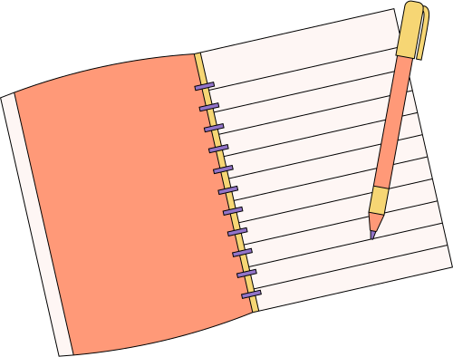
DEFINITION
Media platforms are digital or traditional channels that facilitate the creation, distribution, and consumption of information, entertainment, and communication. These platforms enable individuals, businesses, and organizations to share content with a wide audience, influencing public opinion, culture, and commerce.

Slide 3


SOCIAL MEDIA
BROADCASTING NETWORKS
STREAMING SERVICES
NEWS WEBSITES
Websites and apps that encourage user-generated content and interaction (e.g., Facebook, Twitter, Instagram).
Platforms that provide on-demand content, such as music, videos, and podcasts (e.g., Netflix, Spotify, YouTube).
Online portals that offer real-time news updates, analysis, and investigative journalism (e.g., The New York Times, BBC News, Al Jazeera).
Television and radio stations that distribute news, entertainment, and educational programs (e.g., CNN, BBC, ABS-CBN).

Slide 4

HISTORY & TIMELINE

Slide 5

19th Century – Traditional Media Emerges
The rise of print media (newspapers, magazines) made information widely accessible. The telegraph (1830s-1840s) revolutionized long-distance communication, and later, the radio (1896) enabled audio broadcasts.
Key Developments:
1830s-1840s – Telegraph enhances communication.
1896 – Marconi invents wireless radio.
Late 1800s – Newspapers dominate mass communication.
20th Century – Broadcast Media & Television
Radio became a major source of live news and entertainment, while the 1950s saw television dominate media consumption. The rise of film, recorded music, and cable TV reshaped entertainment.
Key Developments:
1920s – Radio gains mainstream popularity.
1930s-1940s – Hollywood’s Golden Age.
1950s-1960s – TV overtakes radio as the leading medium.
1980s-1990s – Cable TV introduces 24-hour news networks.

Slide 6

1990s – The Internet Revolution
The launch of the World Wide Web shifted media to digital platforms. Online news, search engines (Yahoo!, Google), and personal blogs transformed information sharing.
Key Developments:
1991 – The Web is introduced.
1995 – Online news platforms emerge.
Late 1990s – Blogging and digital journalism rise.
2000s – Social Media & User-Generated Content
The rise of Facebook, YouTube, and Twitter made content creation and sharing instant. Smartphones and mobile apps revolutionized media consumption.
Key Developments:
2004 – Facebook launches social networking.
2005 – YouTube enables global video-sharing.
2006 – Twitter introduces microblogging.
Late 2000s – Mobile apps boost accessibility.

Slide 7

2010s – Streaming & Mobile-First Content
Streaming services like Netflix, Spotify, and Twitch displaced traditional TV and radio. Algorithms enhanced personalization, and short-form content (TikTok, 2016) became dominant.
Key Developments:
2011 – Snapchat introduces disappearing content.
2015 – Live streaming (Twitch, Facebook Live) rises.
2016 – TikTok revolutionizes short videos.
2019 – Subscription-based media expands.
Present & Future – AI, VR & Decentralization
AI, VR, and blockchain are shaping the future of media. AI-driven content personalization, immersive VR experiences, and decentralized platforms are emerging trends.
Expected Trends:
AI-powered content recommendations (e.g., ChatGPT, deepfakes).
The Metaverse enables immersive media.
Decentralized social platforms (e.g., Mastodon, Bluesky).
Stricter regulations on privacy, misinformation, and AI-generated content.

Slide 8
TYPES OF MEDIA PLATFORMS

Slide 9
SOCIAL MEDIA PLATFORMS
THESE PLATFORMS ALLOW USERS TO CONNECT, SHARE CONTENT, AND INTERACT IN REAL TIME.
FACEBOOK
TWITTER (X)
INSTAGRAM
A social networking site where users share updates, photos, and videos.
A microblogging platform for sharing short messages, news, and trends.
A photo and video-sharing app focused on visual storytelling.

Slide 10
STREAMING MEDIA PLATFORMS
THESE PLATFORMS PROVIDE ON-DEMAND OR LIVE STREAMING CONTENT SUCH AS VIDEOS, MUSIC, OR GAMES.
YOUTUBE
NETFLIX
SPOTIFY
A video-sharing platform with a wide range of content from creators.
A subscription-based platform for movies and TV series.
A digital music service offering millions of songs and podcasts.

Slide 11
NEWS & INFORMATION PLATFORMS
THESE PLATFORMS PROVIDE NEWS ARTICLES, UPDATES, AND INFORMATION ON VARIOUS TOPICS.
BBC NEWS
CNN
GOOGLE NEWS
A global news platform covering politics, business, and world events.
A news outlet delivering real-time updates and in-depth analysis.
An aggregator that compiles news articles from various sources.

Slide 12
E-COMMERCE PLATFORMS
THESE PLATFORMS ENABLE BUYING AND SELLING OF GOODS AND SERVICES ONLINE.
AMAZON
SHOPEE
LAZADA
A global online marketplace offering various products.
An e-commerce platform popular in Southeast Asia.
An online shopping site offering a variety of goods.

Slide 13
MESSAGING & COMMUNICATION PLATFORMS
THESE PLATFORMS ALLOW REAL-TIME COMMUNICATION THROUGH MESSAGING, VOICE, AND VIDEO CALLS.
WHATSAPP
TELEGRAM
ZOOM
A messaging app for texting, voice, and video calls.
A secure messaging app with cloud-based storage.
A video conferencing platform used for meetings and webinars.

Slide 14
ROLE AND IMPORTANCE OF MEDIA PLATFORMS

Slide 15
KEY ROLES
Information Dissemination
Media platforms act as primary sources of news and information.
Fact-checking and responsible journalism are crucial for accuracy and credibility.
Public Opinion and Awareness
Media platforms influence how people perceive social, political, and economic issues.
They help shape discussions on important topics like climate change, human rights, and health crises.

Slide 16
Communication and Social Connectivity
Social media platforms connect individuals, allowing them to share ideas, collaborate, and form communities.
Real-time updates and instant messaging help people stay in touch across the globe.
Business and Economic Growth
Businesses use media platforms for marketing, branding, and customer engagement.
Digital advertising on platforms like Google Ads and Instagram is essential for companies.

Slide 17
IMPORTANCE
Enhancing Education
Makes learning accessible through online courses, digital libraries, and educational videos.
Encourages continuous learning with free access to podcasts, research articles, and blogs.
Supporting Innovation and Digital Transformation
Drives technological advancements in AI, augmented reality (AR), and virtual reality (VR).
Encourages creative industries like content creation, gaming, and digital art.

Slide 18

Creating Career Opportunities
Generates jobs in journalism, digital marketing, content creation, and entertainment.
Encourages new industries like esports, streaming, and influencer marketing.

Slide 19
CHALLENGES REGARDING MEDIA PLATFORMS

Slide 20
Spread of Misinformation and Fake News
Social media algorithms often prioritize engagement over accuracy, leading to the amplification of misleading content.
The lack of digital literacy among users makes it difficult to distinguish between credible and false sources.
Privacy and Data Security Concerns
Platforms collect vast amounts of user data, often without clear consent.
Personal information is vulnerable to breaches, hacking, and unauthorized surveillance.

Slide 21

Cyberbullying and Online Harassment
Individuals, especially young users, face harassment, trolling, and hate speech.
Anonymity on digital platforms allows people to spread negativity without accountability.
Digital Divide and Accessibility Issues
Not everyone has equal access to media platforms due to economic and technological disparities.
Rural areas and developing countries face connectivity issues.

Slide 22
THE FUTURE OF MEDIA PLATFORMS

Slide 23
AI & Automation – Artificial Intelligence will enhance content recommendations, automated moderation, and personalized experiences.
Virtual & Augmented Reality (VR/AR) – Interactive experiences will become more immersive in social media and entertainment.
Decentralized Platforms – Blockchain-based media platforms may provide more transparency and user control over content.
5G & Faster Internet – High-speed internet will enable better streaming quality and real-time interaction.
Interactive & Personalized Content – AI-driven personalization will provide tailored content based on user preferences.

Slide 24
The End
THANK YOU FOR LISTENING!

