Slide 1
Connect-4
Peshang Alo, Rune Alexander Laursen, Ole Gunvaldsen

Slide 2
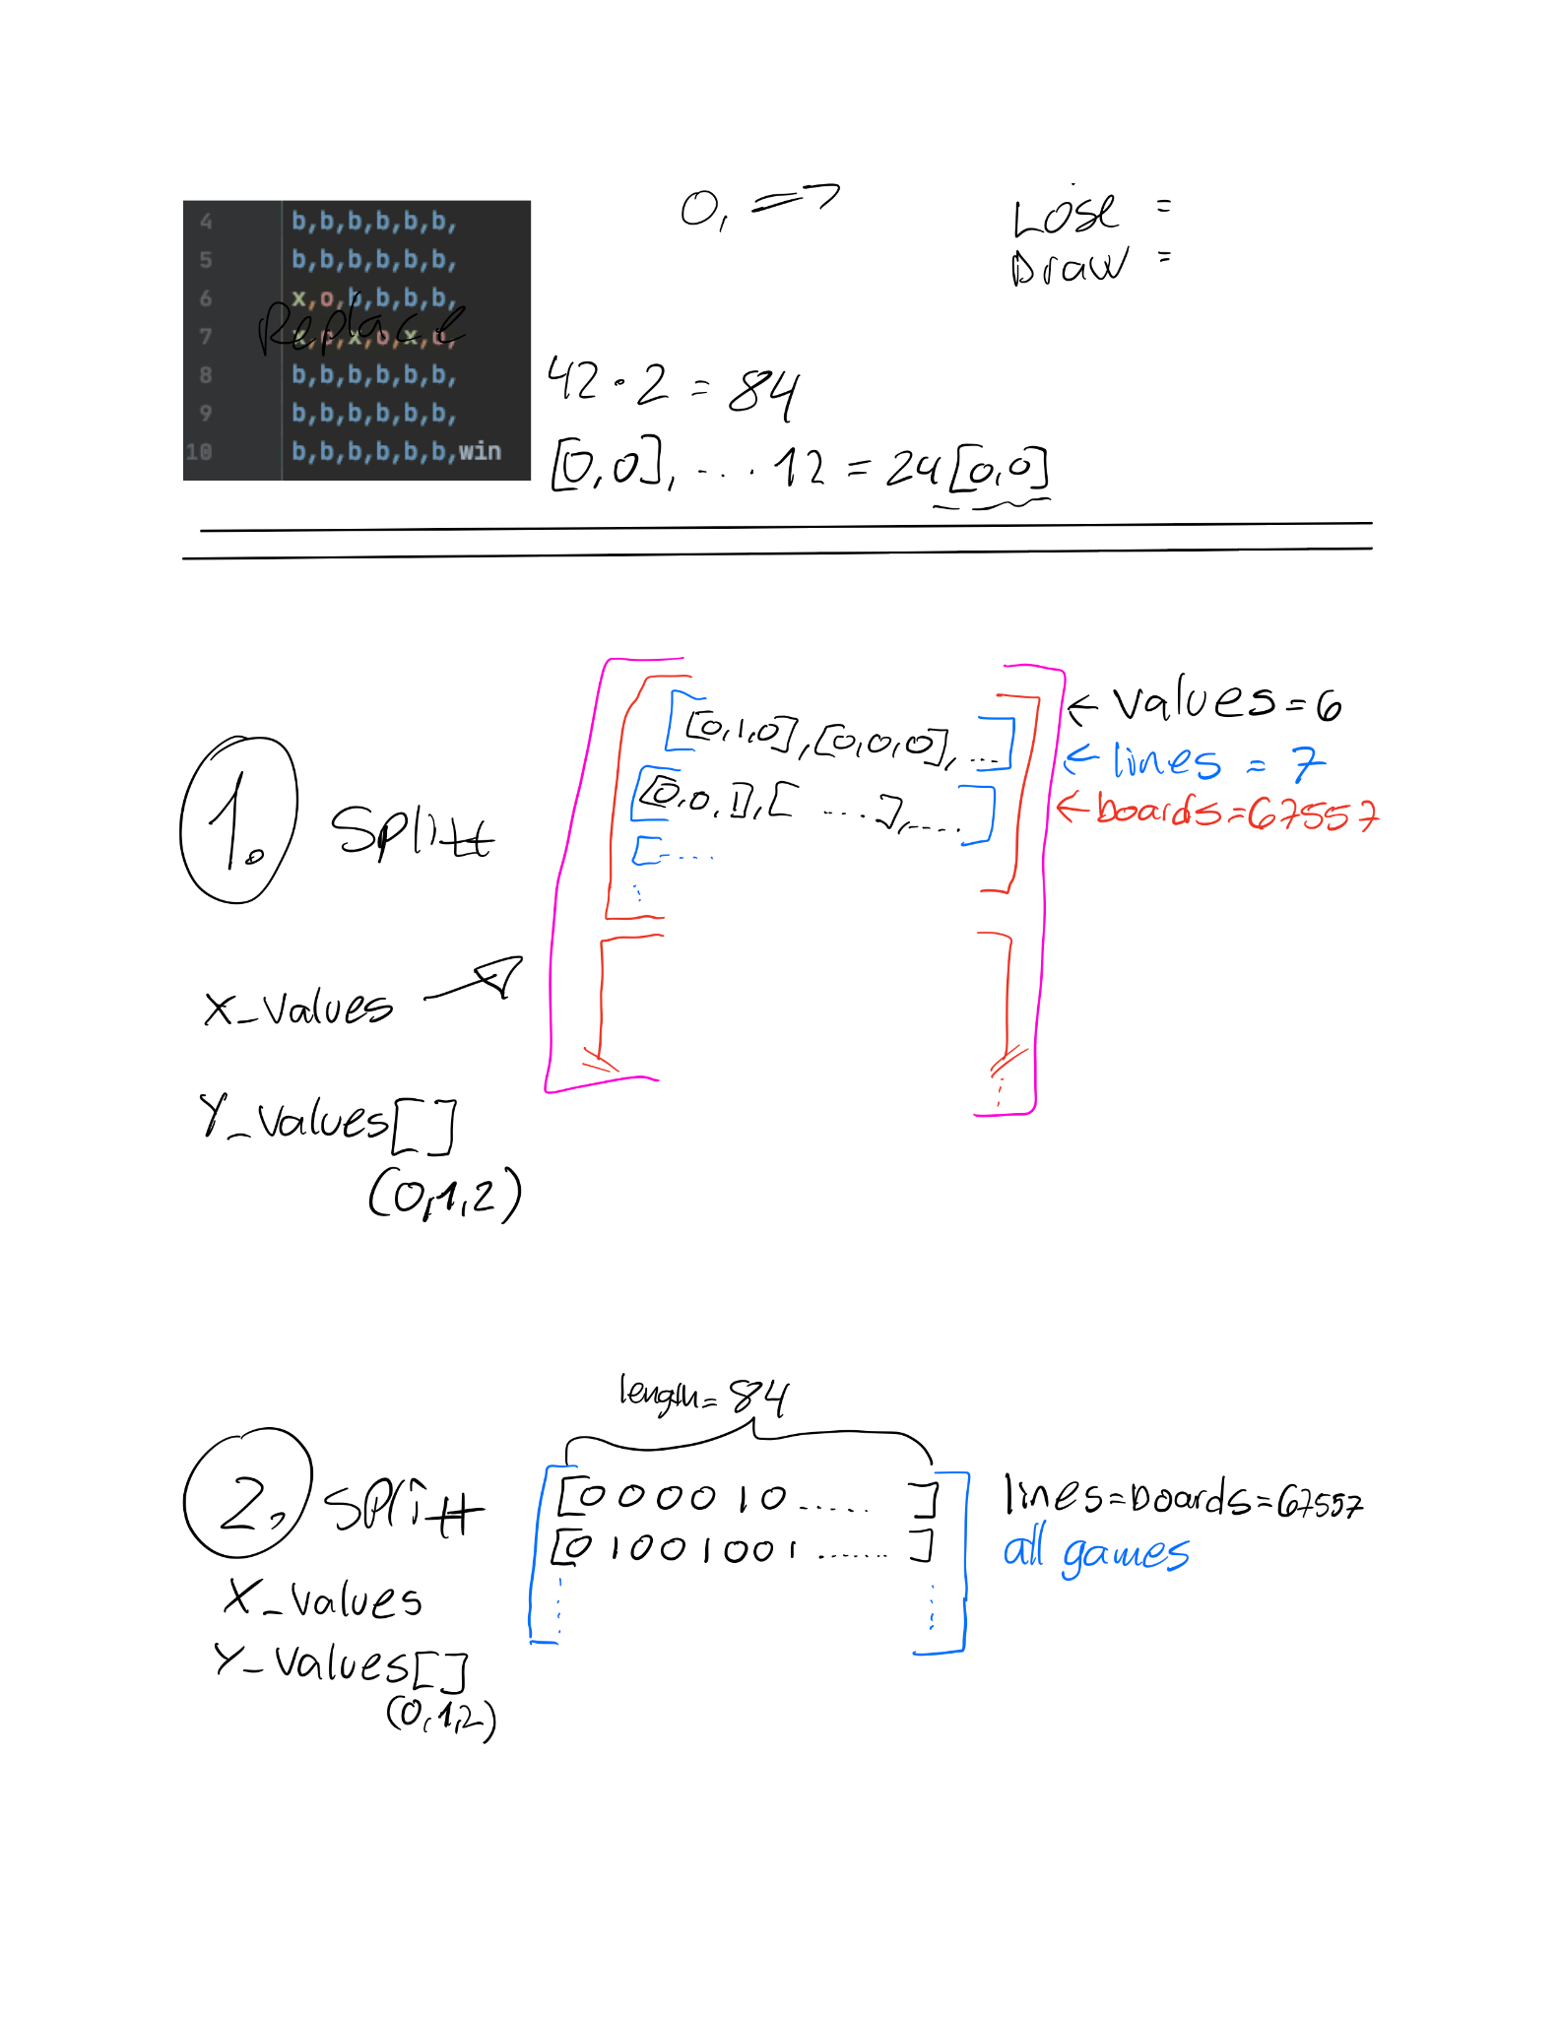
DATA PARSING
(#Clauses = 3000, T = 200, sum = 100) 9 epochs, accuracy ≈ 60% 200s/epoc
Notes:
When starting this assignment, we began thinking bout how we would represent the data. The first thing that comes to our mind is to divide each game into columns and rows similar to how we would view it in real life, and then switch each letter with another array of three bits. So the end result became as we see in the figure in this slide. This way of representing data led to a very slow training process.
This created an array of arrays of arrays of arrays, similar to the representation of the example dataset from mnist.

Slide 3
DATA PARSING
(#Clauses = 10 000, T = 100, sum = 80) over 100 epochs gives accuracy ≈ 80% 200s/epoch
Notes:
After we asked “Ahmed” about the reason for the slow process of training, it was found that data representation plays a major role in the speed and efficiency of the training. And we end up representing each line “game” with a single array.

Slide 4
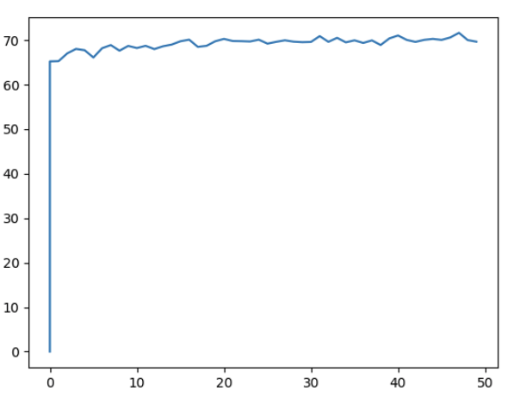
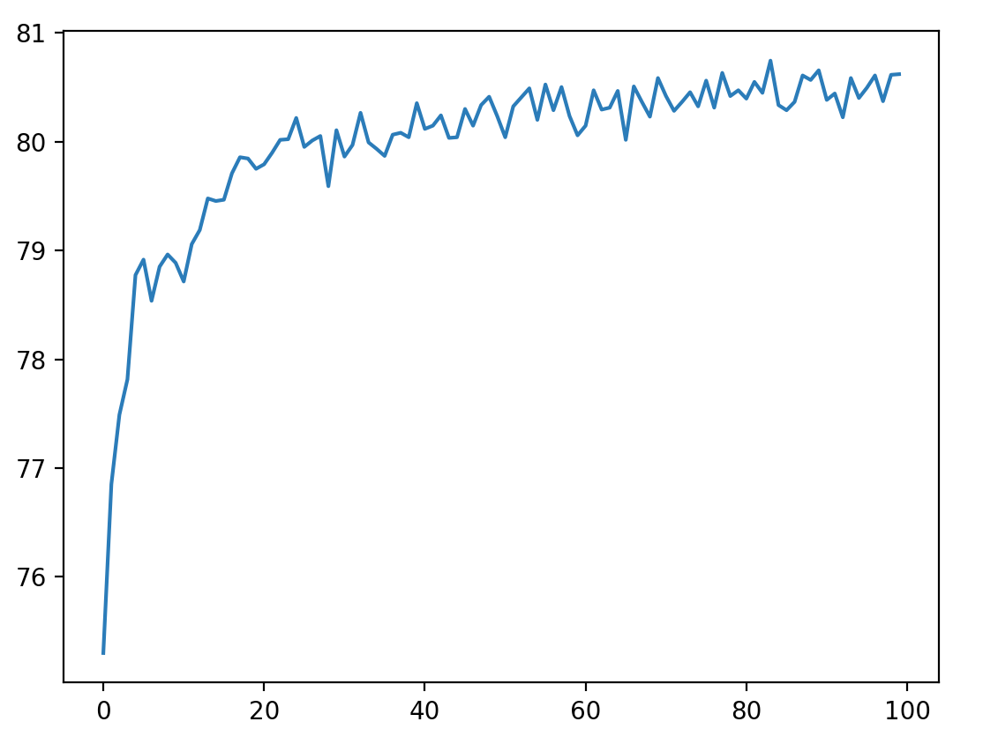
HYPER PARAMETERS & TESTING
For-loop for testing hyper parameters
3 bits instead of 2
Result with hyperparameter (15 000,100,100) over 100 epochs
Result with hyperparameter (500,100,80) over 50 epochs
Notes:
When the data parsing was completed, we started training the machine, and over 100 epochs, the accuracy of the machine was roughly 80 percent.

Slide 5
Clauses
Class 0 Positive Clauses: Clause #0: x3 Clause #2: x13 ∧ x24 Clause #4: x24 Clause #6: ¬x20 ∧ ¬x33 Clause #8: Clause #10: x27 Clause #12: x13 Clause #14: x24
Class 0 Negative Clauses: Clause #1: x11 ∧ ¬x14 Clause #3: x35 ∧ ¬x3 ∧ ¬x31 Clause #5: Clause #7: ¬x18 Clause #9: x11 ∧ ¬x19 Clause #11: ¬x39 Clause #13: x22

Slide 6
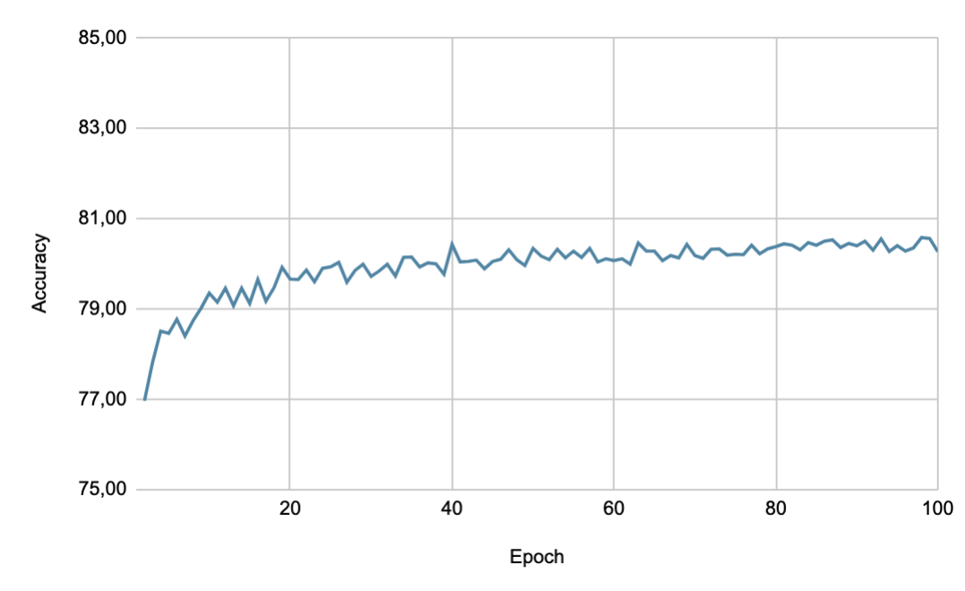
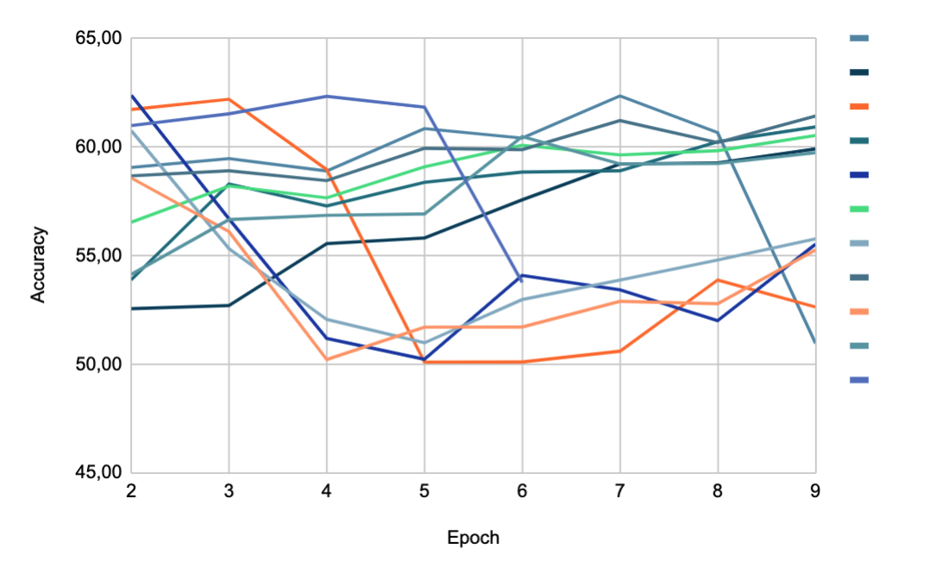
RESULTS
Attempt 1: (3000, 200-10, 100-3) e = 9
Attempt 2: (10 000, 100, 80) e = 100
Attempt 3: (100-500?, 10-200, 3-100)

Slide 7
Code
https://github.com/voljumet/Learning-System/blob/main/connect-4/Connect-copy.py

