Slide 1




WORD PUZZLE PROJECT
By
Volkan Ülker 2018510087
Tunahan Yanmaz 2018510105
Dırahşan Çağrı İrdemez 2018510090

Slide 2

OUTLINE
INTRODUCTION
PROGRESS SUMMARY
- Requirements
-Task Sharing
-Scheduling
-Completed Task
ALGORITHMS AND SOLUTION STRATEGIES
ADDITIONAL IMPROVEMENTS
SCREENSHOTS
CONCLUSION
REFERENCES
..
..
..

Slide 3

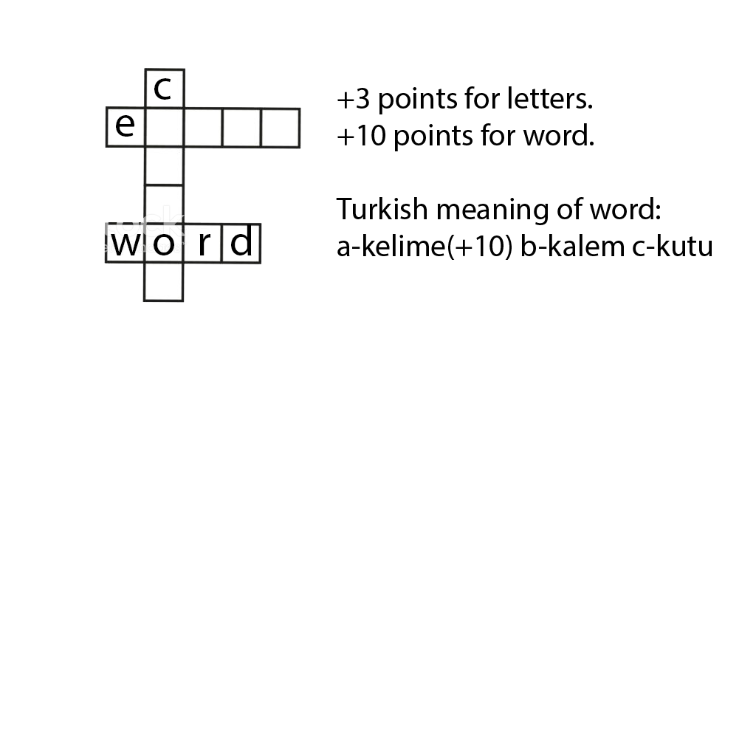
INTRODUCTION
This game playable with 2 players. Main idea of this game is basically crossword.
Objective of the game: guessing words letter by letter and collecting scores.
Each correct letter is 1 point, each correct word is 10 points. After guessing word correctly player can collect 10 more point by signing the turkish meaning of word.
Here is an example of the game

Slide 4





Requirements
Eclipse and, Intellij IDE(Coding)
Powerpoint(Presentation)
Adobe Photoshop(Poster)
Microsoft Word(Reports)
Trello(Sharing Progress)

Slide 5

Task Sharing
Volkan Ülker:
Coding general project.
Error checks.
Bug fixing.
Presentation.
Tunahan Yanmaz:
Coding some parts.
Making poster.
Presentation.
Çağrı İrdemez:
Coding some parts.
Bug fixing.
Presentation.

Slide 6

Scheduling
WEEK 1: Making flowchart and thinking about how to do the project.
WEEK 2: Creating general classes and reading input files.
WEEK 3: Creating word lists as sll.
WEEK 4: Converting word list sll to mll.
WEEK 5: Implementation high score table and score calculation code. Error checks, poster, presentation and finishing project.

Slide 7

Completed Tasks
Reading files properly and taking words as single linked list. Then sorting alphabetically by sll.
Reading puzzle and finding words.
Converting sll to mll.
High score table implementation with double linked list.
Score calculation properly.
Saving high score and fixing possible bugs.

Slide 8

Incompleted Tasks
All tasks are completed.

Slide 9
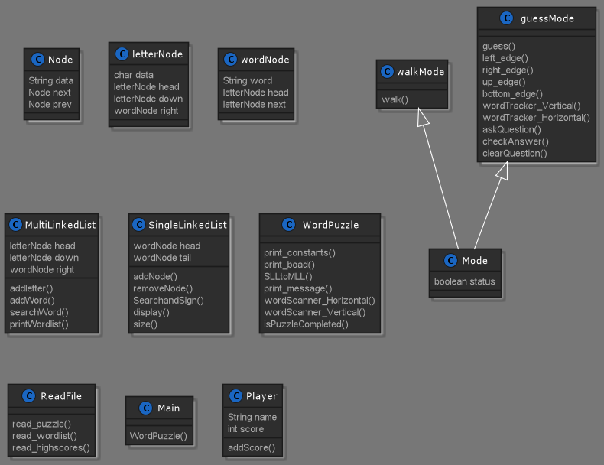
ALGORITHMS AND SOLUTION STRATEGIES
Class Diagram

Slide 10
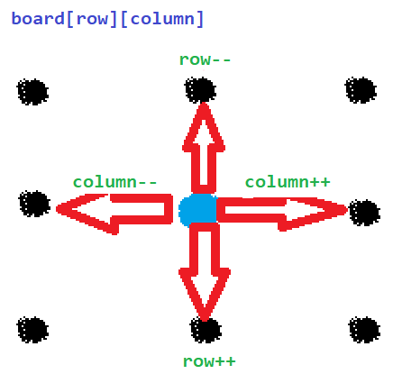

ALGORITHMS AND SOLUTION STRATEGIES
Walk Mode

Slide 11
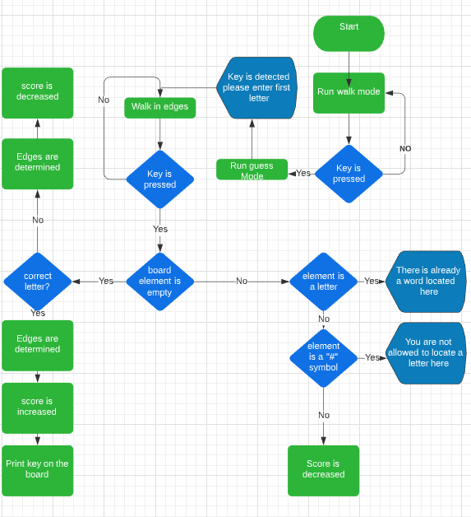
ALGORITHMS AND SOLUTION STRATEGIES
Guess a letter

Slide 12
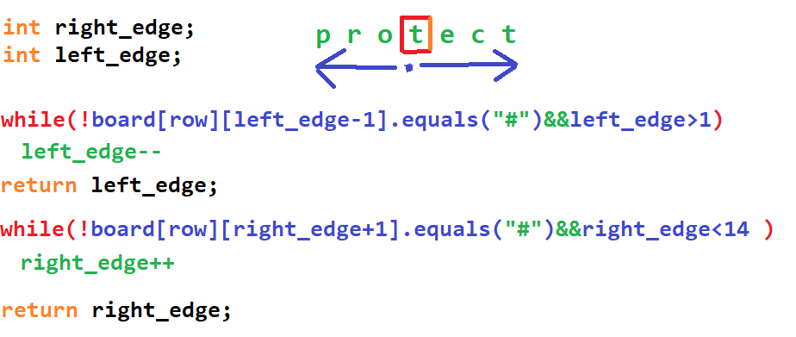
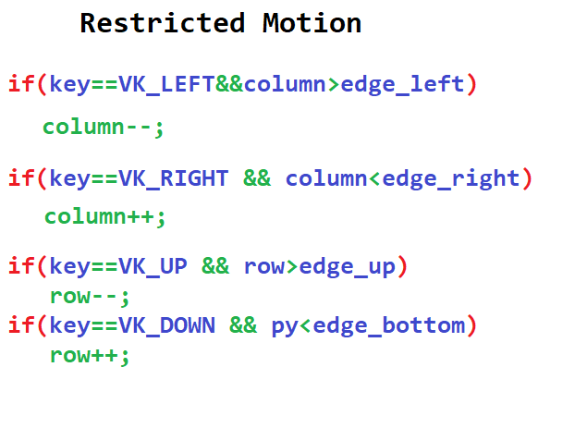
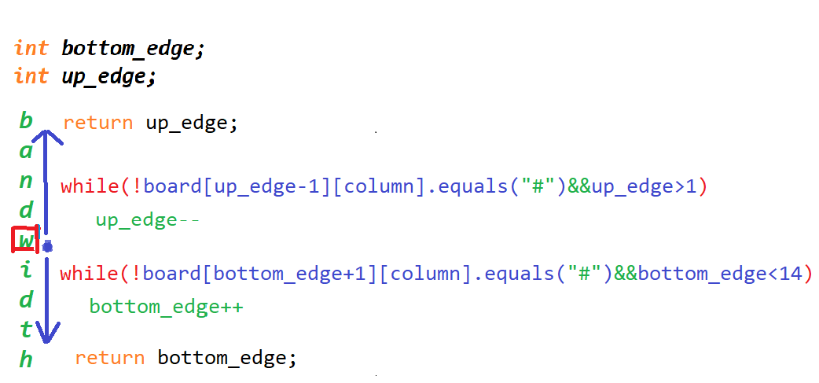
ALGORITHMS AND SOLUTION STRATEGIES
Determine edges

Slide 13
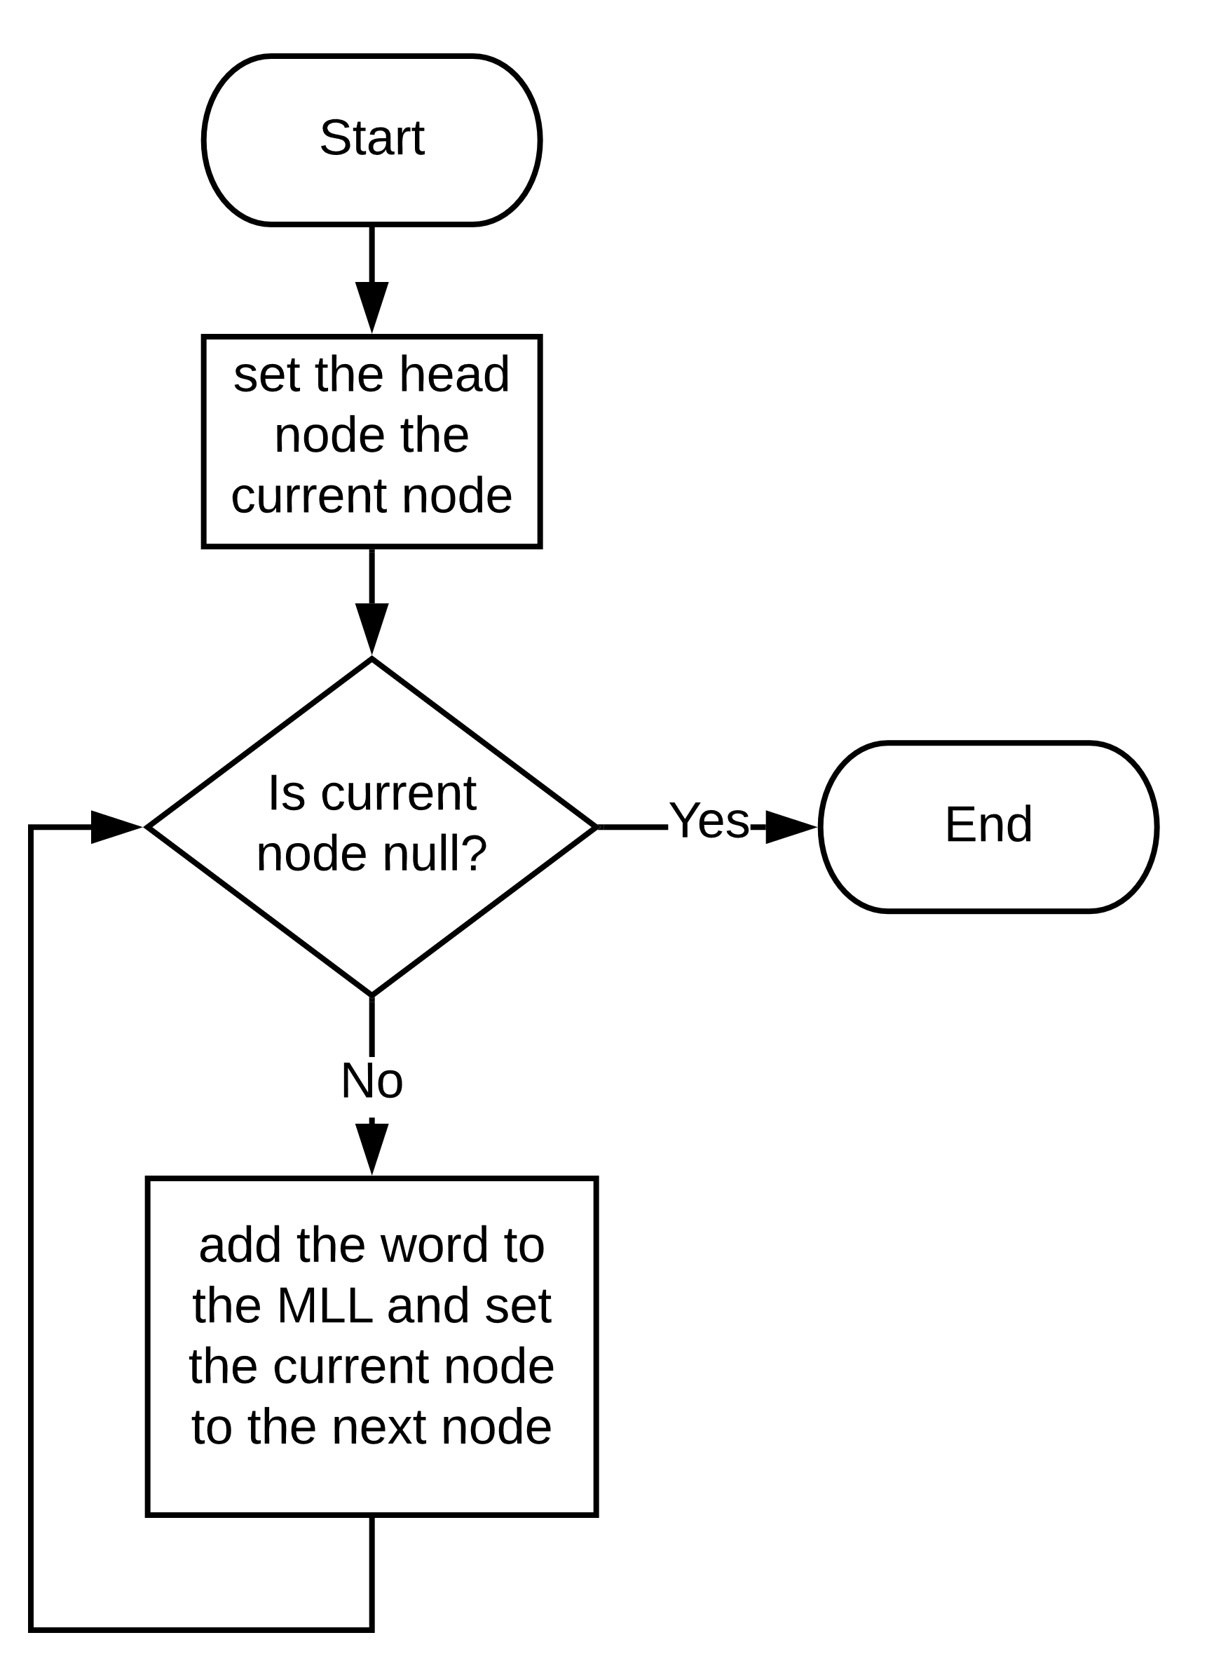
ALGORITHMS AND SOLUTION STRATEGIES
Transforming a Single Linked List to a Multi Linked List
After having the words in the text file in a linked list, the next process was putting them in a multi linked list based on their first letter.
The add word part of the diagram is representing the part where we put the word to the node where it has the same letter with the first letter of the word.

Slide 14
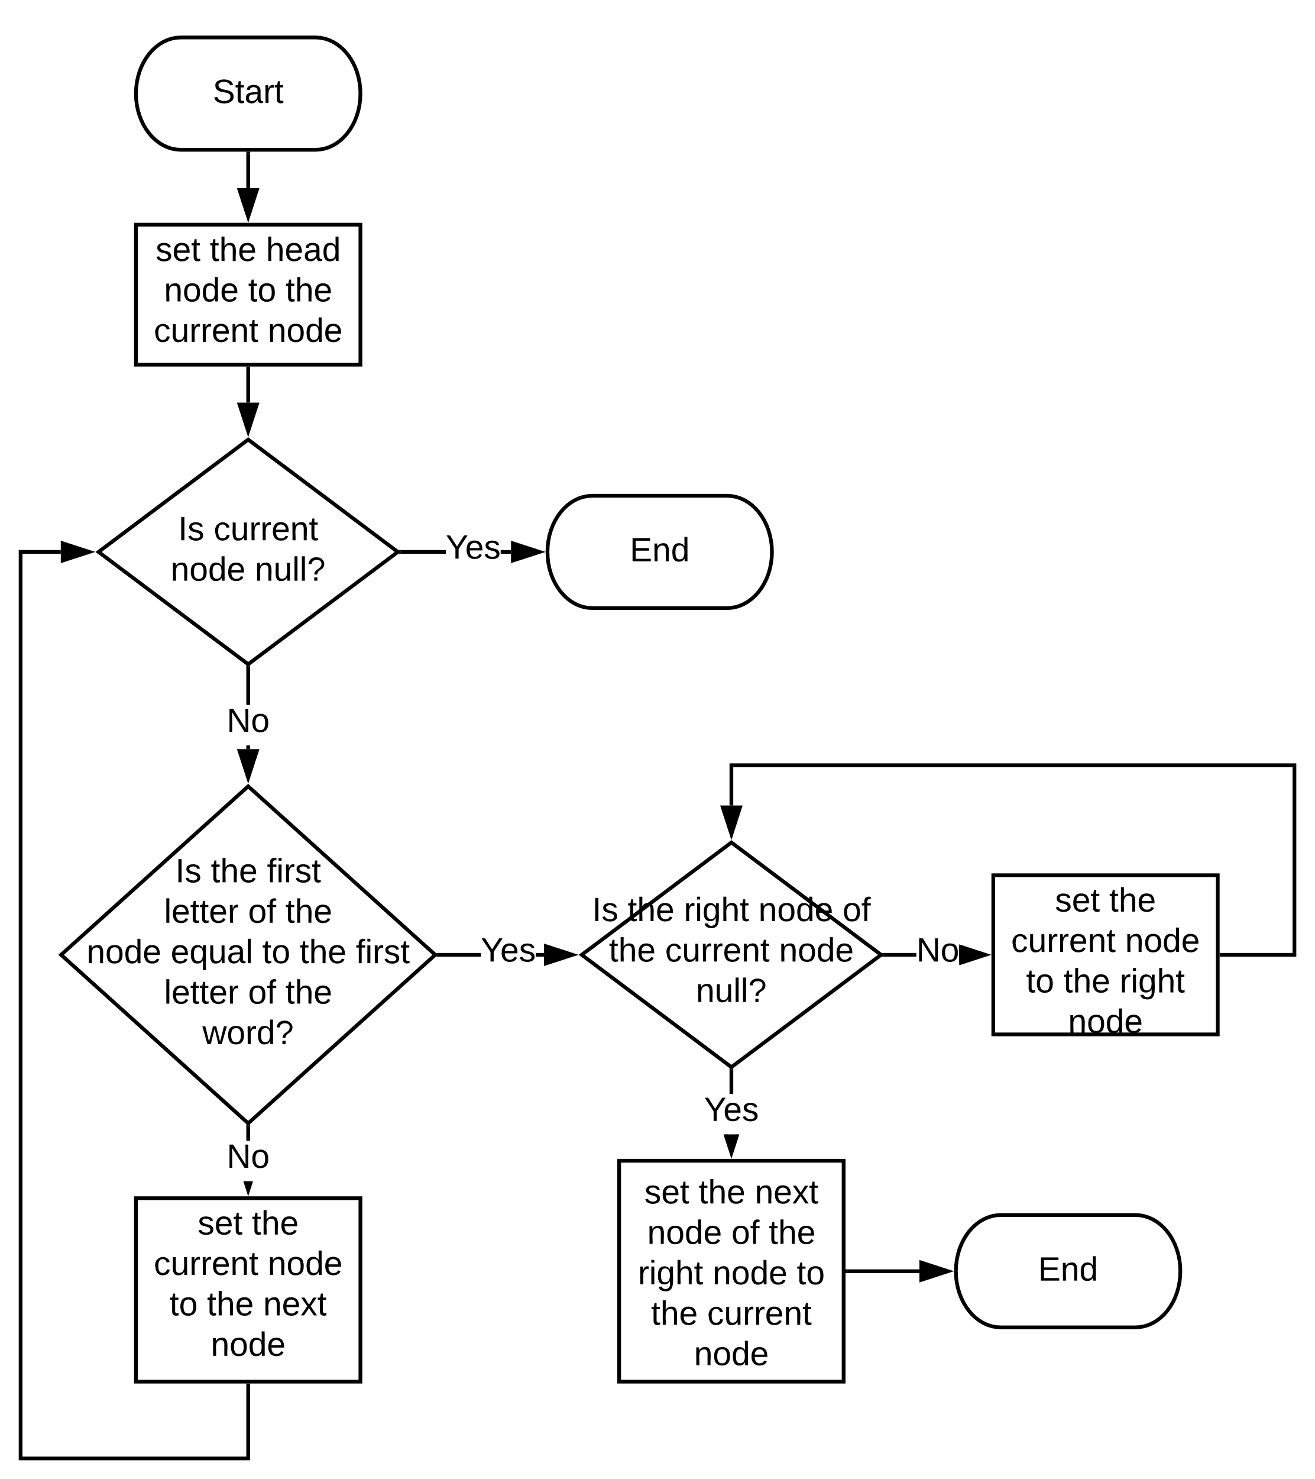
ALGORITHMS AND SOLUTION STRATEGIES
Transforming a Single Linked List to a Multi Linked List
In order to find the place of a given word in the Multi Linked List, we loop through the nodes and compare the first letter of the word with the current node.
After that, we go through the right nodes of the current node until there is no right node and place the word we want.

Slide 15

PROBLEMS ENCOUNTERED
Project document was not informative enough.
Not being able to meet up face to face.
The input problem with the key ‘i’.

Slide 16

Additional Improvements
The information messages has some delay between them to keep the game flow smooth.
The solution of the puzzle is
displayable using num0 key.

Slide 17
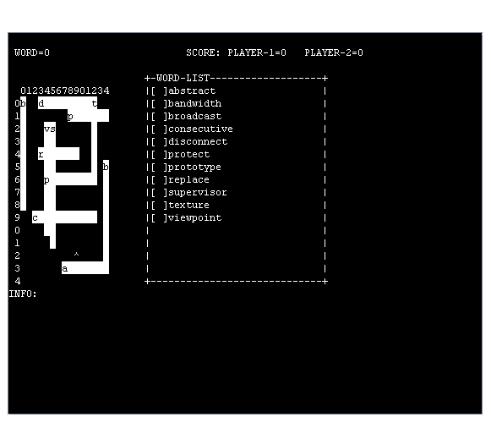
Screenshot (Start Screen)

Slide 18
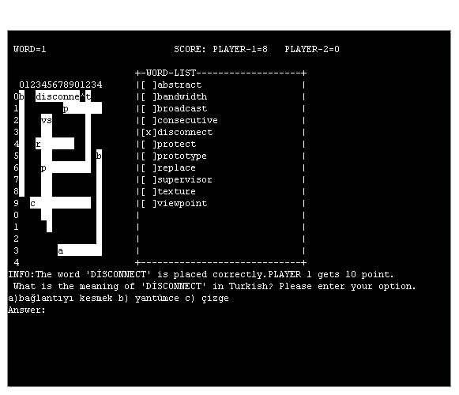
Screenshot (After Question)

Slide 19
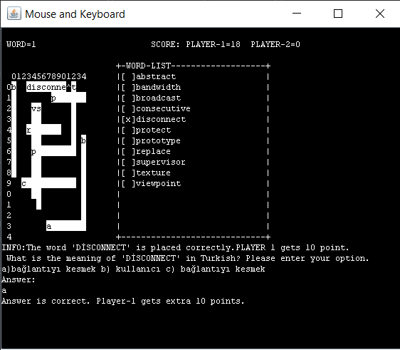
Screenshot (Start Screen)

Slide 20
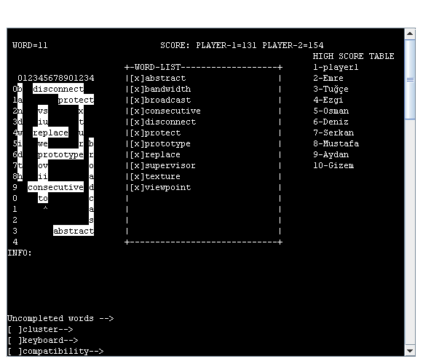
Screenshot (End of The Game)

Slide 21
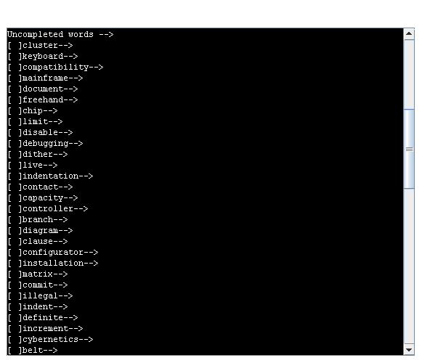
Screenshot (Uncompleted Words)

Slide 22

CONCLUSION
We have learned:
Implementing and using list types like:
Single and Double Linked List
Multi Linked List
We have practised:
Object oriented programming
Game development logic
.
.

Slide 23

REFERENCES
StackOverflow
https://stackoverflow.com/
W3Schools
https://www.w3schools.in/data-structures-tutorial/linked-list/
Geeksforgeeks
https://www.geeksforgeeks.org/linked-list-set-1-introduction/

Slide 24

Thanks For Watching and Listening

