Slide 1

Action Segmentation with Temporal Conv. Net.
Volkan Okbay

Slide 2
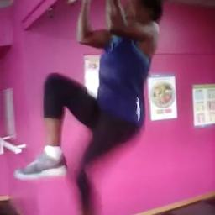
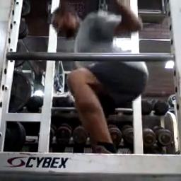
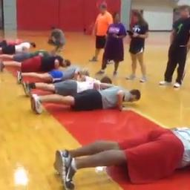
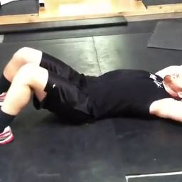

What is the problem ?
Figure 1. Samples from target classes
Kinetics Dataset (Kay et.al., 2017)
YouTube videos labelled with 400/600/700 classes
Challenging content, inconsistencies
We ...
Selected 4 classes (squat, pushup, pullup, situp) and some negative samples
Normalized for consistent 5 fps 256x256 resolution videos
Targeting FTHR board for real-time demonstration

Slide 3
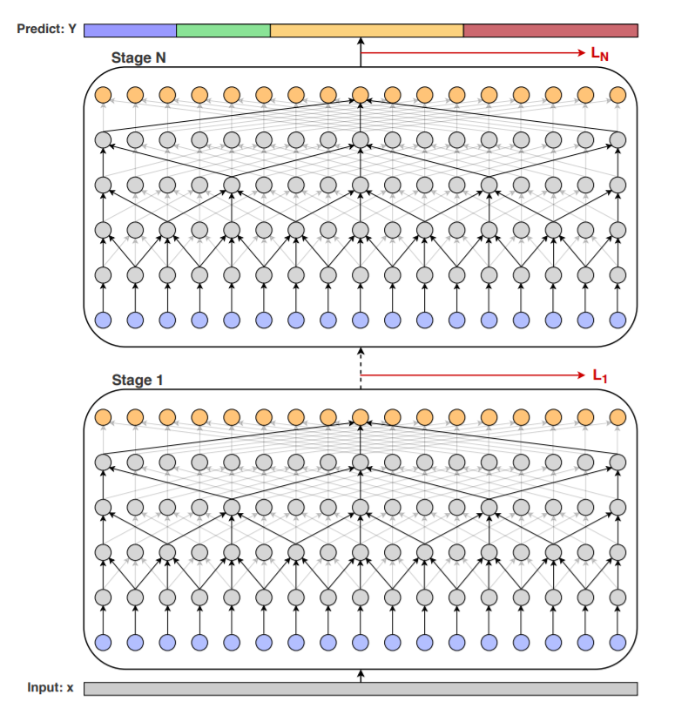
Approach
Temporal Convolutional Networks
CNN based (compatible w/ hardware)
Dilational Causal Convolution
Advantages...
Lightweight (compared to transformers)
Prevents exploding/vanishing parameters
Trained in parallel
Figure 2: An example of TCN (Abu Fahra, 2019)

