Slide 1

Action Segmentation with Temporal Convolutional Networks
Final Presentation
Volkan Okbay, METU EEE
(Istanbul AI Team)

Slide 2
Contents
Problem
Literature
Approach
Experiments
Progress
Fails, Future & Takeaways
References

Slide 3

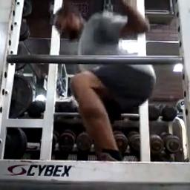
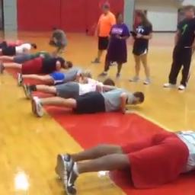

Problem - Definition
Task: Action segmentation + Edge-AI
Kinetics Dataset (Kay et.al., 2017)[4]
YouTube videos labelled with 400/600/700 classes
Challenging content, inconsistencies
We ...
Selected 4 classes (squat, pushup, pullup, situp) and some negative samples
Targeting FTHR board for real-time demonstration
Figure 1: Samples from target classes [4]

Slide 4
Problem - Dataset
Images
256x256 px
Center cropped
Videos
10sec@5fps -> 50 frames
16 frames clips
Data augmentation:
sampling random 16 frame sequences
doubled classes
Figure 2: Original dataset distribution

Slide 5

Problem – An Example
Video 1: A push up class sample

Slide 6
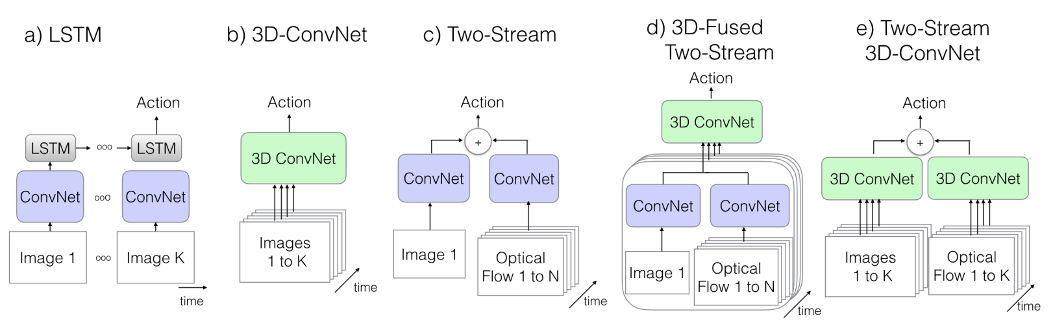
Literature
Figure 3: Common video processing approaches in deep learning [3]

Slide 7
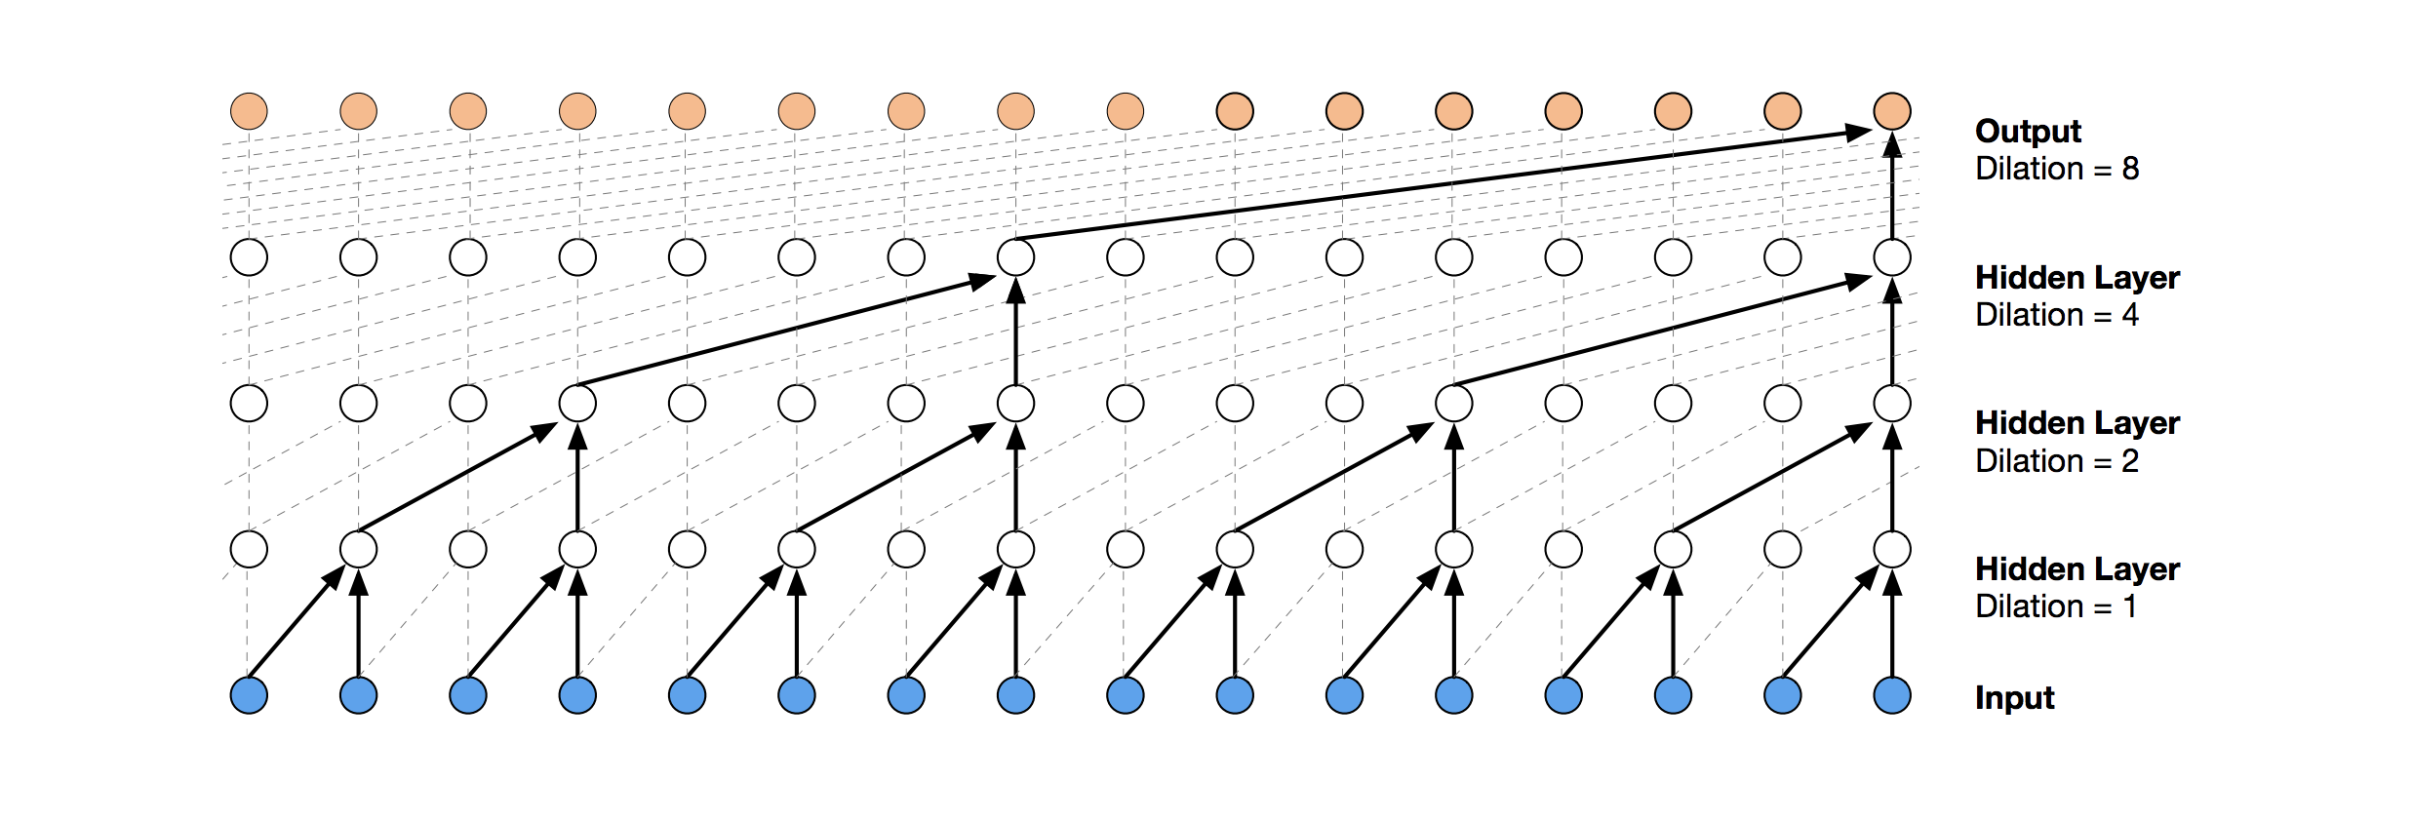
Approach – Temporal Conv Nets
Main features: dilational + causal + convolution
Figure 4: Basic TCN structure

Slide 8
Approach – Temporal Conv Nets
Advantages...
Lightweight (compared to transformers)
Prevents exploding/vanishing parameters
Trained in parallel
Disadvantage...
- Limited and fixed receptive field

Slide 9
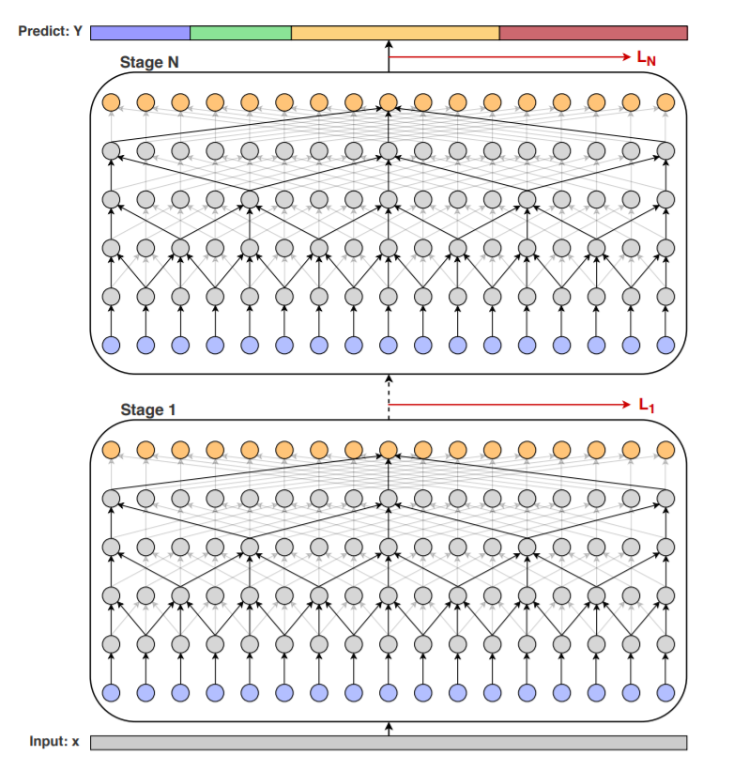
Approach – MS-TCN
Multi stage TCN
Leverages I3D frame vectors: inception based, two-stream backbone.
Only for temporal part 5 stages each with 11 layers
Figure 5: An example of TCN (Abu Fahra, 2019) [5]

Slide 10
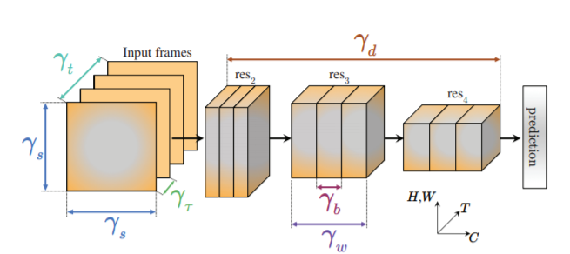
Experiments – PreTrained X3D(Medium)
Image size: 256x256
Sampling rate: 5 fps
Number of frames: 16
Number of params: 3.76M
VALIDATION ACC: 86.98% (5 classes)
79.81% (4 classes)
Pull-ups | Push-up | Situp | Squat | Background
83 | 0 | 0 | 0 | 0
0 | 58 | 0 | 1 | 0
1 | 0 | 53 | 0 | 0
0 | 0 | 1 | 67 | 0
4 | 20 | 21 | 18 | 180
Table 1: X3Dm results
Figure 6: X3D architecture [1]

Slide 11
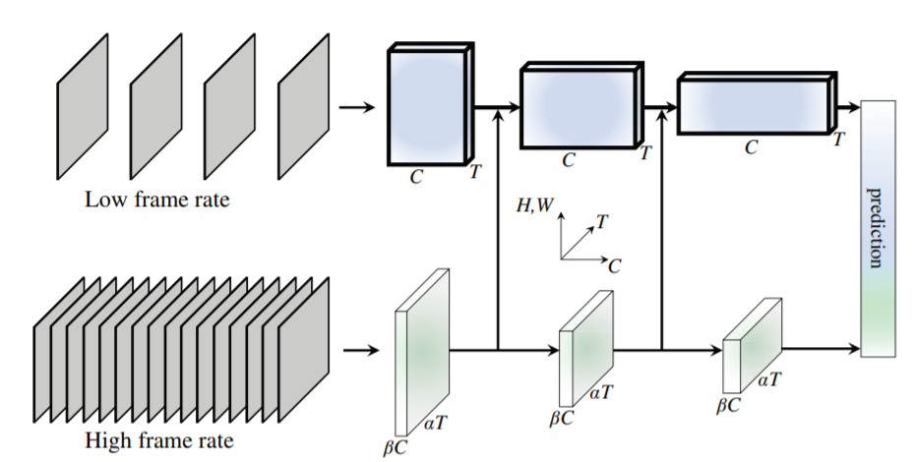
Experiments – PreTrained SlowFast(r50)
Image size: 256x256
Sampling rate: 5 fps
Number of frames: 32
Number of params: 32.9M
VALIDATION ACC: 85.01% (5 classes)
76.75% (4 classes)
Pull-ups | Push-up | Situp | Squat | Background
83 | 1 | 2 | 1 | 0
0 | 58 | 0 | 1 | 0
0 | 0 | 51 | 0 | 0
0 | 1 | 0 | 59 | 0
5 | 18 | 22 | 25 | 180
Table 2: SlowFast results
Figure 7: SlowFast architecture [2]

Slide 12
Experiments – Our Base Model
Linear
CNN
TCN
(a)
TCN
(c)
TCN
(b)
CNN: Spatial processing
13 layers
BatchNorm, ReLU & skip connections
TCN: Temporal processing
Kernel size: 5 – Dilation: 1,1,1,1
Kernel size: 3 – Dilation: 1,2,2,1
Kernel size: 3 – Dilation: 1,2,4
Linear: Classification
Accuracy < 60% in the beginning
Figure 8: Model v1

Slide 13
Experiments – Our Base Model
Image size: 256x256
Sampling rate: 5 fps
Number of frames: 16
Number of params: 760K
VALIDATION ACC: 63.80%
Val. Acc. was around 57% before multiplying data augmentation
Clamped ai8x layers and ai8x normalization
Can overfit as much as 99%
Pull-ups | Push-up | Situp | Squat | Background
374 | 5 | 19 | 94 | 78
1 | 131 | 41 | 31 | 43
7 | 84 | 167 | 14 | 58
71 | 29 | 30 | 336 | 75
82 | 121 | 135 | 99 | 961
Table 3: Our results

Slide 14
Experiments – MS-TCN & SS-TCN
Tried 14 layer CNN (same as previous) and staged TCN on top
Experiments wih 1-3-5 stages
Dropout (TCN, none for CNN)
Acc: 57-63 %
Two ideas...
Basic models
Data centric approach

Slide 15
Progress – Pickling
Pickles: binary formats for faster dataloading
Fixed 50 frames from each sample
Eliminated inconsistent frame counts
Added video indices to dataset

Slide 16
Progress – Blacklists
Score: 100 = 50(slowfast) + 12.5 + 25 + 12.5 (x3dm)
May be done by confidencies
Created blacklists with 0, 1, 30, 50, 75 and 100 threshold
Experiment:
No masking: 67.8%
Masking@100: 69.0%
Masking@30: 69.4%

Slide 17



Progress – Blacklisted Examples
Video 2-3-4: Masked samples

Slide 18
Progress – Other Additions
Tensorboard to monitor metrics and histograms
Dropout (channelwise, spatial)
Weight Decay
Doubling hard-to-learn classes (push up, situp)
Tossing first&last frames (50 frames -> 48 frames)
After all these steps accuricies went up to 66%

Slide 19
Experiments – Soft Voting
CNN
Linear
Linear
. . .
Linear
Simpler spatial processing (8 conv layers)
Linear classifier for each frame
Taking average of soft results
Acc went up to around 70%
Figure 8: A simpler model

Slide 20
Progress – Final Imporevements
Warm Start:
Freezing or without freezing
Almost always decreased accuracy
Conclusion: Not able to train temporal part !
Final improvements...
- More filters at hidden layers
- Increasing background samples (3k -> 27k)
- Introduced single pickle mode for background

Slide 21
Experiments – Soft Voting & Basic Model
Pull-ups | Push-up | Situp | Squat | Background
65 | 1 | 4 | 7 | 9
1 | 55 | 8 | 1 | 8
0 | 7 | 33 | 1 | 9
13 | 5 | 12 | 66 | 10
9 | 10 | 18 | 11 | 144
Pull-ups | Push-up | Situp | Squat
76 | 5 | 7 | 18
2 | 57 | 13 | 2
4 | 13 | 50 | 8
6 | 3 | 5 | 58
ACC: 73.7 % WeightedACC: 73.3%
ACC: 71.6 % WeightedACC: 68.5%
Table 3-4: Highest accuracy results

Slide 22
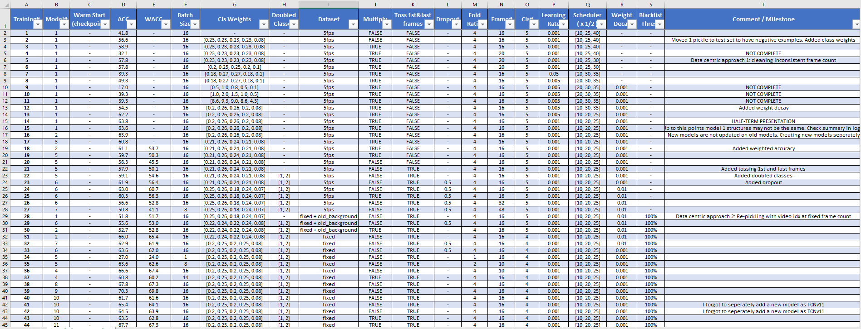
Progress - Finalizing
Figure 9: Results table

Slide 23
Fails & Future
Fails:
Training temporal layers
Future work:
Initialization (currently: He Init)
Removing layers, simpler model
Smaller channel numbers
Better masking

Slide 24
Takeaways
Hands-on PyTorch, Tensorboard experience
Video processing approaches, TCN
Smaller models and hardware limitations
Training on a machine with other
Created an automatic workflow.
Great people.

Slide 25
References
[1] Feichtenhofer, Christoph, «X3D: Expanding Architectures for Efficient Video Recognition.» https://arxiv.org/abs/2004.04730
[2] Feichtenhofer, Christoph et. al, «SlowFast Networks for Video Recognition» https://arxiv.org/pdf/1812.03982.pdf
[3] Carreira, Joao and Zisserman, Andrew «Quo Vadis, Action Recognition? A New Model and the Kinetics Dataset» https://arxiv.org/abs/1705.07750
[4] Kay, Will, et al. «The Kinetics Human Action Video Dataset». arXiv, 19 May 2017. arXiv.org, https://doi.org/10.48550/arXiv.1705.06950
[5] Farha, Yazan Abu, and Juergen Gall. «MS-TCN: Multi-Stage Temporal Convolutional Network for Action Segmentation». arXiv, 2 Apr. 2019. arXiv.org, https://doi.org/10.48550/arXiv.1903.01945

