Slide 1
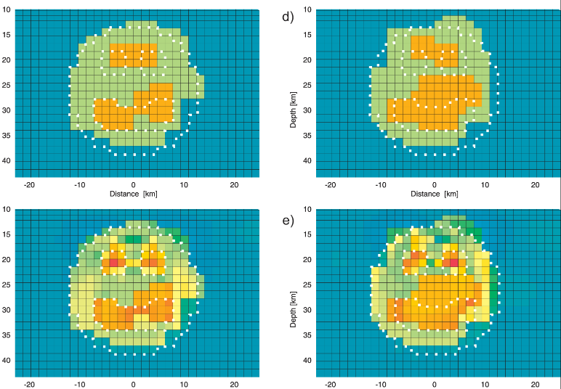

Remarks
on Jacobians in large-scale inverse problems
Volker Rath

Slide 2
Roadmap
Motivation
Jacobians from ModEM: JacoPyAn
Computational issues
How to get them from Modem
Some properties of the Jacobian Sensitivity
(Nullspace shuttle)

Slide 3
Bayesian MAP Estimation: P- and D-Space
Differentiate with respect to parameters and apply, e.g., Gauss-Newton method gives iteration formulae (normal equation)
Jacobian
Note:
Covariance matrices or their inverses for D- and P-space, respectively.
matrices are and , !

Slide 4
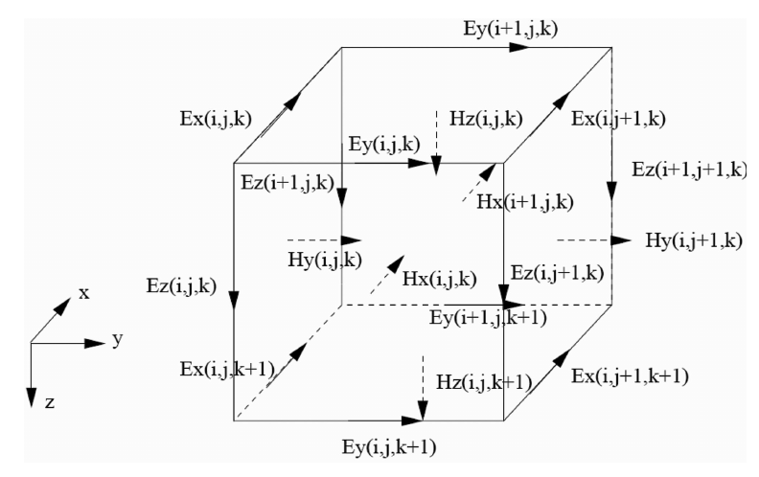
Bayesian MAP Estimation: ModEM
recast as optimization: NLCG (and QN, LBFGS) methods only need gradient of objective function:
transformed setup: forward problem calculates E-fields for 2-Polarisations – more transformations (linear interpolation), lots of geometrical (precomputable) matrices….
Gradient

Slide 5
Bayesian MAP Estimation: ModEM
Transformed equations lead to more elegant (simpler) algorithm:
Note: geometrical transforms not touched.
Transform back to actual model space:

Slide 6
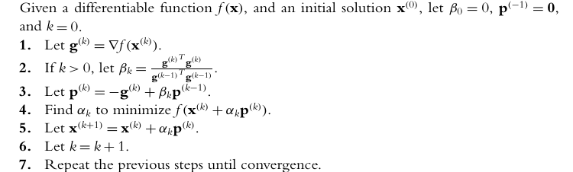
Bayesian MAP Estimation: ModEM
J^{T}r product can be calculated by just 1 additional forward solution per iteration, with data residuals as sources (reciprocity).
Internally, Jacobian J is calculated by N repeated solution.
J output is not scaled by (diagonal) inverse data covariance

Slide 7
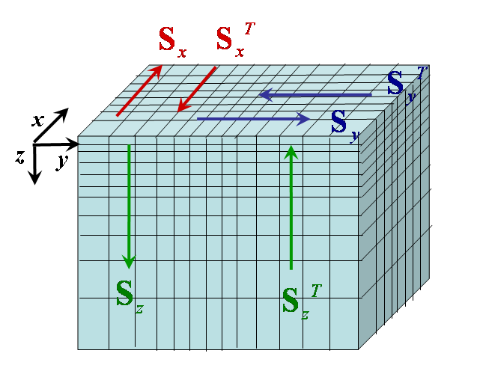
Bayesian MAP Estimation: ModEM
ModEM uses a simple covariance , implemented as a series of 1D dimensional autoregressive smoothers
1D AR smoothers S applied successively in x, y, z
D is diagonal scaling operator, (a) for numerical stability; (b) spatial variations in a priori model uncertainty; (c) account for cell size variations in grid
Convenient to make symmetric:
Adjoint smoothers (S^{T}): reverse direction of AR smoothers (and reverse order: z-y-x)

Slide 8
Bayesian MAP Estimation: ModEM
Smoothing step can be expressed as a matrix (here x direction):
Inverse of S_{ij} is sparse, so also S⁻¹
 < 1. (default 0.2)  S approximately sparse
Proof: Tarantola 1987, 2005; Rodgers 2000

Slide 9
Bayesian MAP Estimation: ModEM
Procedure can be shown to be equivalent to multiply with (kind of) exponential covariance
Nominal length scale (one step):
Important:
penalty defined on a uniform grid
actual cell dimensions not used
length scale not in physical units
large cells not penalized!

Slide 10
Bayesian MAP Estimation: ModEM

Slide 11
How to get Jacobians from ModEM
During inversion, the Jacobian is never formed! Calculation of the Jacobian is only implemented as a testing tool (special, rarely used option).
mpirun -np `cat $OAR_FILE_NODES|wc -l` --machinefile $OAR_NODE_FILE -mca plm_rsh_agent "oarsh“ \
/home/sbyrd/bin/gMod3DMTS_MKL.x \
-J \
SABA8_P.rho SABA8_P.dat SABA8_P.jac SABA.fwd > SABA8_P.out
Dahu stuff
Executable with modifications
Options for Jacobian calculations
model file
data file
Jacobian
(huge, should be on special storage!)
model ctrl
Ouput to screen

Slide 12
How to get Jacobians from ModEM
…
-J \
SABA8_P.rho SABA8_P.dat SABA8_P.jac SABA.fwd > SABA8_P.out
model file
data file
Jacobian
model ctrl
Remarks:
Here the model is from a phase tensor inversion, but the data file can be whatever you want.
As the Jacobian is independent of the data, this feature can be used for survey planning or optimization using virtual sites.
Model-based Optimal Experimetal Design (OED) using the SVD

Slide 13
Computational Issues
Jacobians in this formulation are independent of data, but should be scaled with inverse errors
Jacobians are large-to-huge, but have many “zeros”, and are “structured”
Can be sparsified or compressed offline or “on the fly”, i.e., column-wise within ModEM
Values for
Rathlin Basin (RB):
68 × 59 × 82 = 328984 Cells, 15196 data
5⋅10⁹ elements, 37 GB
Rathlin Island (RI):
53 × 61 × 72 = 232776 Cells, 1560 data
≈ 4⋅10⁶ elements, 2.6 GB
Thresh | nnz RB (RI) | Size RB (RI)
1e-4 | <1% (2%) | 170 MB (0.13 MB)
1e-6 | 14% (20%) | 6.1 GB (12 MB)
1e-8 | 45% (38%) | 19.4 GB (324 MB)
1e-10 | 58% (50%) | 25.1 GB (1 GB)
1e-12 | 68% (67%) | 29.2 GB (1.4 GB)
1e-14 | 81% (75%) | 34.8 GB (1.8 GB)

Slide 14
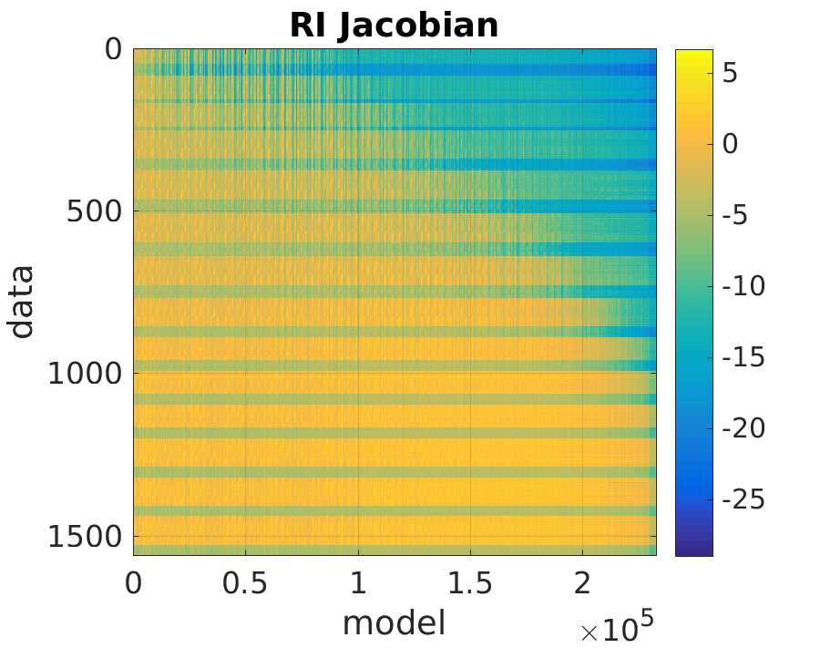
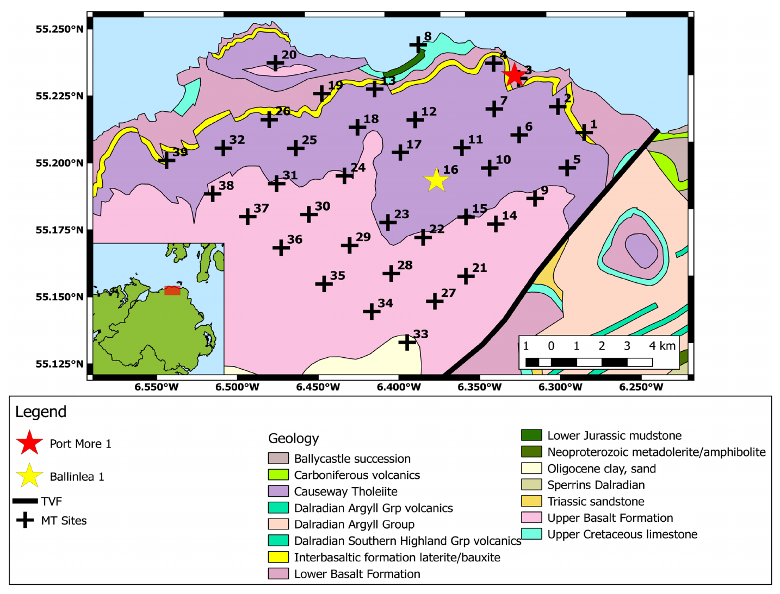
How sparse can we make the Jacobian?
Tipper
Impedances
Rathlin Basin (RB):
68 × 59 × 82 = 328984 Cells, 15196 data
≈ 5⋅10⁹ elements, 37 GB
Rathlin Island (RI):
53 × 61 × 72 = 232776 Cells, 1560 data
≈ 4⋅10⁶ elements, 2.6 GB

Slide 15
JacoPyAn I
Python (3.11) toolbox, with few packages required: (numpy, scipy, matplotlib …)
Preprocessing (sparsify),
manipulation (split/merge)
sensitivity calculations
Randomized SVD
Nullspace shuttle for hypothesis testing and MC (linear domain)
Experimental design
Model space reduction
Installation:
Set up conda environment: conda env create –n as-you-like python=3.11 numpy scipy …
Download JacoPyAn: git clone https://github.com/volkerrath/JacoPyAn.git

Slide 16
JacoPyAn II
Installation:
Set up conda environment: conda env create –n as-you-like python=3.11 numpy scipy … (spyder, jupyterlab, …)
Download JacoPyAn: git clone https://github.com/volkerrath/JacoPyAn.git
Set environment variables (e.g. in .bashrc): export JACOPYAN_ROOT=where-you-have-installed-it export JACOPYAN_DATA=where-you-store-your-data

Slide 19
Sensitivity I
Error-normalized Jacobian
Definition of sensitivity is not unique, and various forms can be found in the literature:
"Raw" sensitivities, defined as No absolute values are involved, hence positive and negative elements occur. This does not conform to what we expect of sensitivity (positivity)
"Euclidean" sensitivities (most common) are is defined as: The square root of this sensitivity is often preferred.
Coverage. Here, the absolute values of the Jacobian are used:
For model blanking/shading, forms (2) and (3) can be used.
In some communities the Jacobian is called “sensitivity matrix”. Not here!

Slide 20
Sensitivity II
When moving from the error-normalised Jacobian to sensitivity, there are more choices for further normalisation, depending on the understanding and use of this parameter. If sensitivity is to be interpreted as an approximation to a continuous field over the volume of the model, it seems useful normalize by the cell volume. On the other hand, effect of the size is important when investigating the true role of this cell in the inversion. Finally, for comparing different data (sub)sets, it is convenient to do a final normalization by the maximum value in the model. All these options are implemented in the
toolbox.

Slide 21
Prior Covariances
Symmetric Positive Definite (SPD)
Nearly always assumed diagonal, i.e. extremely sparse
Often estimated from data
Symmetric Positive Definite (SPD)
Rarely diagonal, often spatial Exponential, Gaussian, Poisson, Matérn
Not sparse, if not localized
Rarely estimated from data (some nice examples from geostatistical inversion)

Slide 22
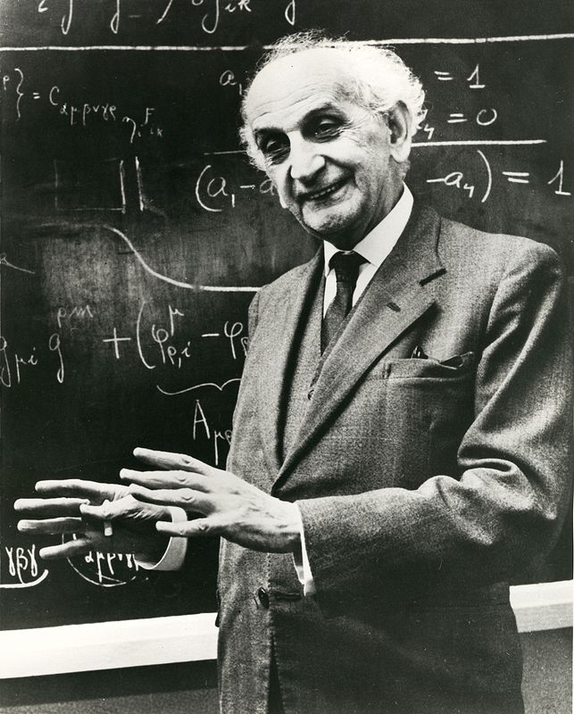
Motivation: Why?
early work on Nullspace Shuttle in MT (Muñoz & Rath, 2006)
renewed interest of related methods in hydrogeology and seismology
movement from 2-D to 3-D (data and modeling) has not improved the situation for uncertainty studies
approximate methods for uncertainty and resolution analysis even more necessary
“Big Data” : emergence of randomized linear algebra (“matrix sketching”)

Slide 23
Singular value decomposition – Basics
Properties:
Σ diagonal
U, V orthogonal(unitary)

Slide 24
Singular value decomposition – Applications
General: Low –rank approximation
Truncated or damped SVD inversion
Principal Component Analysis (PCA/ICA)
Noise-Estimation / reduction (see Poster Kiyan et al.)
Model order reduction (MOR), e.g. Karhunen-Loeve Expansion (KLE)
Uncertainty/resolution estimation
Model-based Experimental design (OED)

Slide 25
Singular value decomposition - Numerics
Traditional (e.g., LINPACK, LAPACK and derivates) all k = min(m,n) , but computational complexity ≈min{mn², m²n}
Iterative methods (e.g., EISPACK, ARPACK , PROPACK)
only k largest values are needed (TSVD)
SVD of A can be calculated by any method for eigendecomposition of: well adapted for sparse matrices
Randomized SVD. Only k largest values Implemented in several machine learning libraries, e.g. scikits.learn (Python, R) Very active area of research (”Big Data”)
First numerical experiments with simple implementation give speedups of more than 2 orders of magnitude for “large” models
Parallelism needs to be further investigated

Slide 26
Singular value decomposition - randomized
[M,N] = size(A);
P = min(2*K,N);
X = randn(N,P);W1 = orth(A*X);
B = W1'*A;
[W2,S,V] = svd(B,'econ');
U = W1*W2;
K=min(K,size(U,2));
U = U(:,1:K);
S = S(1:K,1:K);
V = V(:,1:K);
generate matrix of orthonormal random columns transform M×N matrix to M×2K
calculate SVD of smaller matrix B
back transform
Truncate to standard matlab “econ” form
direct rsvd algorithm (after Antoine Liutkus 2014)

Slide 27
Nullspace shuttle – basic idea
Jacobian J: expand nonlinear model at m₀
Calculate Singular Value Decomposition (SVD) Numerical bottleneck! Truncate SVD, choose nullspace
Construct Nullspace Projector P Note R is called Resolution Matrix
Perturb/deform model (e.g. smoothen, sharpen, and random )
Project to Nullspace: d(m_{null}) ≈ d(m₀)

Slide 28
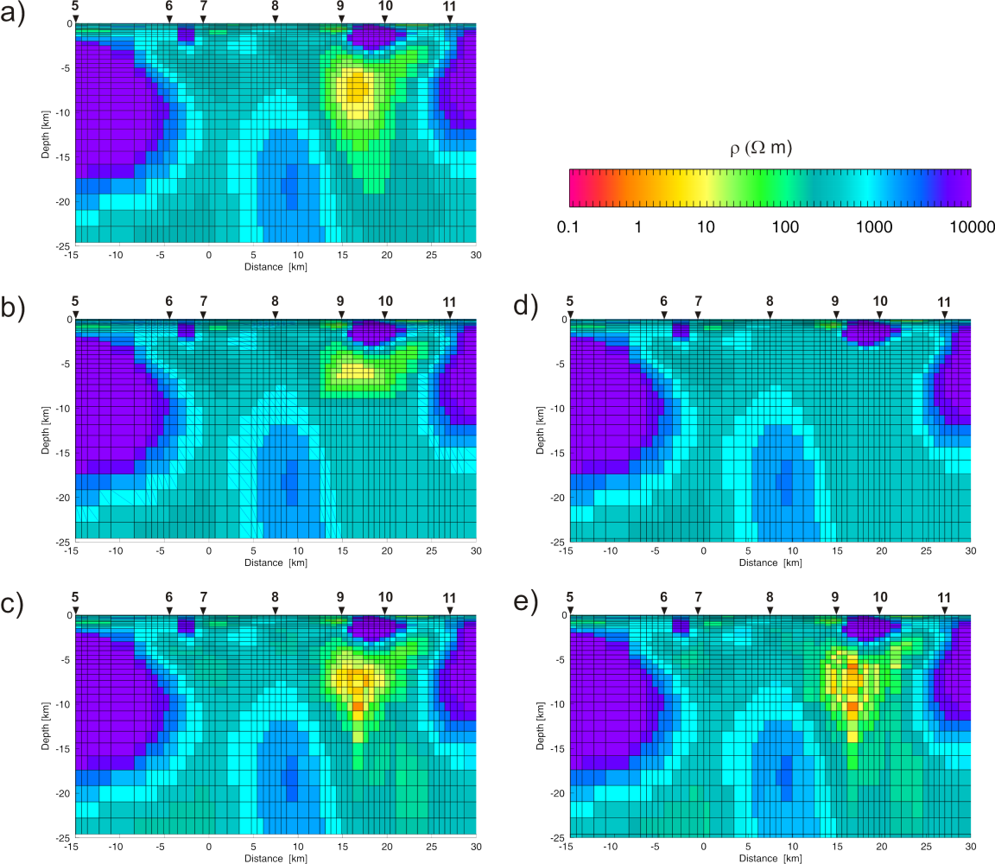
Nullspace shuttle - remarks
NSP replaces the forward model by 2 matrix-vector products, once SVD is given
Inverse problems are ill-posed - need to be regularized to be unique! In NSP we relax the regularization as we need to know what changes the data “tolerate”
Open questions:
Numerics: Full SVD prohibitive ⇒Randomized SVD
How many singular values?
Which domain of validity (linear approximation)
Which perturbations or deformations?

Slide 29
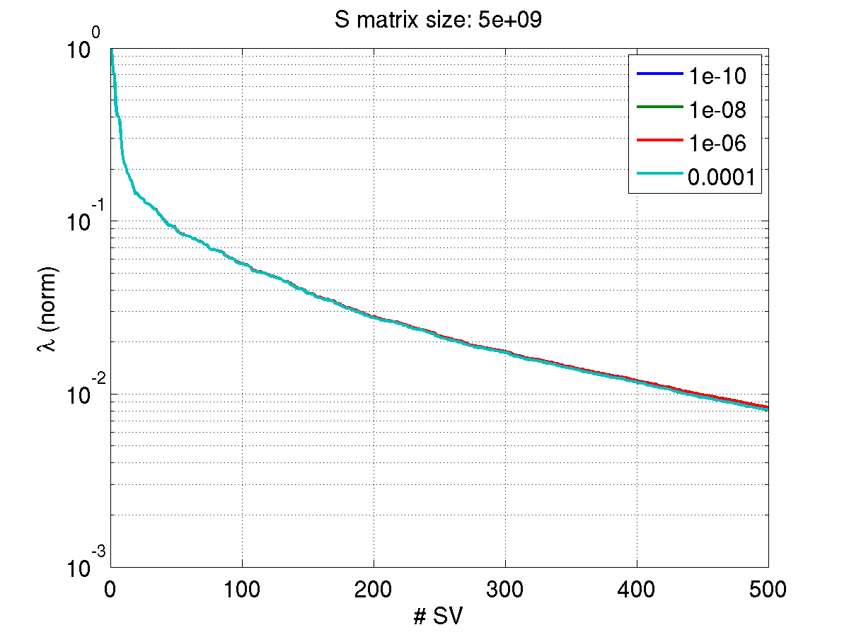
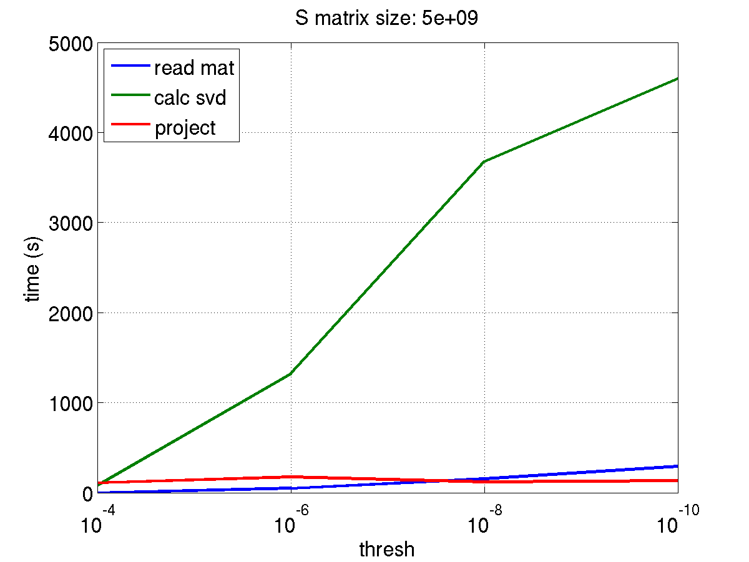
Singular value decomposition - Timing
rsvd algorithm (after Antoine Liutkus 2014)
generate matrix of orthonormal random columns
trans form M×N matrix to M×2K
calculate SVD of smaller matrix
back transform
Truncate to standard matlab “econ” form

Slide 30
Singular value decomposition – experiments
Accuracy of rsvd results

Slide 31
Singular value decomposition – experiments
rsvd vs MATLAB svds
(Baglama & Reichel, 2005)
sparsity

Slide 32
Null-space Monte Carlo - basic idea
Calculate MAP model, Jacobian, and posterior Covariance
Calculate truncated singular value decomposition of the Jacobian
Generate a new random parameter vector using the parameter covariance matrix
Project perturbation vector on the null-space of the Jacobian
New parameter vector is then produced by adding to MAP model
(Tonkin and Doherty, 2009)

Slide 33
Null-space Monte Carlo - Posterior Covariance p-space
(e.g. Flath et al. 2011)

Slide 34
Null-space Monte Carlo - Posterior Covariance d-space

Slide 35
References Nullspace
Baglama J & Reichel, L: Augmented Implicitly Restarted Lanczos Bidiagonalization Methods, SIAM J. Sci. Comp., 2005, 27, 19-42
Bui-Thanh T, Ghattas O, Martin J & Stadler G: A Computational Framework for Infinite-Dimensional Bayesian Inverse Problems Part I: The Linearized Case, with Application to Global Seismic Inversion, SIAM J. Sci. Comp., 2013, 35, A2494-A2523
Deal M & Nolet G: Nullspace shuttles, Geophys. J. Int., 1996, 124, 372-380 Doherty J: Calibration and Uncertainty Analysis for Complex Environmental Models, Watermark, 2015
Flath H, Wilcox L, Akcelik V, Hill J, van Bloemen Waanders B & Ghattas O, Fast Algorithms for Bayesian Uncertainty Quantification in Large-Scale Linear Inverse Problems Based on Low-Rank Partial Hessian Approximations, SIAM J. Sci. Comp., 2011, 33, 407-432
Halko N, Martinsson P G & Tropp J A: Finding Structure with Randomness: Probabilistic Algorithms for Constructing Approximate Matrix Decompositions, SIAM Review, 2011, 53, 217-288
Kannan R & Vempala S: Randomized algorithms in Numerical Linear Algebra, Acta Numerica, 2017, 26, 95-135
Kundu A & Drineas, P: A Note on Randomized Element-wise Matrix Sparsification, 2014, arXiv:1404.0320v1.
Lanczos C: Linear Differential Operators, Van Nostrand , 1961
Isaac T, Petra N, Stadler G & Ghattas O: Scalable and efficient algorithms for the propagation of uncertainty from data through inference to prediction for large-scale problems, with application to flow of the Antarctic ice sheet, J. Comp. Phys., 2015, 296, 348-368
Muñoz G & Rath V: Beyond smooth inversion: the use of nullspace projection for the exploration of non-uniqueness in MT, Geophys. J. Int., 2006, 164, 301-311
Rowbotham P S & Pratt R G: Improved inversion through use of the null space, Geophysics, 1997, 62, 869-883
Tavakoli R, Yoon H, Delshad M, ElSheikh A H, Wheeler M F & Arnold B W: Comparison of ensemble filtering algorithms and null-space Monte Carlo for parameter estimation and uncertainty quantification using CO₂ sequestration data, Water Resour. Res., 2013, 49, 8108-8127
Tonkin M & Doherty J: Calibration-constrained Monte Carlo analysis of highly parameterized models using subspace techniques, Water Resour. Res., 2009, 45, W00B10
Woodruff D P: Sketching as a Tool for Numerical Linear Algebra, Foundations and Trends in Theoretical Computer Science, 2014, 10, 1-157
Xiang H & Zou J : Regularization with randomized SVD for large-scale discrete inverse problems, Inverse Problems, 2013, 29, 085008

Slide 36
References Jacobian
C. D. Rodgers: Inverse Methods for Atmospheric Sounding. World Scientific, 2000.
A. Tarantola, Inverse Problem Theory and Methods for Model Parameter Estimation. SIAM, 2005.

