Slide 1
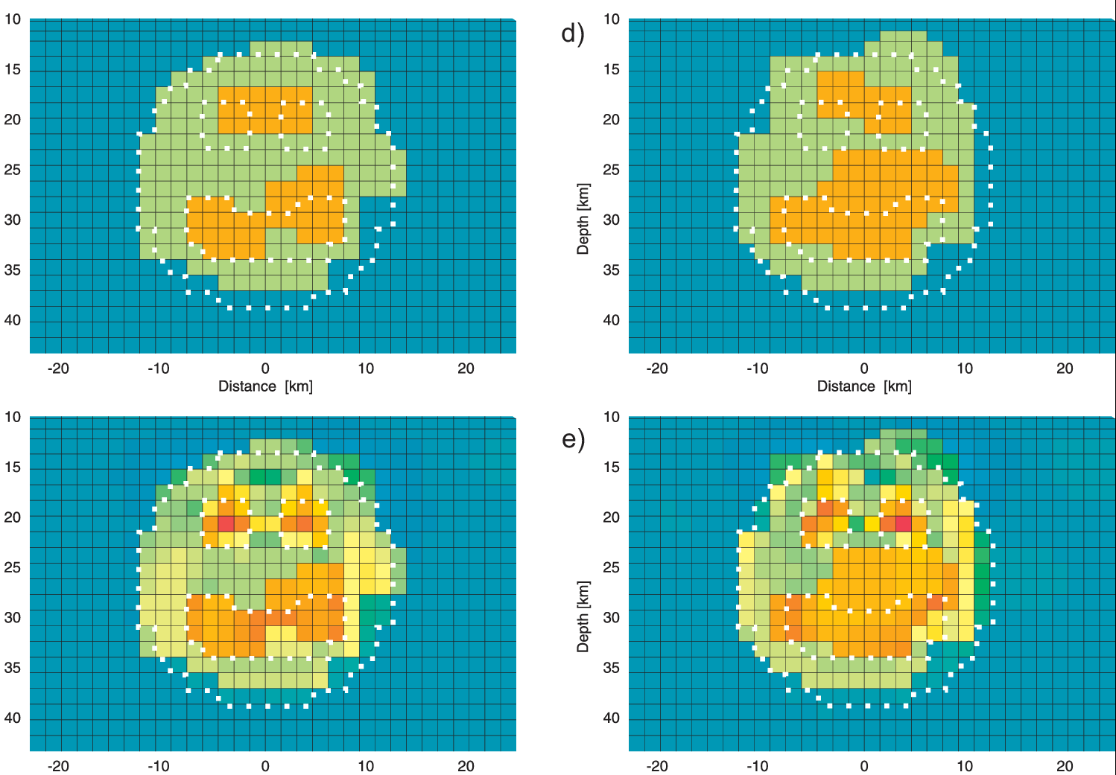

Randomized Lineazr Algebra for large-scale inverse problems
Volker Rath, Duygu Kiyan, Robert Delhaye, Gerard Muñoz

Slide 2
Roadmap
Motivation
Reminder: Singular Value Decomposition (SVD)
Nullspace shuttle
Computational issues
“Sparsity” of the Jacobian in MT
Complexity of SVD – Randomized algorithms
Applications

Slide 3
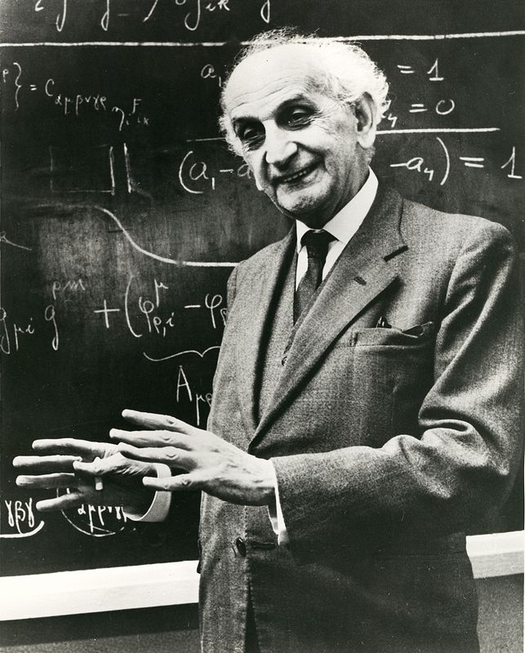
Motivation: Why?
early work on Nullspace Shuttle in MT (Muñoz & Rath, EMTF 2003)
renewed interest of related methods in hydrogeology and seismology
movement from 2-D to 3-D (data and modeling) has not improved the situation for uncertainty studies
approximate methods for uncertainty and resolution analysis even more necessary
“Big Data” : emergence of randomized linear algebra (“matrix sketching”)

Slide 4
Singular value decomposition – Basics
Properties:
Σ diagonal
U, V orthogonal(unitary)

Slide 5
Singular value decomposition – Applications
General: Low –rank approximation
Truncated or damped SVD inversion
Principal Component Analysis (PCA/ICA)
Noise-Estimation / reduction (see Poster Kiyan et al.)
Model order reduction (MOR), e.g. Karhunen-Loeve Expansion (KLE)
Uncertainty/resolution estimation
Model-based Experimental design (OED)

Slide 6
Singular value decomposition - Numerics
Traditional (e.g., LINPACK, LAPACK and derivates) all k = min(m,n) , but computational complexity ≈min{mn², m²n}
Iterative methods (e.g., EISPACK, ARPACK , PROPACK)
only k largest values are needed (TSVD)
SVD of A can be calculated by any method for eigendecomposition of: well adapted for sparse matrices
Randomized SVD. Only k largest values Implemented in several machine learning libraries, e.g. scikits.learn (Python, R) Very active area of research (”Big Data”)
First numerical experiments with simple implementation give speedups of more than 2 orders of magnitude for “large” models
Parallelism needs to be further investigated

Slide 7
Singular value decomposition - randomized
[M,N] = size(A);
P = min(2*K,N);
X = randn(N,P);W1 = orth(A*X);
B = W1'*A;
[W2,S,V] = svd(B,'econ');
U = W1*W2;
K=min(K,size(U,2));
U = U(:,1:K);
S = S(1:K,1:K);
V = V(:,1:K);
generate matrix of orthonormal random columns transform M×N matrix to M×2K
calculate SVD of smaller matrix B
back transform
Truncate to standard matlab “econ” form
direct rsvd algorithm (after Antoine Liutkus 2014)

Slide 8
Nullspace shuttle – basic idea
Jacobian J: expand nonlinear model at m₀
Calculate Singular Value Decomposition (SVD) Numerical bottleneck! Truncate SVD, choose nullspace
Construct Nullspace Projector P Note R is called Resolution Matrix
Perturb/deform model (e.g. smoothen, sharpen, and random )
Project to Nullspace: d(m_{null}) ≈ d(m₀)

Slide 9
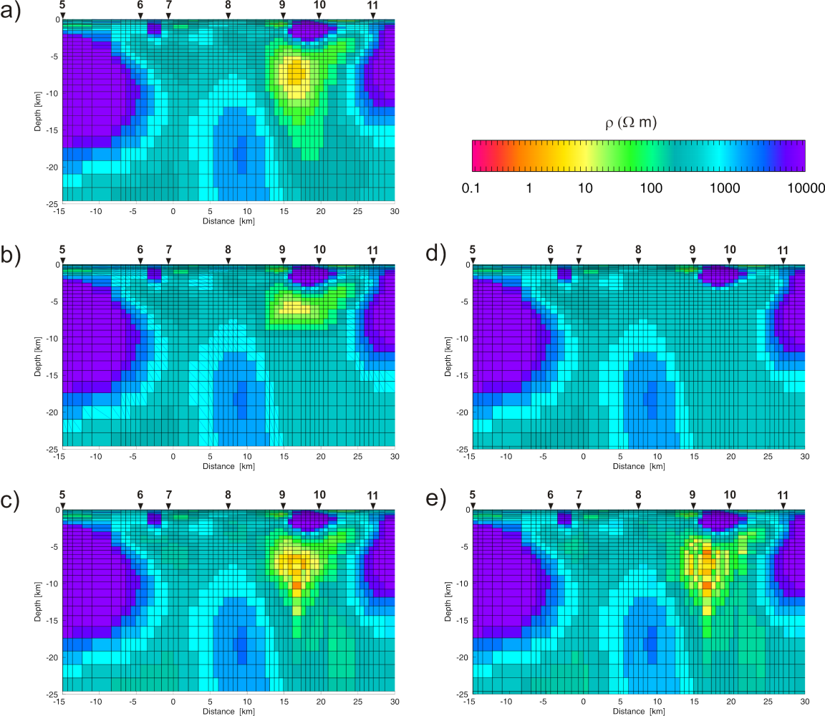
Nullspace shuttle - remarks
NSP replaces the forward model by 2 matrix-vector products, once SVD is given
Inverse problems are ill-posed - need to be regularized to be unique! In NSP we relax the regularization as we need to know what changes the data “tolerate”
Open questions:
Numerics: Full SVD prohibitive ⇒Randomized SVD
How many singular values?
Which domain of validity (linear approximation)
Which perturbations or deformations?

Slide 10
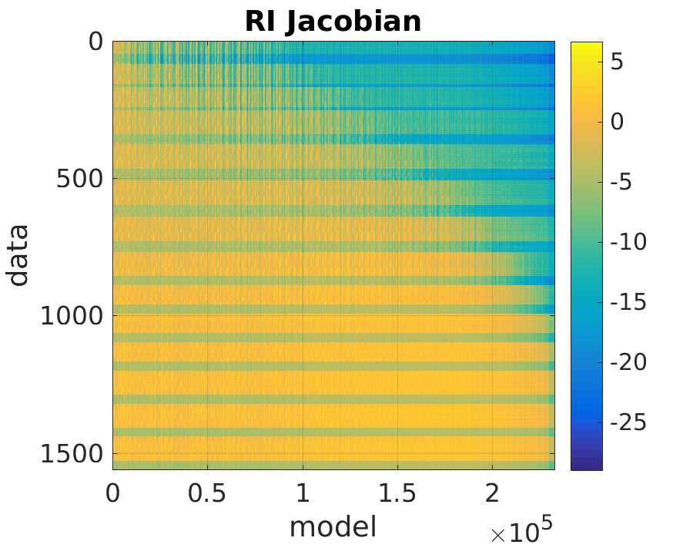
How sparse can we make the Jacobian?
Jacobians are large, but have many “zeros”, and structured
Should (and can!) be sparsified “on the fly”, i.e., column-wise within the modeling code
Thresh | nnz RB (RI) | Size RB (RI)
1e-4 | <1% (2%) | 170 MB (0.13 MB)
1e-6 | 14% (20%) | 6.1 GB (12 MB)
1e-8 | 45% (38%) | 19.4 GB (324 MB)
1e-10 | 58% (50%) | 25.1 GB (1 GB)
1e-12 | 68% (67%) | 29.2 GB (1.4 GB)
1e-14 | 81% (75%) | 34.8 GB (1.8 GB)
Rathlin Basin (RB):
68 × 59 × 82 = 328984 Cells, 15196 data
≈ 5⋅10⁹ elements, 37 GB
Rathlin Island (RI):
53 × 61 × 72 = 232776 Cells, 1560 data
≈ 4⋅10⁶ elements, 2.6 GB

Slide 11
Singular value decomposition – experiments
Accuracy of rsvd results

Slide 12
Singular value decomposition – experiments
rsvd vs MATLAB svds
(Baglama & Reichel, 2005)
sparsity

Slide 13
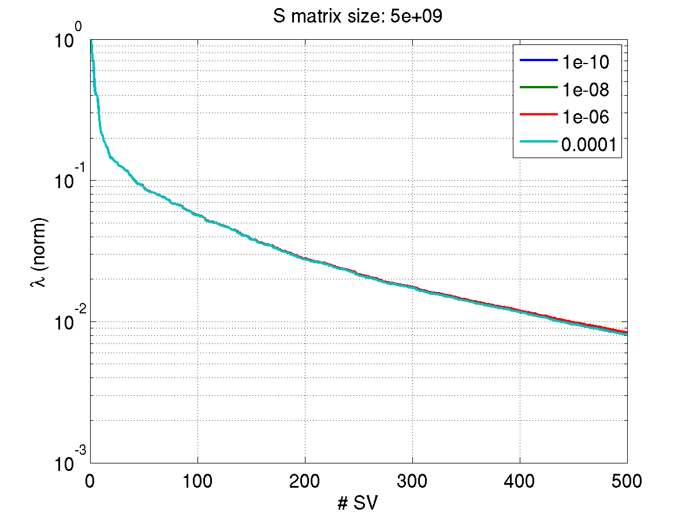
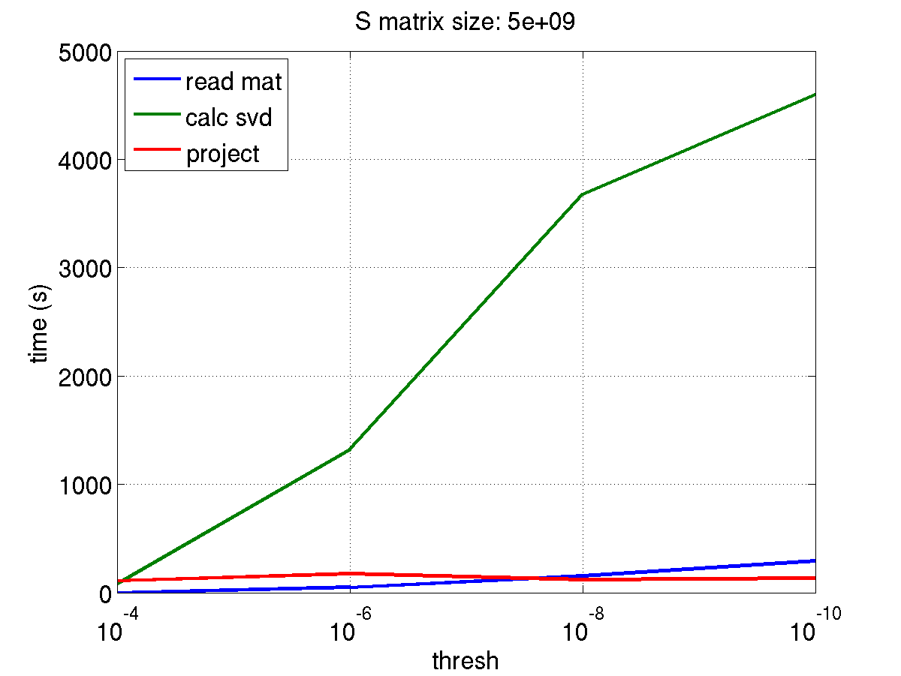
Singular value decomposition - Timing
rsvd algorithm (after Antoine Liutkus 2014)
generate matrix of orthonormal random columns
trans form M×N matrix to M×2K
calculate SVD of smaller matrix
back transform
Truncate to standard matlab “econ” form

Slide 14
Null-space Monte Carlo - basic idea
Calculate MAP model, Jacobian, and posterior Covariance
Calculate truncated singular value decomposition of the Jacobian
Generate a new random parameter vector using the parameter covariance matrix
Project perturbation vector on the null-space of the Jacobian
New parameter vector is then produced by adding to MAP model
(Tonkin and Doherty, 2009)

Slide 15
Bayesian MAP Estimation
Differentiate with respect to parameters and apply, e.g., Gauss-Newton method gives iteration formulae
Jacobian
Parameter covariance a posteriori and resolution matrices may be estimated near the optimum model by:

Slide 16
Null-space Monte Carlo - Posterior Covariance p-space
(e.g. Flath et al. 2011)

Slide 17
Null-space Monte Carlo - Posterior Covariance d-space

Slide 18
Prior Covariances
Symmetric Positive Definite (SPD)
Nearly always assumed diagonal, i.e. extremely sparse
Often estimated from data
Symmetric Positive Definite (SPD)
Rarely diagonal, often spatial Exponential, Gaussian, Poisson, Matérn
Not sparse, if not localized
Rarely estimated from data (some nice examples from geostatitical inversion)

Slide 19
References I
Baglama J & Reichel, L: Augmented Implicitly Restarted Lanczos Bidiagonalization Methods, SIAM J. Sci. Comp., 2005, 27, 19-42
Bui-Thanh T, Ghattas O, Martin J & Stadler G: A Computational Framework for Infinite-Dimensional Bayesian Inverse Problems Part I: The Linearized Case, with Application to Global Seismic Inversion, SIAM J. Sci. Comp., 2013, 35, A2494-A2523
Deal M & Nolet G: Nullspace shuttles, Geophys. J. Int., 1996, 124, 372-380
Doherty J: Calibration and Uncertainty Analysis for Complex Environmental Models, Watermark, 2015
Flath H, Wilcox L, Akcelik V, Hill J, van Bloemen Waanders B & Ghattas O, Fast Algorithms for Bayesian Uncertainty Quantification in Large-Scale Linear Inverse Problems Based on Low-Rank Partial Hessian Approximations, SIAM J. Sci. Comp., 2011, 33, 407-432
Halko N, Martinsson P G & Tropp J A: Finding Structure with Randomness: Probabilistic Algorithms for Constructing Approximate Matrix Decompositions, SIAM Review, 2011, 53, 217-288
Kannan R & Vempala S: Randomized algorithms in numerical linear algebra, Acta Numerica, 2017, 26, 95-135
Kundu A & Drineas, P: A Note on Randomized Element-wise Matrix Sparsification, 2014, arXiv:1404.0320v1.
Lanczos C: Linear Differential Operators, Van Nostrand , 1961
Isaac T, Petra N, Stadler G & Ghattas O: Scalable and efficient algorithms for the propagation of uncertainty from data through inference to prediction for large-scale problems, with application to flow of the Antarctic ice sheet, J. Comp. Phys., 2015, 296, 348-368
Muñoz G & Rath V: Beyond smooth inversion: the use of nullspace projection for the exploration of non-uniqueness in MT, Geophys. J. Int., 2006, 164, 301-311
Rowbotham P S & Pratt R G: Improved inversion through use of the null space, Geophysics, 1997, 62, 869-883
Tavakoli R, Yoon H, Delshad M, ElSheikh A H, Wheeler M F & Arnold B W: Comparison of ensemble filtering algorithms and null-space Monte Carlo for parameter estimation and uncertainty quantification using CO₂ sequestration data, Water Resour. Res., 2013, 49, 8108-8127

Slide 20
References II
Tonkin M & Doherty J: Calibration-constrained Monte Carlo analysis of highly parameterized models using subspace techniques, Water Resour. Res., 2009, 45, W00B10
Woodruff D P: Sketching as a Tool for Numerical Linear Algebra, Foundations and Trends in Theoretical Computer Science, 2014, 10, 1-157
Xiang H & Zou J : Regularization with randomized SVD for large-scale discrete inverse problems, Inverse Problems, 2013, 29, 085008

