Slide 1
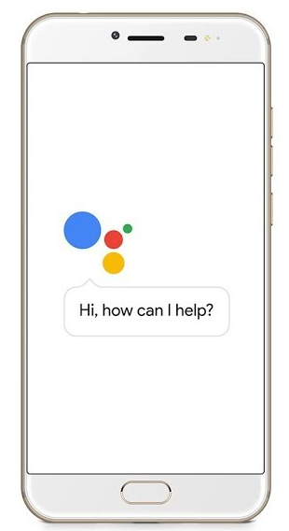
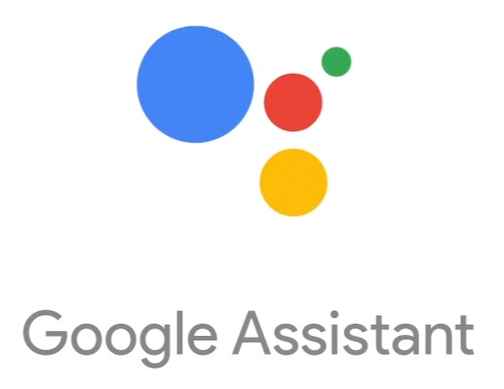






Google Cloud Platform
Firebase
FireStore
Stundenplan-Import
Cloud Function

