Slide 1

Audio System E-commerce Website Project.
Prepared by:
Srithan Reddy Ganji
Pavani Jaya Keerthana Chittedi
Vangala Ruchitha
Sathwika Vadnala
Sai Sresta Adusumalli
Jyothika Vollireddy

Slide 2
Introduction.
This project entailed developing a secure and user-friendly ecommerce store for an audio systems company that is modern and optimized for the current digital age. The site was built using the latest web development technologies using html, bootstrap, tailwind, JavaScript & css. It was furthermore, optimized for search engines to increase the online presence of the company.
The site was integrated with cyber security features such as OTP authentication and authorization of users signups and logins, as well as encryption of customer data(passwords) to protect their sensitive information. As part of the authentication process, the project implemented strong password validation in addition to the OTP authentication. With these security integrations, only authorized users have access to sensitive information and prevent unauthorized access. Another security feature that will be implemented in the project is the integration of a secure payment process by using third-party Stripe. This approach allows us to leave issues of security to stripe minimizing risk.
Furthermore, we explore the implementation of site cookie policies which will allow us to identify and assess questionable users. The project will be deployed on Azure which provides secure hosting services further strengthening security. Other features such as multilayer security will also be explored through implementation of firewalls to protect APIs and databases.

Slide 3
Introduction.
The platform will be tested and evaluated to ensure its accuracy and effectiveness in protecting customer data and providing a user-friendly experience. In addition, the platform will be optimized for mobile devices to allow customers to easily access the store from their smartphones or tablets.
By developing a secure and user-friendly ecommerce platform for the audio systems company, this project provides a solution that will help the company modernize its operations and enable it to migrate from brick and mortar stores. The cyber security features will provide customers with the assurance that their data is protected, while the user-friendly interface will encourage more customers to interact with the brand and make purchases from the store. The platform will also help the company increase its online presence and reach a global customer base, ultimately driving sales and revenue growth.

Slide 4
Problem Statement
This project aims to solve the lack of a secure and user-friendly ecommerce platform for an audio systems company that is seeking to modernize its operations and migrate from the brick and mortar stores. The audio company which is struggling with low sales due to the lack of an online presence and the inability to effectively reach a global customer base.
The existing traditional ecommerce platforms often lack sufficient cyber security features to protect customer data and prevent unauthorized access. the company requires a platform that is secure and can protect customer data while providing a user-friendly experience to enable the transition from brick and mortar stores to an online presence.

Slide 5
Languages used in the project
During the design, development, and implementation of security features of the website, the following programming languages were used:
HTML
CSS/TAILWING/BOOTSRAP
PHP
JAVASCRIPT
jQuery

Slide 6
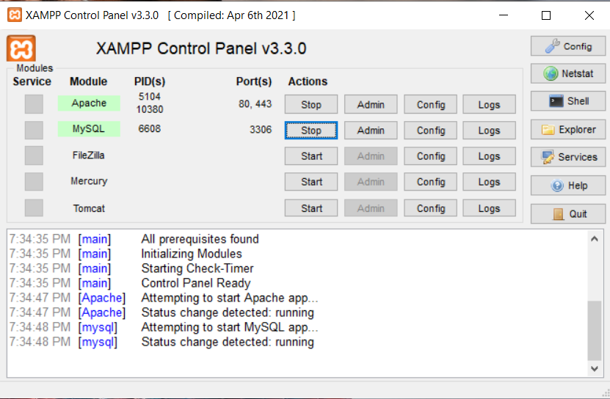
Xampp:
XAMPP is a free and open-source cross-platform web server solution stack that includes Apache, MySQL, PHP. It is a widely used tool for developing and testing web applications locally on a personal computer or workstation.
XAMPP provides an easy way to install and configure a local web server environment that can run on Windows, macOS, and Linux operating systems.
It is a convenient solution for web developers who want to create and test dynamic websites and web applications without the need for a remote server or internet connection.

Slide 7
Methodology
We tackled development of our project using the below methodology as our guideline. The development phases were majorly divided into the backend and frontend.
Frontend design
Backend design
Implementing security features
Site testing
Planning
Designing the Frontend
TM#1: Landing/Home page
TM#2: Cart & Checkout pages
TM #3: Signup & Login pages
TM#4: Styling pages
TM#5: Adding security features and testing site

Slide 8
Methodology
Backend development methodology was implemented as below:
Designing the Backend
TM#1: Database design
TM#2: JavaScript for signup & login page functionality
TM #3: OTPs & password encryption
TM#4: database connection PHP scripts

Slide 9
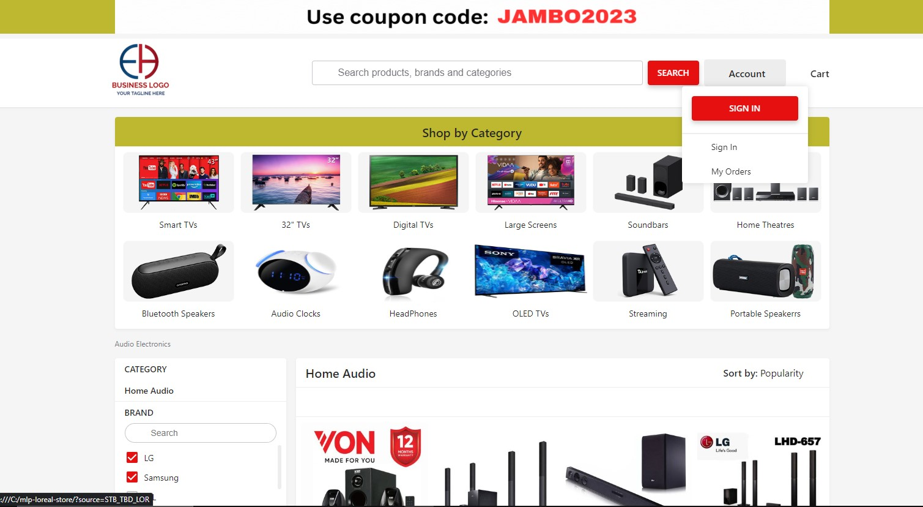
Methodology
Front end/Home page:
( the homepage was developed capturing all the site functionalities highlighted earlier in proposal)

Slide 10
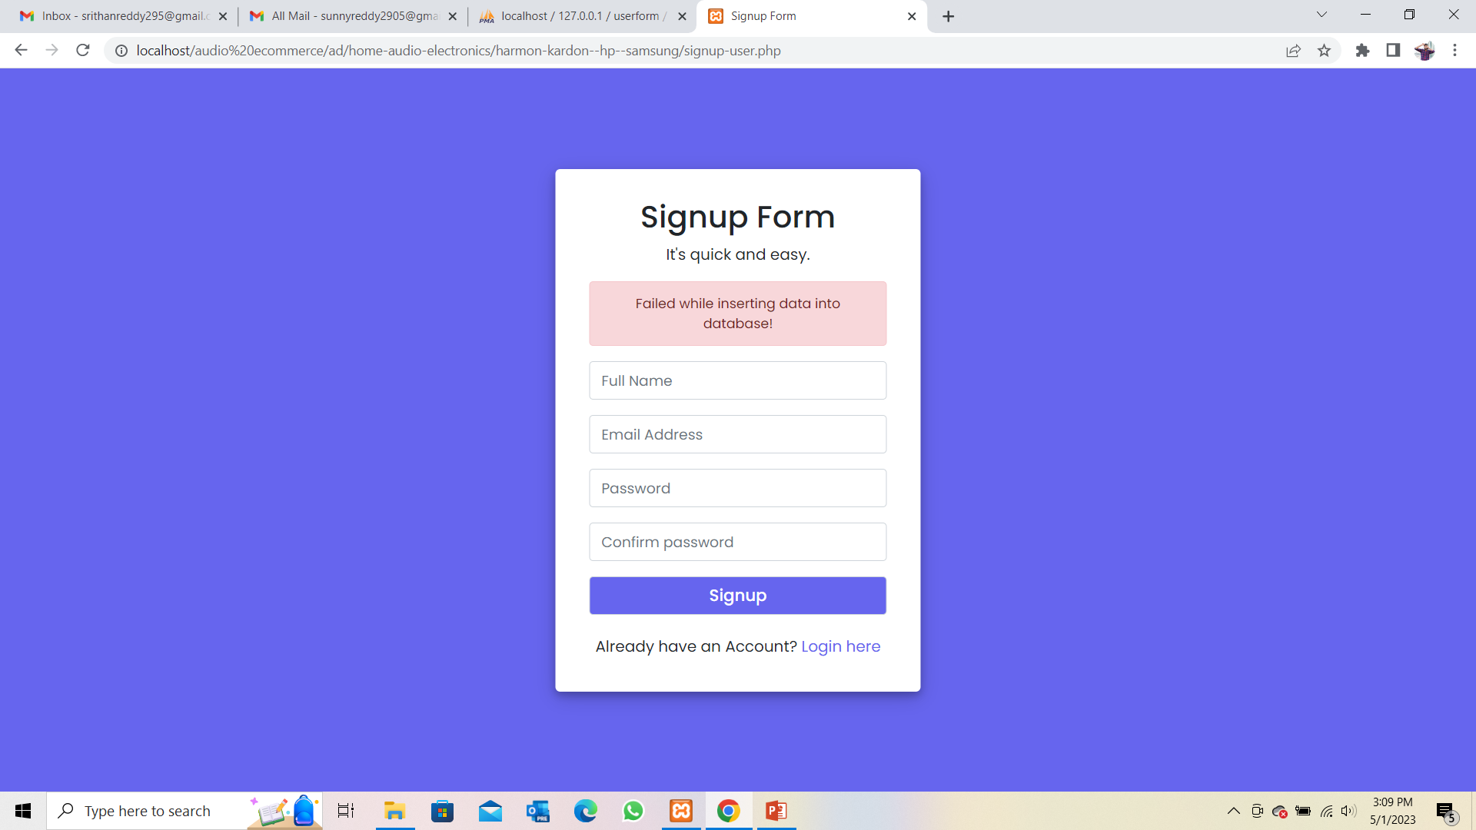
Sign-up:
We are asking the customers to signup with their name, email and password as of they are the new logins.
The password which they are going to enter must satisfy some certain conditions.
And we have included E-mail verification as a security feature by getting a 6 digit OTP code, so by they can secure the data.
If they haven’t complete the E-mail verification they cannot sign in as user.

Slide 11
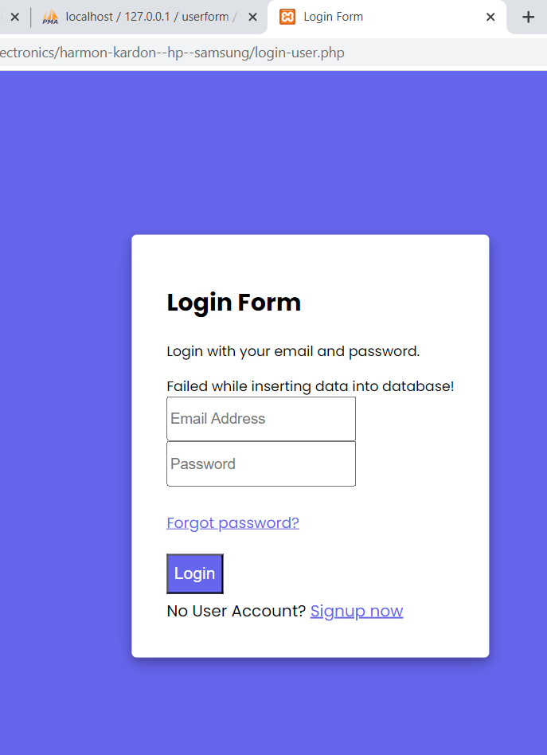
Login :
Once the user completes the signup they must re login with their email address and password.
If they are the previous customers they can directly login to the website page.
If the user forgets the password then he can get a reset link to his email address, so ther by he can create a new password.

Slide 12
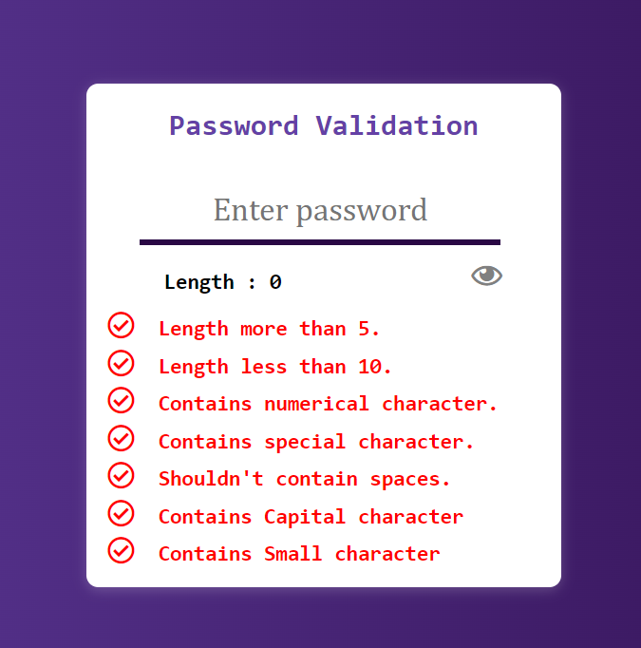
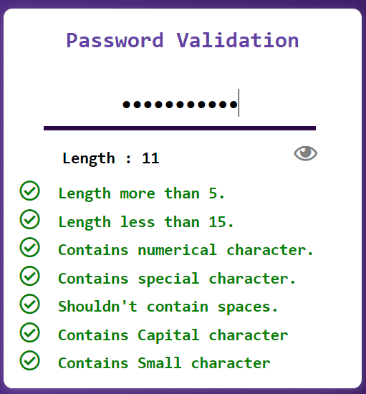
Security Features:
Password Validation:
Password validation is a security feature that enforces rules on user-created passwords to help prevent unauthorized access to user accounts.
These rules may include minimum length requirements, complexity requirements, password expiration, lockout after failed attempts, and blacklist of commonly used passwords

Slide 13
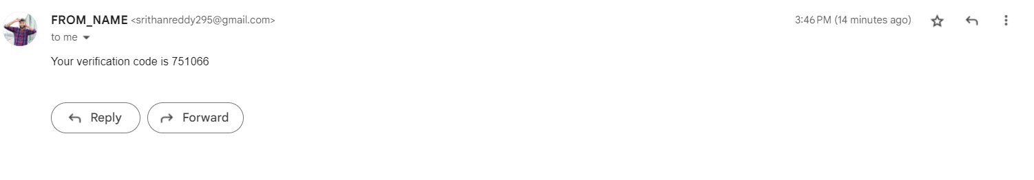
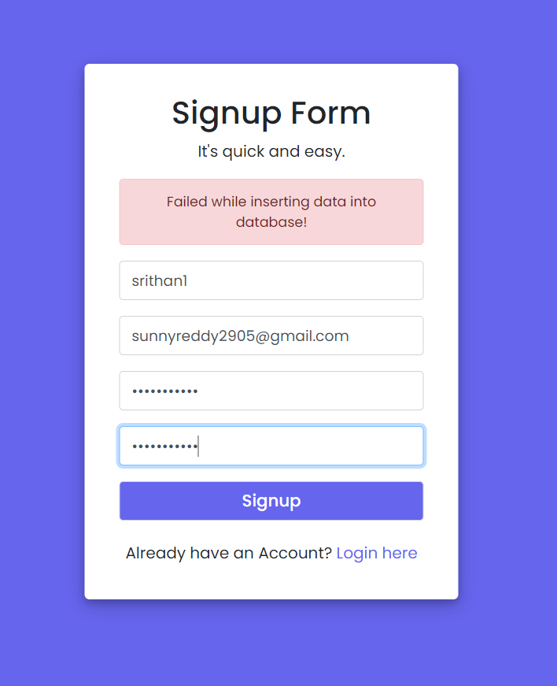
OTP:
OTP or One-Time Password is a security feature used as a second factor in two-factor authentication to ensure only authorized users can access their accounts.
It is a unique code generated by a trusted authentication server and sent to the user's registered mobile phone number or email address.
OTP is widely adopted by organizations to prevent unauthorized access to user accounts and protect against phishing attacks, hacking attempts, and other forms of cyber threats.

Slide 14
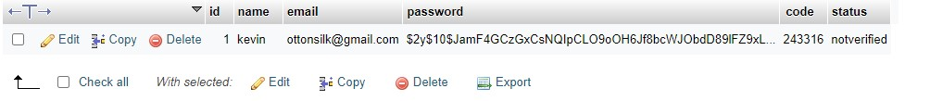
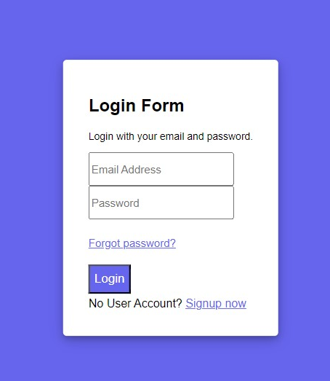
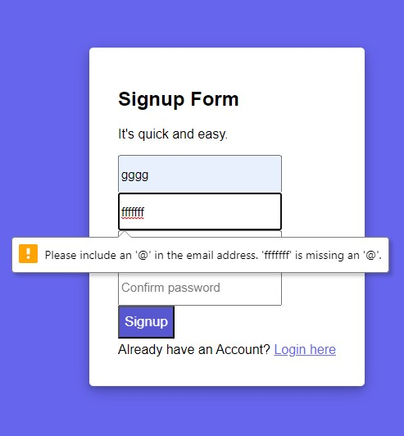
Analysis/Results
We were able to develop our site as well as implement the afore-mentioned security features.
The OTP verification was successfully implemented as seen in code in our database above.
Functioning login page with password reset provisions
Functional signup page with OTP verification enabled

Slide 15
Conclusion
Aims:
Objectives:
Security Features:
The aim of solving the lack of a secure and user-friendly ecommerce platform for an audio systems company that is seeking to modernize its operations and migrate from brick and mortar stores was also achieved
Further, we were able to implement the security features to our audio website making the site to be in a better position to tackle modern cybersecurity challenges, the features include;
In conclusion, we accomplished our project objectives of developing a modern secure audio system website.
Strong password validation
OTP verifications
Secure payment gateway using Stripe
Website cookies for user activity monitoring

Slide 16
Future Scope
Recommendations:
The site is recommended to use SSL and SLH once its live for further increased online security
A more robust use of NodeJS can be used in future development
In addition to the use cookies, machine learning algorithms may be incorporated in the site for an optimized user experience and behavior training
The agile development method is also recommended for efficient management of such projects in future
If a high level of match is determined, you may have to resubmit your work
This is where uploading two days prior to the due date will help.

Slide 17
Youtube video link:
https://youtu.be/8ATy0yvfLAw

Slide 18
Thank You!

