Slide 1
Progress report
Master thesis progress report
24.06.15

Slide 2
Toolflow
Program
source
clang -c source.c -o foo.bc
User view
Computing centre view
opt - … -optmigrate -o bar.bc
foo.bc
bar.bc
foobar.out
ld -lmaxeleros -l...

Slide 3
Control flow
foobar.out
Some function
Entry
UseAccelerator
Calculate costs based on:
Data dimension sizes
Convolution: filter size
Matrix-Multiplication: size
Original operation
HW-Accelerator
Call
Accelerator
implementations
Exit

Slide 4
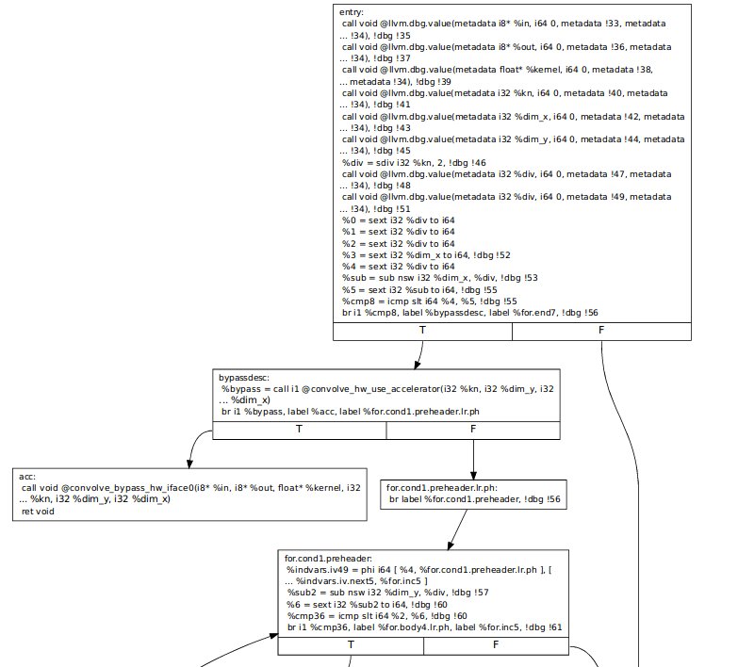

Slide 5
Convolution detection
Based on loop-vectorization pass
Identifies reduction and tracks back operations
Deduction of convolution parameters
  Required parameters for offloading
    Number of dimensions
    Filter kernel size
    Data source/destination
    Filter kernel coefficients
    For each dimension: data length
    Data layout

Slide 6
Convolution detection
Deduction of convolution parameters
void convolve(const u_int8_t **in, u_int8_t **out, float *kernel, int kn, int nx, int ny){
for(i = kn/2 to ny-kn/2)
for(j = kn/2 to nx – kn/2) ←(1)
for(k = -kn/2 to kn/2) ←(2)
for(l = -kn/2 to kn/2)
}
SCEV BE expression ((sext i32 %div to i64) + (-1 * (sext i32 (-1 * %div) to i64)))
  Simplification: (2 * (sext i32 %div to i64))
  Backwards search %div = sdiv i32 %kn, 2
  → Filter kernel size %kn
(-1 + (sext i32 ((-1 * %div) + %dim_x) to i64))
  Unknown value search
  Dimension size: %dim_x

Slide 7
First benchmark results
./convolve 1024 3 0 0,03s user 0,00s system 97% cpu 0,030 total // ohne HW
./convolve 1024 3 0 0,01s user 0,02s system 71% cpu 0,047 total // mit HW (hot)
./convolve 1024 3 0 0,02s user 0,02s system 10% cpu 0,330 total // mit HW (cold)
----------------------------------------------------------------------------------------------------
./convolve 2048 3 0 0,15s user 0,00s system 99% cpu 0,155 total // ohne HW
./convolve 2048 3 0 0,04s user 0,02s system 58% cpu 0,105 total // mit HW (hot)
./convolve 2048 3 0 0,04s user 0,02s system 15% cpu 0,383 total // mit HW (cold)
----------------------------------------------------------------------------------------------------
./convolve 4096 3 0 0,65s user 0,02s system 99% cpu 0,670 total // ohne HW
./convolve 4096 3 0 0,13s user 0,03s system 42% cpu 0,372 total // mit HW (hot)
./convolve 4096 3 0 0,12s user 0,04s system 25% cpu 0,617 total // mit HW (cold)

Slide 8
Next steps
Identify MM idioms
Benchmark different overlays
Cost calculation for offloading
Offload overlays into database

