Slide 1
The next football star
BY: Ben volovelsky and izar hasson
Deep learning spring 2024

Slide 2
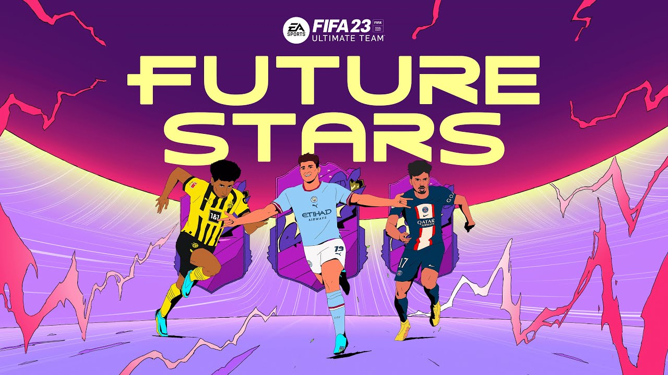
Project goals
Discovering the next Football Stars based on current and previous years data:
Predict a players’ potential
Estimate a player market value
Learn about the use of Deep Learning tools learned in class

Slide 3
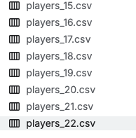
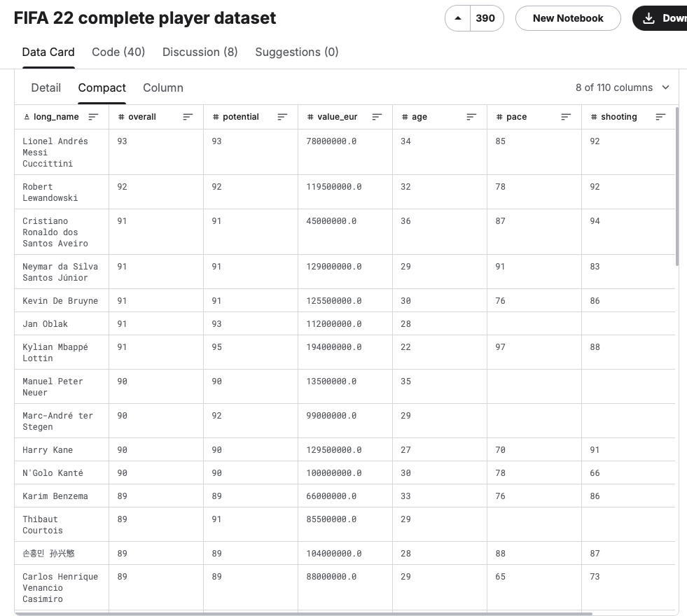
How did we do it?
The data set

Slide 4
How did we do it?
Feature Engineering:
Numerical values only
Matching between sets (only if exists in all)
Filling the blanks
Scaling
FIFA 20-22 Only
“Use-collumns” (value- all, potential- filter_use)
['overall', 'potential', 'pace', 'shooting', 'passing', 'dribbling', 'defending', 'physic', 'value_eur', 'club_team_id','attacking_finishing']

Slide 5
SKIPPING TO THE END
EVALUATION:
Choosing the evaluation metric was a hard decision, we needed to decide what is a “hit”
We chose: 10% mistake range for the player value and 2% mistake range for the potential

Slide 6

Model choosing
NUMERICAL DATA REGRESSORS
TABNET
ENSEMBLE -STACKING DEIFFERENT MODELS (MLP+XGBoost Random Forrest+ SVR)
CATBOOST:
gradient boosting library, an algorithm for machine learning that uses decision trees as base predictors and builds them sequentially to minimize errors.

Slide 7

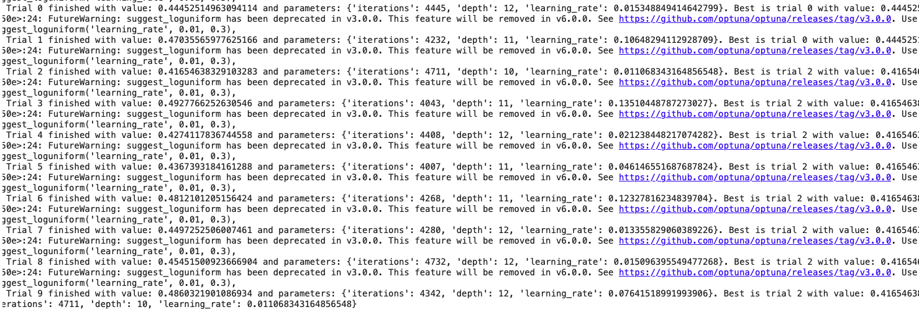
Hyper-parameter tuning
OPTUNA!

Slide 8
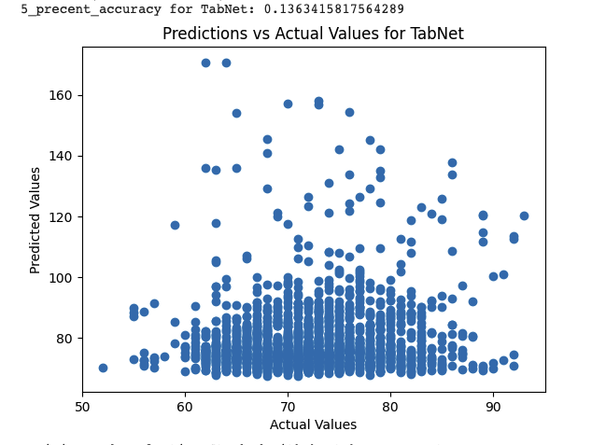
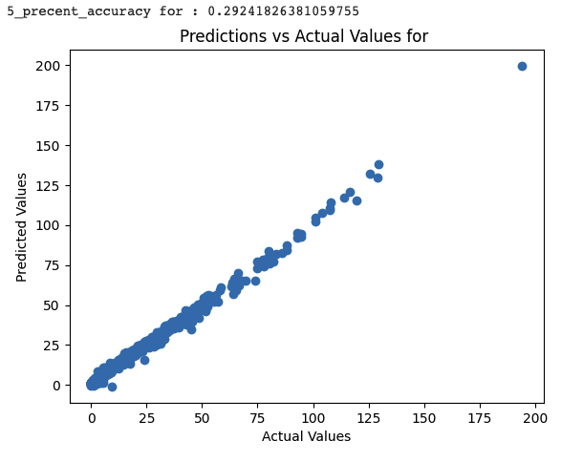
RESULTS – rough start with tabnet
VALUE (EURO MIL)
POTENTIAL (1-”100”)

Slide 9
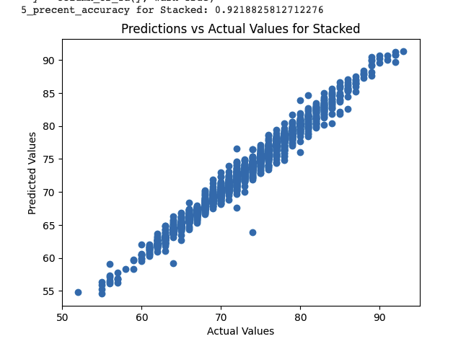
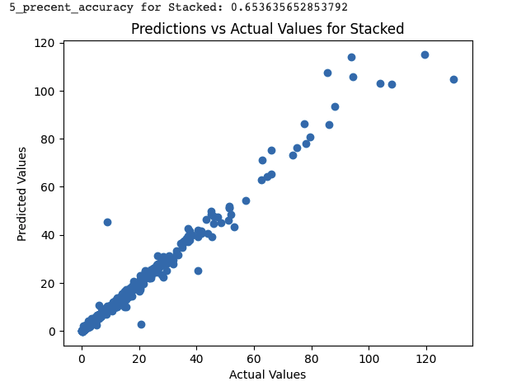
IT'S GETTING STACKED in here
POTENTIAL (1-”100”)
VALUE (EURO MIL)

Slide 10
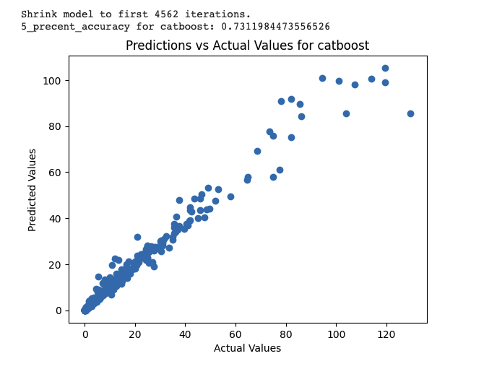
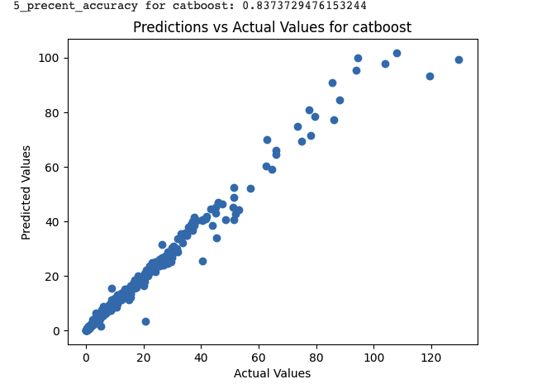
RESULTS – IT GETS BETTER ☺ CATBOOST
VALUE (EURO MIL)
HYPER-
PARAMETERS
TUNING

Slide 11
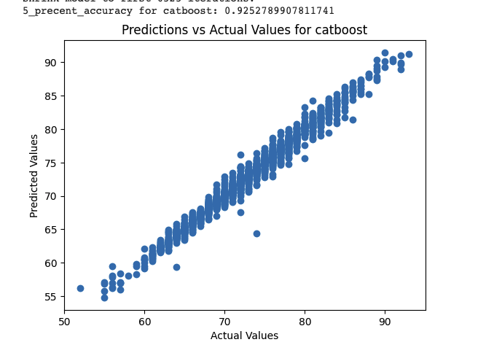
RESULTS – IT GETS BETTER ☺ CATBOOST
POTENTAIL(1-100)
TUNING WORKS HERE TOO!

Slide 12
CONCLUSIONS
Tabular regressors don’t work well on pure numerical datasets
Hyper-Paramaters are important - Optuna will take a lot of your time but will improve your preformence dramaticlly
Predicting a number in the range 1-100 is easier then predicting a number between 0.005-100
Scaling is critical
Too many features can have bad influence
Predicting different features will demand model adjustments
Boosting works really well!

