Slide 1
Is/are vs was/were

Slide 2
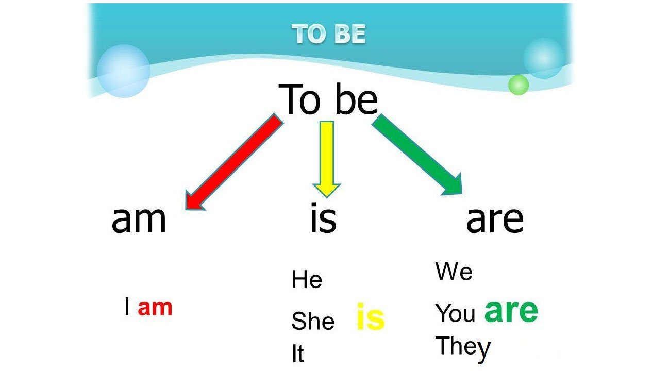

Slide 3
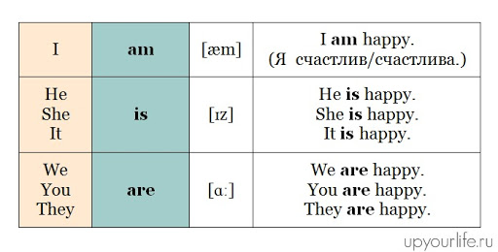

Slide 4


Slide 5
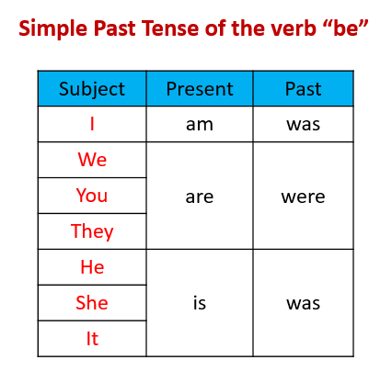

Slide 6
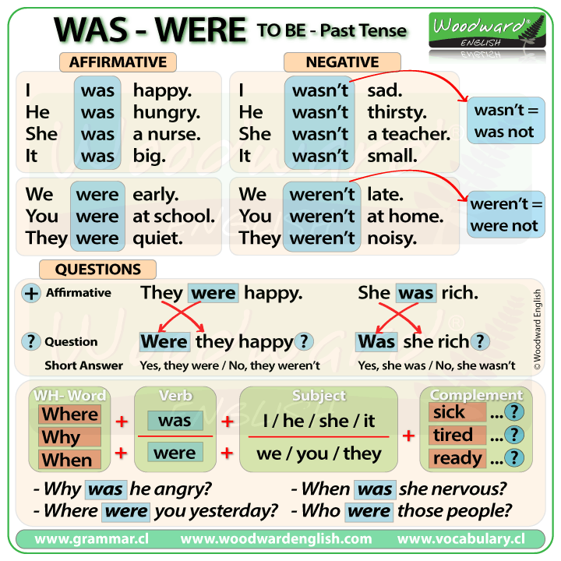

Slide 7
https://www.youtube.com/watch?v=7fF60Kjw5zE
Пісні
https://www.youtube.com/watch?v=7XyH4u6zaPw
https://www.youtube.com/watch?v=Vbt7XZ7fpFU
I am a pupil
I was a pupil
He is a teacher
He was a teacher
They are happy
They were happy
https://www.liveworksheets.com/worksheets/en/English_as_a_Second_Language_(ESL)/Was_or_were/Was_or_were$_yr18112if

