Slide 1
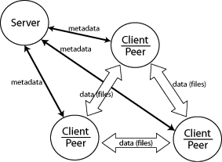
Twainet
IPC and RPC library

Slide 2
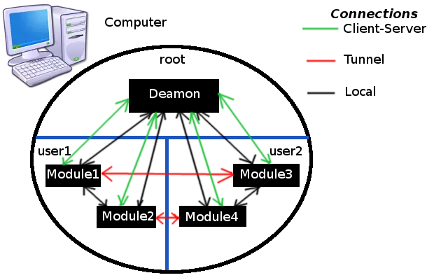
Interprocess Communication(IPC)
Architecture

Slide 3
Interprocess Communication(IPC)
Functionality
Daemon — Coordinator monitors all running processes involved in the ipc, Local server allow you to communicate the processes belonging to different users.
Direct communication between modules (processes) and single user connection through a secure tunnel between the modules(processes) of different users.
Providing lists of modules (processes) available to connect list and modules (processes) that are already connected.
Sending a message to another module(processes), both directly and through the co-ordinator or the server.

Slide 4
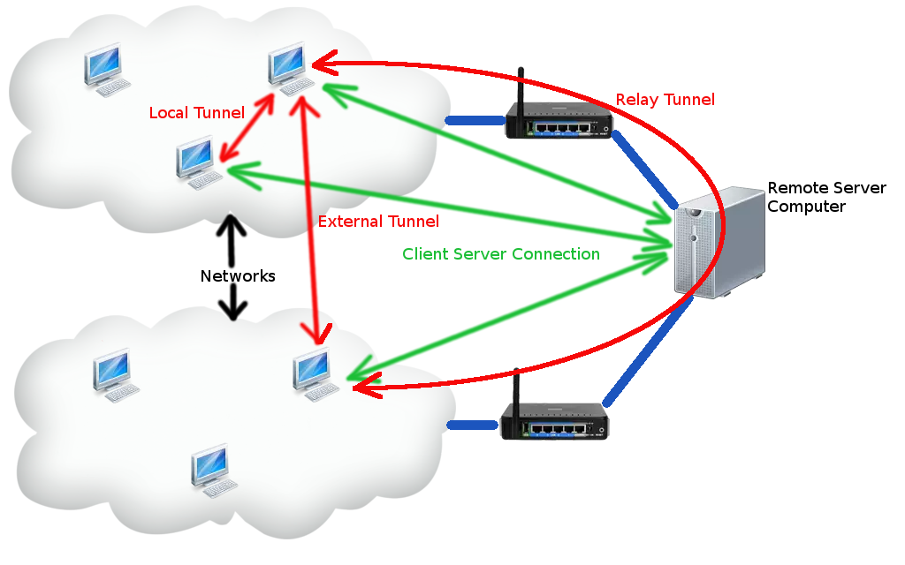
Remote Process Communication(RPC)
Architecture

Slide 5
Remote Process Communication(RPC)
Functionality
Server — Module that allows clients to communicate with each other.
The ability to create 3 different types of tunnel:
local — local tcp or udp connection between clients which are located on a single network
external — udp connection between clients which are located behind a routers
relay — tcp or udp connection which takes place through the server

Slide 6
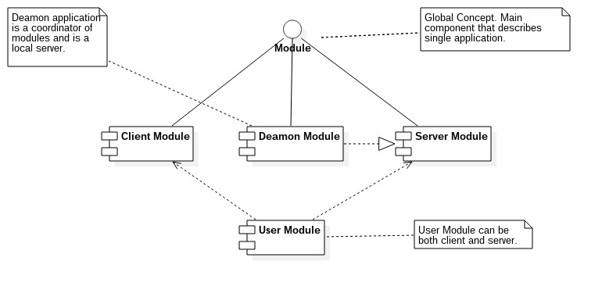
Components
IPC Components
    Deamon application
    Twainet shared library
    User applications
RPC Component
          Server application
          Client Aplication

Slide 7
Security
Local connection(single connection between modules of single user) is not encrypted
Server connection and Tunnel connection is encrypted rsa-aes algoritm on both sides.
  Both sides are generated rsa public keys and are sent each other.
  Both sides are generated aes key and after them are encrypted, they are sent each other them.
  Further communication encryption by aes keys.

