Slide 1
Research Progress
Huang Jiahui
2026/10/13
Data Engineering Lab, IPS, Waseda Univ.
Notes:
Today I will present the construction and evaluation of a QA dataset for agentic knowledge graph retrieval. I will first explain how the construction plan turns existing problems into question families and controlled perturbations, using actual records to illustrate fields and generation prompts. I will then describe the local retrieval stores, ReAct actions and evaluation metrics. Finally, I will analyze the saved gpt-6-luna results, focusing on false edges, answer formatting and tool-call metrics, before outlining the next round of multi-model experiments.
今天主要汇报QA数据集构造和评测。首先按照构造方案，说明现有问题怎样转化为不同题型与受控干扰，并结合真实题目介绍字段和造题提示词。随后介绍评测中的局部检索库、ReAct动作和各项指标。最后分析保存的gpt-6-luna结果，重点讨论噪声边、答案格式以及工具调用指标带来的差异，再提出下一轮多模型实验的计划。

Slide 2
Addressing Current Issues in Benchmark Design
Current issue | Construction response
Different versions of datasets | V0(single hop), V1(paraphrase), V2(multi hop), V3(distractors), V4(noise edges)
Ambiguity, multiple answers, and unanswerable questions | Create a separate version for each case
Type questions need variants | Use the entry’s schema types together with their parent and sibling from hierarchy
Reranker recall should be reported | Annotate each question with gold edges, distractors, and noise edges. Evaluate initial retrieval recall, reranker recall, and answer accuracy separately
Non-KG fact reasoning should appear in the answering process. The model should decide when to query the graph and how many steps to take | Provide an agent_plan for each question, labeling each step as kg_retrieve or text_infer
Distractors should be semantically similar, with a configurable number(parameter) | Select the top k most similar candidates sharing the same relation and object type, with k = 0, 2, or 5.
Add noise edges | Add one type-compatible edge that the source text does not support. Exclude it from the gold evidence.
2

Slide 3
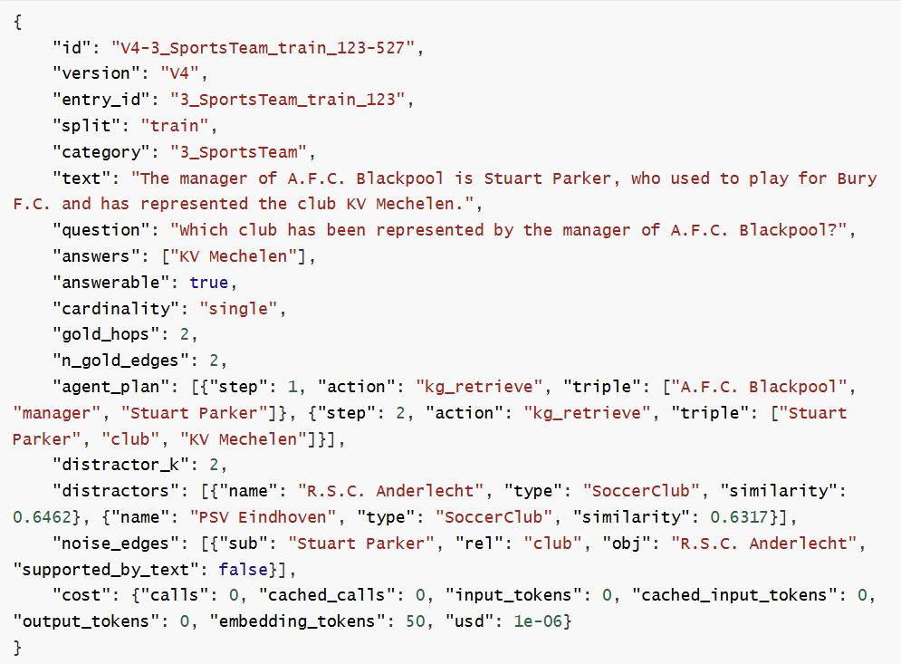
Example
Answer type
Required number of graph retrieval steps. Parallel edges sharing the same subject count as one hop. Unanswerable questions have zero hops
Number of kg_retrieve entries in agent_plan
Gold action plan used for evaluation
Number of distractor entities: 2 or 5 for V3, and 0 for other versions
List of distractor entities
Noise edges added to the retrieval database but excluded from the gold action plan. Non-empty only for V4
3

Slide 4
Bench instance
Values of cardinality
Value | Meaning
single | One answer
multiple | A set of answers. Omitting any answer makes the response incomplete
non_unique | The attested answer is one of multiple possible answers, as indicated by the source text
unanswerable | The agent should abstain
Fields of agent_plan
Field | Meaning
step | Step index, starting from 1
action | kg_retrieve: query the graph; text_infer: read and infer from the source text; abstain: abstain from answering
triple | [subject, relation, object]. Used by kg_retrieve; set to null when abstaining
span | Relevant passage from the source text. Used by text_infer
4

Slide 5
V0 and V1: single-hop and paraphrase
100 V0 records and 100 V1 records preserve the same gold facts
Source: “Hugo Sperrle was a commander in the Battle of France.”
Version | Question | Gold answer
V0: rule template | What is the commander of Battle of France? | Hugo Sperrle
V1: LLM paraphrase | Who commanded the Battle of France? | Hugo Sperrle
Shared evidence
(Battle of France , commander , Hugo Sperrle)
V1 keeps the exact answer, excludes it from the question and changes the phrasing.
The saved wording illustrates both template awkwardness and a more natural rewrite.
5
Notes:
The source identifies Hugo Sperrle as a commander in the Battle of France. V0 asks, “What is the commander of Battle of France?” V1 rewrites this as, “Who commanded the Battle of France?” Both records keep Hugo Sperrle as the gold answer and share the same commander edge and one-step plan. Retaining the exact saved wording shows how the paraphrase changes the awkward template question. This comparison controls phrasing while preserving the annotated answer and evidence.
这组配对的原文说，Hugo Sperrle是法国战役的一位指挥官。V0保留了模板式的What is the commander of Battle of France?，V1则改写为Who commanded the Battle of France?。两题的金标答案都是Hugo Sperrle，共享同一条commander关系和一步检索计划。这个例子也保留了模板问句不够自然的特点，方便直接看到改写改变了什么。我们控制的是问法，而不是答案或支持证据。

Slide 6
V2: multi hop
100 questions: 70 with two hops and 30 with three hops
 | Two-hop example | Three-hop example
Question | Where was the person who starred in Bananaman born? | Who is the leader of the country where the location of Amdavad ni Gufa is found?
Supporting triples | (Bananaman , starring , Graeme Garden) (Graeme Garden , birthPlace , Aberdeen) | (Amdavad ni Gufa , location , Gujarat) (Gujarat , country , India) (India , leader , Sumitra Mahajan)
Gold answer | Aberdeen | Sumitra Mahajan
Prompt constraints
Name the starting entity. Hide intermediate entities and the final answer.
Require the whole chain. The first triple alone must be insufficient.
6
Notes:
V2 contains seventy two-hop questions and thirty three-hop questions. Bananaman connects to Graeme Garden and then to Aberdeen. The three-hop example connects Amdavad ni Gufa to Gujarat, then India, and finally the leader named in the source, Sumitra Mahajan. This reproduces the benchmark record, not a claim about current office holders. The prompt requires the start entity, hides intermediate entities and the answer, and states that the first triple must be insufficient. The supporting chain is explicitly provided to the generator.
中文讲稿
V2共有70道两跳题和30道三跳题。Bananaman这个例子先找到Graeme Garden，再检索其出生地Aberdeen。三跳例子则从Amdavad ni Gufa到Gujarat，再到India，最后得到原始记录给出的领导人Sumitra Mahajan。这里复现的是来源材料中的事实，不是在陈述现任职务。生成提示要求保留起点、隐藏中间实体和答案，并让第一条边不足以回答；但提示本身已经明确提供了这条支持路径。

Slide 7
Mixed questions: text inferring and comparison
The gold plan marks the step that graph triples cannot directly express
 | Parenthetical detail | Year comparison
Question | Which county is named in the description of Maple Ridge Township, and which country does the record assign to it? | Was 103 Colmore Row completed before 1980?
Source | Text: Maple Ridge Township (Alpena County, Michigan) is in the United States. Triple: (Maple Ridge Township, country, United States) | Text: 103 Colmore Row, located in Birmingham, with 23 floors, was completed in 1976. Triple: (103 Colmore Row, completionYear, 1976)
Gold answer | Alpena County , United States | Yes
Agent Plan | text_infer: Alpena County kg_retrieve: (Maple Ridge Township, country, United States) | kg_retrieve: (103 Colmore Row, completionYear, 1976) text_infer: 1976 is before 1980
Required behavior | Retrieve the graph fact and read the source detail | Retrieve the year and compute the comparison
Coverage limits: all 20 comparisons questions’ answers are “Yes”.
7
Notes:
The parenthetical example extracts Alpena County from the text and retrieves United States through kg triples.
The comparison example retrieves 103 Colmore Row’s completion year, 1976, and checks whether it is before 1980, producing Yes.
Each combines one graph edge with another operation.
There are also coverage limits: all twenty comparison answers are Yes.
中文讲稿
mixed的第一种操作是从正文读取信息。这里从xx后面的括号提取xx，再用xx关系得到xx。第二种是比较：xx的建成年份是xx，判断是否早于xx，得到Yes。
两题各有一条图谱证据，再增加文本抽取或比较动作。覆盖范围也有局限：20道年份题全部是Yes。

Slide 8
Multiple answers, ambiguity and unanswerable
Source: Darinka Dentcheva is a citizen of the United States, the country where John Roberts is one of the leaders.
Type | Question | Gold target and rationale
multi n = 50 | Who created Bolt? | [Dan Mishkin, Gary Cohn] Two parallel creator edges; gold_hops = 1
ambiguous n = 24 | Who is the leader of United States? | John Roberts is the attested answer. Source says “one of the leaders”; no uniqueness claim
unanswerable n = 50 | When did Adam Koc die? | answers = []; answerable = false Source gives the place of death, not its date
8
Notes:
The answer contracts differ across these families. Bolt requires both Dan Mishkin and Gary Cohn, supported by parallel creator edges. The ambiguous source names John Roberts as one of the leaders of the United States, making him the attested answer without establishing uniqueness or current office. Adam Koc’s source gives a place of death but no date, so the target is an empty answer with abstention. Multiple answers use set F1; non-unique answers also receive an overclaim check; unsupported questions require abstention.
中文讲稿
这三类题的答案约定不同。Bolt需要Dan Mishkin和Gary Cohn两个名字，由两条并列边支持。歧义例子的原文称John Roberts为美国领导人之一，所以他是这条记录证实的答案，但不能据此声称唯一性。这里也不对当前职务作判断。Adam Koc的原文只给出死亡地点，没有日期，因此应返回空答案并弃答。多答案使用集合F1，非唯一答案还要检查过度断言，无答案则检查弃答行为。

Slide 9
Type questions: schema types and hierarchy
50 records combine type identification with a subclass check
What schema type is assigned to Republic of Ireland, and is that type a subclass of PopulatedPlace?
Component | Saved or constructed evidence
Gold schema edge 1 | (Republic of Ireland , type , Country)
Gold schema edge 2 | (Country , subClassOf , PopulatedPlace)
Sibling distractor | State, PopulatedPlace
Answer and annotations | [Country, Yes] gold_hops = 2 cardinality = multiple
The evaluator adds schema edges and the sibling distractor from type_question metadata.
9
Notes:
This item asks for the schema type of Republic of Ireland and whether that type is a subclass of PopulatedPlace. The gold path connects the entity to Country, then Country to PopulatedPlace, producing [Country, Yes]. The evaluator constructs both schema edges from type_question and adds a sibling card, “State, PopulatedPlace.” This evidence comes from entry types and the ontology hierarchy, beyond the original factual triples. All fifty current type records use true parent relations, so the sample covers type identification with positive subclass checks.
中文讲稿
这个类型题询问Republic of Ireland的schema类型，以及该类型是否属于PopulatedPlace。金标路径先到Country，再到PopulatedPlace，所以答案为Country和Yes。评估程序会根据type_question补充这两条schema边，并加入State, PopulatedPlace这张兄弟类型卡片。这些信息来自条目类型和本体层级，而不是简单复制原始事实三元组。当前50道类型题全部使用真实父类关系，因此这里展示的是类型识别与正向层级判断。

Slide 10
V3 and V4: distractors and noise edges
The same question: Where was the person who starred in Bananaman born?
Gold answer and two gold edges remain fixed
Condition | Distractors entity | Noise edge
V2 (k = 0) | None | None
V3 (k = 2) | Regina, Londrina | None
V3 (k = 5) | Regina, Londrina, Charlottetown, Birmingham, Nottingham | None
V4 (k = 2) | Regina, Londrina | (Graeme Garden , birthPlace , Regina)
Selection rule
Rank candidates within the same relation and object type by embedding similarity.
V4 adds one type-compatible edge with supported_by_text = false.
10
Notes:
The Bananaman family keeps the question, answer Aberdeen, and two gold edges fixed. V3 adds two or five similar cities. V4 keeps Regina and Londrina and adds the unsupported birthPlace edge from Graeme Garden to Regina. Candidates share the relation and object type and are ranked by embedding similarity. The false edge is type-compatible but is excluded from the gold plan. In the saved evaluation, all four variants answer Aberdeen correctly. This example illustrates how perturbations are constructed, rather than a noise-induced failure.
中文讲稿
Bananaman这组配对保持问句、答案Aberdeen和两条金标边不变。V3加入两个或五个相近城市；V4保留Regina和Londrina，并额外加入Graeme Garden的出生地为Regina这条假边。候选来自相同关系和宾语类型，按向量相似度排序。假边的类型合理，但没有原文支持，也不属于金标计划。需要注意，保存的评估中，这个例子在四种条件下都回答正确。它说明扰动是怎样构造的，并不是一个噪声导致失败的案例。

Slide 11
Question-generation prompts and checks
Model: gpt-6-luna
Shared system prompt (exact)
“You write one English question about a short source text.
Return JSON only, with a single key named question.”
Prompt | Inputs | Instruction excerpt
V1 | Text, gold triple, original question | “The only correct answer must remain exactly {gold answer}”
V2 | Text, ordered chain, start, answer, forbidden names | “A reader who sees only the first triple must not be able to answer it.”
Unanswerable | Text and one existing fact | “Ask for a missing attribute, number, date, or person that the text does not give.”
Checks: required / forbidden strings and a question mark. Retry adds rejection reasons.
11
Notes:
Only V1, V2, and unanswerable questions use model-generated wording. Their prompts are in prompts.py, and the system requests a JSON object containing question. V1 must preserve the exact answer. V2 receives both the source and a preselected chain, retaining the start entity while hiding intermediate entities and the answer. Unanswerable questions target missing information. The code checks question marks, required and forbidden strings, and paraphrase difference, with at most one retry. These checks constrain form but do not independently establish semantic validity.
中文讲稿
生成提示集中在prompts.py，只有V1、V2和无答案题使用模型生成问句。系统提示要求只返回包含question的JSON对象。V1必须保持精确答案不变；V2不仅收到原文，也收到预先选好的路径，并被要求保留起点、隐藏中间实体和答案。无答案提示要求询问缺失信息。生成后，程序检查问号、必含和禁含字符串，以及是否完成改写，失败时最多再试一次。因此，这些检查约束的是形式，还不能独立证明语义正确。

Slide 12
The constructed dataset
824 records, 10 families and 374 source entry IDs across 19 domains
Family | Records | Control / coverage
V0 / V1 | 100 / 100 | Single-edge templates / matched paraphrases
V2 | 100 | 70 two-hop + 30 three-hop
V3 / V4 | 200 / 100 | 100 base questions × k = 2, 5 / k = 2 + noise
multi / type / mixed | 50 / 50 / 50 | Sets / hierarchy / 30 parenthetical + 20 compare
ambiguous / unanswerable | 24 / 50 | Non-unique evidence / missing information
Reuse matters
524 base instances
482 distinct question strings
492 question–answer pairs
Checks found no duplicate IDs and consistent gold labels across the V2/V3/V4 variants.
12
Notes:
The dataset contains 824 records from 374 source entries across nineteen domains. There are 524 base instances, 482 distinct question strings, and 492 question–answer pairs.
Checks found unique IDs and consistent gold labels across the V2/V3/V4 variants.
中文讲稿
最终数据集有824条记录，来自374个原始条目和19个领域。其中有524个基础实例、482个不同问句，以及492组不同的问答组合。
检查没有发现重复ID，V2、V3和V4的配对金标也保持一致。保存的构建成本估算约0.00756美元，包含固定单价和缓存响应记账，不是本次汇报新产生的费用。

Slide 13
Evaluation
Each question has its own local evidence store and a recorded ReAct trajectory
Module | Implementation | Saved evidence
Store | Load all triples of the source entry. Add version-specific cards(distractors or noise edges). | V3 distractors; V4 noise edge; type schema edges + sibling
Retrieval stage 1 | BM25 ranks every card in the local store. | Keep top M = 3
Retrieval stage 2 | text-embedding-3-small cosine similarity reranks those 3. | Show top n = 2 to the agent
ReAct | Execute actions and save every tool interaction. | traces.jsonl
Score | Score trajectories and aggregate by family, hops and k. | scores.json
13
Notes:
Each question has its own small evidence store. It contains every triple from the source entry, plus the distractors or noise edges required by that question's version. V3 adds entity distractors. V4 adds two entity distractors and one unsupported edge. Type questions add two schema edges and a sibling-class card. A graph query first uses BM25 to select up to three cards. Embedding cosine similarity then reranks those candidates and shows up to two. The model sees their text without gold or noise labels. Source reading is a separate action available on every question.
中文讲稿
每道题都有一个独立的小型证据库，其中包括来源条目的全部三元组，再按题目版本加入相应卡片。V3 加入实体干扰项；V4 加入两个实体干扰项和一条不受原文支持的边；类型题则加入两条模式边，以及一张兄弟类卡片。每次图谱查询先用 BM25 选出最多三张卡片，再用嵌入向量的余弦相似度重排，向模型展示最多两张。展示内容不带金标准或噪声标签。读取原文是另一个独立动作，所有题目都可以使用。
// The current setup evaluates small entry-level stores. It does not search one global KG.

Slide 14
ReAct actions and run configuration
The agent initially sees the question and action instructions
Action | Behavior | Stop the loop?
kg_retrieve | Search the item’s cards with query | No
read_text | Read the question’s original source text | No
answer | Return an answer and used triples | Yes
abstain | Record an empty answer | Yes
Saved run
gpt-6-luna
Up to 6 total turns
Up to 500 tokens / turn
reasoning_effort = none
temperature=0
824 / 824 scored
Action JSON
{"action":"kg_retrieve", "query":"Bananaman",
"used_triples":[], "answer":null}
14
Notes:
There are 4 actions: kg_retrieve, read_text, answer, or abstain. Retrieval and source reading continue the loop; answering or abstaining ends it. The six-turn and 500-token settings are upper limits, and the final answer uses a turn. Two consecutive invalid responses also terminate the attempt.
中文讲稿
四种动作：检索图谱卡片、读取原文、作答或弃答。检索和原文读取会继续循环，作答或弃答则结束本题。六轮和每轮 500 个 token 都是上限，最终答案也占用一轮。连续两次响应无效同样会终止本题。已有 gpt-6-luna 运行包含 824 条已评分轨迹，推理强度设为 none。原文读取适用于每一类题目。记录费用约为 11.5 美分，包含初始化嵌入，并使用项目固定的 token 单价计算，因此它是估计费用。

Slide 15
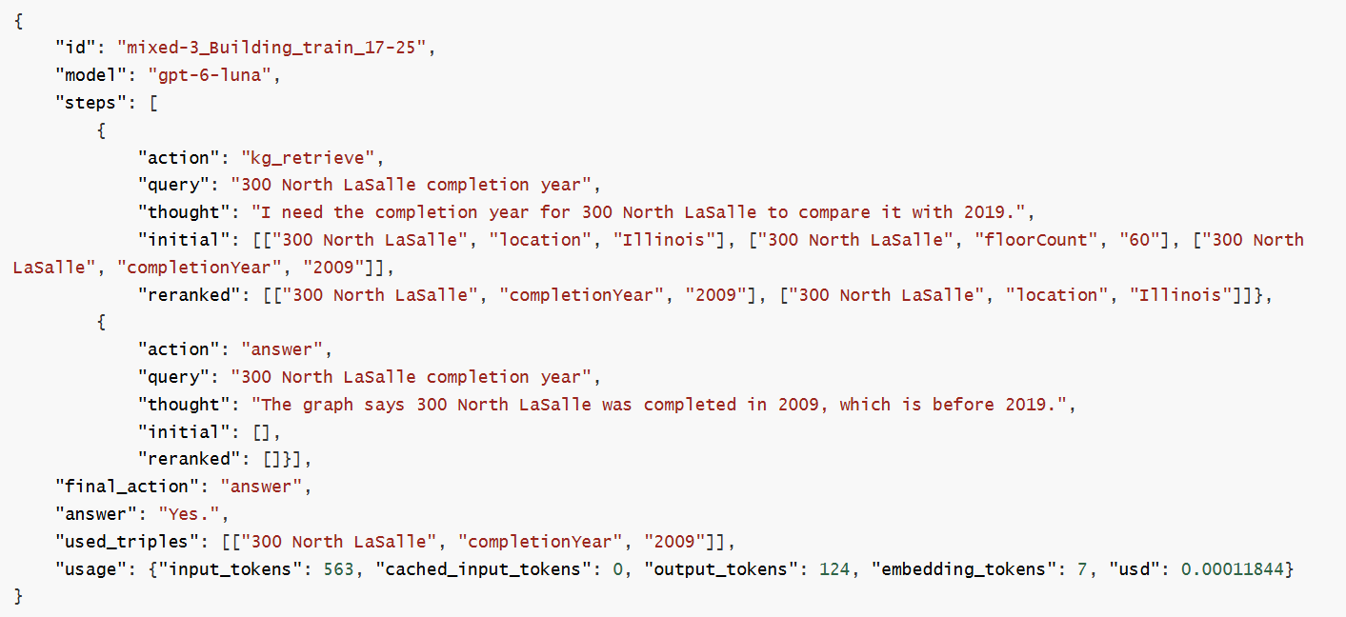
ReAct actions traces example
14

Slide 16
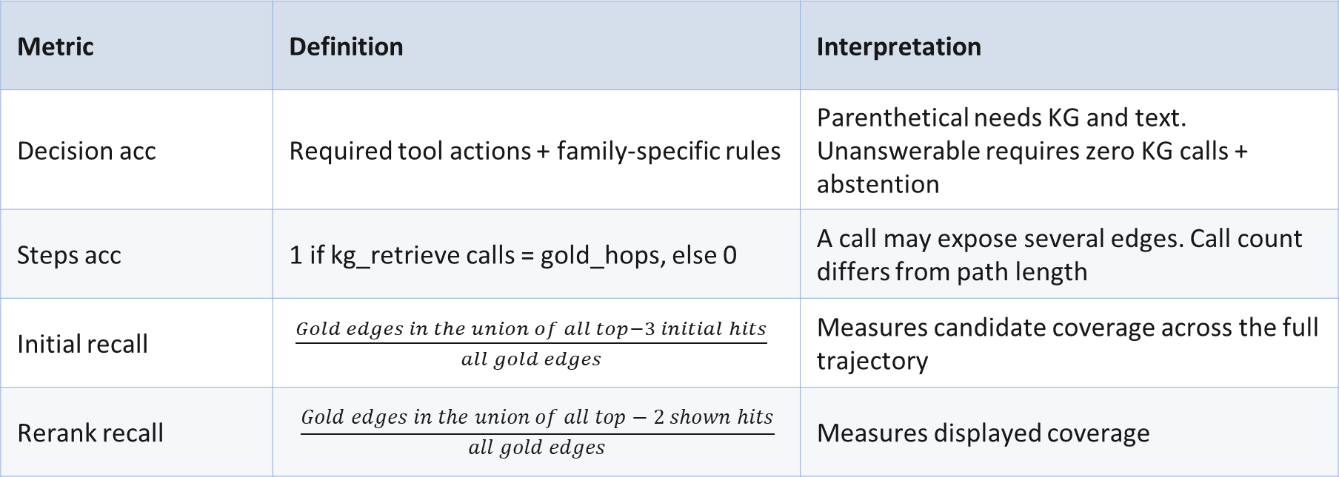
Evaluation Metrics: Decision acc, steps match and retrieval metrics
Metrics use the gold agent_plan and the accumulated trajectory
Metric | Definition | Interpretation
Decision acc | Required tool actions + family-specific rules | Parenthetical needs KG and text. Unanswerable requires zero KG calls + abstention
Steps acc | 1 if kg_retrieve calls = gold_hops, else 0 | A call may expose several edges. Call count differs from path length
Initial recall | $\frac{Gold edges in the union of all top−3 initial hits}{all gold edges}$ | Measures candidate coverage across the full trajectory
Rerank recall | $$\frac{Gold edges in the union of all top−2 shown hits}{all gold edges}$$ | Measures displayed coverage
Example: one of two gold edges retrieved gives recall = 0.5. No-gold items are excluded.
15
Notes:
Decision accuracy checks whether all applicable action requirements are met. For example, parenthetical questions require graph retrieval and source reading, while the current unanswerable rule requires zero graph calls and abstention.
Steps accuracy compares the number of graph retrieval calls with gold_hops. These are different quantities: one retrieval can expose a two-edge chain.
For each recall metric, we count recovered gold edges and divide by the total gold edges. Initial recall uses the union of top-three candidates; reranked recall uses the union of shown top-two results across the entire trace. Questions without gold edges are excluded from recall averages.
中文讲稿
决策准确率检查所有适用的动作要求是否满足。例如，括号信息题必须检索图谱并读取原文，而当前无答案题的规则要求零次图谱检索并最终弃答。调用次数准确率则比较图谱查询次数和 gold_hops。二者并非同一个量，因为一次检索就可能展示完整的两边路径。两种召回率都将找回的金标准边数除以金标准边总数：初检召回累计所有前三名候选，重排召回累计整条轨迹中展示的前两名结果。没有金标准边的题目不进入召回率的平均值。

Slide 17
Evaluation Metrics: Answer acc.
Target | Scoring rule | Example
single / non_unique | Exact match. single requires one value; non_unique checks the first prediction. | Match to the attested gold answer
multiple | Set F1 = 2PR / (P + R) P: Precision R: Recall | Return 1 answer but gold answers contains 2 answers: P = 1, R = 0.5, F1 = 0.667
unanswerable | Empty answer and final_action = abstain | Abstention earns answer score 1
edge F1 | Set F1 of used_triples against the gold edges | Self-reported evidence selection
oracle_context | Mean answer score only when all gold edges appeared in shown context | A conditional subset, not forced oracle retrieval
16
Notes:
The first table row combines two slightly different checks. A single answer requires exactly one matching value. A non-unique answer checks the first prediction against the supported answer. Multiple answers use set F1, so returning one of two creators earns two-thirds credit. Unanswerable items require empty abstention. Normalization retains punctuation. Edge F1 scores the self-reported used triples, while oracle_context averages answers only within traces that showed every gold edge across their retrievals. This is an observed subset, not a forced-context experiment. Overclaim is a separate wording check; it does not reduce the primary answer score.
中文讲稿
第一行合并了两种略有差异的检查：单答案题必须只有一个匹配值，答案不唯一的题目则将首个预测值与受支持答案比较。多答案采用集合 F1，所以两位创作者只答出一位，可获得三分之二的分数。无答案题要求空答案弃答。规范化会保留标点。Edge F1 评分的是模型自报的已用三元组；oracle_context 只对那些跨多次检索已经展示全部金标准边的轨迹计算答案均分。这是已有轨迹中的条件子集，不是主动提供金标准上下文的实验。Overclaim 是独立的措辞检查，不会扣减主要答案得分。

Slide 18
Experiments
Types | n | Decision acc | Steps acc | Initial recall | Rerank recall | Answer acc | Edge F1
V0 | 100 | 100.0 | 100.0 | 100.0 | 100.0 | 98.0 | 99.0
V1 | 100 | 99.0 | 98.0 | 99.0 | 99.0 | 89.0 | 97.0
V2 | 100 | 96.0 | 10.0 | 96.0 | 82.3 | 88.0 | 76.3
V3 | 200 | 96.0 | 11.5 | 91.6 | 78.3 | 83.5 | 69.0
V4 | 100 | 96.0 | 12.0 | 91.3 | 74.3 | 49.0 | 61.8
multi | 50 | 100.0 | 98.0 | 100.0 | 93.0 | 95.3 | 95.3
type | 50 | 100.0 | 28.0 | 84.0 | 75.0 | 4.0 | 53.6
mixed | 50 | 62.0 | 64.0 | 64.0 | 58.0 | 54.9 | 54.0
ambiguous | 24 | 100.0 | 100.0 | 100.0 | 95.8 | 95.8 | 95.8
unanswerable | 50 | 0.0 | 0.0 | N/A | N/A | 100.0 | 100.0
Answer score uses exact match, set F1 or an abstention check, depending on the question type.
17
Notes:
This table covers all ten question types. The saved run includes 824 records with no missing trajectories, and our recalculation reproduces every grouped score. The columns distinguish action decisions, retrieval-call matching, initial and displayed gold-edge recall, final answers, and selected-edge F1. Answer scores use different definitions: exact match for single answers, set F1 for multiple answers, and an abstention check for unanswerable questions. V0 reaches 98%, V4 falls to 49%, and type questions record 4% mean set F1. These contrasts identify where closer inspection is needed, but low scores do not automatically establish reasoning failures.
中文讲稿
这张表汇总了全部十个题型。保存的运行覆盖 824 条记录，没有缺失轨迹，我们重新计算后也复现了所有分组分数。各列区分动作决策、调用次数匹配、初检和展示后的金标边召回、最终答案，以及所选边的 F1。这里的答案分数并非统一口径：单答案题使用精确匹配，多答案题使用集合 F1，无答案题检查是否正确弃答。V0 达到 98%，V4 降至 49%，type 的平均集合 F1 为 4%。这些差异告诉我们应该进一步检查哪里，但不能将每个低分都直接解释为推理能力不足。下面先看配对扰动，再检查具体轨迹和评分规则

Slide 19
Experiments
The same 100 base questions appear in each condition
V3 k = 2 vs V4
−36 percentage points in answer acc.
36 correct-to-wrong pairs
18
Notes:
These four conditions use the same 100 questions. Clean V2 reaches 88% answer accuracy. Adding two and five distractor entities reduces this to 85% and 82%. Adding one unsupported edge to the two-distractor condition reduces accuracy to 49%. Compared with the paired k=2 condition, this is a 36-percentage-point decline: 36 questions switch from correct to incorrect. Displayed gold-edge recall declines only from 78.83% to 74.33%. Evidence coverage alone therefore does not describe the entire answer-score change. The next case examines how the agent uses conflicting evidence. These are descriptive comparisons within the saved run.
中文讲稿
这里的四个条件使用同一组 100 道问题。无干扰的 V2 答案准确率为 88%；加入两个和五个干扰实体后，分别降至 85% 和 82%。在两个干扰实体的基础上再加入一条缺乏原文支持的边，准确率降至 49%。与配对的 k=2 条件相比，这是 36 个百分点的下降：36 道题由正确变为错误，没有反向变化。展示后的金标边召回仅从 78.83% 降至 74.33%。因此，证据覆盖变化本身不足以描述整个答案分数的下降，下一页需要进一步检查模型如何使用相互冲突的证据。这些是本次保存运行中的描述性比较。

Slide 20
A noise edge can contaminate a retrieved answer
Actual V4 trace: New Jersey and the largest city of its country
Q: What is the largest city in the country that New Jersey is part of?
Evidence | Triple
Gold edge 1 | New Jersey , country , United States
Gold edge 2 | United States , largestCity , New York City
Injected noise edge | United States , largestCity , Newark
V2 / V3 answer
New York City
V4 answer
[New York City, Newark]
Both gold edges were shown. Rerank recall = 100%, answer = 0, selected-edge F1 = 0.8.
Across V4, 35/100 select the noise edge and all 35 fail: 23 mix true + noise, 12 use only noise.
19
Notes:
This question asks for the largest city in the country containing New Jersey. The gold path leads to New York City. In V3, Newark is only a distractor entity card, and the answer remains New York City. V4 adds Newark as a conflicting largestCity relation. Although both gold edges are retrieved, the agent returns New York City and Newark, treating both as supported. The answer score falls from one to zero despite complete gold recall. This mechanism is not isolated: 35 V4 trajectories report using the injected edge, and all fail. Twenty-three return both gold and false values, while twelve return only the false value. New Jersey illustrates the first pattern.
中文讲稿
这个问题询问新泽西州所属国家最大的城市。金标路径通向 New York City。在 V3 中，Newark 只是一个干扰实体卡片，模型仍然回答 New York City。V4 则把 Newark 加为一条相互冲突的 largestCity 关系。模型虽然检索到了两条金标边，却同时输出 New York City 和 Newark，认为图谱支持这两个值。因此，答案分从 1 变为 0，而金标召回仍然完整。这个机制具有一定代表性：V4 中有 35 条轨迹报告使用了注入边，全部答错；其中 23 条同时返回金标和假值，12 条只返回假值。New Jersey 展示的是前一种答案污染模式。

Slide 21
Output formatting changes the apparent result
Trace diagnostics supplement the official scores; they do not replace them
 | Type questions (n = 50) | Mixed comparisons (n = 20)
Score | Mean set F1 = 4.0% | Exact match = 25.0%
Gold target | [Town, Yes] | Yes
Actual prediction | “Doesburg is assigned the schema type Town, which is a subclass of Settlement.” | Yes.
Observed pattern | 22 abstain. 28 return prose containing the type and parent; 24 score zero. | 5 return Yes; 15 return Yes. All 20 gold labels are positive.
Diagnostic implication | The result mixes retrieval, abstention and answer-contract mismatch. | Removing the terminal period yields 20/20 matches in this audit only.
Next evaluation: enforce structured answer fields and test balanced positive / negative cases.
20
Notes:
These examples show how output format affects the recorded scores. Type questions achieve 4% mean set F1: 22 abstain and 28 produce prose. The Doesburg response states the type Town and its parent Settlement, but the gold answer is the set Town and Yes, so the scorer gives zero. Comparison questions have a related issue: five outputs are Yes and fifteen are Yes with a period, while all twenty gold answers are Yes. Official exact match is therefore 25%. Removing the period yields 100% in a formatting audit, but does not replace the official score or test negative comparisons. These findings support repairing the answer contract, not sweeping capability claims.
中文讲稿
这两个例子说明，输出格式会显著影响现有分数。Type 的平均集合 F1 为 4%，其中 22 道题弃答，28 道题以完整语句作答。Doesburg 的回答说明了 Town 类型及其父类 Settlement，但金标要求集合 Town、Yes，评分器因此给出零分。年份比较题也有类似问题：5 次输出 Yes，15 次输出带句号的 Yes.，而 20 个金标答案全是 Yes，所以官方精确匹配只有 25%。仅去掉句号后的复核为 100%，但这不替代官方分数，也没有检验负例比较能力。这些结果支持修复答案格式与评分契约，而不是直接宣称某项推理能力很差或已经解决。

Slide 22
Agent-plan compliance and answer quality differ
The saved traces explain large gaps between decision, call-count and answer scores
Case | Observed trace behavior | What the metric captures
V2 composition | Answer = 88%; Step acc = 10% 68/100 use exactly one KG call | One call can expose two edges. Text fallback can also support the answer.
Unanswerable | 50/50 make one KG call, then abstain Answer = 100%; decision = 0% | The gold plan requires zero KG calls, so a verification lookup fails the plan.
Mixed parenthetical | 30/30 read_text; only 12/30 retrieve KG Decision = 40%; answer F1 = 74.8% | 18 cases skip KG retrieval. Missing text reading does not explain the gap.
21
Notes:
Tool-plan compliance differs from answer quality. V2 scores 88% on answers but 10% on call matching; 68/100 questions use one KG call. One call can expose multiple gold edges. All fifty unanswerable questions retrieve once and correctly abstain, earning 100% answer credit but zero decision credit. All thirty parenthetical questions read text; only twelve retrieve KG.
中文讲稿
动作流程匹配与答案质量并不相同。V2 的答案准确率为 88%，调用次数匹配率为 10%；100 道题中，68 道只进行一次 KG 检索。一次调用能够展示多条金标边。全部 50 道无答案题都检索一次后正确弃答，答案得分为 100%，决策分却为零。全部 30 道括号题都读取了文本，仅 12 道执行 KG 检索。
中文解释
本页将调用次数指标与最终结果分开。V2 的答案准确率为 88%，调用次数匹配率为 10%；100 题中有 68 题只检索一次。一次工具返回最多两张卡片，能够同时展示两条金标边，Euro 真实案例证明了这种可能性。50 道无答案题全部进行一次 KG 检索后弃答，因此最终答案得分 100%，但不符合金标的零检索动作要求，decision=0。32 道无答案题还读了原文，不要把所有样本画成完全相同的两步轨迹。30 道括号题全部读取原文，仅 12 道调用 KG，故主要动作分歧是缺少规定的 KG 步骤，并非缺少 read_text。页脚的完整金标上下文条件分数已经按轨迹复核：V2 为 63/65=96.9%，V3 为 111/115=96.5%，V4 为 24/50=48.0%。这三个题型在相关子集上的答案指标均为二元精确匹配，因此分子确实是答对题数。分母表示自然运行中所有金标边都曾在重排展示结果中出现的题数；不是原始题目总数，也不是强制提供金标上下文的实验。各版本条件子集不同，不能将其直接视为配对因果比较。原文读取也会为其他题提供替代证据路径，不能将整个运行称为纯 KG 多跳测试。

Slide 23
Conclusion
Current work
Dataset construction
  Built QA dataset across V0–V4 and five additional question types, covering different difficulty levels, distractors and noisy edges
Evaluation framework
  Implemented a ReAct agent with two-stage retrieval and metrics for tool decisions, evidence coverage and answer quality
Experiments and analysis
  Evaluated gpt-6-luna on QA dataset
Future work
Repair the answer rule
  Structured answer fields; documented normalization
Broaden model comparisons
  Experiments on other large models
Strengthen the dataset
  Add negative type/year cases
22
Notes:
Finally, I would like to summarize the work completed so far and the next steps.
Our current work covers three areas. First, we constructed and refined the QA dataset, including V0 through V4 and five additional question types. These cover different difficulty levels, similar entity distractors, and noisy edges. Second, we implemented a ReAct agent with two-stage retrieval and evaluated tool decisions, evidence coverage, and final answer quality separately. Third, we evaluated gpt-6-luna on the dataset and examined its execution traces to interpret the results.
For future work, we will first improve the answer format and scoring rules through structured answer fields and clearly defined normalization, reducing the impact of formatting differences. We will then compare other large models to check whether the current findings hold across models. We will also refine the dataset by adding negative cases to type questions and year comparisons, providing more balanced coverage.
目前的工作主要包括三个方面。首先是数据集构建与优化：我们构建了 V0 到 V4，以及五类补充题型，覆盖不同难度、相近实体干扰和噪声边。其次是评测框架：我们实现了一个采用两阶段检索的 ReAct 智能体，并分别评估工具决策、证据覆盖和最终答案质量最后，我们使用 gpt-6-luna 完成了数据集上的实验，并结合执行轨迹分析结果。
接下来，首先要完善答案输出和评分规则，使用结构化答案字段，并明确归一化方式，减少格式差异对分数的影响。其次，我们将用其他大模型开展对比实验，检查当前发现是否具有一致性。此外，还会继续优化数据集，为类型题和年份比较题增加否定答案的样本，使评测更全面。

