Slide 1
WebMall Shopping Agents
Recent Experiments and Baseline Comparisons
Jiang Boyuan 2026.10.15
Data Engineering Lab, IPS, Waseda Univ.

Slide 2
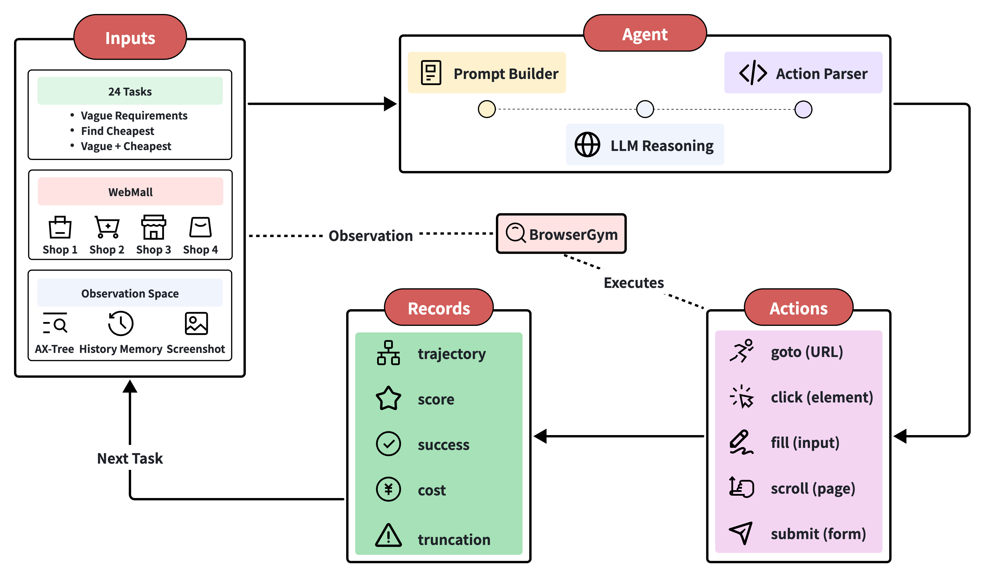
Baseline

Slide 3
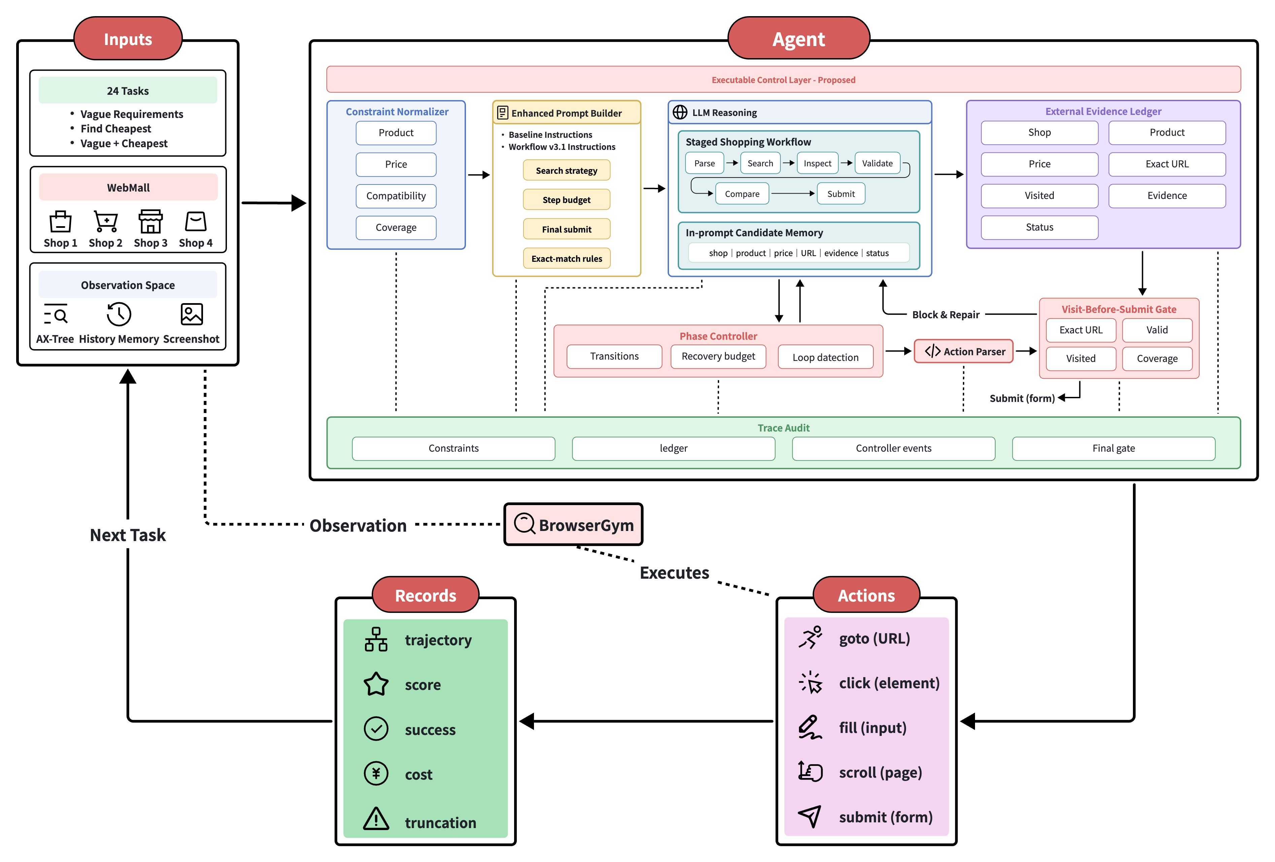
Agent

Slide 4
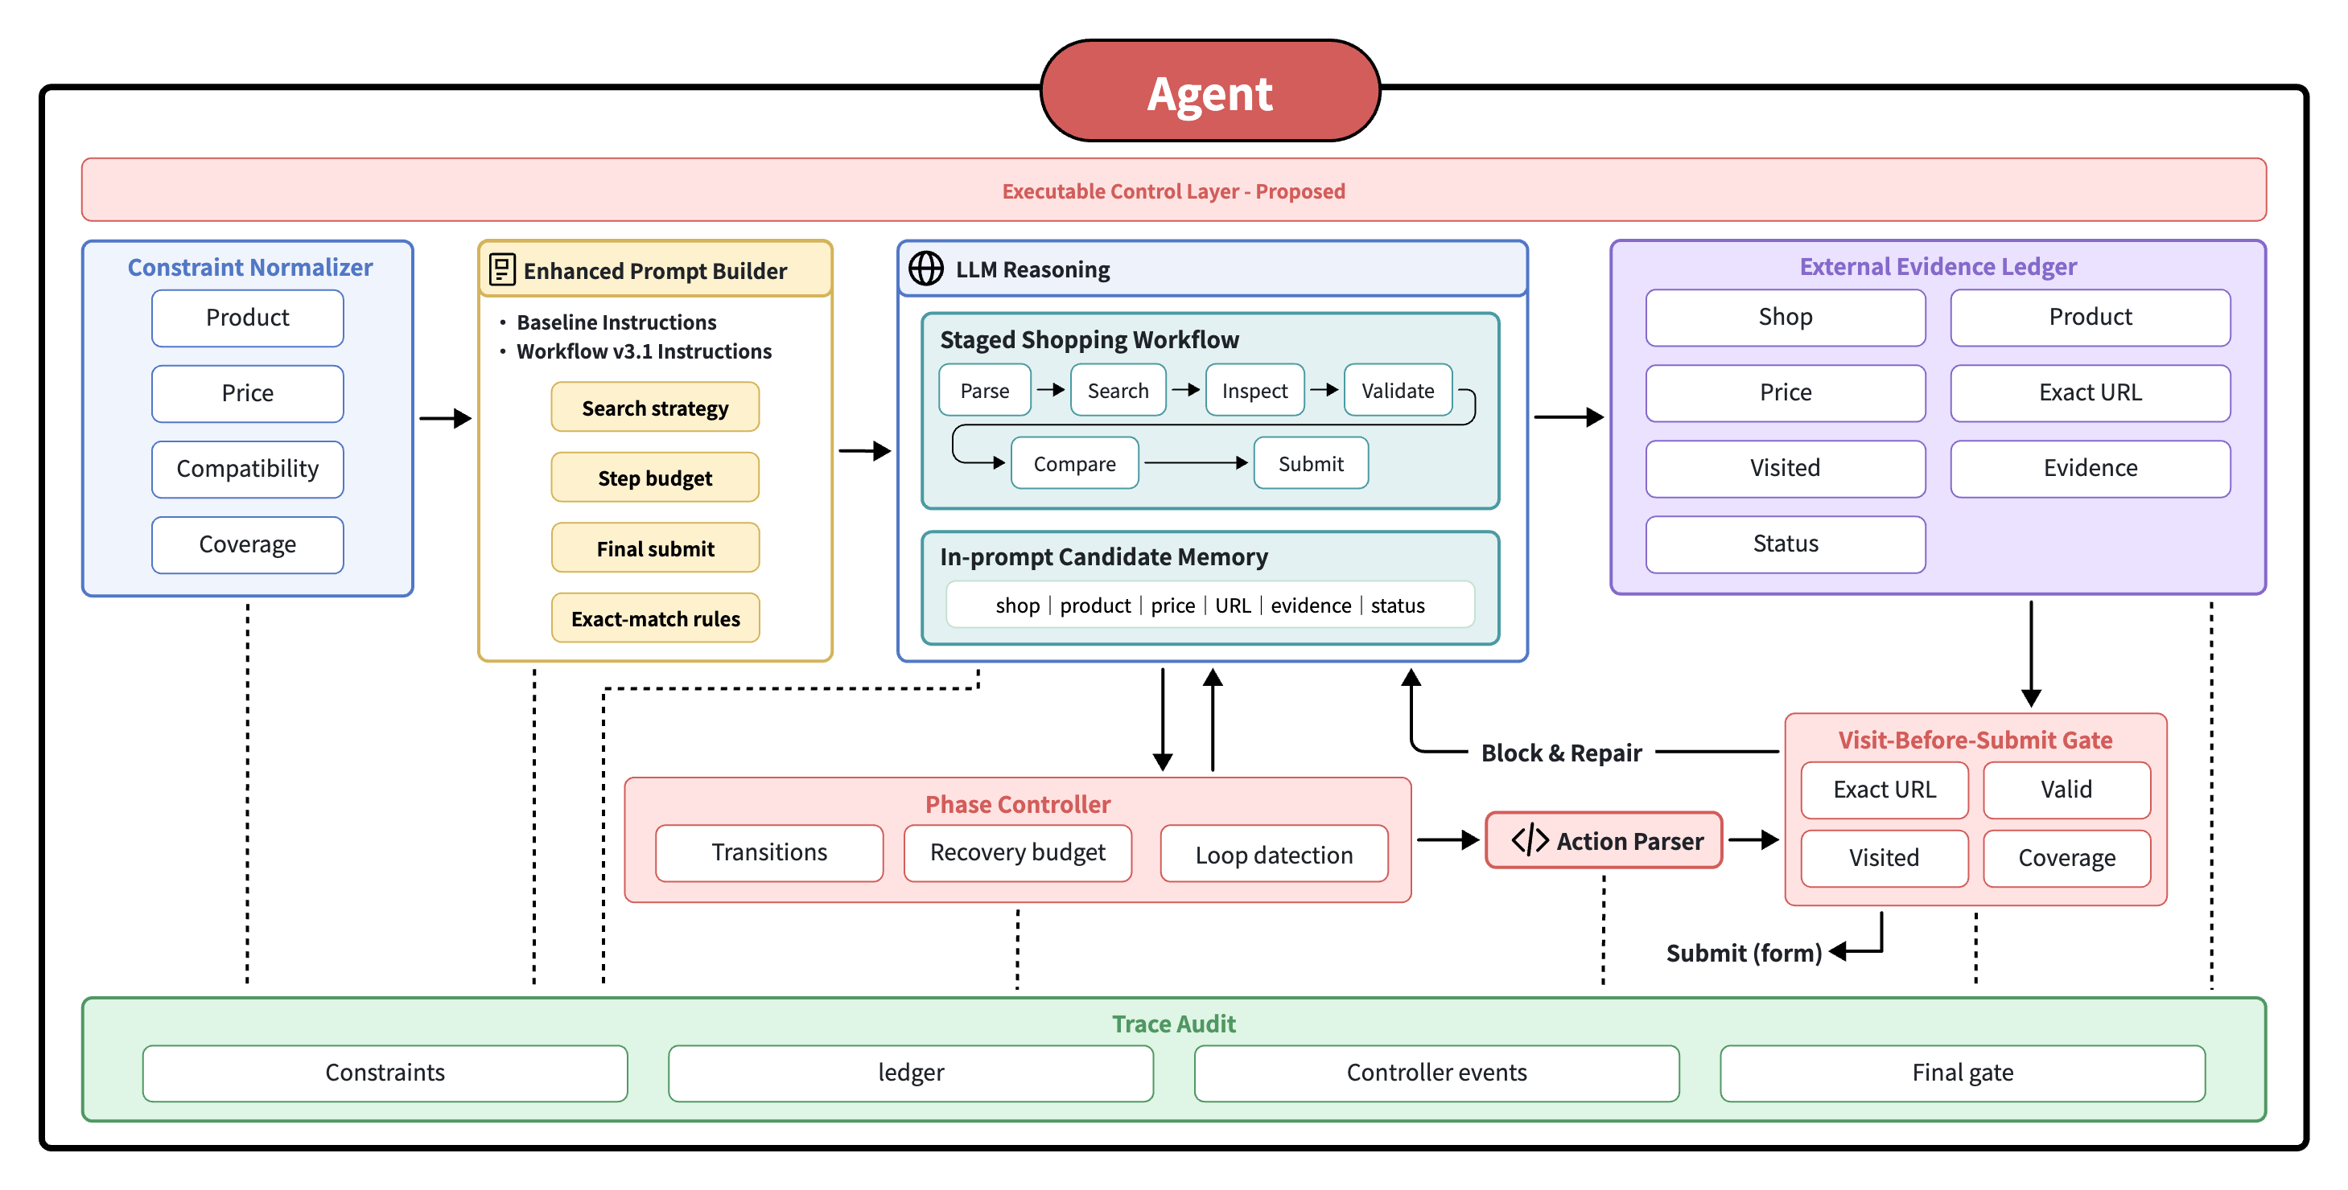
Agent

Slide 5
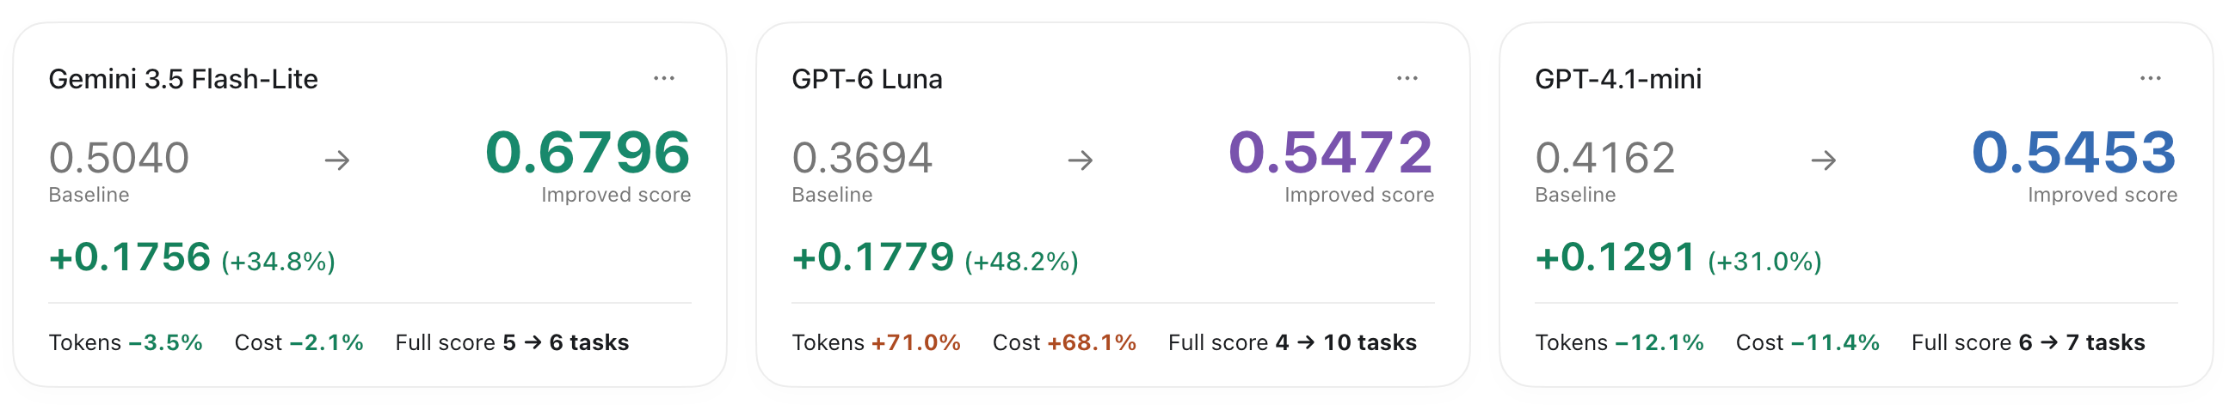
Experimental Results
3 Models · 24 Tasks · Same-Model Baseline Comparisons
Average Score · Per-Task Differences · Tokens & Cost
Open Interactive Result Report

Slide 6
Next Steps
Ablation Studies
  Fix models and tasks
  Isolate candidate state, submission checks, and phase control
Evaluation Metrics
  Quality: answer correctness, constraint satisfaction, candidate coverage
  Efficiency: submission, truncation, steps, tokens, and cost

