Slide 1
THE FASTEST API IN THE PYTHONIC WORLD
Volodymyr Pivoshenko ML Engineer

Slide 2
Table Of Contents
1. Web Frameworks vs API Frameworks
2. Overview
3. Killer Features
4. Hidden Stones
6. Demo
7. References

Slide 3
Web Frameworks vs API Frameworks
WEB |  | API
Django |  | Falcon
Pyramid |  | Starlette
Web2Py |  | Eve
Flask | FastAPI
Web Frameworks – tools designed to support the development of web applications including web services, web resources, and web APIs.
API Frameworks – toolkits for building only web APIs.

Slide 4

Overview
FastAPI is a modern, fast (high-performance) framework for building APIs with Python 3.6+ based on standard Python type hints.
The key features are:
Fast
Fewer bugs
Intuitive
Easy
Robust
Standards-based

Slide 5








Killer Features
WebSockets support
GraphQL support
Pydantic support
Code generation
OpenAPI (Swagger)
Security and authentication
Plugins

Slide 6
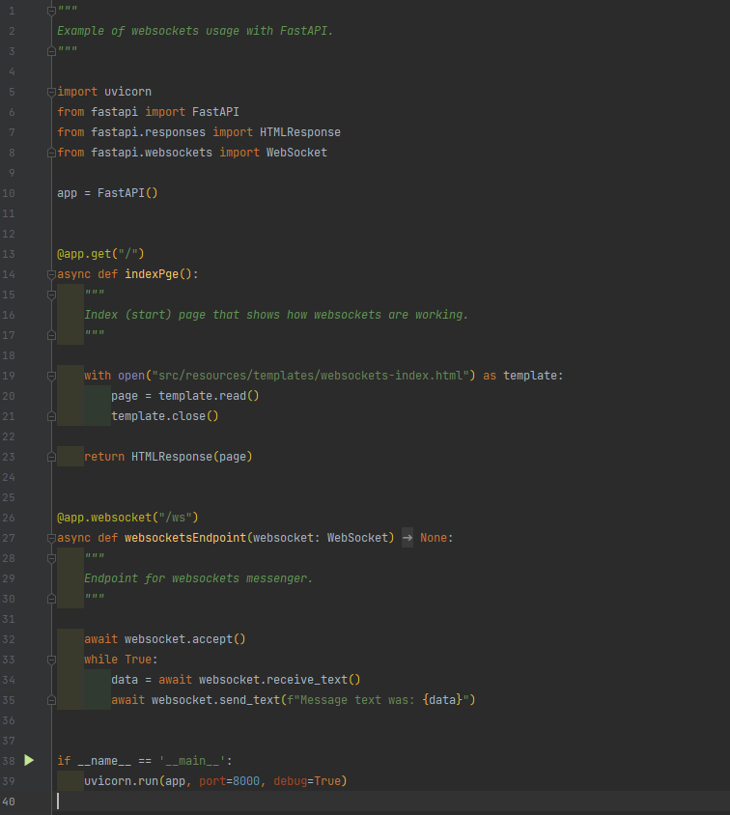
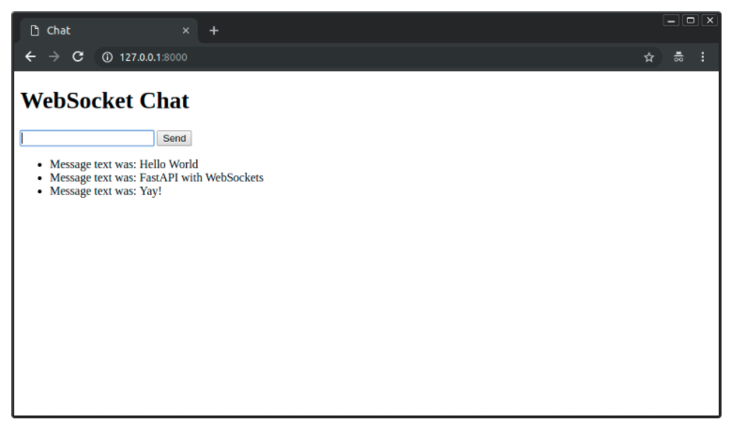
WebSockets Support
The WebSocket API is an advanced technology that makes it possible to open a two-way interactive communication session between the user's browser and a server. With this API, you can send messages to a server and receive event-driven responses without having to poll the server for a reply.
FastAPI uses Starlette and includes a WebSocket class that fulfils a similar role to the HTTP request, but that allows sending and receiving data on a websocket.

Slide 7
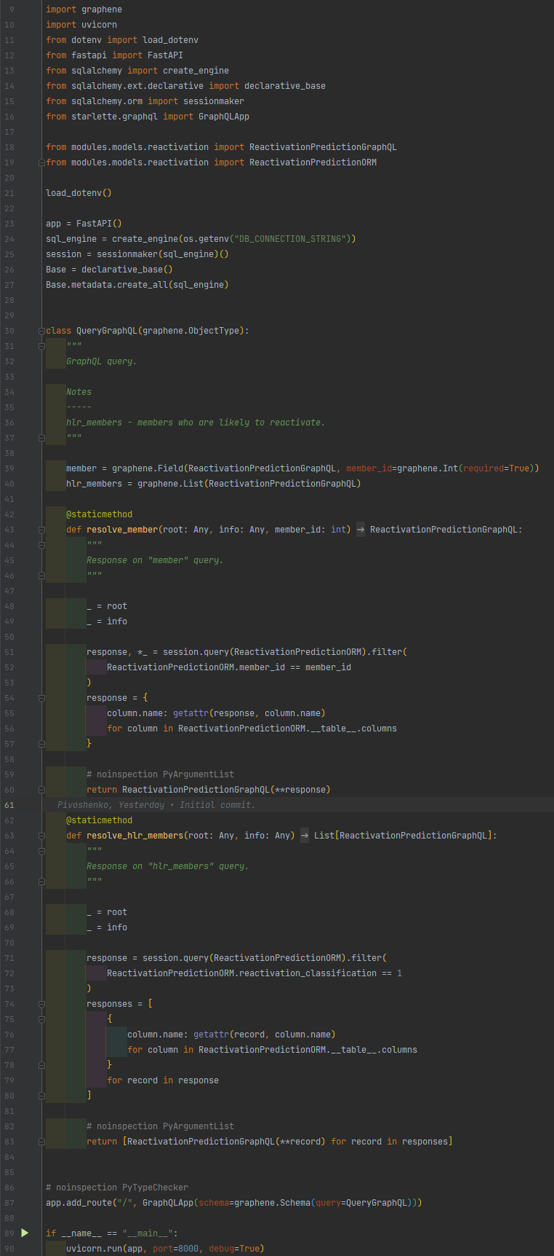
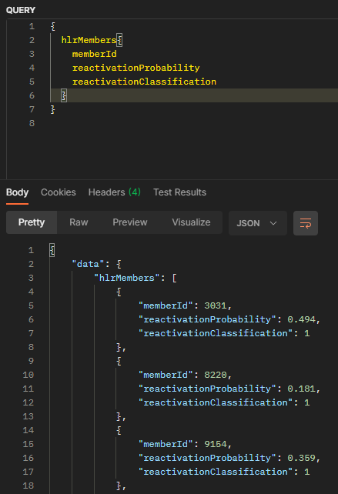
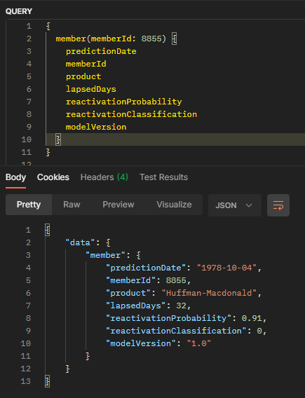
GRAPHQL Support
GraphQL is a query language for APIs and a runtime for fulfilling those queries with your existing data. GraphQL provides a complete and understandable description of the data in your API, gives clients the power to ask for exactly what they need and nothing more, makes it easier to evolve APIs over time, and enables powerful developer tools.
FastAPI has optional support for GraphQL (provided by Starlette directly), using the graphene library.

Slide 8
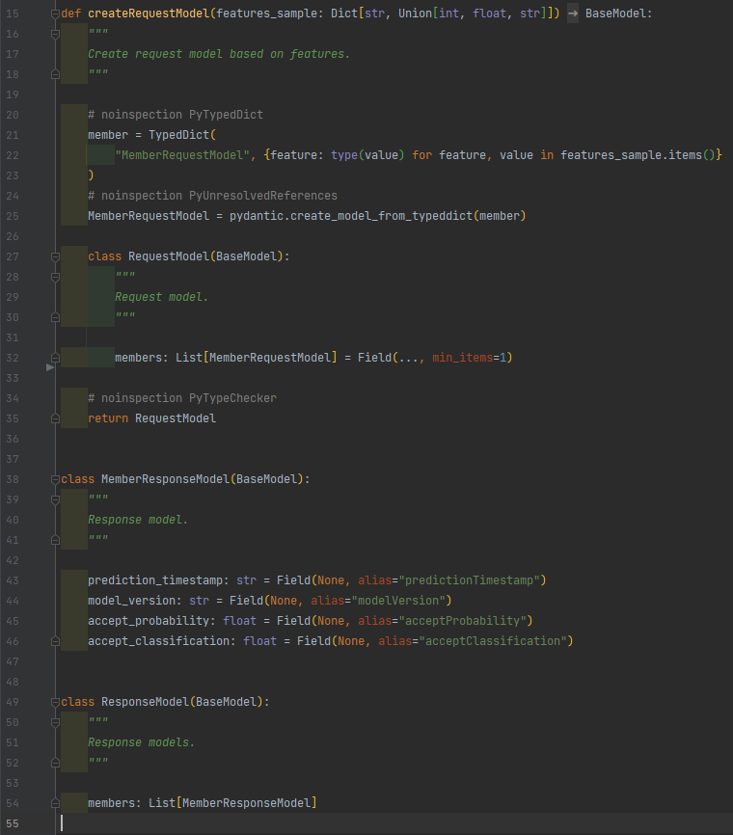
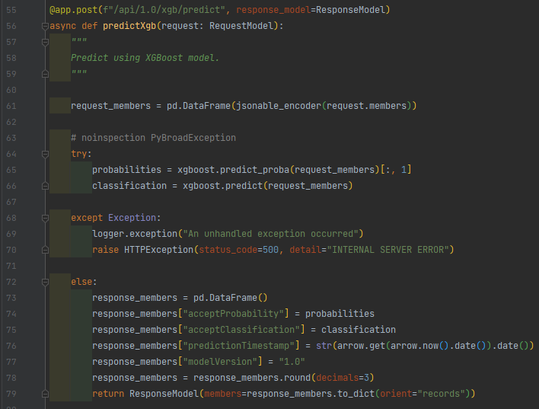
PYDANTIC SUPPORT
Data validation and settings management using Python type hinting. Fast and extensible, pydantic plays nicely with your linters/IDE/brain. Define how data should be in pure, canonical Python 3.6+; validate it with pydantic.
FastAPI uses pydantic as models and validators for requests and responses.

Slide 9
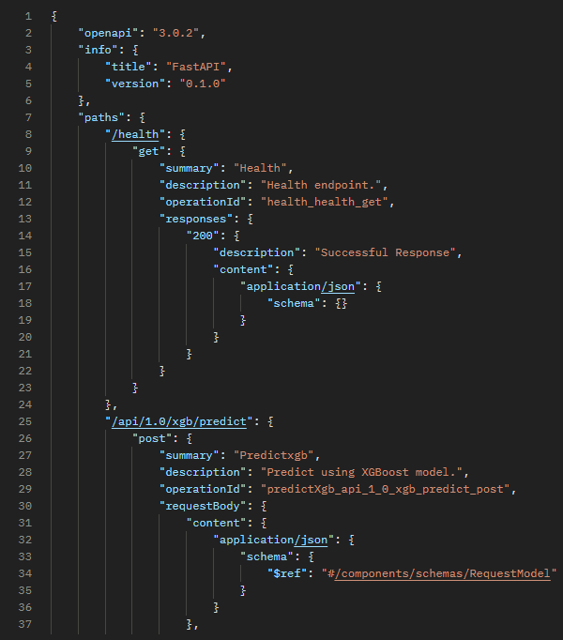
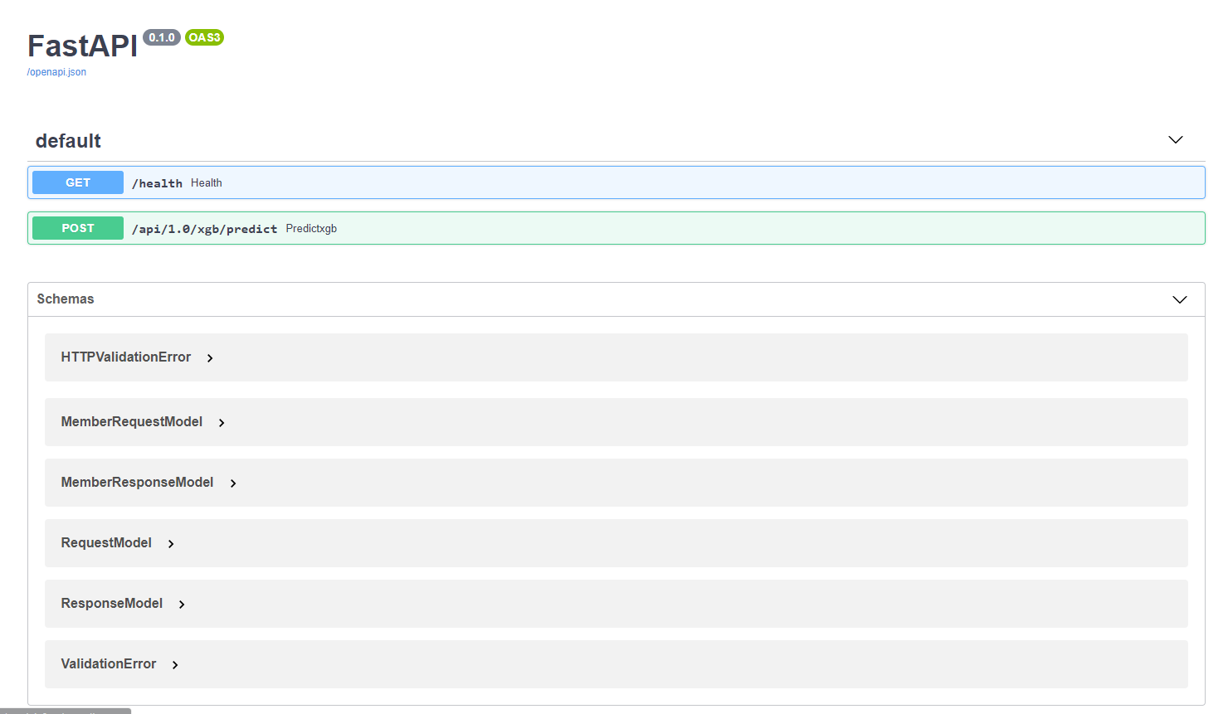
OPENAPI (SWAGGER)
The OpenAPI Specification (OAS) defines a standard, language-agnostic interface to RESTful APIs which allows both humans and computers to discover and understand the capabilities of the service without access to source code, documentation, or through network traffic inspection. When properly defined, a consumer can understand and interact with the remote service with a minimal amount of implementation logic. An OpenAPI definition can then be used by documentation generation tools to display the API, code generation tools to generate servers and clients in various programming languages, testing tools, and many other use cases.

Slide 10
Security and authentication
FastAPI provides several tools to help you deal with Security easily, rapidly, in a standard way, without having to study and learn all the security specifications.
apiKey - an application specific key that can come from:
query parameter
header
cookie
http - standard HTTP authentication systems, including:
bearer - a header Authorization with a value of Bearer plus a token. This is inherited from OAuth2.
HTTP Basic authentication.
HTTP Digest.
oauth2 - all the OAuth2 ways to handle security (called "flows"). Several of these flows are appropriate for building an OAuth 2.0 authentication provider:
implicit
clientCredentials
authorizationCode
password
openIdConnect - has a way to define how to discover OAuth2 authentication data automatically. This automatic discovery is what is defined in the OpenID Connect specification.

Slide 11
HIDDEN STONES
Because FastAPI is relatively new, the community is small compared to other frameworks, and regardless of its detailed documentation, there is very little external educational materials;
Incompatible revisions of the newest versions of the FastAPI with old plugins.

Slide 12
DEMO

Slide 13
REFERENCES
FastAPI Documentation
WebSockets
GraphQL
Pydantic
Code generation
OpenAPI (Swagger)
Demo code

Slide 14
Thank YOU

