Slide 1


A web-based platform for experimental design and time series analysis
Samedan, 15th and 16th of April 2010
Giovani ricercatori cercansi – Junge Forscher gesucht 2010
Fabiano Lever
Federico Scrinzi
Matteo Poletti
Severino Zeni
With acknowledgements to:
Cesare Furlanello
Marco Grimaldi

Slide 2
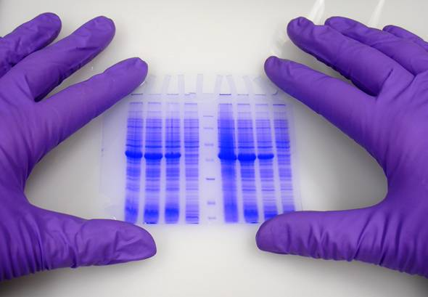
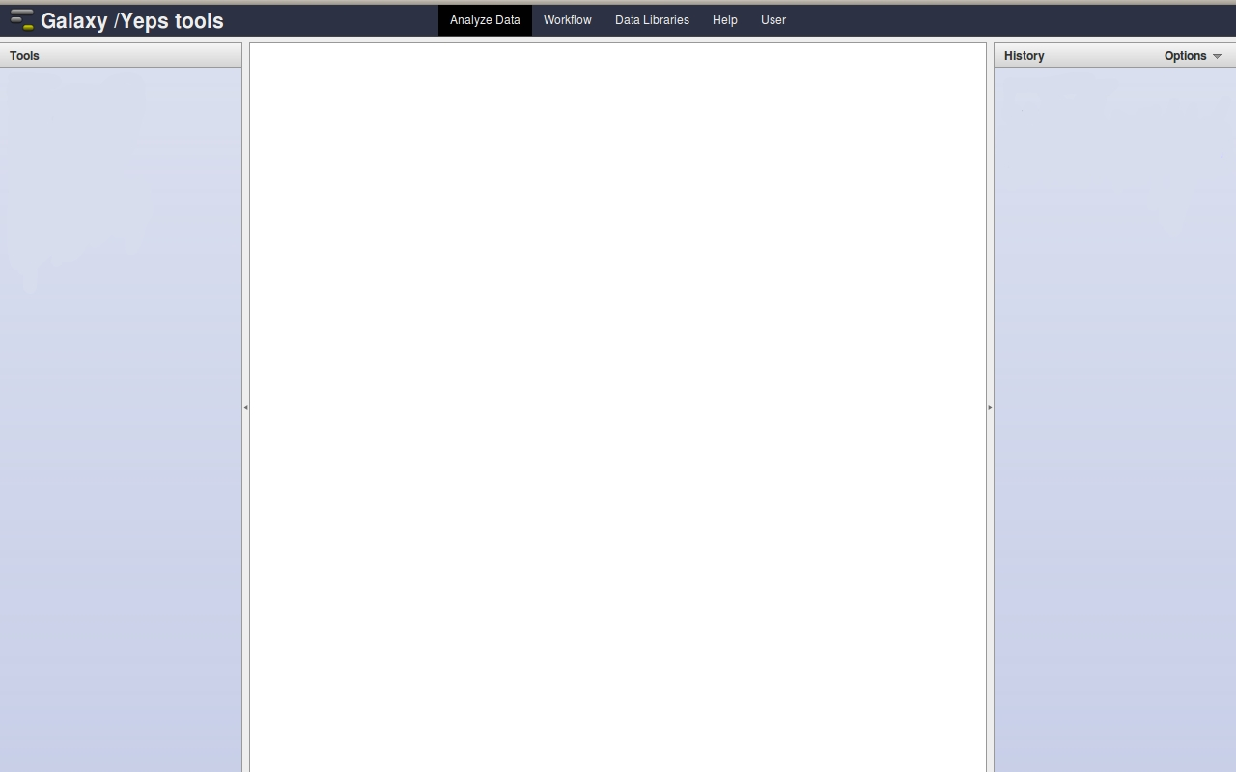
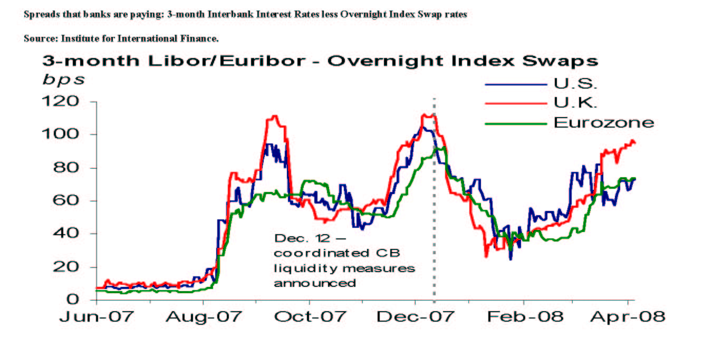
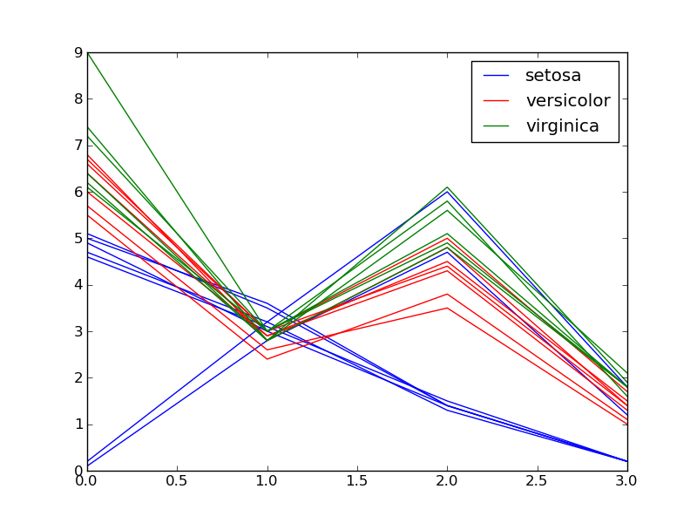
ICT
Computing
Resources
(CPU / GPU)
Research
Research
Time series
analysis and
experimental
design tools
Produced data
(time series)
Result

Slide 3
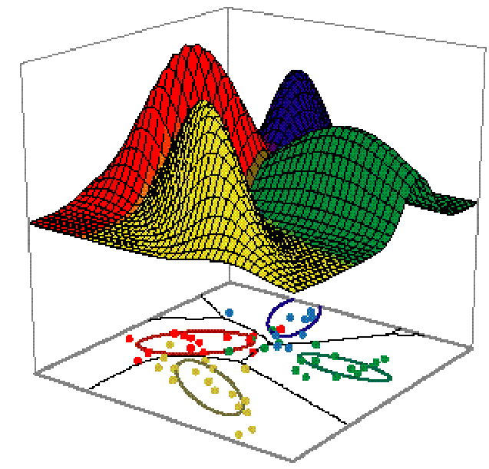
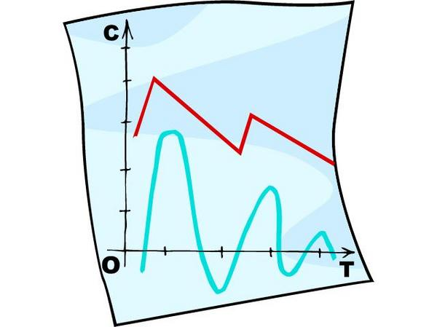
Process and Analise Large Databases
  Difficult to process
  Hard to extract useful information
  May require specific technical
  knowledge to operate on
Research produces
huge amounts of data
Technical problems
Scientific problems
Large Data require large computer
facilities: really expensive!
There is the need of dedicated
appliances to access computing
resources
IT knowledge is often required to
run scientific experiments and
to process data.
Data/knowledge/procedure
sharing allows research to grow
up faster but it isn't simple
It's not simple to reproduce an
experiment made by another
researcher
Lack of a good tool to design
reproducible experiments

Slide 4

Possible solutions
Centralized computing resources
Accessible everywhere and with any
appliance (even a smartphone)
Easy-to-use
Possibility to share datasets
experiments, procedures and results
Web-based platform
New technology that allows to build powerful but cheap HPC (High performance computing) systems
GPGPU

Slide 5
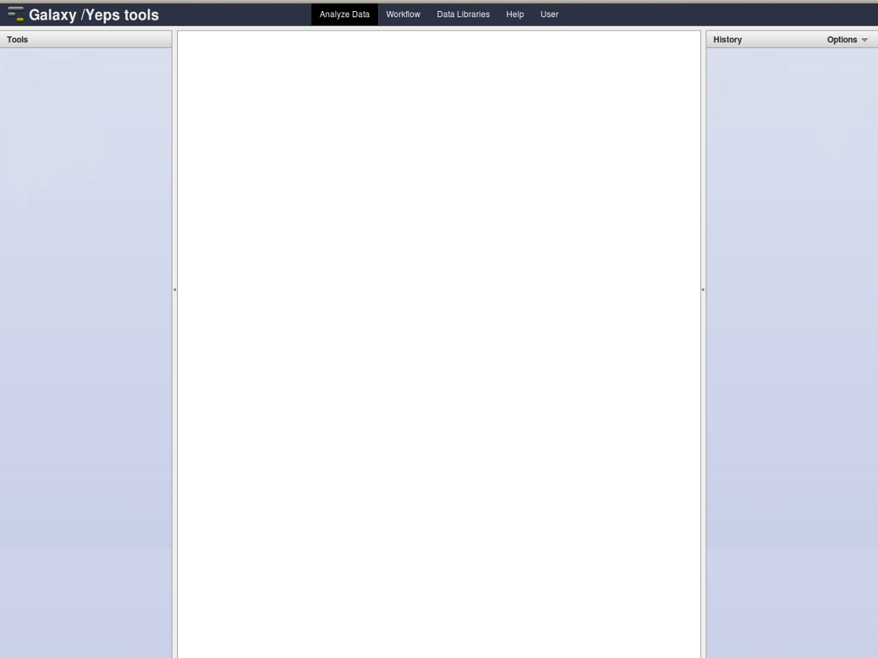
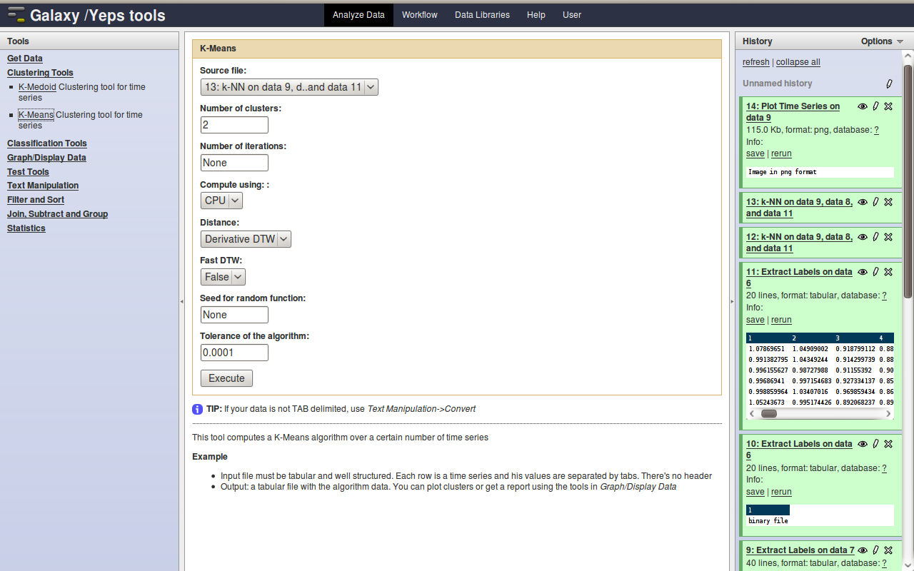
Galaxy
Researchers
Developers
Easy-to-use
Easy to share
experiments,
procedures
and results
Centralized
computing
resources
Scalable web
framework
Versatile and
extensible
Designed for
research
Open source
Designed for biologists
Includes a lot of tools only for genomic
analisys but not for other research fields.
We decided to:
Integrate it with tools for time series analysis
Develop a plotting system to represent data

Slide 6
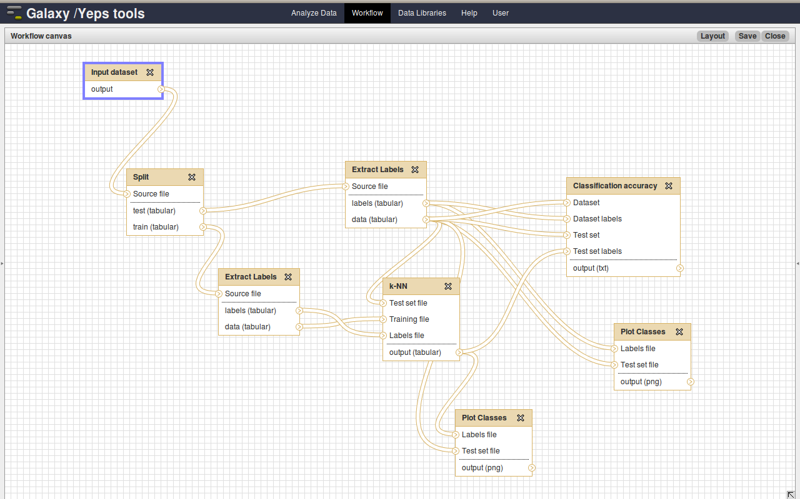
Experimental design
Creating a workflow is simple! Just choose the tools and input boxes you want to use and connect them with lines, that represent data flow.
Easy-to-use graphical interface to design
experiments
Workflows are truly reproducible! Any
researcher can reproduce someone else's
results using the same input data, the same
workflow and the same system.
Procedures are saved in Galaxy and can be
shared among researchers

Slide 7
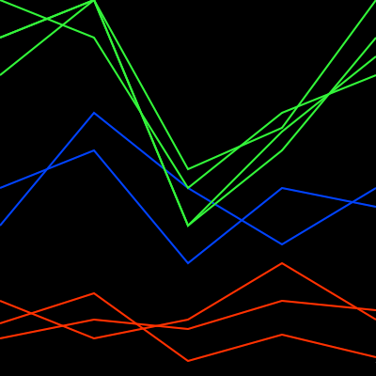
Time series analysis
Why time series? Time series are widely used in research.
Time series analysis comprises methods to extract meaningful information.
Clustering
Clustering is the assignment of a set of observations into subsets (called clusters) of similar observations.
Algorithms developed:
K-Means
K-Medoid
Classification
Classification is a procedure in which individual items are placed into groups on the base of their similarity with a set of previously labeled items (training set).
Algorithm developed:
k-NN (k-nearest neighbor)
These machine learning algorithms are very useful to start exploring and extracting information from large amounts of data (data-mining).
All these algorithms are based on time series “similarity”.

Slide 8
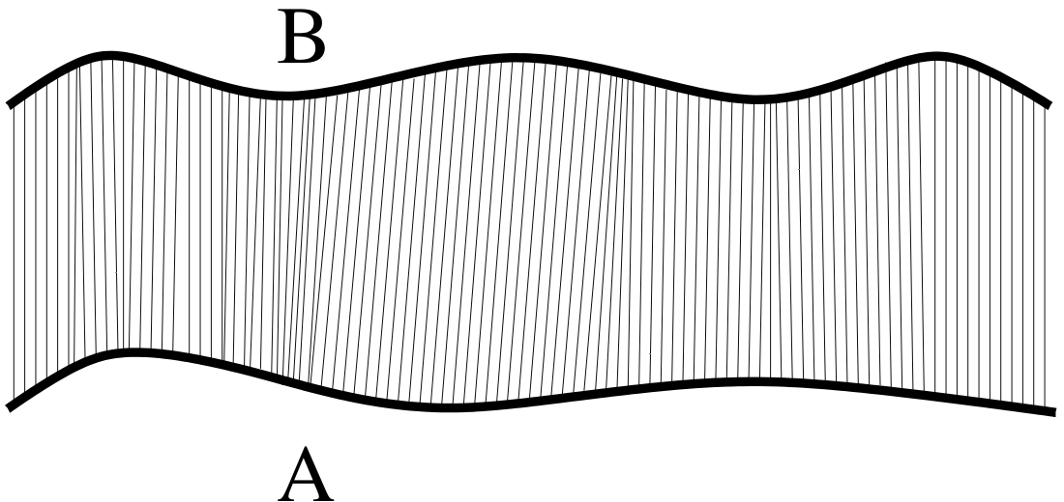
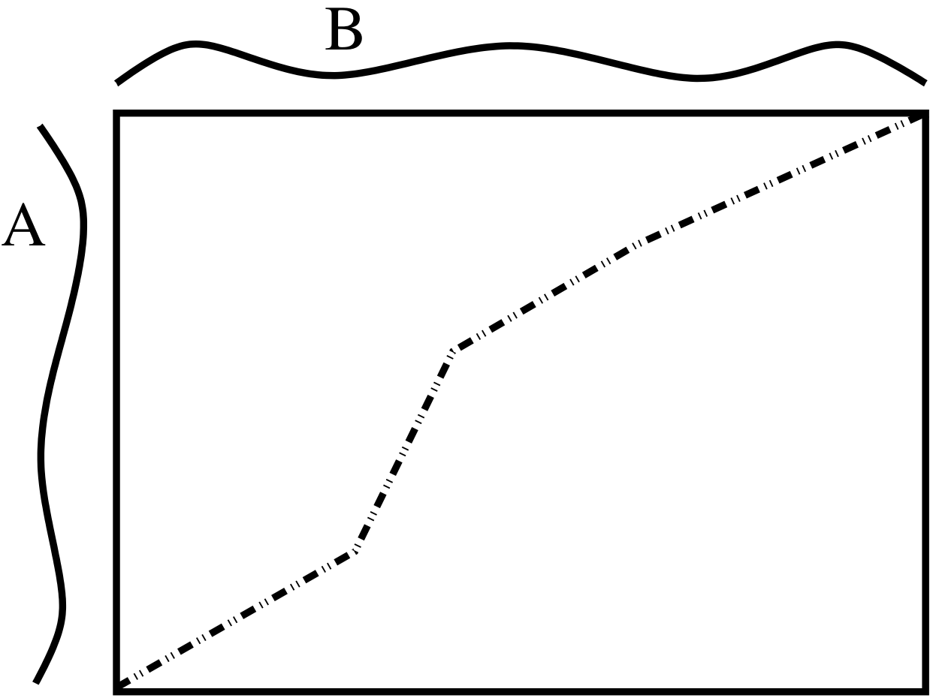
Time series distance and DTW
Dynamic Time Warping (DTW) is a pattern matching technique used to compare time series, not necessarily of the same length, based on their characteristic shapes.
Beside the classical version we developed several variants such as the DDTW (Derivative DTW).
The major drawback of this algorithm is that it is quadratic in time samples.
To overcome this problem we developed the FastDTW algorithm and employed GPGPU.

Slide 9
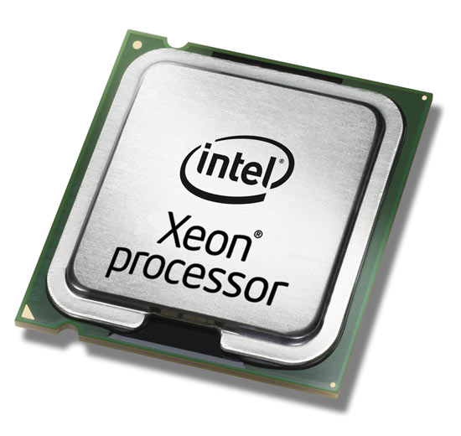
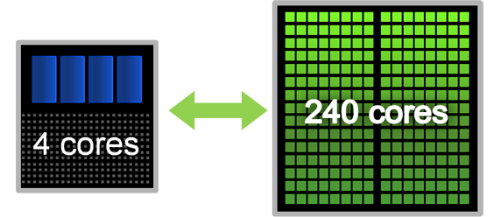
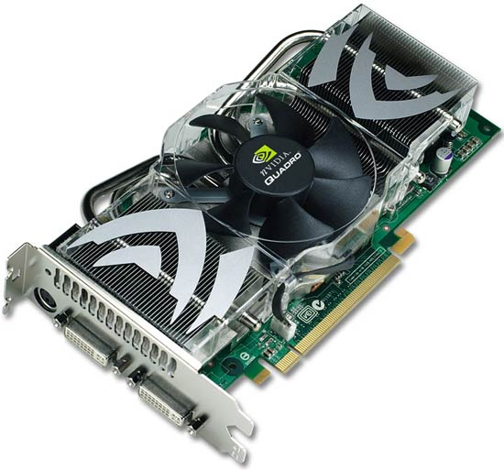
GPGPU
The algorithms are computationally expensive.
GPGPU allows us to: parallelize computation and improve performances. Nowadays GPU is probably the most powerful computational hardware taking into account the price.
CPU computing vs GPU computing
x6,5
Tool
Tool
DTW
DTW
DTW
DTW
x14
CPU
GPU
GPU
GPU
Results
Results

Slide 10






Software used and on-line collaboration
Most of them Open Source!
Plotting
Web-platform
Computing
Online Collaboration
Git + Wiki + Mailing List
C

Slide 11
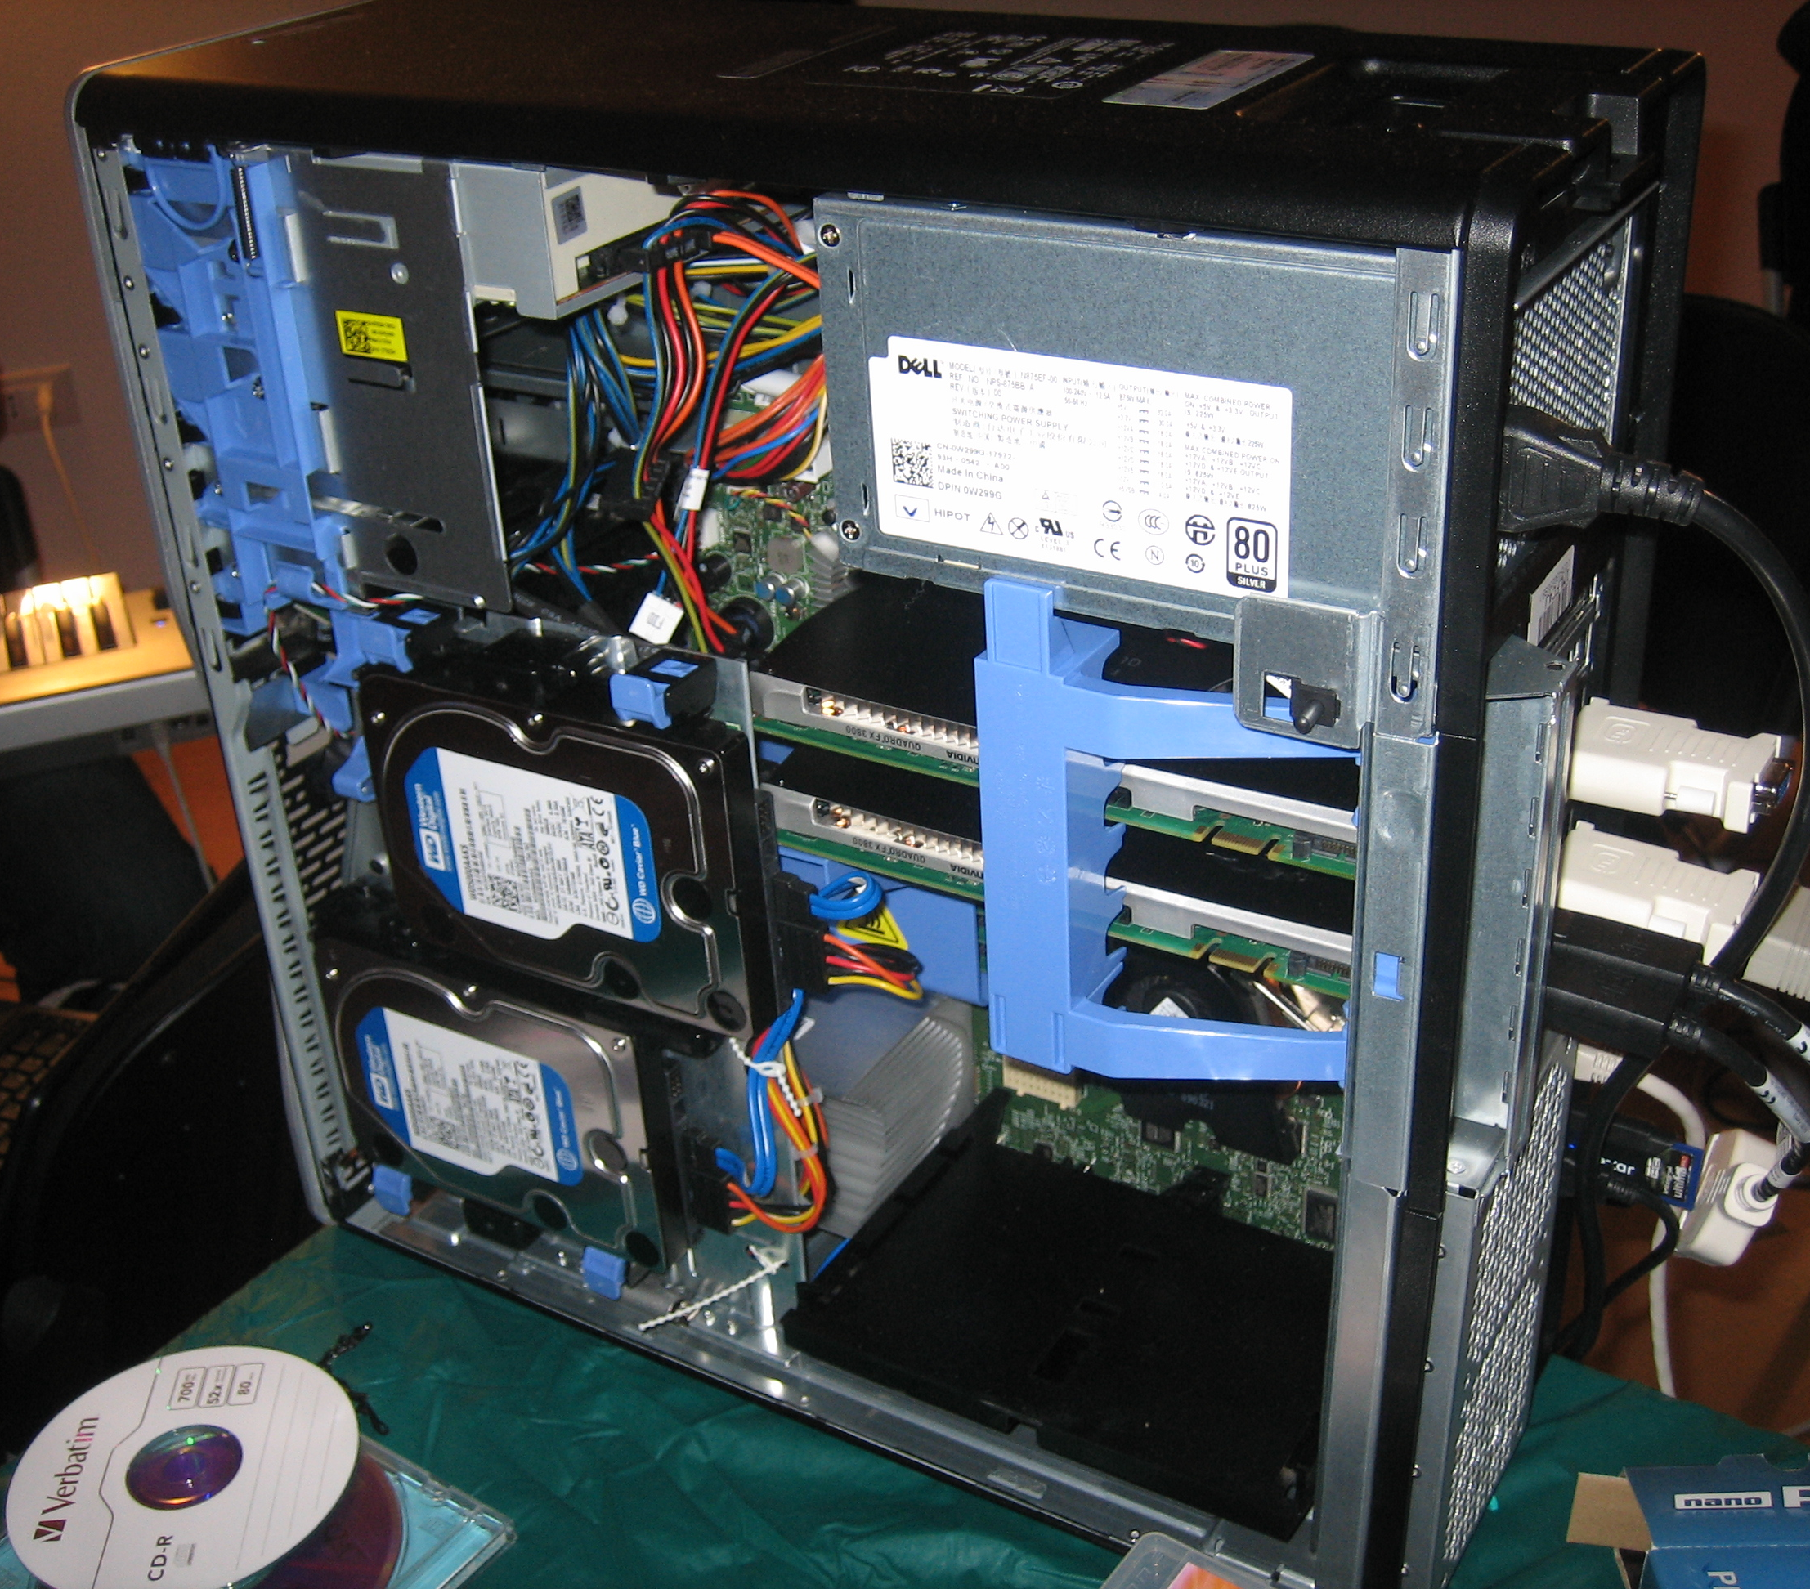
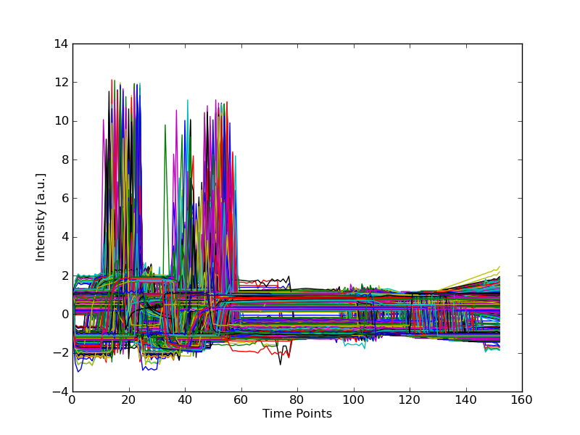
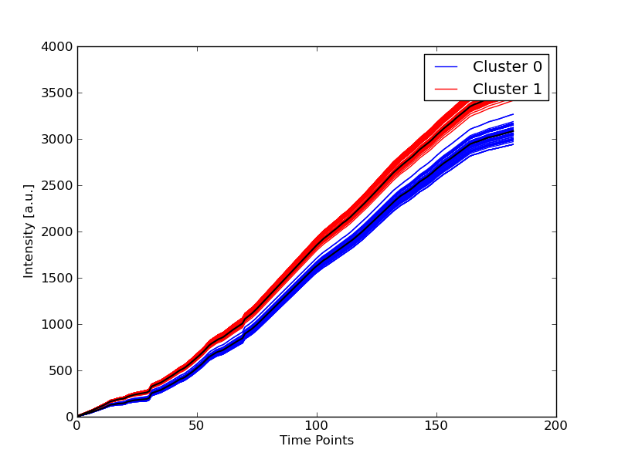
Conclusions and future work
We set up a fully working server with our project.
It is only a prototype but the development will continue in the future.
It is our aim to further improve the performances of the analysis tools together with the addition of more sophisticated analysis modules.

